Slide 1

Designing an Effective PowerPoint:
Quick Guide
Purdue OWL staff
Brought to you in cooperation with the Purdue Online Writing Lab
Notes:
Welcome to “Designing an Effective PowerPoint: Quick Guide.” This presentation is designed to quickly introduce you into the world of PowerPoint creation. The information presented here are a much shorter version of the three Designing an Effective PowerPoint guides found also on the OWL. This presentation has chiseled the information in the other presentations down into the most useful and effective information. This presentation is ideal for beginning a PowerPoint very near its due date or as an enticement to check out the other three guides.
Directions: Each slide is activated by a single mouse click, unless otherwise noted in bold at the bottom of each notes page.
Writer and Designer: Lars Erik Söderlund
Special Thanks to Robin Williams, whose Non-Designer’s Design Book and Design Workshop were helpful aids in the development of these materials.
Design Contributor and Revising Author: Veronika Maliborska, 2014
Developed with resources courtesy of the Purdue University Writing Lab
Grant funding courtesy of the Multimedia Instructional Development Center at Purdue University
© Copyright Purdue University

Slide 2
The Rhetorical Situation
When designing a PowerPoint, consider the project’s
Topic
Purpose
Audience
Presentation length
Notes:
Your PowerPoint will require some planning to be effective. The study of rhetoric can help. Sometimes in today’s culture we use “rhetoric” to mean empty politics or crafty political maneuvering, but that’s not the word’s original definition. Rhetoric is a study of communication originated in ancient times that can be helpful in making your communication better. One example is the concept of the rhetorical situation, which is all the conditions under which a communication occurs.
To be effective in your presentation, you must think about three key parts of your project: your presentation, your audience, and your subject matter. Your audience will be all the people whom your presentation will reach. Your subject matter will be the message your PowerPoint is trying to get across. Your presentation will be all that you do to communicate your subject matter to your audience.
Good PowerPoint projects come from making design decisions that fit the presentation’s need, so you should base every design decision in your presentation on what would be suitable for your audience relative to what works the best with your subject matter. For example, if you are presenting your lab findings to a group of Physics colleagues who have no patience for time wasted, you will want to make your PowerPoint quick and to the point, without lengthy animations or transitions. Also, you will want the information you present to be clear immediately. If, on the other hand, you are trying to impress a group of High School students with your presentation about quadratic equations, you might use a fun template for your presentation or use a few carefully placed transitions to grab their attention.
For best results, view the rest of this PowerPoint and its notes with a blank sheet of paper or a pen with which to write out your thoughts about the suggestions this PowerPoint will make. Or you can make a Word document on which you can answer the questions.
Click mouse for each paragraph.

Slide 3
Drafting
A to-do list before you get started:
Decide what you are going to include in the PowerPoint
In a Word file, draft the titles of each section/slide
Pick images / tables / charts you are going to use and save them in a separate folder or file.
Consider the time it would take to present each slide; pick only the most important information.
Notes:
Saving the original data or images you will use in the PowerPoint will help you save time in case you want to redesign the presentation or in case your file gets lost/corrupted and you have to create the file from scratch.
Click mouse for each paragraph.

Slide 4
Arrangement
Decide how you want to organize your PowerPoint
Possible organization strategies:
Overview, Body, Conclusion
Anecdote, Content, Conclusion
Plan, Benefits, Anecdote
Notes:
A rhetorical concept very important in creating a PowerPoint is “Arrangement.” Just as an essay or speech has to be carefully ordered to enthrall and educate its audience, so too must your PowerPoint presentation be ordered carefully so that your audience buys into your argument (argument here means whatever you are trying to convince your audience of, whether it’s that your company is a success, or that your school needs new chairs, or that the audience should give more attention to recycling; it’s whatever point you’re trying to make).
The order of your PowerPoint will depend on what you think your audience needs. If they need clarity in your presentation because you think there is a risk of them getting lost in your complicated points, you might start by giving them an overview of the order and goals of your presentation, then proceed into the “Body” of your presentation, making your points and providing your evidence, and finally wrap everything up with a conclusion of what you went over (it’s important if you choose this ordering scheme to not be repetitive in your vocabulary). If, on the other hand, your audience might be bored even before you start, you might start with an anecdote. Using an amusing or emotionally compelling story can get your audience invested in your presentation right away. Similarly, if you are attempting to convince an audience to establish something new (like buying new chairs or starting a recycling program, two examples I mentioned above) and are facing an audience that demands your presentation be short and to the point, you can start with the plan of action you suggest, then discuss the benefits of that plan, and once your audience is hooked perhaps throw in an anecdote at the end to
make the plan’s benefits real in your audience’s mind. Whatever you do, organize your PowerPoint conscientiously and create it squarely for the benefit of your audience.

Slide 5
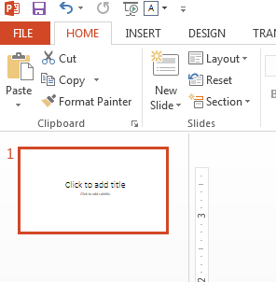
Getting Started
Open Microsoft PowerPoint.
Save your file: File > Save as.
Later save your progress by clicking Save or press Ctrl + S.
A new file will automatically have a Title slide.
Notes:
Note: This guide is based on Microsoft Power Point 2013 for Windows.
The first step in making any PowerPoint is to create a new file. A new file always has one empty slide, which is usually the title slide. You can enter the title of your presentation here.
The next step will be to add more slides.

Slide 6
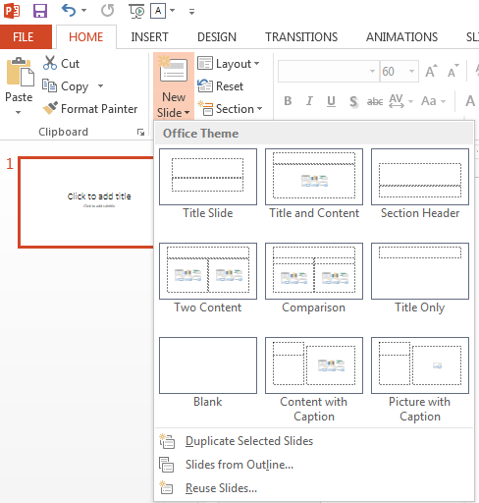
Getting Started
Next, add new slides: Home > New Slide Pick the type of slide you need.
If you want to, you can modify the chosen template to fit your content.
Notes:
When adding a content slide, you can chose from available templates and later modify them if you need to.

Slide 7
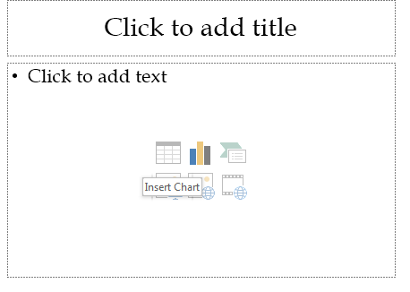
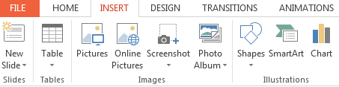
Getting Started
Use an empty slide or the PowerPoint Insert tab to add tables, graphics, charts, diagrams, or formulas. This will make formatting your PowerPoint easier.
Notes:
Adding data to your PowerPoint through the Insert tab will make formatting quick and easy, compared to pasting it from another file.

Slide 8
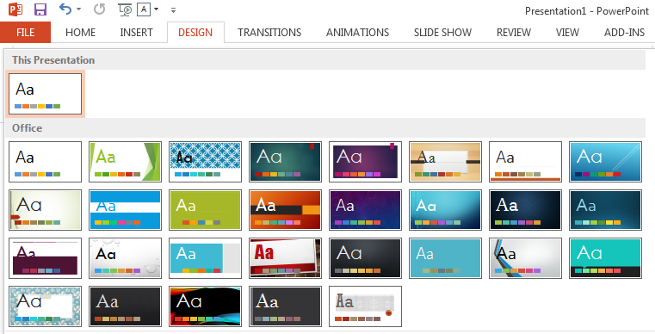
Design
Chose an appropriate theme for your presentation in the Design tab or browse the Microsoft Office website for more themes.
Notes:
For more design themes go to https://store.office.live.com/templates/templates-for-PowerPoint

Slide 9
Transitions and Animations
Transition - an effect that determines how slides progressively show up on the screen, e.g. Cut, Fade, Push, Wipe, etc.
Animation - an effect that determines in which order and how elements of a slide appear on the screen, e.g. Appear, Fade, Fly In, Float In, etc.

Slide 10
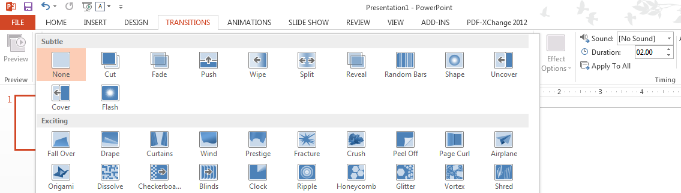
Creating Transitions
Select the slide you wish to edit
Go to Transitions, select transition from the drop-down menu; adjust Duration time if needed.
Notes:
When creating transitions, you can also select all, select multiple, or select one slide. The chosen transition will be applied to the slides you select.
To select all: Click on one slide in the left slide preview section, then click Ctrl + A. Click on the desired transition
To select multiple: Click on one slide in the left slide preview section, then hold Ctrl and click on the other slides you want to select. Click on the desired transition
You can also click the Apply to All button in the Transition tab.

Slide 11
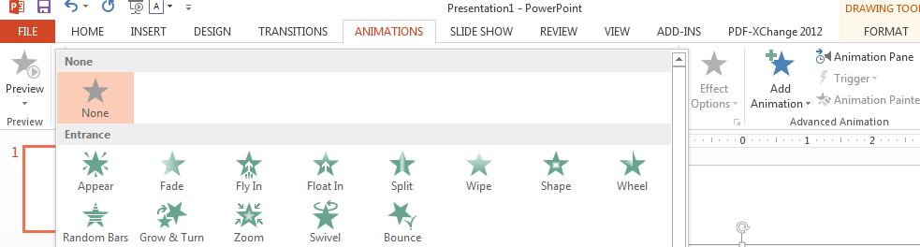
Creating Animations
Select a slide element (title, graph, paragraph, word)
Go to Animations, select animation from the drop-down menu or click Add Animation.
Open the Animation Pane for more settings.
Notes:
Animations are what people often picture in their minds when they think of PowerPoint. Have you ever seen the items of a bulleted list PowerPoint fly across the screen into place, one by one?

Slide 12
Presentation Preview
When previewing your presentation, pay attention to:
Text on each slide (the less text the better)
Clarity of ideas and logical organization
How fast the text or slides appear
Font and format consistency
Grammar, spelling, and punctuation
Notes:
Review your presentation just like you would review a paper.

Slide 13
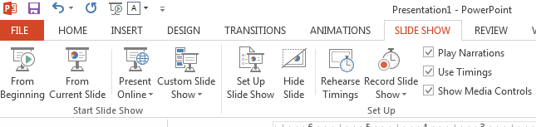
Presentation Preview
Finally, preview and time your presentation: Go to Slide Show > From Beginning or Rehearse Timings
Notes:
To exit the Slide Show mode, click Escape on your keyboard.
After editing a slide, you can go back to the slide show by clicking From Current Slide.

Slide 14
Contrast
To highlight important information in your presentation, try using different font formats to create contrast.
Size Contrast
Color Contrast
Type Contrast
However, remember to be consistent.
Notes:
This slide focuses on contrast. The purpose of contrast in a PowerPoint is to focus your audience’s attention on one particular element within your PowerPoint. To adequately create focus you must make the object of attention very different from the other elements that surround it. If you do not, it will simply blend in with the other aspects of the PowerPoint.
To create size contrast, simply make larger or smaller the element you wish to draw focus. Remember to be bold- the type size difference should be at least twenty percent.
To create color contrast, make the color of the focus object dramatically different from the rest of the composition. Color theory (the study of how colors affect the human brain) is complicated, but it helps to remember that cool colors (e.g. blue, purple) appear to recede from your eye (for this reason the OWL has made the background of our template a cool blue) while warmer colors (red, orange) appear to pop out from the page.
Type contrast can be even more complex, but is summarized neatly by saying that it is contrast created by differences in font. I will address type contrast later in this PowerPoint, but if you are especially interested in knowing about type contrast you should at least briefly research the art of typesetting (Robin Williams, the graphic designer, has a great book on this called The Non-Designer’s Type Book).
The most important guidance regarding contrast is to be strategic. It is impossible to make your audience focus on everything- trying to do so will just scatter the audience. Thus, control your contrast.

Slide 15
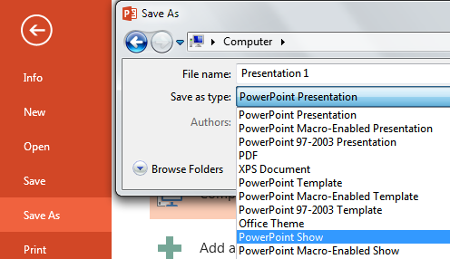
Save Your Presentation
You can save your file as a
regular PowerPoint document, and
a slide show (see Notes for details)
Go to File > Save as > (Select save location) > Save as type > PowerPoint Show
Notes:
A slide show file will save each slide as an image, preventing formatting distortion in case you use a different computer or operating system for your presentation. However, slide shows can not be edited, so make sure to save your file as a regular PowerPoint file as well.
The facilitator can demonstrate how the two files are different.

Slide 16
Exterior Content
Exterior Content - Everything in your presentation other than your PowerPoint.
The best presentations include practiced hand gestures, polished verbal delivery, and some form of crowd interaction.
Notes:
For a presentation to be effective, it must include content that outside of PowerPoint.

Slide 17
Exterior Content Help
TIPS:
Use your PowerPoint as an aid to your presentation, not as your presentation
Be sure that your Exterior Content and your Interior Content are different
Know your presentation space and execute your gestures and volume accordingly
Notes:
Rationale: When planning the delivery of your presentation, keep in mind what will be best expressed by you in your own voice; remember, rarely can even the best PowerPoint take the place of a real, human voice. Similarly, try not to rely too much on a laser pointer; instead use the design of your slides to direct your audience’s attention.
Remember what PowerPoint can do and what it can't (and keep in mind what you're comfortable doing in PowerPoint and not). If you want to have an audience’s complete, undivided attention, leave time between slides to talk uninterrupted, or even insert a white, blank slide and look your audience in the eye as you speak to them. Further, you can use ”Presenter Tools" and other facilities in the newer versions of PowerPoint to enhance your presentation. Search your Office software’s Help for assistance on presenter tools, and consult rhetoric and elocution manuals for help in public speaking.

Slide 18
Where to Go
for More Help
Purdue University Writing Lab, Heavilon 226
Check our web site: http://owl.english.purdue.edu
Email brief questions to OWL Mail: http://owl.english.purdue.edu/writinglab/topic/owlmail/
Notes:
Directions: As the presentation concludes, the facilitator can remind students that they can come to the Writing Lab for extra help with organizing their arguments.

Slide 19
The End
DESIGNING AN EFFECTIVE POWERPOINT: QUICK GUIDE
Purdue OWL staff
Brought to you in cooperation with the Purdue Online Writing Lab

