Slide 1
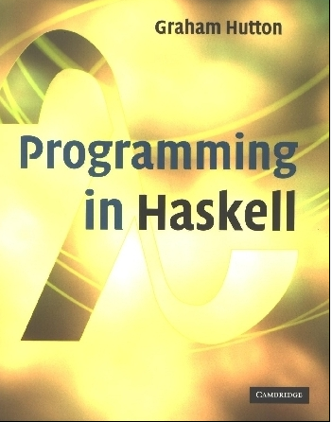
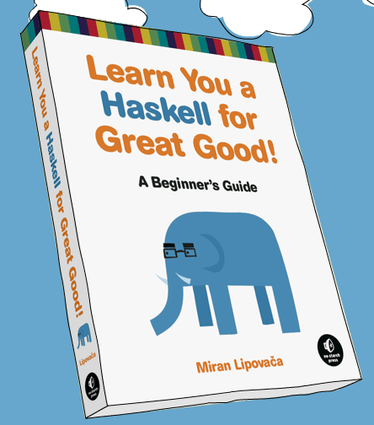
PROGRAMMING IN HASKELL
An Introduction
Based on lecture notes by Graham Hutton
The book “Learn You a Haskell for Great Good”
(and a few other sources)

Slide 2
First Note: Get the Glasgow Haskell Compiler
GHC is the leading implementation of Haskell, and comprises a compiler and interpreter;
The interactive nature of the interpreter makes it well suited for teaching and prototyping;
GHC is freely available from:
www.haskell.org/downloads

Slide 3
What is a Functional Language?
Opinions differ, and it is difficult to give a precise definition, but generally speaking:
Functional programming is style of programming in which the basic method of computation is the application of functions to arguments;
A functional language is one that supports and encourages the functional style.

Slide 4
Example
Summing the integers 1 to 10 in Java:
total = 0;
for (i = 1; i ≤ 10; ++i)
total = total+i;
The computation method is variable assignment.
3

Slide 5
Example
Summing the integers 1 to 10 in Haskell:
sum [1..10]
The computation method is function application. No variables.
4

Slide 6
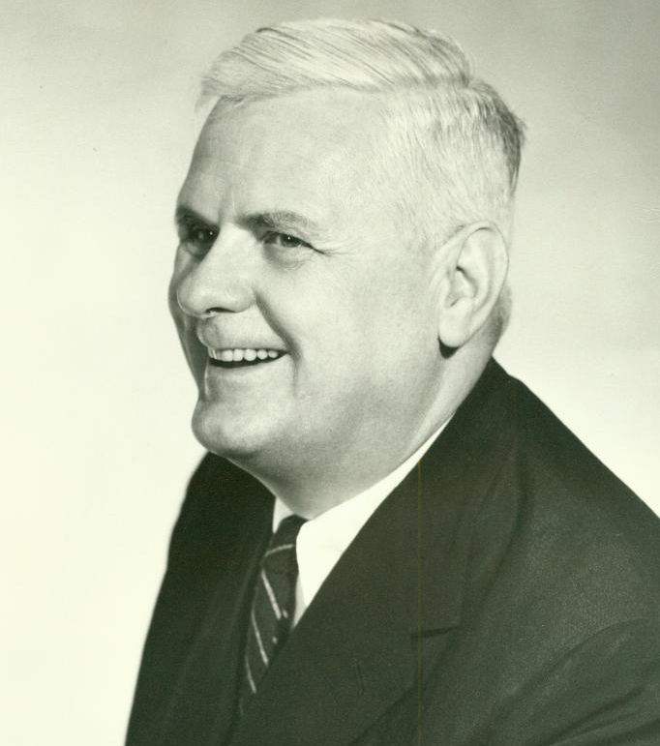

Historical Background
1930s:
Alonzo Church develops the lambda calculus, a simple but powerful theory of functional computation.
Advised Alan Turing on his dissertation
5

Slide 7
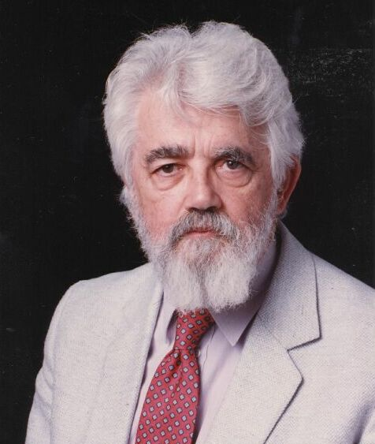
Historical Background
1950s:
John McCarthy develops Lisp, the first functional language, with some influences from the lambda calculus, but retaining variable assignments.
6

Slide 8
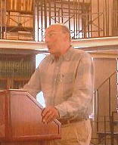
Historical Background
1960s:
Peter Landin develops ISWIM, the first pure functional language, based strongly on the lambda calculus, with no assignments.
7

Slide 9
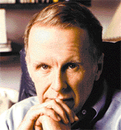
Historical Background
1970s:
John Backus develops FP, a functional language that emphasizes higher-order functions and reasoning about programs.
8

Slide 10
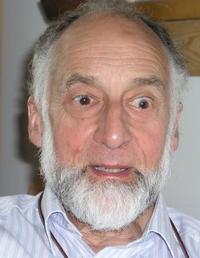
Historical Background
1970s:
Robin Milner and others develop ML, the first modern functional language, which introduced type inference and polymorphic types.
9

Slide 11

Historical Background
1970s - 1980s:
David Turner develops a number of lazy functional languages, culminating in the Miranda system.
10

Slide 12
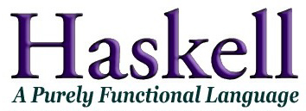
Historical Background
1987:
An international committee of researchers initiates the development of Haskell, a standard lazy functional language.
Partially in response to “Can programming be liberated from the Von Neuman style?”, by John Backus.
(Named in honor of logician Haskell B. Curry.)
11

Slide 13
Can programming be liberated from the Von Neuman style?
First paragraph of abstract:
Conventional programming languages are growing ever more enormous, but not stronger. Inherent defects at the most basic level cause them to be both fat and weak: their primitive word-at-a-time style of programming inherited from their common ancestor—the von Neumann computer, their close coupling of semantics to state transitions, their division of programming into a world of expressions and a world of statements, their inability to effectively use powerful combining forms for building new programs from existing ones, and their lack of useful mathematical properties for reasoning about programs.
– John Backus

Slide 14
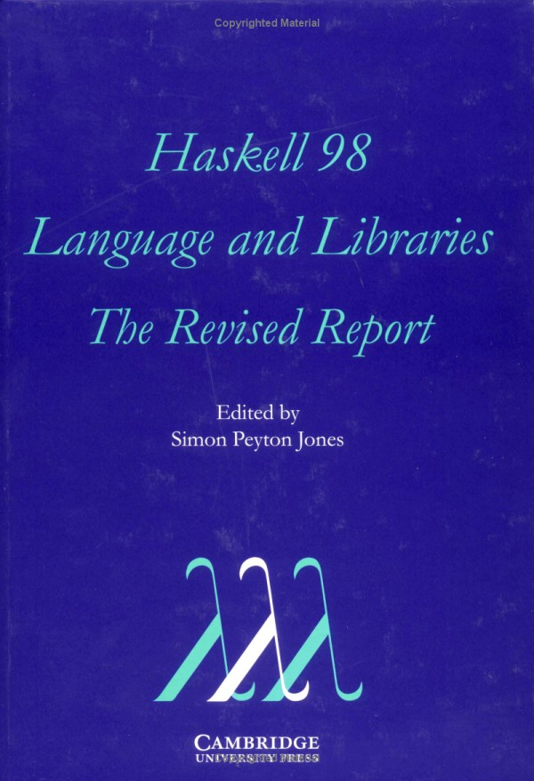
Historical Background
2003:
The committee publishes the Haskell 98 report, defining a stable version of the language.
13

Slide 15
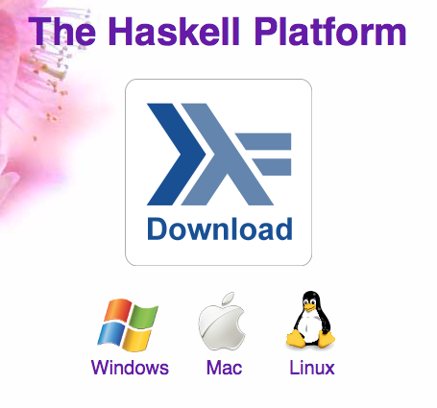
Historical Background
2003-date:
Standard distribution, library support, new language features, development tools, use in industry, influence on other languages, etc.
14

Slide 16
A Taste of Haskell
f [] = []
f (x:xs) = f ys ++ [x] ++ f zs
where
ys = [a | a ← xs, a ≤ x]
zs = [b | b ← xs, b > x]
?
15

Slide 17
Basic Structure
Purely functional
Lazy evaluation
Statically typed with strong typing
Uses type inference (like Python)
VERY concise – small and elegant code
Types are KEY (like Java or C – but more)
Features we care about:
Supported on Linux/Windows/Mac
Website with interface (somewhat limited functionality)
Free and easy to download locally

Slide 18
Purely Functional
Function output only depends on function evaluation and function parameters (inputs)
“Side-effect free”
Consider functions f, g, and h
If g(x) == h(x), then f(g(x)) == f(h(x)) for all functions g and h
No global or hidden state
We are going to get started using the language, and then come back to this concept later.

Slide 19
Glasgow Haskell Compiler
GHC is the leading implementation of Haskell, and comprises a compiler and interpreter;
The interactive nature of the interpreter makes it well suited for teaching and prototyping;
GHC is freely available from:
www.haskell.org/downloads

Slide 20
Starting GHC
The GHC interpreter can be started from the Unix command prompt % by simply typing ghci:
% ghci
GHCi, version 7.4.1: http://www.haskell.org/ghc/ :? for help
Loading package ghc-prim ... linking ... done.
Loading package integer-gmp ... linking ... done.
Loading package base ... linking ... done.
ghci>

Slide 21
The GHCi prompt > means that the interpreter is ready to evaluate an expression.
For example:
> 2+3*4
14
> (2+3)*4
20
> sqrt (3^2 + 4^2)
5.0

Slide 22
Function Application
In mathematics, function application is denoted using parentheses, and multiplication is often denoted using juxtaposition or space.
f(a,b) + c d
Apply the function f to a and b, and add the result to the product of c and d.

Slide 23
In Haskell, function application is denoted using space, and multiplication is denoted using *.
f a b + c*d
As previously, but in Haskell syntax.

Slide 24
Moreover, function application is assumed to have higher priority than all other operators.
f a + b
Means (f a) + b, rather than f (a + b).

Slide 25
Examples
Mathematics
Haskell
f(x)
f x
f(x,y)
f x y
f(g(x))
f (g x)
f(x,g(y))
f x (g y)
f(x)g(y)
f x * g y

Slide 26
Lists!
Haskell comes with a large number of standard library functions. In addition to the familiar numeric functions such as + and *, the library also provides many useful functions on lists.
Select the first element of a list:
> head [1,2,3,4,5]
1

Slide 27
Remove the first element from a list:
> tail [1,2,3,4,5]
[2,3,4,5]
Select the nth element of a list:
> [1,2,3,4,5] !! 2
3
Select the first n elements of a list:
> take 3 [1,2,3,4,5]
[1,2,3]

Slide 28
Remove the first n elements from a list:
> drop 3 [1,2,3,4,5]
[4,5]
Calculate the length of a list:
> length [1,2,3,4,5]
5
Calculate the sum of a list of numbers:
> sum [1,2,3,4,5]
15

Slide 29
Calculate the product of a list of numbers:
> product [1,2,3,4,5]
120
Append two lists:
> [1,2,3] ++ [4,5]
[1,2,3,4,5]
Reverse a list:
> reverse [1,2,3,4,5]
[5,4,3,2,1]

Slide 30
Types
All computation in Haskell is done via evaluation of expressions to get values.
Every value has an associated type and is a first-class object.
Examples:
Int 5
Char ‘A’
Int->Int multiplyByTwo()
[Num]->Num sum’()
[a] -> Integer length()

Slide 31
Types in Haskell
If evaluating an expression e would produce a value of type t, then e has type t, written
e :: t
Every well-formed expression has a type, which can be automatically calculated at compile time using a process called type inference.

Slide 32
All type errors are found at compile time, which makes programs safer and faster by removing the need for type checks at run time.
In GHCi, the :type command calculates the type of an expression, without evaluating it:
> not False
True
> :type not False
not False :: Bool
> :t head
head :: [a] -> a

Slide 33
My First Script
When developing a Haskell script, it is useful to keep two windows open, one running an editor for the script, and the other running GHCi.
Start an editor, type in the following two function definitions, and save the script as test.hs:
myDouble :: Num a => a -> a
myDouble x = x + x
myQuadruple :: Num a => a -> a
myQuadruple x = double (double x)

Slide 34
Leaving the editor open, in another window start up GHCi with the new script:
% ghci test.hs
Now both the standard library and the file test.hs are loaded, and functions from both can be used:
> myQuadruple 10
40
> take (double 2) [1,2,3,4,5,6]
[1,2,3,4]

Slide 35
Leaving GHCi open, return to the editor, add the following two definitions, and resave:
myFactorial n = product [1..n]
myAverage ns = sum ns `div` length ns
Note:
div is enclosed in back quotes, not forward;
x `f` y is just syntactic sugar for f x y.
So this is just saying “div (sum ns) (length ns)

Slide 36
GHCi does not automatically detect that the script has been changed, so a reload command must be executed before the new definitions can be used:
> :reload
Reading file "test.hs"
> factorial 10
3628800
> average [1,2,3,4,5]
3

Slide 37
Pattern Matching
Pattern matching is a form of conditional execution:
This function uses two patterns:
factorial :: (Integer a) => a -> a
factorial 0 = 1
factorial n = n * factorial (n - 1)
Patterns can also “unbox” complex parameters:
x:xs refers to a list
x is the head
xs is the remainder
head :: [a] -> a
head (x:xs) = x

Slide 38
Functions can have multiple patterns. Patterns are evaluated in order, and only one executes.
tell :: (Show a) => [a] -> String
tell [] = "The list is empty"
tell (x:[]) = "The list has one element: " ++ show x
tell (x:y:[]) = "The list has two elements: " ++ show x ++ " and " ++ show y
tell (x:y:_) = "This list is long!”

Slide 39
Exercise
Write a program to find the number of elements in a list. Here’s how to start:
myLength :: [a] -> Int
myLength [] =
myLength (x:xs) =
How do you test this to be sure it works?
Log out of ghci using :quit. Type :help to see commands.

Slide 40
Naming Requirements
Function and argument names must begin with a lower-case letter. For example:
myFun
fun1
arg_2
x’
By convention, list arguments usually have an s suffix on their name. For example:
xs
ns
nss

Slide 41
The Layout Rule
In a sequence of definitions, each definition must begin in precisely the same column:
a = 10
b = 20
c = 30
a = 10
b = 20
c = 30
a = 10
b = 20
c = 30

Slide 42
The layout rule avoids the need for explicit syntax to indicate the grouping of definitions.
a = b + c
where
b = 1
c = 2
d = a * 2
a = b + c
where
{b = 1;
c = 2}
d = a * 2
means
implicit grouping
explicit grouping

Slide 43
Exercise
Fix the syntax errors in the program below, and test your solution using GHCi.
N = a ’div’ length xs
where
a = 10
xs = [1,2,3,4,5]
(Copy your corrected version into an email to me, but don’t send yet.)

