Slide 1
Data Representation in Memory CSCI 224 / ECE 317: Computer Architecture
Instructor:
Prof. Jason Fritts
Slides adapted from Bryant & O’Hallaron’s slides

Slide 2
Data Representation in Memory
Basic memory organization
Bits & Bytes – basic units of Storage in computers
Representing information in binary and hexadecimal
Representing Integers
Unsigned integers
Signed integers
Representing Text
Representing Pointers

Slide 3
Byte-Oriented Memory Organization
0x00•••0
0xFF•••F
• • •
Byte-Addressable Memory
Conceptually a very large array of bytes
Each byte has a unique address
Processor width determines address range:
32-bit processor has 2³² unique addresses: 4GB max
0x00000000 to 0xffffffff
64-bit processor has 2⁶⁴ unique addresses: ~ 1.8x10¹⁹ bytes max
0x0000000000000000 to 0xffffffffffffffff
Memory implemented with hierarchy of different memory types
OS provides virtual address space private to particular “process”
virtual memory to be discussed later…

Slide 4
Data Representation in Memory
Basic memory organization
Bits & Bytes – basic units of Storage in computers
Representing information in binary and hexadecimal
Representing Integers
Unsigned integers
Signed integers
Representing Text
Representing Pointers

Slide 5
Representing Voltage Levels as Binary Values
0
1
0
3.3V
2.8V
0.5V
0.0V
Digital transistors operate in high and low voltage ranges
Voltage Range dictates Binary Value on wire
high voltage range (e.g. 2.8V to 3.3V) is a logic 1
low voltage range (e.g. 0.0V to 0.5V) is a logic 0
voltages in between are indefinite values

Slide 6
Bits & Bytes
Transistors have two states, so computers use bits
“bit” is a base-2 digit
{L, H} => {0, 1}
Single bit offers limited range, so grouped in bytes
1 byte = 8 bits
a single datum may use multiple bytes
Data representation 101:
Given N bits, can represent 2^{N} unique values

Slide 7
Encoding Byte Values
Processors generally use multiples of Bytes
common sizes: 1, 2, 4, 8, or 16 bytes
Intel data names:
Byte 1 byte (8 bits)
Word 2 bytes (16 bits)
Double word 4 bytes (32 bits)
Quad word 8 bytes (64 bits)
Unfortunately, most processor architectures
call 2 bytes a ‘halfword’, 4 bytes a ‘word’, etc.,
so we’ll often use C data names instead
(but these vary in size too… /sigh)

Slide 8
C Data Types
32-bit
64-bit
C Data Type | Typical 32-bit | Intel IA32 | x86-64
char | 1 | 1 | 1
short | 2 | 2 | 2
int | 4 | 4 | 4
long | 4 | 4 | 8
long long | 8 | 8 | 8
float | 4 | 4 | 4
double | 8 | 8 | 8
long double | 8 | 10/12 | 10/16
pointer (addr) | 4 | 4 | 8
key
differences

Slide 9
Data Representation in Memory
Basic memory organization
Bits & Bytes – basic units of Storage in computers
Representing information in binary and hexadecimal
Representing Integers
Unsigned integers
Signed integers
Representing Text
Representing Pointers

Slide 10
Encoding Byte Values
1 Byte = 8 bits
Binary: 00000000₂ to 11111111₂
A byte value can be interpreted in many ways!
depends upon how it’s used
For example, consider byte with: 01010101₂
as text: ‘U’
as integer: 85₁₀
as IA32 instruction: pushl %ebp
part of an address or real number
a medium gray pixel in a gray-scale image
could be interpreted MANY other ways…

Slide 11
Encoding Byte Values
Different syntaxes for a byte
Binary: 00000000₂ to 11111111₂
Decimal: 0₁₀ to 255₁₀
Hexadecimal: 00₁₆ to FF₁₆
Base-16 number representation
Use characters ‘0’ to ‘9’ and ‘A’ to ‘F’
in C/C++ programming languages, D3₁₆ written as either
0xD3
0xd3

Slide 12
Decimal vs Binary vs Hexadecimal
Decimal | Binary | Hexadecimal
0 | 0000 | 0
1 | 0001 | 1
2 | 0010 | 2
3 | 0011 | 3
4 | 0100 | 4
5 | 0101 | 5
6 | 0110 | 6
7 | 0111 | 7
8 | 1000 | 8
9 | 1001 | 9
10 | 1010 | A
11 | 1011 | B
12 | 1100 | C
13 | 1101 | D
14 | 1110 | E
15 | 1111 | F

Slide 13



Binary and Hexadecimal Equivalence
Problem with binary – Hard to gauge size of binary numbers
e.g. approx. how big is: 1010011101010001011101011₂ ?
Would be nice if native computer base was decimal: 21,930,731
but a decimal digit requires 3.322 bits… won’t work
Need a larger base equivalent to binary, such that
for equivalence, R and x must be integers – then 1 digit in R equals x bits
equivalence allows direct conversion between representations
two options closest to decimal:
octal:
hexadecimal:
$$R^{1}=2^{x}$$
$$8^{1}=2^{3}$$
$${16}^{1}=2^{4}$$

Slide 14
Binary and Hexadecimal Equivalence
Octal or Hexadecimal?
binary : 1010011101010001011101011₂
octal: 123521353₈
hexadecimal number: 14EA2EB₁₆
decimal: 21930731
Octal a little closer in size to decimal, BUT…
How many base-R digits per byte?
Octal: 8/3 = 2.67 octal digits per byte -- BAD
Hex: 8/4 = 2 hex digits per byte -- GOOD
Hexadecimal wins: 1 hex digit ⇔ 4 bits

Slide 15
Convert Between Binary and Hex
Convert Hexadecimal to Binary
Simply replace each hex digit with its equivalent 4-bit binary sequence
Example: 6 D 1 9 F 3 C₁₆
Convert Binary to Hexadecimal
Starting from the radix point, replace each sequence of 4 bits with the equivalent hexadecimal digit
Example: 101100100011010111010110001010011₂
0110 1101 0001 1001 1111 0011 1100₂
1 6 4 6 B A C 5 3₁₆

Slide 16
Data Representation in Memory
Basic memory organization
Bits & Bytes – basic units of Storage in computers
Representing information in binary and hexadecimal
Representing Integers
Unsigned integers
Signed integers
Representing Text
Representing Pointers

Slide 17



Unsigned Integers – Binary
Computers store Unsigned Integer numbers in Binary (base-2)
Binary numbers use place valuation notation, just like decimal
Decimal value of n-bit unsigned binary number:
$${value}_{10}=\sum_{i=0}^{n−1}{a_{i}∗2^{i}}$$
0 | 1 | 1 | 1 | 0 | 1 | 0 | 1
2⁷
2⁶
2⁵
2⁴
2³
2²
2¹
2⁰
$${value}_{10}={0∗2}^{7}+{1∗2}^{6}+{1∗2}^{5}+{1∗2}^{4}+{0∗2}^{3}+{1∗2}^{2}+{0∗2}^{1}+{1∗2}^{0}$$
$$=2^{6}+2^{5}+2^{4}+2^{2}+2^{0}$$
$$=64+32+16+4+1 ={117}_{10}$$

Slide 18





Unsigned Integers – Base-R
Convert Base-R to Decimal
Place value notation can similarly determine decimal value of any base, R
Decimal value of n-digit base r number:
Example:
$${value}_{10}=\sum_{i=0}^{n−1}{a_{i}∗r^{i}}$$
$${317}_{8}={ ? }_{10}$$
$${value}_{10}={3∗8}^{2}+{1∗8}^{1}+{7∗8}^{0}$$
$$=3∗64+1∗8+7∗1$$
$$=192+8+7 ={207}_{10}$$

Slide 19




Unsigned Integers – Hexadecimal
Commonly used for converting hexadecimal numbers
Hexadecimal number is an “equivalent” representation to binary, so often need to determine decimal value of a hex number
Decimal value for n-digit hexadecimal (base 16) number:
Example:
$${value}_{10}=\sum_{i=0}^{n−1}{a_{i}∗{16}^{i}}$$
$${9E4}_{16}={ ? }_{10}$$
$${value}_{10}={9∗16}^{2}+{14∗16}^{1}+{4∗16}^{0}$$
$$=9∗256+14∗16+4∗1$$
$$=2304+224+4 ={2532}_{10}$$

Slide 20


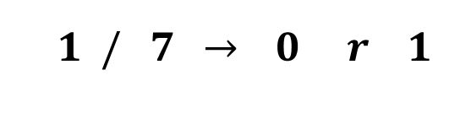
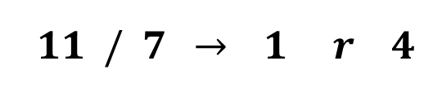
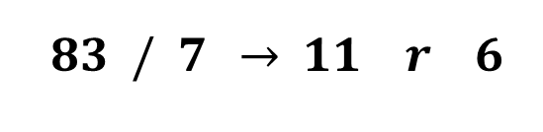
Unsigned Integers – Convert Decimal to Base-R
Also need to convert decimal numbers to desired base
Algorithm for converting unsigned Decimal to Base-R
Assign decimal number to NUM
Divide NUM by R
Save remainder REM as next least significant digit
Assign quotient Q as new NUM
Repeat step b) until quotient Q is zero
Example:
$${83}_{10}={ ? }_{7}$$
least significant digit
NUM
R
Q
REM
$$83 / 7 \underset{→}{ } 11 r 6$$
$$={146}_{7}$$
$$11 / 7 \underset{→}{ } 1 r 4$$
$$1 / 7 \underset{→}{ } 0 r 1$$
most significant digit

Slide 21
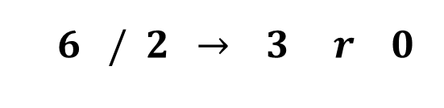

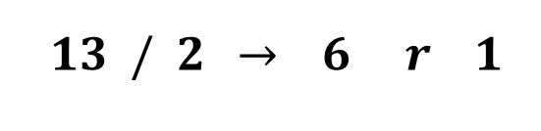

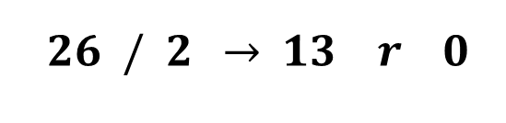
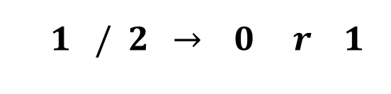
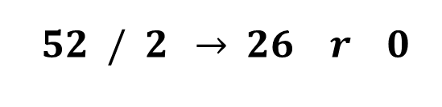
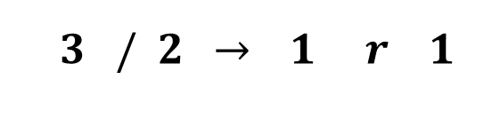
Unsigned Integers – Convert Decimal to Binary
Example with Unsigned Binary:
$${52}_{10}={ ? }_{2}$$
least significant digit
NUM
R
Q
REM
$$52 / 2 \underset{→}{ } 26 r 0$$
$$={110100}_{2}$$
$$26 / 2 \underset{→}{ } 13 r 0$$
$$13 / 2 \underset{→}{ } 6 r 1$$
$$6 / 2 \underset{→}{ } 3 r 0$$
most significant digit
$$3 / 2 \underset{→}{ } 1 r 1$$
$$1 / 2 \underset{→}{ } 0 r 1$$

Slide 22

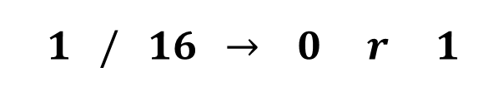
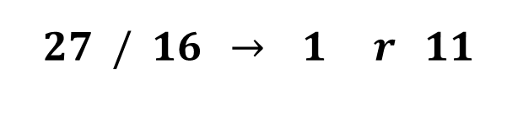

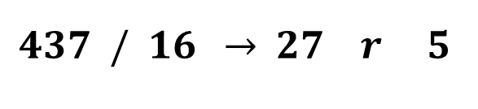
Unsigned Integers – Convert Decimal to Hexadecimal
$${437}_{10}={ ? }_{16}$$
Example with Unsigned Hexadecimal:
least significant digit
NUM
R
Q
REM
$$437 / 16 \underset{→}{ } 27 r 5$$
$$={1B5}_{16}$$
$$27 / 16 \underset{→}{ } 1 r 11$$
$$1 / 16 \underset{→}{ } 0 r 1$$
most significant digit

Slide 23
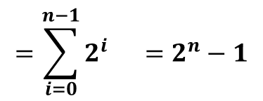



Unsigned Integers – Ranges
Range of Unsigned binary numbers based on number of bits
Given representation with n bits, min value is always sequence
0....0000 = 0
Given representation with n bits, max value is always sequence
1....1111 = 2^{n} – 1
So, ranges are:
unsigned char:
unsigned short:
unsigned int:
$$0 → 255 \left(2^{8}−1\right)$$
$$0 →65,535 \left(2^{16}−1\right)$$
$$0 →4,294,967,295 \left(2^{32}−1\right)$$
1 | 1 | ⋅ ⋅ ⋅ | 1 | 1 | 1 | 1
$$=\sum_{i=0}^{n−1}{2^{i}} =2^{n}−1$$
2^{n-1}
2^{n-2}
2³
2²
2¹
2⁰

Slide 24
Data Representation in Memory
Basic memory organization
Bits & Bytes – basic units of Storage in computers
Representing information in binary and hexadecimal
Representing Integers
Unsigned integers
Signed integers
Representing Text
Representing Pointers

Slide 25
Signed Integers – Binary
Signed Binary Integers converts half of range as negative
Signed representation identical, except for most significant bit
For signed binary, most significant bit indicates sign
0 for nonnegative
1 for negative
Must know number of bits for signed representation
Unsigned Integer representation:
2⁷
2⁶
2⁵
2⁴
2³
2²
2¹
2⁰
Place value of
most significant bit
is negative
for signed binary
Signed Integer representation:
-2⁷
2⁶
2⁵
2⁴
2³
2²
2¹
2⁰

Slide 26
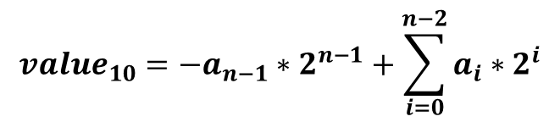


Signed Integers – Binary
Decimal value of n-bit signed binary number:
Positive (in-range) numbers have same representation:
$${value}_{10}={−a}_{n−1}∗2^{n−1}+\sum_{i=0}^{n−2}{a_{i}∗2^{i}}$$
Unsigned Integer representation:
0 | 1 | 1 | 0 | 1 | 0 | 0 | 1
$$=10510$$
2⁷
2⁶
2⁵
2⁴
2³
2²
2¹
2⁰
Signed Integer representation:
0 | 1 | 1 | 0 | 1 | 0 | 0 | 1
$$=10510$$
-2⁷
2⁶
2⁵
2⁴
2³
2²
2¹
2⁰

Slide 27
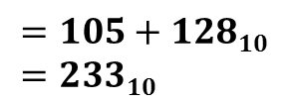
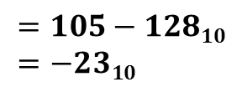
Signed Integers – Binary
Only when most significant bit set does value change
Difference between unsigned and signed integer values is 2^{N}
Unsigned Integer representation:
0 1 | 1 | 1 | 0 | 1 | 0 | 0 | 1
$$=105+12810=23310$$
2⁷
2⁶
2⁵
2⁴
2³
2²
2¹
2⁰
Signed Integer representation:
0 1 | 1 | 1 | 0 | 1 | 0 | 0 | 1
$$=105−12810=−2310$$
-2⁷
2⁶
2⁵
2⁴
2³
2²
2¹
2⁰

Slide 28
Signed Integers – Ranges
Range of Signed binary numbers:
Given representation with n bits, min value is always sequence
100....0000 = – 2^{n-1}
Given representation with n bits, max value is always sequence
011....1111 = 2^{n-1} – 1
So, ranges are:
C data type | # bits | Unsigned range | Signed range
char | 8 | 0 → 255 | -128 → 127
short | 16 | 0 → 65,535 | -32,768 → 32,767
int | 32 | 0 → 4,294,967,295 | -2,147,483,648 → 2,147,483,647

Slide 29
Signed Integers – Convert to/from Decimal
Convert Signed Binary Integer to Decimal
Easy – just use place value notation
two examples given on last two slides
Convert Decimal to Signed Binary Integer
MUST know number of bits in signed representation
Algorithm:
Convert magnitude (abs val) of decimal number to unsigned binary
Decimal number originally negative?
If positive, conversion is done
If negative, perform negation on answer from part a)
zero extend answer from a) to N bits (size of signed repr)
negate: flip bits and add 1

Slide 30



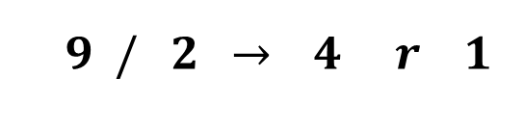
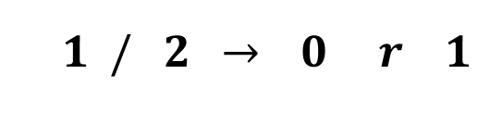
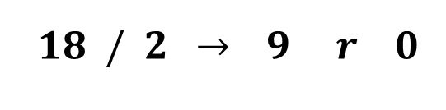
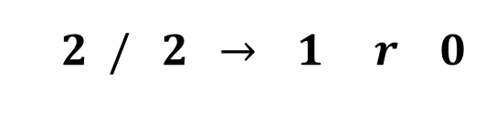
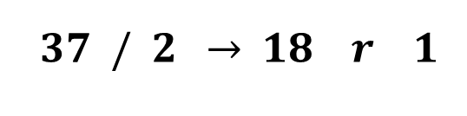
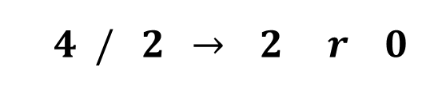
Signed Integers – Convert Decimal to Base-R
Example:
A)
$${−37}_{10}={ ? }_{8−bit signed}$$
$$\left|{−37}_{10}\right|={ ? }_{2}$$
least significant bit
NUM
R
Q
REM
$$37 / 2 \underset{→}{ } 18 r 1$$
$$={100101}_{2}$$
$$18 / 2 \underset{→}{ } 9 r 0$$
$$9 / 2 \underset{→}{ } 4 r 1$$
$$4 / 2 \underset{→}{ } 2 r 0$$
most significant bit
$$2 / 2 \underset{→}{ } 1 r 0$$
$$1 / 2 \underset{→}{ } 0 r 1$$

Slide 31






Signed Integers – Convert Decimal to Base-R
Example:
B) -37₁₀ was negative, so perform negation
zero extend 100101 to 8 bits
negation
flip bits:
add 1:
$${−37}_{10}={ ? }_{8−bit signed}$$
$${100101}_{2} → 00{100101}_{2}$$
$$={11011011}_{2}$$
$$00{100101}_{2}$$
$${11011010}_{2}$$
Can validate answer using
place value notation
$${+ 1}_{2}$$
$${11011011}_{2}$$

Slide 32



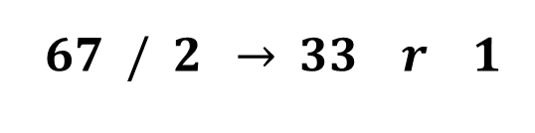
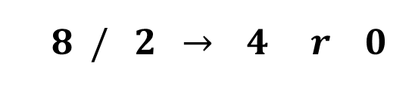
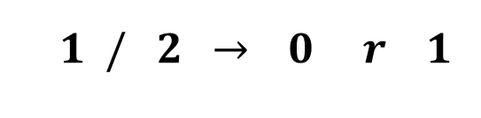
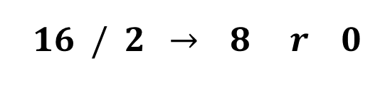
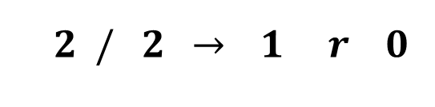
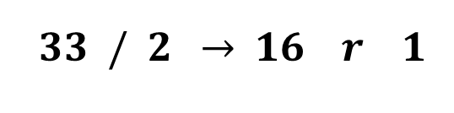
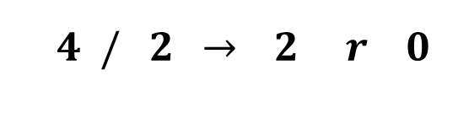
Signed Integers – Convert Decimal to Base-R
Example:
A)
$${67}_{10}={ ? }_{8−bit signed}$$
$$\left|{67}_{10}\right|={ ? }_{2}$$
least significant bit
NUM
R
Q
REM
$$67 / 2 \underset{→}{ } 33 r 1$$
$$33 / 2 \underset{→}{ } 16 r 1$$
$$={1000011}_{2}$$
$$16 / 2 \underset{→}{ } 8 r 0$$
$$8 / 2 \underset{→}{ } 4 r 0$$
$$4 / 2 \underset{→}{ } 2 r 0$$
most significant bit
$$2 / 2 \underset{→}{ } 1 r 0$$
$$1 / 2 \underset{→}{ } 0 r 1$$

Slide 33

Signed Integers – Convert Decimal to Base-R
Example:
B) 67₁₀ was positive, so done
$${67}_{10}={ ? }_{8−bit signed}$$
$$={1000011}_{2}$$
Can validate answer using
place value notation

Slide 34








Signed Integers – Convert Decimal to Base-R
Be careful of range!
Example:
A)
B) -183₁₀ was negative, so perform negation
zero extend 10110111 to 8 bits // already done
negation
flip bits:
add 1:
$${−183}_{10}={ ? }_{8−bit signed}$$
$$\left|{−183}_{10}\right|={ ? }_{2}$$
$$={10110111}_{2}$$
$${10110111}_{2}$$
not -183₁₀… WRONG!
-183₁₀ is not in valid range
for 8-bit signed
$${01001000}_{2}$$
$${+ 1}_{2}$$
$${01001001}_{2}$$
$$={73}_{10}$$

Slide 35
Data Representation in Memory
Basic memory organization
Bits & Bytes – basic units of Storage in computers
Representing information in binary and hexadecimal
Representing Integers
Unsigned integers
Signed integers
Representing Text
Representing Pointers

Slide 36
Representing Strings
char S[6] = "18243";
Strings in C
Represented by array of characters
Each character encoded in ASCII format
Standard 7-bit encoding of character set
Character “0” has code 0x30
String should be null-terminated
Final character = 0
ASCII characters organized such that:
Numeric characters sequentially increase from 0x30
Digit i has code 0x30+i
Alphabetic characters sequentially increase in order
Uppercase chars ‘A’ to ‘Z’ are 0x41 to 0x5A
Lowercase chars ‘A’ to ‘Z’ are 0x61 to 0x7A
Control characters, like <RET>, <TAB>, <BKSPC>, are 0x00 to 0x1A
Intel / Linux
0x31
0x38
0x32
0x34
0x33
0x00
‘1’
‘8’
‘2’
‘4’
‘3’
null term

Slide 37
Representing Strings
UTF-16 on Intel
Limitations of ASCII
7-bit encoding limits set of characters to 2⁷ = 128
8-bit extended ASCII exists, but still only 2⁸ = 256 chars
Unable to represent most other languages in ASCII
Answer: Unicode
first 128 characters are ASCII
i.e. 2-byte Unicode for ‘4’: 0x34 -> 0x0034
i.e. 4-byte Unicode for ‘T’: 0x54 -> 0x00000054
UTF-8: 1-byte version // commonly used
UTF-16: 2-byte version // commonly used
allows 2¹⁶ = 65,536 unique chars
UTF-32: 4-byte version
allows 2³² = ~4 billion unique characters
Unicode used in many more recent languages, like Java and Python
0x31
0x00
0x38
0x00
0x32
0x00
‘1’
‘8’
‘2’
0x34
0x00
0x33
0x00
0x00
0x00
‘4’
‘3’
null term

Slide 38
Data Representation in Memory
Basic memory organization
Bits & Bytes – basic units of Storage in computers
Representing information in binary and hexadecimal
Representing Integers
Unsigned integers
Signed integers
Representing Text
Representing Pointers

Slide 39
Representing Pointers
int B = -15213;
int *P = &B;
Sun
IA32
x86-64
EF
FF
FB
2C
D4
F8
FF
BF
0C
89
EC
FF
FF
7F
00
00
Different compilers & machines assign different locations to objects

Slide 40
Word-Oriented Memory Organization
32-bit
Words
64-bit
Words
Bytes
Addr.
Addresses Specify Byte Locations
Address of first byte in word
Addresses of successive words differ by 4 (32-bit) or 8 (64-bit)
0000
Addr
=
??
0001
0000
0002
Addr
=
??
0003
0000
0004
Addr
=
??
0005
0004
0006
0007
0008
Addr
=
??
0009
0008
0010
Addr
=
??
0011
0008
0012
Addr
=
??
0013
0012
0014
0015

Slide 41
Byte Ordering
How should bytes within a multi-byte word be ordered in memory?
Conventions
Big Endian: Sun, PPC Mac, Internet
Least significant byte has highest address
Little Endian: x86
Least significant byte has lowest address

Slide 42
Byte Ordering Example
Big Endian
Least significant byte has highest address
Little Endian
Least significant byte has lowest address
Example
Variable x has 4-byte representation 0x01234567
Address given by &x is 0x100
Big Endian
0x100
0x101
0x102
0x103
01
01
23
23
45
45
67
67
Little Endian
0x100
0x101
0x102
0x103
67
67
45
45
23
23
01
01

Slide 43
Reading Byte-Reversed Listings
Disassembly
Text representation of binary machine code
Generated by program that reads the machine code
Example Fragment
Deciphering Numbers
Value: 0x12ab
Pad to 32 bits: 0x000012ab
Split into bytes: 00 00 12 ab
Reverse: ab 12 00 00
Address Instruction Code Assembly Rendition
8048365: 5b pop %ebx
8048366: 81 c3 ab 12 00 00 add $0x12ab,%ebx
804836c: 83 bb 28 00 00 00 00 cmpl $0x0,0x28(%ebx)

Slide 44
Examining Data Representations
Code to Print Byte Representation of Data
Casting pointer to unsigned char * creates byte array
typedef unsigned char *pointer;
void show_bytes(pointer start, int len){
int i;
for (i = 0; i < len; i++)
printf(”%p\t0x%.2x\n",start+i, start[i]);
printf("\n");
}
Printf directives:
%p: Print pointer
%x: Print Hexadecimal

Slide 45
Representing Integers
Decimal: 15213
Binary: 0011 1011 0110 1101
Hex: 3 B 6 D
int A = 15213;
long int C = 15213;
IA32, x86-64
Sun
IA32
x86-64
Sun
6D
00
3B
00
6D
6D
00
00
3B
3B
3B
00
00
6D
00
00
3B
00
00
6D
00
int B = -15213;
00
IA32, x86-64
Sun
00
00
93
FF
C4
FF
FF
C4
FF
93
Two’s complement representation
(Covered later)

Slide 46
show_bytes Execution Example
int a = 15213;
printf("int a = 15213;\n");
show_bytes((pointer) &a, sizeof(int));
Result (Linux):
int a = 15213;
0x11ffffcb8 0x6d
0x11ffffcb9 0x3b
0x11ffffcba 0x00
0x11ffffcbb 0x00

Slide 47
Today: Bits, Bytes, and Integers
Representing information as bits
Bit-level manipulations
Integers
Representation: unsigned and signed
Conversion, casting
Expanding, truncating
Addition, negation, multiplication, shifting
Summary

Slide 48
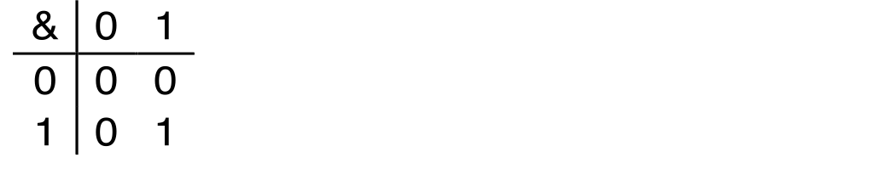
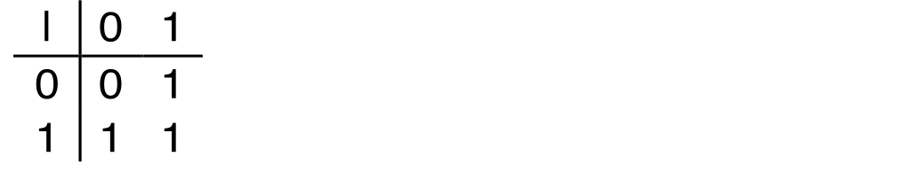
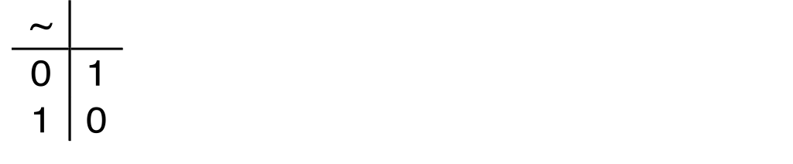
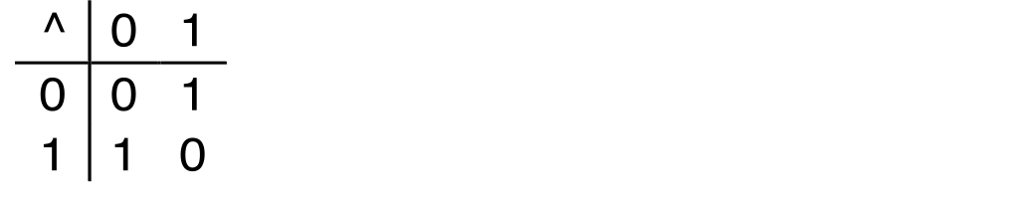
Boolean Algebra
Developed by George Boole in 19th Century
Algebraic representation of logic
Encode “True” as 1 and “False” as 0
And
A&B = 1 when both A=1 and B=1
Or
A|B = 1 when either A=1 or B=1
Not
~A = 1 when A=0
Exclusive-Or (Xor)
A^B = 1 when either A=1 or B=1, but not both

Slide 49
Application of Boolean Algebra
Applied to Digital Systems by Claude Shannon
1937 MIT Master’s Thesis
Reason about networks of relay switches
Encode closed switch as 1, open switch as 0
A&~B
Connection when
A&~B | ~A&B
A
~B
~A
B
~A&B
= A^B

Slide 50
General Boolean Algebras
Operate on Bit Vectors
Operations applied bitwise
All of the Properties of Boolean Algebra Apply
01101001
& 01010101
01000001
01101001
| 01010101
01111101
01101001
^ 01010101
00111100
~ 01010101
10101010
01000001
01111101
00111100
10101010

Slide 51
Representing & Manipulating Sets
Representation
Width w bit vector represents subsets of {0, …, w–1}
aj = 1 if j ∈ A
01101001 { 0, 3, 5, 6 }
76543210
01010101 { 0, 2, 4, 6 }
76543210
Operations
& Intersection 01000001 { 0, 6 }
| Union 01111101 { 0, 2, 3, 4, 5, 6 }
^ Symmetric difference 00111100 { 2, 3, 4, 5 }
~ Complement 10101010 { 1, 3, 5, 7 }

Slide 52
Bit-Level Operations in C
Operations &, |, ~, ^ Available in C
Apply to any “integral” data type
long, int, short, char, unsigned
View arguments as bit vectors
Arguments applied bit-wise
Examples (Char data type)
~0x41 ➙ 0xBE
~010000012 ➙ 101111102
~0x00 ➙ 0xFF
~000000002 ➙ 111111112
0x69 & 0x55 ➙ 0x41
011010012 & 010101012 ➙ 010000012
0x69 | 0x55 ➙ 0x7D
011010012 | 010101012 ➙ 011111012

Slide 53
Contrast: Logic Operations in C
Contrast to Logical Operators
&&, ||, !
View 0 as “False”
Anything nonzero as “True”
Always return 0 or 1
Early termination
Examples (char data type)
!0x41 ➙ 0x00
!0x00 ➙ 0x01
!!0x41 ➙ 0x01
0x69 && 0x55 ➙ 0x01
0x69 || 0x55 ➙ 0x01
p && *p (avoids null pointer access)

Slide 54
Shift Operations
Left Shift: x << y
Shift bit-vector x left y positions
Throw away extra bits on left
Fill with 0’s on right
Right Shift: x >> y
Shift bit-vector x right y positions
Throw away extra bits on right
Logical shift
Fill with 0’s on left
Arithmetic shift
Replicate most significant bit on right
Undefined Behavior
Shift amount < 0 or ≥ word size
Argument x
01100010
<< 3
00010000
00010000
00010000
Log. >> 2
00011000
00011000
00011000
Arith. >> 2
00011000
00011000
00011000
Argument x
10100010
<< 3
00010000
00010000
00010000
Log. >> 2
00101000
00101000
00101000
Arith. >> 2
11101000
11101000
11101000

Slide 55
Integer C Puzzles
x < 0 ⇒ ((x*2) < 0)
ux >= 0
x & 7 == 7 ⇒ (x<<30) < 0
ux > -1
x > y ⇒ -x < -y
x * x >= 0
x > 0 && y > 0 ⇒ x + y > 0
x >= 0 ⇒ -x <= 0
x <= 0 ⇒ -x >= 0
(x|-x)>>31 == -1
ux >> 3 == ux/8
x >> 3 == x/8
x & (x-1) != 0
Initialization
int x = foo();
int y = bar();
unsigned ux = x;
unsigned uy = y;

Slide 56
Memory – Data Representation
Representing information as bits
Bit-level manipulations
Integers
Representation: unsigned and signed
Conversion, casting
Expanding, truncating
Addition, negation, multiplication, shifting
Summary

Slide 57
Mapping Between Signed & Unsigned
Two’s Complement
Unsigned
T2U
x
T2B
B2U
ux
X
Maintain Same Bit Pattern
Unsigned
U2T
Two’s Complement
ux
U2B
B2T
x
X
Maintain Same Bit Pattern
Mappings between unsigned and two’s complement numbers: keep bit representations and reinterpret

Slide 58
Mapping Signed ↔ Unsigned
Bits
0000
0001
0010
0011
0100
0101
0110
0111
1000
1001
1010
1011
1100
1101
1110
1111
Signed
0
1
2
3
4
5
6
7
-8
-7
-6
-5
-4
-3
-2
-1
Unsigned
0
1
2
3
4
5
6
7
8
9
10
11
12
13
14
15
T2U
U2T

Slide 59
Mapping Signed ↔ Unsigned
Bits
0000
0001
0010
0011
0100
0101
0110
0111
1000
1001
1010
1011
1100
1101
1110
1111
Signed
0
1
2
3
4
5
6
7
-8
-7
-6
-5
-4
-3
-2
-1
Unsigned
0
1
2
3
4
5
6
7
8
9
10
11
12
13
14
15
=
+/- 16

Slide 60
Relation between Signed & Unsigned
Two’s Complement
Unsigned
T2U
x
T2B
B2U
ux
X
Maintain Same Bit Pattern
w–1
0
ux
+
+
+
• • •
+
+
+
x
-
+
+
• • •
+
+
+
Large negative weight
becomes
Large positive weight

Slide 61
Conversion Visualized
2’s Comp. → Unsigned
Ordering Inversion
Negative → Big Positive
UMax
UMax – 1
TMax + 1
Unsigned
Range
TMax
TMax
2’s Complement Range
0
0
–1
–2
TMin

Slide 62
Signed vs. Unsigned in C
Constants
By default are considered to be signed integers
Unsigned if have “U” as suffix
0U, 4294967259U
Casting
Explicit casting between signed & unsigned same as U2T and T2U
int tx, ty;
unsigned ux, uy;
tx = (int) ux;
uy = (unsigned) ty;
Implicit casting also occurs via assignments and procedure calls
tx = ux;
uy = ty;

Slide 63
Casting Surprises
Expression Evaluation
If there is a mix of unsigned and signed in single expression, signed values implicitly cast to unsigned
Including comparison operations <, >, ==, <=, >=
Examples for W = 32: TMIN = -2,147,483,648 , TMAX = 2,147,483,647
Constant₁ Constant₂ Relation Evaluation
0 0U
-1 0
-1 0U
2147483647 -2147483647-1
2147483647U -2147483647-1
-1 -2
(unsigned)-1 -2
2147483647 2147483648U
2147483647 (int) 2147483648U
0 0U == unsigned
-1 0 < signed
-1 0U > unsigned
2147483647 -2147483648 > signed
2147483647U -2147483648 < unsigned
-1 -2 > signed
(unsigned) -1 -2 > unsigned
2147483647 2147483648U < unsigned
2147483647 (int) 2147483648U > signed

Slide 64
Summary Casting Signed ↔ Unsigned: Basic Rules
Bit pattern is maintained
But reinterpreted
Can have unexpected effects: adding or subtracting 2^{w}
Expression containing signed and unsigned int
int is cast to unsigned!!

Slide 65
Code Security Example
/* Kernel memory region holding user-accessible data */
#define KSIZE 1024
char kbuf[KSIZE];
/* Copy at most maxlen bytes from kernel region to user buffer */
int copy_from_kernel(void *user_dest, int maxlen) {
/* Byte count len is minimum of buffer size and maxlen */
int len = KSIZE < maxlen ? KSIZE : maxlen;
memcpy(user_dest, kbuf, len);
return len;
}
Similar to code found in FreeBSD’s implementation of getpeername
There are legions of smart people trying to find vulnerabilities in programs

Slide 66
Typical Usage
/* Kernel memory region holding user-accessible data */
#define KSIZE 1024
char kbuf[KSIZE];
/* Copy at most maxlen bytes from kernel region to user buffer */
int copy_from_kernel(void *user_dest, int maxlen) {
/* Byte count len is minimum of buffer size and maxlen */
int len = KSIZE < maxlen ? KSIZE : maxlen;
memcpy(user_dest, kbuf, len);
return len;
}
#define MSIZE 528
void getstuff() {
char mybuf[MSIZE];
copy_from_kernel(mybuf, MSIZE);
printf(“%s\n”, mybuf);
}

Slide 67
Malicious Usage
/* Declaration of library function memcpy */
void *memcpy(void *dest, void *src, size_t n);
/* Kernel memory region holding user-accessible data */
#define KSIZE 1024
char kbuf[KSIZE];
/* Copy at most maxlen bytes from kernel region to user buffer */
int copy_from_kernel(void *user_dest, int maxlen) {
/* Byte count len is minimum of buffer size and maxlen */
int len = KSIZE < maxlen ? KSIZE : maxlen;
memcpy(user_dest, kbuf, len);
return len;
}
#define MSIZE 528
void getstuff() {
char mybuf[MSIZE];
copy_from_kernel(mybuf, -MSIZE);
. . .
}

Slide 68
Today: Bits, Bytes, and Integers
Representing information as bits
Bit-level manipulations
Integers
Representation: unsigned and signed
Conversion, casting
Expanding, truncating
Addition, negation, multiplication, shifting
Summary

Slide 69
Sign Extension
Task:
Given w-bit signed integer x
Convert it to w+k-bit integer with same value
Rule:
Make k copies of sign bit:
X ′ = x_{w–1} ,…, x_{w–1} , x_{w–1} , x_{w–2} ,…, x₀
k copies of MSB
w
X
• • •
• • •
X ′
• • •
• • •
k
w

Slide 70
Sign Extension Example
short int x = 15213;
int ix = (int) x;
short int y = -15213;
int iy = (int) y;
Decimal
Hex
Binary
x
15213
3B 6D
00111011 01101101
ix
15213
00 00 3B 6D
00000000 00000000 00111011 01101101
y
-15213
C4 93
11000100 10010011
iy
-15213
FF FF C4 93
11111111 11111111 11000100 10010011
Converting from smaller to larger integer data type
C automatically performs sign extension

Slide 71
Summary: Expanding, Truncating: Basic Rules
Expanding (e.g., short int to int)
Unsigned: zeros added
Signed: sign extension
Both yield expected result
Truncating (e.g., unsigned to unsigned short)
Unsigned/signed: bits are truncated
Result reinterpreted
Unsigned: mod operation
Signed: similar to mod
For small numbers yields expected behaviour

Slide 72
Today: Bits, Bytes, and Integers
Representing information as bits
Bit-level manipulations
Integers
Representation: unsigned and signed
Conversion, casting
Expanding, truncating
Addition, negation, multiplication, shifting
Summary

Slide 73
Negation: Complement & Increment
Claim: Following Holds for 2’s Complement
~x + 1 == -x
Complement
Observation: ~x + x == 1111…111 == -1
Complete Proof?
x
1
0
0
1
1
1
0
1
+
~x
0
1
1
0
0
0
1
0
-1
1
1
1
1
1
1
1
1

Slide 74
Complement & Increment Examples
x = 15213
x = 0

Slide 75
Unsigned Addition
u
Operands: w bits
• • •
+
v
• • •
True Sum: w+1 bits
u + v
• • •
Discard Carry: w bits
UAdd_{w}(u , v)
• • •
Standard Addition Function
Ignores carry output
Implements Modular Arithmetic
s = UAdd_{w}(u , v) = u + v mod 2^{w}

Slide 76
Visualizing (Mathematical) Integer Addition
Integer Addition
4-bit integers u, v
Compute true sum Add₄(u , v)
Values increase linearly with u and v
Forms planar surface
Add₄(u , v)
v
u

Slide 77
Visualizing Unsigned Addition
Wraps Around
If true sum ≥ 2^{w}
At most once
Overflow
UAdd₄(u , v)
True Sum
2^{w+1}
Overflow
2^{w}
v
0
Modular Sum
u

Slide 78
Mathematical Properties
Modular Addition Forms an Abelian Group
Closed under addition
0 ≤ UAdd_{w}(u , v) ≤ 2^{w} –1
Commutative
UAdd_{w}(u , v) = UAdd_{w}(v , u)
Associative
UAdd_{w}(t, UAdd_{w}(u , v)) = UAdd_{w}(UAdd_{w}(t, u ), v)
0 is additive identity
UAdd_{w}(u , 0) = u
Every element has additive inverse
Let UComp_{w} (u ) = 2^{w} – u UAdd_{w}(u , UComp_{w} (u )) = 0

Slide 79
Two’s Complement Addition
Operands: w bits
u
• • •
+
v
• • •
True Sum: w+1 bits
u + v
• • •
Discard Carry: w bits
TAdd_{w}(u , v)
• • •
TAdd and UAdd have Identical Bit-Level Behavior
Signed vs. unsigned addition in C:
int s, t, u, v;
s = (int) ((unsigned) u + (unsigned) v);
t = u + v
Will give s == t

Slide 80
TAdd Overflow
Functionality
True sum requires w+1 bits
Drop off MSB
Treat remaining bits as 2’s comp. integer
True Sum
0 111…1
2^{w}–1
PosOver
TAdd Result
0 100…0
2^{w –1}
011…1
0 000…0
0
000…0
1 011…1
–2^{w –1}–1
100…0
1 000…0
–2^{w}
NegOver

Slide 81
Visualizing 2’s Complement Addition
NegOver
Values
4-bit two’s comp.
Range from -8 to +7
Wraps Around
If sum ≥ 2^{w–1}
Becomes negative
At most once
If sum < –2^{w–1}
Becomes positive
At most once
TAdd₄(u , v)
v
u
PosOver

Slide 82
Characterizing TAdd
Positive Overflow
Functionality
True sum requires w+1 bits
Drop off MSB
Treat remaining bits as 2’s comp. integer
TAdd(u , v)
> 0
v
< 0
< 0
> 0
u
Negative Overflow
2^{w}
(NegOver)
2^{w}
(PosOver)

Slide 83
Mathematical Properties of TAdd
Isomorphic Group to unsigneds with UAdd
TAdd_{w}(u , v) = U2T(UAdd_{w}(T2U(u ), T2U(v)))
Since both have identical bit patterns
Two’s Complement Under TAdd Forms a Group
Closed, Commutative, Associative, 0 is additive identity
Every element has additive inverse

Slide 84
Multiplication
Computing Exact Product of w-bit numbers x, y
Either signed or unsigned
Ranges
Unsigned: 0 ≤ x * y ≤ (2^{w} – 1) ² = 2^{2w} – 2^{w+1} + 1
Up to 2w bits
Two’s complement min: x * y ≥ (–2^{w–1})*(2^{w–1}–1) = –2^{2w–2} + 2^{w–1}
Up to 2w–1 bits
Two’s complement max: x * y ≤ (–2^{w–1}) ² = 2^{2w–2}
Up to 2w bits, but only for (TMin_{w})²
Maintaining Exact Results
Would need to keep expanding word size with each product computed
Done in software by “arbitrary precision” arithmetic packages

Slide 85
Unsigned Multiplication in C
u
• • •
Operands: w bits
*
v
• • •
True Product: 2*w bits
u · v
• • •
• • •
UMult_{w}(u , v)
Discard w bits: w bits
• • •
Standard Multiplication Function
Ignores high order w bits
Implements Modular Arithmetic
UMult_{w}(u , v) = u · v mod 2^{w}

Slide 86
Code Security Example #2
SUN XDR library
Widely used library for transferring data between machines
void* copy_elements(void *ele_src[], int ele_cnt, size_t ele_size);
ele_src
malloc(ele_cnt * ele_size)

Slide 87
XDR Code
void* copy_elements(void *ele_src[], int ele_cnt, size_t ele_size) {
/*
* Allocate buffer for ele_cnt objects, each of ele_size bytes
* and copy from locations designated by ele_src
*/
void *result = malloc(ele_cnt * ele_size);
if (result == NULL)
/* malloc failed */
return NULL;
void *next = result;
int i;
for (i = 0; i < ele_cnt; i++) {
/* Copy object i to destination */
memcpy(next, ele_src[i], ele_size);
/* Move pointer to next memory region */
next += ele_size;
}
return result;
}

Slide 88
XDR Vulnerability
malloc(ele_cnt * ele_size)
What if:
ele_cnt = 2²⁰ + 1
ele_size = 4096 = 2¹²
Allocation = ??
How can I make this function secure?

Slide 89
Signed Multiplication in C
u
• • •
Operands: w bits
*
v
• • •
True Product: 2*w bits
u · v
• • •
• • •
TMult_{w}(u , v)
Discard w bits: w bits
• • •
Standard Multiplication Function
Ignores high order w bits
Some of which are different for signed vs. unsigned multiplication
Lower bits are the same

Slide 90
Power-of-2 Multiply with Shift
Operation
u << k gives u * 2^{k}
Both signed and unsigned
Examples
u << 3 == u * 8
u << 5 - u << 3 == u * 24
Most machines shift and add faster than multiply
Compiler generates this code automatically
k
u
• • •
Operands: w bits
*
2^{k}
0
•••
0
1
0
•••
0
0
True Product: w+k bits
u · 2^{k}
• • •
0
•••
0
0
Discard k bits: w bits
UMult_{w}(u , 2^{k})
•••
0
•••
0
0
TMult_{w}(u , 2^{k})

Slide 91
Compiled Multiplication Code
C Function
int mul12(int x)
{
return x*12;
}
Compiled Arithmetic Operations
Explanation
leal (%eax,%eax,2), %eax
sall $2, %eax
t <- x+x*2
return t << 2;
C compiler automatically generates shift/add code when multiplying by constant

Slide 92
Unsigned Power-of-2 Divide with Shift
Quotient of Unsigned by Power of 2
u >> k gives ⎣ u / 2^{k} ⎦
Uses logical shift
k
u
•••
•••
Binary Point
Operands:
/
2^{k}
0
•••
0
1
0
•••
0
0
Division:
u / 2^{k}
0
.
0
•••
0
0
•••
•••
Result:
⎣ u / 2^{k} ⎦
0
0
•••
0
0
•••

Slide 93
Compiled Unsigned Division Code
C Function
unsigned udiv8(unsigned x)
{
return x/8;
}
Compiled Arithmetic Operations
Explanation
shrl $3, %eax
# Logical shift
return x >> 3;
Uses logical shift for unsigned
For Java Users
Logical shift written as >>>

Slide 94
Signed Power-of-2 Divide with Shift
Quotient of Signed by Power of 2
x >> k gives ⎣ x / 2^{k} ⎦
Uses arithmetic shift
Rounds wrong direction when u < 0
k
x
•••
•••
Binary Point
Operands:
/
2^{k}
0
•••
0
1
0
•••
0
0
Division:
x / 2^{k}
0
•••
•••
.
•••
Result:
RoundDown(x / 2^{k})
0
•••
•••

Slide 95
Correct Power-of-2 Divide
Quotient of Negative Number by Power of 2
Want ⎡ x / 2^{k} ⎤ (Round Toward 0)
Compute as ⎣ (x+2^{k}-1)/ 2^{k} ⎦
In C: (x + (1<<k)-1) >> k
Biases dividend toward 0
Case 1: No rounding
k
Dividend:
u
1
•••
0
•••
0
0
+2^{k} –1
0
•••
0
0
1
•••
1
1
Binary Point
1
•••
1
•••
1
1
Divisor:
/
2^{k}
0
•••
0
1
0
•••
0
0
⎡ u / 2^{k} ⎤
0
.
1
•••
1
1
1
•••
1
•••
1
1
Biasing has no effect

Slide 96
Correct Power-of-2 Divide (Cont.)
Case 2: Rounding
k
Dividend:
x
1
•••
•••
+2^{k} –1
0
•••
0
0
1
•••
1
1
1
•••
•••
Incremented by 1
Binary Point
Divisor:
/
2^{k}
0
•••
0
1
0
•••
0
0
⎡ x / 2^{k} ⎤
.
0
1
•••
1
1
1
•••
•••
Incremented by 1
Biasing adds 1 to final result

Slide 97
Compiled Signed Division Code
C Function
int idiv8(int x)
{
return x/8;
}
Compiled Arithmetic Operations
Explanation
testl %eax, %eax
js L4
L3:
sarl $3, %eax
ret
L4:
addl $7, %eax
jmp L3
if x < 0
x += 7;
# Arithmetic shift
return x >> 3;
Uses arithmetic shift for int
For Java Users
Arith. shift written as >>

Slide 98
Arithmetic: Basic Rules
Addition:
Unsigned/signed: Normal addition followed by truncate, same operation on bit level
Unsigned: addition mod 2^{w}
Mathematical addition + possible subtraction of 2w
Signed: modified addition mod 2^{w} (result in proper range)
Mathematical addition + possible addition or subtraction of 2w
Multiplication:
Unsigned/signed: Normal multiplication followed by truncate, same operation on bit level
Unsigned: multiplication mod 2^{w}
Signed: modified multiplication mod 2^{w} (result in proper range)

Slide 99
Arithmetic: Basic Rules
Unsigned ints, 2’s complement ints are isomorphic rings: isomorphism = casting
Left shift
Unsigned/signed: multiplication by 2^{k}
Always logical shift
Right shift
Unsigned: logical shift, div (division + round to zero) by 2^{k}
Signed: arithmetic shift
Positive numbers: div (division + round to zero) by 2^{k}
Negative numbers: div (division + round away from zero) by 2^{k} Use biasing to fix

Slide 100
Today: Integers
Representation: unsigned and signed
Conversion, casting
Expanding, truncating
Addition, negation, multiplication, shifting
Summary

Slide 101
Properties of Unsigned Arithmetic
Unsigned Multiplication with Addition Forms Commutative Ring
Addition is commutative group
Closed under multiplication
0 ≤ UMult_{w}(u , v) ≤ 2^{w} –1
Multiplication Commutative
UMult_{w}(u , v) = UMult_{w}(v , u)
Multiplication is Associative
UMult_{w}(t, UMult_{w}(u , v)) = UMult_{w}(UMult_{w}(t, u ), v)
1 is multiplicative identity
UMult_{w}(u , 1) = u
Multiplication distributes over addtion
UMult_{w}(t, UAdd_{w}(u , v)) = UAdd_{w}(UMult_{w}(t, u ), UMult_{w}(t, v))

Slide 102
Properties of Two’s Comp. Arithmetic
Isomorphic Algebras
Unsigned multiplication and addition
Truncating to w bits
Two’s complement multiplication and addition
Truncating to w bits
Both Form Rings
Isomorphic to ring of integers mod 2^{w}
Comparison to (Mathematical) Integer Arithmetic
Both are rings
Integers obey ordering properties, e.g.,
u > 0 ⇒ u + v > v
u > 0, v > 0 ⇒ u · v > 0
These properties are not obeyed by two’s comp. arithmetic
TMax + 1 == TMin
15213 * 30426 == -10030 (16-bit words)

Slide 103
Why Should I Use Unsigned?
Don’t Use Just Because Number Nonnegative
Easy to make mistakes
unsigned i;
for (i = cnt-2; i >= 0; i--)
a[i] += a[i+1];
Can be very subtle
#define DELTA sizeof(int)
int i;
for (i = CNT; i-DELTA >= 0; i-= DELTA)
. . .
Do Use When Performing Modular Arithmetic
Multiprecision arithmetic
Do Use When Using Bits to Represent Sets
Logical right shift, no sign extension

