Slide 1
Methods of Inquiry
David Ferry
CORE 1000 – The Most Human Computer
Saint Louis University

Slide 2
The Nature of Truth
Define “narcissism”

Slide 3
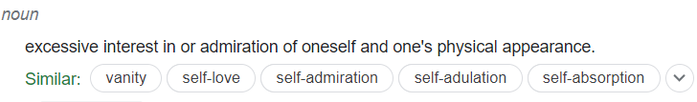
The Nature of Truth
Define “narcissism”

Slide 4
The Nature of Truth
Define “narcissism”
The Myth of Narcissus: A man is walking through the forest, and sees his own reflection in a pool of water. He falls so deeply in love with it he cannot leave it. He eventually realizes it is himself and is not real. He becomes utterly despondent because he will never love anything as much as this, so he loses the will to live and kills himself.

Slide 5
The Nature of Truth
Define “narcissism”
The Myth of Narcissus: A man is walking through the forest, and sees his own reflection in a pool of water. He falls so deeply in love with it he cannot leave it. He eventually realizes it is himself and is not real. He becomes utterly despondent because he will never love anything as much as this, so he loses the will to live and kills himself.
Which is correct? Is one factual? Which matters more?

Slide 6
Activity
With a partner
Select a figure you’d find on Wikipedia
Historical or modern
Leader, artist, philosopher, scientist, etc.
Tell your partner why you picked them
Copy the first paragraph as a factual summary
Write a short story (1-3 sentences) telling us why they matter

Slide 7
Example:
Abraham Lincoln was an American lawyer, politician, and statesman who served as the 16th president of the United States from 1861 until his assassination in 1865. He led the United States through the American Civil War, defending the nation as a constitutional union, defeating the insurgent Confederacy, playing a major role in the abolition of slavery, expanding the power of the federal government, and modernizing the U.S. economy.
Abraham Lincoln freed the slaves.
Abraham Lincoln unified the country.
Abraham Lincoln came out of poverty, educated himself, and carefully led the nation through the most divisive period in our history.

Slide 8
Major Course Questions
A few major course themes:
What does it mean to be human?
What makes a meaningful human experience?
What is good for people?
And more…
What kind of answers matter the most to you?
How would you express those answers effectively?

Slide 9
Activity
With a partner, take turns answering some of the following questions:
What does it mean to be human?
What makes a meaningful human experience?
What is good for people?
First give a “dictionary” answer, then come up with a short story or parable to illustrate the same answer.

Slide 10
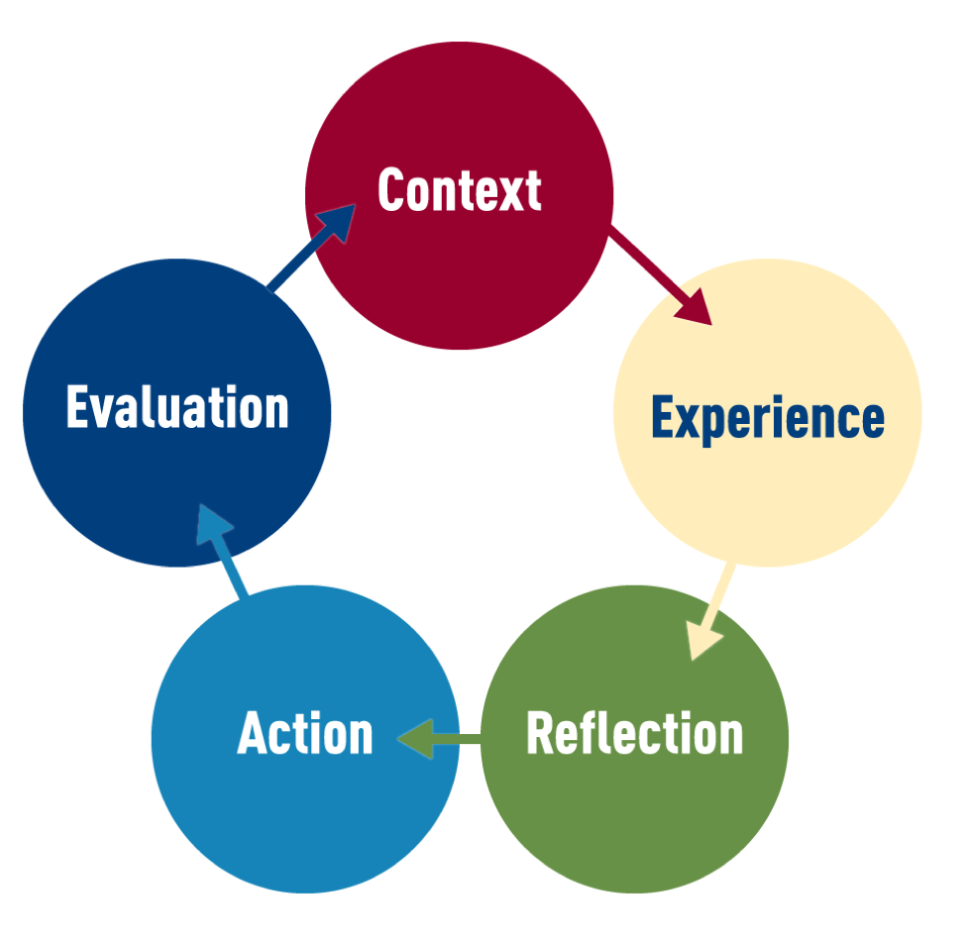
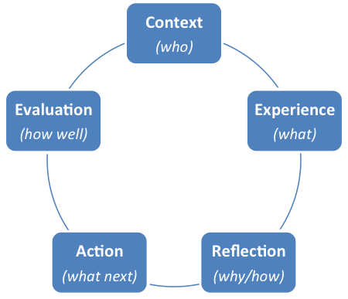
Ignatian Pedagogical Paradigm
A model for self-reflection, understanding oneself, and understanding the world

Slide 11
What are models for understanding?
Examples:
Ben Franklin’s list of pros and cons
Analogies
Francis Bacon’s scientific method
Others:
Alan Turing’s imitation game (Turing test)
Statistical quality control
FAA crash investigation procedures

Slide 12
Critical Thinking!
Not just “thinking real hard.”
Prof. Ferry’s hot take of the day:
Anyone can tell you what they think to be true.
The hallmark of an educated person is they have solid foundations for why they think something to be true.

Slide 13
Basis of Ignatian Paradigm
Iteration toward your end goal
There is no fixed methodology for teaching
Set a goal, and iterate towards that goal
Teachers accompany learners
Why do we need a method?
Full growth of the person, leading to action in the world
Urges toward self-discipline, integrity, and accuracy
Prevent slip-shod, superficial thinking unworthy and dangerous to the individual and the world
“Forming men and women for others”

Slide 14
Ignatius’ Spiritual Exercises
A story-based explanation of some tenuous link between you sitting here today and the founder of the Jesuit order.
The Spiritual Exercises are not meant to be merely cognitive activities or devotional practices. They are, instead, rigorous exercises of the spirit wholly engaging the body, mind, heart and soul of the human person. Thus they offer not only matters to be pondered, but also realities to be contemplated, scenes to be imagined, feelings to be evaluated, possibilities to be explored, options to be considered, alternatives to be weighed, judgments to be reached and choices of action to be made -- all with the expressed aim of helping individuals to seek and find the will of God at work in the radical ordering of their lives.
Ignatian Pedagogy: A Practical Approach, Society of Jesus

Slide 15
Ignatius’ Spiritual Exercises
A fundamental dynamic of the Spiritual Exercises of Ignatius is the continual call to reflect upon the entirety of one's experience in prayer in order to discern where the Spirit of God is leading. Ignatius urges reflection on human experience as an essential means of validating its authenticity, because without prudent reflection delusion readily becomes possible and without careful reflection the significance of one's experience may be neglected or trivialized. Only after adequate reflection on experience and implications of what one studies can one proceed freely and confidently toward choosing appropriate courses of action that foster the integral growth of oneself as a human being. Hence, reflection becomes a pivotal point for Ignatius in the movement from experience to action
Ignatian Pedagogy: A Practical Approach, Society of Jesus

Slide 16
Dynamics of the Paradigm
Five steps, but not necessarily a strict cycle
Context Experience Reflection ➔ Action
Action ➔ Evaluation
Evaluation ➔ New Context

Slide 17

Context
The real context of your life
Our greater socio-economic, political, and cultural context
The specific context of SLU
The student’s existing body of ideas

Slide 18
Activity - Context
On a sheet of paper, write down at least five elements of your personal context:
Recall:
Social, political, economic, cultural context in America today
The context of SLU today
Your personal history, how you got here

Slide 19

Experience
For Ignatius meant “to taste something internally”
Your intellectual response to the subject
Sensations of an affective nature
“I like A,” “B threatens me,” “C is boring”
Experience is any relevant personal data: What do I know about it, and how do I react to it?

Slide 20
Activity - Experience
Subject of meditation for the day:
Going to college
Write down five things in your experience about going to college:
Things you believe to be true intellectually
Sensations you feel / have felt

Slide 21

Reflection
Clarifies internal motivations and reasons behind your judgements (recall: “I like this,” or “bored”)
Probe the causes and implications of experiences
Weigh possible options and likely consequences
Achieve personal insights into ideas and truth
Come to an understanding of who I am (“Why do I feel that way?”)

Slide 22
Activity - Reflection
You should have at least five pieces of context, and five experiences.
Put a star next to the three items that speak to you most strongly on the topic Going to college
What do these three items say most strongly about Going to college? Write that.

Slide 23

Action
An extension of reflection
Reflection begins with the reality of experience and should end with the same reality
Reflection internalizes meanings, attitudes, or values
Action is to do something consistent with the new convictions

Slide 24
Activity - Action
You should have written a statement strongly believe about Going to college.
What meaning does that statement have for your life? What is your emotional reaction to that statement?
What can you do, today, to better align your actions with your conviction in that statement?

Slide 25
Evaluation
You have already finished the cycle of self-meditation/contemplation
Evaluation brings your conclusions to the attention of your teacher and larger community
We’re all stronger together than we are separate
Checks your motivations against your community- “forming men and women for others”
Checks integrity and accuracy
Gives feedback to students own internal processes

Slide 26
Activity
I’m not your teacher in the Ignatian sense.
Talk to someone about your reasoning, conclusion, and plan of action. What do they have to say about it?
Roommate
Friend
Parent
College advisor

