Slide 1
CS:APP Chapter 4
Computer Architecture
Pipelined
Implementation
Randal E. Bryant
adapted by Jason Fritts
http://csapp.cs.cmu.edu
CS:APP2e

Slide 2
Overview
General Principles of Pipelining
Goal
Difficulties
Creating a Pipelined Y86 Processor
Rearranging SEQ to create pipelined datapath, PIPE
Inserting pipeline registers
Problems with data and control hazards

Slide 3
Fundamentals of Pipelining

Slide 4


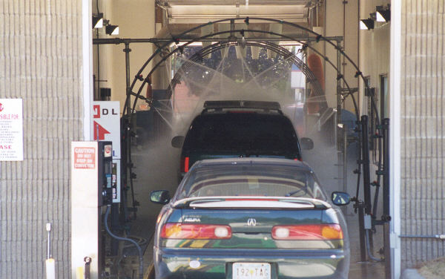
Real-World Pipelines: Car Washes
Sequential
Parallel
Pipelined
Idea
Divide process into independent stages
Move objects through stages in sequence
At any given times, multiple objects being processed

Slide 5
Computational Example
300 ps
20 ps
Combinational
logic
R
e
g
Delay = 320 ps
Throughput = 3.12 GIPS
Clock
System
Computation requires total of 300 picoseconds
Additional 20 picoseconds to save result in register
Must have clock cycle of at least 320 ps

Slide 6
3-Way Pipelined Version
100 ps
20 ps
100 ps
20 ps
100 ps
20 ps
Comb.
logic
A
R
e
g
Comb.
logic
B
R
e
g
Comb.
logic
C
R
e
g
Delay = 360 ps
Throughput = 8.33 GIPS
Clock
System
Divide combinational logic into 3 blocks of 100 ps each
Can begin new operation as soon as previous one passes through stage A.
Begin new operation every 120 ps
Overall latency increases
360 ps from start to finish

Slide 7
Pipeline Diagrams
Unpipelined
Cannot start new operation until previous one completes
3-Way Pipelined
Up to 3 operations in process simultaneously
OP1
OP2
OP3
Time
OP1
A
B
C
OP2
A
B
C
OP3
A
B
C
Time

Slide 8
Operating a Pipeline
239
241
300
359
Clock
OP1
A
B
C
OP2
A
B
C
OP3
A
B
C
0
120
240
360
480
640
Time
100 ps
20 ps
100 ps
20 ps
100 ps
20 ps
100 ps
100 ps
100 ps
20 ps
20 ps
20 ps
100 ps
100 ps
100 ps
20 ps
20 ps
20 ps
100 ps
100 ps
100 ps
20 ps
20 ps
20 ps
Comb.
logic
A
R
e
g
Comb.
logic
B
R
e
g
Comb.
logic
C
Comb.
logic
A
R
e
g
Comb.
logic
B
R
e
g
Comb.
logic
C
R
e
g
Comb.
logic
A
Comb.
logic
A
R
e
g
R
e
g
Comb.
logic
B
Comb.
logic
B
R
e
g
R
e
g
Comb.
logic
C
Comb.
logic
C
R
e
g
R
e
g
R
e
g
Clock
Clock
Clock
Clock

Slide 9
Limitations: Nonuniform Delays
50 ps
20 ps
150 ps
20 ps
100 ps
20 ps
Comb.
logic
A
R
e
g
Comb.
logic
B
R
e
g
Comb.
logic
C
R
e
g
Delay = 510 ps
Throughput = 5.88 GIPS
Clock
OP1
A
B
C
OP2
A
B
C
OP3
A
B
C
Time
Throughput limited by slowest stage
Other stages sit idle for much of the time
Challenging to partition system into balanced stages

Slide 10
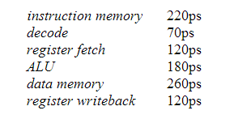
Sample Circuit Delays & Pipelining
20ps delay for hardware register at end of cycle
Single-cycle processor:
Clock cycle = 220 + 70 + 120 + 180 + 260 + 120 + 20 = 990ps
Clock freq = 1 / 990ps = 1 / 990*10⁻¹² = 1.01 GHz
Combine and/or split stages for pipelining
Need to balance time per stage since clock freq determined by slowest time
Must maintain original order of stages, so can’t combine non-neighboring stages (e.g. can’t combine decode & data mem)

Slide 11
Sample Circuit Delays & Pipelining
20ps delay added for hardware register at end of each cycle
3-stage pipeline:
Best combination for minimizing clock cycle time:
1st stage – instr mem & decode: 220 + 70 + 20 = 310ps
2nd stage – reg fetch & ALU: 120 + 180 + 20 = 320ps
3rd stage – data mem & reg WB: 260 + 120 + 20 = 400ps
Slowest stage is 400ps, so clock cycle time is 400ps
Clock freq = 1 / 400ps = 1 / 400*10⁻¹² = 2.5 GHz

Slide 12
Sample Circuit Delays & Pipelining
20ps delay added for hardware register at end of each cycle
5-stage pipeline:
Best combination for minimizing clock cycle time:
1st stage – instr mem: 220 + 20ps = 240ps
2nd stage – decode & reg fetch: 70 + 120 + 20ps = 210ps
3rd stage – ALU: 180 + 20ps = 200ps
4th stage – data mem: 260 + 20ps = 280ps
5th stage – reg WB: 120 + 20ps = 140ps
Slowest stage is 280ps, so clock cycle time is 280ps
Clock freq = 1 / 280ps = 1 / 280*10⁻¹² = 3.57 GHz

Slide 13
Sample Circuit Delays & Pipelining
20ps delay added for hardware register at end of each cycle
9-stage pipeline:
Assuming can split stages evenly into halves, thirds, or quarters
not a valid assumption, but useful for simplifying problem
Best combination for minimizing clock cycle time:
Each circuit is its own stage, with 20ps added delay for reg
Split instr mem circuit into two stages, each 110+20ps
Split data mem circuit into two stages, each 130+20ps
Split ALU circuit into two stages, each 90+20ps
Slowest stage is 150ps, so clock cycle time is 150ps
Clock freq = 1 / 150ps = 1 / 150*10⁻¹² = 6.67 GHz

Slide 14
Limitations: Register Overhead
50 ps
20 ps
50 ps
20 ps
50 ps
20 ps
50 ps
20 ps
50 ps
20 ps
50 ps
20 ps
Comb.
logic
R
e
g
Comb.
logic
R
e
g
Comb.
logic
R
e
g
Comb.
logic
R
e
g
Comb.
logic
R
e
g
Comb.
logic
R
e
g
Clock
Delay = 420 ps, Throughput = 14.29 GIPS
As try to deepen pipeline, overhead of loading registers becomes more significant
Percentage of clock cycle spent loading register:
1-stage pipeline: 6.25%
3-stage pipeline: 16.67%
6-stage pipeline: 28.57%
High speeds of modern processor designs obtained through very deep pipelining

Slide 15
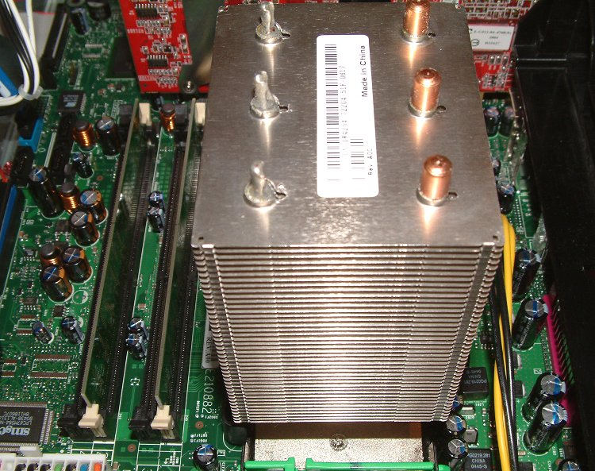
In Practice
i386 – 3 stage pipeline
I486 – 5 stages
Pentium 3 – 11 stages
Pentium 4 (willamette)
20 stages
Pentium 4 (prescott)
31 stages!
Up to 3.8GHz
Severe heat problems
Long pipeline actually hurt some application’s performance
115 Watts dissipation

Slide 16
Converting SEQ to PIPE, a pipelined datapath

Slide 17
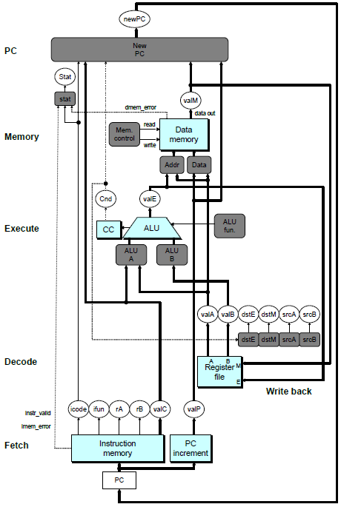
SEQ Hardware
Stages occur in sequence
One operation in process at a time
To convert to pipelined datapath, start by adding registers between stages, resulting in 5 pipeline stages:
Fetch
Decode
Execute
Memory
Writeback

Slide 18
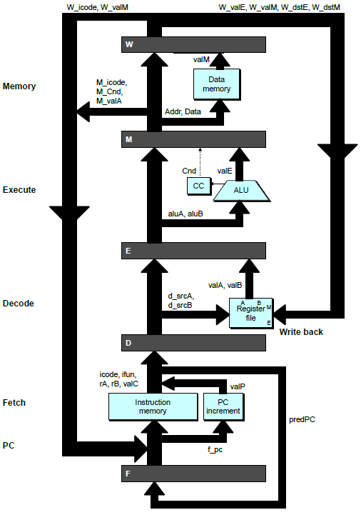
Converting to pipelined datapath
PC
newPC
Write back
valE
,
valM
valM
Data
Memory
Data
memory
memory
Addr
, Data
valE
CC
CC
ALU
Execute
Cnd
ALU
aluA
,
aluB
Add pipeline registers between stages
valA
,
valB
Decode
srcA
,
srcB
A
A
B
dstA
,
dstB
B
M
Register
M
Register
Register
Register
file
file
file
file
E
E
icode
,
ifun
valP
rA
,
rB
valC
Instruction
PC
Instruction
PC
Fetch
memory
increment
memory
increment
PC

Slide 19
Problem: Fetching a new instruction each cycle
Two problems
PC generated in last stage of SEQ datapath
PC sometimes not available until end of Execute or Memory stage
PC needs to be computed early
In order to fetch a new instruction every cycle, PC generation must be moved to first stage of datapath
Solve first problem by moving PC generation from end of SEQ to beginning of SEQ
Use prediction to select PC early
Solve second problem by predicting next instruction from current instruction
If prediction is wrong, squash (kill) predicted instructions

Slide 20
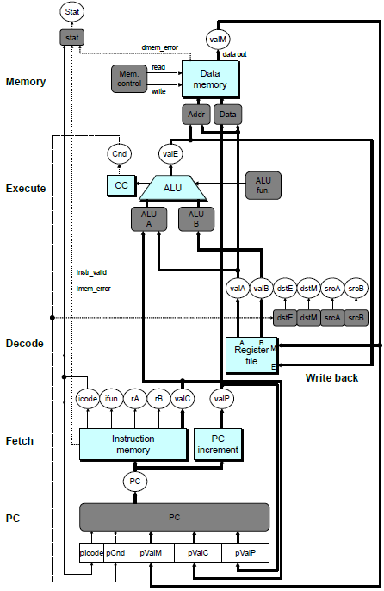
SEQ+ Hardware
Still sequential implementation
Reorder PC stage to put at beginning
PC Stage
Task is to select PC for current instruction
Based on results computed by previous instruction
Processor State
PC is no longer stored in register
But, can determine PC based on other stored information

Slide 21
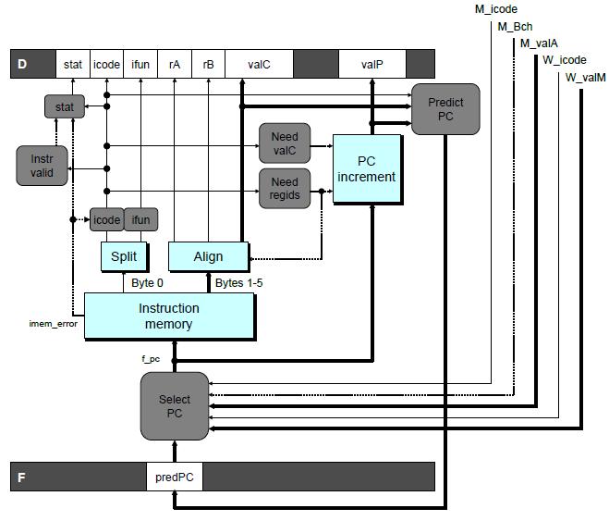
Predicting the PC
Start fetch of new instruction after current has been fetched
Not enough time to fully determine next instruction
Attempt to predict which instruction will be next
Recover if prediction was incorrect

Slide 22
Our Prediction Strategy
Predict next instruction from current instruction
Instructions that Don’t Transfer Control
Predict next PC to be valP
Always reliable
Call and Unconditional Jumps
Predict next PC to be valC (destination)
Always reliable
Conditional Jumps
Predict next PC to be valC (destination)
Only correct if branch is taken
Typically right 60% of time
Return Instruction
Don’t predict, just stall

Slide 23
Recovering from PC Misprediction
Mispredicted Jump
Will see branch condition flag once instruction reaches memory stage
Can get fall-through PC from valA (value M_valA)
Return Instruction
Will get return PC when ret reaches write-back stage (W_valM)

Slide 24
Pipeline Stages
Fetch
Select current PC
Read instruction
Compute incremented PC
Decode
Read program registers
Execute
Operate ALU
Memory
Read or write data memory
Write Back
Update register file

Slide 25
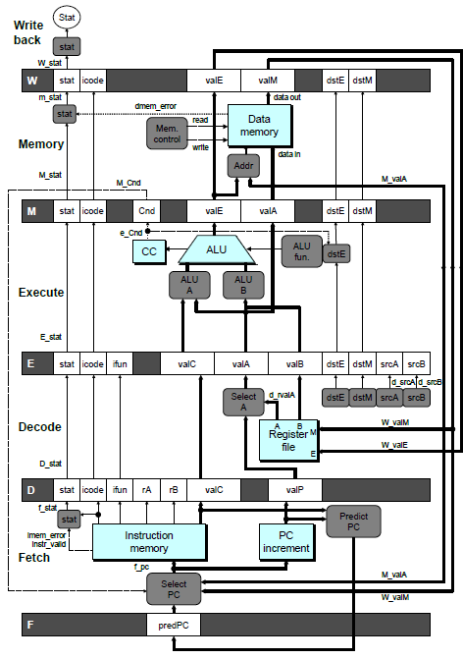
PIPE- Hardware
Pipeline registers hold intermediate values from instruction execution
Forward (Upward) Paths
Values passed from one stage to next
Cannot jump past stages
e.g., valC passes through decode

Slide 26
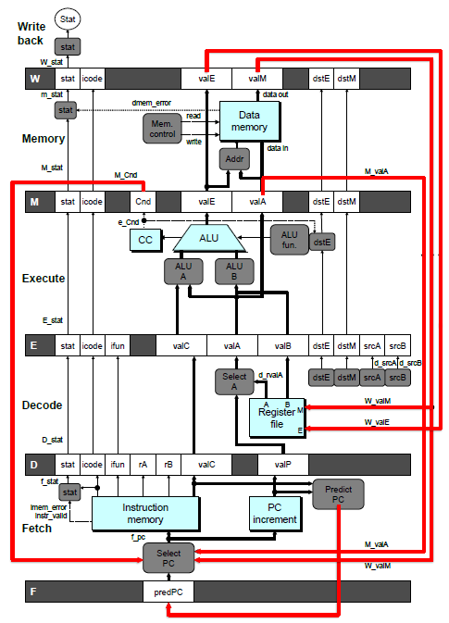
Feedback Paths
Important for distinguishing dependencies between pipeline stages
Predicted PC
Guess value of next PC
Branch information
Jump taken/not-taken
Fall-through or target address
Return point
Read from memory
Register updates
To register file write ports

Slide 27
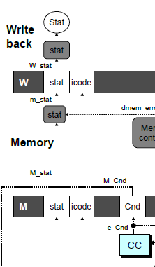
Signal Naming Conventions
S_Field
Value of Field held in stage S pipeline register
s_Field
Value of Field computed in stage S

Slide 28
Dealing with Dependencies between Instructions

Slide 29
Hazards
Hazards
Problems caused by dependencies between separate instructions in the pipeline
Data Hazards
Instruction having register R as source follows shortly after instruction having register R as destination
Common condition, don’t want to slow down pipeline
Control Hazards
Mispredict conditional branch
Our design predicts all branches as being taken
Naïve pipeline executes two extra instructions
Getting return address for ret instruction
Naïve pipeline executes three extra instructions

Slide 30
Dealing with Dependencies between Instructions
Data Hazards

Slide 31
Data Dependencies - not a problem in SEQ
Combinational
logic
R
e
g
Clock
OP1
OP2
OP3
Time
System
Each operation depends on result from preceding one

Slide 32
Data Hazards - the problems caused by data dependences in pipelined datapaths
Comb.
logic
A
R
e
g
Comb.
logic
B
R
e
g
Comb.
logic
C
R
e
g
OP1
A
B
C
Clock
OP2
A
B
C
OP3
A
B
C
OP4
A
B
C
Time
Result does not feed back around in time for next operation
Pipelining has changed behavior of system

Slide 33
Data Dependencies between Instructions
1 irmovl $50, %eax
2 addl %eax , %ebx
3 mrmovl 100( %ebx ), %edx
Result from one instruction used as operand for another
Read-after-write (RAW) dependency
Dependency is between writeback stage of earlier instruction and decode stage of later instruction
Very common in actual programs
Must make sure our pipeline handles these properly
Get correct results
Minimize performance impact

Slide 34
Data Dependencies – Loop-Carried Dependencies
mrmovl 4(%esp), %ecx
mrmovl 8(%esp), %edx
mrmovl 12(%esp),%ebx
LOOP: mrmovl 0(%ecx), %edi
mrmovl 0(%edx), %eax
%ecx
addl %eax, %edi
%edx
rmmovl %edi, 0(%edx)
%edx
%ecx
iaddl $4, %ecx
%edx
iaddl $4, %edx
%ebx
iaddl $-1, %ebx
jne LOOP

Slide 35
Pipeline Demonstration
1
2
3
4
5
6
7
8
9
irmovl $1,%eax #I1
F
D
E
M
W
irmovl $2,%ecx #I2
F
D
E
M
W
irmovl $3,%edx #I3
F
D
E
M
W
irmovl $4,%ebx #I4
F
D
E
M
W
halt #I5
F
D
E
M
W
Cycle 5
W
I1
M
I2
All the instructions are independent
of each other
- No dependencies exist
E
I3
D
I4
F
I5

Slide 36
Data Dependencies: 3 Nop’s
1
2
3
4
5
6
7
8
9
10
11
F
F
D
D
E
E
M
M
W
0x000:
irmovl
$10,%
edx
W
F
F
D
D
E
E
M
M
W
0x006:
irmovl
$3,%
eax
W
F
F
D
D
E
E
M
M
W
0x00c:
nop
W
F
F
D
D
E
E
M
M
W
0x00d:
nop
W
F
F
D
D
E
E
M
M
W
0x00e:
nop
W
F
F
D
D
E
E
M
M
W
0x00f:
addl
%
edx
,%
eax
W
F
F
D
D
E
E
M
M
W
0x011: halt
W
The addl instruction depends on the first two instructions
addl depends upon %edx from the 1st instr
addl depends upon %eax from the 2nd instr
addl must wait 3 cycles after the 2nd instruction, so that it doesn’t fetch the two registers before they’ve been written to the register file
Cycle 6
W
W
f
R[
f
R[
]
]
3
%
3
%
eax
eax
Cycle 7
D
D
f
valA
f
valA
R[
R[
]
]
=
=
10
%
10
%
edx
edx
f
valB
f
valB
R[
R[
]
]
=
=
3
%
3
%
eax
eax

Slide 37
Data Dependencies: 2 Nop’s
1
2
3
4
5
6
7
8
9
10
F
F
D
D
E
E
M
M
W
0x000:
irmovl
$10,%
edx
W
F
F
D
D
E
E
M
M
W
0x006:
irmovl
$3,%
eax
W
F
F
D
D
E
E
M
M
W
0x00c:
nop
W
F
F
D
D
E
E
M
M
W
0x00d:
nop
W
F
F
D
D
E
E
M
M
W
0x00e:
addl
%
edx
,%
eax
W
F
F
D
D
E
E
M
M
W
0x010: halt
W
Cycle 6
W
W
W
f
f
R[
f
R[
R[
]
]
]
3
3
%
3
%
%
eax
eax
eax
If addl executes one cycle earlier, it gets the wrong value for %eax
•
•
•
•
•
•
D
D
D
f
f
valA
f
valA
valA
R[
R[
R[
]
]
]
=
=
=
10
10
%
10
Error
%
%
edx
edx
edx
f
f
valB
f
valB
valB
R[
R[
R[
]
]
]
=
=
=
0
0
%
0
%
%
eax
eax
eax

Slide 38
Data Dependencies: 1 Nop
1
2
3
4
5
6
7
8
9
0x000:
irmovl
$10,%
edx
F
D
E
M
W
0x006:
irmovl
$3,%
eax
F
D
E
M
W
F
F
D
D
E
E
M
M
W
0x00c:
nop
W
F
F
D
D
E
E
M
M
W
0x00d:
addl
%
edx
,%
eax
W
F
F
D
D
E
E
M
M
W
0x00f: halt
W
Cycle 5
W
W
f
R[
f
R[
]
]
10
%
10
%
edx
edx
If addl executes two cycles earlier, it gets the wrong value for both %eax and %edx
M
M_
valE
= 3
M_
dstE
=
%
eax
•
•
•
D
D
Error
f
valA
f
valA
R[
R[
]
]
=
=
0
%
0
%
edx
edx
f
valB
f
valB
R[
R[
]
]
=
=
0
%
0
%
eax
eax

Slide 39
Data Dependencies: No Nop
1
2
3
4
5
6
7
8
0x000:
irmovl
$10,%
edx
F
D
E
M
W
0x006:
irmovl
$3,%
eax
F
D
E
M
W
0x00c:
addl
%
edx
,%
eax
F
D
E
M
W
0x00e: halt
F
D
E
M
W
Cycle 4
M
Like the prior case, if addl executes three cycles earlier, it gets the wrong value for both %eax and %edx
M_
valE
= 10
M_
dstE
=
%
edx
E
e_
valE
f
0 + 3 = 3
E_
dstE
=
%
eax
D
D
Error
f
valA
f
valA
R[
R[
]
]
=
=
0
%
0
%
edx
edx
f
valB
f
valB
R[
R[
]
]
=
=
0
%
0
%
eax
eax

Slide 40
Stalling for Data Dependencies
1
2
3
4
5
6
7
8
9
10
11
0x000: irmovl $10,%edx
F
D
E
M
W
0x006: irmovl $3,%eax
F
D
E
M
W
0x00c: nop
F
D
E
M
W
0x00d: nop
F
D
E
M
W
bubble
E
M
W
0x00e: addl %edx,%eax
F
D
D
E
M
W
0x010: halt
F
F
D
E
M
W
If instruction follows too closely after one that writes register, slow it down
Hold instruction in decode
Dynamically inject nop into execute stage

Slide 41
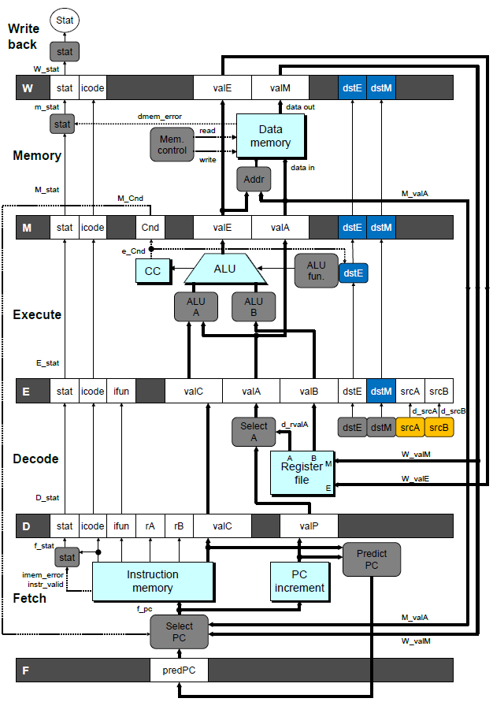
Stall Condition
Source Registers
srcA and srcB of current instruction in decode stage
Destination Registers
dstE and dstM fields
Instructions in execute, memory, and write-back stages
Special Case
Don’t stall for register ID 15 (0xF)
Indicates absence of register operand
Don’t stall for failed conditional move

Slide 42
Detecting Stall Condition
1
2
3
4
5
6
7
8
9
10
11
0x000: irmovl $10,%edx
F
D
E
M
W
0x006: irmovl $3,%eax
F
D
E
M
W
0x00c: nop
F
D
E
M
W
0x00d: nop
F
D
E
M
W
bubble
E
M
W
0x00e: addl %edx,%eax
F
D
D
E
M
W
0x010: halt
F
F
D
E
M
W
Cycle 6
W
W_dstE = %eax
W_valE = 3
•
•
•
D
srcA = %edx
srcB = %eax

Slide 43
Stalling X3
1
2
3
4
5
6
7
8
9
10
11
0x000: irmovl $10,%edx
F
D
E
M
W
0x006: irmovl $3,%eax
F
D
E
M
W
bubble
E
M
W
bubble
E
M
W
bubble
E
M
W
0x00c: addl %edx,%eax
F
D
D
D
D
E
M
W
0x00e: halt
F
F
F
F
D
E
M
W
Cycle 6
W
Cycle 5
W_dstE = %eax
M
Cycle 4
M_dstE = %eax
•
•
•
E
•
•
•
E_dstE = %eax
D
D
D
srcA = %edx
srcB = %eax
srcA = %edx
srcB = %eax
srcA = %edx
srcB = %eax

Slide 44
What Happens When Stalling?
Cycle 4
Cycle 5
Cycle 6
Cycle 7
Cycle 8
0x000: irmovl $10,%edx
Write Back
0x000: irmovl $10,%edx
0x006: irmovl $3,%eax
bubble
bubble
0x006: irmovl $3,%eax
Memory
0x000: irmovl $10,%edx
0x006: irmovl $3,%eax
bubble
bubble
bubble
0x00c: addl %edx,%eax
Execute
0x006: irmovl $3,%eax
bubble
bubble
bubble
0x00c: addl %edx,%eax
0x00e: halt
Decode
0x00c: addl %edx,%eax
0x00c: addl %edx,%eax
0x00c: addl %edx,%eax
0x00c: addl %edx,%eax
0x00e: halt
Fetch
0x00e: halt
0x00e: halt
0x00e: halt
0x00e: halt
Stalling instruction held back in decode stage
Following instruction stays in fetch stage
Bubbles injected into execute stage
Like dynamically generated nop’s
Move through later stages

Slide 45
Pipeline Register Modes
Rising
Rising
Input = y
Output = x
_
clock
_
Output = y
clock
Normal
x
x
y
y
stall
bubble
= 0
= 0
Rising
Rising
Input = y
Output = x
_
clock
_
Output = x
clock
Stall
x
x
x
x
stall
bubble
= 1
= 0
Rising
Rising
Input = y
Output = x
_
clock
_
Output =
nop
clock
n
Bubble
x
x
o
p
stall
bubble
= 0
= 1

Slide 46
Implementing Stalling
Pipe
control
logic
W_stat
W
W_stall
stat
icode
valE
valM
dstE
dstM
M_icode
M_bubble
M
stat
icode
Cnd
valE
valA
dstE
dstM
m_stat
e_Cnd
stat
set_cc
CC
E_dstM
E_icode
E_bubble
E
stat
icode
ifun
valC
valA
valB
dstE
dstM
srcA
srcB
d_srcB
d_srcA
srcB
D_icode
srcA
D_bubble
D
D_stall
stat
icode
ifun
rA
rB
valC
valP
F_stall
F
predPC
Pipeline Control
Combinational logic detects stall condition
Sets mode signals for how pipeline registers should update

Slide 47
Data Forwarding
Naïve Pipeline
Register isn’t written until completion of write-back stage
Source operands read from register file in decode stage
Needs to be in register file at start of stage
Observation
Value generated in execute or memory stage
Trick
Pass value directly from generating instruction to decode stage
Needs to be available at end of decode stage

Slide 48
Data Forwarding Example
1
2
3
4
5
6
7
8
9
10
F
F
D
D
E
E
M
M
W
0x000:
irmovl
$10,%
edx
W
F
F
D
D
E
E
M
M
W
0x006:
irmovl
$3,%
eax
W
F
F
D
D
E
E
M
M
W
0x00c:
nop
W
F
F
D
D
E
E
M
M
W
0x00d:
nop
W
F
F
D
D
E
E
M
M
W
0x00e:
addl
%
edx
,%
eax
W
F
F
D
D
E
E
M
M
W
0x010: halt
W
irmovl in write-back stage
Destination value in W pipeline register
Forward as valB for decode stage
Cycle 6
W
W_
dstE
=
%
eax
R[
%
eax
]
f
3
W_
valE
= 3
•
•
•
D
srcA
=
%
edx
valA
f
R[
%
edx
]
=
10
srcB
=
%
eax
valB
f
W_
valE
=
3

Slide 49
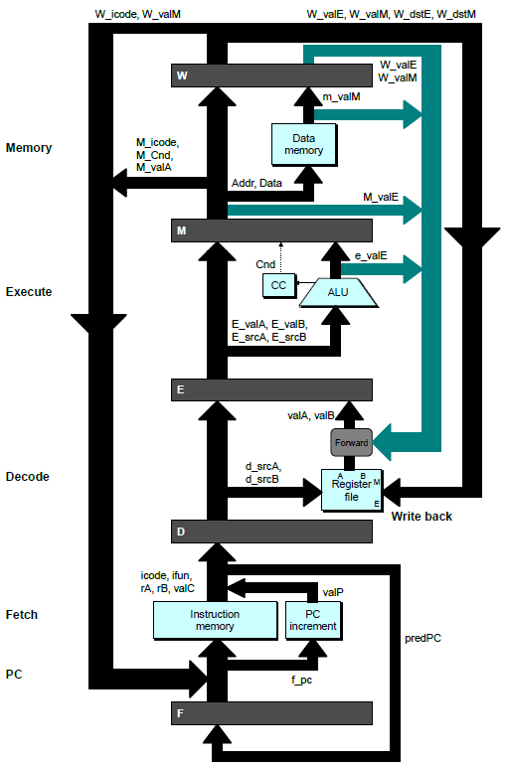
Bypass Paths
Decode Stage
Forwarding logic selects valA and valB
Normally from register file
Forwarding: get valA or valB from later pipeline stage
Forwarding Sources
Execute: valE
Memory: valE, valM
Write back: valE, valM

Slide 50
Data Forwarding Example #2
Register %edx
Generated by ALU during previous cycle
Forward from memory as valA
Register %eax
Value just generated by ALU
Forward from execute as valB

Slide 51
Forwarding Priority
1
2
3
4
5
6
7
8
9
10
F
F
D
D
E
E
M
M
W
0x000: irmovl $1, %eax
W
F
F
D
D
E
E
M
M
W
0x006: irmovl $2, %eax
W
F
F
D
D
E
E
M
M
W
0x00c: irmovl $3, %eax
W
F
F
D
D
E
E
M
M
W
0x012: rrmovl %eax, %edx
W
F
F
D
D
E
E
M
M
W
0x014: halt
W
Multiple Forwarding Choices
Which one should have priority
Match serial semantics
Use matching value from earliest pipeline stage
Cycle 5
W
W
f
R[
f
R[
]
]
3
%
1
%
eax
eax
W
M
f
R[
f
R[
]
]
3
%
2
%
eax
eax
W
E
f
R[
f
R[
]
]
3
%
3
%
eax
eax
D
D
D
f
f
valA
f
valA
valA
R[
R[
R[
]
]
]
=
=
=
10
10
%
?
%
%
edx
edx
eax
f
f
valB
f
valB
valB
R[
R[
0
%
eax
]
=
0

Slide 52
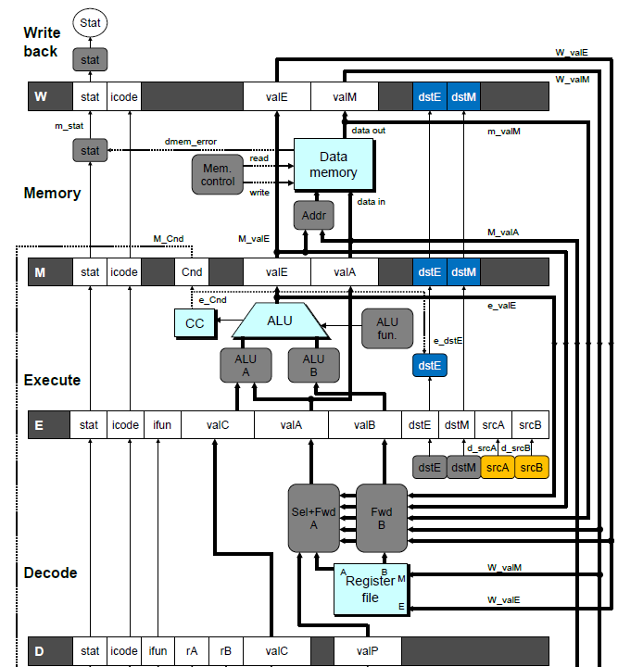
Implementing Forwarding
Add additional feedback paths from E, M, and W pipeline registers into decode stage
Create logic blocks to select from multiple sources for valA and valB in decode stage

Slide 53
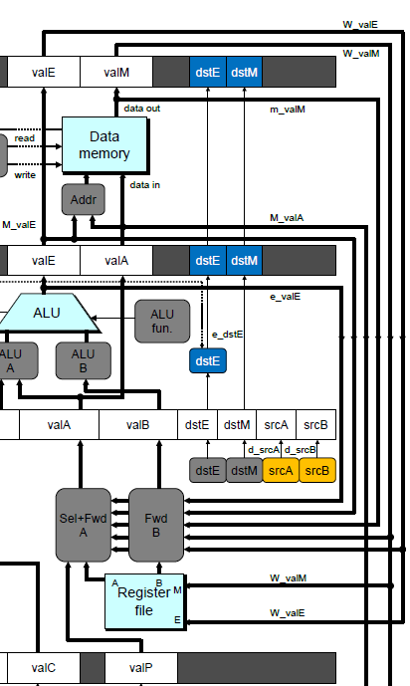
Implementing Forwarding
## What should be the A value?
int new_E_valA = [
# Use incremented PC
D_icode in { ICALL, IJXX } : D_valP;
# Forward valE from execute
d_srcA == e_dstE : e_valE;
# Forward valM from memory
d_srcA == M_dstM : m_valM;
# Forward valE from memory
d_srcA == M_dstE : M_valE;
# Forward valM from write back d_srcA == W_dstM : W_valM;
# Forward valE from write back
d_srcA == W_dstE : W_valE;
# Use value read from register file
1 : d_rvalA;
];

Slide 54
Limitation of Forwarding
Load-use dependency
Value needed by end of decode stage in cycle 7
Value read from memory in memory stage of cycle 8

Slide 55
Avoiding Load/Use Hazard
Stall using instruction for one cycle
Can then pick up loaded value by forwarding from memory stage

Slide 56
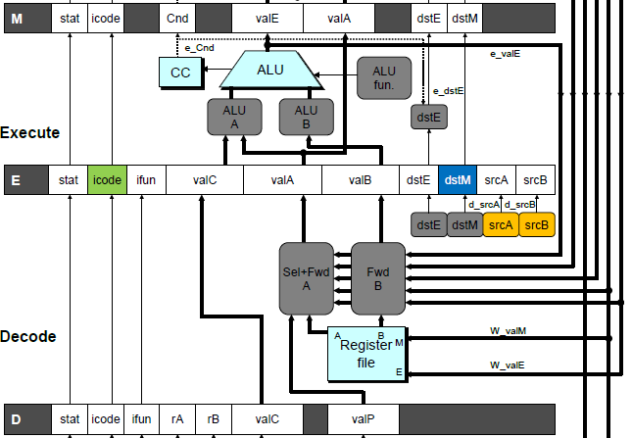
Detecting Load/Use Hazard
Condition | Trigger
Load/Use Hazard | E_icode in { MRMOVL, POPL } && E_dstM in { d_srcA, d_srcB }

Slide 57
Control for Load/Use Hazard
1
2
3
4
5
6
7
8
9
10
11
12
F
F
D
D
E
E
M
M
W
0x000:
irmovl
$128,%
edx
W
F
F
D
D
E
E
M
M
W
0x006:
irmovl
$3,%
ecx
W
F
F
D
D
E
E
M
M
W
0x00c:
rmmovl
%
ecx
, 0(%
edx
)
W
F
F
D
D
E
E
M
M
W
0x012:
irmovl
$10,%
ebx
W
%
eax
# Load %
eax
F
F
F
D
D
D
E
E
E
M
M
M
W
W
0x018:
mrmovl
0(%
edx
),
W
bubble
E
M
W
0x01e:
addl
%
ebx
,
%
eax
# Use %
eax
F
D
D
E
M
W
0x020: halt
F
F
D
E
M
W
Stall instructions in fetch and decode stages
Inject bubble into execute stage
Condition | F | D | E | M | W
Load/Use Hazard | stall | stall | bubble | normal | normal

Slide 58
Dealing with Dependencies between Instructions
Control Hazards

Slide 59
Branch Misprediction Example
0x000: xorl %eax,%eax
0x002: jne t # Not taken
0x007: irmovl $1, %eax # Fall through
0x00d: nop
0x00e: nop
0x00f: nop
0x010: halt
0x011: t: irmovl $3, %edx # Target (Should not execute)
0x017: irmovl $4, %ecx # Should not execute
0x01d: irmovl $5, %edx # Should not execute
Should only execute first 7 instructions

Slide 60
Branch Misprediction Trace
1
2
3
4
5
6
7
8
9
0x000:
xorl
F
D
E
M
W
%
eax
,%
eax
0x002:
jne
t # Not taken
F
D
E
M
W
0x011: t:
irmovl
$3, %
edx
# Target
F
D
E
M
W
0x017:
irmovl
$4, %
ecx
# Target+1
F
D
E
M
W
F
F
D
D
E
E
M
M
W
0x007:
irmovl
$1, %
eax
# Fall Through
W
Cycle 5
Incorrectly execute two instructions at branch target
M
M_Cnd =
0
M_
valA
= 0x007
E
E
f
valE
f
valE
3
3
dstE
dstE
=
=
%
%
edx
edx
D
D
valC
valC
=
=
4
4
dstE
dstE
=
=
%
%
ecx
ecx
F
F
f
valC
f
valC
1
1
f
rB
f
rB
%
%
eax
eax

Slide 61
Handling Misprediction
Predict branch as taken
Fetch 2 instructions at target
Cancel when mispredicted
Detect branch not-taken in execute stage
On following cycle, replace instructions in execute and decode by bubbles
No side effects have occurred yet

Slide 62
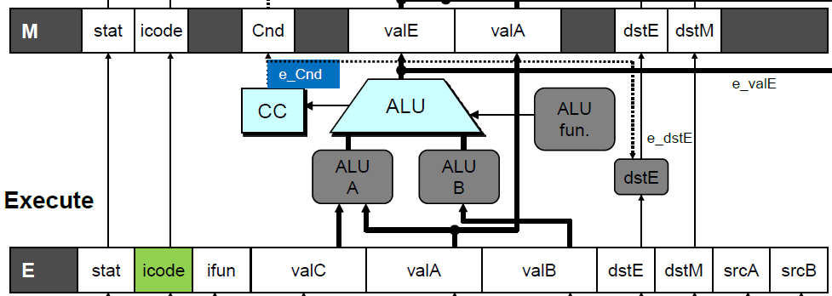
Detecting Mispredicted Branch
Condition | Trigger
Mispredicted Branch | E_icode == JXX & !e_Cnd

Slide 63
Control for Misprediction
Condition | F | D | E | M | W
Mispredicted Branch | normal | bubble | bubble | normal | normal

Slide 64
Return Example
demo-retb.ys
0x000: irmovl Stack,%esp # Initialize stack pointer
0x006: call p # Procedure call
0x00b: irmovl $5,%esi # Return point
0x011: halt
0x020: .pos 0x20
0x020: p: irmovl $-1,%edi # procedure
0x026: ret
0x027: irmovl $1,%eax # Should not be executed
0x02d: irmovl $2,%ecx # Should not be executed
0x033: irmovl $3,%edx # Should not be executed
0x039: irmovl $4,%ebx # Should not be executed
0x100: .pos 0x100
0x100: Stack: # Stack: Stack pointer
Previously executed three additional instructions

Slide 65
Incorrect Return Example
Incorrectly execute 3 instructions following ret

Slide 66
Correct Return Example
0x026: ret
F
D
E
M
W
bubble
F
D
E
M
W
bubble
F
D
E
M
W
bubble
F
D
E
M
W
F
F
D
D
E
E
M
M
W
0x00b:
irmovl
$5,%
esi
# Return
W
As ret passes through pipeline, stall at fetch stage
While in decode, execute, and memory stage
Inject bubble into decode stage
Release stall when reach write-back stage
W
W
valM
valM
=
=
0x0b
0x0b
•
•
•
F
F
f
valC
f
valC
5
5
f
rB
f
rB
%
%
esi
esi

Slide 67
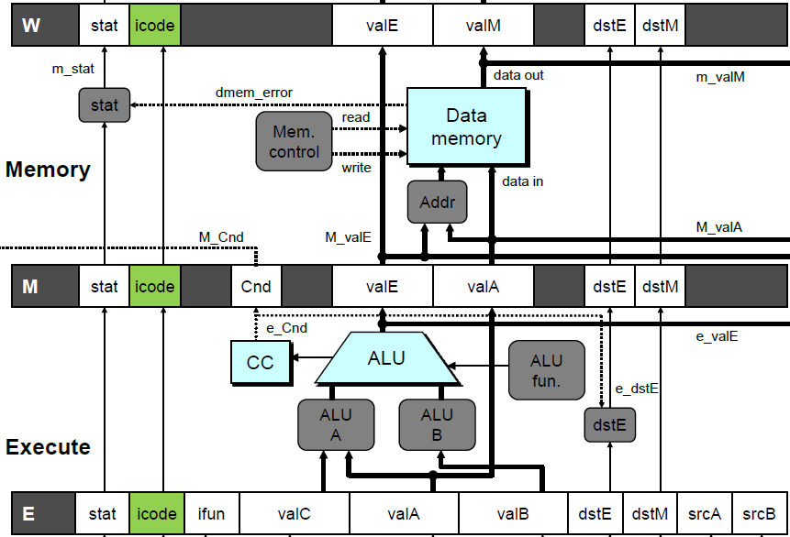
Detecting Return
Condition | Trigger
Processing ret | IRET in { D_icode, E_icode, M_icode }

Slide 68
Control for Return
# demo
-
retb
0x026: ret
F
D
E
M
W
bubble
F
D
E
M
W
bubble
F
D
E
M
W
bubble
F
D
E
M
W
F
F
D
D
E
E
M
M
W
0x00b:
irmovl
$5,%
esi
# Return
W
Condition | F | D | E | M | W
Processing ret | stall | bubble | normal | normal | normal

Slide 69
Special Control Cases
Detection
Action (on next cycle)
Condition | Trigger
Processing ret | IRET in { D_icode, E_icode, M_icode }
Load/Use Hazard | E_icode in { IMRMOVL, IPOPL } && E_dstM in { d_srcA, d_srcB }
Mispredicted Branch | E_icode = IJXX & !e_Cnd
Condition | F | D | E | M | W
Processing ret | stall | bubble | normal | normal | normal
Load/Use Hazard | stall | stall | bubble | normal | normal
Mispredicted Branch | normal | bubble | bubble | normal | normal

Slide 70
Implementing Pipeline Control
Pipe
control
logic
W_stat
W
W_stall
stat
icode
valE
valM
dstE
dstM
M_icode
M_bubble
M
stat
icode
Cnd
valE
valA
dstE
dstM
m_stat
e_Cnd
stat
set_cc
CC
E_dstM
E_icode
E_bubble
E
stat
icode
ifun
valC
valA
valB
dstE
dstM
srcA
srcB
d_srcB
d_srcA
srcB
D_icode
srcA
D_bubble
D
D_stall
stat
icode
ifun
rA
rB
valC
valP
F_stall
F
predPC
Combinational logic generates pipeline control signals
Action occurs at start of following cycle

Slide 71
Initial Version of Pipeline Control
bool F_stall =
# Conditions for a load/use hazard
E_icode in { IMRMOVL, IPOPL } && E_dstM in { d_srcA, d_srcB } ||
# Stalling at fetch while ret passes through pipeline
IRET in { D_icode, E_icode, M_icode };
bool D_stall =
# Conditions for a load/use hazard
E_icode in { IMRMOVL, IPOPL } && E_dstM in { d_srcA, d_srcB };
bool D_bubble =
# Mispredicted branch
(E_icode == IJXX && !e_Cnd) ||
# Stalling at fetch while ret passes through pipeline
IRET in { D_icode, E_icode, M_icode };
bool E_bubble =
# Mispredicted branch
(E_icode == IJXX && !e_Cnd) ||
# Load/use hazard
E_icode in { IMRMOVL, IPOPL } && E_dstM in { d_srcA, d_srcB };

Slide 72
Control Combinations
Special cases that can arise on same clock cycle
Combination A
Not-taken branch
ret instruction at branch target
Combination B
Instruction that reads from memory to %esp
Followed by ret instruction

Slide 73
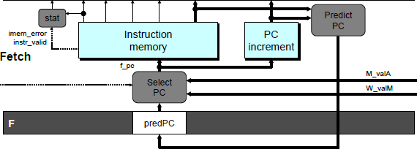
Control Combination A
1
1
Mispredict
1
Mispredict
ret
ret
ret
M
M
M
M
M
JXX
E
JXX
E
E
E
E
ret
ret
D
ret
D
D
D
D
Combination A
Condition | F | D | E | M | W
Processing ret | stall | bubble | normal | normal | normal
Mispredicted Branch | normal | bubble | bubble | normal | normal
Combination | stall | bubble | bubble | normal | normal
Should handle as mispredicted branch
Stalls F pipeline register
But PC selection logic will be using M_valM anyhow

Slide 74
Control Combination B
1
1
Load/use
ret
1
ret
ret
M
M
M
M
E
Load
E
E
E
Use
ret
ret
D
D
ret
D
D
Combination B
Condition | F | D | E | M | W
Processing ret | stall | bubble | normal | normal | normal
Load/Use Hazard | stall | stall | bubble | normal | normal
Combination | stall | bubble + stall | bubble | normal | normal
Would attempt to bubble and stall pipeline register D
Signaled by processor as pipeline error

Slide 75
Handling Control Combination B
1
1
Load/use
ret
1
ret
ret
M
M
M
M
E
Load
E
E
E
Use
ret
ret
D
D
ret
D
D
Combination B
Condition | F | D | E | M | W
Processing ret | stall | bubble | normal | normal | normal
Load/Use Hazard | stall | stall | bubble | normal | normal
Combination | stall | stall | bubble | normal | normal
Load/use hazard should get priority
ret instruction should be held in decode stage for additional cycle

Slide 76
Corrected Pipeline Control Logic
bool D_bubble =
# Mispredicted branch
(E_icode == IJXX && !e_Cnd) ||
# Stalling at fetch while ret passes through pipeline
IRET in { D_icode, E_icode, M_icode }
# but not condition for a load/use hazard
&& !(E_icode in { IMRMOVL, IPOPL }
&& E_dstM in { d_srcA, d_srcB });
Condition | F | D | E | M | W
Processing ret | stall | bubble | normal | normal | normal
Load/Use Hazard | stall | stall | bubble | normal | normal
Combination | stall | stall | bubble | normal | normal
Load/use hazard should get priority
ret instruction should be held in decode stage for additional cycle

Slide 77
Pipeline Control Logic
A sequence of control instructions complicates the control logic
in particular, should stall in Decode stage (instead of bubble, as an initial inspection suggests)
Load/use hazard should get priority
ret instruction should be held in decode stage for additional cycle
Condition | F | D | E | M | W
Processing ret | stall | bubble | normal | normal | normal
Load/Use Hazard | stall | stall | bubble | normal | normal
Combination | stall | stall | bubble | normal | normal

Slide 78
Pipeline Summary
Concept
Break instruction execution into 5 stages
Run instructions through in pipelined mode
Limitations
Can’t handle dependencies between instructions when instructions follow too closely
Data dependencies
One instruction writes register, later one reads it
Control dependency
Instruction sets PC in way that pipeline did not predict correctly
Mispredicted branch and return

Slide 79
Pipeline Summary
Data Hazards
Read-after-write dependencies handled by forwarding
No performance penalty
Load/use hazard requires one cycle stall
Control Hazards
Cancel instructions when detect mispredicted branch
Two clock cycles wasted
Stall fetch stage while ret passes through pipeline
Three clock cycles wasted
Control Combinations
Must analyze carefully
First version had subtle bug
Only arises with unusual instruction combination

