Slide 1
Data Representation in Memory CSCI 2400 / ECE 3217: Computer Architecture
Instructor:
David Ferry
Slides adapted from Bryant & O’Hallaron’s slides via Jason Fritts

Slide 2
Data Representation in Memory
Basic memory organization
Bits & Bytes – basic units of Storage in computers
Representing information in binary and hexadecimal
Representing Integers
Unsigned integers
Signed integers
Representing Text
Representing Pointers

Slide 3
Byte-Oriented Memory Organization
0x00•••0
0xFF•••F
• • •
Modern processors: Byte-Addressable Memory
Conceptually a very large array of bytes
Each byte has a unique address
Processor address space determines address range:
32-bit address space has 2³² unique addresses: 4GB max
0x00000000 to 0xffffffff (in decimal: 0 to 4,294,967,295)
64-bit address space has 2⁶⁴ unique addresses: ~ 1.8x10¹⁹ bytes max
0x0000000000000000 to 0xffffffffffffffff
Enough to give everyone on Earth about 2 Gb
Address space size is not the same as processor size!
E.g.: The original Nintendo was an 8-bit processor with a 16-bit address space

Slide 4
Data Representation in Memory
Basic memory organization
Bits & Bytes – basic units of Storage in computers
Representing information in binary and hexadecimal
Representing Integers
Unsigned integers
Signed integers
Representing Text
Representing Pointers

Slide 5
Why Use Bits & Binary?
0
1
0
3.3V
2.8V
0.5V
0.0V
Digital transistors operate in high and low voltage ranges
Voltage Range dictates Binary Value on wire
high voltage range (e.g. 2.8V to 3.3V) is a logic 1
low voltage range (e.g. 0.0V to 0.5V) is a logic 0
voltages in between are indefinite values
Ternary or quaternary systems have practicality problems

Slide 6
Bits & Bytes
Computers use bits:
a “bit” is a base-2 digit
{L, H} => {0, 1}
Single bit offers limited range, so grouped in bytes
1 byte = 8 bits
a single datum may use multiple bytes
Data representation 101:
Given N bits, can represent 2^{N} unique values
Letters of the alphabet?
Colors?

Slide 7
Encoding Byte Values
Processors generally use multiples of Bytes
common sizes: 1, 2, 4, 8, or 16 bytes
Intel data names:
Byte 1 byte (8 bits) 2⁸ = 256
Word 2 bytes (16 bits) 2¹⁶ = 65,536
Double word 4 bytes (32 bits) 2³² = 4,294,967,295
Quad word 8 bytes (64 bits) 2⁶⁴ = 18,446,744,073,709,551,616
Unfortunately, these names are not standard
so we’ll often use C data names instead
(but these vary in size too… /sigh)

Slide 8
C Data Types
32-bit
64-bit
C Data Type | Typical 32-bit | Intel IA32 | x86-64
char | 1 byte | 1 | 1
short | 2 | 2 | 2
int | 4 | 4 | 4
long | 4 | 4 | 8
long long | 8 | 8 | 8
float | 4 | 4 | 4
double | 8 | 8 | 8
long double | 8 | 10/12 | 10/16
pointer (addr) | 4 | 4 | 8
key
differences

Slide 9
Data Representation in Memory
Basic memory organization
Bits & Bytes – basic units of Storage in computers
Representing information in binary and hexadecimal
Representing Integers
Unsigned integers
Signed integers
Representing Text
Representing Pointers

Slide 10
Encoding Byte Values
1 Byte = 8 bits
Binary: 00000000₂ to 11111111₂
A byte value can be interpreted in many ways!
depends upon how it’s used
For example, consider byte with: 01010101₂
as ASCII text: ‘U’
as integer: 85₁₀
as IA32 instruction: pushl %ebp
the 86th byte of memory in a computer
a medium gray pixel in a gray-scale image
could be interpreted MANY other ways…

Slide 11



Binary is Hard to Represent!
Problem with binary – Cumbersome to use
e.g. approx. how big is: 1010011101010001011101011₂ ?
Would be nice if the representation was closer to decimal: 21,930,731
Let’s define a larger base so that
for equivalence, R and x must be integers – then 1 digit in R equals x bits
equivalence allows direct conversion between representations
two options closest to decimal:
octal: (base eight)
hexadecimal: (base sixteen)
$$R^{1}=2^{x}$$
$$8^{1}=2^{3}$$
$${16}^{1}=2^{4}$$

Slide 12
Representing Binary Efficiently
Octal or Hexadecimal?
binary : 1010011101010001011101011₂
octal: 123521353₈
hexadecimal number: 14EA2EB₁₆
decimal: 21930731
Octal and Hex are closer in size to decimal, BUT…
How many base-R digits per byte?
Octal: 8/3 = 2.67 octal digits per byte -- BAD
Hex: 8/4 = 2 hex digits per byte -- GOOD
Hexadecimal wins: 1 hex digit ⇔ 4 bits

Slide 13
Expressing Byte Values
Juliet: "What's in a name? That which we call a rose By any other name would smell as sweet."
Common ways of expressing a byte
Binary: 00000000₂ to 11111111₂
Decimal: 0₁₀ to 255₁₀
Hexadecimal: 00₁₆ to FF₁₆
Base-16 number representation
Use characters ‘0’ to ‘9’ and ‘A’ to ‘F’
in C/C++ programming languages, D3₁₆ written as either
0xD3
0xd3

Slide 14
Decimal vs Binary vs Hexadecimal
Decimal | Binary | Hexadecimal
0 | 0000 | 0
1 | 0001 | 1
2 | 0010 | 2
3 | 0011 | 3
4 | 0100 | 4
5 | 0101 | 5
6 | 0110 | 6
7 | 0111 | 7
8 | 1000 | 8
9 | 1001 | 9
10 | 1010 | A
11 | 1011 | B
12 | 1100 | C
13 | 1101 | D
14 | 1110 | E
15 | 1111 | F
16 | 10000 | 10
17 | 10001 | 11
18 | 10010 | 12

Slide 15
Convert Between Binary and Hex
Convert Hexadecimal to Binary
Simply replace each hex digit with its equivalent 4-bit binary sequence
Example: 6 D 1 9 F 3 C₁₆
Convert Binary to Hexadecimal
Starting from the radix point, replace each sequence of 4 bits with the equivalent hexadecimal digit
Example: 101100100011010111010110001010011₂
0110 1101 0001 1001 1111 0011 1100₂
1 6 4 6 B A C 5 3₁₆

Slide 16
Data Representation in Memory
Basic memory organization
Bits & Bytes – basic units of Storage in computers
Representing information in binary and hexadecimal
Representing Integers
Unsigned integers
Signed integers
Representing Text
Representing Pointers

Slide 17



Unsigned Integers – Binary
Computers store Unsigned Integer numbers in Binary (base-2)
Binary numbers use place valuation notation, just like decimal
Decimal value of n-bit unsigned binary number:
$${value}_{10}=\sum_{i=0}^{n−1}{a_{i}∗2^{i}}$$
0 | 1 | 1 | 1 | 0 | 1 | 0 | 1
2⁷
2⁶
2⁵
2⁴
2³
2²
2¹
2⁰
$${value}_{10}={0∗2}^{7}+{1∗2}^{6}+{1∗2}^{5}+{1∗2}^{4}+{0∗2}^{3}+{1∗2}^{2}+{0∗2}^{1}+{1∗2}^{0}$$
$$=2^{6}+2^{5}+2^{4}+2^{2}+2^{0}$$
$$=64+32+16+4+1 ={117}_{10}$$

Slide 18





Unsigned Integers – Base-R
Convert Base-R to Decimal
Place value notation can similarly determine decimal value of any base, R
Decimal value of n-digit base r number:
Example:
$${value}_{10}=\sum_{i=0}^{n−1}{a_{i}∗r^{i}}$$
$${317}_{8}={ ? }_{10}$$
$${value}_{10}={3∗8}^{2}+{1∗8}^{1}+{7∗8}^{0}$$
$$=3∗64+1∗8+7∗1$$
$$=192+8+7 ={207}_{10}$$

Slide 19




Unsigned Integers – Hexadecimal
Commonly used for converting hexadecimal numbers
Hexadecimal number is an “equivalent” representation to binary, so often need to determine decimal value of a hex number
Decimal value for n-digit hexadecimal (base 16) number:
Example:
$${value}_{10}=\sum_{i=0}^{n−1}{a_{i}∗{16}^{i}}$$
$${9E4}_{16}={ ? }_{10}$$
$${value}_{10}={9∗16}^{2}+{14∗16}^{1}+{4∗16}^{0}$$
$$=9∗256+14∗16+4∗1$$
$$=2304+224+4 ={2532}_{10}$$

Slide 20


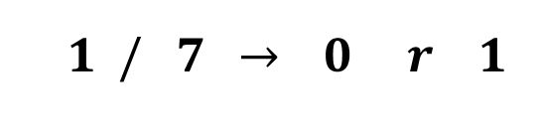
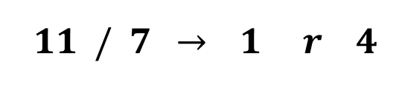
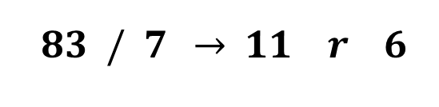
Unsigned Integers – Convert Decimal to Base-R
Also need to convert decimal numbers to desired base
Algorithm for converting unsigned Decimal to Base-R
Assign decimal number to NUM
Divide NUM by R
Save remainder REM as next least significant digit
Assign quotient Q as new NUM
Repeat step b) until quotient Q is zero
Example:
$${83}_{10}={ ? }_{7}$$
least significant digit
NUM
R
Q
REM
$$83 / 7 \underset{→}{ } 11 r 6$$
$$={146}_{7}$$
$$11 / 7 \underset{→}{ } 1 r 4$$
$$1 / 7 \underset{→}{ } 0 r 1$$
most significant digit

Slide 21
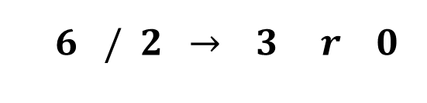

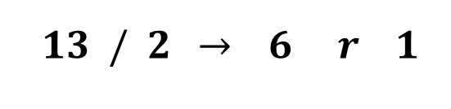

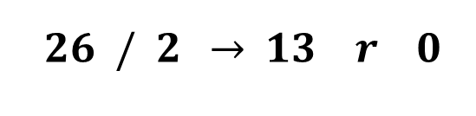
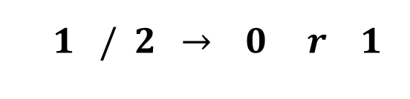
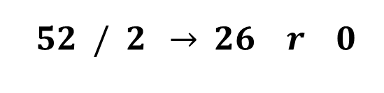
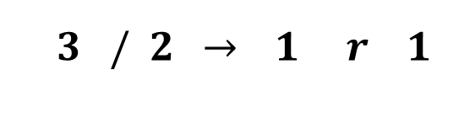
Unsigned Integers – Convert Decimal to Binary
Example with Unsigned Binary:
$${52}_{10}={ ? }_{2}$$
least significant digit
NUM
R
Q
REM
$$52 / 2 \underset{→}{ } 26 r 0$$
$$={110100}_{2}$$
$$26 / 2 \underset{→}{ } 13 r 0$$
$$13 / 2 \underset{→}{ } 6 r 1$$
$$6 / 2 \underset{→}{ } 3 r 0$$
most significant digit
$$3 / 2 \underset{→}{ } 1 r 1$$
$$1 / 2 \underset{→}{ } 0 r 1$$

Slide 22

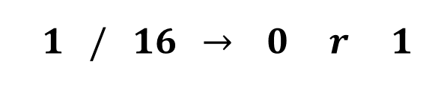
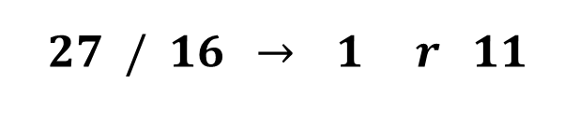

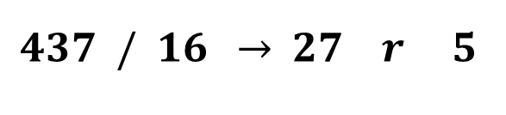
Unsigned Integers – Convert Decimal to Hexadecimal
$${437}_{10}={ ? }_{16}$$
Example with Unsigned Hexadecimal:
least significant digit
NUM
R
Q
REM
$$437 / 16 \underset{→}{ } 27 r 5$$
$$={1B5}_{16}$$
$$27 / 16 \underset{→}{ } 1 r 11$$
$$1 / 16 \underset{→}{ } 0 r 1$$
most significant digit

Slide 23
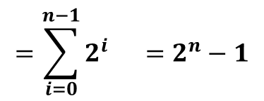



Unsigned Integers – Ranges
Range of Unsigned binary numbers based on number of bits
Given representation with n bits, min value is always sequence
0....0000 = 0
Given representation with n bits, max value is always sequence
1....1111 = 2^{n} – 1
So, ranges are:
unsigned char:
unsigned short:
unsigned int:
$$0 → 255 \left(2^{8}−1\right)$$
$$0 →65,535 \left(2^{16}−1\right)$$
$$0 →4,294,967,295 \left(2^{32}−1\right)$$
1 | 1 | ⋅ ⋅ ⋅ | 1 | 1 | 1 | 1
$$=\sum_{i=0}^{n−1}{2^{i}} =2^{n}−1$$
2^{n-1}
2^{n-2}
2³
2²
2¹
2⁰

Slide 24
Data Representation in Memory
Basic memory organization
Bits & Bytes – basic units of Storage in computers
Representing information in binary and hexadecimal
Representing Integers
Unsigned integers
Signed integers
Representing Text
Representing Pointers

Slide 25
Signed Integers – Binary
Signed Binary Integers converts half of range as negative
Signed representation identical, except for most significant bit
For signed binary, most significant bit indicates sign
0 for nonnegative
1 for negative
Must know number of bits for signed representation
Unsigned Integer representation:
2⁷
2⁶
2⁵
2⁴
2³
2²
2¹
2⁰
Place value of
most significant bit
is negative
for signed binary
Signed Integer representation:
-2⁷
2⁶
2⁵
2⁴
2³
2²
2¹
2⁰

Slide 26
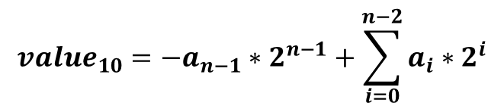


Signed Integers – Binary
Decimal value of n-bit signed binary number:
Positive (in-range) numbers have same representation:
$${value}_{10}={−a}_{n−1}∗2^{n−1}+\sum_{i=0}^{n−2}{a_{i}∗2^{i}}$$
Unsigned Integer representation:
0 | 1 | 1 | 0 | 1 | 0 | 0 | 1
$$=10510$$
2⁷
2⁶
2⁵
2⁴
2³
2²
2¹
2⁰
Signed Integer representation:
0 | 1 | 1 | 0 | 1 | 0 | 0 | 1
$$=10510$$
-2⁷
2⁶
2⁵
2⁴
2³
2²
2¹
2⁰

Slide 27
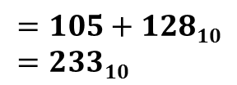
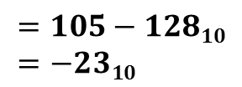
Signed Integers – Binary
Only when most significant bit set does value change
Difference between unsigned and signed integer values is 2^{N}
Unsigned Integer representation:
0 1 | 1 | 1 | 0 | 1 | 0 | 0 | 1
$$=105+12810=23310$$
2⁷
2⁶
2⁵
2⁴
2³
2²
2¹
2⁰
Signed Integer representation:
0 1 | 1 | 1 | 0 | 1 | 0 | 0 | 1
$$=105−12810=−2310$$
-2⁷
2⁶
2⁵
2⁴
2³
2²
2¹
2⁰

Slide 28
Quick Check:
For an 8-bit representation:
What bit pattern has the minimum value?
What bit pattern has the maximum value?
What bit pattern represents 0?
What bit pattern represents -1?

Slide 29
Signed Integers – Ranges
Range of Signed binary numbers:
Given representation with n bits, min value is always sequence
100....0000 = – 2^{n-1}
Given representation with n bits, max value is always sequence
011....1111 = 2^{n-1} – 1
So, ranges are:
C data type | # bits | Unsigned range | Signed range
char | 8 | 0 → 255 | -128 → 127
short | 16 | 0 → 65,535 | -32,768 → 32,767
int | 32 | 0 → 4,294,967,295 | -2,147,483,648 → 2,147,483,647

Slide 30
Signed Integers – Convert to/from Decimal
Convert Signed Binary Integer to Decimal
Easy – just use place value notation
two examples given on last two slides
Convert Decimal to Signed Binary Integer
MUST know number of bits in signed representation
Algorithm:
Convert magnitude (abs val) of decimal number to unsigned binary
Decimal number originally negative?
If positive, conversion is done
If negative, perform negation on answer from part a)
zero extend answer from a) to N bits (size of signed repr)
negate: flip bits and add 1

Slide 31



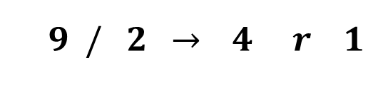
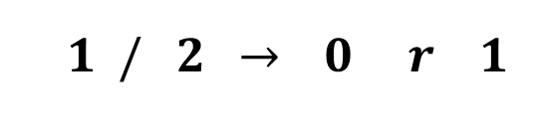
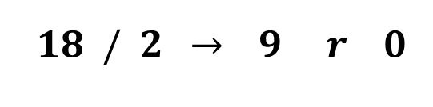
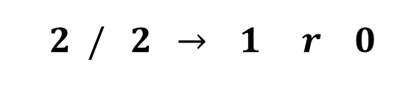
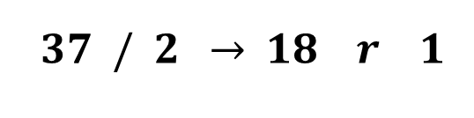
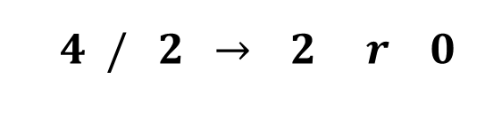
Signed Integers – Convert Decimal to Base-R
Example:
A)
$${−37}_{10}={ ? }_{8−bit signed}$$
$$\left|{−37}_{10}\right|={ ? }_{2}$$
least significant bit
NUM
R
Q
REM
$$37 / 2 \underset{→}{ } 18 r 1$$
$$={100101}_{2}$$
$$18 / 2 \underset{→}{ } 9 r 0$$
$$9 / 2 \underset{→}{ } 4 r 1$$
$$4 / 2 \underset{→}{ } 2 r 0$$
most significant bit
$$2 / 2 \underset{→}{ } 1 r 0$$
$$1 / 2 \underset{→}{ } 0 r 1$$

Slide 32






Signed Integers – Convert Decimal to Base-R
Example:
B) -37₁₀ was negative, so perform negation
zero extend 100101 to 8 bits
negation
flip bits:
add 1:
$${−37}_{10}={ ? }_{8−bit signed}$$
$${100101}_{2} → 00{100101}_{2}$$
$$={11011011}_{2}$$
$$00{100101}_{2}$$
$${11011010}_{2}$$
Can validate answer using
place value notation
$${+ 1}_{2}$$
$${11011011}_{2}$$

Slide 33
Quick check:
For an 8-bit representation:
Convert 67₁₀ into a signed integer

Slide 34



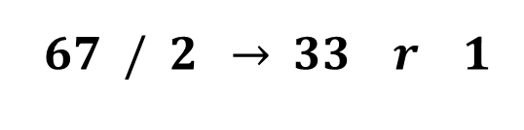
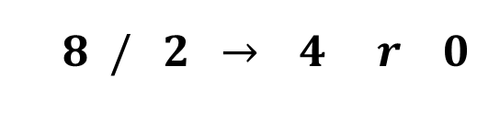
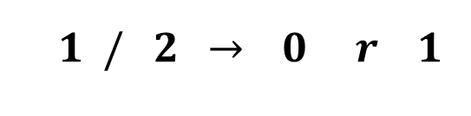
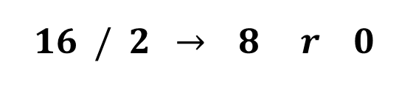
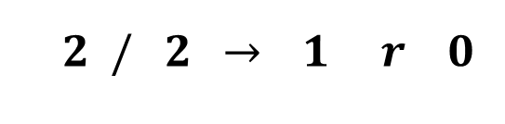
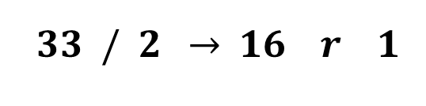
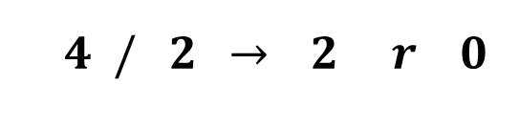
Signed Integers – Convert Decimal to Base-R
Example:
A)
$${67}_{10}={ ? }_{8−bit signed}$$
$$\left|{67}_{10}\right|={ ? }_{2}$$
least significant bit
NUM
R
Q
REM
$$67 / 2 \underset{→}{ } 33 r 1$$
$$33 / 2 \underset{→}{ } 16 r 1$$
$$={1000011}_{2}$$
$$16 / 2 \underset{→}{ } 8 r 0$$
$$8 / 2 \underset{→}{ } 4 r 0$$
$$4 / 2 \underset{→}{ } 2 r 0$$
most significant bit
$$2 / 2 \underset{→}{ } 1 r 0$$
$$1 / 2 \underset{→}{ } 0 r 1$$

Slide 35

Signed Integers – Convert Decimal to Base-R
Example:
B) 67₁₀ was positive, so done
$${67}_{10}={ ? }_{8−bit signed}$$
$$={1000011}_{2}$$
Can validate answer using
place value notation

Slide 36
Quick check:
For an 8-bit representation:
Convert -100₁₀ into a signed integer

Slide 37



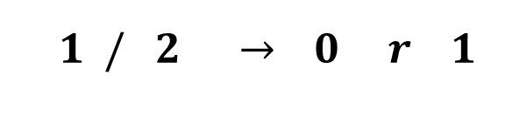
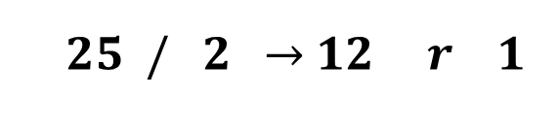
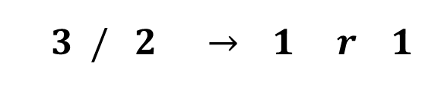
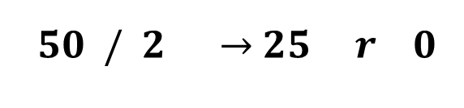
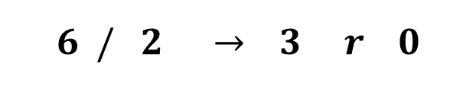
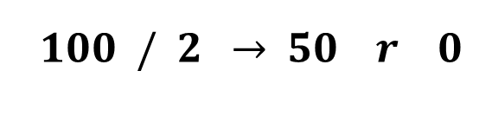
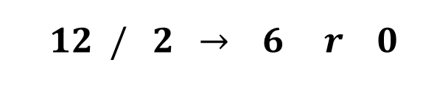
Signed Integers – Convert Decimal to Base-R
Example:
A)
$${−100}_{10}={ ? }_{8−bit signed}$$
$$\left|{−100}_{10}\right|={ ? }_{2}$$
least significant bit
NUM
R
Q
REM
$$100 / 2 \underset{→}{ } 50 r 0$$
$$={1100100}_{2}$$
$$50 / 2 \underset{→}{ } 25 r 0$$
$$25 / 2 \underset{→}{ } 12 r 1$$
$$12 / 2 \underset{→}{ } 6 r 0$$
most significant bit
$$6 / 2 \underset{→}{ } 3 r 0$$
$$3 / 2 \underset{→}{ } 1 r 1$$
$$1 / 2 \underset{→}{ } 0 r 1$$

Slide 38





Signed Integers – Convert Decimal to Base-R
Example:
B) -100₁₀ was negative, so perform negation
zero extend 100101 to 8 bits
negation
flip bits:
add 1:
$${−100}_{10}={ ? }_{8−bit signed}$$
$${1100100}_{2} → 01100100$$
$$={10011100}_{2}$$
$${01100100}_{2}$$
$${10011011}_{2}$$
Can validate answer using
place value notation
$${+ 1}_{2}$$
$${10011100}_{2}$$

Slide 39








Signed Integers – Convert Decimal to Base-R
Be careful of range!
Example:
A)
B) -183₁₀ was negative, so perform negation
zero extend 10110111 to 8 bits // already done
negation
flip bits:
add 1:
$${−183}_{10}={ ? }_{8−bit signed}$$
$$\left|{−183}_{10}\right|={ ? }_{2}$$
$$={10110111}_{2}$$
$${10110111}_{2}$$
not -183₁₀… WRONG!
-183₁₀ is not in valid range
for 8-bit signed
$${01001000}_{2}$$
$${+ 1}_{2}$$
$${01001001}_{2}$$
$$={73}_{10}$$

Slide 40
Representation of Signed Integers
Multiple possible ways:
Sign magnitude
Ones’ Complement
Two’s Complement (what has been presented)
Two’s Complement greatly simplifies addition & subtraction in hardware
We’ll see why when we cover operations
Generally the only method still used

Slide 41
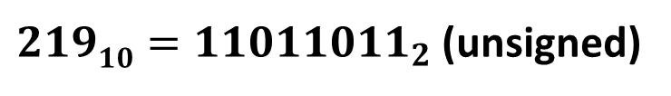



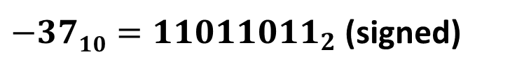
Representation of Signed Integers
Why the name Two’s Complement?
For a w-bit signed representation, we represent -x as 2^{w} – x
E.g.: consider the 8-bit representation of${ −37}_{10}$
$$28=25610$$
$$28−3710=21910$$
$21910={11011011}_{2}$ (unsigned)
$−3710={11011011}_{2}$ (signed)

Slide 42
Data Representation in Memory
Basic memory organization
Bits & Bytes – basic units of Storage in computers
Representing information in binary and hexadecimal
Representing Integers
Unsigned integers
Signed integers
Representing Text
Representing Pointers

Slide 43
Representing Strings
char S[6] = "18243";
Strings in C
Represented by array of characters
Each character encoded in ASCII format
Standard 7-bit encoding of character set
Character “0” has code 0x30
String should be null-terminated
Final character = 0
ASCII characters organized such that:
Numeric characters sequentially increase from 0x30
Digit i has code 0x30+i
Alphabetic characters sequentially increase in order
Uppercase chars ‘A’ to ‘Z’ are 0x41 to 0x5A
Lowercase chars ‘A’ to ‘Z’ are 0x61 to 0x7A
Control characters, like <RET>, <TAB>, <BKSPC>, are 0x00 to 0x1A
Intel / Linux
0x31
0x38
0x32
0x34
0x33
0x00
‘1’
‘8’
‘2’
‘4’
‘3’
null term

Slide 44
Representing Strings
UTF-16 on Intel
Limitations of ASCII
7-bit encoding limits set of characters to 2⁷ = 128
8-bit extended ASCII exists, but still only 2⁸ = 256 chars
Unable to represent most other languages in ASCII
Answer: Unicode
first 128 characters are ASCII
i.e. 2-byte Unicode for ‘4’: 0x34 -> 0x0034
i.e. 4-byte Unicode for ‘T’: 0x54 -> 0x00000054
UTF-8: 1-byte version // commonly used
UTF-16: 2-byte version // commonly used
allows 2¹⁶ = 65,536 unique chars
UTF-32: 4-byte version
allows 2³² = ~4 billion unique characters
Unicode used in many more recent languages, like Java and Python
0x31
0x00
0x38
0x00
0x32
0x00
‘1’
‘8’
‘2’
0x34
0x00
0x33
0x00
0x00
0x00
‘4’
‘3’
null term

Slide 45
String Representation Links
ASCII
http://www.ascii-code.com/
Unicode
http://unicode-table.com/en/

Slide 46
Quick Check:
Convert the following strings to ASCII-
char school[4] = “SLU”;
char name[6] = “Frank”;

Slide 47
Data Representation in Memory
Basic memory organization
Bits & Bytes – basic units of Storage in computers
Representing information in binary and hexadecimal
Representing Integers
Unsigned integers
Signed integers
Representing Text
Representing Pointers

Slide 48
What is a Pointer?
Recall:
Memory is a contiguous array of individual bytes
Consider a machine with 16-bit addresses
0x0000
0x0001
0x0002
0x0003
0x0004

Slide 49
What is a Pointer?
Recall:
Memory is a contiguous array of individual bytes
Consider a machine with 16-bit addresses and 32-bit data
unsigned X = 15398; //0x00003C26
26
3C
00
00
0x0000
0x0001
0x0002
0x0003
0x0004

Slide 50
Pointer Representation
26
3C
00
00
0xA244
0xA245
0xA246
0xA247
Points to a location in memory
Suppose:
unsigned X = 15398; //0x00003C26
unsigned *ptr = &X; //0xA244
A pointer is a variable that holds the address of another variable
Different compilers and machines assign different locations to objects
0x44
0xA2
0xB710
0xB711
0xB712
0xB713

Slide 51
Endianness
Recall that memory is byte-addressable
Four bytes in a 32-bit integer, which order are they stored with?
Two ways to store: unsigned X = 15398; //0x00003C26
Little Endian
Least significant bits stored first in memory
Big Endian
Most significant bits stored first in memory
26
3C
00
00
0x0000
0x0001
0x0002
0x0003
0x0004
00
00
26
3C
0x0000
0x0001
0x0002
0x0003
0x0004

Slide 52
Quick Check
Consider the string: char S[6] = “HELLO”;
What is S[0] ?
What is &S[0] ?
What is S[3]?
What is &S[3]?
‘H’
0x48
0x45
0x4C
0x4C
0x4F
0x00
0xACED
0xACEE
0xACEF
0xACF0
0xACF1
0xACF2
‘E’
‘L’
‘L’
‘O’
null term

