Slide 1
Data Representation – Floating Point CSCI 2400 / ECE 3217: Computer Architecture
Instructor:
David Ferry
Slides adapted from Bryant & O’Hallaron’s slides
via Jason Fritts

Slide 2
Today: Floating Point
Background: Fractional binary numbers
Example and properties
IEEE floating point standard: Definition
Floating point in C
Summary

Slide 3
Fractional binary numbers
What is 1011.101₂?
How can we express fractions like ¼ in binary?

Slide 4
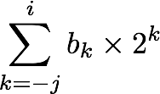
Place-Value Fractional Binary Numbers
2^{i}
2^{i-1}
2² = 4
2¹ = 2
2⁰ = 1
• • •
bi | bi-1 | ••• | b2 | b1 | b0 | b-1 | b-2 | b-3 | ••• | b-j
2⁻¹ = 1/2
2⁻² = 1/4
2⁻³ = 1/8
2^{-j}
• • •
Representation
Bits to right of “binary point” represent fractional powers of 2
Represents rational number:
Notes:
Latex source for equation: \sum_{k=-j}^i b_k \times 2^k

Slide 5
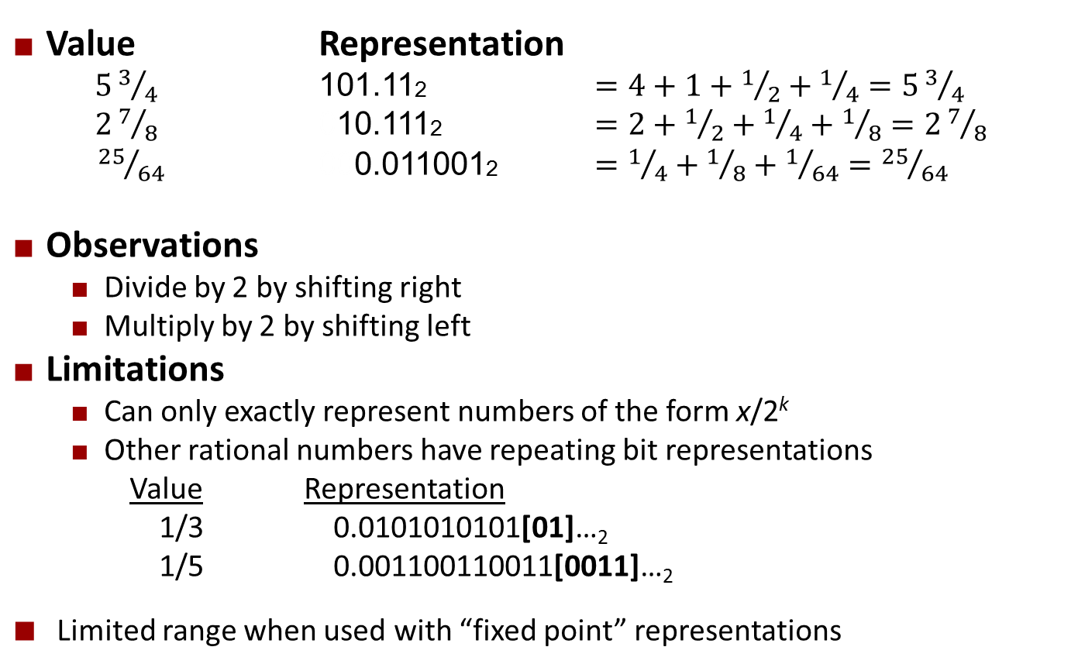
Fractional Binary Numbers: Examples
Value Representation
$53/4$ 101.112 $=4+1+1/2+1/4=53/4$
$27/8$ 010.1112 $=2+1/2+1/4+1/8=27/8$
${25}/{64}$ 000.0110012 $=1/4+1/8+1/{64}={25}/{64}$
Observations
Divide by 2 by shifting right
Multiply by 2 by shifting left
Limitations
Can only exactly represent numbers of the form x/2^{k}
Other rational numbers have repeating bit representations
Value Representation
1/3 0.0101010101[01]…₂
1/5 0.001100110011[0011]…₂
Limited range when used with “fixed point” representations

Slide 6
Quick Check
Convert:
255 ⁹⁄₁₆ to binary
10101.10101₂ to decimal

Slide 7
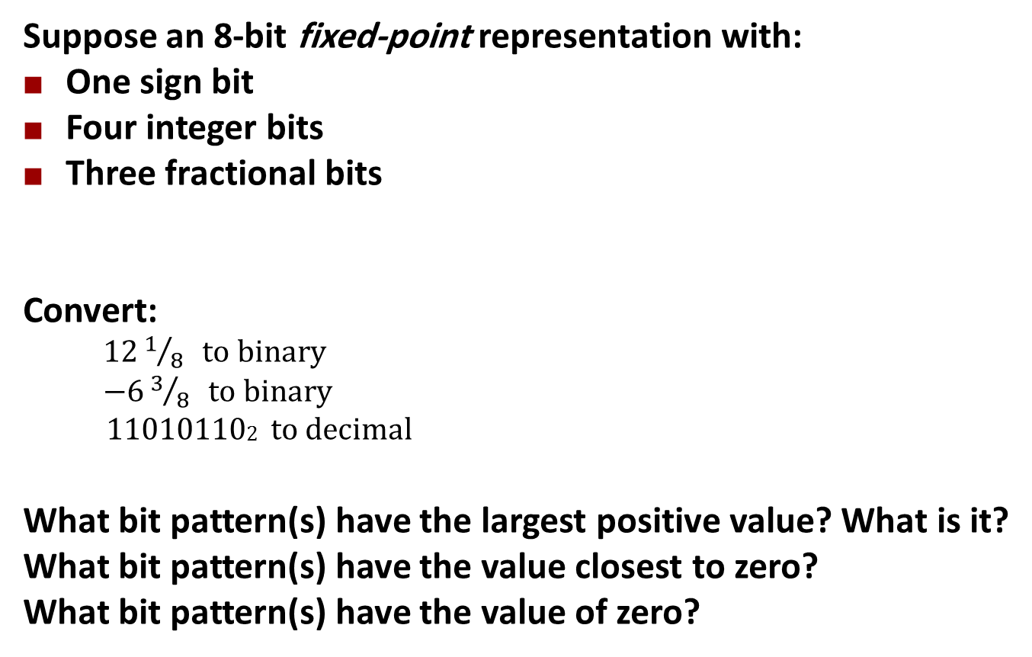
Quick Check
Suppose an 8-bit fixed-point representation with:
One sign bit
Four integer bits
Three fractional bits
Convert:
$121/8 to binary$
$−63/8 to binary$
110101102 to decimal
What bit pattern(s) have the largest positive value? What is it?
What bit pattern(s) have the value closest to zero?
What bit pattern(s) have the value of zero?
s | integer | fractional
1 | 4-bits | 3-bits

Slide 8
Today: Floating Point
Background: Fractional binary numbers
Example and properties
IEEE floating point standard: Definition
Floating point in C
Summary

Slide 9
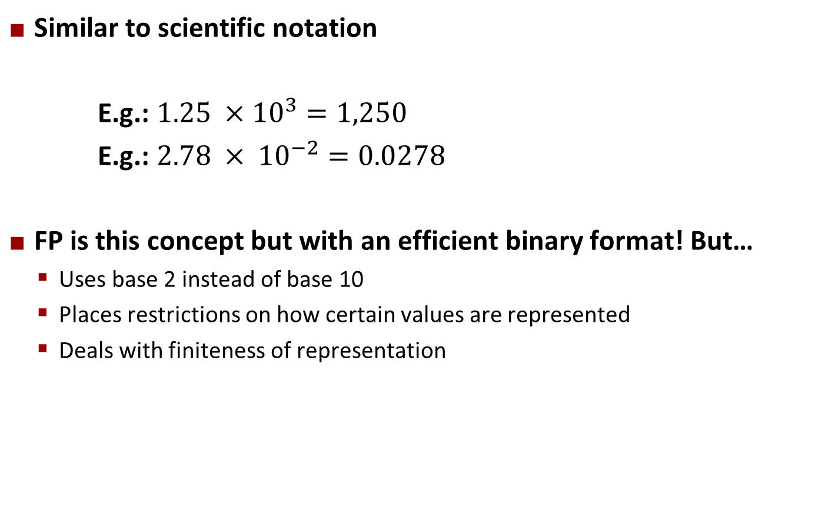
Floating Point Representation
Similar to scientific notation
E.g.: $1.25 ×{10}^{3}=1,250$
E.g.: $2.78 × {10}^{−2}=0.0278$
FP is this concept but with an efficient binary format! But…
Uses base 2 instead of base 10
Places restrictions on how certain values are represented
Deals with finiteness of representation

Slide 10
Floating Point Representation
Numerical Form: (–1)^{s} M 2E
Sign bit s determines whether number is negative or positive
Significand (mantissa) M normally a fractional value in range [1.0, 2.0)
Exponent E weights value by power of two
Encoding
s is sign bit s
exp field encodes E (but is not equal to E)
frac field encodes M (but is not equal to M)
s | exp | frac

Slide 11
Tiny Floating Point Example
s | exp | frac
1 | 4-bits | 3-bits
8-bit Floating Point Representation
the sign bit is in the most significant bit
the next four bits are the exponent (exp)
exp (not E) encoded as a 4-bit unsigned integer
Uses a bias to represent negative exponents
the last three bits are the fraction (frac)
encodes fractional part of a fractional binary number

Slide 12
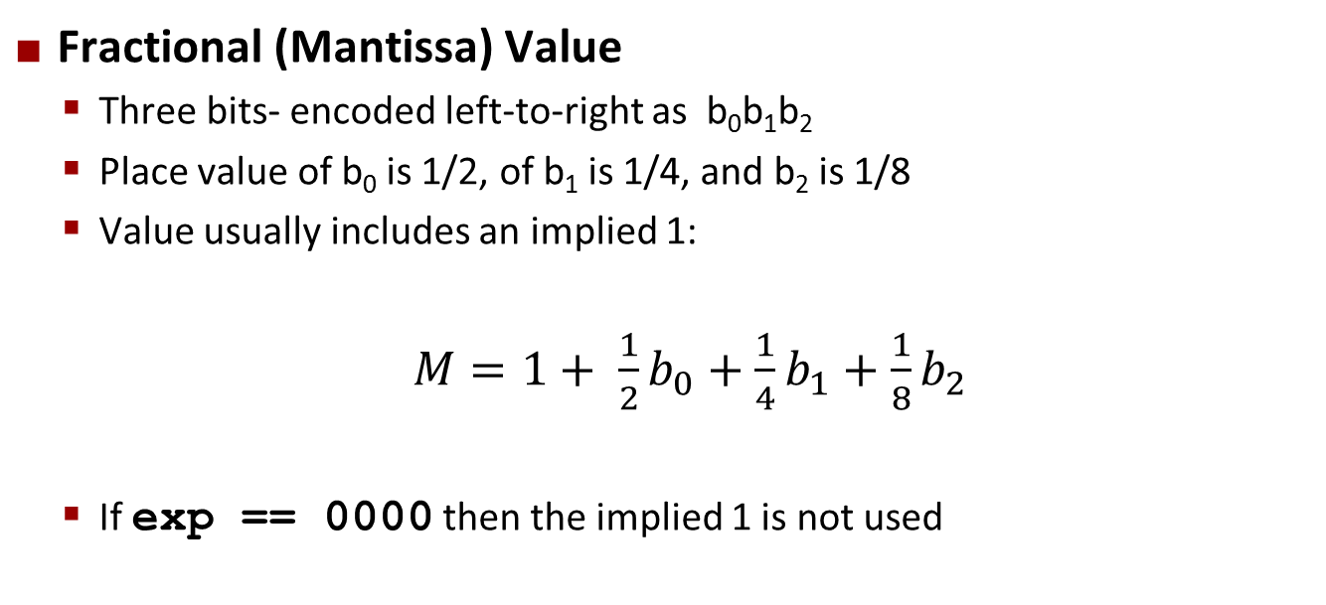
Tiny Floating Point Example
s | exp | frac
1 | 4-bits | 3-bits
Fractional (Mantissa) Value
Three bits- encoded left-to-right as b₀b₁b₂
Place value of b₀ is 1/2, of b₁ is 1/4, and b₂ is 1/8
Value usually includes an implied 1:
$M=1+ \frac{1}{2}b_{0}+\frac{1}{4}b_{1}+$ $\frac{1}{8}b_{2}$
If exp == 0000 then the implied 1 is not used

Slide 13
Tiny Floating Point Example
s | exp | frac
1 | 4-bits | 3-bits
Exponent bias
enable exponent to represent both positive and negative powers of 2
use half of range for positive and half for negative power
given k exponent bits, bias is then 2^{k-1} – 1
Exponent Value
is usually computed E = exp – bias
if exp == 0000 then E = 1 - bias

Slide 14
Floating Point Encodings and Visualization
Five encodings:
Two general forms: normalized, denormalized
Three special values: zero, infinity, NaN (not a number)
Name Exponent(exp) Fraction(frac)
zero exp == 0000 frac == 000
denormalized exp == 0000 frac != 000
normalized 0000 < exp < 1111 frac != 000
infinity exp == 1111 frac == 000
NaN exp == 1111 frac != 000
−∞
+∞
−Normalized
−Denorm
+Denorm
+Normalized
NaN
NaN
−0
+0

Slide 15
Dynamic Range (Positives)
v = (–1)^{s} M 2E
norm: E = Exp – Bias
denorm: E = 1 – Bias
s exp frac E Value
0 0000 000 -6 0
0 0000 001 -6 1/8*1/64 = 1/512
0 0000 010 -6 2/8*1/64 = 2/512
…
0 0000 110 -6 6/8*1/64 = 6/512
0 0000 111 -6 7/8*1/64 = 7/512
0 0001 000 -6 8/8*1/64 = 8/512
0 0001 001 -6 9/8*1/64 = 9/512
…
0 0110 110 -1 14/8*1/2 = 14/16
0 0110 111 -1 15/8*1/2 = 15/16
0 0111 000 0 8/8*1 = 1
0 0111 001 0 9/8*1 = 9/8
0 0111 010 0 10/8*1 = 10/8
…
0 1110 110 7 14/8*128 = 224
0 1110 111 7 15/8*128 = 240
0 1111 000 n/a inf
0 1111 xxx n/a NaN
closest to zero
Denormalized
numbers
largest denorm
smallest norm
closest to 1 below
Normalized
numbers
closest to 1 above
largest norm
infinity
NaN (not a number)

Slide 16
Distribution of Values
(reduced format from 8 bits
to 6 bits for visualization)
6-bit IEEE-like format
e = 3 exponent bits
f = 2 fraction bits
Bias is 2³⁻¹-1 = 3
Notice how the distribution gets denser toward zero.
s | exp | frac
1 | 3-bits | 2-bits
8 denormalized values
(blowup of -1 → 1)

Slide 17
Quick Check
10-bit IEEE-like format
e = 5 exponent bits
f = 4 fraction bits
What is the exponent bias?
s | exp | frac
1 | 5-bits | 4-bits

Slide 18

Quick Check
10-bit IEEE-like format
e = 5 exponent bits
f = 4 fraction bits
What is the exponent bias? $2^{5−1}−1=15$
s | exp | frac
1 | 5-bits | 4-bits

Slide 19
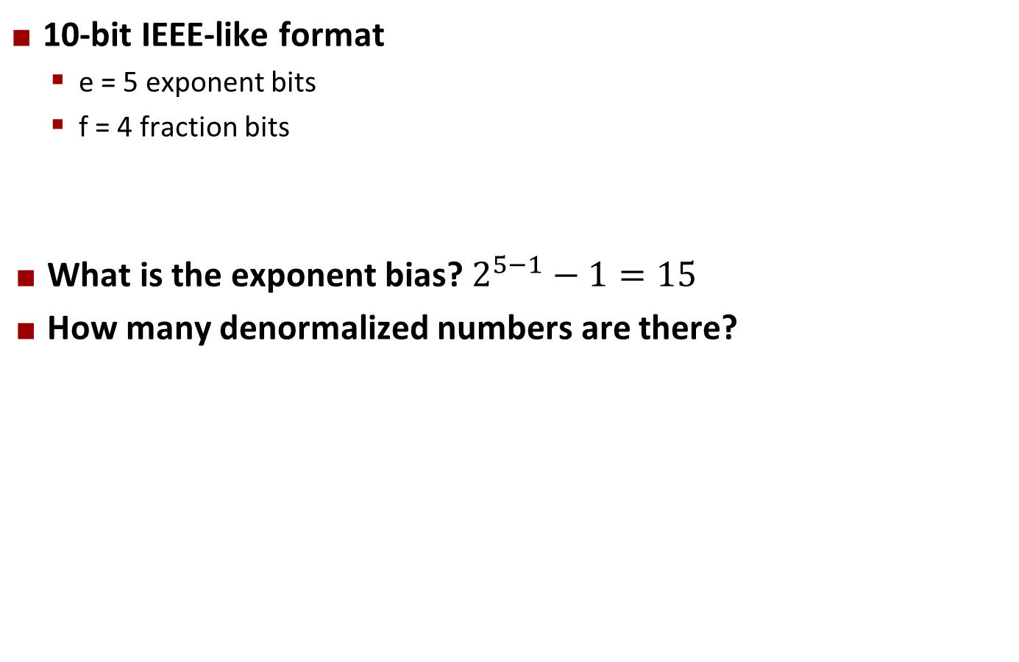
Quick Check
10-bit IEEE-like format
e = 5 exponent bits
f = 4 fraction bits
What is the exponent bias? $2^{5−1}−1=15$
How many denormalized numbers are there?
s | exp | frac
1 | 5-bits | 4-bits

Slide 20
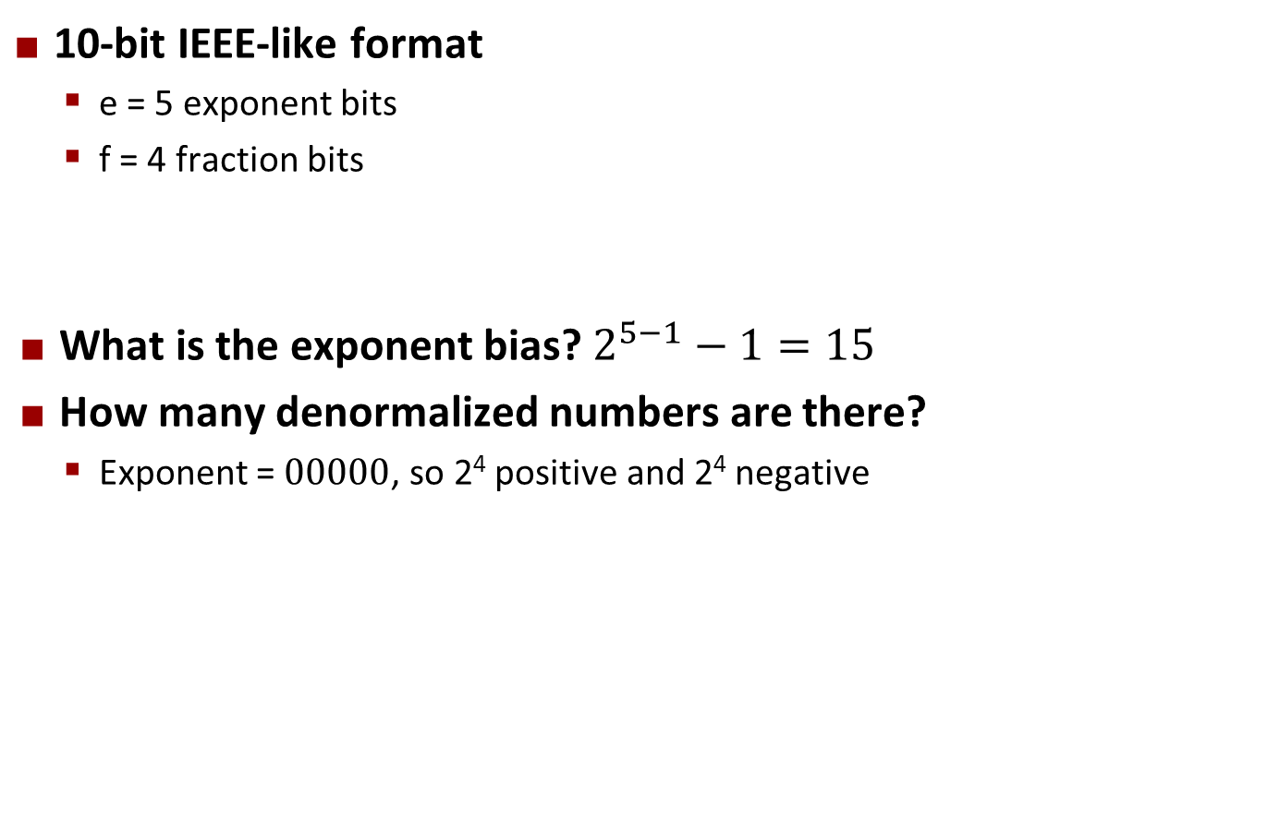
Quick Check
10-bit IEEE-like format
e = 5 exponent bits
f = 4 fraction bits
What is the exponent bias? $2^{5−1}−1=15$
How many denormalized numbers are there?
Exponent = $00000$, so 2⁴ positive and 2⁴ negative
s | exp | frac
1 | 5-bits | 4-bits

Slide 21
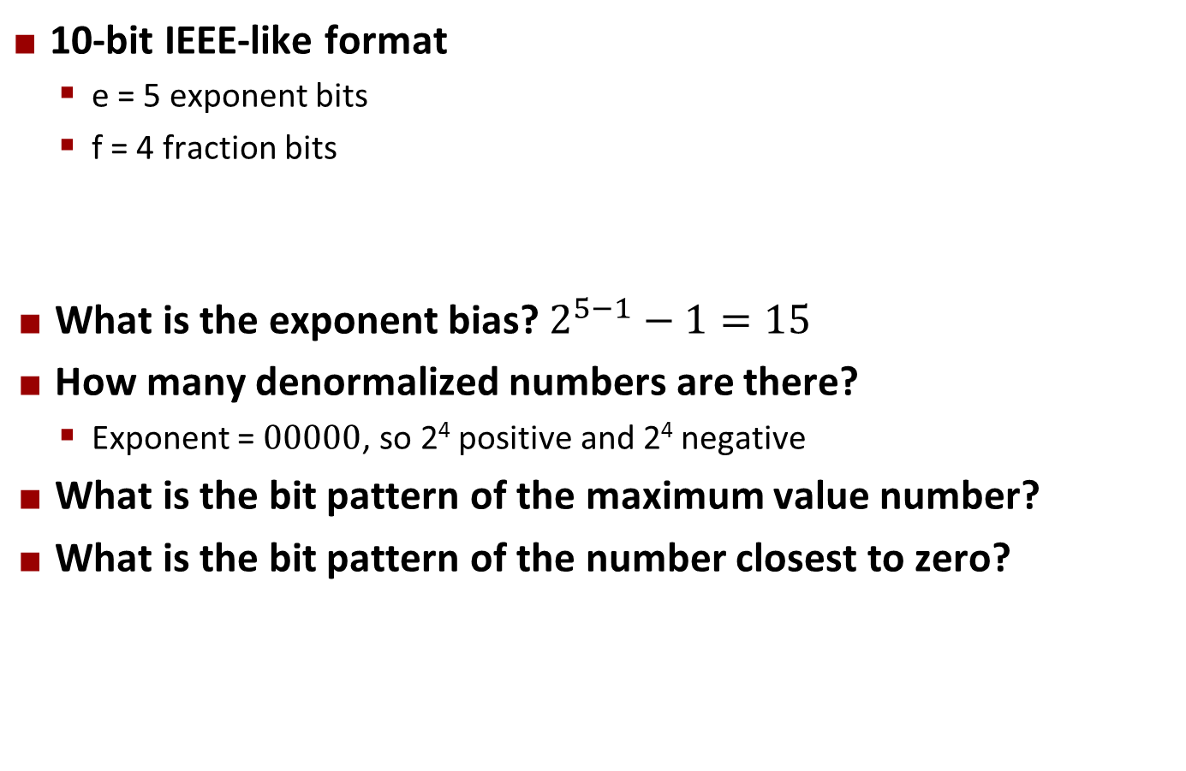
Quick Check
10-bit IEEE-like format
e = 5 exponent bits
f = 4 fraction bits
What is the exponent bias? $2^{5−1}−1=15$
How many denormalized numbers are there?
Exponent = $00000$, so 2⁴ positive and 2⁴ negative
What is the bit pattern of the maximum value number?
What is the bit pattern of the number closest to zero?
s | exp | frac
1 | 5-bits | 4-bits

Slide 22
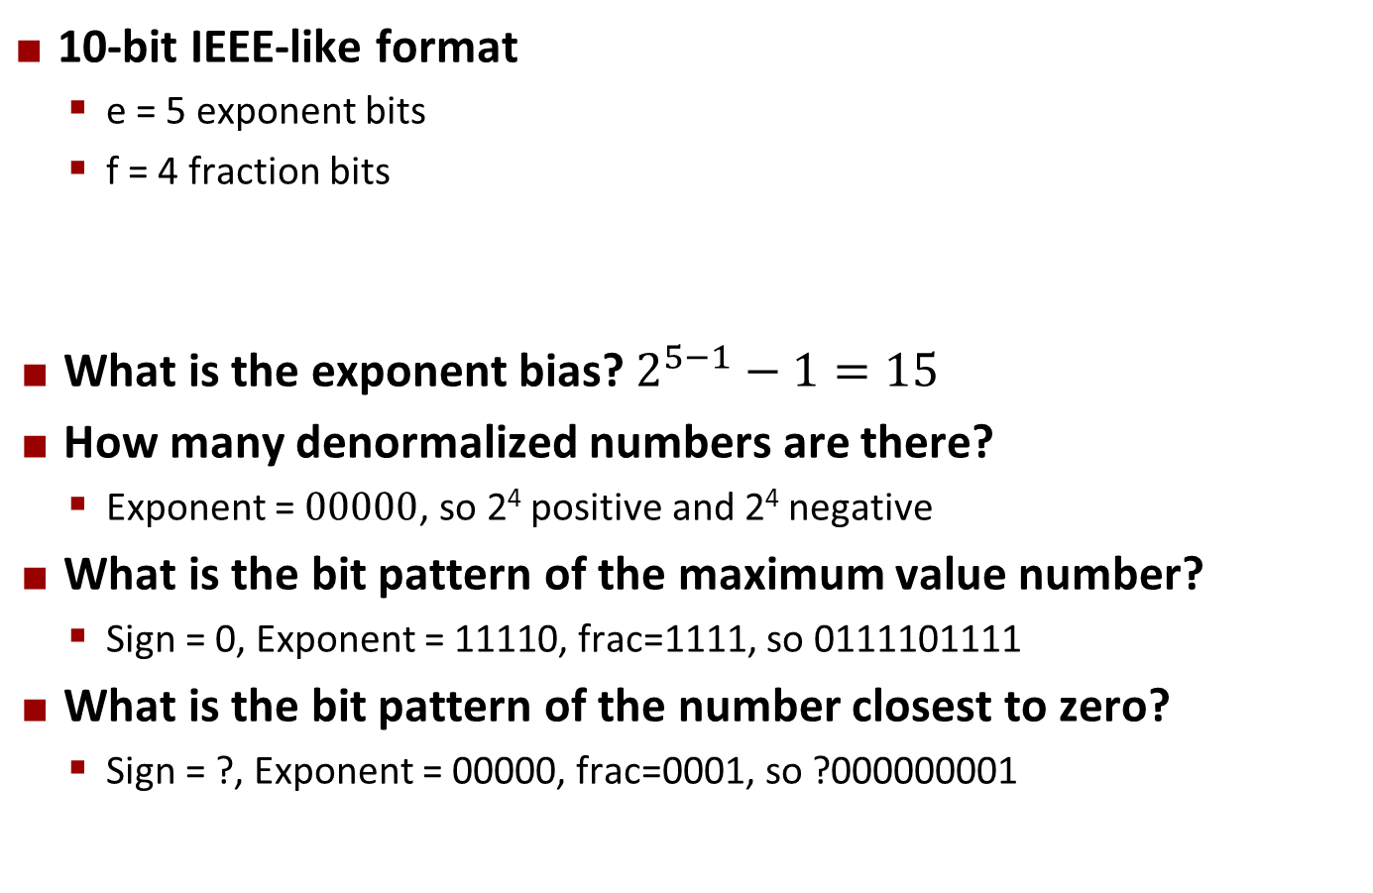
Quick Check
10-bit IEEE-like format
e = 5 exponent bits
f = 4 fraction bits
What is the exponent bias? $2^{5−1}−1=15$
How many denormalized numbers are there?
Exponent = $00000$, so 2⁴ positive and 2⁴ negative
What is the bit pattern of the maximum value number?
Sign = 0, Exponent = 11110, frac=1111, so 0111101111
What is the bit pattern of the number closest to zero?
Sign = ?, Exponent = 00000, frac=0001, so ?000000001
s | exp | frac
1 | 5-bits | 4-bits

Slide 23
Quick Check
10-bit IEEE-like format
e = 5 exponent bits
f = 4 fraction bits
What is the bit pattern of the smallest positive normal number?
s | exp | frac
1 | 5-bits | 4-bits

Slide 24
Quick Check
10-bit IEEE-like format
e = 5 exponent bits
f = 4 fraction bits
What is the bit pattern of the smallest positive normal number?
Sign = 0, exp = 00001, frac = 0000; so 0000010000
s | exp | frac
1 | 5-bits | 4-bits

Slide 25
Quick Check
10-bit IEEE-like format
e = 5 exponent bits
f = 4 fraction bits
What is the bit pattern of the smallest positive normal number?
Sign = 0, exp = 00001, frac = 0000; so 0000010000
What is the value of the smallest positive normal number?
s | exp | frac
1 | 5-bits | 4-bits

Slide 26
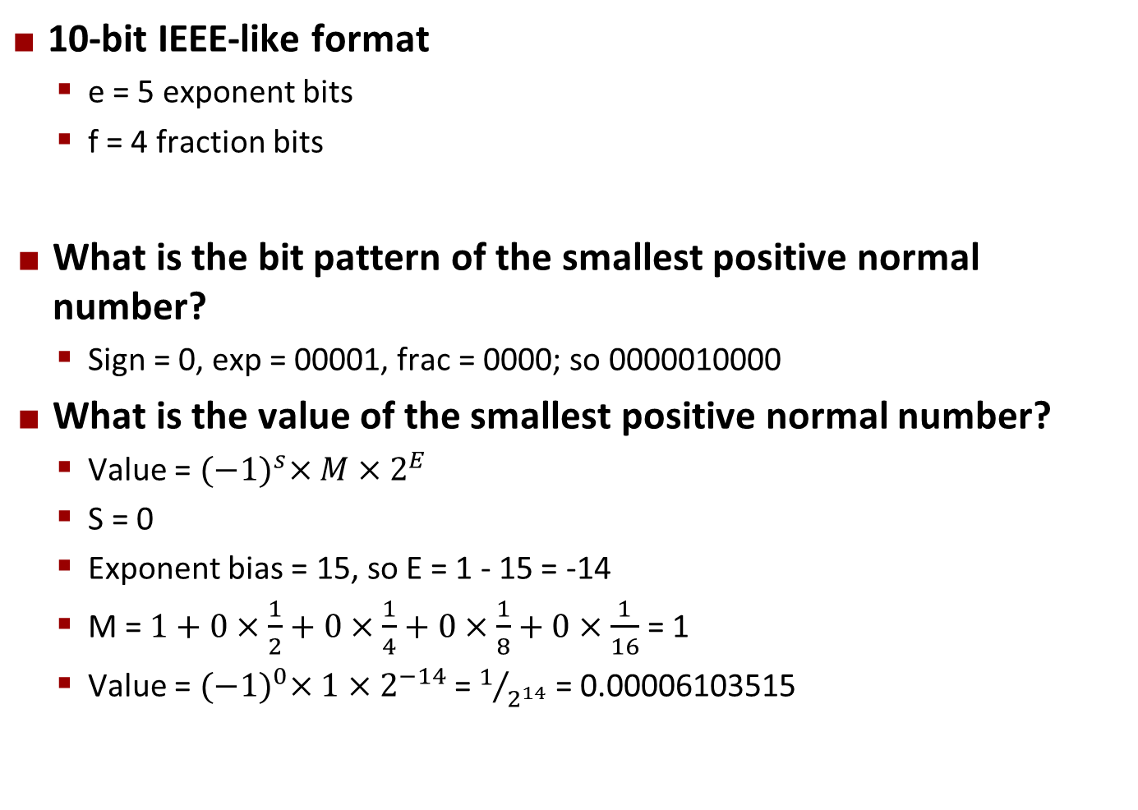
Quick Check
10-bit IEEE-like format
e = 5 exponent bits
f = 4 fraction bits
What is the bit pattern of the smallest positive normal number?
Sign = 0, exp = 00001, frac = 0000; so 0000010000
What is the value of the smallest positive normal number?
Value = ${(−1)}^{s}×M×2^{E}$
S = 0
Exponent bias = 15, so E = 1 - 15 = -14
M = $1+0×\frac{1}{2}+0×\frac{1}{4}+0×\frac{1}{8}+0×\frac{1}{16}$ = 1
Value = ${(−1)}^{0}×1×2^{−14}$ = $1/{2^{14}}$ = 0.00006103515
s | exp | frac
1 | 5-bits | 4-bits

Slide 27
Quick Check
10-bit IEEE-like format
e = 5 exponent bits
f = 4 fraction bits
Given a 32-bit floating point number, and a 32-bit integer, which can represent more discrete values?
s | exp | frac
1 | 5-bits | 4-bits

Slide 28
Quick Check
10-bit IEEE-like format
e = 5 exponent bits
f = 4 fraction bits
Given a 32-bit floating point number, and a 32-bit integer, which can represent more discrete values?
Both can represent 2³² values, but some bit patterns duplicate values, e.g. +0/-0, +∞/-∞, and many NaNs (exponent = 11…1, frac != 00…0)
s | exp | frac
1 | 5-bits | 4-bits

Slide 29
Today: Floating Point
Background: Fractional binary numbers
Example and properties
IEEE floating point standard: Definition
Floating point in C
Summary

Slide 30
IEEE Floating Point
IEEE Standard 754
Established in 1985 as uniform standard for floating point arithmetic
Before that, many idiosyncratic formats
Supported by all major CPUs
Driven by numerical concerns
Nice standards for rounding, overflow, underflow
Hard to make fast in hardware
Numerical analysts predominated over hardware designers in defining standard

Slide 31
Floating Point Representation
Numerical Form: (–1)^{s} M 2E
Sign bit s determines whether number is negative or positive
Significand (mantissa) M normally a fractional value in range [1.0, 2.0)
Exponent E weights value by power of two
Encoding
s is sign bit s
exp field encodes E (but is not equal to E)
frac field encodes M (but is not equal to M)
s | exp | frac

Slide 32
Standard Types
Single precision: 32 bits (c type: float)
Double precision: 64 bits (c type: double)
Extended precision: 80 bits (Intel only)
s | exp | frac
1 | 8-bits | 23-bits
s | exp | frac
1 | 11-bits | 52-bits
s | exp | frac
1 | 15-bits | 63 or 64-bits

Slide 33
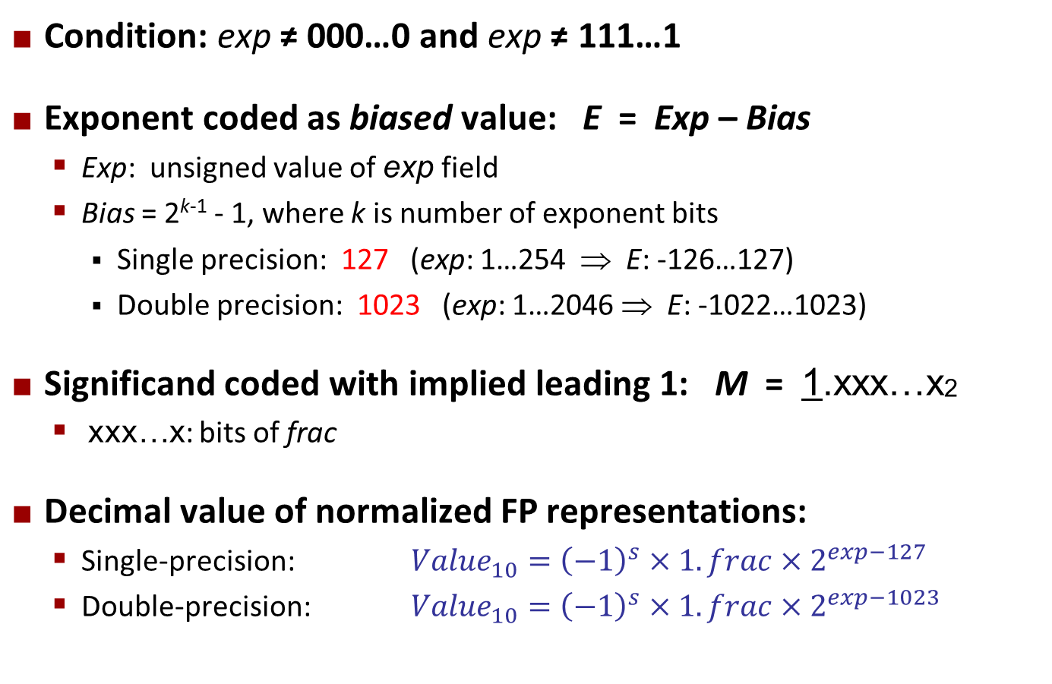
Normalized Values
Condition: exp ≠ 000…0 and exp ≠ 111…1
Exponent coded as biased value: E = Exp – Bias
Exp: unsigned value of exp field
Bias = 2^{k-1} - 1, where k is number of exponent bits
Single precision: 127 (exp: 1…254 ⇒ E: -126…127)
Double precision: 1023 (exp: 1…2046 ⇒ E: -1022…1023)
Significand coded with implied leading 1: M = 1.xxx…x2
xxx…x: bits of frac
Decimal value of normalized FP representations:
Single-precision: ${Value}_{10}={\left(−1\right)}^{s}×1.frac×2^{exp−127}$
Double-precision: ${Value}_{10}={\left(−1\right)}^{s}×1.frac×2^{exp−1023}$

Slide 34
Normalized Encoding Example
shift binary point by K bits so that
only one leading 1 bit remains on
the left side of the binary point
(here, shifted right by 13 bits, so K = 13),
then multiply by 2^{K} (here, 2¹³)
Value: float F = 15213.5;
15213.5₁₀ = 11101101101101.1₂
= 1.11011011011011₂ x 2¹³
Significand
M = 1.11011011011011₂
frac = 11011011011011000000000₂
Exponent (E = Exp – Bias)
E = 13
Bias = 127
Exp = E + Bias = 140 = 10001100₂
0 10001100 11011011011011000000000
s
exp
frac

Slide 35
Denormalized Values
Condition: exp = 000…0
Exponent value: E = 1 – Bias (instead of E = 0 – Bias)
Significand coded with implied leading 0: M = 0.xxx…x2
xxx…x: bits of frac
Cases
exp = 000…0, frac = 000…0
Represents zero value
Note distinct values: +0 and –0 (why?)
exp = 000…0, frac ≠ 000…0
Numbers very close to 0.0
Lose precision as get smaller
Equispaced

Slide 36
Special Values
Special condition: exp = 111…1
Case: exp = 111…1, frac = 000…0
Represents value ∞ (infinity)
Operation that overflows
Both positive and negative
E.g., 1.0/0.0 = −1.0/−0.0 = +∞, 1.0/−0.0 = −∞
Case: exp = 111…1, frac ≠ 000…0
Not-a-Number (NaN)
Represents case when no numeric value can be determined
E.g., sqrt(–1), ∞ − ∞, ∞ × 0

Slide 37
Interesting Numbers
{single,double}
Description exp frac Numeric Value
Zero 00…00 00…00 0.0
Smallest Pos. Denorm. 00…00 00…01 2^{– {23,52}} x 2^{– {126,1022}}
Single ≈ 1.4 x 10^{–45}
Double ≈ 4.9 x 10^{–324}
Largest Denormalized 00…00 11…11 (1.0 – ε) x 2^{– {126,1022}}
Single ≈ 1.18 x 10^{–38}
Double ≈ 2.2 x 10^{–308}
Smallest Pos. Normalized 00…01 00…00 1.0 x 2^{– {126,1022}}
Just larger than largest denormalized
One 01…11 00…00 1.0
Largest Normalized 11…10 11…11 (2.0 – ε) x 2^{{127,1023}}
Single ≈ 3.4 x 10³⁸
Double ≈ 1.8 x 10³⁰⁸

Slide 38
Precision
How accurate are floating point numbers? Consider again:
Size of frac limits how many decimal places we can represent
E.g. single precision has 23 explicit bits + 1 implicit bit
15213₁₀ = 11101101101101.1₂
11011011011011000000000
frac
123456789₁₀ = 111010110111100110100010101₂
M = 1.11010110111100110100010101₂ x 2²⁶
frac = 11010110111100110100011₂ (round up)

Slide 39
Loss of Precision Example
Value: float F = 123456789;
123456789₁₀ = 111010110111100110100010101₂
= 1.11010110111100110100010101₂ x 2²⁶
Significand
M = 1.11010110111100110100010101₂
frac = 11010110111100110100011₂
Reconstructed Value
(-1)^{S} * M * 2E
M = 1 + 0.5 + 0.25 + … = 1.83964955806732177734375
V = 1.83964955806732177734375 * 2^26
V = 123456792

Slide 40
Today: Floating Point
Background: Fractional binary numbers
Example and properties
IEEE floating point standard: Definition
Floating point in C
Summary

Slide 41
Floating Point in C
C Guarantees Two Levels
float single precision
double double precision
Conversions/Casting
Casting between int, float, and double changes bit representation
double/float → int
Truncates fractional part
Like rounding toward zero
Not defined when out of range or NaN: Generally sets to TMin
int → double
Exact conversion, as long as int has ≤ 53 bit word size
int → float
Will round according to rounding mode

Slide 42
Today: Floating Point
Background: Fractional binary numbers
Example and properties
IEEE floating point standard
Floating point in C
Rounding, addition, multiplication
Summary

Slide 43
Floating Point Operations: Basic Idea
x +f y = Round(x + y)
x ×f y = Round(x × y)
Basic idea
First compute exact result
Make it fit into desired precision
Possibly overflow if exponent too large
Possibly round to fit into frac

Slide 44
Rounding
Rounding Modes (illustrate with $ rounding)
$1.40 $1.60 $1.50 $2.50 –$1.50
Towards zero $1 $1 $1 $2 –$1
Round down (−∞) $1 $1 $1 $2 –$2
Round up (+∞) $2 $2 $2 $3 –$1
Nearest Even (default) $1 $2 $2 $2 –$2

Slide 45
Closer Look at Round-To-Even
Default Rounding Mode
Hard to get any other kind without dropping into assembly
All others are statistically biased
Sum of set of positive numbers will consistently be over- or under- estimated
Applying to Other Decimal Places / Bit Positions
When exactly halfway between two possible values
Round so that least significant digit is even
E.g., round to nearest hundredth
7.8949999 7.89 (Less than half way)
7.8950001 7.90 (Greater than half way)
7.8950000 7.90 (Half way—round up)
7.8850000 7.88 (Half way—round down)

Slide 46
Rounding Binary Numbers
Binary Fractional Numbers
“Even” when least significant bit is 0
“Half way” when bits to right of rounding position = 100…2
Examples
Round to nearest 1/4 (2 bits right of binary point)
Value Binary Rounded Action Rounded Value
2 3/32 10.000112 10.002 (<1/2—down) 2
2 3/16 10.001102 10.012 (>1/2—up) 2 1/4
2 7/8 10.111002 11.002 ( 1/2—up) 3
2 5/8 10.101002 10.102 ( 1/2—down) 2 1/2

Slide 47

Scientific Notation Multiplication
$\left(2.5×{10}^{3}\right)×(3.0×{10}^{2})$ = ?
Compute result by pieces:
Sign : sign_{left} * sign_{right} = 1*1 = 1
Significand : M_{left} * M_{right} = 2.5 * 3.0 = 7.5
Exponent : E_{left} + E_{right} = 3 + 2 = 5
Result: $7.5 ×{10}^{5}$

Slide 48
FP Multiplication
(–1)^{s1} M1 2^{E1} x (–1)^{s2} M2 2^{E2}
Exact Result: (–1)^{s} M 2E
Sign s: s1 ^ s2
Significand M: M1 x M2
Exponent E: E1 + E2
Fixing
If M ≥ 2, shift M right, increment E
If E out of range, overflow
Round M to fit frac precision
Implementation
Biggest chore is multiplying significands

Slide 49

Scientific Notation Addition
$\left(2.5×{10}^{3}\right)+(3.0×{10}^{2})$ = ?
Assume E_{left} is larger that E_{right}
Align by decimal point:
Significand : 2.5 + .3 2.8
Exponent : E = E_{left} = 3
Result: $2.8 ×{10}^{3}$

Slide 50
Floating Point Addition
(–1)^{s1} M1 2^{E1} + (-1)^{s2} M2 2^{E2}
Assume E1 > E2
Exact Result: (–1)^{s} M 2E
Sign s, significand M:
Result of signed align & add
Exponent E: E1
Fixing
If M ≥ 2, shift M right, increment E
if M < 1, shift M left k positions, decrement E by k
Overflow if E out of range
Round M to fit frac precision
Get binary points lined up
E1–E2
(–1)^{s1} M1
+
(–1)^{s2} M2
(–1)^{s} M

Slide 51
Mathematical Properties of FP Add
Compare to those of Abelian Group
Commutative?
(a + b) = (b + a)
Associative?
Overflow and inexactness of rounding
(3.14+1e10)-1e10 = 0, 3.14+(1e10-1e10) = 3.14
Yes
No

Slide 52
Mathematical Properties of FP Mult
Compare to Commutative Ring
Multiplication Commutative?
Ex: (1e20*1e-20)=(1e-20*1e20)
Multiplication is Associative?
Possibility of overflow, inexactness of rounding
Ex: (1e20*1e20)*1e-20= inf, 1e20*(1e20*1e-20)= 1e20
Multiplication distributes over addition?
Possibility of overflow, inexactness of rounding
1e20*(1e20-1e20)= 0.0, 1e20*1e20 – 1e20*1e20 = NaN
Yes
No
No

Slide 53
Summary
Represents numbers of form M x 2E
One can reason about operations independent of implementation
As if computed with perfect precision and then rounded
Not the same as real arithmetic
Violates associativity/distributivity
Makes life difficult for compilers & serious numerical applications programmers

