Slide 1
Machine-Level Programming I – Introduction CSCI 2400: Computer Architecture
Instructor:
David Ferry
Slides adapted from Bryant & O’Hallaron’s slides
via Jason Fritts

Slide 2
Turning a corner…
Course theme:
Low level (machine level) operation of a processor
What we’ve seen so far:
Bit-level representation of data
int, unsigned, char, float, double
Strings (arrays)
Bit-level operations on data
Arithmetic (+, -, *, /, %)
Bitwise (&, |, ^, ~, <<, >>)
We’ve done data at a low level, what about programs?

Slide 3
State of the Course
Past:
Machine organization
Data representation
Data operations
Intro to C and Linux
Future:
Program representation (assembly language)
Program execution
Processor architecture / organization
Memory and cache architecture / organization

Slide 4
Machine Programming I – Basics
Instruction Set Architecture
Software Architecture vs. Hardware Architecture
Common Architecture Classifications
The Intel x86 ISA – History and Microarchitectures
Dive into C, Assembly, and Machine code
The Intel x86 Assembly Basics:
Registers and Operands
mov instruction
Intro to x86-64
AMD was first!

Slide 5
Assembly Programmer’s View
Memory
CPU
Registers
Addresses
Object Code
Program Data
OS Data
Data
PC
Processor implementation (not visible)
Instructions
Condition
Codes
Stack
Programmer-Visible State
PC: Program counter
Holds address of next instruction
Register file
Temp storage for program data
Condition codes
Store status info about recent operation
Used for conditional branching
Memory
Byte addressable array
Code, user data, (some) OS data
Includes stack used to support procedures

Slide 6
Hardware vs. Software Architecture
There are two parts to the computer architecture of a processor:
Software architecture
known as the Architecture or Instruction Set Architecture (ISA)
Hardware architecture
known as the Microarchitecture
a hardware architecture implements an ISA
The (software) architecture includes all aspects of the design that are visible to programmers
The microarchitecture refers to one specific implementation of a software architecture
e.g. number of cores, processor frequency, cache sizes, etc.
the set of all independent hardware architectures for a given software architecture is known as the processor family
e.g. the Intel x86 family

Slide 7
Separation of hardware and software
The reason for the separation of the (software) architecture from the microarchitecture (hardware) is backwards compatibility
Backwards compatibility ensures:
software written on older processors will run on newer processors (of the same ISA)
processor families can always utilize the latest technology by creating new hardware architectures (for the same ISA)
However, new microarchitectures often add to the (software) architecture, so software written on newer processors may not run on older processors

Slide 8
Example Parts of the ISA
Register file
Fast, on-processor data storage, very limited
On Hopper:
14 general purpose registers (rax, rbc, rcx, rdx, rsi, rdi, and r8-r15)
Two stack registers (rbp, rsp)
Instruction pointer (rip)
Flags register (eflags)
Instruction set
The set of available instructions
movl – moves 32-bit data (“movl %edx, %eax” moves %edx to %eax)
addl – adds two 32-bit operands (“addl %eax, %ebx” adds %eax to %ebx)
call – call a function
These instructions map directly to binary machine code!

Slide 9
Parts of the Software Architecture
There are 4 parts to the (software) architecture
processor instruction set
the set of available instructions and the rules for using them
register file organization
the number, size, and rules for using registers
memory organization & addressing
the organization of the memory and the rules for accessing data
operating modes
the various modes of execution for the processor
there are usually at least two modes:
user mode (for general use)
system mode (allows access to privileged instructions and memory)

Slide 10
Software Architecture: Instruction Set
The Instruction Set defines
the set of available instructions
fundamental nature of the instructions
simple and fast (how many cycles?)
complex and concise
instruction formats
define the rules for using the instructions
the width (in bits) of the datapath
this defines the fundamental size of data in the CPU, including:
the size (number of bits) for the data buses in the CPU
the number of bits per register in the register file
the width of the processing units
the number of address bits for accessing memory

Slide 11
Software Architecture: Instruction Set
There are 9 fundamental categories of instructions
arithmetic
these instruction perform integer arithmetic, such as add, subtract, multiply, and negate
Note: integer division is commonly done in software
logical
these instructions perform Boolean logic (AND, OR, NOT, etc.)
relational
these instructions perform comparisons, including ==, !=, <, >, <=, >=
some ISAs perform comparisons in the conditional branches
control
these instructions enable changes in control flow, both for decision making and modularity
the set of control instruction includes:
conditional branches
unconditional jumps
procedure calls and returns

Slide 12
Software Architecture: Instruction Set
memory
these instructions allow data to be read from or written to memory
floating-point
these instruction perform real-number operations, including add, subtract, multiply, division, comparisons, and conversions
shifts
these instructions allow bits to be shifted or rotated left or right
bit manipulation
these instructions allow data bits to be set or cleared
some ISAs do not provide these, since they can be done via logic instructions
system instructions
specialized instructions for system control purposes, such as
STOP or HALT (stop execution)
cache hints
interrupt handling
some of these instructions are privileged, requiring system mode

Slide 13
Software Architecture: Register File
The Register File is a small, fast temporary storage area in the processor’s CPU
it serves as the primary place for holding data values currently being operated upon by the CPU
The organization of the register file determines
the number of registers
a large number of registers is desirable, but having too many will negatively impact processor speed
the number of bits per register
this is equivalent to the width of the datapath
the purpose of each register
ideally, most registers should be general-purpose
however, some registers serve specific purposes

Slide 14
Purpose of Register File
Registers are much faster to access than memory
Time to access a local register: ~1 CPU cycle
Time to access memory (RAM): hundreds to thousands of CPU cycles
Operating on memory data requires loads and stores
More instructions to be executed
Compilers store values in registers whenever possible
Only spill to memory for less frequently used variables
Register optimization is important!

Slide 15
Software Architecture: Memory
The Memory Organization & Addressing defines
how memory is organized in the architecture
where data and program memory are unified or separate
the amount of addressable memory
usually determined by the datapath width
the number of bytes per address
most processors are byte-addressable, so each byte has a unique addr
whether it employs virtual memory, or just physical memory
virtual memory is usually required in complex computer systems, like desktops, laptops, servers, tablets, smart phones, etc.
simpler systems use embedded processors with only physical memory
rules identifying how instructions access data in memory
what instructions may access memory (usually only loads, stores)
what addressing modes are supported
the ordering and alignment rules for multi-byte primitive data types

Slide 16
Software Architecture: Operating Modes
Operating Modes define the processor’s modes of execution
The ISA typically supports at least two operating modes
user mode
this is the mode of execution for typical use
system mode
allows access to privileged instructions and memory
aside from interrupt and exception handling, system mode is typically only available to system programmers and administrators
used to implement operating system privilieges
Processors also generally have hardware testing modes, but these are usually part of the microarchitecture, not the (software) architecture

Slide 17
Machine Programming I – Basics
Instruction Set Architecture
Software Architecture vs. Hardware Architecture
Common Architecture Classifications
The Intel x86 ISA – History and Microarchitectures
Dive into C, Assembly, and Machine code
The Intel x86 Assembly Basics:
Registers
Operands
mov instruction
Intro to x86-64
AMD was first!

Slide 18
Common Architecture (ISA) Classifications:
Concise vs. Fast: CISC vs. RISC
CISC – Complex Instruction Set Computers
complex instructions targeting efficient program representation
variable-length instructions
versatile addressing modes
specialized instructions and registers implement complex tasks
NOT optimized for speed – tend to be SLOW
RISC – Reduced Instruction Set Computers
small set of simple instructions targeting high speed implementation
fixed-length instructions
simple addressing modes
many general-purpose registers
leads to FAST hardware implementations
but less memory efficient

Slide 19
Is x86 CISC? How does it get speed?
Hard to match RISC performance, but Intel has done just that! ….In terms of speed; less so for power
CISC instruction set makes implementation difficult
Hardware translates instructions to simpler micro-operations
simple instructions: 1–to–1
complex instructions: 1–to–many
Micro-engine similar to RISC
Market share makes this economically viable
Comparable performance to RISC
Compilers avoid CISC instructions

Slide 20
Classifications: Unified vs. Separate Memory
von Neumann vs. Harvard architecture
relates to whether program and data in unified or separate memory
von Neumann architecture
program and data are stored in the same unified memory space
requires only one physical memory
allows self-modifying code
however, code and data must share the same memory bus
used by most general-purpose processors (e.g. Intel x86)
Harvard architecture
program and data are stored in separate memory spaces
requires separate physical memory
code and data do not share same bus, giving higher bandwidths
often used by digital signal processors for data-intensive applications

Slide 21
Classifications: Performance vs. Specificity
Microprocessor vs. Microcontroller
Microprocessor
processors designed for high-performance and flexibility in personal computers and other general purpose applications
architectures target high performance through a combination of high speed and parallelism
processor chip contains only CPU(s) and cache
no peripherals included on-chip
Microcontroller
processors designed for specific purposes in embedded systems
only need performance sufficient to needs of that application
processor chip generally includes:
a simple CPU
modest amounts of RAM and (Flash) ROM
appropriate peripherals needed for specific application
also often need to meet low power and/or real-time requirements

Slide 22
Machine Programming I – Basics
Instruction Set Architecture
Software Architecture vs. Hardware Architecture
Common Architecture Classifications
The Intel x86 ISA – History and Microarchitectures
Dive into C, Assembly, and Machine code
The Intel x86 Assembly Basics:
Registers
Operands
mov instruction
Intro to x86-64
AMD was first!

Slide 23
Intel x86 Processors
The main software architecture for Intel is the x86 ISA
also known as IA-32
for 64-bit processors, it is known as x86-64
Totally dominate laptop/desktop/server market
Evolutionary design
Backwards compatible back to 8086, introduced in 1978
Added more features as time goes on
Complex instruction set computer (CISC)
Many different instructions with many different formats
but, only small subset used in Linux programs

Slide 24
Intel x86 Family: Many Microarchitectures
Architectures
Processors
X86-16
8086
286
1978
X86-32 / IA32
386
486
Pentium
Pentium MMX
Pentium III
Pentium 4
Pentium 4E
1985
1993
MMX
SSE
SSE2
SSE3
2000
X86-64 / Intel 64
Pentium 4F
Core 2 Duo
Core i7
time
2004
2006
SSE4
2010
IA: often redefined as latest Intel architecture

Slide 25
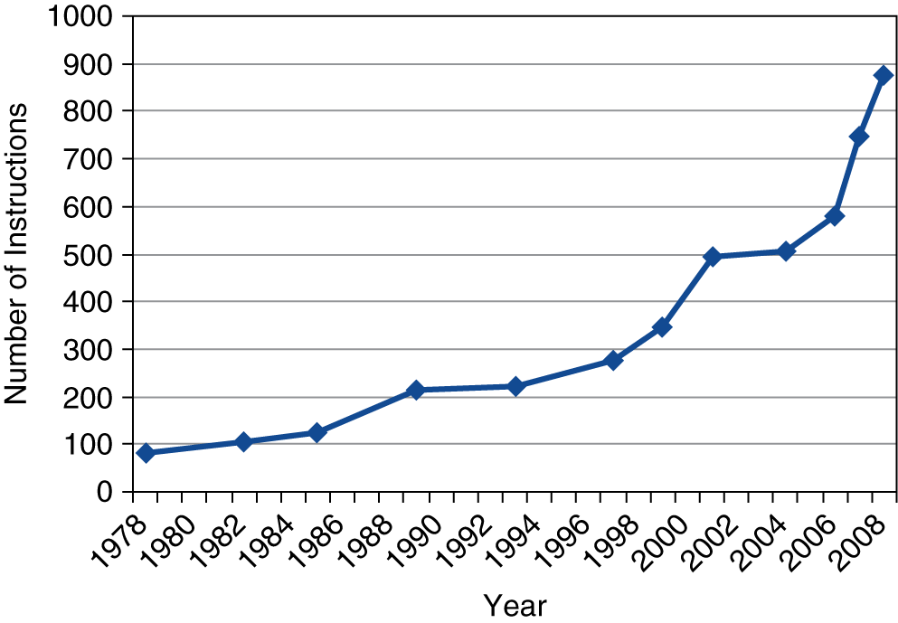
Software architecture can grow
Backward compatibility does not mean instruction set is fixed
new instructions and functionality can be added to the software architecture over time
Intel added additional features over time
Instructions to support multimedia operations (MMX, SSE)
SIMD parallelism – same operation done across multiple data
Instructions enabling more efficient conditional operations
x86 instruction set

Slide 26
Intel x86: Milestones & Trends
Name Date Transistors MHz
8086 1978 29K 5-10
First 16-bit processor. Basis for IBM PC & DOS
1MB address space
386 1985 275K 16-33
First 32 bit processor, referred to as IA32
Added “flat addressing”
Pentium 1993 3.1M 50-75
Pentium II 1996 7.5M 233-300
Pentium III 1999 9.5-21M 450-800
Pentium 4F 2004 169M 3200-3800
First Intel 64-bit processor
Got very hot (up to 115 watts!)
Core i7 2008 731M 2667-3333

Slide 27
Intel’s 64-Bit History
2001: Intel Attempts Radical Shift from IA32 to IA64
Totally different architecture (Itanium)
Executes IA32 code only as legacy
Performance disappointing
2003: AMD Steps in with Evolutionary Solution
x86-64 (now called “AMD64”)
Intel Felt Obligated to Focus on IA64
Hard to admit mistake or that AMD is better
2004: Intel Announces EM64T extension to IA32
Extended Memory 64-bit Technology
Almost identical to x86-64!
All but low-end x86 processors support x86-64
But, lots of code still runs in 32-bit mode

Slide 28
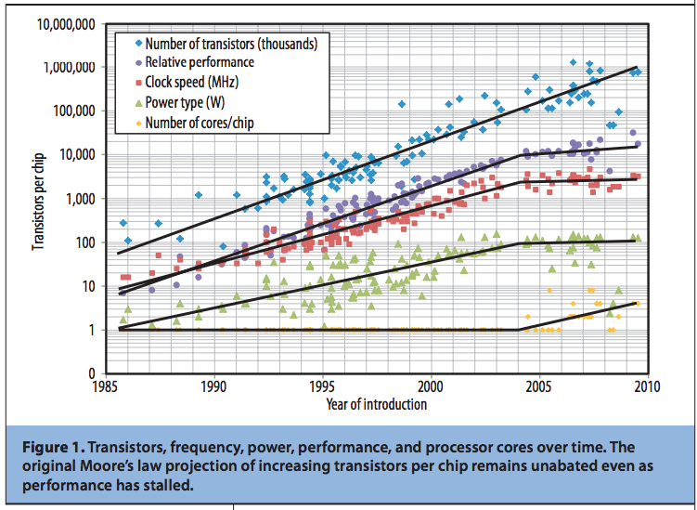
Processor Trends
Number of transistors has continued to double every 2 years
In 2004 – we hit the Power Wall
Processor clock speeds started to leveled off
Recently – multi-cores have hit the Memory Wall

Slide 29
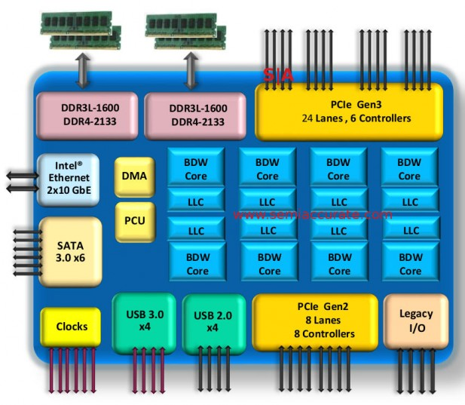
2017 State of the Art
Core i7 Kaby Lake 2017
Xeon E7-8890V4 2016
Desktop Model
4 cores
Integrated graphics
2.9-4.2 GHz
35, 65, 91W
Server Model
24 cores
Integrated I/O
2.2-3.4 GHz
165W
$10,000

Slide 30
Machine Programming I – Basics
Instruction Set Architecture
Software Architecture (“Architecture” or “ISA”) vs.
Hardware Architecture (“Microarchitecture”)
The Intel x86 ISA – History and Microarchitectures
Dive into C, Assembly, and Machine code
The Intel x86 Assembly Basics:
Registers
Operands
mov instruction
Intro to x86-64
AMD was first!

Slide 31
Turning C into Object Code
Code in separate translation units: p1.c p2.c
Compile with command: gcc –O1 –m32 p1.c p2.c -o p
Use basic optimizations (-O1)
Put resulting binary in file p
On 64-bit machines, specify 32-bit x86 code (-m32)
text
C program (p1.c p2.c)
Compiler (gcc –S –m32)
text
Asm program (p1.s p2.s)
Assembler (gcc or as)
binary
Object program (p1.o p2.o)
Static libraries (.a)
Linker (gcc or ld)
binary
Executable program (p)

Slide 32
Compiling Into Assembly
C Code
Generated IA32 Assembly
int sum(int x, int y)
{
int t = x+y;
return t;
}
sum:
pushl %ebp
movl %esp,%ebp
movl 12(%ebp),%eax
addl 8(%ebp),%eax
popl %ebp
ret
Some compilers use instruction “leave”
Obtain with command:
gcc –O1 -S –m32 code.c
-S specifies compile to assembly (vs object) code, and produces file code.s

Slide 33
Assembly Characteristics: Simple Types
Integer data of 1, 2, or 4 bytes
Data values
Addresses (void* pointers)
Floating point data of 4, 8, or 10 bytes
No concept of aggregate types such as arrays or structures
Just contiguously allocated bytes in memory

Slide 34
Assembly Characteristics: Operations
Perform some operation on register or memory data
arithmetic
logical
bit shift or manipulation
comparison (relational)
Transfer data between memory and register
Load data from memory into register
Store register data into memory
Transfer control
Unconditional jumps to/from procedures
Conditional branches

Slide 35
Object Code
Assembler
Translates .s into .o
Binary encoding of each instruction
Nearly-complete image of executable code
Missing linkages between code in different files
Linker
Resolves references between files
Combines with static run-time libraries
E.g., code for malloc, printf
Some libraries are dynamically linked
Linking occurs when program begins execution
Code for sum
0x401040 <sum>:
0x55
0x89
0xe5
0x8b
0x45
0x0c
0x03
0x45
0x08
0x5d
0xc3
Total of 11 bytes
Each instruction 1, 2, or 3 bytes
Starts at address 0x401040

Slide 36
Machine Instruction Example
C Code
Add two signed integers
Assembly
Add 2 4-byte integers
“Long” words in GCC parlance
Same instruction whether signed or unsigned
Operands:
x: Register %eax
y: Memory M[%ebp+8]
t: Register %eax
Return function value in %eax
Object Code
3-byte instruction
Stored at address 0x80483ca
int t = x+y;
addl 8(%ebp),%eax
Similar to expression:
x += y
More precisely:
int eax;
int *ebp;
eax += ebp[2]
0x80483ca: 03 45 08

Slide 37
Disassembling Object Code
Disassembled
080483c4 <sum>:
80483c4: 55 push %ebp
80483c5: 89 e5 mov %esp,%ebp
80483c7: 8b 45 0c mov 0xc(%ebp),%eax
80483ca: 03 45 08 add 0x8(%ebp),%eax
80483cd: 5d pop %ebp
80483ce: c3 ret
Disassembler
objdump -d p
Useful tool for examining object code
Analyzes bit pattern of series of instructions
Produces approximate rendition of assembly code
Can be run on either a.out (complete executable) or .o file

Slide 38
Alternate Disassembly
Disassembled
Object
0x401040:
0x55
0x89
0xe5
0x8b
0x45
0x0c
0x03
0x45
0x08
0x5d
0xc3
Dump of assembler code for function sum:
0x080483c4 <sum+0>: push %ebp
0x080483c5 <sum+1>: mov %esp,%ebp
0x080483c7 <sum+3>: mov 0xc(%ebp),%eax
0x080483ca <sum+6>: add 0x8(%ebp),%eax
0x080483cd <sum+9>: pop %ebp
0x080483ce <sum+10>: ret
Within gdb Debugger
gdb p
disassemble sum
Disassemble procedure
x/11xb sum
Examine the 11 bytes starting at sum

Slide 39
What Can be Disassembled?
% objdump -d WINWORD.EXE
WINWORD.EXE: file format pei-i386
No symbols in "WINWORD.EXE".
Disassembly of section .text:
30001000 <.text>:
30001000: 55 push %ebp
30001001: 8b ec mov %esp,%ebp
30001003: 6a ff push $0xffffffff
30001005: 68 90 10 00 30 push $0x30001090
3000100a: 68 91 dc 4c 30 push $0x304cdc91
Anything that can be interpreted as executable code
Disassembler examines bytes and reconstructs assembly source

Slide 40
Machine Programming I – Basics
Instruction Set Architecture
Software Architecture vs. Hardware Architecture
Common Architecture Classifications
The Intel x86 ISA – History and Microarchitectures
Dive into C, Assembly, and Machine code
The Intel x86 Assembly Basics:
Common instructions
Registers, Operands, and mov instruction
Addressing modes
Intro to x86-64
AMD was first!

Slide 41
World-wary aside: Instruction Syntax
Two prevalent assembler syntaxes:
AT&T syntax
Aka GNU Assembler syntax, aka GAS syntax
Dominant in Unix/Linux world
Subject of this class
E.g.: movl $5, %eax
E.g.: movl 8(%ebp), %eax
Intel Syntax
Aka Microsoft Assembler syntax, aka MASM syntax
Dominant in Microsoft world
E.g.: mov eax, 5
E.g.: mov eax, [ebp + 8]

Slide 42
Typical Instructions in Intel x86
Arithmetic
add, sub, neg, imul, div, inc, dec, leal, …
Logical (bit-wise Boolean)
and, or, xor, not
Relational
cmp, test, sete, …
Control
je, jle, jg, jb, jmp, call, ret, …
Moves & Memory Access
mov, push, pop, movswl, movzbl, cmov, …
nearly all x86 instructions can access memory
Shifts
shr, sar, shl, sal (same as shl)
Floating-point
fld, fadd, fsub, fxch, addsd, movss, cvt…, ucom…
float-point change completely with x86-64

Slide 43
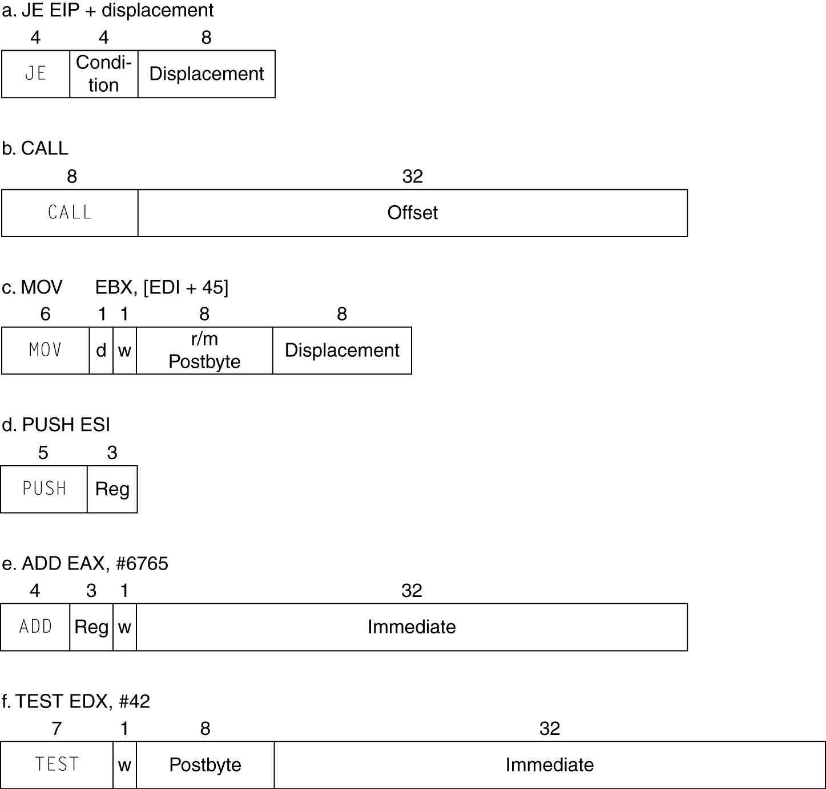
CISC Instructions: Variable-Length

Slide 44
Machine Programming I – Basics
Instruction Set Architecture
Software Architecture (“Architecture” or “ISA”) vs.
Hardware Architecture (“Microarchitecture”)
The Intel x86 ISA – History and Microarchitectures
Dive into C, Assembly, and Machine code
The Intel x86 Assembly Basics:
Common instructions
Registers, Operands, and mov instruction
Addressing modes
Intro to x86-64
AMD was first!

Slide 45
Integer Registers (IA32)
Origin
(mostly obsolete)
%eax
%ax
%ah
%al
accumulate
%ecx
%cx
%ch
%cl
counter
%edx
%dx
%dh
%dl
data
general purpose
%ebx
%bx
%bh
%bl
base
%esi
source
index
%si
%edi
destination
index
%di
%esp
stack
pointer
%sp
%ebp
base
pointer
%bp
16-bit virtual registers
(backwards compatibility)

Slide 46
Moving Data: IA32
%eax
%ecx
Moving Data
movl Source, Dest
Operand Types
Immediate: Constant integer data
example: $0x400, $-533
like C constant, but prefixed with ‘$’
encoded with 1, 2, or 4 bytes
Register: One of 8 integer registers
example: %eax, %edx
but %esp and %ebp reserved for special use
others have special uses in particular situations
Memory: 4 consecutive bytes of memory at address given by register
simplest example: (%eax)
various other “address modes”
%edx
%ebx
%esi
%edi
%esp
%ebp

Slide 47
movl Operand Combinations
Source
Dest
Src, Dest
C Analog
Reg
movl $0x4,%eax
temp = 0x4;
Imm
Mem
movl $-147,(%eax)
*p = -147;
movl
Reg
movl %eax,%edx
temp2 = temp1;
Reg
Mem
movl %eax,(%edx)
*p = temp;
Mem
Reg
movl (%eax),%edx
temp = *p;
Cannot do memory-memory transfer with a single instruction

Slide 48
Machine Programming I – Basics
Instruction Set Architecture
Software Architecture (“Architecture” or “ISA”) vs.
Hardware Architecture (“Microarchitecture”)
The Intel x86 ISA – History and Microarchitectures
Dive into C, Assembly, and Machine code
The Intel x86 Assembly Basics:
Common instructions
Registers, Operands, and mov instruction
Addressing modes
Intro to x86-64
AMD was first!

Slide 49
Simple Memory Addressing Modes
Normal: (R) Mem[Reg[R]]
Register R specifies memory address movl (%ecx),%eax
Displacement: D(R) Mem[Reg[R]+D]
Register R specifies start of memory region
Constant displacement D specifies offset movl 8(%ebp),%edx

Slide 50
Using Simple Addressing Modes
swap:
pushl %ebx
movl 8(%esp), %edx
movl 12(%esp), %eax
movl (%edx), %ecx
movl (%eax), %ebx
movl %ebx, (%edx)
movl %ecx, (%eax)
popl %ebx
ret
void swap(int *xp, int *yp)
{
int t0 = *xp;
int t1 = *yp;
*xp = t1;
*yp = t0;
}
Set
Up
Body
Finish

Slide 51
Using Simple Addressing Modes
swap:
pushl %ebx
movl 8(%esp), %edx
movl 12(%esp), %eax
movl (%edx), %ecx
movl (%eax), %ebx
movl %ebx, (%edx)
movl %ecx, (%eax)
popl %ebx
ret
void swap(int *xp, int *yp)
{
int t0 = *xp;
int t1 = *yp;
*xp = t1;
*yp = t0;
}
Set
Up
Body
Finish

Slide 52
Understanding Swap
•
•
•
void swap(int *xp, int *yp)
{
int t0 = *xp;
int t1 = *yp;
*xp = t1;
*yp = t0;
}
Stack
(in memory)
Offset
12
yp
8
xp
4
Rtn adr
0
Old %ebx
%esp
Register Value
%edx xp
%ecx yp
%ebx t0
%eax t1
movl 8(%esp), %edx # edx = xp
movl 12(%esp), %eax # eax = yp
movl (%edx), %ecx # ecx = *xp (t0)
movl (%eax), %ebx # ebx = *yp (t1)
movl %ebx, (%edx) # *xp = t1
movl %ecx, (%eax) # *yp = t0

Slide 53
Understanding Swap
Address
123
0x124
456
0x120
0x11c
%eax
0x118
%edx
Offset
0x114
%ecx
yp
12
0x120
0x110
%ebx
xp
8
0x124
0x10c
%esi
4
Rtn adr
0x108
%esp
0
0x104
%edi
%esp
movl 8(%esp), %edx # edx = xp
movl 12(%esp), %eax # eax = yp
movl (%edx), %ecx # ecx = *xp (t0)
movl (%eax), %ebx # ebx = *yp (t1)
movl %ebx, (%edx) # *xp = t1
movl %ecx, (%eax) # *yp = t0
%ebp
0x104

Slide 54
Understanding Swap
Address
123
0x124
456
0x120
0x11c
%eax
0x118
%edx
0x124
Offset
0x114
%ecx
yp
12
0x120
0x110
xp
8
0x124
%ebx
0x124
0x10c
%esi
4
Rtn adr
0x108
%esp
0
0x104
%edi
%esp
movl 8(%esp), %edx # edx = xp
movl 12(%esp), %eax # eax = yp
movl (%edx), %ecx # ecx = *xp (t0)
movl (%eax), %ebx # ebx = *yp (t1)
movl %ebx, (%edx) # *xp = t1
movl %ecx, (%eax) # *yp = t0
%ebp
0x104

Slide 55
Understanding Swap
Address
123
0x124
456
0x120
0x11c
%eax
0x120
0x118
%edx
0x124
Offset
0x114
%ecx
yp
12
0x120
0x120
0x110
%ebx
xp
8
0x124
0x10c
%esi
4
Rtn adr
0x108
%esp
0
0x104
%edi
%esp
movl 8(%esp), %edx # edx = xp
movl 12(%esp), %eax # eax = yp
movl (%edx), %ecx # ecx = *xp (t0)
movl (%eax), %ebx # ebx = *yp (t1)
movl %ebx, (%edx) # *xp = t1
movl %ecx, (%eax) # *yp = t0
%ebp
0x104

Slide 56
Understanding Swap
Address
123
0x124
456
456
0x120
0x11c
%eax
0x120
0x118
%edx
0x124
Offset
0x114
%ecx
123
yp
12
0x120
0x110
%ebx
xp
8
0x124
0x10c
%esi
4
Rtn adr
0x108
%esp
0
0x104
%edi
%esp
movl 8(%esp), %edx # edx = xp
movl 12(%esp), %eax # eax = yp
movl (%edx), %ecx # ecx = *xp (t0)
movl (%eax), %ebx # ebx = *yp (t1)
movl %ebx, (%edx) # *xp = t1
movl %ecx, (%eax) # *yp = t0
%ebp
0x104

Slide 57
Understanding Swap
Address
123
0x124
456
0x120
0x11c
%eax
0x120
0x118
%edx
0x124
Offset
0x114
%ecx
123
yp
12
0x120
0x110
%ebx
456
xp
8
0x124
0x10c
%esi
4
Rtn adr
0x108
%esp
0
0x104
%edi
%esp
movl 8(%esp), %edx # edx = xp
movl 12(%esp), %eax # eax = yp
movl (%edx), %ecx # ecx = *xp (t0)
movl (%eax), %ebx # ebx = *yp (t1)
movl %ebx, (%edx) # *xp = t1
movl %ecx, (%eax) # *yp = t0
%ebp
0x104

Slide 58
Understanding Swap
Address
456
0x124
456
0x120
0x11c
%eax
0x120
0x118
%edx
0x124
Offset
0x114
%ecx
123
yp
12
0x120
0x110
%ebx
456
xp
8
0x124
0x10c
%esi
4
Rtn adr
0x108
%esp
0
0x104
%edi
%esp
movl 8(%esp), %edx # edx = xp
movl 12(%esp), %eax # eax = yp
movl (%edx), %ecx # ecx = *xp (t0)
movl (%eax), %ebx # ebx = *yp (t1)
movl %ebx, (%edx) # *xp = t1
movl %ecx, (%eax) # *yp = t0
%ebp
0x104

Slide 59
Understanding Swap
Address
456
0x124
123
0x120
0x11c
%eax
0x120
0x118
%edx
0x124
Offset
0x114
%ecx
123
yp
12
0x120
0x110
%ebx
456
xp
8
0x124
0x10c
%esi
4
Rtn adr
0x108
%esp
0
0x104
%edi
%esp
movl 8(%esp), %edx # edx = xp
movl 12(%esp), %eax # eax = yp
movl (%edx), %ecx # ecx = *xp (t0)
movl (%eax), %ebx # ebx = *yp (t1)
movl %ebx, (%edx) # *xp = t1
movl %ecx, (%eax) # *yp = t0
%ebp
0x104

Slide 60
Complete Memory Addressing Modes
Most General Form
D(Rb,Ri,S) Mem[ Reg[Rb] + S * Reg[Ri] + D]
D: Constant “displacement” 1, 2, or 4 bytes
Rb: Base register: Any of 8 integer registers
Ri: Index register: Any, except for %esp (likely not %ebp either)
S: Scale: 1, 2, 4, or 8 (why these numbers?)
Special Cases
(Rb,Ri) Mem[ Reg[Rb] + Reg[Ri] ]
D(Rb,Ri) Mem[ Reg[Rb] + Reg[Ri] + D]
(Rb,Ri,S) Mem[ Reg[Rb]+ S * Reg[Ri] ]

Slide 61
Basic x86 Addressing Modes
Memory addressing modes
Address in register
Address = R_{base} + displacement
Address = R_{base} + R_{index}
Address = R_{base} + 2^{scale} × R_{index} (scale = 0, 1, 2, or 3)
Address = R_{base} + 2^{scale} × R_{index} + displacement

Slide 62
Machine Programming I – Basics
Instruction Set Architecture
Software Architecture vs. Hardware Architecture
Common Architecture Classifications
The Intel x86 ISA – History and Microarchitectures
Dive into C, Assembly, and Machine code
The Intel x86 Assembly Basics:
Common instructions
Registers, Operands, and mov instruction
Addressing modes
Intro to x86-64
AMD was first!

Slide 63
AMD created first 64-bit version of x86
Historically
AMD has followed just behind Intel
A little bit slower, a lot cheaper
2003, developed 64-bit version of x86: x86-64
Recruited top circuit designers from DEC and other diminishing companies
Built Opteron: tough competitor to Pentium 4

Slide 64
Intel’s 64-Bit
Intel Attempted Radical Shift from IA32 to IA64
Totally different architecture (Itanium)
Executes IA32 code only as legacy
Performance disappointing
2003: AMD Stepped in with Evolutionary Solution
Originally called x86-64 (now called AMD64)
2004: Intel Announces their 64-bit extension to IA32
Originally called EMT64 (now called Intel 64)
Almost identical to x86-64!
Collectively known as x86-64
minor differences between the two

Slide 65
Data Representations: IA32 vs. x86-64
Sizes of C Objects (in bytes)
C Data Type Intel IA32 x86-64
unsigned 4 4
int 4 4
long int 4 8
char 1 1
short 2 2
float 4 4
double 8 8
long double 10/12 16
pointer (e.g. char *) 4 8

Slide 66
x86-64 Integer Registers
%rax
%r8
%eax
%r8d
%rbx
%r9
%ebx
%r9d
%rcx
%r10
%ecx
%r10d
%rdx
%r11
%edx
%r11d
%rsi
%r12
%esi
%r12d
%rdi
%r13
%edi
%r13d
%rsp
%r14
%esp
%r14d
%rbp
%r15
%ebp
%r15d
Up to 6 function arguments are passed via registers
Explicitly makes %ebp/%rbp general purpose

Slide 67
New Instructions for 64-bit Operands
Long word l (4 Bytes) ↔ Quad word q (8 Bytes)
New instructions:
movl => movq
addl => addq
sall => salq
etc.
32-bit instructions that generate 32-bit results
Set higher order bits of destination register to 0
Example: addl

Slide 68
32-bit code for int swap
swap:
pushl %ebx
movl 8(%esp), %edx
movl 12(%esp), %eax
movl (%edx), %ecx
movl (%eax), %ebx
movl %ebx, (%edx)
movl %ecx, (%eax)
popl %ebx
ret
void swap(int *xp, int *yp)
{
int t0 = *xp;
int t1 = *yp;
*xp = t1;
*yp = t0;
}
Set
Up
Body
Finish

Slide 69
64-bit code for int swap
swap:
movl (%rdi), %edx
movl (%rsi), %eax
movl %eax, (%rdi)
movl %edx, (%rsi)
ret
Set
Up
void swap(int *xp, int *yp)
{
int t0 = *xp;
int t1 = *yp;
*xp = t1;
*yp = t0;
}
Body
Finish
Operands passed in registers (why useful?)
First input arg (xp) in %rdi, second input arg (yp) in %rsi
64-bit pointers
No stack operations required
32-bit ints held temporarily in %eax and %edx

Slide 70
64-bit code for long int swap
swap_l:
movq (%rdi), %rdx
movq (%rsi), %rax
movq %rax, (%rdi)
movq %rdx, (%rsi)
ret
Set
Up
void swap(long *xp, long *yp)
{
long t0 = *xp;
long t1 = *yp;
*xp = t1;
*yp = t0;
}
Body
Finish
64-bit long ints
Pass input arguments in registers %rax and %rdx
movq operation
“q” stands for quad-word

Slide 71
Machine Programming I – Basics
Instruction Set Architecture
Software Architecture vs. Hardware Architecture
Common Architecture Classifications
The Intel x86 ISA – History and Microarchitectures
Dive into C, Assembly, and Machine code
The Intel x86 Assembly Basics:
Common instructions
Registers, Operands, and mov instruction
Addressing modes
Intro to x86-64
AMD was first!

Slide 72
Machine Programming I – Summary
Instruction Set Architecture
Many different varieties and features of processor architectures
Separation of (software) Architecture and Microarchitecture is key for backwards compatibility
The Intel x86 ISA – History and Microarchitectures
Evolutionary design leads to many quirks and artifacts
Dive into C, Assembly, and Machine code
Compiler must transform statements, expressions, procedures into low-level instruction sequences
The Intel x86 Assembly Basics:
The x86 move instructions cover wide range of data movement forms
Intro to x86-64
A major departure from the style of code seen in IA32

Slide 73
Stored Program Computers
Instructions represented in binary, just like data
Instructions and data stored in memory
Programs can operate on programs
e.g., compilers, linkers, …
Binary compatibility allows compiled programs to work on different computers
Standardized ISAs

Slide 74
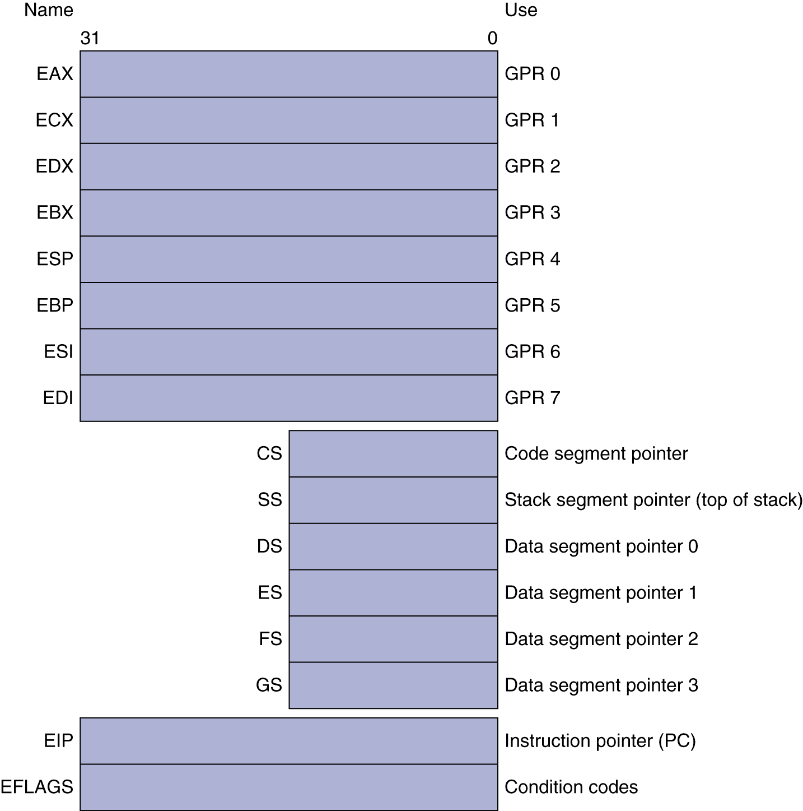
Basic x86 Registers

