Slide 1
Saint Louis University
Course Overview CSCI 2400/ ECE 3217: Computer Architecture
Instructors:
David Ferry
Slides adapted from Bryant & O’Hallaron’s slides

Slide 2
Overview
Saint Louis University
Course theme
Five realities
Logistics

Slide 3
Course Theme: Abstraction Is Good But Don’t Forget Reality
Saint Louis University
Most CS and CE courses emphasize abstraction
Abstract data types
Asymptotic analysis
These abstractions have limits
Especially in the presence of bugs
Need to understand details of underlying implementations
Useful outcomes
Become more effective programmers
Able to find and eliminate bugs efficiently
Able to understand and tune for program performance
Prepare for later “systems” classes in CS & ECE
Compilers, Operating Systems, Networks, Computer Architecture, Embedded Systems

Slide 4
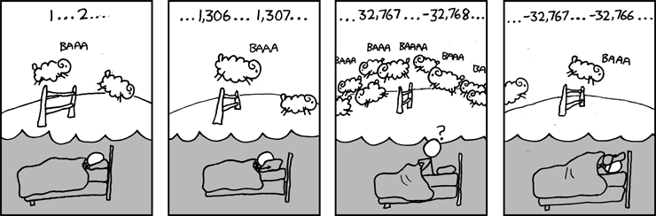
Great Reality #1: Ints are not Integers, Floats are not Reals
Saint Louis University
Example 1: Is x² ≥ 0?
Float’s: Yes!
Int’s:
40000 * 40000 => 1600000000
50000 * 50000 => ??
Example 2: Is (x + y) + z = x + (y + z)?
Unsigned & Signed Int’s: Yes!
Float’s:
(1e20 + -1e20) + 3.14 --> 3.14
1e20 + (-1e20 + 3.14) --> ??
Source: xkcd.com/571

Slide 5
Consequences of Abstraction: Code Security
Saint Louis University
/* Kernel memory region holding user-accessible data */
#define KSIZE 1024
char kbuf[KSIZE];
/* Copy at most maxlen bytes from kernel region to user buffer */
int copy_from_kernel(void *user_dest, int maxlen) {
/* Byte count len is minimum of buffer size and maxlen */
int len = KSIZE < maxlen ? KSIZE : maxlen;
memcpy(user_dest, kbuf, len);
return len;
}
Similar to code found in FreeBSD’s implementation of getpeername
There are legions of smart people trying to find vulnerabilities in programs

Slide 6
Typical Usage
Saint Louis University
/* Kernel memory region holding user-accessible data */
#define KSIZE 1024
char kbuf[KSIZE];
/* Copy at most maxlen bytes from kernel region to user buffer */
int copy_from_kernel(void *user_dest, int maxlen) {
/* Byte count len is minimum of buffer size and maxlen */
int len = KSIZE < maxlen ? KSIZE : maxlen;
memcpy(user_dest, kbuf, len);
return len;
}
#define MSIZE 528
void getstuff() {
char mybuf[MSIZE];
copy_from_kernel(mybuf, MSIZE);
printf(“%s\n”, mybuf);
}

Slide 7
Malicious Usage
Saint Louis University
/* Kernel memory region holding user-accessible data */
#define KSIZE 1024
char kbuf[KSIZE];
/* Copy at most maxlen bytes from kernel region to user buffer */
int copy_from_kernel(void *user_dest, int maxlen) {
/* Byte count len is minimum of buffer size and maxlen */
int len = KSIZE < maxlen ? KSIZE : maxlen;
memcpy(user_dest, kbuf, len);
return len;
}
#define MSIZE 528
void getstuff() {
char mybuf[MSIZE];
copy_from_kernel(mybuf, -MSIZE);
. . .
}
AKA “buffer over-read”
This is essentially what happened with the Heartbleed bug (2014)

Slide 8
Computer Arithmetic
Saint Louis University
Does not generate random values
Arithmetic operations have important mathematical properties
Cannot assume all “usual” mathematical properties
Due to finiteness of representations
Integer operations satisfy “ring” properties
Commutativity, associativity, distributivity
Floating point operations satisfy “ordering” properties
Monotonicity, values of signs
Observation
Need to understand which abstractions apply in which contexts
Important issues for compiler writers and serious application programmers

Slide 9
Great Reality #2: You’ve Got to Know Assembly
Saint Louis University
Chances are, you’ll never write programs in assembly
Compilers are much better & more patient than you are
But: Assembly is key to understanding machine-level execution
Behavior of programs in presence of bugs
High-level language models break down
Tuning program performance
Understand optimizations done / not done by the compiler
Understanding sources of program inefficiency
Implementing system software
Compiler has machine code as target
Operating systems must manage process state
Creating / fighting malware
x86 assembly is the language of choice!

Slide 10
Assembly Code Example
Saint Louis University
Time Stamp Counter
Special 64-bit register in Intel-compatible machines
Incremented every clock cycle
Read with rdtsc instruction
Application
Measure time (in clock cycles) required by procedure
double t;
start_counter();
P();
t = get_counter();
printf("P required %f clock cycles\n", t);

Slide 11
Code to Read Counter
Saint Louis University
Write small amount of assembly code using GCC’s asm facility
Inserts assembly code into machine code generated by compiler
static unsigned cyc_hi = 0;
static unsigned cyc_lo = 0;
/* Set *hi and *lo to the high and low order bits
of the cycle counter.
*/
void access_counter(unsigned *hi, unsigned *lo)
{
asm("rdtsc; movl %%edx,%0; movl %%eax,%1"
: "=r" (*hi), "=r" (*lo)
:
: "%edx", "%eax");
}
Notes:
GCC Extended assembly syntax
asm( assembler syntax
: output operands /*optional */
: input operands /* optional */
: list of clobbered registers /* optional */
);

Slide 12
Great Reality #3: Memory Matters Random Access Memory Is an Unphysical Abstraction
Saint Louis University
Memory is not unbounded
It must be allocated and managed
Many applications are memory dominated
Memory access is relatively slow
Memory referencing bugs especially pernicious
Effects are distant in both time and space
Memory performance is not uniform
Cache and virtual memory effects can greatly affect program performance
Adapting program to characteristics of memory system can lead to major speed improvements

Slide 13
Memory Referencing Bug Example
Saint Louis University
double fun(int i)
{
volatile double d[1] = {3.14};
volatile long int a[2];
a[i] = 1073741824; /* Possibly out of bounds */
return d[0];
}
fun(0) => 3.14
fun(1) => 3.14
fun(2) => 3.1399998664856
fun(3) => 2.00000061035156
fun(4) => 3.14, then segmentation fault
Result is architecture specific

Slide 14
Memory Referencing Bug Example
Saint Louis University
double fun(int i)
{
volatile double d[1] = {3.14};
volatile long int a[2];
a[i] = 1073741824; /* Possibly out of bounds */
return d[0];
}
fun(0) => 3.14
fun(1) => 3.14
fun(2) => 3.1399998664856
fun(3) => 2.00000061035156
fun(4) => 3.14, then segmentation fault
Explanation:
Saved State | 4
d7 ... d4 | 3
d3 ... d0 | 2
a[1] | 1
a[0] | 0
Location accessed by fun(i)

Slide 15
Memory Referencing Errors
Saint Louis University
C and C++ do not provide any memory protection
Out of bounds array references
Invalid pointer values
Abuses of malloc/free
Can lead to nasty bugs
Whether or not bug has any effect depends on system and compiler
Action at a distance
Corrupted object logically unrelated to one being accessed
Effect of bug may be first observed long after it is generated
How can I deal with this?
Program in Java, Python, etc.
Understand what possible interactions may occur
Use or develop tools to detect referencing errors (e.g. Valgrind)

Slide 16
Memory System Performance Example
Saint Louis University
void copyij(int src[2048][2048],
int dst[2048][2048])
{
int i,j;
for (i = 0; i < 2048; i++)
for (j = 0; j < 2048; j++)
dst[i][j] = src[i][j];
}
void copyji(int src[2048][2048],
int dst[2048][2048])
{
int i,j;
for (j = 0; j < 2048; j++)
for (i = 0; i < 2048; i++)
dst[i][j] = src[i][j];
}
21 times slower (Pentium 4)
Hierarchical memory organization
Caches trade off speed and size
Performance depends on access patterns
Including how step through multi-dimensional array

Slide 17
The Memory Mountain
Saint Louis University
Intel Core i7
2.67 GHz
32 KB L1 d-cache
256 KB L2 cache
8 MB L3 cache

Slide 18
Great Reality #4: There’s more to performance than asymptotic complexity
Saint Louis University
Constant factors matter too!
And even exact op count does not predict performance
Easily see 10:1 performance range depending on how code written
Must optimize at multiple levels: algorithm, data representations, procedures, and loops
Must understand system to optimize performance
How programs compiled and executed
How to measure program performance and identify bottlenecks
How to improve performance without destroying code modularity and generality

Slide 19
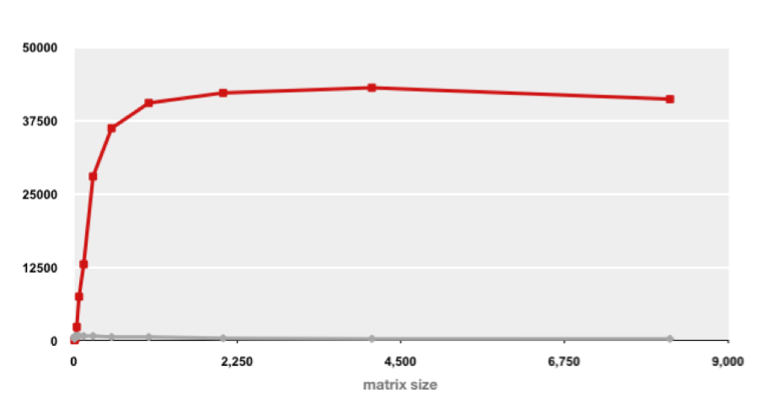
Example Matrix Multiplication
Saint Louis University
Matrix-Matrix Multiplication (MMM) on 2 x Core 2 Duo 3 GHz (double precision)
Gflop/s
Best code (K. Goto)
160x
Triple loop
Standard desktop computer, vendor compiler, using optimization flags
Both implementations have exactly the same operations count (2n³)
What is going on?

Slide 20
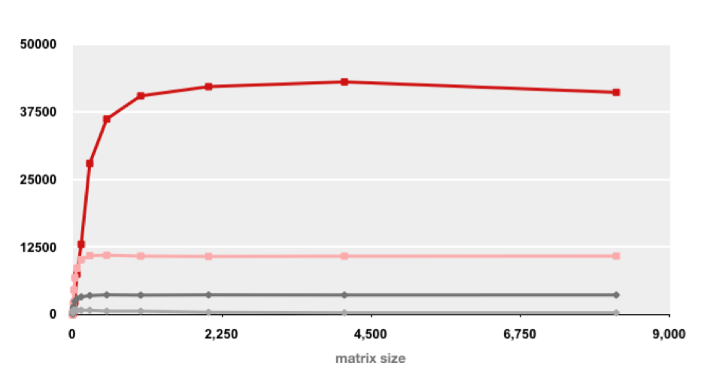
MMM Plot: Analysis
Saint Louis University
Matrix-Matrix Multiplication (MMM) on 2 x Core 2 Duo 3 GHz
Gflop/s
Multiple threads: 4x
Vector instructions: 4x
Memory hierarchy and other optimizations: 20x
Reason for 20x: Blocking or tiling, loop unrolling, array scalarization, instruction scheduling, search to find best choice
Effect: fewer register spills, L1/L2 cache misses, and TLB misses

Slide 21
Great Reality #5: Computers do more than execute programs
Saint Louis University
They need to get data in and out
I/O system critical to program reliability and performance
Hard drives, SSDs, USB, CD/DVD, keyboards, mice, etc.
What’s important? Response time, latency, or throughput?
Large writes vs. Small (4Kb) writes
They communicate with each other over networks
Many system-level issues arise in presence of network
Concurrent operations by autonomous processes
Coping with unreliable media
Cross platform compatibility
Complex performance issues

Slide 22
Course Perspective
Saint Louis University
Most Systems Courses are Builder-Centric
Computer Architecture
Design pipelined processor in Verilog
Operating Systems
Implement large portions of operating system
Compilers
Write compiler for simple language
Networking
Implement and simulate network protocols

Slide 23
Course Perspective (Cont.)
Saint Louis University
This Course is more Programmer-Centric
Purpose is to show how by knowing more about the underlying system, one can be more effective as a programmer
Enable you to
Understand how C/C++ executes in hardware
Write programs that are more reliable and efficient
Incorporate features that require hooks into OS
E.g., concurrency, signal handlers
Not just a course for dedicated hackers
We bring out the hidden hacker in everyone
Imagine a zoologist that didn’t know biology or chemistry
Cover material in this course that you won’t see elsewhere

Slide 24
Course Website
Saint Louis University
Class Website: http://cs.slu.edu/~dferry/courses/csci2400
Detailed class information and policies
Full Schedule, including:
lecture topics and code examples
assignments
exam dates
All assignments posted on website
Most lecture slides posted on website
Class website is the official syllabus and takes precedence over anything that is said in slides or in class
SLU Blackboard
Blackboard is not used for this course

Slide 25
Textbook
Saint Louis University
Randal E. Bryant and David R. O’Hallaron,
“Computer Systems: A Programmer’s Perspective”, Third Edition (CS:APP3e), Prentice Hall, 2016
Textbook’s website: http://csapp.cs.cmu.edu
Recommend getting a hardcopy, since exams are often open book & notes
Laptops, tablets, etc. not allowed during exams
C reference textbook
“C Programming”
a free online reference text for C programming, that may prove beneficial for those who haven’t used C (or C++) before

Slide 26
Grading
Saint Louis University
Exams (50%)
mid-semester exams: 15% each
final 20%
Assignments (45%): approximately 7-9 assignments
Class Participation (5%)
for participation in hands-on work during class
Curving policy on website
Late Policy:
10% penalty for up to 24 hours late
20% penalty for up to 48 hours late
Penalty waived or accepted after 48 hours only at instructor’s discretion

Slide 27
Attendance and Class Guidelines
Saint Louis University
Attendance is at students’ discretion, but highly recommended
Questions and Participation highly encouraged
If you have a question or need clarification, it’s very likely that other students will likewise benefit from your question
Laptops / computers may be used during class
But NOT during exams

Slide 28
Policy for Collaborating on Assignments
Saint Louis University
Collaboration allowed, even encouraged, PROVIDED that:
you only discuss the problem, not the solution
students may help guide each other in the process of solving the problem, BUT each student MUST turn in their own answer
students MUST indicate who they collaborated with on their cover sheet

Slide 29
Cheating
Saint Louis University
What is cheating?
Sharing code or answers: copying, retyping, looking at, or supplying a file
Detailed coaching: helping your friend to write code or an answer, line by line
Copying code from previous course or from elsewhere on WWW
only allowed to use code supplied in class or on course website
must cite such code
What is NOT cheating?
Explaining how to use systems or tools
Helping others understand design issues or the process for solving a problem
Penalty for cheating:
Ranges, based on severity, from zero on assignment to being sent before Academic Honesty Committee
Records saved for all incidents of cheating
Detection of cheating:
Instructor is (unfortunately) extremely experienced at detecting cheating

Slide 30
Topic: Programs and Data
Saint Louis University
Topics
Assembly (and machine) language vs. High-level languagues (HLLs)
Instruction set architecture
CPU (core)
register file
processing units (ALU, FPU, etc.)
Types of instructions
arithmetic
logical
shifts and bit manipulation
memory
compares
branches and jumps
procedure calls & returns
Representation of variables, arrays and data structures

Slide 31
Topic: Computer Architecture
Saint Louis University
Topics
Fundamentals of Logic Design (gates & circuits)
Processor Organization
CPU (core) Organization
Fetch-Decode-Execute Cycle and Datapath Flow
Sequential (single-cycle) Datapath
Pipelined Datapath
purpose / benefit
data and control dependencies
hazards
bypassing / forwarding
branch prediction

Slide 32
Topic: Memory and the Memory Hierarchy
Saint Louis University
Topics
Data representation
Memory technology (disk vs. RAM vs. ROM vs. cache)
Loads & Stores (reads & writes)
Physical vs. Virtual memory
page tables, address translation, and TLB
how memory organized within a process
global vs. heap vs. stack memory
Cache memory
purpose / benefit
locality
how it works

Slide 33
Topic: Performance and Optimization
Saint Louis University
Topics
How simple modifications in assembly / machine code can dramatically affect execution time
Co-optimization (control and data)
Measuring time on a computer
Related to architecture, compilers, and OS

Slide 34
Welcome and Enjoy!
Saint Louis University

