Slide 1
File Systems
David Ferry CSCI 3500 – Operating Systems
Saint Louis University St. Louis, MO 63103

Slide 2
Recall - Disks
A disk (flash drive, etc.) is a large contiguous array of blocks:
Q: How does the file system translate a variable-sized file into a collection of blocks?
Q: How are the read() and write() operations supported?
 |  |  |  |  |  |  |  |  | …
512 bytes

Slide 3
Contiguous Allocation
Again! Recall contiguous allocation of memory.
Filesystem associates each file name with a starting block and a file length, stored in some efficient data structure.
+ High throughput
– Need to specify size of file at creation time
– Hard to modify file size
– Fragmentation
Still used in things like CD/DVD ROMs
A | A | A |  | B | B | C | C | C | …
File A
File B
File C

Slide 4
First Notion of Fragmentation
Under contiguous allocation there can be little “holes” on the disk that are only one or two blocks long as there were with contiguous allocation of process memory.
You could have many free blocks and a lot of free space on the drive, but if it’s all tied up in little holes we couldn’t allocate a large file.
These are less problematic than our holes from memory allocation, because they can’t be arbitrarily small.
A | A | A |  | B | B | C | C | C | …
File A
File B
File C
Hard to use hole

Slide 5
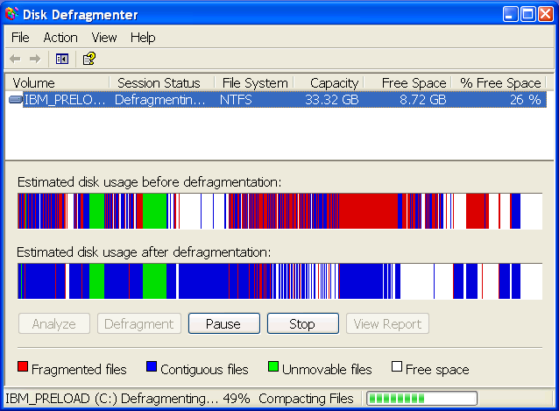
Second Notion of Fragmentation
“Traditional” notion: when a file is not contiguous on the drive and split into pieces
Hard drive seek time takes a non-negligible amount of time.
Having files all together means fewer read head movements.
SSDs still suffer from fragmentation, but to a much lesser degree.
There is OS and device overhead in having many small I/O operations vs a few large ones.
E.g. 3,500 MB/s sequential read vs 900 MB/s random read on a recent SSD review

Slide 6
Linked List Allocation
Contiguous allocation suffered from:
Couldn’t use small holes effectively
Couldn’t resize files effectively
Let’s drop the requirement that files are contiguous on disk…
OS stores a pointer to the first block of a file
Each block in the file stores a pointer to the next block
 | 3 |  | 2 |  | 4 | 1 | …
+ Holes don’t matter (remember fixed block size) + Files can grow or shrink – Need to seek to find the next block
=> Slow, esp. seeking large files
NULL
File Start

Slide 7
FAT – File Allocation Table
Can we have the flexibility of linked list allocation without having to seek through blocks of the hard drive to find data?
Soln: Store list structure in a table, not as a chain of pointers
0
1
2
3
4
5
6
FAT
5
1
-1
3
NULL
File Start
 | 3 |  | 2 |  | 4 | 1 | …
0 | 1 | 2 | 3 | 4 | 5 | 6 | …
OS still needs to store the starting block of each file
No need to seek through list poiners to find blocks
However, now we must maintain this data structure
FAT size scales linearly with size of disks
File Start

Slide 8
FAT Size
Q: How many entries are needed in the FAT?
A: One per block on the storage drive.
Q: How big is an entry in the FAT?
A: Big enough to address every block on the device.
For example, a 1GB disk with 1KB blocks:
Number of blocks = 2³⁰ / 2¹⁰ = 2²⁰ blocks = 2²⁰ FAT entries Bits per entry = 20 or 2.5 bytes per block
Size of FAT = 2²⁰ * 2.5 bytes = 2.5 megabytes

Slide 9
FAT Size 2
Not bad for a 1GB disk, what about a 1TB disk?
For example, a 1TB disk with 1KB blocks:
Number of blocks = 2⁴⁰ / 2¹⁰ = 2³⁰ blocks = 2³⁰ FAT entries Bits per entry = 30 or 3.75 bytes per block
Size of FAT = 2³⁰ * 3.75 bytes = 3.75 gigabytes
All of which needs to be stored on disk and stay in RAM for efficient operation.
For this reason the FAT approach is not used for large disks today- generally the limit is 32GB.

Slide 10
Indexing Large Drives - inodes
Linked list allocation is extensible, and FAT allocation is efficient: how can we get both attributes at once?
An inode is a collection of pointers
Some are pointers to file data
Some are pointers to other pointers
If a file can be described using only the data pointers in the top-level table, then we are done.
If not, we use indirect pointers.
inode
Data Block Ptr 1
Data Block Ptr 2
Data Block Ptr 3
Data Block Ptr 4
Indirect Ptr
Indirect Ptr
Indirect Ptr

Slide 11
inode Pointer Structure
inode
Data Ptr 1
Data Ptr 2
…
Data Ptr 12
Single Indirect
Double Indirect
Triple Indirect
Data Ptr 1
Data Ptr 2
…
Data Ptr 128
Data Ptr 1
Data Ptr 2
…
Data Ptr 128
Pointer Block 1
Pointer Block 2
…
Pointer Block 128
Data Ptr 1
Data Ptr 2
…
Data Ptr 128
Top level indexes 12 data blocks
Single indirect indexes 128 data blocks
Double indirect indexes 128² = 16K data blocks
Triple indirect indexes 128³ = 2M data blocks

Slide 12
inode File System
Top level inodes are stored in a big table on drive and created at filesystem creation time
The total number of inodes is limited on traditional systems, it’s possible to run out of inodes before you run out of drive space…
Single indirect pointer is a pointer to a hard drive block- e.g. if the HD block is 1024B and the pointer size is 48 bits, that’s room for 170 single indirect pointers
Double and triple indirect pointers follow the same pattern, but with two or three chained pointers to hard drive blocks
Single, double, and triple indirect blocks don’t need to be created if the file is small
Attributes data is stored in the top level inode

Slide 13
inode Performance
Access time is commensurate with file size- small files are fast, large files are slow
Can access blocks 1-12 with one drive access to get the top level inode
Can access blocks 13-140 with two drive accesses
Can access blocks 141-16,524 with three drive accesses
Can access triply indirect blocks with four drive accesses
Storage size is commensurate with file size- small files have small overhead, large files have more (but still small)
Files that fit in blocks 1-12 only need the top level inode, which is typically around 128 bytes or less
Files that need up to 140 data blocks allocate a single extra hard drive block for single indirect pointers, less than 1% overhead
Files that need up to 16,524 data blocks allocate up to 130 extra hard drive blocks for single and double indirect pointers, still < 1% overhead
File blocks don’t need to be contiguous, as each data block has its own pointer

Slide 14
File System Conclusion
Contiguous
Simple, high throughput
Inflexible for file placement and resizing
Linked List
Simple, flexible for file placement and sizing
Slow for large files, accessing block 20 requires 20 hard drive seeks
FAT
Flexible for placement and sizing, fast (one seek per access)
Large FAT size limits usefulness for large volumes
inode
Flexible for placement and sizing, fast according to file size, storage overhead grows according to file size

