Slide 1
Scheduling Classes and Real-Time Scheduling in Linux
David Ferry, Chris Gill
CSE 522S - Advanced Operating Systems
Washington University in St. Louis
St. Louis, MO 63143

Slide 2
Scheduling Classes
Multiple schedulers are implemented as different scheduling classes.
Normal:
SCHED_NORMAL: regular, interactive CFS tasks
SCHED_BATCH: low priority, non-interactive CFS tasks
SCHED_IDLE: very low priority tasks
Real-time:
SCHED_RR: round-robin
SCHED_FIFO: first-in, first-out
SCHED_DEADLINE: earliest deadline first

Slide 3
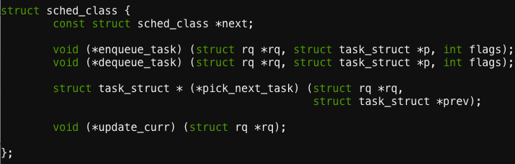
struct sched_class
A few major functions:
Other functions:
Task migration
Task yielding
Task state queries
Other utilities

Slide 4
Current Scheduling Classes and Ordering
stop_sched_class //for halting processors
dl_sched_class
rt_sched_class
fair_sched_class
idle_sched_class
Declared in /kernel/sched/sched.h

Slide 5
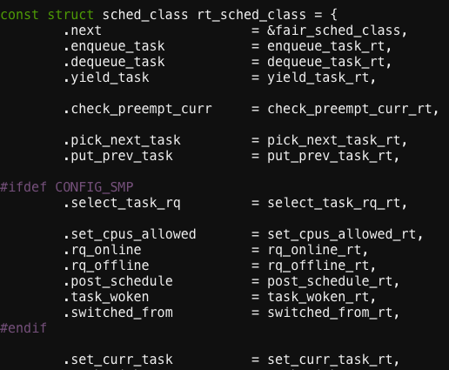
Example sched_class Definition
From:
/kernel/sched/rt.c

Slide 6
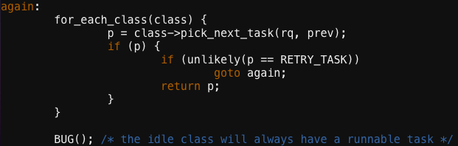
How the Next Runnable Task is Picked
Function pick_next_task() from /kernel/sched/core.c
Have all scheduling classes try to pick a new task
The last class, SCHED_IDLE, should always return some idle task

Slide 7
Real-Time Scheduling
Real-time tasks execute repeatedly (usually are periodic) under some time constraint
Task
Task
Task
Time
0ms
5ms
10ms
E.g., a task is released to execute every 5 msec,
and each invocation has a deadline of 5 msec
Separate priority range from nice:
Priorities range from 1 (low) to 99 (high)

Slide 8
Real-Time OS Support
Goal is to achieve predictable execution:
Sources of uncertainty (and solutions):
Scheduling preemptions (real-time scheduling)
Interrupts (can mask interrupts)
Migrations (can pin tasks to cores)
OS latency & jitter (RT_PREEMPT patch set)
Ideal:
Real world:
Preempt
Migrate

Slide 9
SCHED_RR
Round-robin scheduling
Among tasks of equal priority:
Rotate through all tasks
Each task gets a fixed time slice
Cannot run if higher priority tasks are runnable
Task 1
Task 2
Task 3
Task 1
Task 2
Task 3
Task 1
Task 2
Task 3
Time

Slide 10
SCHED_FIFO
First-in, First-out scheduling
The first enqued task of highest priority executes to completion
A task will only relinquish a processor when it completes, yields, or blocks
Task 1
Task 2
Task 3
Time

Slide 11
SCHED_DEADLINE
Earliest Deadline First (EDF) scheduling
Whichever task has next deadline gets to run
Theory exists to analyze such systems
Linux implements bandwidth reservation to prevent deadline abuse
Task 1
Deadline: 5 Exec time: 4
Task 2
Deadline: 12 Exec time: 3
Task 3
Deadline: 8 Exec time: 2
Task 1
Task 2
Task 3
Time 0
5
8
12

