Slide 1
Layer 3 – The Network Layer
David Ferry CSCI 3500 – Operating Systems
Saint Louis University St. Louis, MO 63103

Slide 2
Recall: 7-Layer OSI Model
Last time: The data-link and physical layers allow communication between two directly connected machines
Today: Suppose machine A is connected to B, and B is connected to C… how can machines A and C communicate?
Application
Presentation
Session
Transport
Network
Data-Link
Physical
Application to Application
Application
Presentation
Session
Transport
Network
Data-Link
Physical
Protocol to Protocol
Entity to Entity
Process to Process
Interface to Interface
Hardware to Hardware
Physical Connection

Slide 3




The Network

Slide 4
Routing in a Network
C
A
1
3
2
3
1
B
2
E
D
Each device has one or more network interfaces
Routing is deciding which network interface to send a communication over, with the intent of getting it to a final destination
The routing decision is a local decision

Slide 5
Layer 3 Protocols: IPv4 and IPv6
IP = “Internet Protocol”
Purpose is to answer that routing question- how does data get to a distant remote machine?
All hosts are identified by an IP Address
IPv4 Addresses – 4 bytes expressed as decimal octets
2³² total addresses
E.g. 165.134.107.80 (hopper.slu.edu)
SLU owns all of 165.134.XXX.XXX
Each octet has possible values 0-255
IPv6 Addresses – 16 bytes expressed as hexadecimal octets
2¹²⁸ possible addresses
E.g. fe80::c083:ecff:fe0a:1538 (zero-value octets omitted at :: )

Slide 6
IPv4 vs IPv6
IPv4 and IPv6 – most notable difference is address space size and representation
32 bits vs 128 bits
Some early adopters have huge address spaces, which ate up a lot of the IPv4 address space early on (see https://xkcd.com/195/)
But IPv6 also has improvements to efficiency and security as well
Currently in practice almost all networking hardware/software supports both IPv4 and IPv6

Slide 7
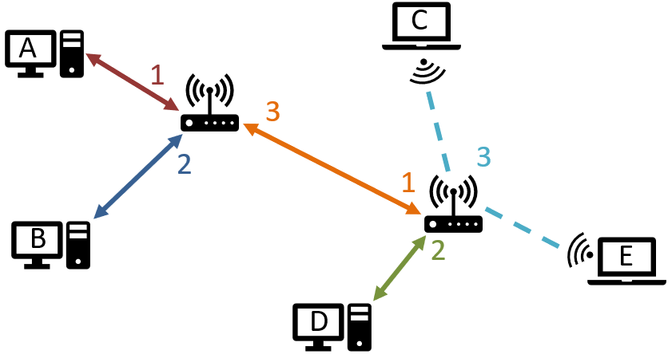
The Routing Question
Q: Given an IP address destination, how does a packet get there?
Recall that routing decisions are local!
Q: Given an IP address destination, which interface do I send it out over?

Slide 8
Routing Tables
Each machine maintains its own routing table.
Creates a mapping between IP address destinations and output interfaces
Router selects the output interface based on the longest prefix match in the routing table
E.g. the third rule matches both addresses 192.168.0.10 and 192.168.0.11 to the 31st bit
Many routing tables can contain other info as well: e.g. cost
Destination | Network Mask | Interface | Cost
0.0.0.0 | 0.0.0.0 | eth0 | 1000
192.168.0.0 | 255.255.0.0 | wlan0 | 10
192.168.0.10 | 255.255.255.254 | eth1 | 1
165.134.13.254 | 255.255.255.255 | eth2 | 1

Slide 9
Routing Example
192.168.1.100
C
A
192.168.0.0
192.168.0.10
192.168.1.101
B
192.168.1.0
E
192.168.0.11
D
192.168.1.10
Suppose that computer B wants to contact computer E, and already has its destination address of 192.168.1.101

Slide 10
Routing Example
192.168.1.100
C
A
192.168.0.0
192.168.0.10
eth0
192.168.1.101
B
192.168.1.0
E
192.168.0.11
D
192.168.1.10
Machine B Routing Table
Destination | Mask | Interface
0.0.0.0 | 0.0.0.0 | eth0
192.168.0.11 | 255.255.255.255 | loopback

Slide 11
Routing Example
192.168.1.100
C
A
192.168.0.0
192.168.0.10
eth0
eth1
eth2
192.168.1.101
B
192.168.1.0
E
192.168.0.11
192.168.0.0 Routing Table
D
Destination | Mask | Interface
0.0.0.0 | 0.0.0.0 | eth2
192.168.0.10 | 255.255.255.255 | eth0
192.168.0.11 | 255.255.255.255 | eth1
192.168.1.0 | 255.255.255.0 | eth2
192.168.1.10

Slide 12
Routing Example
192.168.1.100
C
A
192.168.0.0
192.168.0.10
wlan0
eth0
192.168.1.101
B
192.168.1.0
E
eth1
192.168.0.11
192.168.1.0 Routing Table
Destination | Mask | Interface
192.168.1.10 | 255.255.255.255 | eth1
192.168.0.0 | 255.255.255.0 | eth0
192.168.1.100 | 255.255.255.255 | wlan0
192.168.1.101 | 255.255.255.255 | wlan0
192.168.0.10 | 255.255.255.255 | eth0
D
192.168.1.10

Slide 13
Other Elements of Internet Protocol
Fragmentation: Divides large communications into packets of (typically) 64K or less.
Reassembles (de-fragments) large communications on the receiving end.
IPv6: Encrypts/decrypts packets
You can do this with IPv4 as well, but it was built on top of IPv4, so was not universally available. The IPv6 standard requires encryption, which means that all IPv6 capable devices must also support encryption.

Slide 14

The Missing Piece
OK- so IP routing is done locally via routing tables… how do we actually get those routing tables in the first place?
Small networks – can be built by hand
Some networks – can be done by standard
E.g. Home networks almost always look like this:
Large networks – done by network engineers with algorithms
E.g. Border Gateway Protocol (BGP) allows large internet providers to cooperate and declare what IP addresses they can route to
ISP

Slide 15



The Internet
Really just a big collection of routers and routing tables
Vaguely hierarchical because it’s easier to manage
Internet Backbone
Charter Core Router
Verizon Core Router
Charter Mid-level Router
Verizon Mid-level Router
Your Home
Friend’s Home

Slide 16
Some Routing Tools
Routing information is public to a degree
Windows:
ipconfig – get current machine’s IP information
nslookup – resolve domain names
ping – see if you can get a response from a server
tracert – trace path to host
Linux:
ifconfig – get current machine’s IP information
host – resolve domain names
ping – see if you can get a response from a server
traceroute – trace path to host
route – see routing tables

