Slide 1
Kernel Tracing
David Ferry, Chris Gill
CSE 522S - Advanced Operating Systems
Washington University in St. Louis
St. Louis, MO 63143

Slide 2
Class Notes
Piazza page:
Search for CSE 522 under classes
Will become a class FAQ for subsequent semesters
Extra readings on class page:
Not always intended to be read in full
Won’t have specific test questions from these

Slide 3
Debugging Linux
Debuggers exist:
gdb
kgdb
But have serious limitations:
Full debugging requires specialized, two machine setup
Limited ability to do execution stepping
Can still do breakpoints
Can still inspect memory contents
Can still inspect call stack
Instead, tracing is used.

Slide 4
Simplest Tracer: printk()
printk() prints information to the system log
Messages stored in circular buffer
Can be read with dmesg
Eight possible log levels (set with dmesg –n)
Example:
printk(KERN_ALERT “bad thing %ld”, bad_thing);
Uses same format as printf()
Note there is no comma after log level

Slide 5
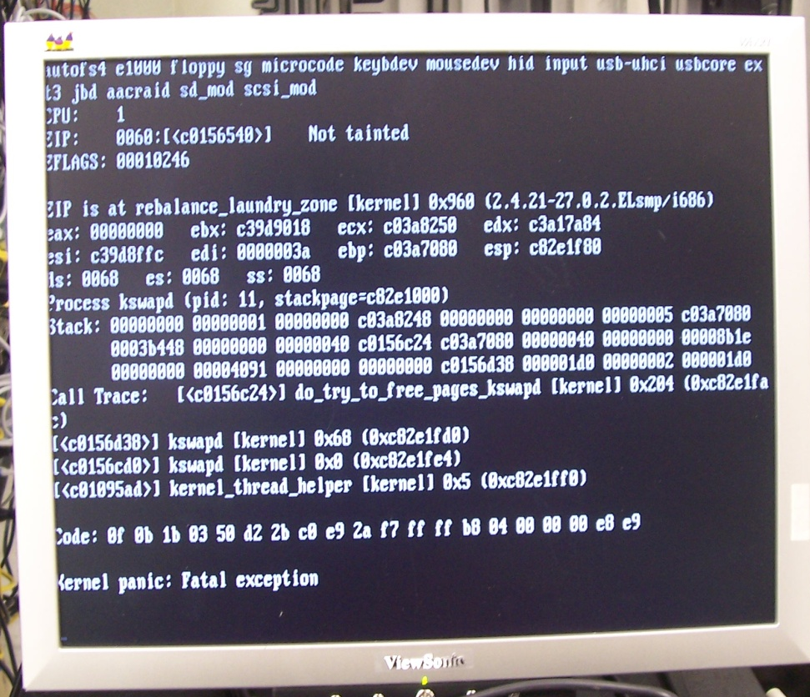
Kernel Oopses and Panics
A kernel panic is unrecoverable and results in an instant halt
An oops communicates something bad happened but the kernel tries to continue executing
An oops means the kernel is not totally broken, but is probably in an inconsistent state
An oops in interrupt context, the idle task (pid 0), or the init task (pid 1) results in a panic
"Kernel-panic" by Kevin
http://flickr.com/photos/kevincollins/74279815/

Slide 6
Ftrace – the Function Tracer
Not just functions! Many features:
Event tracepoints (scheduler, interrupts, etc.)
Trace any kernel function
Call graphs
Kernel stack size
Latency tracing
How long interrupts disabled
How long preemption disabled
Has a user interface called trace-cmd
Very nice graphical trace browser called Kernelshark

Slide 7
Ftrace Internals
When tracing is enabled, the kernel maintains:
Per-CPU ring buffer for holding events
Per-CPU kernel thread that empties ring buffer
If readers can’t keep up, data is lost
Tracepoints in kernel:
Kernel maintains list of tracepoint locations
Locations normally converted to no-ops (ftrace_make_nop())
Trace code is runtime-patched into kernel code when activated (ftrace_make_call())

Slide 8
Userspace Tracing: Strace
Allows one userspace process (tracer) to inspect the system calls made by another thread (tracee).
Tracer calls ptrace() on tracee
Tracee halts at every system call, system call return, and signal (except SIGKILL)
Tracer records info, and releases tracee to continue
Note:
Tracing is per-thread
Seriously warps program timings

