Slide 1
Scheduling of Non-Real-Time Tasks in Linux (SCHED_NORMAL/SCHED_OTHER)
David Ferry, Chris Gill
CSE 522S - Advanced Operating Systems
Washington University in St. Louis
St. Louis, MO 63143

Slide 2
Traditional Scheduling Concerns
Throughput: Maximize tasks finished per time
Latency: Minimize time between creation and completion
Response time: Minimize time between wakeup and execution
Starvation: All tasks guaranteed some processor time
Fairness: All tasks given equal processor time
Overhead: Multicore scalability, efficiency
A scheduler must compromise!

Slide 3
Scheduler Target Audiences
Pure Compute Bound (e.g. while(true) )
Wants to keep cache hot
Pure I/O Bound (e.g. always waits for keyboard)
Wants fast response
Server
Minimize outstanding requests (throughput & latency)
Desktop
Maximize interactivity
Heterogeneous workload
Real-time
Minimize response time
Guarantee timeliness of high priority tasks

Slide 4
Big Two Scheduling Operations
Which task should run next?
How long should it run (timeslice)?

Slide 5
O(1) Scheduler
Per-CPU runqueue, contains two priority arrays
Active array feeds processor
When tasks exhaust their timeslice they move to expired array, if blocking they stay active
When active array is empty we pointer swap
Priority arrays give highest priority task in constant time
Timeslice is scaled to (priority / priority_range)
which results in inconsistent timeslices
Active
RQ
Expired

Slide 6
O(1) Scheduler
Per-CPU runqueue, contains two priority arrays
Active array feeds processor
When tasks exhaust their timeslice they move to expired array, if blocking they stay active
When active array is empty we pointer swap
Priority arrays give highest priority task in constant time
Timeslice is scaled to (priority / priority_range)
which results in inconsistent timeslices
Active
RQ
Expired

Slide 7
Normal Task Priorities
Based on niceness levels
Levels range from [-20, 19], default is 0
“More nice” => “Lower Priority” (higher)
“Less nice” => “Higher priority” (lower)
Can be adjusted heuristically for interactive and CPU bound tasks

Slide 8
Problems with O(1) Scheduler
Inconsistent timeslices:
Nice priorities determine fixed timeslice length
Equal priority tasks equally share a processor
Two tasks of 0 priority might switch every 100ms
Two tasks of 19 priority might switch every 5ms
Fixed timeslices cause problems:
Large numbers of high priority interactive tasks starve CPU bound tasks
Large numbers of CPU bound background tasks cause large latencies for interactive tasks

Slide 9
Completely Fair Scheduler (CFS)
Goal: All tasks receive an equal proportion of processor time.
On a system with N tasks, each task should be promised 1/N processor time
I.e. “completely fair”
Allows interactive tasks to run at high priority while sharing CPU equally between CPU bound tasks.
Abandons notion of fixed timeslice and varying fairness for fixed fairness and varying timeslice

Slide 10
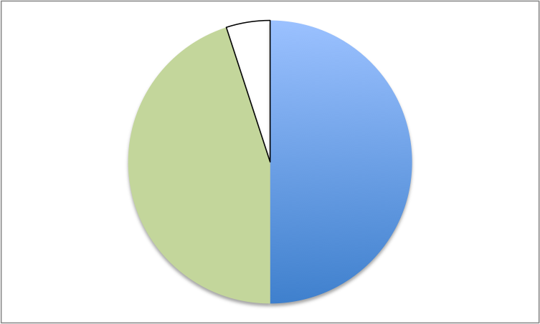
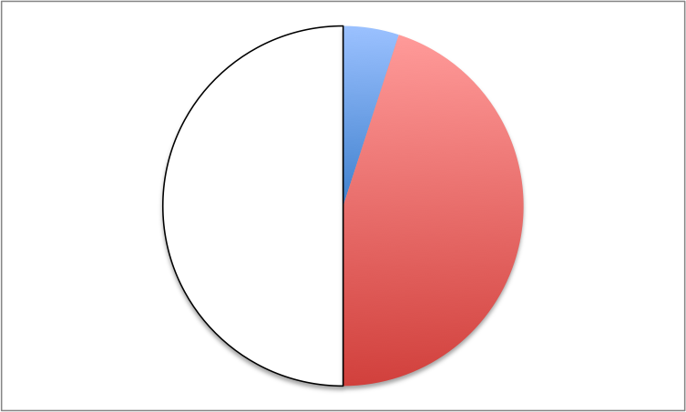
CFS Example
Consider a video encoder and a text editor
Video encoder
Entitled proportion: 50%
Text editor
Entitled proportion:50%
Used
Unused
Over-use
Actual proportion: 95%
Has low priority.
Actual proportion: 5%
Has high priority when it wants to run.

Slide 11
Virtual Runtime
Virtual runtime: the actual running time of a process weighted by its priority, stored as nanoseconds value
If all tasks have nice priority 0, their virtual runtime is equal to their actual runtime
If some task has nonzero priority, then:
where weights are determined by nice priority.
Updated in update_curr() in fair.c

Slide 12
CFS Scheduling Operations
Which task?
Pick task with lowest virtual runtime
How long to run?
Keeps virtual runtime as fair as possible, so tasks get swapped out each tick
Uses minimum tick length to avoid thrashing

Slide 13
CFS Run Queue Implementation
Needs to pick the task with shortest virtual runtime in constant time.
Per-CPU run queues stored as red-black trees (self-balancing binary search tree)
Task with least virtual runtime is leftmost node
Tasks are charged for a whole timeslice even if its not used
6
3
8
1
5
7
9

