Slide 1
Read-Copy-Update Synchronization in the Linux Kernel
David Ferry, Chris Gill
CSE 522S - Advanced Operating Systems
Washington University in St. Louis
St. Louis, MO 63143

Slide 2
The Synchronization Problem
A common kernel problem:
Multiple threads share a data structure.
Some are reading
Some are writing
Reads and writes should not interfere!
Shared
data

Slide 3
Synchronization Design Tradeoffs
All synchronization methods need to balance the needs of readers and writers:
Reads tend to be more common
Lots of reads Few writes
Balanced Reads and writes
Lots of writes Few reads
Synchronization can prevent concurrency…
Reader/writer locks
Mutual exclusion
Or it can allow concurrency at the expense of overheads:
Lock free / wait free algorithms
Transactional memory

Slide 4
RCU Philosophy
Under RCU:
Concurrent reads are synchronization-free (which means scalability!)
Writers must guarantee that all readers only ever see a consistent view of memory
Similar to a publish-subscribe model
Before the details, let’s look at the API…

Slide 5
RCU Writer API
Even if pointer write is atomic:
struct foo *ptr = NULL;
p = kmalloc(...);
p->A = 1;
p->B = 2;
p->C = 3;
ptr = p;
Overall code is not safe!
Compiler may re-order lines 3-6

Slide 6
RCU Writer API
RCU encapsulates memory fences
struct foo *ptr = NULL;
p = kmalloc(...);
p->A = 1;
p->B = 2;
p->C = 3;
rcu_assign_ptr(ptr,p);
rcu_assign_ptr method publishes P

Slide 7
RCU Reader API
Consider reading a data structure:
p = ptr;
if (p != NULL)
do_something(p->A, p->B, p->C);
This is also not safe! The values of A, B, and C could change between reads!

Slide 8
RCU Reader API
Consider reading a data structure:
rcu_read_lock();
p = rcu_dereference(ptr);
if (p != NULL)
do_something(p->A, p->B, p->C);
rcu_read_unlock();
rcu_dereference() can be thought of as subscribing to a specific, valid version of ptr
lock/unlock defines RCU critical section

Slide 9
RCU Encapsulation
Note, RCU semantics can be encapsulated for specific data structures:
rcu_list_add()
rcu_for_each_read()
But not:
rcu_for_each_write()
RCU does not allow for concurrent writes!

Slide 10
What does RCU actually do?
RCU Read Critical Section
RCU Read Critical Section
RCU Read Critical Section
RCU Read Critical Section
RCU Read Critical Section
RCU Read Critical Section
RCU Read Critical Section
RCU Read Critical Section
Creation
Removal
Grace Period
Reclamation
Time

Slide 11
wait_for_readers()
A critical implementation detail is how to wait for outstanding reads.
Explicit: reference counting
reader locks
Implicit:
Linux context switch
RCU Read Critical Section
RCU Read Critical Section
RCU Read Critical Section
RCU Read Critical Section
RCU Read Critical Section
Creation
Removal
Grace Period
Reclamation
Time

Slide 12
RCU Linked List - Delete
1. Want to delete node D
H
D
Ptr
2. Atomically assign
pointer over D
H
D
Ptr
3. D is safe to delete
when all reader
locks are done
H
D

Slide 13
RCU Linked List - Update
1
4
Q
M
H
H
P
P
2
Q
5
Q
M
H
H
P
3
Q
M
6
M
H
H
P

Slide 14
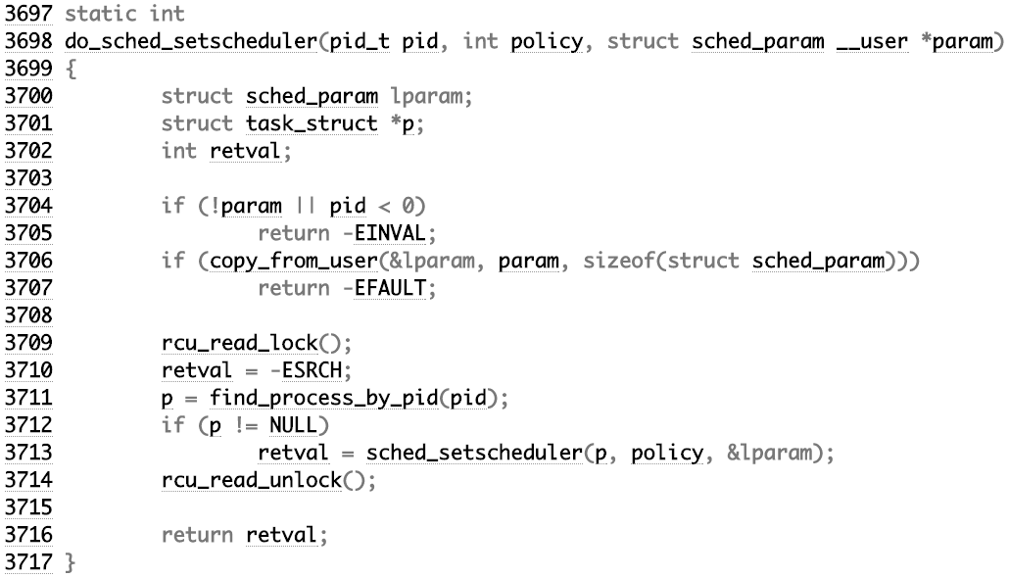
RCU usage in sched/core.c
RCU-iterates over list of processes
Writes back to RCU-protected structure

