Slide 1
Introduction to Operating Systems
David Ferry CSCI 3500 – Operating Systems
Saint Louis University St. Louis, MO 63103

Slide 2
Why Take This Course?
Knowledge
Systems programming using the OS
Become an avid consumer of OS mechanisms
Jumping off point to higher systems courses
History
See the evolution of computing
Understand different computing paradigms
Practice
Programming intensive course
Understand your own ability before you start

Slide 3
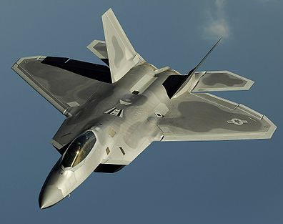
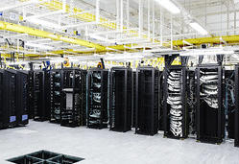
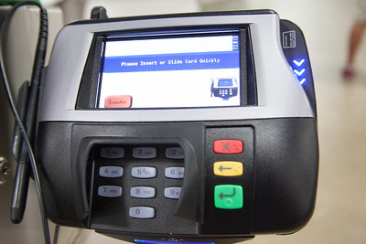
Knowledge
“Systems programming” vs. regular programming
What makes the computer hardware usable
cstdlib, compilers, shell, etc…
Be an avid consumer of the system
Lots of great features we don’t normally use
Understand where different capabilities lie
One hallmark of systems work is in satisfying non-functional requirements: timing, scalability, security, etc.
Image: US Air Force Public Domain
Image: CommScope on Flickr
Image: www.bluecoat.com

Slide 4
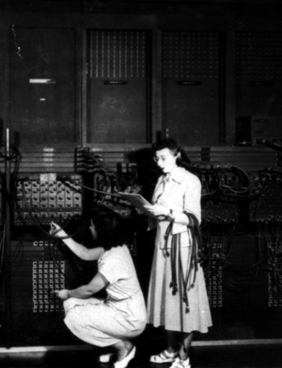
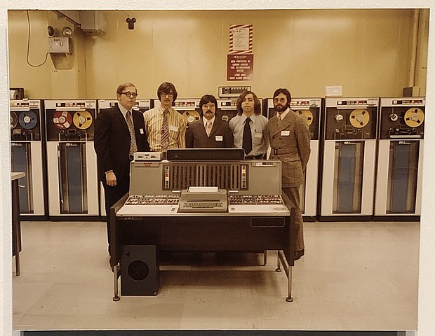
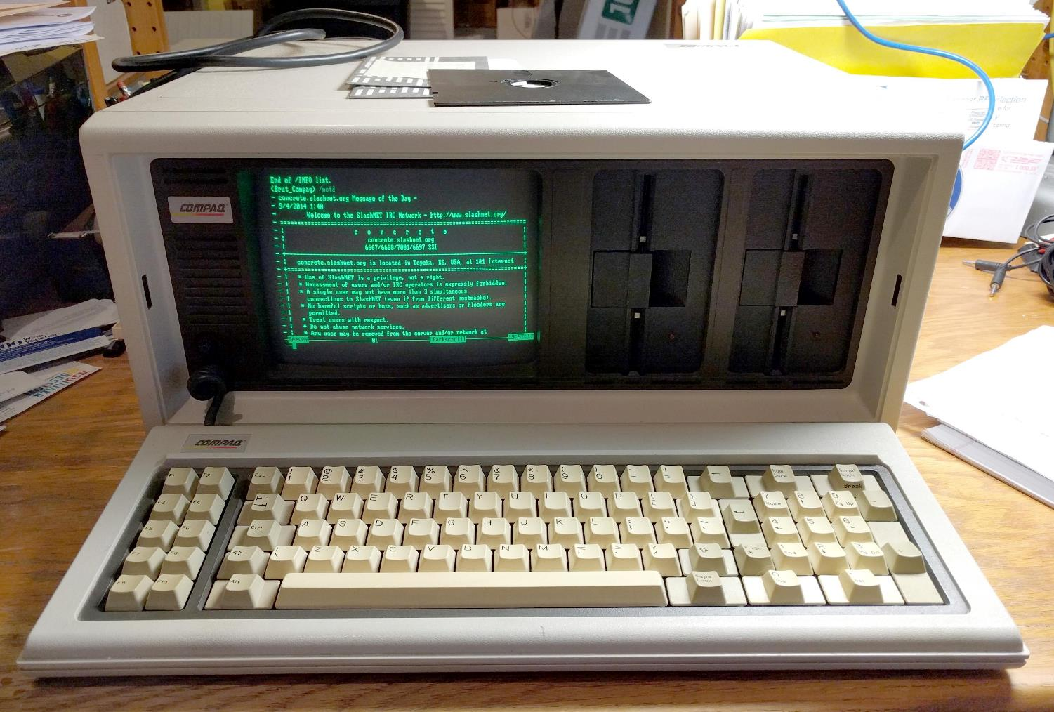
History – Evolution Over Time
History of computing: getting the machine to do what you want
Early computers programmed by hand
Once setting up a program became easy the challenge was operating the machine
Modern machines run many programs for us simultaneously
ENIAC - Image: US Army Public Domain
Image: Public Domain
Image: mbbrutmann on Reddit

Slide 5
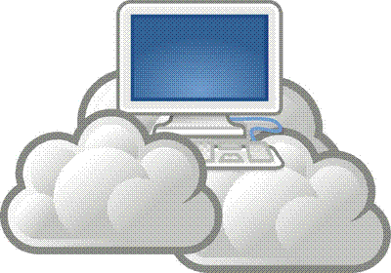
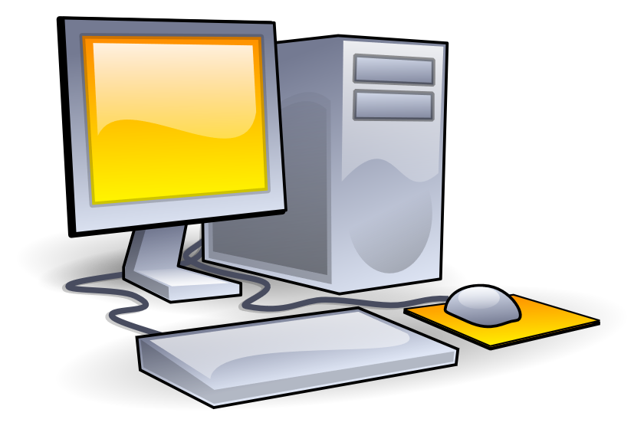
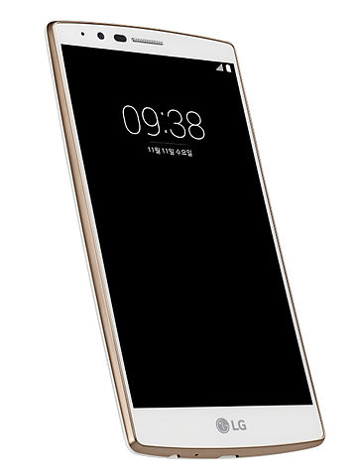
History – Evolution of Hardware
OSes evolve in response to demand
Changes in computer hardware
PC’s, mainframes, data centers, cloud computing, embedded systems, etc.
2. The way we use computers
Networking, desktop vs. laptop vs. portable, GPS, etc.
Image: Πrate on Wikimedia Commons
Image: CommScope on Flickr
Image: Public Domain on Wikimedia Commons
Image: LG Electronics on Wikimedia Commons

Slide 6
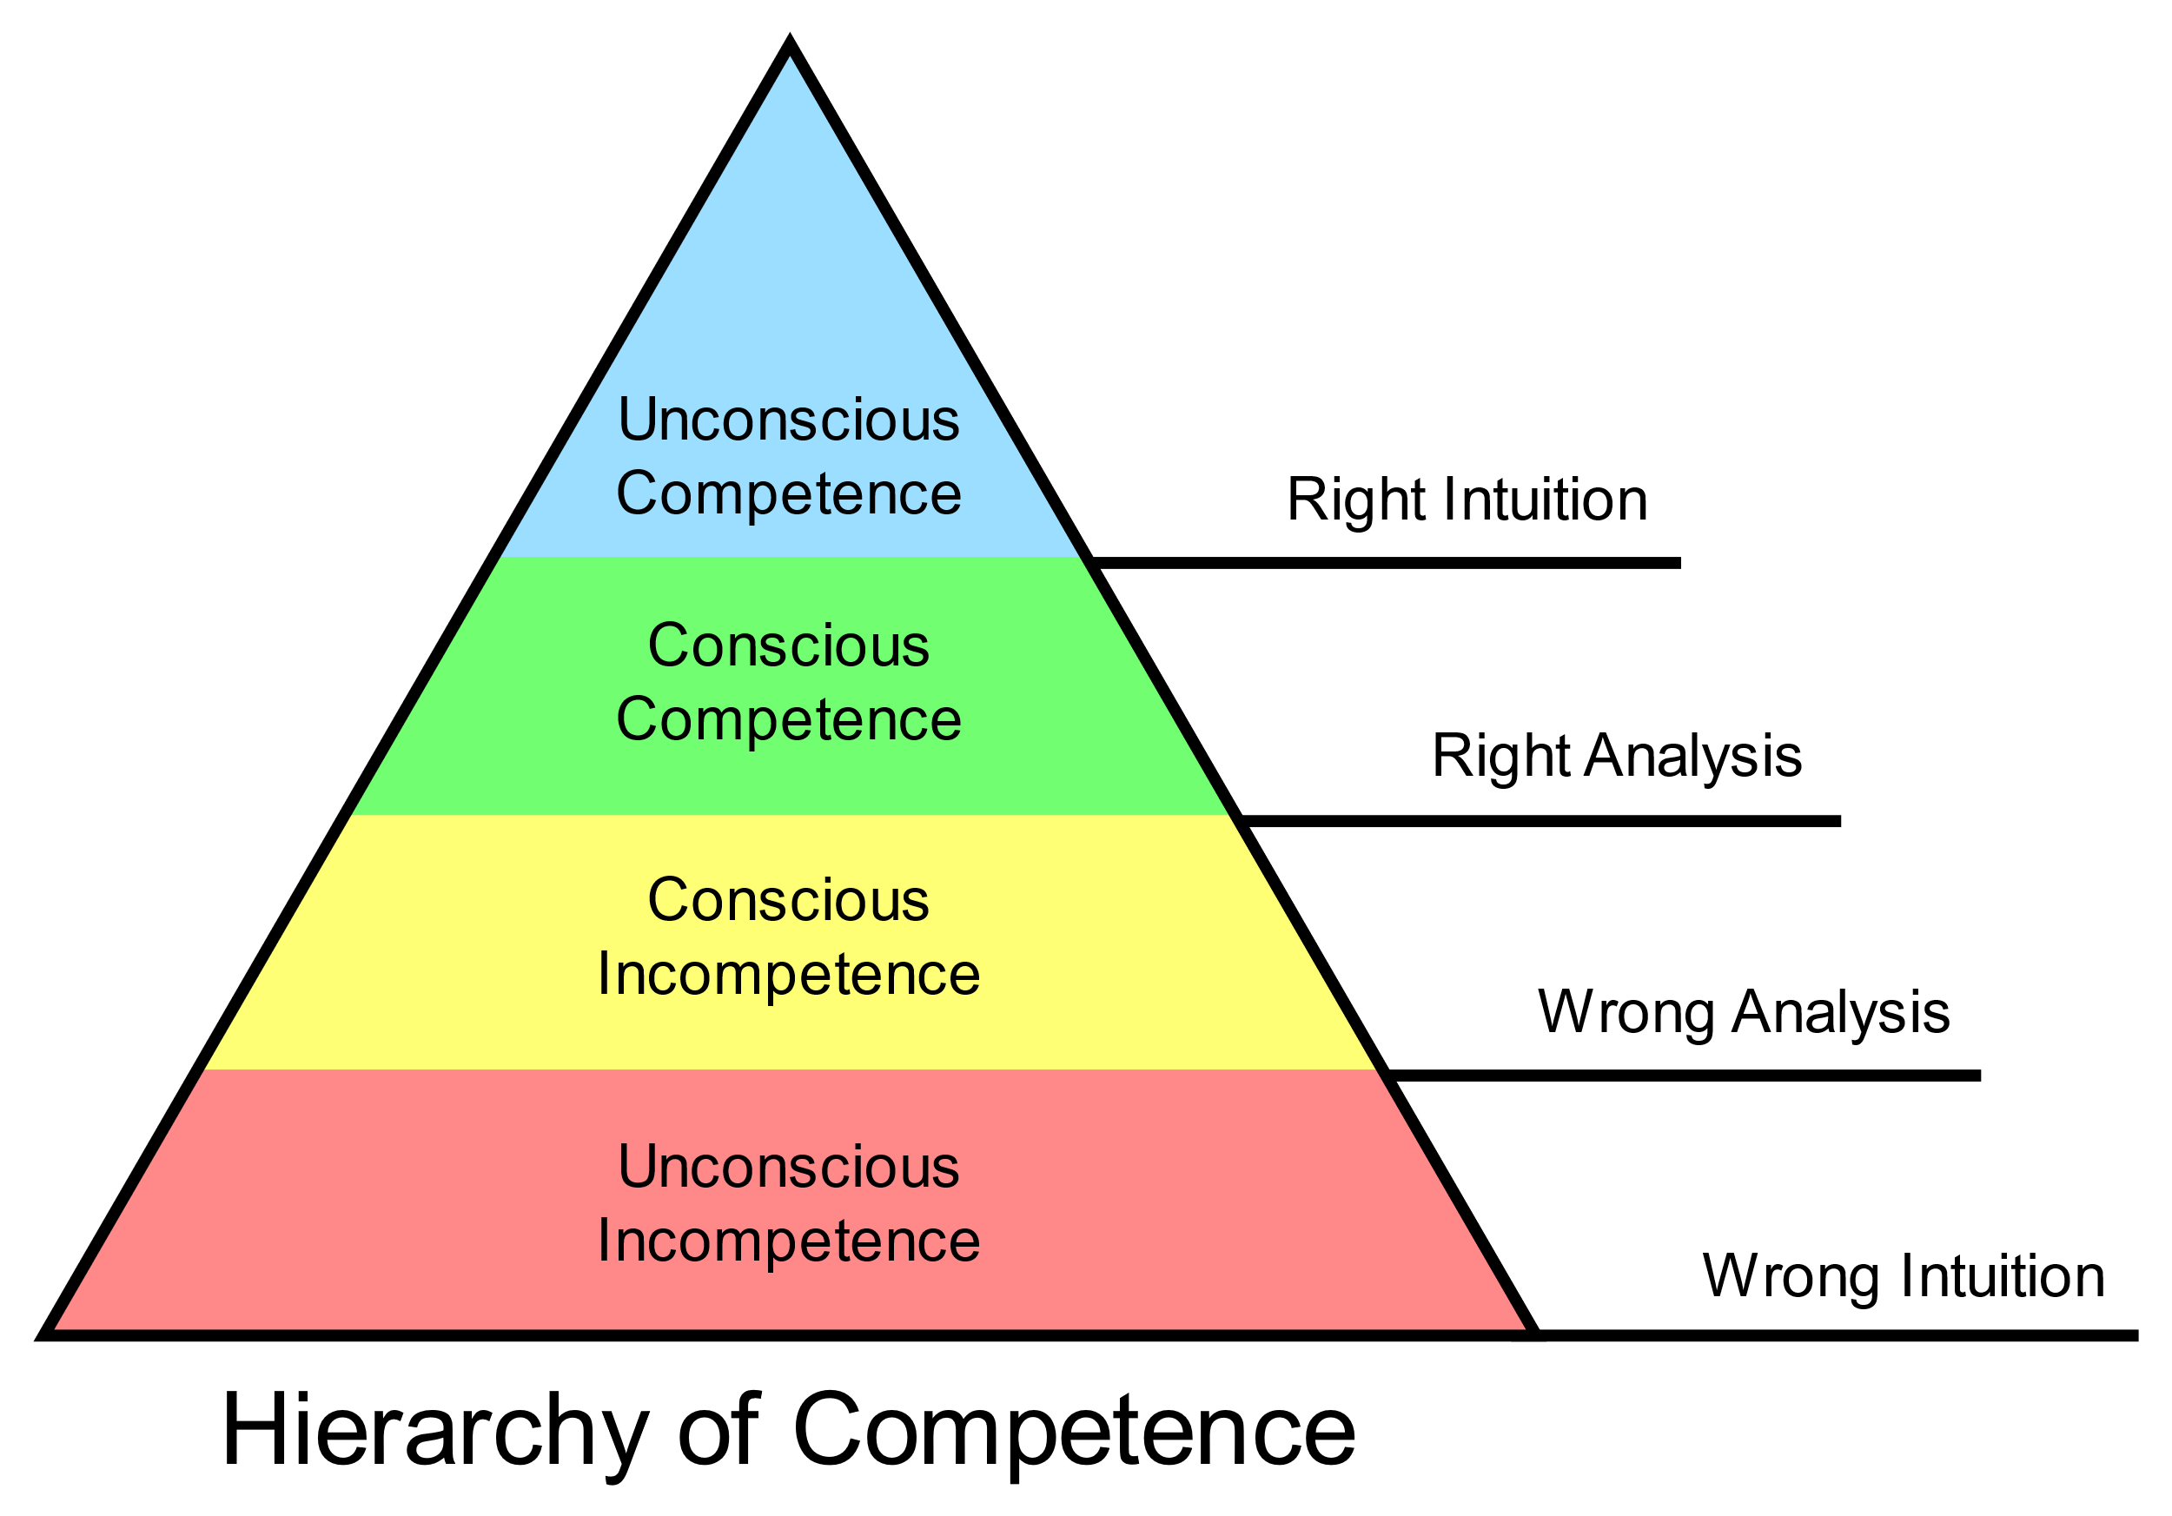
Practice
Practice allows you to understand your own ability
Goal is to go along the path from
“conscious incompetence” to “conscious competence”
My experience as undergrad:
Projects full of uncertainty as to whether I’d succeed or how far I could go
Sometime during grad school:
This project requires A, B, and C. I know A, I kind of know B, I don’t know C
Understanding your own ability before you start is a critical life and professional skill.
Image: TylzaeL on Wikimedia Commons

Slide 7
How This Course Approaches OS
Two basic types of OS courses:
Practical systems programming, with lecture focus on OS theory / practice (this course)
See better how the OS facilitates applications
Can touch a lot more systems topics
More relevant skill set
Build an OS from first principles (not us)
Focuses on nuts and bolts from boot to running first programs
Lots of details, some are not that important
Not a skill most of us will need

Slide 8
What is an Operating System?
Application
Middleware
(Optional)
System Libraries
OS Kernel
Sits between the hardware and all of the other software that runs on the system.
You are here.
Hardware

Slide 9
What is an Operating System?
The OS serves two basic functions:
Abstracts hardware
The OS provides a single, consistent and beautiful interface to different hardware devices
Different manufacturers (E.g. Intel vs. AMD) have different ways of doing things
The Intel Software Developer’s Manual for their CPUs is over 5000 pages
Many hardware devices serve the same purpose but have very different underlying technologies
E.g. files on hard drives vs. SSDs vs. DVD etc. are all opened and accessed in the same way

Slide 10
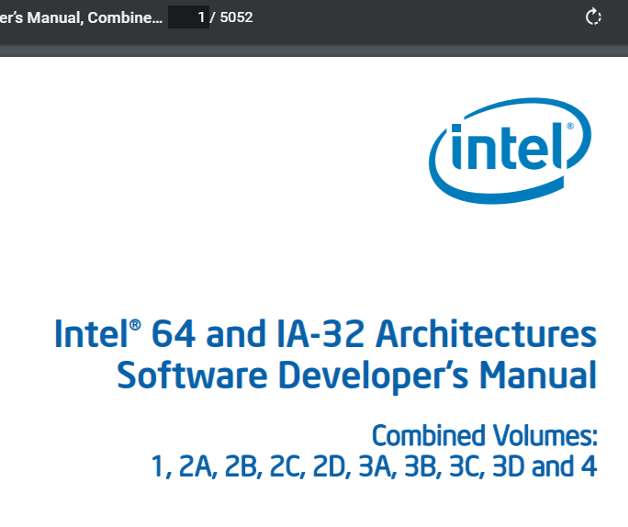
As of August 2020:

Slide 11
What is an Operating System?
The OS serves two basic functions:
Resource manager
Some resources need to be shared
HW resources: processor time, memory, disk drive read head, etc.
SW resources: Mouse/keyboard focus, terminal console output
Prioritization
It’s my hardware, I paid for it
Some programs are more important than others
Some programs may be malicious
Some users may not be aware they can do harmful things

Slide 12
The Modern Software Stack
Middleware – Can be a set of libraries specialized for a specific purpose.
Unity is a platform to build video games so that they “run anywhere” (smartphone, PC, browser, etc.)
OpenMP and Cilk Plus take an active role in managing parallel computing
System Libraries – Portable software libraries that exist above the OS
Standard C Library is cstdlib
Applications libraries for math, graphics, etc.
Provides an OS-independent user interface for programming and application development
OS Kernel – Provides a high level interface to the hardware and maps actions to hardware device drivers
Provides system calls as its fundamental interface
Application
Middleware
(Optional)
System Libraries
OS Kernel
Hardware

Slide 13
Different Scales of OSes
All OSes exist to make hardware functional
Mainframe (data centers or supercomputers)
1000’s of disks
1000’s of processors
Networked system of systems
Individual servers (e.g. hopper.slu.edu)
Many concurrent users
Protect system from users
Protect users from users
Responsiveness critical

Slide 14
Different Scales of OSes
Personal Computers
Must do everything pretty well
Games, media, browsing, videos, …
… often at the same time
Mobile Devices
Just as capable of PCs
Additional hardware such as cell radios/GPS
Battery life critical

Slide 15
Different Scales of OSes
Embedded OSes
Small, low power
Often battery sensitive
Special purpose hardware
E.g. flash/RAM memory
Special Purpose Systems (E.g. Real-Time)
Application specific, behavior and features depend on purpose
E.g. might need deterministic execution
E.g. might be safety critical
OSes for all these systems need to accomplish the same kinds of things, but may have very different considerations.

Slide 16
Topics for This Course
System Calls and the OS Interface
Processes
Threads
Race conditions, mutexes, atomicity
Scheduling
Memory Management, paging, TLB
Files and the File System
Networking, layers of the OSI model
A short week on Security (maybe – Fall 2020)

