Slide 1
Code Reviews
Kevin Scannell, David Ferry CSCI 5030 – Principles of Software Development
Saint Louis University St. Louis, MO 63103

Slide 2
Purpose
Everyone has blind spots, especially as creators
We can get attached to our own work
We have implicit biases
E.g. native English speakers vs. non-native speakers
We don’t like to redo or expand work
Deadline is looming, what do we do?
Performance eval is coming up, what do we do?
Diverse teams have members with different experiences and specialties
Testers, developers, QA, computer security, etc.
Studies show good code reviews can catch up to 60%-70% of code defects
Defects can be correctness problems, but also maintainability, style, inefficiencies, architecture problems…

Slide 3
Historic Code Reviews
Early 70’s: Traditional waterfall model projects incorporate code reviews to locate errors during development and before testing:
Recall large cost of errors in waterfall model
Called inspection, peer review, etc.
Often highly formal, can have its own defined process
Large groups (5-20 or more)
Printed binders with code
Lots of documentation: who, what, why, and results

Slide 4
Example Checklist (can lead to ~60-70% correctness)
Use of uninitialized variables
Array index out of bounds
Array indices that aren’t integers
Null pointers
Memory leaks, allocation without deallocation
Index off-by-one errors
<= vs < errors
Class inheritance is correct, all virtual functions have implementations
Integer arithmetic vs. floating point usage
Overflow/underflow in calculations
Division by zero
Appropriate typing (signed vs. unsigned)
Values in meaningful ranges? (e.g. 0.0-1.0 instead of any floating point value)
Equality comparison with floats
Order of operations is clear
Double-check complicated Boolean expressions
Do all loops terminate?
Is there any dead (unreachable) code?
Are all assumptions stated and enforced?
Order of arguments passed to functions
Units on numerical arguments and agreement between interfaces
Global variables, constant variables, etc. handled properly

Slide 5
Agile Code Reviews
Anything that gets a second, third, etc. set of eyes on your code:
Change-based review (e.g. Google)
Author creates a changeset– statement of changes and purpose- after automated tests pass
Peer provides “notes” to author, may go back several times, eventually signs off on changes and commit
Only after automated testing succeeds
Pair programming
Formal reviews
Analyze high level questions of design
Interfaces, public APIs
Multi-team impacts
Crosscutting concerns (performance, security, etc.)

Slide 6
Agile Reviews
TDD/unit/integration tests ensure code is already “correct,” what else is there?
Catch corner/edge cases and not covered by test suite
“Code smells” and code hygiene
Improve maintainability, “go fast forever”
Lack of scalability, lack of modularity
Poor architecture or design
Managed/triggered in different ways:
When merging feature branches to main (E.g. Git)
When bugs are fixed in a bug tracker (E.g. Bugzilla)
Other tools with version control (E.g. Reviewboard)

Slide 7
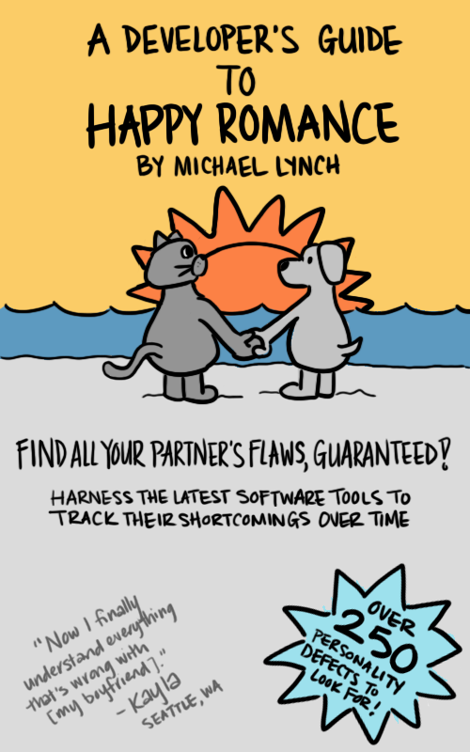
Human Side of Code Review
Code review goal: improve shared codebase, make every one’s life easier, improve team working relationship
Hazards in reality:
Feedback can be seen as criticism or personal attacks
Tone of voice and body language cannot be seen via text
Nit-picking over personal preferences
Code style, design “what-ifs”
Reviewer brings in out-of-scope problems to address
Author and reviewer stalemate
mtlynch.io

Slide 8
Respecting the Human
Bring the code up a letter grade or two, not from an F to an A
Trust they will get better over time
Tie feedback to principles, not opinions
Sometimes hard to articulate, try anyway
Is it not scalable, not modular, too much happening in one class/function, not according to style guide
Frame feedback as requests, not commands
You wouldn’t tell a co-worker “go get me a coffee”
Use inclusive language: “we should add error-checking here”
Split large reviews into small reviews
Accept good pieces and build momentum
Return reviews quickly- motivates authors to submit small changesets vs. it takes a week for 100 lines or 1000 lines
Offer sincere praise where possible
Don’t hold up approval over trivial changes
Trust their professionalism
Let the machines handle unit/integration tests, code style, indentation, etc.

Slide 9
Gitlab Demo
New changes are created in a branch
Author proposes merging changes
Prompts review and discussion on proposed changes
Reviewer approves and system automatically merges, squashes, and deletes feature branch

Slide 10
Rest of Today
Whereas, evidence of code reviews is necessary for your project grade:
Meet with group and decide on a code review methodology (doesn’t have to be Gitlab)
Who gets what reviews? How are you going to load balance?
Do you have a formal changeset format? Are you going to use a checklist? A guiding set of questions?
Create a code review request, even if trivial, and send it to a reviewer
Complete a code review, even if trivial
Practice “Respecting the human”

