Slide 1
Case Study: Mozilla
Kevin Scannell, David Ferry CSCI 5030 – Principles of Software Development
Saint Louis University St. Louis, MO 63103

Slide 2
Mozilla’s Origins
History: The Browser Wars
Mosaic (1992) was the first big GUI web browser
Developed by UI Urbana-Champaign
Netscape Navigator (1994) quickly eclipsed Mosaic
Netscape was the commercialization of Mosaic, included top Mosaic developers
Microsoft IE (1995) enters the market and quickly becomes dominant
Mozilla (1998) – Netscape open-sources its application suite and forms an OSS community
Firefox (2002) – Standalone web browser

Slide 3
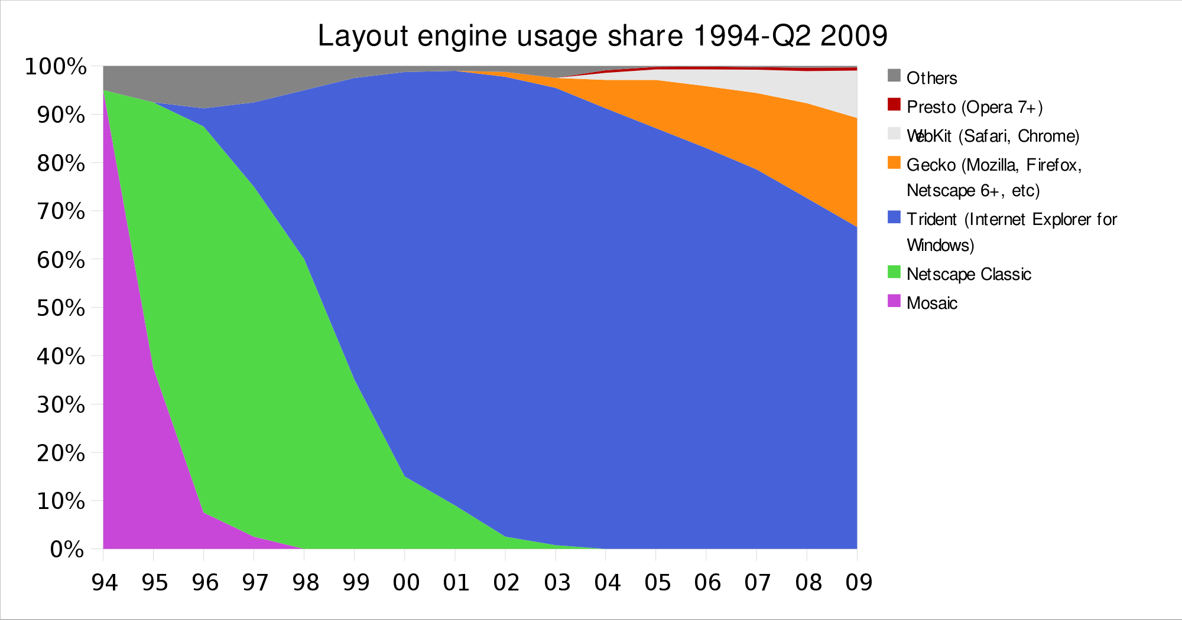
Browser Market Share Over Time
https://commons.wikimedia.org/wiki/File:Layout_engine_usage_share-2009-01-07.svg

Slide 4
Mozilla
Open-source community development
But also the Mozilla Foundation
But also the Mozilla Corporation
Firefox
Thunderbird
Bugzilla
Rust programming language
Libraries like Network Security Services (NSS)
Many others…

Slide 5
Repository
Browse: https://dxr.mozilla.org/mozilla-central/source/
All projects are combined into a single source tree
Any project (Firefox, Thunderbird) can use features of other projects (e.g. NSS, OS-specific graphics, javascript engine)

Slide 6
Firefox
Very large project:
~20,000 html files
~12,000 javascript files
~8,000 C/C++ files
Also: .py, .java, .sh, .asm, many more
In all- 8.85M lines of code, mostly in C/C++

Slide 7
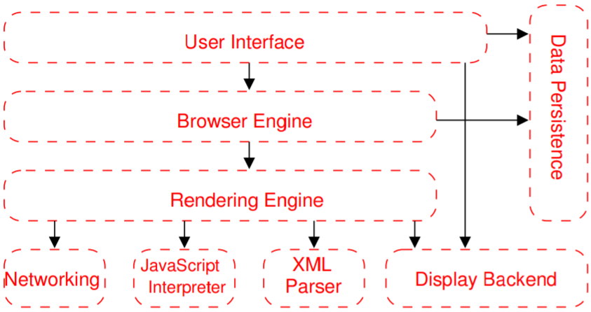
Web Browser Reference Architecture
A. Grosskurth and M. W. Godfrey, "A reference architecture for Web browsers," 21st IEEE International Conference on Software Maintenance (ICSM'05), Budapest, Hungary, 2005, pp. 661-664. doi: 10.1109/ICSM.2005.13
A B means A depends on B
Layered architecture
Recall the 7-layer OSI model- higher level components rely on functionality provided by lower levels
If API is stable layers can be built and tested in isolation
Promotes reuse of components in other projects

Slide 8
Web Browser Reference Architecture
A. Grosskurth and M. W. Godfrey, "A reference architecture for Web browsers," 21st IEEE International Conference on Software Maintenance (ICSM'05), Budapest, Hungary, 2005, pp. 661-664. doi: 10.1109/ICSM.2005.13
A B means A depends on B
Networking: fetch URLs, deals with security (SSL, TLS, etc…), handles host-to-network and network-to-host translations, caching to minimize network traffic
JS Interpreter: Executes .js code embedded in HTML, but also .js code running in browser (addons and more, etc.)

Slide 9
Web Browser Reference Architecture
A. Grosskurth and M. W. Godfrey, "A reference architecture for Web browsers," 21st IEEE International Conference on Software Maintenance (ICSM'05), Budapest, Hungary, 2005, pp. 661-664. doi: 10.1109/ICSM.2005.13
A B means A depends on B
XML Parser: parses structured markup languages, used both to parse web resources and also internally (config files, etc.)
Display Backend: Primitive drawing and windowing methods. The main OS-dependent piece, hopefully everything else should be OS-independent. Keep this small and walled-off for portability!

Slide 10
Web Browser Reference Architecture
A. Grosskurth and M. W. Godfrey, "A reference architecture for Web browsers," 21st IEEE International Conference on Software Maintenance (ICSM'05), Budapest, Hungary, 2005, pp. 661-664. doi: 10.1109/ICSM.2005.13
A B means A depends on B
Rendering Engine: Creates visual representation of a URL. Interprets HTML, CSS, XML, .js as necessary and generates the layout that is displayed in the UI. A complex part and a testing problem- needs to balance handling of malformed HTML that appears “in the wild” with adherence to standards.

Slide 11
Web Browser Reference Architecture
A. Grosskurth and M. W. Godfrey, "A reference architecture for Web browsers," 21st IEEE International Conference on Software Maintenance (ICSM'05), Budapest, Hungary, 2005, pp. 661-664. doi: 10.1109/ICSM.2005.13
A B means A depends on B
Browser Engine: High level interface to rendering engine. Methods for loading a URL, reload, back, forward
UI: What you’re used to seeing and interacting with. The browser window and user interactions, but also addons manager, developer console, bookmarks, preferences dialog, print manager, download manager

Slide 12
Web Browser Reference Architecture
A. Grosskurth and M. W. Godfrey, "A reference architecture for Web browsers," 21st IEEE International Conference on Software Maintenance (ICSM'05), Budapest, Hungary, 2005, pp. 661-664. doi: 10.1109/ICSM.2005.13
A B means A depends on B
Data persistence: user profile, store bookmarks, passwords, cookies, form info, etc.

Slide 13
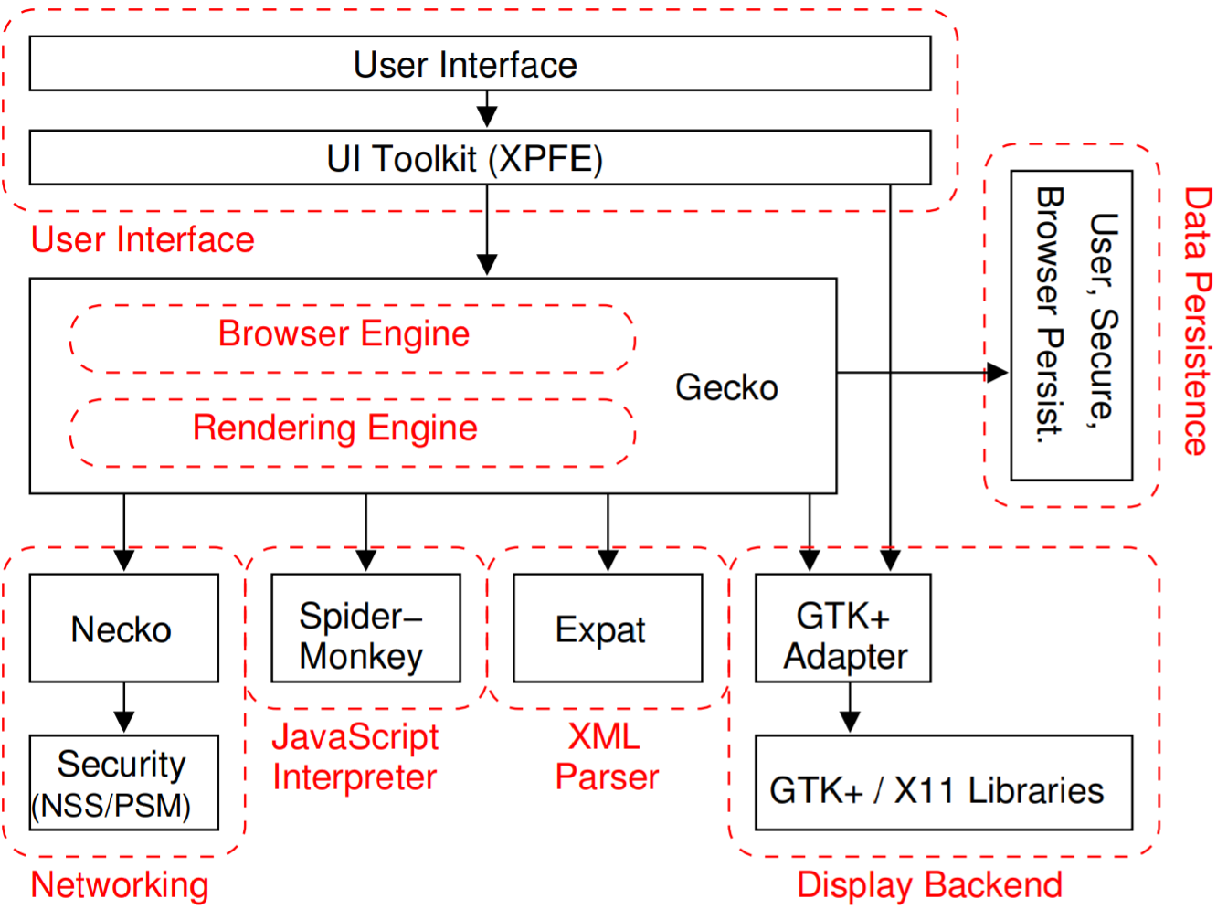
Firefox Architecture:
Necko: Platform independent API for networking. Create an HTTP channel, get a URL over that channel, etc.
NSS – encryption, certificate validation, etc.
SpiderMonkey – written in C, independent of everything
Expat – open source, outside project
A. Grosskurth and M. W. Godfrey, "A reference architecture for Web browsers," 21st IEEE International Conference on Software Maintenance (ICSM'05), Budapest, Hungary, 2005, pp. 661-664. doi: 10.1109/ICSM.2005.13

Slide 14
Firefox Architecture:
Display Backend: GTK/X11 on Linux, MFC on Windows, Aqua on Mac OSX
Gecko: General layout engine for HTML, CSS, .js. Takes content and displays the formatted content on the screen. Paints the browser’s content area. Used by more than just Firefox.
A. Grosskurth and M. W. Godfrey, "A reference architecture for Web browsers," 21st IEEE International Conference on Software Maintenance (ICSM'05), Budapest, Hungary, 2005, pp. 661-664. doi: 10.1109/ICSM.2005.13

Slide 15
Firefox Architecture:
XPFE – Cross Platform Front End – builds and displays user interfaces based on HTML components and HTML-like components, CSS styling, and made interactive with JavaScript. No compilation or low-level coding required.
A. Grosskurth and M. W. Godfrey, "A reference architecture for Web browsers," 21st IEEE International Conference on Software Maintenance (ICSM'05), Budapest, Hungary, 2005, pp. 661-664. doi: 10.1109/ICSM.2005.13

Slide 16
Mozilla Development Methodology
“Module Ownership Governance System”
Module Owner – leadership of module, responsible for code quality, revisions and innovations as appropriate, coordinating development with rest of Mozilla, documentation, etc.
Peers- help do code reviews, review the module owner’s contributions
Firefox is a module (Dave Townsend owner, 63 peers)
Can have submodules too- Thunderbird is divided into addressbook, compose, prefs, testing, etc.

Slide 17
Code Submission
Most patches must be signed-off-on by the module owner or a peer of each affected module.
Signing off-on means:
“I don’t believe this patch does harm” esp. security, performance, accessibility
If problems arise because of this patch, I’ll help fix it
Test coverage is good
Does not require “best possible solution” or “style is 100% consistent” – remember that code review consumes the scarce high-cognitive effort time we have each day

Slide 18
Code Review
Reviewers should have domain expertise, but there are no inherent limitations of what comments a reviewer might make
Goal review – does the patch fix a bug or solve the fundamental problem?
API/design review – changes to any API must conform to API rules, pass an API checklist, and meet naming guidelines
Maintainability review – readability, code style
Security review – meets security best practice, does this code need additional security testing such as fuzz testing or static analysis

Slide 19
Code Review Part 2
Integration review – does this code work properly with other Mozilla modules, is it localized/internationalized, does it have any dependencies, does it have documentation?
Testing review – are there appropriate behavior tests and unit tests for error conditions and likely incorrect inputs?
Performance review – has the code been profiled, will this code impact other code performance?
License review – does the code follow the Mozilla licensing rules?

Slide 20
Rapid Release Cycle
A new version is released every six weeks, there are four main branches:
mozilla-central (nightlies, unstable)
mozilla-aurora (experimental branch)
mozilla-beta
release
Every six weeks there is “merge day” where code on aurora goes to beta and central goes to aurora
No new features ever skip this cycle, all must “bubble up” from central
Idea is that each level has 10x more users and is commensurately more stable

Slide 21
Testing
Changes ready for mozilla-central will first land on mozilla-inbound.
This branch merges with central about once per day
There are users that use central’s nightly builds, so you can’t break their software
Commits to inbound will kick off automated tests, and if anything bad happens it can be undone before merged to central
Commit authors expected to be around for four hours after a commit
Each tree has a “sheriff” that polices the tree and will yell at you or back out your changes if you aren’t available (“keeps the trees green”)

Slide 22
Testing Part 2
Checkout live tests on:
https://treeherder.mozilla.org
Arcane Test Notation:
B: compiled code tests
X: xpcshell tests (JS tests, low level)
J: JS engine tests
C: crash tests (catalog of HTML pages that have crashed the browser in the past)
R: reference tests (compares output of two HTML pages that “should” produce the same output)
M: mochitest (plugin APIs, UI automation tests)
T: Talos (performance testing)

