Slide 1
Project
David Ferry CSCI 5030 – Principles of Software Development
Saint Louis University St. Louis, MO 63103

Slide 2
Purpose & Evaluation
Recall course assessment objectives:
Conduct a software development project as part of a team, using an agile process such as Scrum
Make effective use of a modern version control system
Use principles of software design in the implementation of a medium-to-large scale software project
Conduct effective code reviews and refactor existing code
You will be assessed by:
Checking git logs
Adherence to methodology
Participation in code reviews (will be discussed later)
Peer evaluations at Alpha, Beta, and Final milestones
Evaluation does not rely on completing certain features.

Slide 3
Scrum for CSCI 5030
First 10 minutes of future classes will be a standup meeting
Project owner: me, and “you”
Scrum master: self-selected
Project backlog – manage how you want
Sprint backlog – manage how you want, possibly use Gitlab “issues board”

Slide 4
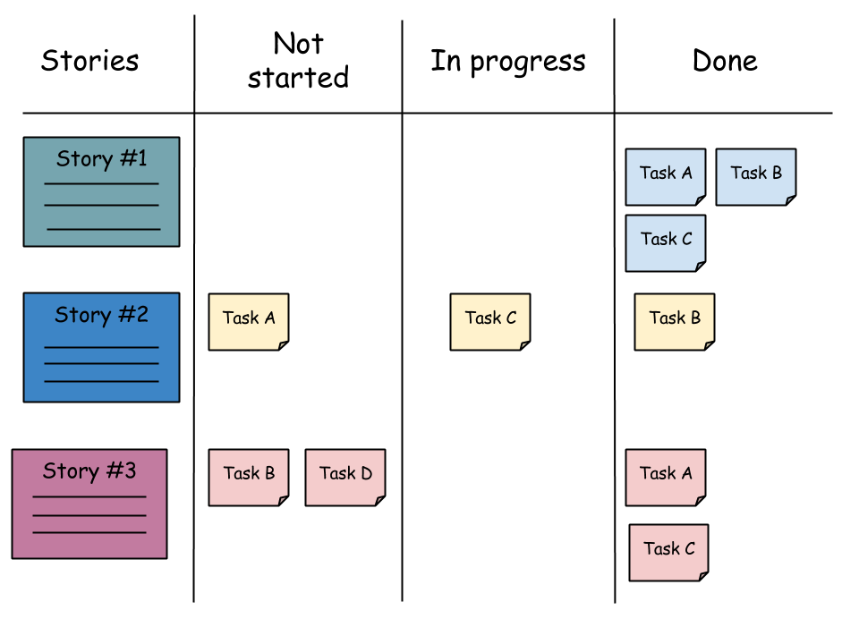
Backlog Boards
Ideal:
No place to put physical board
Gitlab gets the above minus stories organization
Lots of online tools: Trello, etc.

Slide 5
Sprint Planning
Move some user stories from project backlog into sprint backlog
Estimate sizes of stories and team ability
Populate user stories with tasks
Team assigns tasks to itself

Slide 6
Group Assignments
Group 1:
Keenan Berry
Hayden Clarke
Patrick Cuba
Aman Khalid
Bikram Pokhrel
Scott Lambert
Group 2:
Ren Chao
Eric Husa
Alex Ipatov
Rashmi Kamath
Maria Mushtaq
Rafeeq Shodeinde
Group 3:
Rahul Chauhan
Qingjie Lu
Sagar Rajashekar
Krithika
Venkatanarasimhan
Paul Wheeler

