Slide 1
Software Architecture
Kevin Scannell, David Ferry CSCI 5030 – Principles of Software Development
Saint Louis University St. Louis, MO 63103

Slide 2
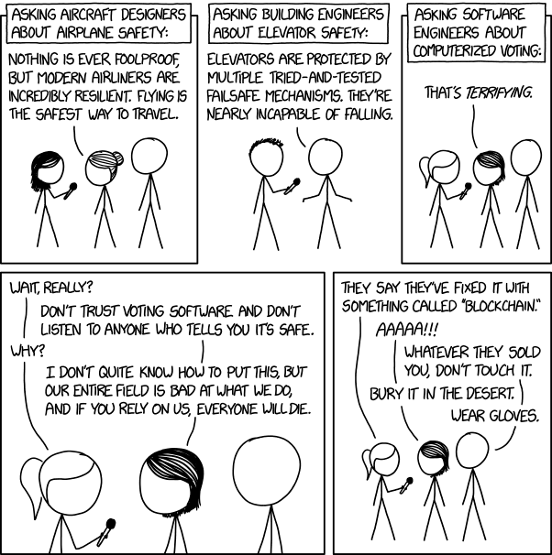
https://xkcd.com/2030/

Slide 3
What is Software Architecture?
Still an infant discipline
Little understood by practitioners, teachers, and especially students
Some basic questions are not answered:
What problems does an architect solve?
What are the tools that are used?
What are the constraints that are considered?
Is there an underlying consistent theory?
And yet… “you know it when you see it”
Lots of individual approaches and “silos” of knowledge, no unified theory

Slide 4
What Problems Does an Architect Solve?
How do customer requirements map into technology needs?
How is a high-level task divided into low-level software units?
How are software components connected?
How do software components map to hardware components?
How are business objectives met and how do stakeholders interact with the software?
How are non-functional attributes achieved?

Slide 5
What tools are used?
Stakeholder interaction: user stories, requirements, specifications, etc…
Modeling: system-level modeling and physical simulation, formal verification, model checking,
Documentation: block or component diagrams, UML diagrams, ER models, call graphs, etc…
Architecture patterns: describe how software components interact with each other
Software design patterns: describe how individual components might be implemented

Slide 6
What constraints are considered?
Performance and scalability, both now and in the future
This is where many large tech companies have their edge… Facebook, Twitter, etc. are not conceptually difficult to implement
Other attributes: adaptability, testability, maintainability, availability, reliability, recoverability, safety, and security
Cost to build and maintain system

Slide 7
Is there a consistent theory?
Any architecture can be considered an abstraction or model of an actual system.
Each abstraction specifies a certain structure that yields a desired attribute. Each abstraction has some set of prerequisite assumptions that motivate the specific structure.
The basic goal of a practicing software architect is to identify the existing abstractions relevant to a new work in order to simplify the design and implementation process.
Alternately, the absence of relevant abstractions hints at the opportunity to add to the universe of discourse.

Slide 8
Software Architecture Examples
Client/Server Model
A central Server provides services to multiple callers called Clients
Examples: internet in general
Master/Slave Model
A central Master sends requests to multiple workers called Slaves
Inverse of Client/Server
Voted most politically-incorrect term of 2004
Examples: Bluetooth

Slide 9
Software Architectural Examples
Service-Oriented Architecture
All services are provided through a network communication protocol
Any component can access and request services from any other component
Components work together regardless of language, technology, physical location, etc.
Easy to compose higher level services from lower level services
Individual components are separately maintained and deployed
Example: Amazon in its entirety

Slide 10
Software Design Pattern Examples
Active Object
Introduces concurrency natively through asynchronous object methods
Traditional Object
Active Object
Object.methodA();
Object.methodA();
Object
Object
Thread Pool
Object.getResult()
methodA()
methodA()
Result
Result

Slide 11
Software Design Pattern Examples
Factory Pattern
How do we create objects if we don’t know the type beforehand?
Not maintainable (what if taxi2 has a different engine?):
var motor;
if ( type == “gasoline” )
motor = new gasEngine();
elseif ( type == “electric” )
motor = new electricEngine(); taxi = new Car( motor );

Slide 12
Software Design Pattern Examples
Factory Pattern: create any abstract type in one method
class EngineFactory()
GetEngine( type ){
if ( type == “gasoline” )
return new gasEngine();
elseif ( type == “electric” )
return new electricEngine();
}
var motor = EngineFactory.getEngine( type );
taxi = new Car( motor );

Slide 13
What next?
You could spend multiple semesters looking at a veritable zoo of architectural artifacts.
Software architecture is more than just having a catalogue of existing patterns
It’s analyzing and understanding the key challenges in a software project
It’s seeing how existing abstractions do and don’t solve those challenges
Our approach: case studies- Mozilla and Twitter

