Slide 1
Project
David Ferry CSCI 5030 – Principles of Software Development
Saint Louis University St. Louis, MO 63103

Slide 2
Purpose & Evaluation
Recall course assessment objectives:
Conduct a software development project as part of a team, using an agile process such as Scrum
Make effective use of a modern version control system
Use principles of software design in the implementation of a medium-to-large scale software project
Conduct effective code reviews and refactor existing code
You will be assessed by:
Checking git logs
Adherence to methodology
Participation in code reviews (will be discussed later)
Peer evaluations at Alpha, Beta, and Final milestones
Evaluation does not rely on completing certain features.

Slide 3
Scrum for CSCI 5030
We can’t do the full scrum experience
We don’t work 40 hour weeks on this class
Find two times a week to meet for 15-20 minutes for the “standup” meeting
Project owner: me, and “you”
I will develop a set of user stories and features, but you are free to go your own direction as well
Scrum master: self-selected
Project backlog – manage how you want
Sprint backlog – manage how you want, possibly use Gitlab “issues board”

Slide 4
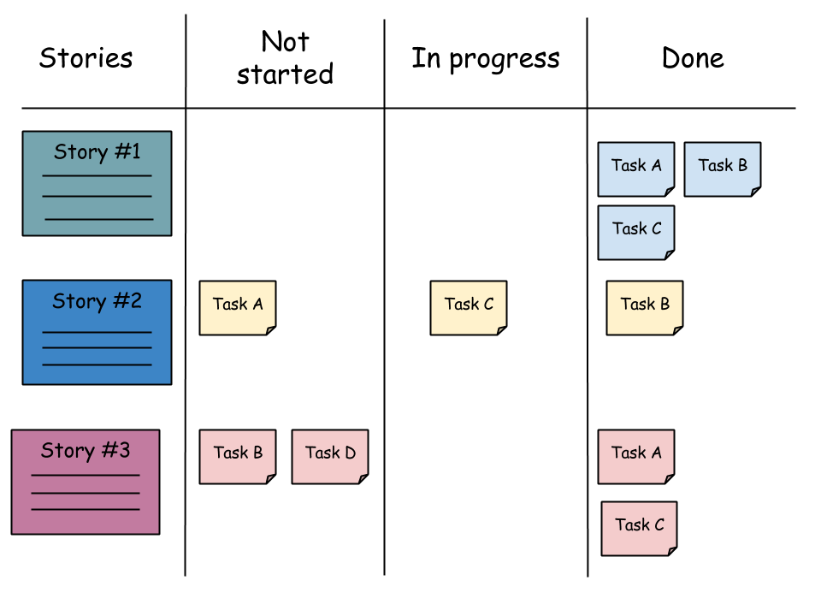
Backlog Boards
Ideal:
No place to put physical board
Gitlab gets the above minus stories organization
Lots of online tools: Trello, etc.

Slide 5
Sprint Planning – Next Time
Move some user stories from project backlog into sprint backlog
Estimate sizes of stories and team ability
Populate user stories with tasks
Team assigns tasks to itself

Slide 6
Group Assigments
I will have you fill out a survey tonight
We could do slightly larger, or slightly smaller groups (5-6 versus 3-4).
Groups will have a mix of ability levels and backgrounds
Both general experience and specific experience in the project technologies
To the best of my ability, each group will have a mix of more experienced and less experienced programmers

