Slide 1
Refactoring
David Ferry, Kevin Scannell CSCI 5030 – Principles of Software Development
Saint Louis University St. Louis, MO 63103

Slide 2
Goal of Refactoring
Refactoring – improving codebase without changing functional behavior
Why?
Architectural improvements
Performance/scalability
Fix non-functional bugs (e.g. memory leaks)
Code maintenance and organization
Reduce code complexity
Eliminate “code smells”

Slide 3
Opinions on Refactoring
Bjarne Stroustrup, inventor of C++
“I like my code to be elegant and efficient. The logic should be straightforward to make it hard for bugs to hide, the dependencies minimal to ease maintenance, error handling complete according to an articulated strategy, and performance close to optimal so as not to tempt people to make the code messy with unprincipled optimizations. Clean code does one thing well.”

Slide 4
Opinions on Refactoring
Grady Booch, object-orientation guru
“Clean code is simple and direct. Clean code reads like well-written prose. Clean code never obscures the designer’s intent but rather is full of crisp abstractions and straightforward lines of control.”

Slide 5
Opinions on Refactoring
“Big Dave” Thomas, Eclipse godfather
“Clean code can be read and enhanced by a developer other than its original author. It has unit and acceptance tests. It has meaningful names. It provides one way rather than many ways for doing one thing. It has minimal dependencies, which are explicitly defined, and provides a clear and minimal API. Code should be literate since depending on the language, not all necessary information can be expressed clearly in code alone.”

Slide 6
Opinions on Refactoring
Michael Feathers, refactoring guru
“I could list all of the qualities that I notice in clean code, but there is one overarching quality that leads to all of them. Clean code always looks like it was written by someone who cares. There is nothing obvious that you can do to make it better. All of those things were thought about by the code’s author, and if you try to imagine improvements, you’re led back to where you are, sitting in appreciation of the code someone left for you -- code left by someone who cares deeply about the craft.”

Slide 7
Opinions on Refactoring
Ward Cunningham, inventor of the wiki
“You know you are working on clean code when each routine you read turns out to be pretty much what you expected. You can call it beautiful code when the code also make it look like the language was made for the problem.”

Slide 8
Themes
Clean or not messy
Readable
Simple
Minimal
Straightforward
Like with some other topics- “you know it when you see it,” but there is no checklist
Refactoring is not tied to a specific style
But, adherence to style makes code “simple and direct” and “pretty much what you expected”

Slide 9
When to Refactor
Part of day-to-day programming is advised
“Boy scout principle” – leave code better than you found it
If adding a new feature would be difficult, first refactor to make adding that feature easy, then write the feature
Splits a big task into two or more smaller commits
Verifies your architectural changes don’t change behavior
Assess new features after they’re added and working- is there room for refactoring while everything is fresh in your head?
When you struggle to understand code, refactor such that you wouldn’t struggle next time

Slide 10
Code Refactoring Tools
Commonly integrated into IDEs
Many specific refactoring recipes (e.g. from Martin Fowler’s book on refactoring)
Tools are language-aware, e.g. ignore comments
For example:
Change function signature
Parameter order, add extra parameter, etc.
Extract as method
Pulls highlighted code out into a new method, replaces with method call
Extract superclass
Pulls common methods and fields into a new class and subclasses existing objects to that superclass

Slide 11
Review Tools
Remember that code review is a high-level cognitive task- automate where possible
Turn on all compiler warnings, consider using “warnings are errors” flag
Linters or other static code analyzers
Style review and automatic formatting
Non-error errors: uninitialized variable use, array bounds checking, dead code, null pointer dereference, etc.
Dynamic (runtime) code analyzers
Memory leak detection, concurrency and race conditions, invariant inference, performance and profiling, etc.
Write your own tools for common problems

Slide 12
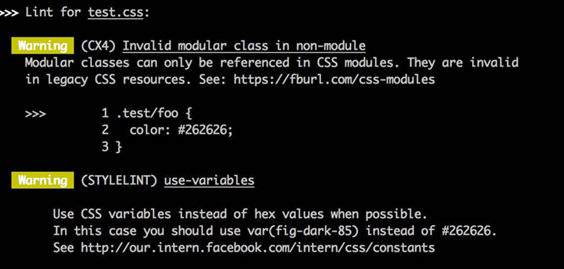
Example Linter Output
https://engineering.fb.com/open-source/improving-css-quality-at-facebook-and-beyond/

Slide 13
Case Study: Google
Searching for Build Debt: Experiences Managing Technical Debt at Google by J. David Morgenthaler et al.
Monolithic code repository (like Mozilla)
Hundred-millions lines of code
Single build system, CI system
Upsides:
Developers have access to entire source code
Large scale code re-use, faster development
Unified code review and indexing system

Slide 14
Case Study: Google
Challenges:
Easy to create large technical debt
Difficult to make simple changes- rename class, change internal API
Rapid code change- on average a dozen commits per minute
Build system is managed manually:
Dependency debt – build dependencies are managed manually
Visibility debt – no notion of public or private APIs, so projects can depend on internal details of other projects

Slide 15
Google Technical Debt Solutions
Automation tools to:
Remove dependencies that are not actually used
Find dependencies that are not declared
Make it easy to do the right thing:
Automatic tools to do refactoring on entire monolithic code base
Make it hard to do the wrong thing:
New default-private visibility settings that force teams to choose which APIs are public

Slide 16
Facebook Case Study
Large, changing codebase, thousands of CSS files
Traditional code reviews, style guidelines, and refactoring tools do not catch all mistakes
Browsers ignore malformed CSS and give best-effort rendering, so many errors fail silently
Old solution, regex based linter:
Cryptic regex – hard to understand or change
Slow – re-scan code for each regex
Not always clear what causes failure

Slide 17
Facebook: Regex Insufficient
Coming up with new regex rules for each problem encountered is just whack-a-mole
Hard to write good rules to cover all bad formats… can you spot three bugs in this code?
{
display: none:
background_color: #8B1D3;
padding: 10px,10px,0,0;
opacity: 1.0f;
}

Slide 18
Facebook: Regex Insufficient
Coming up with new regex rules for each problem encountered is just whack-a-mole
Hard to write good rules to cover all bad formats… can you spot three bugs in this code?
{
display: none:
background_color: #8B1D3;
padding: 10px,10px,0,0;
opacity: 1.0f;
}
Underscore in property name
Consider all properties with a dash in the name…
Hex color is too short
Comma separators should be spaces
Again, consider all possible properties with this pattern…

Slide 19
Facebook Case Study
Solution, abstract syntax tree parser:
Existing tools can create the AST for you
Each property becomes a node in the AST with a value
Catches invalid syntax automatically
Test cases are much simpler and clearer:
if ( node.prop === 'text-transform' && node.value === 'uppercase') {
error(‘Not internationalization-friendly’);
}
If ( node.prop === ‘opacity’ ){
warn(‘Performance: this property is slow’);
}

