Slide 1
Methods of Inquiry
David Ferry
CORE 1000 – The Most Human Computer
Saint Louis University

Slide 2
The Nature of Truth
Define “narcissism”

Slide 3
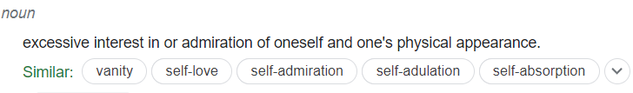
The Nature of Truth
Define “narcissism”

Slide 4
The Nature of Truth
Define “narcissism”
The Myth of Narcissus: A man is walking through the forest, and sees his own reflection in a pool of water. He falls so deeply in love with it he cannot leave it. He eventually realizes it is himself and is not real. He becomes utterly despondent because he will never love anything as much as this, so he loses the will to live and kills himself.

Slide 5
The Nature of Truth
Define “narcissism”
The Myth of Narcissus: A man is walking through the forest, and sees his own reflection in a pool of water. He falls so deeply in love with it he cannot leave it. He eventually realizes it is himself and is not real. He becomes utterly despondent because he will never love anything as much as this, so he loses the will to live and kills himself.
Which is correct? Is one factual? Which matters more?

Slide 6
Major Course Questions
A few major course themes:
What does it mean to be human?
What does it mean to be conscious?
What makes a meaningful human experience?
What kind of answer(s) matter the most to you? How would you express it?

Slide 7
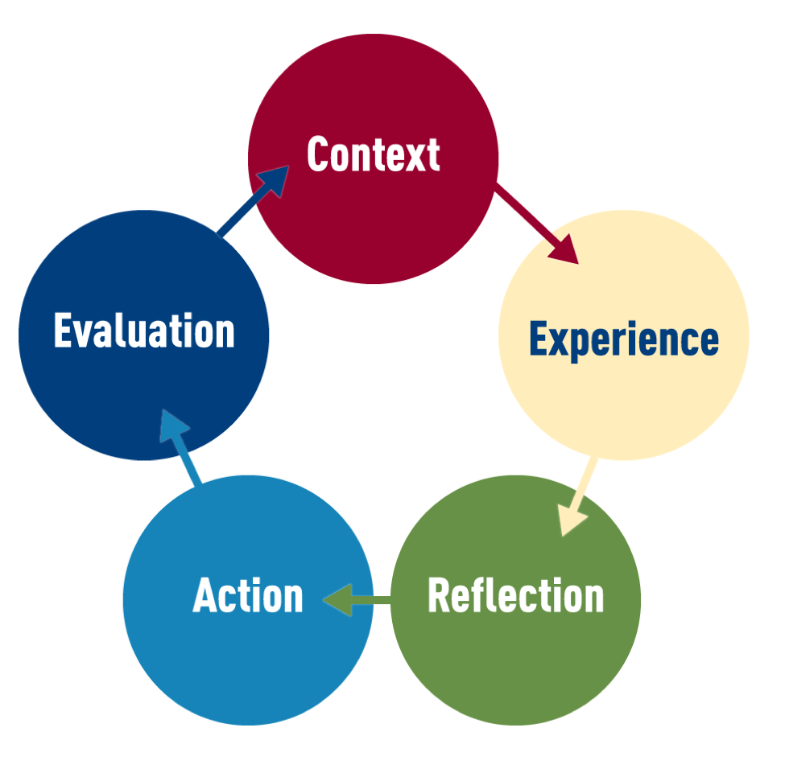
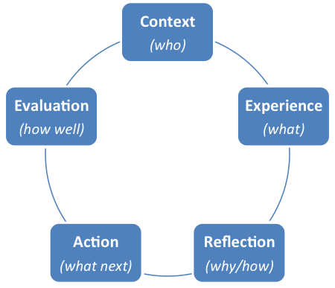
Ignatian Pedagogical Paradigm

Slide 8
Basis
Teachers accompany learners
There is no fixed methodology for teaching
Set an end goal, and iterate towards that goal
What is the goal?
Full growth of the person, leading to action in the world
Urges toward self-discipline, integrity, and accuracy
Slip-shod, superficial thinking unworthy and dangerous to the individual and the world
“Forming men and women for others”
How?

Slide 9
Ignatius’ Spiritual Exercises
The Spiritual Exercises are not meant to be merely cognitive activities or devotional practices. They are, instead, rigorous exercises of the spirit wholly engaging the body, mind, heart and soul of the human person. Thus they offer not only matters to be pondered, but also realities to be contemplated, scenes to be imagined, feelings to be evaluated, possibilities to be explored, options to be considered, alternatives to be weighed, judgments to be reached and choices of action to be made -- all with the expressed aim of helping individuals to seek and find the will of God at work in the radical ordering of their lives.
Ignatian Pedagogy: A Practical Approach, Society of Jesus

Slide 10
Ignatius’ Spiritual Exercises
A fundamental dynamic of the Spiritual Exercises of Ignatius is the continual call to reflect upon the entirety of one's experience in prayer in order to discern where the Spirit of God is leading. Ignatius urges reflection on human experience as an essential means of validating its authenticity, because without prudent reflection delusion readily becomes possible and without careful reflection the significance of one's experience may be neglected or trivialized. Only after adequate reflection on experience and implications of what one studies can one proceed freely and confidently toward choosing appropriate courses of action that foster the integral growth of oneself as a human being. Hence, reflection becomes a pivotal point for Ignatius in the movement from experience to action
Ignatian Pedagogy: A Practical Approach, Society of Jesus

Slide 11
Dynamics of the Paradigm
Five steps, but not necessarily a strict cycle
Context Experience Reflection ➔ Action
Action ➔ Evaluation
Evaluation ➔ New Context

Slide 12

Context
The real context of a student’s life
Our greater socio-economic, political, and cultural context
The specific context of SLU
The student’s existing body of ideas

Slide 13

Experience
For Ignatius meant “to taste something internally”
A cognitive grasp of the matter considered
Sensations of an affective nature
“I like this,” “this threatens me,” “I’m bored”
Experience is any relevant data: What do I know about it, and how do I react to it?

Slide 14

Reflection
Clarifies internal motivations and reasons behind your judgements (recall: “I like this,” or “bored”)
Probe the causes and implications of experiences
Weigh possible options and likely consequences
Achieve personal insights into ideas and truth
Come to an understanding of who I am (“Why do I feel that way?”)

Slide 15

Action
An extension of reflection
Reflection begins with the reality of experience and should end with the same reality
Reflection internalizes meanings, attitudes, or values
Action is to do something consistent with the new convictions

Slide 16
Evaluation
Brings student to the attention of instructor and larger community
Checks motivation- “forming men and women for others”
Checks integrity and accuracy
Gives feedback to students own internal processes

