Slide 1
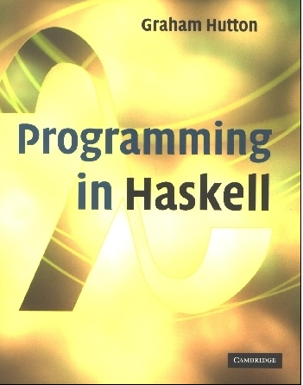
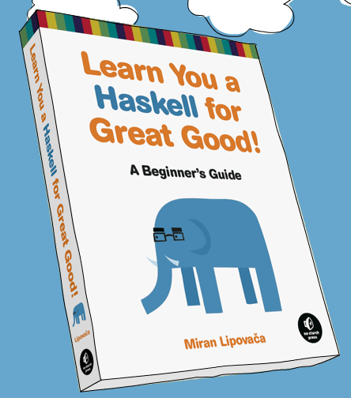
PROGRAMMING IN HASKELL
Typeclasses and higher order functions
Based on lecture notes by Graham Hutton
The book “Learn You a Haskell for Great Good”
(and a few other sources)

Slide 2
Pattern Matching
Many functions have a particularly clear definition using pattern matching on their arguments.
not :: Bool → Bool
not False = True
not True = False
not maps False to True, and True to False.

Slide 3
Functions can often be defined in many different ways using pattern matching. For example
(&&) :: Bool → Bool → Bool
True && True = True
True && False = False
False && True = False
False && False = False
can be defined more compactly by
True && True = True
_ && _ = False

Slide 4
However, the following definition is more efficient, because it avoids evaluating the second argument if the first argument is False:
True && b = b
False && _ = False
Note:
The underscore symbol _ is a wildcard pattern that matches any argument value.

Slide 5
Patterns are matched in order. For example, the following definition always returns False:
_ && _ = False
True && True = True
Patterns may not repeat variables. For example, the following definition gives an error:
b && b = b
_ && _ = False

Slide 6
List Patterns
Internally, every non-empty list is constructed by repeated use of an operator (:) called “cons” that adds an element to the start of a list.
[1,2,3,4]
Means 1:(2:(3:(4:[]))).

Slide 7
Functions on lists can be defined using x:xs patterns.
head :: [a] → a
head (x:_) = x
tail :: [a] → [a]
tail (_:xs) = xs
head and tail map any non-empty list to its first and remaining elements.

Slide 8
Note:
x:xs patterns only match non-empty lists:
> head []
Error
x:xs patterns must be parenthesised, because application has priority over (:). For example, the following definition gives an error:
head x:_ = x

Slide 9
Type Classes
We’ve seen types already:
ghci> :t 'a'
'a' :: Char
ghci> :t True
True :: Bool
ghci> :t "HELLO!"
"HELLO!" :: [Char]
ghci> :t (True, 'a')
(True, 'a') :: (Bool, Char)
ghci> :t 4 == 5
4 == 5 :: Bool

Slide 10
Type of functions
It’s good practice (and REQUIRED in this class) to also give functions types in your definitions.
removeNonUppercase :: [Char] -> [Char]
removeNonUppercase st =
[ c | c <- st, c `elem` ['A'..'Z']]
addThree :: Int -> Int -> Int -> Int
addThree x y z = x + y + z

Slide 11
Type Classes
In a typeclass, we group types by what behaviors are supported. (These are NOT object oriented classes – closer to Java interfaces.)
Example:
ghci> :t (==)
(==) :: (Eq a) => a -> a -> Bool
Everything before the => is called a type constraint, so the two inputs must be of a type that is a member of the Eq class.

Slide 12
Type Classes
Other useful typeclasses:
Ord is anything that has an ordering.
Show are things that can be presented as strings.
Enum is anything that can be sequentially ordered.
Bounded means has a lower and upper bound.
Num is a numeric typeclass – so things have to “act” like numbers.
Integral and Floating what they seem.

Slide 13
Type Classes: some notes
Some of these things have dependencies:
For example, to be a member of Ord, you must first be a member of Eq
(This makes sense – how can you be ordered if you can’t test equality?)
Show will be particularly relevant for us, since that is what allows things to print to the screen.
Read is the opposite of show – all things that can be read.

Slide 14
Type Classes: Read
Read takes a string and converts it to a class that is in read:
ghci> read "True" || False
True
ghci> read "8.2" + 3.8
12.0
ghci> read "5" - 2
3
ghci> read "[1,2,3,4]" ++ [3]
[1,2,3,4,3]

Slide 15
Type Classes: Read
This can be ambiguous:
ghci> read "4"
<interactive>:1:0:
Ambiguous type variable `a' in the constraint:
`Read a' arising from a use of `read' at <interactive>:1:0-7
Probable fix: add a type signature that fixes these type variable(s)

Slide 16
Type Classes: Read
To fix, we need to specify what it should convert to:
ghci> read "5" :: Int
5
ghci> read "5" :: Float
5.0
ghci> (read "5" :: Float) * 4
20.0
ghci> read "[1,2,3,4]" :: [Int]
[1,2,3,4]
ghci> read "(3, 'a')" :: (Int, Char)
(3, 'a')

Slide 17
Back to Curried Functions
In Haskell, every function officially only takes 1 parameter (which means we’ve been doing something funny so far).
ghci> max 4 5
5
ghci> (max 4) 5
5
ghci> :type max
max :: Ord a => a -> a -> a
Note: same as max :: (Ord a) => a -> (a -> a)

Slide 18
Reminder:
Polymorphic Functions
A function is called polymorphic (“of many forms”) if its type contains one or more type variables.
length :: [a] → Int
for any type a, length takes a list of values of type a and returns an integer.

Slide 19
Overloaded Functions
A polymorphic function is called overloaded if its type contains one or more class constraints.
sum :: Num a ⇒ [a] → a
for any numeric type a, sum takes a list of values of type a and returns a value of type a.

Slide 20
Note:
Constrained type variables can be instantiated to any types that satisfy the constraints:
> sum [1,2,3]
6
> sum [1.1,2.2,3.3]
6.6
> sum [’a’,’b’,’c’]
ERROR
a = Int
a = Float
Char is not a numeric type

Slide 21
Hints and Tips
When defining a new function in Haskell, it is useful to begin by writing down its type;
Within a script, it is good practice to state the type of every new function defined;
When stating the types of polymorphic functions that use numbers, equality or orderings, take care to include the necessary class constraints.
:type can help

Slide 22
Exercise
What are the types of the following functions, including type constraints? (Try to guess, but you can load and check to be sure.)
second xs = head (tail xs)
swap (x,y) = (y,x)
pair x y = (x,y)
double x = x*2
palindrome xs = reverse xs == xs
twice f x = f (f x)

Slide 23
Higher order functions
Remember that functions can also be inputs:
applyTwice :: (a -> a) -> a -> a
applyTwice f x = f (f x)
After loading, we can use this with any function:
ghci> applyTwice (+3) 10
16
ghci> applyTwice (++ " HAHA") "HEY"
"HEY HAHA HAHA"
ghci> applyTwice ("HAHA " ++) "HEY"
"HAHA HAHA HEY"
ghci> applyTwice (3:) [1]
[3,3,1]

Slide 24
Useful functions: zipwith
zipWith is a default in the prelude, but if we were coding it, it would look like this:
zipWith :: (a -> b -> c) -> [a] -> [b] -> [c]
zipWith _ [] _ = []
zipWith _ _ [] = []
zipWith f (x:xs) (y:ys) =
f x y : zipWith' f xs ys
Look at declaration for a bit…

Slide 25
Useful functions: zipwith
Using zipWith:
ghci> zipWith (+) [4,2,5,6] [2,6,2,3]
[6,8,7,9]
ghci> zipWith max [6,3,2,1] [7,3,1,5]
[7,3,2,5]
ghci> zipWith (++) ["foo ", "bar ", "baz "]
["fighters", "hoppers", "aldrin"]
["foo fighters","bar hoppers","baz aldrin"]
ghci> zipWith' (*) (replicate 5 2) [1..]
[2,4,6,8,10]
ghci> zipWith' (zipWith' (*))
[[1,2,3],[3,5,6],[2,3,4]]
[[3,2,2],[3,4,5],[5,4,3]]
[[3,4,6],[9,20,30],[10,12,12]]

Slide 26
Useful functions: flip
The function “flip” just flips order of inputs to a function:
flip’ :: (a -> b -> c) -> (b -> a -> c)
Flip’ f = g
where g x y = f y x
ghci> flip' zip [1,2,3,4,5] "hello"
[('h',1),('e',2),('l',3),('l',4),('o',5)]
ghci> zipWith (flip' div) [2,2..] [10,8,6,4,2]
[5,4,3,2,1]

Slide 27
Useful functions: map
The function map applies a function across a list:
map :: (a -> b) -> [a] -> [b]
map _ [] = []
map f (x:xs) = f x : map f xs
ghci> map (+3) [1,5,3,1,6]
[4,8,6,4,9]
ghci> map (++ "!") ["BIFF", "BANG", "POW"]
["BIFF!","BANG!","POW!"]
ghci> map (replicate 3) [3..6]
[[3,3,3],[4,4,4],[5,5,5],[6,6,6]]
ghci> map (map (^2)) [[1,2],[3,4,5,6],[7,8]]
[[1,4],[9,16,25,36],[49,64]]

Slide 28
Useful functions: filter
The function fliter:
filter :: (a -> Bool) -> [a] -> [a]
filter _ [] = []
filter p (x:xs)
| p x = x : filter p xs
| otherwise = filter p xs
ghci> filter (>3) [1,5,3,2,1,6,4,3,2,1]
[5,6,4]
ghci> filter (==3) [1,2,3,4,5]
[3]
ghci> filter even [1..10]
[2,4,6,8,10]

Slide 29
Using filter: quicksort!
quicksort :: (Ord a) => [a] -> [a]
quicksort [] = []
quicksort (x:xs) =
let smallerSorted = quicksort (filter (<=x) xs)
biggerSorted = quicksort (filter (>x) xs)
in smallerSorted ++ [x] ++ biggerSorted
(Also using let clause, which temporarily binds a function in the local context. The function actually evaluates to whatever “in” is.)

Slide 30
Exercise
Write a function
myZip :: [a] -> [b] -> [(a, b)]
which zips two lists together:
myZip [1,2,3] "abc" = [(1, 'a'), (2, 'b'), (3, 'c')]
(If one list is smaller, just go ahead and stop whenever one of them ends.)
Hint: I’d do this with recursion! But you can also do it with map or other higher order functions, if you want a challenge.

Slide 31
Conditional Expressions
As in most programming languages, functions can be defined using conditional expressions.
abs :: Int → Int
abs n = if n ≥ 0 then n else -n
abs takes an integer n and returns n if it is non-negative and -n otherwise.

Slide 32
Conditional expressions can be nested:
signum :: Int → Int
signum n = if n < 0 then -1 else
if n == 0 then 0 else 1
Note:
In Haskell, conditional expressions must always have an else branch, which avoids any possible ambiguity issues.

Slide 33
Guarded Equations
As an alternative to conditionals, functions can also be defined using guarded equations.
abs n | n ≥ 0 = n
| otherwise = -n
As previously, but using guarded equations.

Slide 34
Guarded equations can be used to make definitions involving multiple conditions easier to read:
signum n | n < 0 = -1
| n == 0 = 0
| otherwise = 1
Note:
The catch all condition otherwise is defined in the prelude by otherwise = True.

