Slide 1
More on scanning: NFAs and Flex

Slide 2
Last time
Scanners: the first step in compilation
Divides the program into tokens, or smallest meaningful units
This makes later parsing much simpler
Theory end of things: tokenizing is equivalent to specifying a DFA, which recognizes a regular language

Slide 3
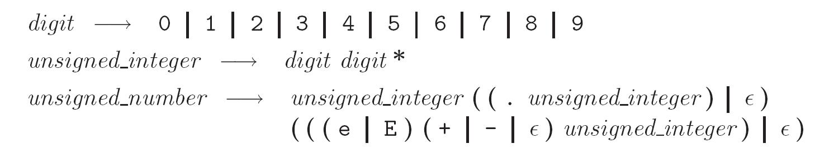
Scanning with Regular Languages
Unsigned integers in Pascal:
Examples: 4, or 82.3, or 5.23e-26
Formally:

Slide 4
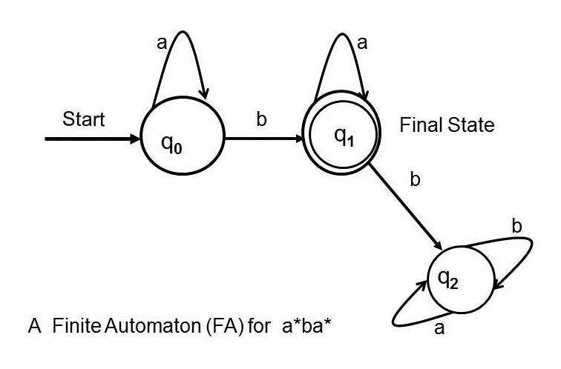
DFAs
More often, we’ll just draw a picture (like in graph theory)
Example:

Slide 5
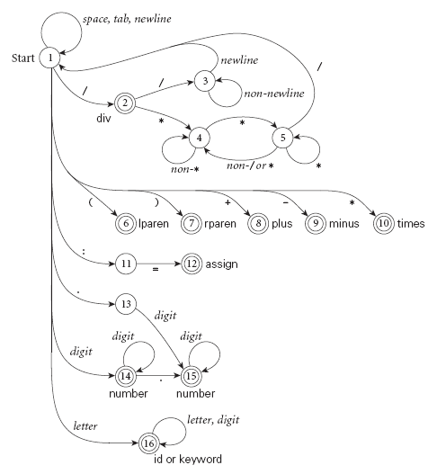
Scanning with DFAs
Pictorial representation of a scanner for calculator tokens, in the form of a finite automaton
Copyright © 2009 Elsevier

Slide 6
Regular expression recap
Write a DFA that recognizes any 0,1 string that has the number of 0’s in the string equal to 0 mod 3:

Slide 7
NFAs
Nondeterministic finite automata (NFA) are a variant of DFAs.
NFAs allow for ambiguity:
If a character is read, there can be multiple arrows showing where to go
Empty string transitions allow state transitions without reading an input character
DFAs have no ambiguity- must have exactly one transition for each input character in each state

Slide 8
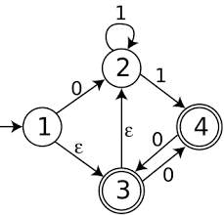
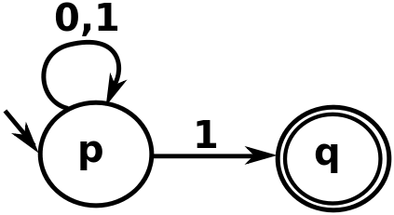
NFA Examples
NFAs accept a string when there is any path to an accept state.
What do the following NFAs accept?

Slide 9
More NFAs
Some things are easier with NFAs than DFAs:
unsigned_number -> unsigned_int (ε|.unsigned_int)
unsigned_int -> [0-9]

Slide 10
Are NFAs more powerful?
DFAs take exactly one transition each input
We can think of an NFA as modeling “all possible” transitions simultaneously
Can NFAs describe more languages than DFAs? E.g. could they recognize the language of balanced parentheses?
Theorem: Every NFA has an equivalent DFA.
Both just recognize the regular languages, even though NFAs seem more powerful!

Slide 11
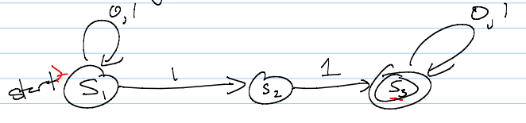
Converting NFAs to DFAs
To convert, mimic set of possible states given an input
A state is an accept state if any state in it is an accept state – that means the string could have ended in an accept state, and so is in the language

Slide 12
Why do we care?
You may ask: why do we care about NFAs?
Well, in terms of defining a parser, we usually start with regular expressions.
We then need a DFA (since NFAs are harder to code).
However, getting from a regular expression to a DFA in one step is difficult.
Instead, programs convert to an NFA, and THEN to a DFA.
Somewhat un-intuitively, this winds up being easier to code.

Slide 13
Constructing NFAs
The construction process for NFAs is pretty easy.
Recall how a regular expression is defined:
A single character or ε
Concatenation
An “or”
Kleene star
So all we need to do is show how to do each of these in an NFA (and how to combine them)

Slide 14
Constructing NFAs
Easy first step: What is the NFA for a single character, or for the empty string?
Now: what if I have NFAs for 2 regular expressions, and want to concatenate?

Slide 15
Constructing NFAs
A bit harder: what about an “or” or Kleene star?

Slide 16
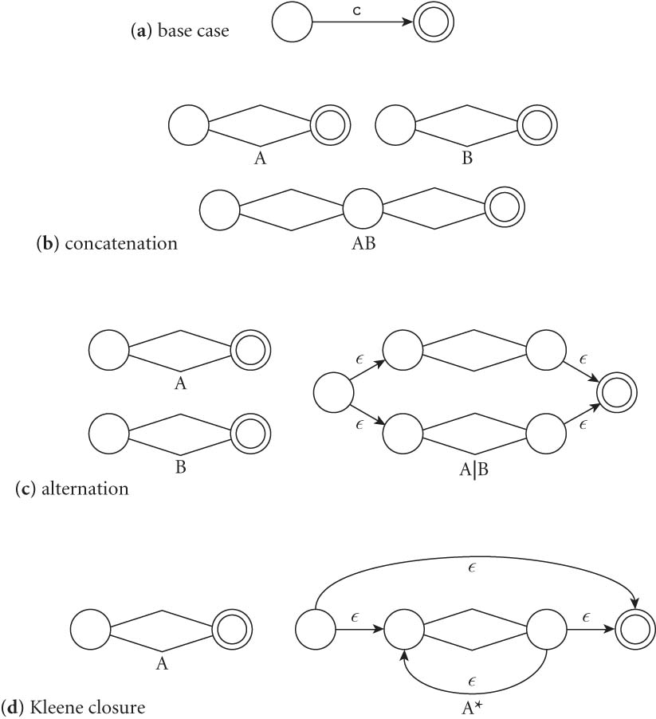
Constructing NFAs
Final picture (2.7 in book):

Slide 17
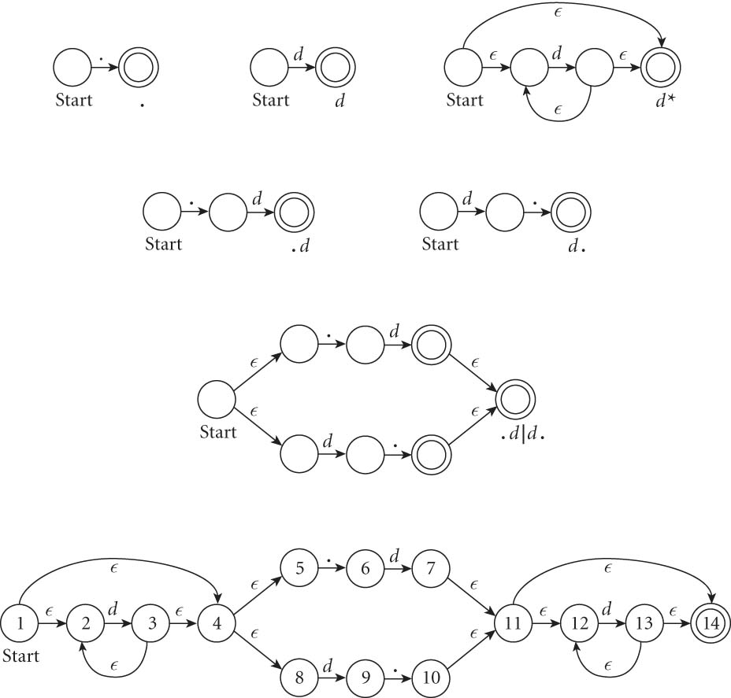
An example: decimals
Let d = [0-9], then decimals are: d* (.d | d. ) d*

Slide 18
From NFAs to DFAs
NFAs are hard to compute with, but easy to specify
“Guessing” the right transition if there are multiple transitions is hard to code
DFAs are unambiguous. Much easier to convert to DFA and then compute, even though it can get bigger.
(Side note: how much bigger?)
A practical approach is to go: RegEx => NFA => DFA

Slide 19
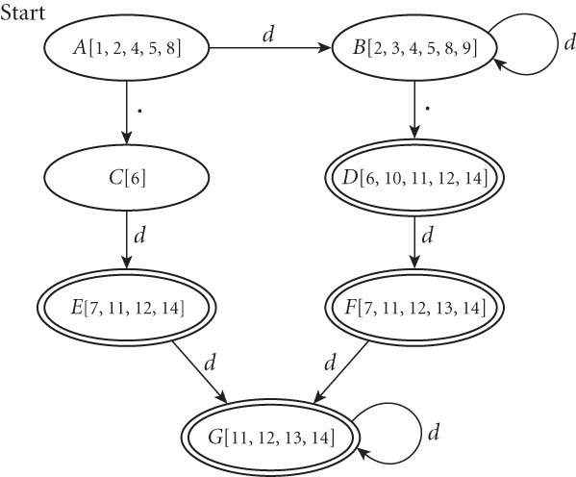
From NFAs to DFAs
If we automate this conversion on our last NFA (of decimals), we get:

Slide 20
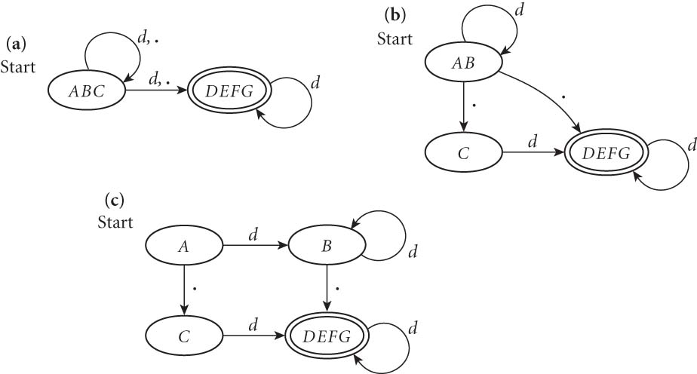
Minimizing DFAs
In addition, scanners take this final DFA and minimize.
(We won’t do this part by hand – I just want you to know that the computer does it automatically, to speed things up later.)

Slide 21
Coding DFAs (scanners)
So, given a DFA, code can be implemented in 2 ways:
A bunch of if/switch/case statements
A table and driver
Both have merits, and are described further in the book.
We’ll mainly use the second route in homework, simply because there are many good tools out there.

Slide 22
Scanners
Writing a pure DFA as a set of nested case statements is a surprisingly useful programming technique
though it's often easier to use perl, awk, sed
for details see Figure 2.11
Table-driven DFA is what lex and scangen produce
lex (flex) in the form of C code – this will be an upcoming homework
scangen in the form of numeric tables and a separate driver (for details see Figure 2.12)

Slide 23
Limitations of regular languages
Certain languages are simply NOT regular.
Example: Consider the language 0^{n}1^{n}
How would you do a regular expression of DFA/NFA for this one?

Slide 24
Beyond regular expressions
Unfortunately, we need things that are stronger than regular expressions.
A simple example: we need to recognize nested expressions
expr -> id | number | -expr |
(expr)| expr op expr
op -> + | - | * | /
Regular expressions can’t quite manage this, since could do ((((x + 7) * 2) + 3) - 1)

Slide 25
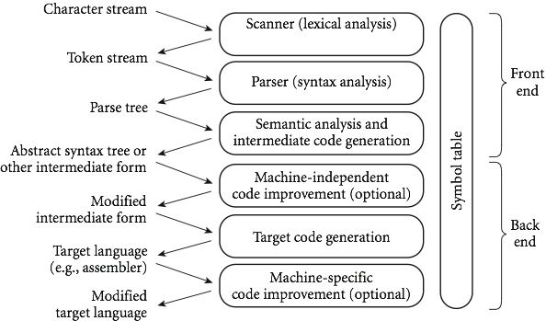
Next time
Flex, a c-style scanner
Later: parsing and CFGs, which are stronger than DFAs/scanning

