Slide 1
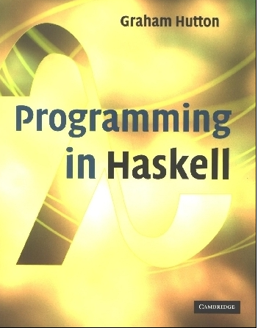
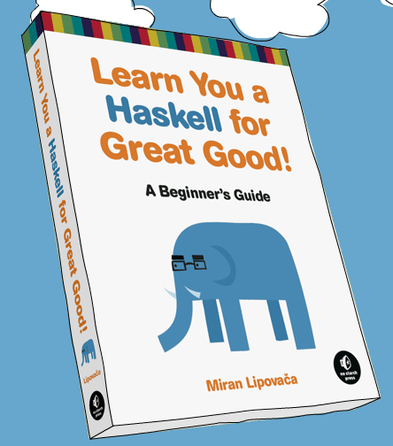
PROGRAMMING IN HASKELL
Lecture 2
Based on lecture notes by Graham Hutton
The book “Learn You a Haskell for Great Good”
(and a few other sources)

Slide 2
Glasgow Haskell Compiler
GHC is the leading implementation of Haskell, and comprises a compiler and interpreter;
The interactive nature of the interpreter makes it well suited for teaching and prototyping;
GHC is freely available from:
www.haskell.org/platform

Slide 3
Starting GHC
The GHC interpreter can be started from the Unix command prompt % by simply typing ghci:
% ghci
GHCi, version 7.4.1: http://www.haskell.org/ghc/ :? for help
Loading package ghc-prim ... linking ... done.
Loading package integer-gmp ... linking ... done.
Loading package base ... linking ... done.
Prelude>

Slide 4
Useful GHCi Commands
Command Meaning
:load name load script name
:reload reload current script
:edit name edit script name
:edit edit current script
:type expr show type of expr
:? show all commands
:quit quit GHCi

Slide 5
Useful included functions
We started seeing some of what Haskell has to offer last time.
In particular, amazing support for list operations!
I can’t teach you all of these in lecture slides, but feel free to use posted resources (or the Haskell wiki) to find other list functions.
You’re welcome to use any default included ones on the homework. However, don’t use one the ones that just do what I’m asking!
(i.e. don’t call sort for the question that asks you to implement sorting)

Slide 6
Naming Requirements
Function and argument names must begin with a lower-case letter. For example:
myFun
fun1
arg_2
x’
By convention, list arguments usually have an s suffix on their name. For example:
xs
ns
nss

Slide 7
The Layout Rule
In a sequence of definitions, each definition must begin in precisely the same column:
a = 10
b = 20
c = 30
a = 10
b = 20
c = 30
a = 10
b = 20
c = 30

Slide 8
The layout rule avoids the need for explicit syntax to indicate the grouping of definitions.
a = b + c
where
b = 1
c = 2
d = a * 2
a = b + c
where
{b = 1;
c = 2}
d = a * 2
means
implicit grouping
explicit grouping

Slide 9
Exercise
Fix the syntax errors in the program below, and test your solution using GHCi.
N = a ’div’ length xs
where
a = 10
xs = [1,2,3,4,5]
(Copy your corrected version into an email to me, but don’t send yet.)

Slide 10
What is a Type?
A type is a name for a collection of related values. For example, in Haskell the basic type
Bool
contains the two logical values:
False
True

Slide 11
Type Errors
Applying a function to one or more arguments of the wrong type is called a type error.
> 1 + False
Error
1 is a number and False is a logical value, but + requires two numbers.

Slide 12
Types in Haskell
If evaluating an expression e would produce a value of type t, then e has type t, written
e :: t
Every well formed expression has a type, which can be automatically calculated at compile time using a process called type inference.

Slide 13
All type errors are found at compile time, which makes programs safer and faster by removing the need for type checks at run time.
In GHCi, the :type command calculates the type of an expression, without evaluating it:
> not False
True
> :type not False
not False :: Bool

Slide 14
Basic Types
Haskell has a number of basic types, including:
Bool
- logical values
Char
- single characters
String
- strings of characters
Int
- fixed-precision integers
Integer
- arbitrary-precision integers
Float
- floating-point numbers

Slide 15
List Types
A list is sequence of values of the same type: Lists are homogenous!
[False,True,False] :: [Bool]
[’a’,’b’,’c’,’d’] :: [Char]
In general:
[t] is the type of lists with elements of type t.

Slide 16
Note:
The type of a list says nothing about its length:
[False,True] :: [Bool]
[False,True,False] :: [Bool]
The type of the elements is unrestricted. For example, we can have lists of lists:
[[’a’],[’b’,’c’]] :: [[Char]]

Slide 17
Tuple Types
A tuple is a sequence of values of different types:
Tuples are heterogenous!
(False,True) :: (Bool,Bool)
(False,’a’,True) :: (Bool,Char,Bool)
In general:
(t1,t2,…,tn) is the type of n-tuples whose ith components have type ti for any i in 1…n.

Slide 18
Note:
The type of a tuple encodes its size:
(False,True) :: (Bool,Bool)
(False,True,False) :: (Bool,Bool,Bool)
The type of the components is unrestricted:
(’a’,(False,’b’)) :: (Char,(Bool,Char))
(True,[’a’,’b’]) :: (Bool,[Char])

Slide 19
Tuples and Lists
The size of a tuple is part of its type.
Lists are homogenous.
=> Lists of tuples are only valid when
The tuples are the same size
The tuples have the same types
not allowed: [ (1,2), ('a','b') ]
not allowed: [ (1,2), (3,4,5) ]
allowed: [ (1, 'a'), (2, 'b') ]

Slide 20
Exercise
What are the types of the following values?
[’a’,’b’,’c’]
(’a’,’b’,’c’)
[(False,’0’),(True,’1’)]
([False,True],[’0’,’1’])
[tail,init,reverse]
(Again, add this to that email.)

Slide 21
Function Type Notation
The arrow → is typed at the keyboard as ->.
The argument and result types are unrestricted. For example, functions with multiple arguments or results are possible using lists or tuples:
add :: (Int,Int) → Int
add (x,y) = x+y
zeroto :: Int → [Int]
zeroto n = [0..n]

Slide 22
Curried Functions (Partial Application)
Functions with multiple arguments by default will return functions as results:
myAdd :: Int → Int → Int
myAdd x y = x+y
z = myAdd 42
:type z
z :: Int → Int
myAdd takes an integer x and returns a function myAdd x. In turn, this function takes an integer y and returns the result x+y.

Slide 23
Note:
add and add’ produce the same final result, but add takes its two arguments at the same time, whereas add' takes them one at a time:
add :: (Int,Int) → Int
add' :: Int → Int → Int
Functions that take their arguments one at a time are called curried functions, celebrating the work of Haskell Curry on such functions.

Slide 24
Functions with more than two arguments can be curried by returning nested functions:
mult :: Int → (Int → (Int → Int))
mult x y z = x*y*z
mult takes an integer x and returns a function mult x, which in turn takes an integer y and returns a function mult x y, which finally takes an integer z and returns the result x*y*z.

Slide 25
Why is Currying Useful?
Curried functions are more flexible than functions on tuples, because useful functions can often be made by partially applying a curried function.
For example:
add’ 1 :: Int → Int
take 5 :: [Int] → [Int]
drop 5 :: [Int] → [Int]

Slide 26
Currying Example
map takes a function and list, and applies the function to every element of the list.
The following are equivalent:
mul5 x = 5 * x
map mul5 [1, 2, 3]=
[5, 10, 15]
map (5*) [1, 2, 3]=
[5, 10, 15]

Slide 27
Currying Conventions
To avoid excess parentheses when using curried functions, two simple conventions are adopted:
The arrow → associates to the right.
Int → Int → Int → Int
Means Int → (Int → (Int → Int)).

Slide 28
As a consequence, it is then natural for function application to associate to the left.
mult x y z
Means ((mult x) y) z.
Unless tupling is explicitly required, all functions in Haskell are normally defined in curried form.

Slide 29
Polymorphic Functions
A function is called polymorphic (“of many forms”) if its type contains one or more type variables.
length :: [a] → Int
for any type a, length takes a list of values of type a and returns an integer.

Slide 30
Note:
Type variables can be instantiated to different types in different circumstances:
> length [False,True]
2
> length [1,2,3,4]
4
a = Bool
a = Int
Type variables must begin with a lower-case letter, and are usually named a, b, c, etc.

Slide 31
Many of the functions defined in the standard prelude are polymorphic. For example:
fst :: (a,b) → a
head :: [a] → a
take :: Int → [a] → [a]
zip :: [a] → [b] → [(a,b)]
id :: a → a
Note: Two types a and b may be the same type, but don't have to be.

Slide 32
Ranges in Haskell
As already discussed, Haskell has extraordinary range capability on lists:
ghci> [1..15]
[1,2,3,4,5,6,7,8,9,10,11,12,13,14,15]
ghci> ['a'..'z']
"abcdefghijklmnopqrstuvwxyz"
ghci> ['K'..'Z']
"KLMNOPQRSTUVWXYZ”
ghci> [2,4..20]
[2,4,6,8,10,12,14,16,18,20]
ghci> [3,6..20]
[3,6,9,12,15,18]

Slide 33
Ranges in Haskell
But be careful:
ghci> [0.1, 0.3 .. 1]
[0.1,0.3,0.5,0.7,0.8999999999999999,1.0999999999999999]
(I’d recommend just avoiding floating point in any range expression in a list – imprecision is just too hard to predict.)

Slide 34
Infinite Lists
Can be very handy – these are equivalent:
[13,26..24*13] --closed list
take 24 [13,26..] --infinite list
A few useful infinite list functions:
ghci> take 10 (cycle [1,2,3])
[1,2,3,1,2,3,1,2,3,1]
ghci> take 12 (cycle "LOL ")
"LOL LOL LOL "
ghci> take 10 (repeat 5)
[5,5,5,5,5,5,5,5,5,5]

Slide 35
List Comprehensions
Very similar to standard set theory list notation:
ghci> [x*2 | x <- [1..10]]
[2,4,6,8,10,12,14,16,18,20]
Can even add predicates to the comprehension:
ghci> [x*2 | x <- [1..10], x*2 >= 12]
[12,14,16,18,20]
ghci> [ x | x <- [50..100], x `mod` 7 == 3]
[52,59,66,73,80,87,94]

Slide 36
List Comprehensions
Can even combine lists:
ghci> let nouns = ["hobo","frog","pope"]
ghci> let adjectives =
["lazy","grouchy","scheming"]
ghci> [adjective ++ " " ++ noun | adjective
<- adjectives, noun <- nouns]
["lazy hobo","lazy frog","lazy pope","grouchy hobo","grouchy frog",
"grouchy pope","scheming hobo","scheming frog","scheming pope"]

Slide 37
Exercise
Write a function called myodds that takes a list and filters out just the odds using a list comprehension.
Then test it by giving it an infinite list, but then only “taking” the first 12 elements:
take 12 (myodds [2,4..]
Note: Your code will start with something like:
myodds :: [a] -> [a]
myodds xs = [ put your code here ]
Bonus: Now do it with recursion instead!

