Slide 1
CSCI 3200: Programming Languages
Instructor: Dr. David Ferry
Office: ISE 234C
Email: dferry@slu.edu
Website: https://dferry.github.io/csci3200/

Slide 2
Acknowledgements
Dr. Erin Chambers
Dr. Kevin Scannell

Slide 3
Today:
Syllabus overview (boring but necessary)
HW 1 is posted – due next Friday
An intro to programming languages

Slide 4
A: What’s the whole point?
A: Of all this stuff.
B: Like, all of it?
A: Yes.
B: Do you mean this slide? Or this class? Or life, the universe, and everything?
A: Yes.

Slide 5
A: What’s the whole point?
A: Of all this stuff.
B: Like, all of it?
A: Yes.
B: Do you mean this slide? Or this class? Or life, the universe, and everything?
A: Yes.
For this CS program:
1. Train software developers and academic computer scientists.
2. Write good code.
3. Go fast forever. – Matthew Parker

Slide 6
A note on outcomes (or: why the heck study this?)
Hiring manager friend: “I want to see that the applicant has mastered one language.”
Studying language design will make learning new languages easier
This also establishes a common terminology for comparison of languages
It is difficult to understand hidden “features” of various languages – we’ll look at a lot of them.
Choosing an appropriate language is a key professional skill
Need to understand actual implementation cost.

Slide 7
Question:
What programming languages have you used before? What makes them good?
Python?
C++/C?
Java?
Matlab?
Others?

Slide 8
Categories of language features
Many categories:
High level versus low level
Restrictive vs. permissive
Intuitive vs. awkward
Static vs. dynamic
Compile time vs. runtime
Procedural vs. object-oriented vs. functional
Examples?

Slide 9
High level languages
This began to change in the 1950s with Fortran, when people realized it would make more sense to have common languages and then translate them for the machine
This is the advent of the notion of compilation.
The idea was slow to catch on, since compiled code was usually slower to run.

Slide 10
Continuous improvement…
Programming languages are still very much evolving:
Structured programming (loops and function calls) – 1960’s
Object orientation – 1980’s.
Python – 1991, Python3 – 2008
Rust – 2010
C++ – 1985, C++03, C++11, C++14, C++17, C++20, C++23

Slide 11
Why so many? (cont)
Special purpose languages are very common:
C was developed to write Unix => is good for low level coding
RegEx is good for character and string manipulations
Python was supposed to be easy and intuitive but powerful
C# was supposed to be not-Java

Slide 12
Many issues:
Ease of use
Learning curve
Standardization
Open source
Good compliers available
Economics and history
Pure inertia (e.g. Fortran 2018)

Slide 13
First big distinction: Paradigm
The major paradigms we’ll discuss this semester are:
Imperative languages: programmer describes how the computer should do something. (This is the dominant paradigm.)
Declarative languages: programmer describes what the result should be.

Slide 14
Imperative language categories
Procedural: Fortran, C, etc.
- Based on computation with variables
Object oriented: C++, Java, Python
- Focuses on objects for data and code encapsulation rather than just variables
Scripting languages: bash, awk, perl, etc.
- Tailored for specific use cases over speed, expression, or control

Slide 15
Declarative language categories
1. Functional languages: Lisp, Scheme, Haskell, etc.
based on recursive definitions of functions
Inspired by lamba calculus
2. Logic based: prolog
computation is based on attempts to find values that satisfy specified relationships
3. Data flow: id, val
flow of information (tokens) among nodes

Slide 16
Functional example:
Consider the gcd algorithm (finding the greatest common divisor)
Divisors of a and b are the same as the divisors of a-b and b
Euclid’s algorithm:
Enter Integers A and B
If A == B
A = max(A,B)
B = min(A,B)
A = A - B
False
True
GCD = A

Slide 17
GCD in C
int main() {
int i = getint(), j = getint();
while (i != j) {
if (i > j)
i = i - j;
else
j = j - i;
}
putint(i);
}

Slide 18
GCD in Haskell
Haskell is based entirely on function calls – there is essentially no such thing as a variable in this language.
selfGCD :: Integral f =>
f -> f -> f
selfGCD a b =
if b == a then a
else selfGCD b (a-b) (ignoring the maximization for now)

Slide 19
GCD in prolog
Prolog is all about stating true axioms, and then evaluating for something to be true based off these
gcd(X,Y,Z):- X>=Y, X1=X-Y, gcd(X1,Y,Z).
gcd(X,Y,Z):- X<Y, X1=Y- X, gcd(X1,X,Z).
gcd(0,X,X):- X>0.

Slide 20
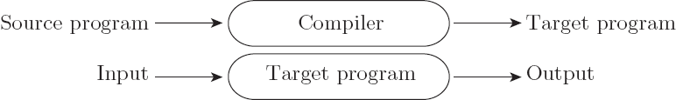

Second big distinction: Compilation
Next distinction is compilation versus interpretation
Compilation:
Interpretation:

Slide 21
Versus?
In reality, the difference is not so clear cut.
These are not opposites, and most languages fall somewhere in between on the spectrum
In general, interpretation gives greater flexibility and more things are done at runtime (think Python)
Compilers can analyze programs before they are run, for safety, better performance, and more (think C/C++)

Slide 22
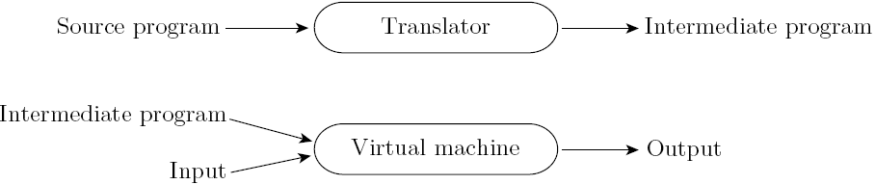
Compilation and Interpretation
Many languages include a mix:
The Python interpreter can invoke efficient pre-compiled routines
Note that compilation doesn’t have to produce machine code – just a translation to another language
Think of Java to Java Bytecode

Slide 23
Implementation of compilation
Lexing (scanning):
Translates syntactic elements into tokens
Parsing:
Identifies higher level semantic structures – i.e. loops and subroutines
Code generation:
Turns semantic structures into assembly
Won’t cover in this class

Slide 24
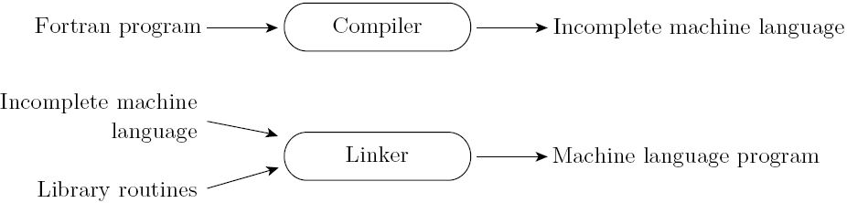
Compiling (cont.)
Linking
Compiler uses a linker program add subroutines from a library
You’ve done this if you ever used a #include from the standard template library

Slide 25
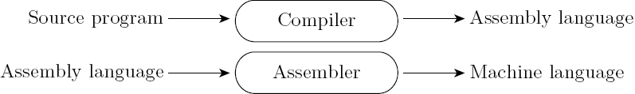
Compilers (cont)
Post-compilation: outputs assembly
Makes debugging and optimizing easier, since assembler is MUCH easier than machine code
Isolates compiler from low level machine changes – many architectures can use the same assembly, but machine level code is very specific

Slide 26
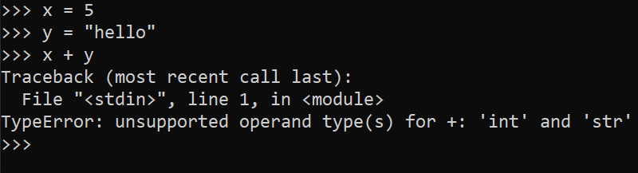
Interpreted Languages
In interpreted languages, a compiler still generates code somewhere
But assumptions about inputs are not finalized
Dynamic checks occur at runtime

Slide 27
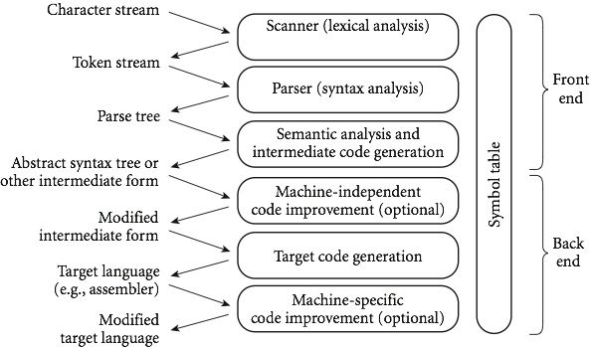
Phases of compilation

Slide 28
Next time
We’ll be spending our first few weeks on compilers, since a basic understanding of this helps to understand programming language design.
Remember, compilers is usually a class all by itself! We’ll be covering just enough of the basics to get us by.
We won’t even really get to the lower level stuff from the previous slide – go take a compilers course to cover that.
Next up: lexing and tokenizing

