Slide 1
Course Conclusion
Extension on homework until Monday
Final Exam Review on Monday
Final Exam – Tuesday the 13th at 12:00
50 minute exam, 12:00-12:50
Not cumulative, but don’t forget everything from first half of semester

Slide 2
Course Conclusion
First half of semester:
Functional Programming
Haskell
Second half of the semester:
Compiler technology
Regex, DFAs, NFAs, CFGs, lexing, parsers

Slide 3
Functional Programming
A counterpoint to most other programming languages
Explicitly makes different choices in language design
Different to work with, not necessarily easier or harder
Can get the same results either way

Slide 4
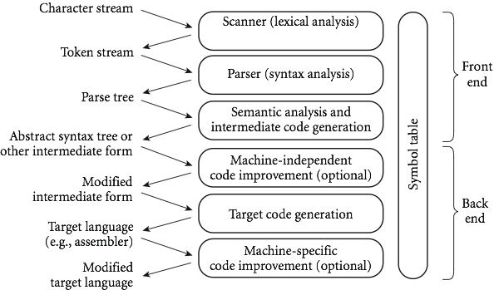
Compilation phases
Front- End
Middle
Back- End

Slide 5
Forward Directions
Compilation Technology
AST to machine-independent code (MIC)
MIC to target-machine code
Optimizations
Language Design

Slide 6
Language Design
There are many ways to categorize programming languages.
High level vs. low level
Imperative, procedural, object-oriented…
Chapters 11-14 in book
There are just as many low-level decisions that are made when developing a new language
Chapters 6-10 in book

Slide 7
Core Language Design
Chapter 6 – Control Flow
Order of execution, precedence, sequencing, recursion
Chapter 7 – Type Systems
Strong vs. weak, static vs. dynamic, orthogonality
Chapter 8 – Composite Types
Arrays, collections, records, pointers, etc.
Chapter 9 – Subroutines / Functions
Ordering, parameter passing, exceptions,
Chapter 10 – Data Abstraction
Objects, interfaces, inheritance, etc.

Slide 8

Lifetime and Storage Management
Key events
creation of objects
creation of bindings
references to variables (which use bindings)
(temporary) deactivation of bindings
reactivation of bindings
destruction of bindings
destruction of objects
Copyright © 2009 Elsevier

Slide 9
Binding
Binding Time is the point at which a binding is created or, more generally, the point at which any implementation decision is made
Many different times at which this can be decided:
language design time
Decide primitive types, available constructors, etc.
language implementation time
Decide precision, stack/heap issues, etc.
Copyright © 2009 Elsevier

Slide 10
Binding
Possible times (cont.):
program writing time
Programmer chooses algorithms, names, etc.
compile time
Compiler must plan for data layout
link time
Standard libraries are imported, compiler decides layout of whole program in memory
load time
Actual choice of physical addresses
Copyright © 2009 Elsevier

Slide 11
Binding
Possible times (cont.):
run time
Must finalize value/variable bindings, sizes of strings
Note that run time includes:
program start-up time
module entry time
elaboration time (point a which a declaration is first "seen")
procedure entry time
block entry time
statement execution time
Copyright © 2009 Elsevier

Slide 12
Lifetime and Storage Management
Storage Allocation mechanisms
Static
Stack
Heap
Each stores different type of information, and (in general) each type is used in most modern programming languages, although level of control given to the programmer varies heavily.
Copyright © 2009 Elsevier

Slide 13
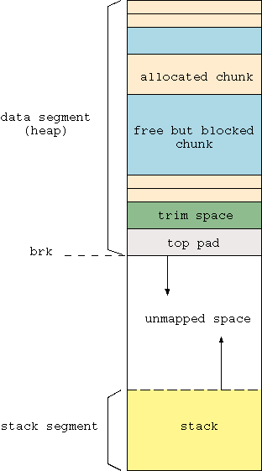
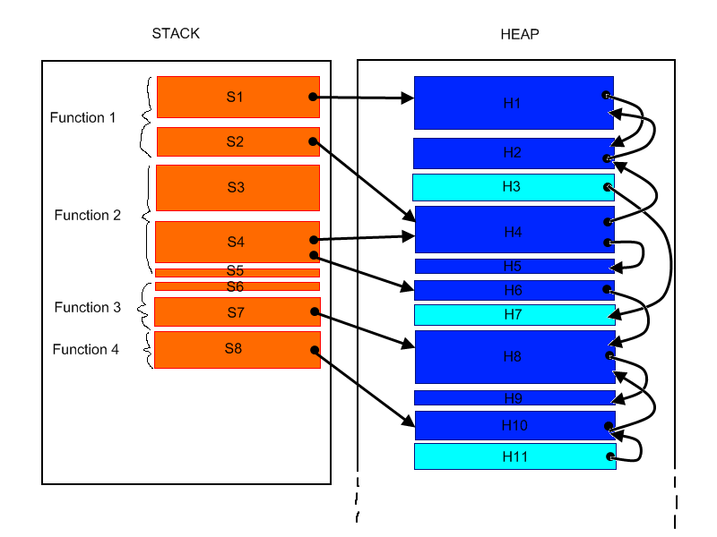
The heap and the stack
The heap and the stack are closely linked.
Copyright © 2009 Elsevier
Copyright © 2009 Elsevier

Slide 14
Scope Rules
A scope is a program section of maximal size in which no bindings change, or at least in which no re-declarations are permitted (see below)
In most languages with subroutines, we OPEN a new scope on subroutine entry. This includes:
create bindings for new local variables,
deactivate bindings for global variables that are re-declared (these variable are said to have a "hole" in their scope)
make references to variables
Copyright © 2009 Elsevier

Slide 15
Scope Rules: Static vs. Dynamic
Perhaps the most common use of dynamic scope rules is to provide implicit parameters to subroutines
Example: Set default base to print numbers in, or set precision of reals, as we did in Python.
This is generally considered bad programming practice nowadays
Alternative mechanisms exist
static variables that can be modified by auxiliary routines
default and optional parameters
Copyright © 2009 Elsevier

Slide 16
Names within a scope
Aliasing
What are aliases good for?
space saving - modern data allocation methods are better
multiple representations
linked data structures
Also, aliases arise in parameter passing as an (sometimes unfortunate) side effect
Euclid scope rules are designed to prevent this
Copyright © 2009 Elsevier

Slide 17
Sequencing
Usually, order of execution is just top to bottom, left to right.
Or is it?
Precedence of operation is one issue, and right to left is not quite true:
Example: int a = b + c*min(x,y);
More formally: an expression is either a simple object/token or is an expression of expressions
Note: looks like our grammars!

Slide 18
Infix, Postfix and Prefix
Prefix: op a b or op(a,b)
Actually standard in many languages
In Lisp: (* (+ 1 3) 2)
Infix: a op b
Sometimes just “syntatic sugar”; for example, in C++, a + b really calls operator+(a,b)
Postfix: a b op
Least common - used in Postscript, Forth, and intermediate code of some compilers
Also appears in C (and its descendants) and Pascal examples, such as ++value in C and the pointer dereferencing operator (^) in Pascal
Copyright © 2009 Elsevier

Slide 19
Expression Evaluation
Application of arithmetic identities: when can we assume an operation will work even if things are moved around?
Commutativity is assumed to be safe
If x + y works, then y + x should also
associativity (known to be dangerous)
a + (b + c) works if a~=maxint and b~=minint and c<0
(a + b) + c does not
This type of operation can be useful, though, for code optimization
Copyright © 2009 Elsevier

Slide 20
Expression versus statements
Most languages distinguish between expressions and statements.
Expressions always produce a value, and may or may not have a side effect.
Example: In python, b + c
Statements are executed solely for their side effects, and return no useful value
Example: in Python, mylist.sort()
A construct has a side effect if it influences subsequent computation in some way (other than simply returning a value).
Copyright © 2009 Elsevier

Slide 21
C and assignments within expressions
Combining expressions with assignments can have unfortunate side effects, depending on the language.
Pathological example: C has no true boolean type (just uses ints or their equivalents), and allows assignments within expressions.
Example: What does this do?
if (a =b) {
…
}
(Note – might be good reason for doing this!)
Copyright © 2009 Elsevier

Slide 22
A dirty word: GOTO
In C:
#include <stdio.h>
int main() {
int i = 0;
printf(“%d\n”,i);
goto some_label;
i = 1;
some_label:
printf(“%d\n”, i);
return 0;
}
Copyright © 2009 Elsevier

Slide 23
Alternatives to goto
Getting rid of goto was actually fairly easy, since it was usually used in certain ways.
Goto to jump to end of current subroutine: use return instead
Goto to escape from the middle of a loop: use exit or break
Goto to repeat sections of code: loops
Copyright © 2009 Elsevier

Slide 24
Biggest need for goto
Several settings are very useful for gotos, however.
Want to end a procedure/loop early (for example, if target value is found).
Solution: break or continue
Problem: What about “bookkeeping”? We’re breaking out of code which might end a scope - need to call desctructors, deallocate variables, etc.
Adds overhead to stack control - must be support for “unwinding the stack”
Copyright © 2009 Elsevier

Slide 25
Iteration
Ability to perform some set of operations repeatedly.
Loops
Recursion
Can think of iteration as the only way a function won’t run in constant time.
In a real sense, this is the most powerful component of programming.
In general, loops are more common in imperative languages, while recursion is more common in functional languages.
Copyright © 2009 Elsevier

Slide 26
Iteration: iterator based loops
Other languages (Ruby, Python, C# etc.) require any container to provide an iterator that enumerates items in that class.
This is extremely high level, and relatively new.
Example:
for item in mylist:
#code to look at items
Can even iterate over non-linear structures, such as binary trees.
Copyright © 2009 Elsevier

Slide 27
Recursion
Recursion
equally powerful when compared to iteration
mechanical transformations back and forth
often more intuitive (sometimes less)
naïve implementation less efficient
no special syntax required
fundamental to functional languages like Scheme
Copyright © 2009 Elsevier

Slide 28
Recursion
Tail recursion
No computation follows recursive call
int gcd (int a, int b) {
/* assume a, b > 0 */
if (a == b) return a;
else if (a > b) return gcd (a - b,b);
else return gcd (a, b – a);
}
A good compiler will translate this to machine code that runs “in place”, essentially returning to the start of the function with new a,b values.
Copyright © 2009 Elsevier

