Slide 1
Deadlock
David Ferry CSCI 2510 – Principles of Computing Systems
Saint Louis University St. Louis, MO 63103

Slide 2
Blocking Operations
Recall- Some operations cause a program to wait.
Quiz: Which of the following operations could cause blocking?
A. Locking a mutex
B. Opening a file
C. Reading a file
D. Reading from a pipe
E. Writing to a pipe

Slide 3
Blocking Operations
Recall- Some operations cause a program to wait.
Quiz: Which of the following operations could cause blocking?
A. Locking a mutex (already locked)
B. Opening a file (disk I/O)
C. Reading a file (disk I/O)
D. Reading from a pipe (pipe is empty)
E. Writing to a pipe (pipe is full)

Slide 4
Deadlock
A specific hazard occurs with blocking operations:
Could an adversary scheduler break our code?
mutex a, b;
Thread 1: Thread 2:
lock(a) lock(b)
lock(b) lock(a)
//Critical section //Critical section
unlock(b) unlock(a)
unlock(a) unlock(b)

Slide 5
Deadlock
A specific hazard occurs with blocking operations:
Could an adversary scheduler break our code?
mutex a, b;
Thread 1: Thread 2:
lock(a) lock(b)
lock(b) lock(a)
//Critical section //Critical section
unlock(b) unlock(a)
unlock(a) unlock(b)
1.
4.
Infinite wait
2.
3.

Slide 6
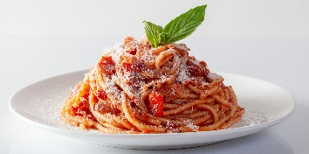
Classic Deadlock Example: Dining Philosophers
A group of philosophers are sharing a delicious spaghetti meal.
Six thinkers, six forks, each needs two forks to eat.
Each philosopher follows the procedure:
while( 1 ){ 1. Ponder mysteries for a while
2. Grab fork to their left (or wait)
3. Grab fork to their right (or wait)
4. Eat
5. Release forks
}
Spaghetti: Powerpoint Stock Photos

Slide 7

Recall – Lab 2
How could deadlock occur if the parent shell process waits on each child after forking instead of just the last?
SLU Shell Process
fork()
fork()
fork()
STDOUT
grep
sort
ls
STDIN
sort output
ls output
pipe
pipe

Slide 8
Recall – Lab 2
How could deadlock occur if the parent shell process waits on each child after forking instead of just the last?
SLU Shell Process
fork()
fork()
fork()
STDOUT
grep
sort
ls
STDIN
sort output
ls output
pipe
pipe

Slide 9
Necessary Conditions for Deadlock
Which of the following elements occurred in all three examples?
Philosophers Locking
Graph cycles Mutex variables
Processes Waiting
Threads Pipes
Resource exclusion Spaghetti

Slide 10
Necessary Conditions for Deadlock
Which of the following elements occurred in all three examples?
Philosophers Locking
Graph cycles Mutex variables
Processes Waiting
Threads Pipes
Resource exclusion Spaghetti
Deadlock is not just a property of threads, locks, and mutexes- it is a general systems problem.

Slide 11
Deadlock Conditions
Resource exclusion – Processes can hold resources in a non-shareable state
Hold-while-waiting – Processes can hold a resource while waiting for another resource
No preemption – Only the process holding a resource can release it
Circular wait – There can exist a set of waiting processes P₁…P_{N} such that P₁ waits on P₂, P₂ waits on P₃, … P_{N-1} waits on P_{N}, and P_{N} waits on P₁
1
6
2
5
3
4

Slide 12
Deadlock does not require explicit resource acquisition
The shell process calls wait() on the first child process, the child process calls write() on the pipe. The pipe is full. No process ever explicitly acquires a resource.
Possibility of deadlock is an inherent property of a design
That said, most of the time we talk about explicit acquisition
SLU Shell Process
fork()
fork()
fork()
STDOUT
grep
sort
ls
STDIN
sort output
ls output
pipe
pipe

Slide 13
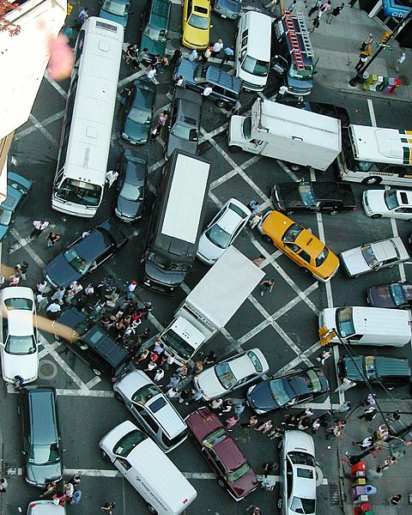
Real-World Example: Gridlock
Is this deadlock?
Resource exclusion
Hold-while-waiting
No preemption
Circular wait
Attribution: Rgoogin at the English Wikipedia

Slide 14
Which of these contain Deadlock?
Rule: Cars must drive in a straight line until they’re out of their box.
C
E
A
D
B

Slide 15
Can Deadlock is not Will Deadlock
Deadlock may or may not occur during any specific execution
Usually results from a race, so depends on timing
Just like race conditions, thorough testing is not guarantee of finding deadlock
Developer must reason about the system and convince themselves the system is deadlock-free
E.g. Philosophers don’t always deadlock Exercise: Give an execution for Dining Philosophers that doesn’t deadlock

Slide 16
Starvation
Related concept, will only introduce here:
Starvation – Individual processes may be “unlucky” and unable to progress
Example: Threads race and 1 never gets to lock(a)
mutex a, b
Thread 1 Thread 2 Thread 3
lock(a) lock(a) lock(a)
lock(b) lock(b) lock(b)
//process data //process data //process data
unlock(b) unlock(b) unlock(b)
unlock(a) unlock(a) unlock(a)

Slide 17
Livelock
Related concept, will only introduce here:
Livelock – Threads aren’t blocked/waiting but also never make progress
Example: Suppose we have “polite threads” that release their first lock if not able to acquire the second lock.
Thread 1: Lock a Thread 2: Lock b Thread 1: Try to lock b and fail
Thread 2: Try to lock a and fail
Thread 1: Release a
Thread 2: Release b Repeat

Slide 18
Deadlock Analysis
Deadlock scenarios are usually analyzed with a directed graph called a resource allocation graph:
Recall: A directed graph G = (V,E) is a set of vertices V and directed edges E, such that an edge a→b does not imply an edge b→a.
Example: V = {1, 2, 3, 4, 5, 6}
E = {1→2, 2→3, 3→4, 4→5, 5→6, 6→1}
1
6
2
5
3
4

Slide 19
Resource Allocation Graph
The RAG has two sets of vertices-
A set processes/threads drawn as circles
A set of resources drawn as squares
Edge from P to R: P is trying to acquire R
Edge from R to P: P is holding R
P
R
P is waiting for R
R
P
R is held by P

Slide 20
The Deadly Embrace
A cycle in the RAG indicates deadlock!
mutex a, b;
Thread P: Thread Q:
lock(a) lock(b)
lock(b) lock(a)
RAG: Processes = Resources =
Edges =
P
R
P is waiting for R
R
P
R is held by P
1.
4.
Infinite wait
2.
3.

Slide 21
The Deadly Embrace
A cycle in the RAG indicates deadlock!
mutex a, b;
Thread P: Thread Q:
lock(a) lock(b)
lock(b) lock(a)
RAG: Processes = { P, Q } Resources = {a, b}
Edges = { a→P, b→Q, Q→a, P→b }
P
R
P is waiting for R
R
P
R is held by P
1.
4.
Infinite wait
2.
3.
b
P
Q
a

Slide 22
Exercise
Does the following sequence result in deadlock? If so, at which step does the system deadlock?
Processes = { P, Q, R} Resources = {a, b, c, d, e}
1 P.acquire(a)
2 Q.acquire(c)
3 R.acquire(b)
4 P.acquire(c)
5 Q.acquire(d)
6 R.acquire(a)
7 Q.acquire(b)
8 R.acquire(e)
P
R
P is waiting for R
R
P
R is held by P

