Slide 1
Literature Review
Al₂O₃–YAG Coatings
Literature findings and proposed interface design
Group Meeting · 12 October 2026
Notes:
Three-part review for the group meeting. Part I: Paper 1 on a GH864 superalloy with an Al2O3–YAG interlayer and YSZ top layer. Part II: Paper 2 on bulk NiCoCrAlY. Part III: a proposed externally prepared YAG/Al2O3 coating on CoNiCrAlY, using sol-assisted interface anchoring and secondary nano-Al2O3 pore sealing. The proposal is not an experimentally validated outcome.
Ren, He & Wang. Cyclic oxidation behavior and thermal barrier effect of YSZ–(Al2O3/YAG) double-layer TBCs prepared by the composite sol–gel method. Surface & Coatings Technology 206 (2011), 1461–1468. DOI: 10.1016/j.surfcoat.2011.09.025.
Ren, He & Wang. High-temperature cyclic oxidation behavior of Al2O3–YAG composite coating prepared by EPD and microwave sintering. Applied Surface Science 258 (2012), 5739–5745. DOI: 10.1016/j.apsusc.2012.02.081.
Figures are excerpts supplied by the user for this internal academic presentation; schematics are original explanatory drawings, not to scale.

Slide 2
YSZ / Al₂O₃–YAG Double-Layer TBCs
1
Notes:
Ren, He & Wang. Cyclic oxidation behavior and thermal barrier effect of YSZ–(Al2O3/YAG) double-layer TBCs prepared by the composite sol–gel method. Surface & Coatings Technology 206 (2011), 1461–1468. DOI: 10.1016/j.surfcoat.2011.09.025.

Slide 3
Part I · A composite interlayer beneath YSZ
YSZ / Al₂O₃–YAG double-layer TBC
Design
Al₂O₃–YAG interlayer
+ YSZ top coat.
Heat + oxygen
YSZ top layer
Aim
Al₂O₃ matrix
+ YAG particles
Oxidation protection
+ thermal insulation.
GH864 superalloy
Gold: YAG · Pale blue: Al₂O₃
Ren et al., Surf. Coat. Technol., 2011. Original schematic; not to scale.
03
Notes:
Ren, He & Wang. Cyclic oxidation behavior and thermal barrier effect of YSZ–(Al2O3/YAG) double-layer TBCs prepared by the composite sol–gel method. Surface & Coatings Technology 206 (2011), 1461–1468. DOI: 10.1016/j.surfcoat.2011.09.025.
An alumina–YAG composite interlayer was externally deposited on GH864 superalloy; YSZ was blade-coated on top. This double-layer TBC was tested for cyclic oxidation and thermal insulation. GH864 is not CoNiCrAlY. Original explanatory schematic; colors distinguish layers rather than compositions quantitatively.

Slide 4
Part I · Preparation
1 · Precursor sol
2 · EPD
3 · Interlayer
4 · YSZ + PFMS
+
−
+
Boehmite + Y³⁺
1 wt.% α-Al₂O₃ seeds
30 mA/cm²
6 min
Dry: 24 h
Then PFMS
Blade-coat YSZ
PFMS: 960 °C, 2 h
Ren et al., Surf. Coat. Technol., 2011, §2. Original process schematic.
04
Notes:
Ren, He & Wang. Cyclic oxidation behavior and thermal barrier effect of YSZ–(Al2O3/YAG) double-layer TBCs prepared by the composite sol–gel method. Surface & Coatings Technology 206 (2011), 1461–1468. DOI: 10.1016/j.surfcoat.2011.09.025.
800-grit SiC polishing and acetone cleaning of GH864. Seeded boehmite sol contains 1 wt.% alpha-Al2O3 seeds and Y nitrate. EPD: 30 mA/cm² for 6 min. Room-temperature drying: 24 h, then interlayer microwave sintering. The YSZ slurry is blade-coated and dried; final PFMS schedule is 960 °C for 2 h. The intermediate interlayer heat-treatment schedule is not separately assigned a temperature on this slide. Y/Al ratios are in the full paper. Native drawings simplify the process without implying a measured thickness.

Slide 5
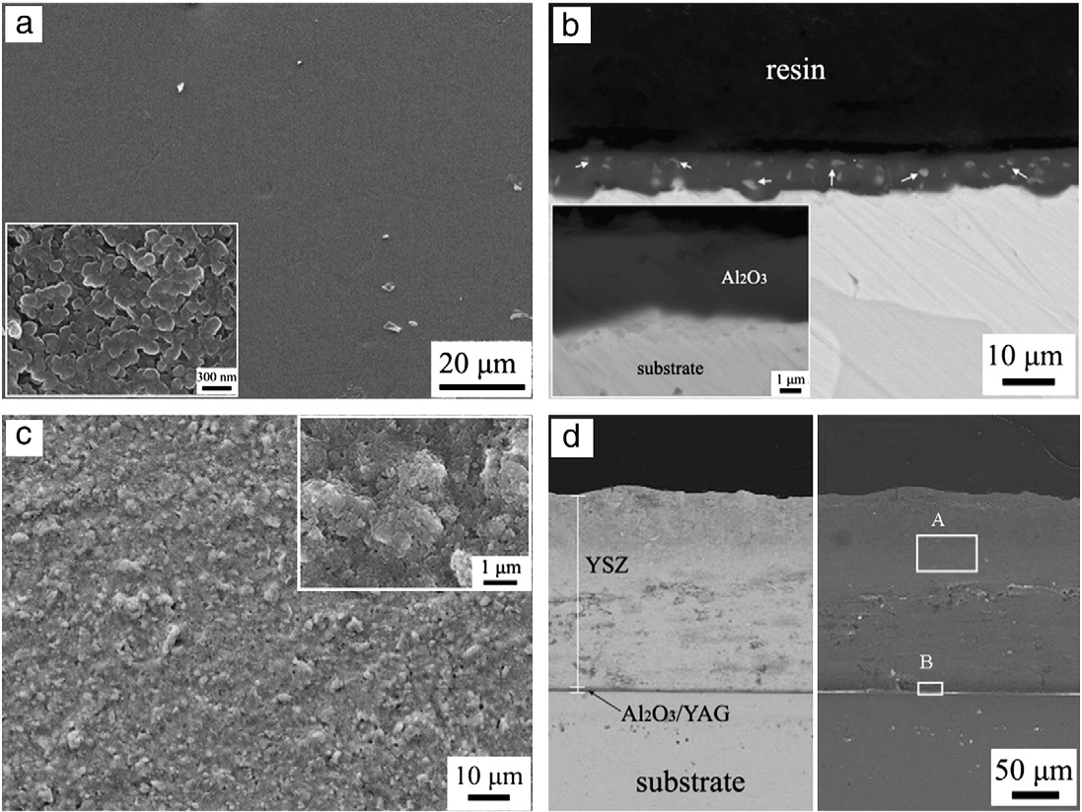
Part I · Structure and performance
SEM: AY1
Interlayer beneath YSZ (d).
1000 °C · 200 h
Mass gain: 1.04 vs. 2.23 mg/cm²
AY3 + YSZ / YSZ
Thermal drop
205 vs. 156 °C (dual / YSZ)
150 μm total thickness
Ren et al., Surf. Coat. Technol., 2011, Fig. 2, Fig. 5 and Table 1.
05
Notes:
Ren, He & Wang. Cyclic oxidation behavior and thermal barrier effect of YSZ–(Al2O3/YAG) double-layer TBCs prepared by the composite sol–gel method. Surface & Coatings Technology 206 (2011), 1461–1468. DOI: 10.1016/j.surfcoat.2011.09.025.
SEM figure 2 shown here is AY1, not the best-performing AY3 specimen. Panels a/b show interlayer surface/section; c/d show the YSZ double layer surface/section. Original labels and scale bars are retained. SEM indicates an identifiable continuous interlayer beneath YSZ; it does not measure bond strength. At 1000 °C and 200 h (10 h hot / 20 min air cooling), AY3+YSZ mass gain is 1.035 mg/cm² vs 2.231 for YSZ and 3.996 for blank; AY3 also has the lowest spallation among double layers. Thermal drop at furnace 1000 °C, N2 8 L/min and 150 µm total coating thickness is 205 °C for dual vs 156 °C for YSZ. These SEM, cyclic oxidation and thermal tests are different specimen conditions; no assertion that AY1 SEM establishes AY3 strength. Delta T is T1 minus T2 as used in results; the source methods have reversed sign.

Slide 6
Al₂O₃–YAG Composite Coatings
2
Notes:
Ren, He & Wang. High-temperature cyclic oxidation behavior of Al2O3–YAG composite coating prepared by EPD and microwave sintering. Applied Surface Science 258 (2012), 5739–5745. DOI: 10.1016/j.apsusc.2012.02.081.

Slide 7

Part II · Al₂O₃–YAG on NiCoCrAlY
Al₂O₃–YAG directly on the alloy
Design
Al₂O₃ matrix
+ dispersed YAG.
Oxygen
Al₂O₃ matrix
+ YAG particles
Aim
Less oxidation
and spallation.
NiCoCrAlY alloy
Bulk NiCoCrAlY substrate
Ren et al., Appl. Surf. Sci., 2012. Original schematic; not to scale.
07
Notes:
Ren, He & Wang. High-temperature cyclic oxidation behavior of Al2O3–YAG composite coating prepared by EPD and microwave sintering. Applied Surface Science 258 (2012), 5739–5745. DOI: 10.1016/j.apsusc.2012.02.081.
The authors deposited a seeded alumina–YAG precursor by EPD directly on polished bulk NiCoCrAlY, then used microwave sintering. They studied cyclic oxidation mass gain and spallation. The alloy is Ni39.5Co32Cr20Al8Y0.5 wt.%. This is not identical to a sprayed CoNiCrAlY bond coat. The drawing represents a ceramic coating externally supplied by deposition rather than a substrate-grown TGO. Both phases crystallize during heat treatment in the source process.

Slide 8
Part II · Preparation
1 · Surface
2 · Precursor sol
3 · EPD
4 · PFMS
+
−
+
1000-grit SiC
Acetone cleaning
Boehmite + Y³⁺
α-Al₂O₃ seeds + PEG
3.0 mA/cm²
8 min
PFMS: 1 h
α-Al₂O₃ + YAG
Ren et al., Appl. Surf. Sci., 2012, §2, Figs. 3–5. PFMS temperature not stated.
08
Notes:
Ren, He & Wang. High-temperature cyclic oxidation behavior of Al2O3–YAG composite coating prepared by EPD and microwave sintering. Applied Surface Science 258 (2012), 5739–5745. DOI: 10.1016/j.apsusc.2012.02.081.
Prepare bulk NiCoCrAlY with 1000-grit grinding and acetone cleaning. Seeded boehmite sol with 1 wt.% alpha-alumina and Y nitrate; Y/Al 0.05, 0.10, 0.20. PEG 0.2 wt.%. Graphite anodes, 10 mm gap. Representative deposition 3 mA/cm² for 8 min. Figure 3 shows a smooth dense surface at 6–8 min and cracking/local spallation at 10 min, so EPD time is a control variable rather than a calibrated thickness. PFMS 1 h forms alpha-Al2O3 and YAG. Source does not explicitly state PFMS temperature; do not import 960 °C from Paper 1. Microscale drawings do not establish real pore dimensions.

Slide 9
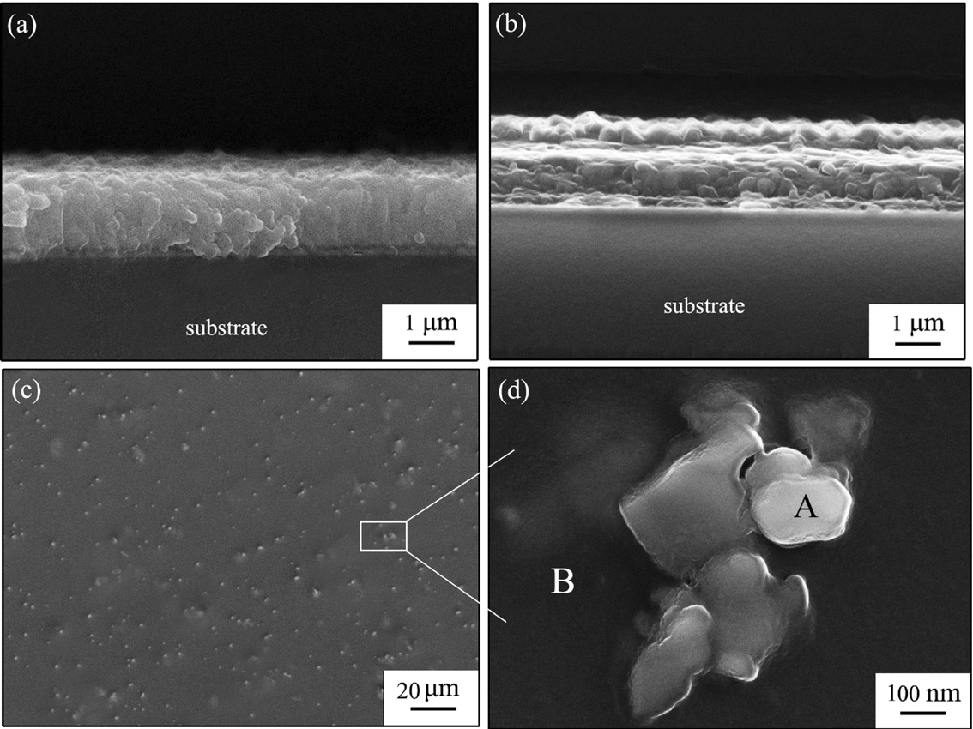
Part II · Structure and performance
SEM + XRD
Fine YAG in an Al₂O₃ matrix.
AY1: lowest mass gain
≈ 0.19 mg/cm² at 200 h
AY3: lowest spallation
0.11 mg/cm² at 200 h
Ren et al., Appl. Surf. Sci., 2012, Figs. 4–7. Fig. 7: 1050 °C; text differs.
09
Notes:
Ren, He & Wang. High-temperature cyclic oxidation behavior of Al2O3–YAG composite coating prepared by EPD and microwave sintering. Applied Surface Science 258 (2012), 5739–5745. DOI: 10.1016/j.apsusc.2012.02.081.
Figure 4a/b are coating sections after 10 min and 1 h PFMS, c/d surfaces after 1 h; EDS panels omitted. Authors identify fine YAG in alumina; phase assignment also supported by XRD Fig.5. Section continuity supports qualitative adherence; no quantitative bond strength is reported. Figure 7 at 200 h shows AY1 lowest mass gain ~0.19 mg/cm² and AY3 lowest spallation ~0.11 mg/cm². Blank mass gain 1.29 and spallation .94; alumina-only .99 and .57. Different Y/Al compositions optimize these separate responses. The prose assigns .19 to AY3 in error; curve labels and kp table support AY1. Methods/Fig7/Table1 state1050 °C, while abstract/conclusion/Fig8 state1000 °C; unresolved source inconsistency retained in footer. Do not assign these quantitative curves to the shown microscopy specimen indiscriminately.

Slide 10
Proposed Coating and Adhesion
3
Notes:
Our proposed route: sol-assisted anchoring, an alumina-rich connecting network, and secondary nano-Al2O3 sealing.

Slide 11
Part III · Proposed route: anchor, then seal
1 · Sol-assisted interface
2 · Al₂O₃-rich network
3 · Secondary sealing
CoNiCrAlY
CoNiCrAlY
CoNiCrAlY
Thin oxide + sol-derived layer
Dispersed, preformed YAG
Nano-Al₂O₃ in open pores
Metal
Sol-derived Al₂O₃
Al₂O₃ network
YAG
Proposed architecture; not to scale. Bonding and pore sealing require validation.
11
Notes:
This is a proposed ex situ route for CoNiCrAlY, not a reported result. A thin, adherent surface oxide and an alumina-sol-derived interface are intended to connect the substrate to an alumina-rich continuous ceramic network containing dispersed preformed YAG particles. The irregular metal boundary remains connected; it is not a layer of detached rectangular metal particles. Gray is metal, a darker thin band is surface oxide, medium blue is sol/sol-derived alumina, pale blue is the desired alumina-rich network, gold is YAG, white is void, and dark-blue small dots are secondary nano-alumina. The desired continuity of the network is a design target, not proof of sintering. Secondary nano-Al2O3 is drawn entering channels open to the surface; closed pores and residual lower voids remain. It cannot be assumed to fill closed pores or to penetrate below its accessible size range. The diagram is not a measured thickness or microstructure. Surface oxide adherence, precursor shrinkage, phase conversion, thermal mismatch, particle neck formation and deposition thickness all require measurement. 1100 °C for1h is only a proposed conventional-furnace baseline; it does not establish strong bonding or equivalence to pressure-filtration microwave sintering.
Ren, He & Wang. Cyclic oxidation behavior and thermal barrier effect of YSZ–(Al2O3/YAG) double-layer TBCs prepared by the composite sol–gel method. Surface & Coatings Technology 206 (2011), 1461–1468. DOI: 10.1016/j.surfcoat.2011.09.025.
Ren, He & Wang. High-temperature cyclic oxidation behavior of Al2O3–YAG composite coating prepared by EPD and microwave sintering. Applied Surface Science 258 (2012), 5739–5745. DOI: 10.1016/j.apsusc.2012.02.081.

Slide 12
Part III · Key question: will the coating stay bonded?
Two possible failure paths
1100 °C × 1 h
1 · Adhesion
2 · Cohesion
Bonding is not yet established.
Screen without CMAS
2
1250 °C × 1 h + cross-section SEM
1
Measure the weak link
CoNiCrAlY
Adhesion + crack location
First verify adhesion and cohesion. Then test long-term CMAS resistance.
1100 °C / 1 h bonding and 1250 °C / 100 h CMAS durability are unverified.
12
Notes:
Critical question based on the user's revised research proposal. Two stress-transfer links must be distinguished: adhesion of the coating/oxide system to CoNiCrAlY and cohesion within the sol-derived alumina/particle network. The red schematic paths are hypothetical failure locations, not observed cracks. A TGO or native oxide cannot automatically be assumed pure alpha-Al2O3, thin, or adherent; oxide chemistry and location must be characterized. Low-temperature sol tack does not establish fired bond strength. Conventional furnace treatment at1100°C for1h may be insufficient for robust necking of preformed YAG/Al2O3 particles; actual behavior depends on powder size, sol fraction, phase evolution and schedule. Thermal mismatch and shrinkage add stress. Ren et al.2012 report morphological adherence and improved spallation with seeded-sol EPD plus PFMS on bulk NiCoCrAlY, not a quantified adhesion strength or validation of drop coating + ordinary furnace on CoNiCrAlY. The source has conflicting1000/1050°C test temperatures and no1250°C CMAS evidence. The unspecific2018 paper in the pasted material has not been verified and is not cited. Proposed minimum comparison: A powder layer; B add a sol-derived interface; C additionally increase the alumina-derived connecting phase. Keep thickness and heat treatment comparable. First screen powdering/cracks after drying and heat treatment; then1250°C for1h without CMAS and cross-sectional SEM to locate damage, with a suitable quantitative adhesion test and failure-mode inspection. Scratch critical load alone is not an intrinsic interface strength. Only then assess prolonged CMAS durability up to100h and secondary sealing.
Ren, He & Wang. High-temperature cyclic oxidation behavior of Al2O3–YAG composite coating prepared by EPD and microwave sintering. Applied Surface Science 258 (2012), 5739–5745. DOI: 10.1016/j.apsusc.2012.02.081.

