Slide 1
YAG / Al₂O₃ + LSM
Laser processing and interface design
18 October 2026
Notes:
SHORT TALK
Today I will discuss two papers about laser processing of oxide coatings. Then I will explain how we can use these ideas for a YAG and alumina precoat on CoNiCrAlY. Our main question is whether the coating can remain firmly attached.
Adraider, Y., Pang, Y.X., Nabhani, F., Hodgson, S.N. and Zhang, Z.Y. Laser-induced deposition of sol–gel alumina coating on stainless steel under wet condition. Surface & Coatings Technology 205 (2011), 5345–5349. DOI: 10.1016/j.surfcoat.2011.05.044.
Yang, K. et al. Achieving a synergistic combination of high hardness, enhanced creep resistance and damage tolerance in plasma-sprayed eutectic/amorphous Al2O3-YAG composite coatings through laser remelting. Surface & Coatings Technology 524 (2026), 133278. DOI: 10.1016/j.surfcoat.2026.133278.
The first uploaded PDF is the 2011 UV-excimer study, not the separate 2013 Materials Letters paper in the shared discussion. All main-paper claims below follow the attached full texts. Limited original figure panels are reproduced with attribution for academic discussion.

Slide 2
Laser-Assisted Sol–Gel Deposition
1
Notes:
SHORT TALK
The first paper combines a wet alumina sol with a UV laser. It gives us a starting point for the binder.
Adraider, Y., Pang, Y.X., Nabhani, F., Hodgson, S.N. and Zhang, Z.Y. Laser-induced deposition of sol–gel alumina coating on stainless steel under wet condition. Surface & Coatings Technology 205 (2011), 5345–5349. DOI: 10.1016/j.surfcoat.2011.05.044.

Slide 3
Part I · Research idea
Wet sol + local laser treatment
Approach
Scan
Coat first.
Irradiate while wet.
Al₂O₃ sol + nanopowder
Research value
A laser can convert
the sol into an
oxide binder.
SS316 stainless steel
Deposited oxide
Adraider et al., Surf. Coat. Technol., 2011. Schematic; not to scale.
Notes:
SHORT TALK
The authors placed a wet alumina sol on stainless steel and scanned it with a UV laser. The laser helped deposit an alumina coating directly from the sol. This supports the idea of using a sol as an oxide binder, but it does not prove strong adhesion on CoNiCrAlY.
SOURCE AND EVIDENCE NOTES
Adraider, Y., Pang, Y.X., Nabhani, F., Hodgson, S.N. and Zhang, Z.Y. Laser-induced deposition of sol–gel alumina coating on stainless steel under wet condition. Surface & Coatings Technology 205 (2011), 5345–5349. DOI: 10.1016/j.surfcoat.2011.05.044. Main idea: abstract and Fig. 1. Substrate: SS316. This was a wet-deposition route, not laser melting of a YAG coating or demonstrated substrate melting.

Slide 4
Part I · Preparation
1 · Mixture
2 · Wet coating
3 · Laser scan
Sol + Al₂O₃ powder
1:1 solid ratio
5.3 wt.% total solids
Polished SS316
Apply the wet sol
Irradiate immediately
248 nm · 3.5 mJ
30 mm/min · 200 Hz
Adraider et al., 2011, §2.1 and Fig. 1. Original process schematic.
Notes:
SHORT TALK
The sol was mixed with alumina nanopowder. The authors applied this mixture to polished SS316 and used the laser immediately, while it was still wet. They used a 248-nanometre excimer laser. These conditions are a reference, not a ready-made setting for our laser.
SOURCE AND EVIDENCE NOTES
Adraider, Y., Pang, Y.X., Nabhani, F., Hodgson, S.N. and Zhang, Z.Y. Laser-induced deposition of sol–gel alumina coating on stainless steel under wet condition. Surface & Coatings Technology 205 (2011), 5345–5349. DOI: 10.1016/j.surfcoat.2011.05.044. Methods: sol-derived solid:nanopowder = 1:1 by mass on a solid basis; final solids 5.3 wt.%. 248 nm KrF laser, nominal energy 3.5 mJ, speed 30 mm/min, 200 Hz, 100 pulses, 4–6 ns pulse length, 25 µm circular beam, 10 × 10 mm scanned area. Coating remained wet before and after irradiation.

Slide 5
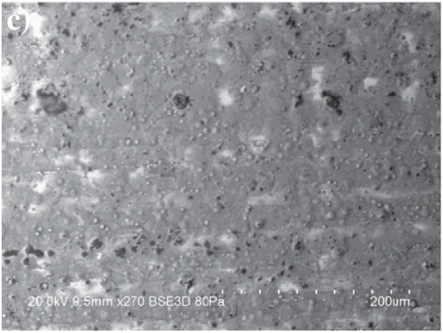
Part I · Structure and performance
SEM: laser-deposited surface
Rough surface; particles remain.
Phase
Partly crystalline γ-Al₂O₃
Reported hardness
0.175 → 0.738 GPa
Adhesion still needs testing.
Adraider et al., 2011, Fig. 2(c), XRD and Table 4. SEM panel cropped.
Notes:
SHORT TALK
The SEM image shows a rough surface with particles and small pores. XRD shows partial formation of gamma alumina. The reported hardness rose from about 0.18 to 0.74 gigapascals. For us, this supports laser conversion of the binder. However, hardness and interface adhesion are different measurements.
SOURCE AND EVIDENCE NOTES
Adraider, Y., Pang, Y.X., Nabhani, F., Hodgson, S.N. and Zhang, Z.Y. Laser-induced deposition of sol–gel alumina coating on stainless steel under wet condition. Surface & Coatings Technology 205 (2011), 5345–5349. DOI: 10.1016/j.surfcoat.2011.05.044. Figure 2(c) is the laser-deposited surface SEM. Figure 2(d), not used here, is the AS-DRIED cross-section. XRD: partly crystalline gamma alumina, not alpha alumina. Table 4: hardness 0.175 ± 0.024 vs 0.738 ± 0.405 GPa; reduced modulus 4.134 ± 0.290 vs 37.484 ± 10.240 GPa. Mean reported coating thickness: 4.2 µm as-dried and 1.9 µm laser-deposited. Indentation depths approach the film thickness, so substrate influence limits intrinsic-property interpretation. No direct quantitative adhesion test establishes strong bonding on CoNiCrAlY.

Slide 6
Laser Remelting of Al₂O₃–YAG
2
Notes:
SHORT TALK
The second paper starts with a much thicker plasma-sprayed coating. It shows how laser remelting changes the coating structure.
Yang, K. et al. Achieving a synergistic combination of high hardness, enhanced creep resistance and damage tolerance in plasma-sprayed eutectic/amorphous Al2O3-YAG composite coatings through laser remelting. Surface & Coatings Technology 524 (2026), 133278. DOI: 10.1016/j.surfcoat.2026.133278.

Slide 7
Part II · Research idea
APS coating
After laser remelting
Aim
Reduce defects.
Strengthen the surface.
Retained
amorphous layer
Key change
Eutectic surface
+ retained amorphous
material below.
NiCr bond coat + steel
Yang et al., Surf. Coat. Technol., 2026. Schematic; not to scale.
Notes:
SHORT TALK
This paper used an alumina–YAG coating made by atmospheric plasma spraying. It was placed on stainless steel with a NiCr bond coat. Laser remelting formed a crystalline surface layer, while part of the deeper coating remained amorphous. This is useful for controlling local structure, but it is a different starting material from our precoat.
SOURCE AND EVIDENCE NOTES
Yang, K. et al. Achieving a synergistic combination of high hardness, enhanced creep resistance and damage tolerance in plasma-sprayed eutectic/amorphous Al2O3-YAG composite coatings through laser remelting. Surface & Coatings Technology 524 (2026), 133278. DOI: 10.1016/j.surfcoat.2026.133278. APS ceramic on a NiCr bond coat and a stainless-steel substrate. Initial ceramic thickness is roughly 0.5 mm; this is not a nanometre-thick sol film. See Figs. 4–6 for the layered eutectic/amorphous structure. No ceramic/CoNiCrAlY interface adhesion improvement is established.

Slide 8
Part II · Laser remelting
Continuous laser + argon
Power window
300–1000 W
20 mm/s
5 × 5 mm spot
Fixed settings
20 mm/s
5 × 5 mm spot
Argon shielding
Ceramic
Steel
Depth + defects both matter.
Remelted track
Yang et al., 2026, §2.2 and Table 3. Original process schematic.
Notes:
SHORT TALK
The authors used a continuous laser with a rectangular spot and argon shielding. They varied the power while keeping the scan speed fixed. Higher power generally produced a deeper remelted layer, but defects and mechanical behavior did not improve in the same way at every setting. We should test a process window rather than choose the highest power.
SOURCE AND EVIDENCE NOTES
Yang, K. et al. Achieving a synergistic combination of high hardness, enhanced creep resistance and damage tolerance in plasma-sprayed eutectic/amorphous Al2O3-YAG composite coatings through laser remelting. Surface & Coatings Technology 524 (2026), 133278. DOI: 10.1016/j.surfcoat.2026.133278. Continuous YLS-5000 laser; power 300, 350, 400, 500, 700, 900 and 1000 W; speed 20 mm/s; 5 × 5 mm rectangular spot; argon shielding. Reported energy densities 3–10 J/mm². These values depend on the beam geometry, speed and source coating; they are not validated settings for a sol-derived precoat or a different laser wavelength.

Slide 9
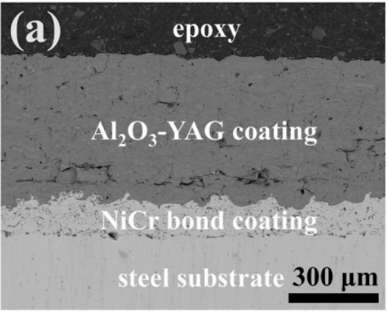
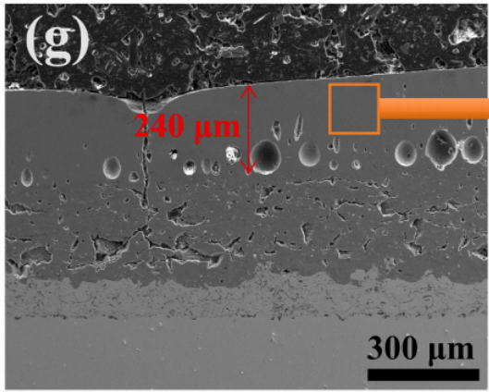
Part II · Structure and performance
As-sprayed
900 W / 20 mm/s
Depth · 900 W
≈ 240 µm
Porosity · local
3.52% → 0.36%
Peak hardness
23.46 GPa
A dense upper region; gas pores remain.
Yang et al., 2026, Fig. 4(a,g), §3.1–3.2. SEM panels cropped.
Notes:
SHORT TALK
These cross-sections compare the original coating with the 900-watt sample. A remelted layer about 240 micrometres deep is visible. The paper reports a lower porosity in this region, but large pores are still visible. The study also reports higher surface hardness. These results support local densification, not proven improvement of the metal–ceramic bond.
SOURCE AND EVIDENCE NOTES
Yang, K. et al. Achieving a synergistic combination of high hardness, enhanced creep resistance and damage tolerance in plasma-sprayed eutectic/amorphous Al2O3-YAG composite coatings through laser remelting. Surface & Coatings Technology 524 (2026), 133278. DOI: 10.1016/j.surfcoat.2026.133278. Original SEM Fig. 4(a) as-sprayed and Fig. 4(g) 900 W / 20 mm/s. Scale bars retained. At 900 W, reported remelted layer ~240 µm and remelt-zone porosity 0.36%, versus 3.52% for the as-sprayed coating; image analysis in selected 300 × 300 µm regions, not a whole-system porosity map. Residual gas pores are clearly visible. Peak near-surface hardness across the study is 23.46 GPa; do not assign every peak to the 900 W specimen. Indentation creep tests used 500 mN and a 60 s hold. The ~65% rate reduction is associated with an optimal sample such as 500 W; 900 W showed coarsening and poorer creep behavior. No 1250 °C CMAS-life or quantitative substrate-interface adhesion result is established.

Slide 10
Our Precoat + LSM Proposal
3
Notes:
SHORT TALK
Now I will connect the literature to our work. We want to control both the coating thickness and its attachment to CoNiCrAlY.
Research proposal, not a demonstrated process.

Slide 11
Part III · Lessons and open question
Sol + laser
Al₂O₃–YAG + laser
CoNiCrAlY + LSM
Convert the oxide binder.
Control depth and porosity.
In-situ oxide (Sun et al.).
Open question: will an external layer stay bonded?
Separate interface adhesion from strength within the coating.
Check thickness, cracks and failure location after thermal cycling.
Adraider (2011); Yang (2026); Sun (2026). Full references in notes.
Notes:
SHORT TALK
The first paper supports laser conversion of a sol binder. The second supports local remelting of alumina–YAG. The third paper studies an oxide formed from the CoNiCrAlY alloy itself. Our coating comes from external material, so the key question remains: will it stay attached? We must check the failure location, not just the hardness.
SOURCE AND EVIDENCE NOTES
Adraider, Y., Pang, Y.X., Nabhani, F., Hodgson, S.N. and Zhang, Z.Y. Laser-induced deposition of sol–gel alumina coating on stainless steel under wet condition. Surface & Coatings Technology 205 (2011), 5345–5349. DOI: 10.1016/j.surfcoat.2011.05.044.
Yang, K. et al. Achieving a synergistic combination of high hardness, enhanced creep resistance and damage tolerance in plasma-sprayed eutectic/amorphous Al2O3-YAG composite coatings through laser remelting. Surface & Coatings Technology 524 (2026), 133278. DOI: 10.1016/j.surfcoat.2026.133278.
Sun, L., Zhu, W. and Chen, H. A pre-formed yttria alumina garnet (YAG) and Al2O3 mixed oxide layer induced by continuous laser surface melting in air for inhibiting β depletion in a CoNiCrAlY bond coat alloy. Corrosion Science 263 (2026), 113713. DOI: 10.1016/j.corsci.2026.113713. Bibliographic title and authors verified with Crossref; full text not available in this task. Used only for the qualitative in-situ route described by the title, not numerical process or lifetime claims.
Proposed validation: compare precoat without laser, precoat with laser, and bare CoNiCrAlY with LSM; add sol-only + laser if separating binder effects. Measure thickness at multiple positions, phase by XRD, cross-sectional cracks and porosity, and quantitative adhesion using a suitable method with failure-location verification. Test thermal cycling before optional CMAS. The proposed process is not yet demonstrated, and ceramic cohesion must be separated from metal–ceramic interface adhesion.

Slide 12
Part III · Proposed precoat + LSM route
YAG / Al₂O₃ + Al₂O₃ sol
Control
Laser scan
Precoat mass
Laser input
Track (target)
Precoat
Verify
Thickness
Phases + cracks
Interface adhesion
CoNiCrAlY
Local melt zone
(to be controlled)
Gold: YAG · Blue: alumina-based phase
Proposed experiment. Schematic only; phases and interface bonding need validation.
Notes:
SHORT TALK
We propose to apply a thin YAG and alumina precoat with an alumina sol binder. Then we scan the surface with the laser. The aim is to form a continuous layer and improve the local interface without causing large cracks or excessive substrate melting. The colored hot zone is a target process region, not a measured result. First we will control deposited mass and laser conditions, then check the section and adhesion.
SOURCE AND EVIDENCE NOTES
Research proposal informed by Adraider, Y., Pang, Y.X., Nabhani, F., Hodgson, S.N. and Zhang, Z.Y. Laser-induced deposition of sol–gel alumina coating on stainless steel under wet condition. Surface & Coatings Technology 205 (2011), 5345–5349. DOI: 10.1016/j.surfcoat.2011.05.044.
Yang, K. et al. Achieving a synergistic combination of high hardness, enhanced creep resistance and damage tolerance in plasma-sprayed eutectic/amorphous Al2O3-YAG composite coatings through laser remelting. Surface & Coatings Technology 524 (2026), 133278. DOI: 10.1016/j.surfcoat.2026.133278.
Sun, L., Zhu, W. and Chen, H. A pre-formed yttria alumina garnet (YAG) and Al2O3 mixed oxide layer induced by continuous laser surface melting in air for inhibiting β depletion in a CoNiCrAlY bond coat alloy. Corrosion Science 263 (2026), 113713. DOI: 10.1016/j.corsci.2026.113713. Bibliographic title and authors verified with Crossref; full text not available in this task. Used only for the qualitative in-situ route described by the title, not numerical process or lifetime claims.
External ceramic supply distinguishes this route from substrate-grown YAG/Al2O3. The beam is shown over a local treatment zone; the whole ceramic layer and alloy are not assumed to melt. The processed track illustrates the desired outcome, not evidence that particles sinter or bind successfully. Local melt depth, wetting, dilution, phase changes, residual stress, evaporation and cracking must be measured. Wet irradiation in Paper 1 is evidence for that specific UV route; for continuous LSM compare controlled pre-drying against wet application rather than assume a wet layer is safe or stable. Control solids loading, deposited mass per area and coat count; measure final thickness. Laser power, speed, spot size, overlap and atmosphere require their own screen. Verify adhesion and thermal stability before optional nano-alumina sealing or CMAS exposure.

Slide 13
Thank You
Dear Professor Chen,
I would welcome your valuable comments and suggestions.
Notes:
SHORT TALK
Thank you. I would welcome your comments on the coating route and the next tests.

