Slide 1
Literature Review
Al₂O₃–YAG Coatings
Part I · YSZ / Al₂O₃–YAG double-layer TBCs
Part II · Al₂O₃–YAG oxidation coating
Part III · Our proposed coating route
Group Meeting · 12 October 2026
Notes:
Three-part review for the group meeting. Part I: Paper 1 on a GH864 superalloy with an Al2O3–YAG interlayer and YSZ top layer. Part II: Paper 2 on bulk NiCoCrAlY. Part III: a proposed externally prepared YAG/Al2O3 coating on CoNiCrAlY, using sol-assisted interface anchoring and secondary nano-Al2O3 pore sealing. The proposal is not an experimentally validated outcome.
Ren, He & Wang. Cyclic oxidation behavior and thermal barrier effect of YSZ–(Al2O3/YAG) double-layer TBCs prepared by the composite sol–gel method. Surface & Coatings Technology 206 (2011), 1461–1468. DOI: 10.1016/j.surfcoat.2011.09.025.
Ren, He & Wang. High-temperature cyclic oxidation behavior of Al2O3–YAG composite coating prepared by EPD and microwave sintering. Applied Surface Science 258 (2012), 5739–5745. DOI: 10.1016/j.apsusc.2012.02.081.
Figures are excerpts supplied by the user for this internal academic presentation; schematics are original explanatory drawings, not to scale.

Slide 2
Part I · What did the first study do?
YSZ / Al₂O₃–YAG double-layer TBC
What was done
Inserted an Al₂O₃–YAG
interlayer beneath YSZ.
Heat + oxygen
YSZ top layer
Why
Al₂O₃ matrix
+ YAG particles
Improve cyclic oxidation
resistance and thermal
insulation.
GH864 superalloy
An externally deposited ceramic interlayer
Ren et al., Surf. Coat. Technol., 2011. Original schematic; not to scale.
02
Notes:
Ren, He & Wang. Cyclic oxidation behavior and thermal barrier effect of YSZ–(Al2O3/YAG) double-layer TBCs prepared by the composite sol–gel method. Surface & Coatings Technology 206 (2011), 1461–1468. DOI: 10.1016/j.surfcoat.2011.09.025.
An alumina–YAG composite interlayer was externally deposited on GH864 superalloy; YSZ was blade-coated on top. This double-layer TBC was tested for cyclic oxidation and thermal insulation. GH864 is not CoNiCrAlY. Original explanatory schematic; colors distinguish layers rather than compositions quantitatively.

Slide 3
Part I · How was the double layer prepared?
1 · Composite sol
2 · EPD
3 · Interlayer
4 · YSZ + PFMS
+
−
Boehmite + 1 wt.%
α-Al₂O₃ seeds
Y nitrate
30 mA/cm²
6 min
Dry: 24 h
Microwave-sinter
Blade-coat YSZ
Final PFMS:
960 °C, 2 h
Ren et al., Surf. Coat. Technol., 2011, §2. Original process schematic.
03
Notes:
Ren, He & Wang. Cyclic oxidation behavior and thermal barrier effect of YSZ–(Al2O3/YAG) double-layer TBCs prepared by the composite sol–gel method. Surface & Coatings Technology 206 (2011), 1461–1468. DOI: 10.1016/j.surfcoat.2011.09.025.
800-grit SiC polishing and acetone cleaning of GH864. Seeded boehmite sol contains 1 wt.% alpha-Al2O3 seeds and Y nitrate. EPD: 30 mA/cm² for 6 min. Room-temperature drying: 24 h, then interlayer microwave sintering. The YSZ slurry is blade-coated and dried; final PFMS schedule is 960 °C for 2 h. The intermediate interlayer heat-treatment schedule is not separately assigned a temperature on this slide. Y/Al ratios are in the full paper. Native drawings simplify the process without implying a measured thickness.

Slide 4
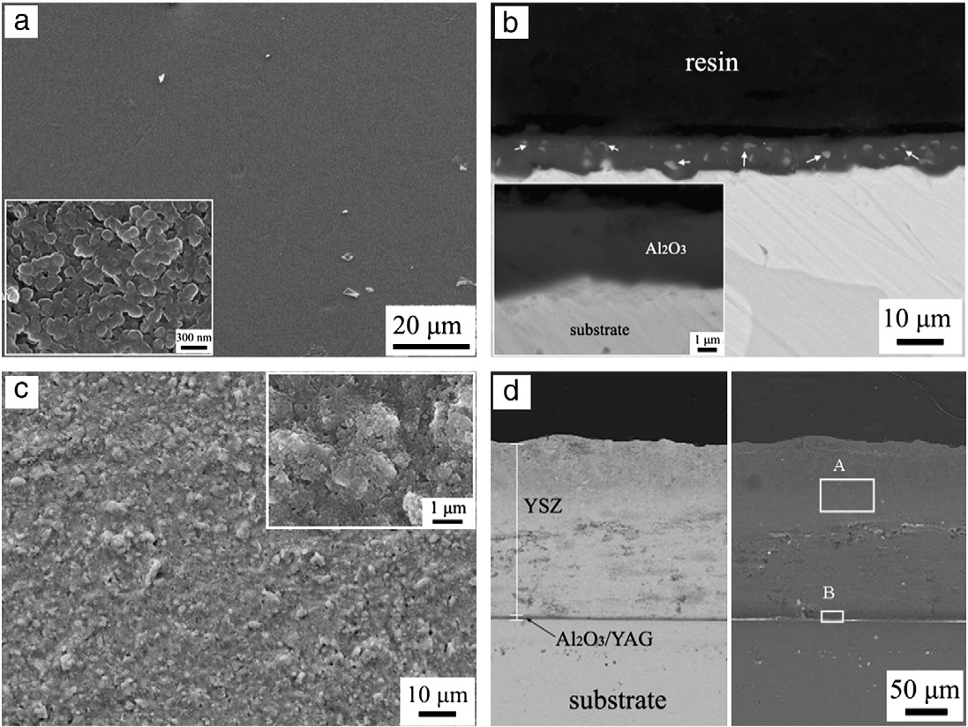
Part I · What were the main results?
SEM: layered structure
Section (d): interlayer beneath YSZ.
SEM specimen: AY1.
Oxidation at 1000 °C
AY3 + YSZ: 1.04 mg/cm² at 200 h
vs. 2.23 mg/cm² for YSZ.
Thermal insulation
ΔT: 205 vs. 156 °C (dual / YSZ)
At 150 μm total coating thickness.
Ren et al., Surf. Coat. Technol., 2011, Fig. 2, Fig. 5 and Table 1.
04
Notes:
Ren, He & Wang. Cyclic oxidation behavior and thermal barrier effect of YSZ–(Al2O3/YAG) double-layer TBCs prepared by the composite sol–gel method. Surface & Coatings Technology 206 (2011), 1461–1468. DOI: 10.1016/j.surfcoat.2011.09.025.
SEM figure 2 shown here is AY1, not the best-performing AY3 specimen. Panels a/b show interlayer surface/section; c/d show the YSZ double layer surface/section. Original labels and scale bars are retained. SEM indicates an identifiable continuous interlayer beneath YSZ; it does not measure bond strength. At 1000 °C and 200 h (10 h hot / 20 min air cooling), AY3+YSZ mass gain is 1.035 mg/cm² vs 2.231 for YSZ and 3.996 for blank; AY3 also has the lowest spallation among double layers. Thermal drop at furnace 1000 °C, N2 8 L/min and 150 µm total coating thickness is 205 °C for dual vs 156 °C for YSZ. These SEM, cyclic oxidation and thermal tests are different specimen conditions; no assertion that AY1 SEM establishes AY3 strength. Delta T is T1 minus T2 as used in results; the source methods have reversed sign.

Slide 5

Part II · What did the second study do?
Al₂O₃–YAG directly on the alloy
What was done
Deposited an Al₂O₃–YAG
composite directly on
NiCoCrAlY.
Oxygen
Al₂O₃ matrix
+ YAG particles
Why
Suppress cyclic oxidation
and coating spallation.
NiCoCrAlY alloy
Bulk alloy coupon; no YSZ top layer
Ren et al., Appl. Surf. Sci., 2012. Original schematic; not to scale.
05
Notes:
Ren, He & Wang. High-temperature cyclic oxidation behavior of Al2O3–YAG composite coating prepared by EPD and microwave sintering. Applied Surface Science 258 (2012), 5739–5745. DOI: 10.1016/j.apsusc.2012.02.081.
The authors deposited a seeded alumina–YAG precursor by EPD directly on polished bulk NiCoCrAlY, then used microwave sintering. They studied cyclic oxidation mass gain and spallation. The alloy is Ni39.5Co32Cr20Al8Y0.5 wt.%. This is not identical to a sprayed CoNiCrAlY bond coat. The drawing represents a ceramic coating externally supplied by deposition rather than a substrate-grown TGO. Both phases crystallize during heat treatment in the source process.

Slide 6
Part II · How was the composite coating made?
1 · Surface
2 · Composite sol
3 · EPD
4 · PFMS
+
−
1000-grit SiC
Acetone cleaning
Seeded boehmite
+ Y nitrate
PEG: 0.2 wt.%
3.0 mA/cm², 8 min
6–8 min: smooth
10 min: cracking
Microwave sinter:
1 h
α-Al₂O₃ + YAG
Ren et al., Appl. Surf. Sci., 2012, §2, Figs. 3–5. PFMS temperature not stated.
06
Notes:
Ren, He & Wang. High-temperature cyclic oxidation behavior of Al2O3–YAG composite coating prepared by EPD and microwave sintering. Applied Surface Science 258 (2012), 5739–5745. DOI: 10.1016/j.apsusc.2012.02.081.
Prepare bulk NiCoCrAlY with 1000-grit grinding and acetone cleaning. Seeded boehmite sol with 1 wt.% alpha-alumina and Y nitrate; Y/Al 0.05, 0.10, 0.20. PEG 0.2 wt.%. Graphite anodes, 10 mm gap. Representative deposition 3 mA/cm² for 8 min. Figure 3 shows a smooth dense surface at 6–8 min and cracking/local spallation at 10 min, so EPD time is a control variable rather than a calibrated thickness. PFMS 1 h forms alpha-Al2O3 and YAG. Source does not explicitly state PFMS temperature; do not import 960 °C from Paper 1. Microscale drawings do not establish real pore dimensions.

Slide 7
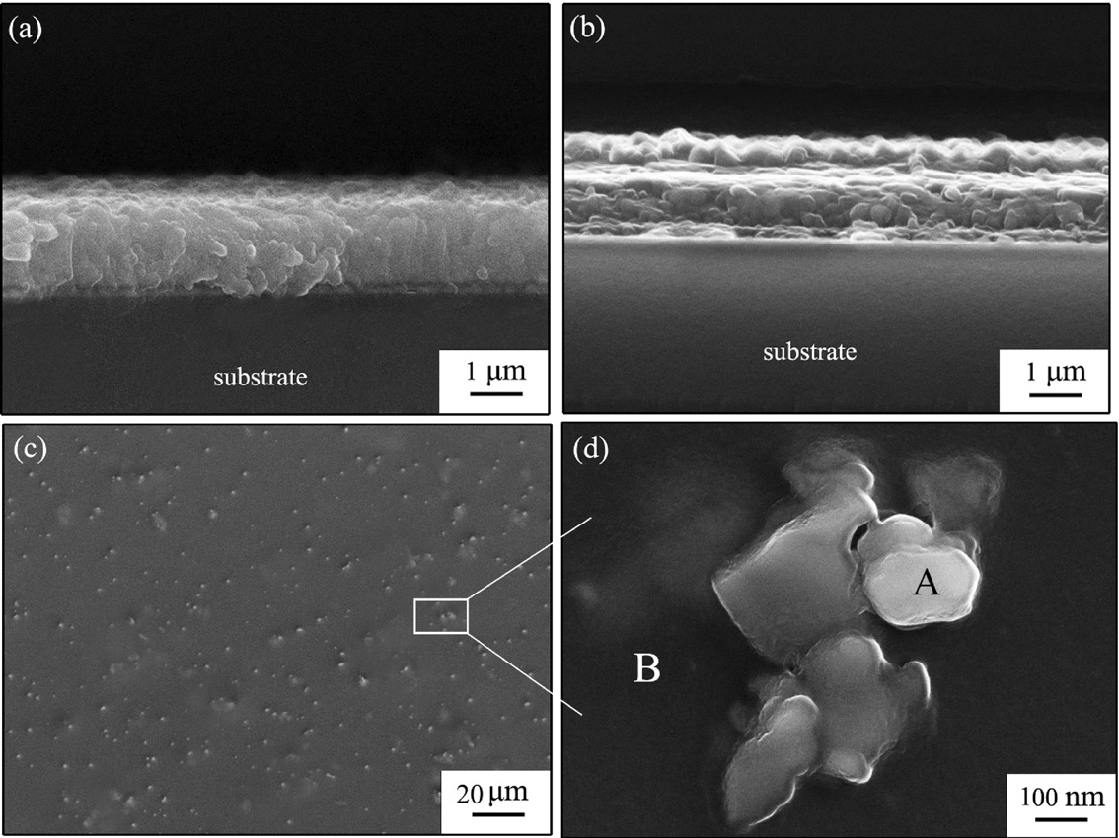
Part II · What were the main results?
SEM + phase evidence
Continuous coating; fine YAG
in an Al₂O₃ matrix (SEM + XRD).
AY1: lowest mass gain
≈ 0.19 mg/cm² at 200 h
AY3: lowest spallation
0.11 mg/cm² at 200 h
Adhesion strength still unmeasured.
Ren et al., Appl. Surf. Sci., 2012, Figs. 4–7. Fig. 7: 1050 °C; text differs.
07
Notes:
Ren, He & Wang. High-temperature cyclic oxidation behavior of Al2O3–YAG composite coating prepared by EPD and microwave sintering. Applied Surface Science 258 (2012), 5739–5745. DOI: 10.1016/j.apsusc.2012.02.081.
Figure 4a/b are coating sections after 10 min and 1 h PFMS, c/d surfaces after 1 h; EDS panels omitted. Authors identify fine YAG in alumina; phase assignment also supported by XRD Fig.5. Section continuity supports qualitative adherence; no quantitative bond strength is reported. Figure 7 at 200 h shows AY1 lowest mass gain ~0.19 mg/cm² and AY3 lowest spallation ~0.11 mg/cm². Blank mass gain 1.29 and spallation .94; alumina-only .99 and .57. Different Y/Al compositions optimize these separate responses. The prose assigns .19 to AY3 in error; curve labels and kp table support AY1. Methods/Fig7/Table1 state1050 °C, while abstract/conclusion/Fig8 state1000 °C; unresolved source inconsistency retained in footer. Do not assign these quantitative curves to the shown microscopy specimen indiscriminately.

Slide 8
Part III · Our route: anchoring + pore sealing
1 · Sol-assisted anchoring
2 · Composite deposition
3 · Nano-Al₂O₃ sealing
CoNiCrAlY
CoNiCrAlY
CoNiCrAlY
Sol wets surface valleys;
a thin interface supports
particle attachment.
Deposit preformed
YAG/Al₂O₃ particles;
control coating thickness.
Infiltrate nano-Al₂O₃;
fill accessible pores
and heat-treat compatibly.
Verify adhesion · Measure thickness · Check cyclic stability
Proposed CoNiCrAlY route, inspired by the two studies; validation is required.
08
Notes:
User-proposed research route, not a reported result in either paper. Prepare an externally supplied YAG/Al2O3 composite coating on CoNiCrAlY, using a sol-assisted interface and a secondary nanoparticle sealing step. Step1 wet a controlled clean/rough surface with a compatible alumina-based sol so liquid enters accessible valleys and supports particle attachment. Step2 deposit externally prepared YAG/Al2O3 composite powder onto/with the sol-derived interface; control solid loading, deposition cycles and measured thickness. Step3 infiltrate dilute nano-Al2O3 suspension or compatible sol into accessible connected pores and dry/heat-treat under a substrate-compatible schedule. Drawn surface relief, particles and filled pores are conceptual and not to scale. Improved anchoring, chemical bonding and sealing are hypotheses requiring interface failure analysis, quantitative adhesion, cross-sectional thickness/porosity, XRD and cyclic stability measurements. Avoid claiming perfect sealing or a validated optimum. Sol wetting, drying shrinkage, thermal mismatch and formation of unwanted alloy oxides must be tested. No specific sintering temperature is prescribed.
Literature rationale: Ren, He & Wang. Cyclic oxidation behavior and thermal barrier effect of YSZ–(Al2O3/YAG) double-layer TBCs prepared by the composite sol–gel method. Surface & Coatings Technology 206 (2011), 1461–1468. DOI: 10.1016/j.surfcoat.2011.09.025.
Ren, He & Wang. High-temperature cyclic oxidation behavior of Al2O3–YAG composite coating prepared by EPD and microwave sintering. Applied Surface Science 258 (2012), 5739–5745. DOI: 10.1016/j.apsusc.2012.02.081.

