Slide 1
Literature Review
Al₂O₃–YAG Coatings
Cyclic Oxidation and
Thermal Barrier Performance
Group Meeting · 12 October 2026
Notes:
This review first explains the two papers, then connects them to our research task. Paper 1 integrates an alumina–YAG interlayer into a YSZ thermal barrier coating on GH864 superalloy. Paper 2 studies the alumina–YAG coating itself on a NiCoCrAlY alloy. The immediate question is whether an externally deposited ceramic layer can provide good adhesion and controllable thickness on our CoNiCrAlY surface. We must distinguish a deposited ceramic layer from the thermally grown oxide formed during service. We will also distinguish evidence from proposals. The two papers are from the same group and are not independent replication.
Ren, He & Wang. Cyclic oxidation behavior and thermal barrier effect of YSZ–(Al2O3/YAG) double-layer TBCs prepared by the composite sol–gel method. Surface & Coatings Technology 206 (2011), 1461–1468. DOI: 10.1016/j.surfcoat.2011.09.025.
Ren, He & Wang. High-temperature cyclic oxidation behavior of Al2O3–YAG composite coating prepared by EPD and microwave sintering. Applied Surface Science 258 (2012), 5739–5745. DOI: 10.1016/j.apsusc.2012.02.081.
Figures are limited excerpts from user-supplied papers, used with attribution for internal academic criticism and discussion. No external redistribution rights are asserted.

Slide 2
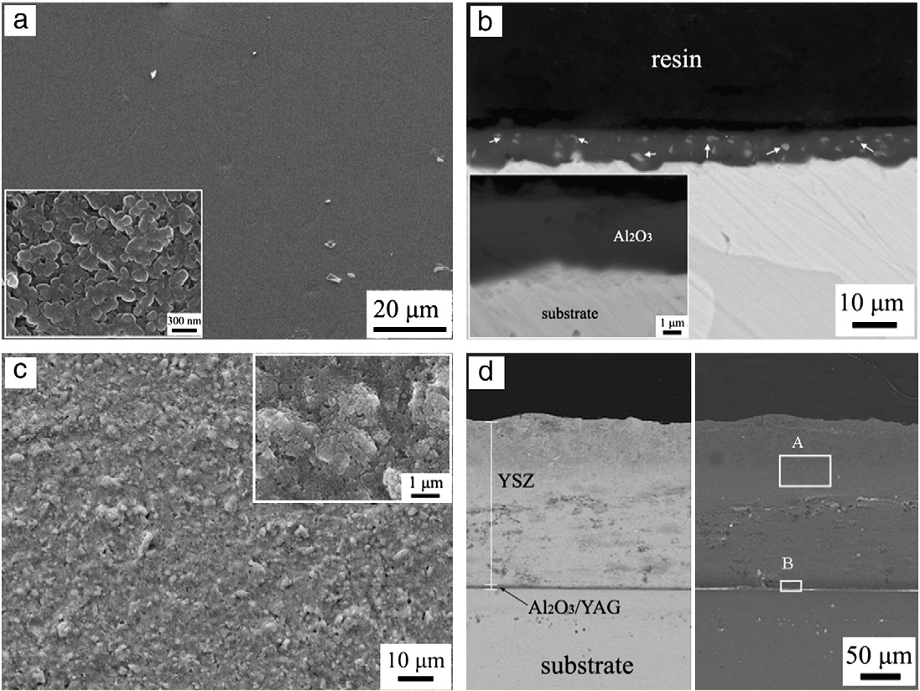
Paper 1: preparation and coating structure
1 · Seeded composite sol
Boehmite + 1 wt.% α-Al₂O₃ seeds
Y nitrate supplies the YAG precursor.
2 · Interlayer deposition
EPD: 30 mA/cm², 6 min
Room-temperature drying: 24 h
3 · YSZ and final PFMS
Blade-coated YSZ top layer
Final treatment: 960 °C, 2 h
Source: Ren et al., Surf. Coat. Technol., 2011, Fig. 2.
02
Notes:
The alloy was GH864, not a CoNiCrAlY bond coat. It was ground with 800-grit SiC and ultrasonically cleaned in acetone. The boehmite sol contained 1 wt.% alpha-alumina seeds with a mean particle size of 40 nm. Y nitrate supplied yttrium, with Y/Al molar ratios of 1:9, 21:79 and 37:63 for AY1, AY2 and AY3. EPD was performed at 0.03 A/cm² for 6 minutes. After room-temperature drying for 24 hours, the interlayer was microwave-sintered. A YSZ slurry was then blade-coated. The final double-layer treatment was PFMS at 960 °C for 2 hours after drying at 80 °C for 24 hours. Figure 2 shows the surface and section of the interlayer and the double-layer coating, specifically for AY1. These micrographs support morphological continuity; they do not quantify bond strength.
Ren, He & Wang. Cyclic oxidation behavior and thermal barrier effect of YSZ–(Al2O3/YAG) double-layer TBCs prepared by the composite sol–gel method. Surface & Coatings Technology 206 (2011), 1461–1468. DOI: 10.1016/j.surfcoat.2011.09.025. Figure 2, PDF p. 2, journal p. 1462; experimental procedure continues on PDF p. 3.

Slide 3
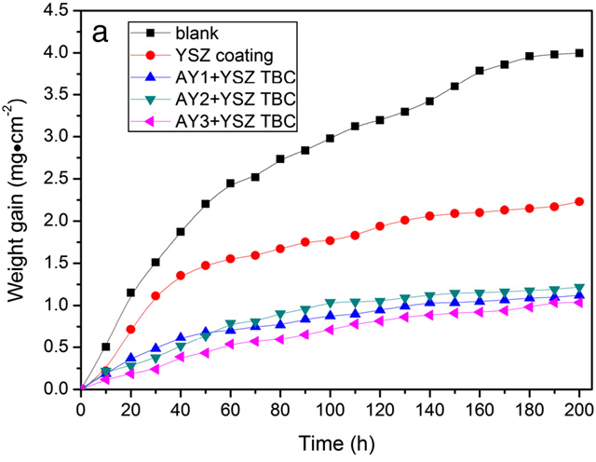
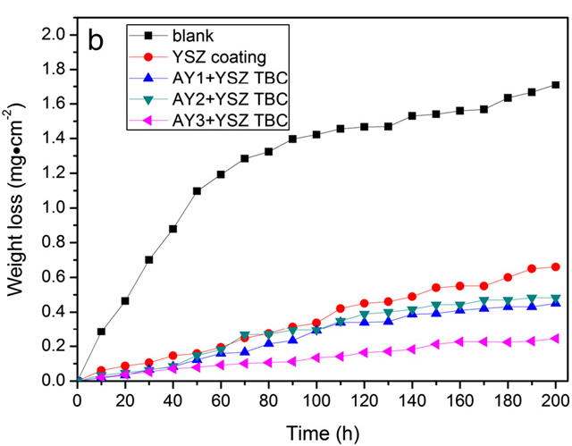
Paper 1: cyclic oxidation at 1000 °C
200 h mass gain: blank 4.00; YSZ 2.23; AY3 + YSZ 1.04 mg/cm²
Source: Ren et al., Surf. Coat. Technol., 2011, Fig. 5.
03
Notes:
The test lasted 200 hours in air at 1000 °C, with 10-hour hot exposures and 20-minute air cooling. The blank sample reached approximately 3.996 mg/cm² weight gain and the YSZ-only sample approximately 2.231 mg/cm². AY3 plus YSZ reached approximately 1.035 mg/cm². The latter is about 54% lower than YSZ alone, calculated as one minus 1.035 divided by 2.231. Figure 5b also shows the lowest spallation loss for AY3 plus YSZ among the tested double-layer coatings. The authors attribute this to alumina sealing, reactive-element effects and composite microstructure. These are proposed mechanisms rather than direct measurements of every transport pathway. Do not compare these absolute mass gains directly with Paper 2 because the substrate and reported test temperature differ.
Ren, He & Wang. Cyclic oxidation behavior and thermal barrier effect of YSZ–(Al2O3/YAG) double-layer TBCs prepared by the composite sol–gel method. Surface & Coatings Technology 206 (2011), 1461–1468. DOI: 10.1016/j.surfcoat.2011.09.025. Figure 5, PDF p. 4, journal p. 1464; discussion pp. 1464–1466.

Slide 4
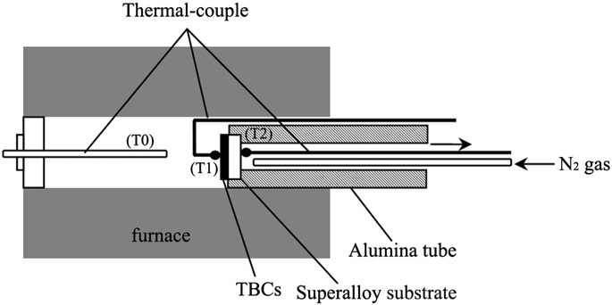
Paper 1: thermal barrier performance
Measured quantity
ΔT = coating surface − substrate backside
T₁ − T₂, with N₂ backside cooling
The double layer gives a larger ΔT than
YSZ alone at the same tested thickness.
Furnace | YSZ 150 μm | Dual 150 μm | YSZ 250 μm | Dual 250 μm
1000 °C | 156 °C | 205 °C | 174 °C | 223 °C
1100 °C | 103 °C | 146 °C | 127 °C | 165 °C
Total coating thickness ≠ target Al₂O₃–YAG interlayer thickness.
Source: Ren et al., Surf. Coat. Technol., 2011, Fig. 1 / Table 1.
04
Notes:
Figure 1 defines the furnace, surface and backside temperatures. This is a cooled-backside test, not a direct thermal conductivity measurement. We use positive temperature drop ΔT = T1 minus T2, consistent with the results section; the methods section prints the opposite sign. At an N₂ flow of 8 L/min and furnace temperature of 1000 °C, the dual-layer drops are 205 and 223 °C for 150 and 250 micrometres. At 1100 °C they are 146 and 165 °C. All four corresponding dual-layer values exceed those of single YSZ at the same total coating thickness. These 150 and 250 micrometre values refer to the tested ceramic coatings, not a prescribed alumina–YAG interlayer thickness. Table 1 also contains data at 5 L/min; this slide intentionally shows the 8 L/min subset. The cooling boundary condition must be matched before making comparisons.
Ren, He & Wang. Cyclic oxidation behavior and thermal barrier effect of YSZ–(Al2O3/YAG) double-layer TBCs prepared by the composite sol–gel method. Surface & Coatings Technology 206 (2011), 1461–1468. DOI: 10.1016/j.surfcoat.2011.09.025. Figure 1, PDF p. 2, journal p. 1462; Table 1, PDF p. 8, journal p. 1468. Source sign inconsistency: §2.4 vs §3.3.

Slide 5

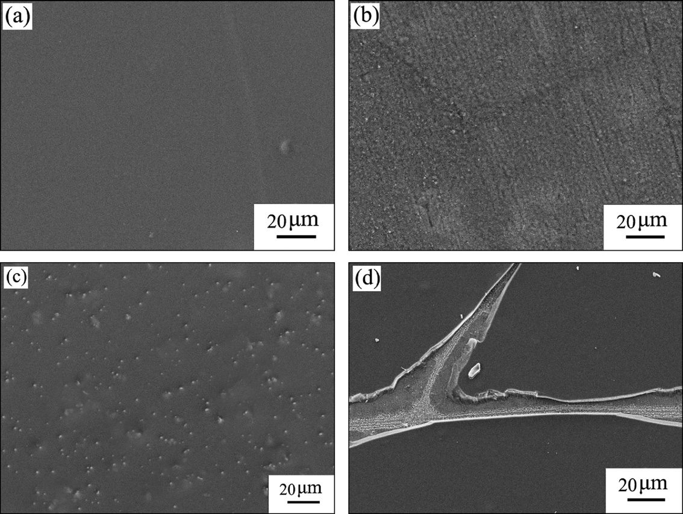
Paper 2: deposition window on NiCoCrAlY
Surface preparation
1000-grit SiC + acetone cleaning
Graphite anodes; 10 mm gap
Suspension and deposition
PEG: 0.2 wt.%
EPD: 3.0 mA/cm², 8 min
Time is a practical control lever
6–8 min: smooth, dense surface
10 min: cracking and local spallation
Source: Ren et al., Appl. Surf. Sci., 2012, Fig. 3 (4–10 min).
05
Notes:
Paper 2 is closer to the current task because its substrate is a NiCoCrAlY alloy, with Ni 39.5, Co 32, Cr 20, Al 8 and Y 0.5 wt.%. This is a bulk alloy coupon, not necessarily representative of an as-sprayed CoNiCrAlY bond coat. The surface was ground to 1000 grit and ultrasonically cleaned in acetone. Positively charged sol particles were deposited on the cathodic alloy with graphite anodes 10 mm away. The seeded sol used 1 wt.% alpha-alumina nanoparticles and Y/Al molar ratios 0.05, 0.10 and 0.20. A PEG concentration of 0.2 wt.% gave the maximum measured zeta potential. Figure 3 compares 4, 6, 8 and 10 minutes: 4 minutes is coarse, 6–8 minutes is smooth and dense, and 10 minutes produces cracks and local spallation. The figure documents a time window, not a universal thickness calibration. The authors selected 8 minutes, with the detailed microstructure specimen at 3.0 mA/cm².
Ren, He & Wang. High-temperature cyclic oxidation behavior of Al2O3–YAG composite coating prepared by EPD and microwave sintering. Applied Surface Science 258 (2012), 5739–5745. DOI: 10.1016/j.apsusc.2012.02.081. Figure 3, PDF p. 3, journal p. 5741; experimental procedure PDF p. 2, journal p. 5740.

Slide 6
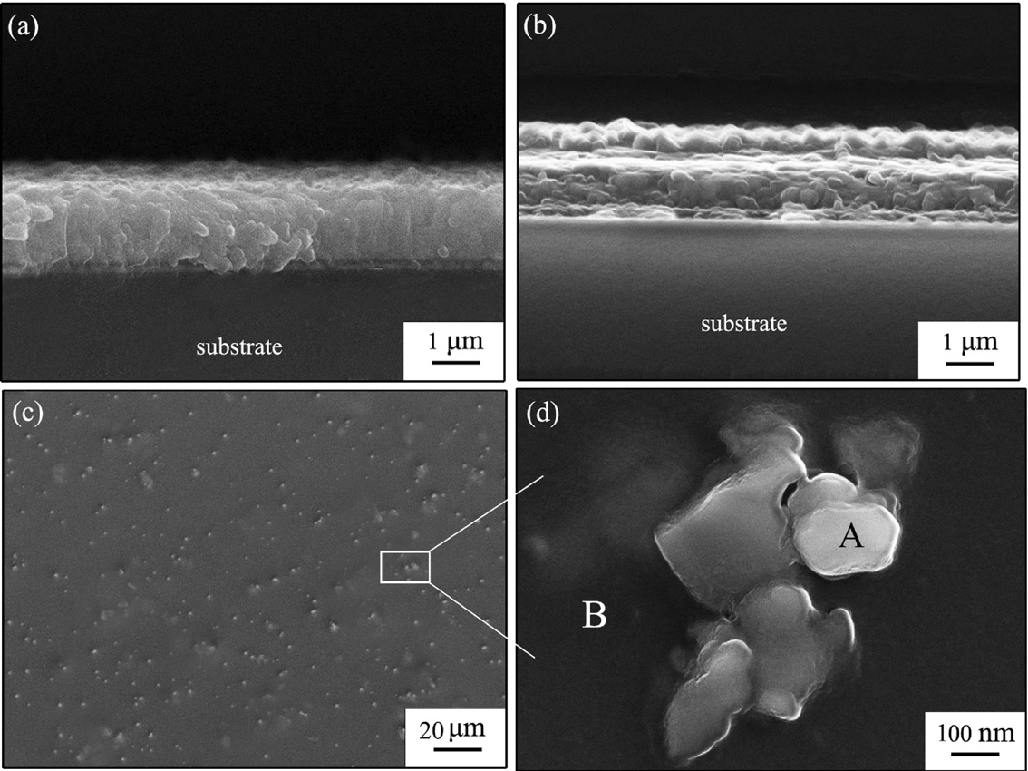
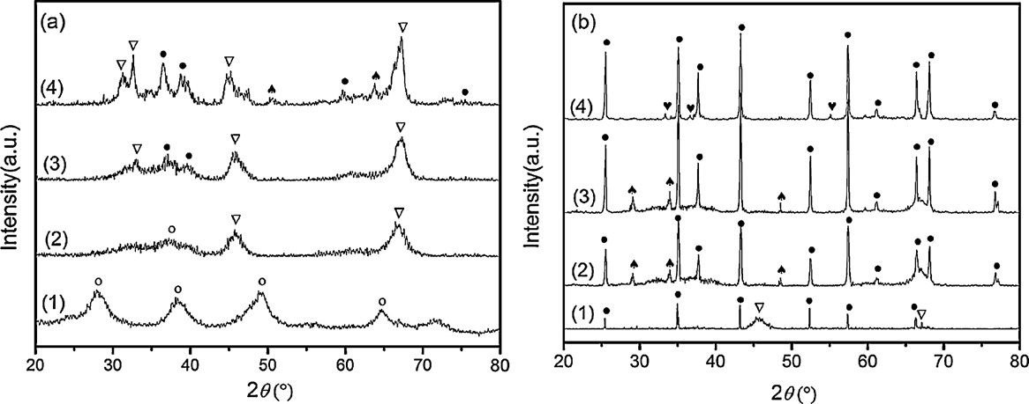
Paper 2: phase formation and interface
Phase evidence
α-Al₂O₃ seeds accelerate crystallization.
YAG is identified after 1 h PFMS.
SEM suggests adherence;
no bond strength is reported.
Source: Ren et al., Appl. Surf. Sci., 2012, Figs. 4–5.
06
Notes:
Figure 4a and 4b compare sections after 10 minutes and 1 hour of microwave sintering. Figure 4c and 4d show low- and high-magnification surfaces after 1 hour; the original EDS panels were omitted in this crop for readability. The authors identify nanoscale YAG particles in an alumina matrix. Figure 5 compares unseeded and seeded coatings. The text reports faster alpha-alumina formation with seeds and identifies YAG after the 1-hour PFMS treatment. The text and numbered time sequence in Figure 5 are not fully consistent, so we do not claim a precise shortest alpha-transformation time. Importantly, this paper does not explicitly state the PFMS temperature in its experimental section; it refers to an earlier paper for the equipment and procedure. The 960 °C schedule in Paper 1 must not be treated as a verified temperature for Paper 2. Interface continuity is qualitative adhesion evidence, not a quantitative interfacial strength or toughness value.
Ren, He & Wang. High-temperature cyclic oxidation behavior of Al2O3–YAG composite coating prepared by EPD and microwave sintering. Applied Surface Science 258 (2012), 5739–5745. DOI: 10.1016/j.apsusc.2012.02.081. Figures 4–5, PDF p. 4, journal p. 5742; phase discussion PDF p. 3, journal p. 5741.

Slide 7
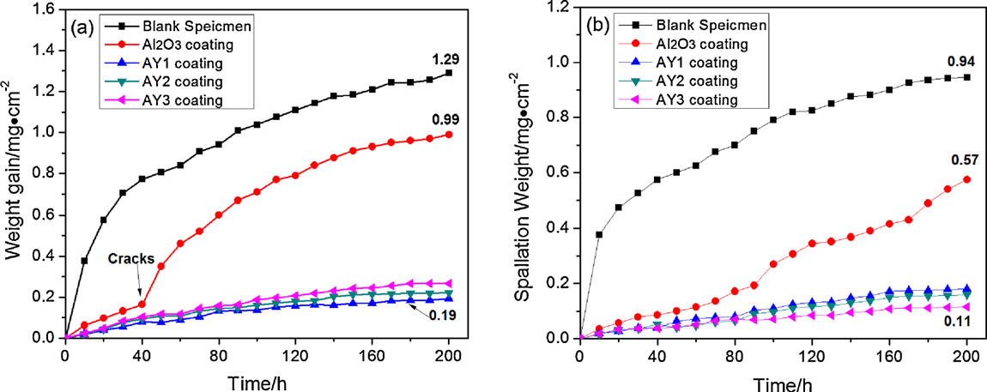
Paper 2: oxidation–spallation trade-off
AY1: mass gain ≈ 0.19 mg/cm²
AY3: spallation = 0.11 mg/cm²
Source: Ren et al., Appl. Surf. Sci., 2012, Fig. 7 (1050 °C).
07
Notes:
Figure 7 is the strongest quantitative result in Paper 2. At 200 hours, blank and alumina-only mass gains are 1.29 and 0.99 mg/cm². The lowest composite curve is AY1, labelled approximately 0.19 mg/cm² in Figure 7a. The prose mistakenly assigns 0.19 to AY3; the plotted series and Table 1 instead support the ranking AY1, AY2, AY3 for oxidation suppression. Table 1 lists initial-stage kp values of 8.46e-8, 1.04e-7 and 1.22e-7 mg² cm⁻⁴ s⁻¹ for AY1, AY2 and AY3. In contrast, AY3 has the lowest spallation weight of 0.11 mg/cm² in Figure 7b, compared with 0.94 for blank and 0.57 for alumina only. Thus minimizing oxygen-related mass gain and minimizing spallation are different optimization objectives. The methods, Figure 7 caption and Table 1 specify 1050 °C, while the abstract, conclusions and Figure 8 caption state 1000 °C. This inconsistency remains unresolved; use the figure-specific condition when presenting Figure 7.
Ren, He & Wang. High-temperature cyclic oxidation behavior of Al2O3–YAG composite coating prepared by EPD and microwave sintering. Applied Surface Science 258 (2012), 5739–5745. DOI: 10.1016/j.apsusc.2012.02.081. Figure 7 and Table 1, PDF p. 5, journal p. 5743; temperature inconsistency spans PDF pp. 1, 2, 5, 6, 7.

Slide 8
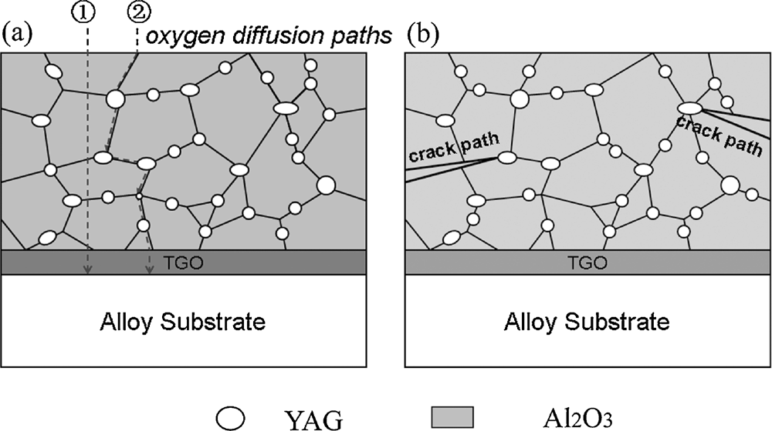
Paper 2: proposed protection mechanisms
Continuous α-Al₂O₃
A continuous layer slows transport.
Oxidation is reduced, not eliminated.
Dispersed YAG
Grain-growth inhibition and crack
deflection are proposed benefits.
Stored energy scales with thickness
U ≈ (1 − ν) σ²h/E
At fixed σ, stored energy increases
with coating thickness h.
Source: Ren et al., Appl. Surf. Sci., 2012, Fig. 9.
08
Notes:
Figure 9 is a schematic model proposed by the authors, not direct imaging of oxygen flux or crack propagation. Continuous alpha-alumina is argued to restrict transport, while Y-containing phases influence grain-boundary transport and oxide adherence. Dispersed YAG can inhibit grain growth and deflect cracks, potentially improving damage tolerance. Both papers use the approximate stored elastic energy scaling U = (1−ν) σ² h / E. Under fixed stress, modulus and Poisson ratio, stored energy per unit area increases with layer thickness. This provides a rationale for avoiding excessive deposition, but it is not a calibrated design law for an unknown CoNiCrAlY system. Modulus and stress may also change with composition, porosity and thermal history. Neither paper reports a direct interfacial fracture toughness measurement, so the proposed toughening and adhesion mechanisms need independent verification.
Ren, He & Wang. High-temperature cyclic oxidation behavior of Al2O3–YAG composite coating prepared by EPD and microwave sintering. Applied Surface Science 258 (2012), 5739–5745. DOI: 10.1016/j.apsusc.2012.02.081. Figure 9 and Eq. 5, PDF p. 7, journal p. 5745; discussion p. 5744. Ren, He & Wang. Cyclic oxidation behavior and thermal barrier effect of YSZ–(Al2O3/YAG) double-layer TBCs prepared by the composite sol–gel method. Surface & Coatings Technology 206 (2011), 1461–1468. DOI: 10.1016/j.surfcoat.2011.09.025. Eq. 1, p. 1465.

Slide 9
Implications for the supervisor’s task
Question | Evidence from papers | Our next task
External layer | Y/Al deposition + PFMS | Check CoNiCrAlY compatibility
Adhesion | Intact sections; less spall | Measure adhesion and failure
Thickness | EPD time affects morphology | Measure thickness vs. time
Heat step | PFMS forms Al₂O₃/YAG | Check phases and alloy damage
Composition | Oxidation vs. spallation | Optimize Y/Al and thickness
Priority: a thin, continuous layer
with measured thickness and verified adhesion.
CMAS can follow after adhesion and thickness control.
Sources: Ren et al., 2011 and 2012. Research implications.
09
Notes:
The main lesson is to externally supply alumina and yttrium precursors, deposit them and heat-treat to form an alumina–YAG ceramic layer. The layer is externally prepared even though its constituent phases form during post-deposition heat treatment. It must be distinguished from substrate-grown TGO. Paper 2 provides the closer precedent on a related MCrAlY alloy. Its polished bulk NiCoCrAlY coupon and our CoNiCrAlY surface may differ in chemistry, roughness, oxide state and coating porosity. We therefore cannot assume the same EPD window, adhesion, or sintering compatibility. Paper 1's 150/250 µm thermal-barrier thickness is not a target interlayer thickness. Paper 2 does not provide a quantitative deposited-thickness-versus-time calibration or a bond-strength number. This slide defines which aspects can be borrowed and which must be measured locally. CMAS was not tested in either paper and is optional for our present problem.
Ren, He & Wang. Cyclic oxidation behavior and thermal barrier effect of YSZ–(Al2O3/YAG) double-layer TBCs prepared by the composite sol–gel method. Surface & Coatings Technology 206 (2011), 1461–1468. DOI: 10.1016/j.surfcoat.2011.09.025.
Ren, He & Wang. High-temperature cyclic oxidation behavior of Al2O3–YAG composite coating prepared by EPD and microwave sintering. Applied Surface Science 258 (2012), 5739–5745. DOI: 10.1016/j.apsusc.2012.02.081.
Only these two full-text papers were available for verified analysis. Complementary current SCI literature could not be verified because the external research endpoints were blocked; no unverified additional citations were inserted.

Slide 10
Next steps: thickness calibration and adhesion
1 · Deposition calibration
2 · Phase and adhesion
3 · Cyclic validation
Fixed composition + current
Screen 4 / 6 / 8 min EPD
Measure deposited mass
and cross-sectional thickness
at multiple positions.
XRD: verify α-Al₂O₃ + YAG
Measure roughness and porosity
Quantify interface adhesion;
identify the failure location.
Controls: uncoated, Al₂O₃-only,
and heat-treated blank
Track mass change, spallation,
TGO thickness and
interface cracking.
Decision: the thinnest continuous layer that retains adhesion during cycling.
Proposed experiment based on the two reviewed papers.
10
Notes:
The proposed plan begins with controlled CoNiCrAlY surface preparation and a documented native oxide and roughness state. Start with the Paper 2 seeded boehmite chemistry and PEG 0.2 wt.% if chemically compatible. First hold Y/Al and current fixed while screening deposition times of 4, 6 and 8 minutes; 10 minutes may be used as an over-deposition reference only if useful. At each condition, measure deposited mass and cross-sectional thickness at multiple positions. Use at least three coupons per selected condition as a proposed replication level, not a requirement established by the papers. Next vary Y/Al between 0.05, 0.10 and 0.20 at a comparable measured thickness to avoid confounding composition and thickness. Verify heat treatment and phase completion by XRD before adopting a schedule; Paper 2 does not specify its temperature, and conventional furnace treatment cannot be assumed equivalent to PFMS. Controls should include an uncoated sample, alumina-only coating and a heat-treated blank. Assess adhesion by a suitable quantitative method such as instrumented scratch or interfacial fracture testing and confirm the failure location in section. During cyclic oxidation, separately measure mass change and collected spall, TGO thickness and delamination. Choose the thinnest continuous layer that meets the adhesion and cyclic-stability criteria. CMAS is a later optional task.
Proposal grounded in: Ren, He & Wang. High-temperature cyclic oxidation behavior of Al2O3–YAG composite coating prepared by EPD and microwave sintering. Applied Surface Science 258 (2012), 5739–5745. DOI: 10.1016/j.apsusc.2012.02.081. §2–5, Figs. 3–9; Ren, He & Wang. Cyclic oxidation behavior and thermal barrier effect of YSZ–(Al2O3/YAG) double-layer TBCs prepared by the composite sol–gel method. Surface & Coatings Technology 206 (2011), 1461–1468. DOI: 10.1016/j.surfcoat.2011.09.025. §2–3. Numerical deposition starting points are from Paper 2 and are not transferred as confirmed optima.

