Slide 1
CST336 Internet programming
Practice 2: PHP Control structures

Slide 2
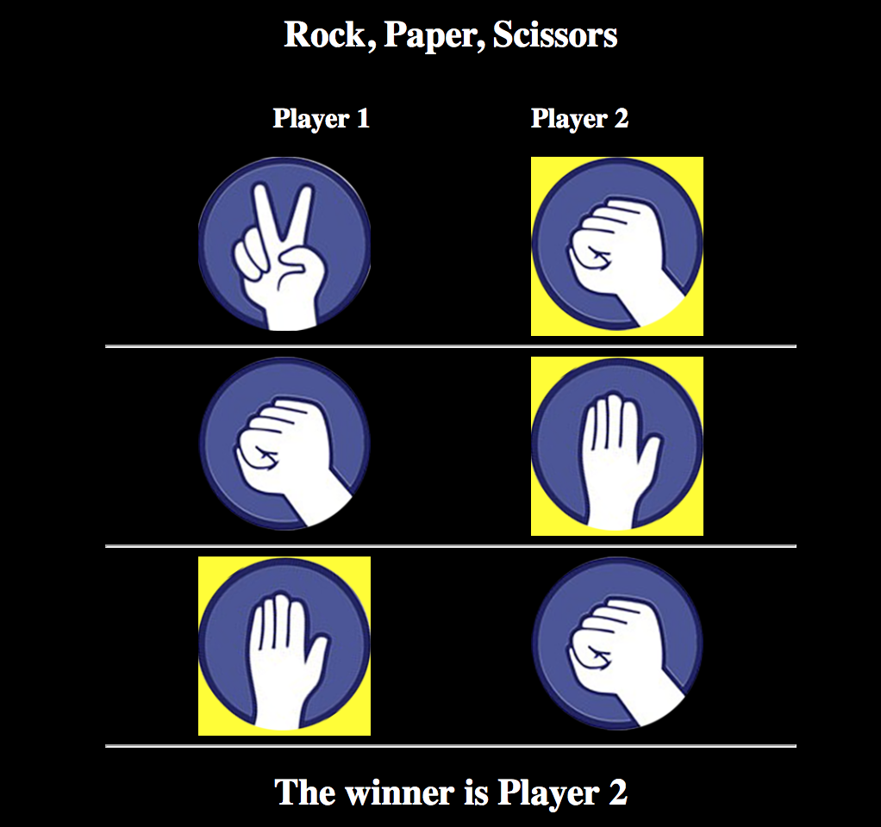
Task: Create a three-match RPS simulation

Slide 3
Directions:
You’ll start working INDIVIDUALLY for 15 minutes.
Individually, do the following:
1) Upload the “rps” folder located in your local computer (from the file you unzipped) to your “practice/img” folder, in C9.
2) Within the “practice” folder in C9, upload the “rps.php” file located in your local computer.
3) Fix the path to the images (by now, you should be able to do it on your own).
4) Start trying to use a for loop to display each of the three random matches

Slide 4
Directions:
You’ll work in pairs for 50 minutes. Remember to use ONLY ONE computer and to SWITCH typing
In pairs, do the following:
Use a for loop to display each of the three random matches
Prevent each match from being a draw (NO tie matches)
Write a function to identify winner per match (using the yellow background)
Write a function to identify the Final Winner
Completers will get two extra points in a homework assignment. Some of you will be selected to show your work via Zoom.

