Slide 1

Analysis of Flight Feasibility
DSC 530: Data Analysis
Author: Don Price

Slide 2
Statistical problem
Background:
Obtaining a flight license requires many hours of flight training. I am interested in learning to fly, but it is difficult to find time given my busy schedule and uncooperative weather conditions in Chicago.
Statistical Question:
Using historical weather data and flight patterns at my local airport, I will attempt to identify optimal conditions to practice flying. These conditions can be used to predict optimal times of the year for flying lessons locally.

Slide 3
Statistical variables
Target Variable
Local Flight Count - Chicago Executive Airport publishes data on the number of flights from the airport. The data is presented monthly. Flight counts are separated into itenerant and local flights. My interest is in the local flights as those align to my intended use. Itenerant flights include larger, executive plans more capable of flying in tougher elements than planes used for local flights. Local flight counts will be the target variable for this analysis.
Independent Variable
Variable | Definition | Hypothesis about Effect
MonthlyMeanTemperature (Fahrenheit) | This represents the dry bulb temperate (used in thermometers). Measure represents average temperature during month. | Fewer flights may occur on colder days. Smaller aircraft aren’t well equipped with heating, cooling, and insulation.
MonthlyDaysWithLT32Temp | Count of the number of days in a month where the temperature is less than 32 degrees Fahrenheit. | Extreme cold may make flying more challenging, and in some cases, make flying impossible.
Wind Gust Count | Number of days during the month where the wind speed exceeds 30mph. Variable derived from ‘DailyPeakWindSpeed’ variable. | Flights may need to be delayed or cancelled if wind speeds are too high.
MonthlyTotalLiquidPrecipitation | Amount of precipitation in inches to hundredths during the month. | Precipitation may make flying too difficult.
MonthlySeaLevelPressure | Sea level pressure is the standard measure for evaluating air pressure. | Lower pressures may affect flight performance.
Target variable obtained from the Chicago Executive Airport website. https://www.chiexec.com/chicago-executive-airport-traffic-statistics
Independent variables obtained from a weather station located in Des Plaines, IL airport (also named Chicago Executive Airport).

Slide 4
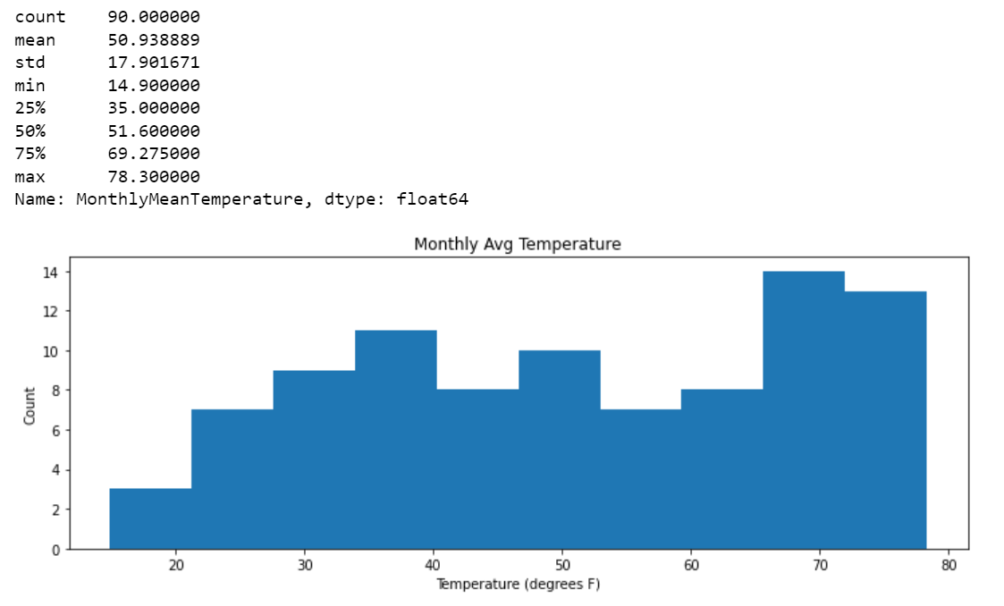
Histograms of key variables
Monthly Mean Temperature
Monthly temperature is bimodal with peaks in the mid 30’s and 70’s.
The standard deviation of 17.9 is quite high given a mean of 51 degrees, although no significant outliers existing in this variable.

Slide 5
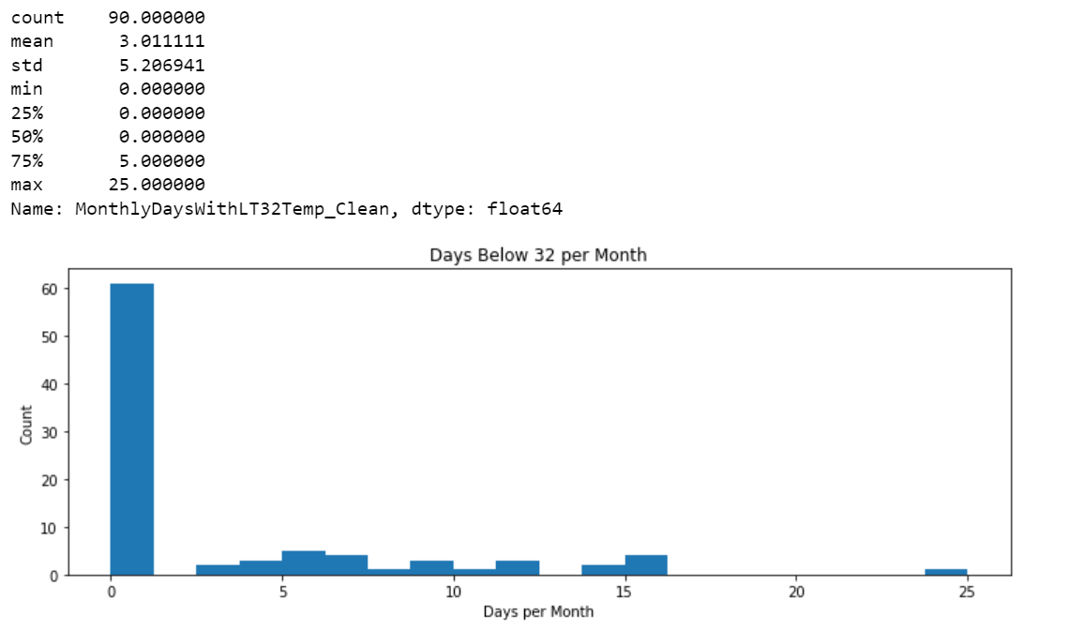
Histograms of key variables
Days per Month Below 32 Degrees
Variable counts number of days within a month that are below 32 degrees. Variable corrects for bimodal issue in monthly mean temperature, but it is skewed with most months having 0 days.
There is one outlier, with 25 days below freezing. This point was February 2015 when Chicago was hit with extreme cold weather from a polar vortex. This irregular pattern is unlikely to recur regularly and should be removed when modeling.

Slide 6
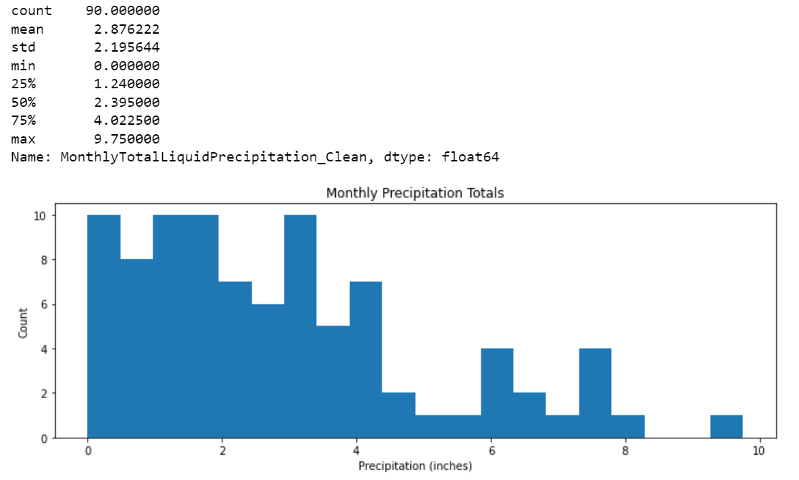
Histograms of key variables
Precipitation Amount per Month
Measure of precipitation (inches) per month is a non-normal distribution. The curve mostly resembles an exponential or logarithmic curve.
Precipitation falls between 1.24 and 4.02 inches per month, but there is a positive skew to the distribution with an upper limit of 9.75 inches. Tail values should not be removed when modeling.

Slide 7
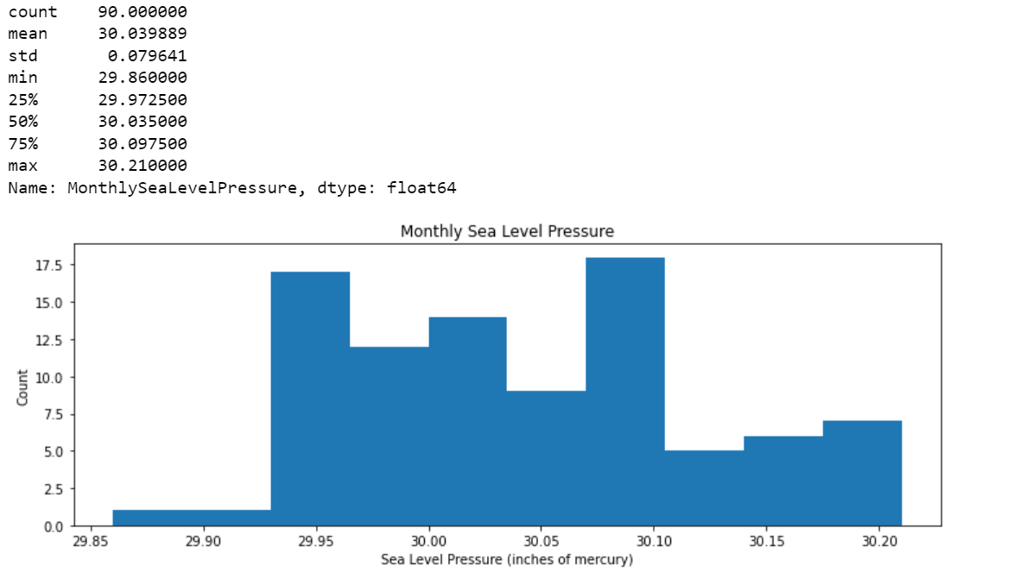
Histograms of key variables
Pressure
Pressure exhibits a somewhat normal distribution, although there is a positive skew to this variable.
Most values are within a tight range with a low standard deviation. No adjustments are needed for outliers.

Slide 8
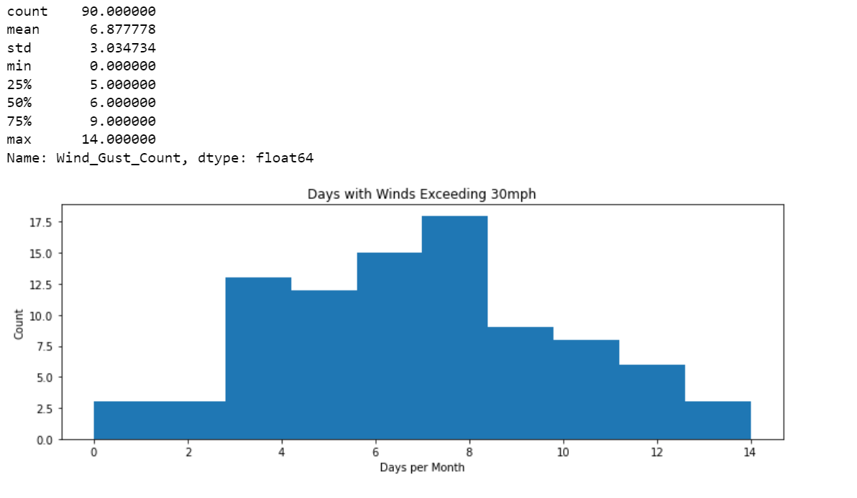
Histograms of key variables
Wind Gusts
Variable is mostly normally distributed, although the mean of 6.87 exceeds the mode suggesting skew.
No adjustments needed for outliers.

Slide 9
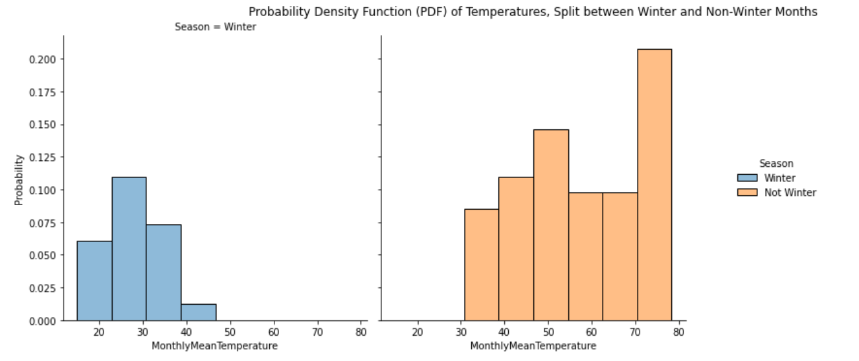
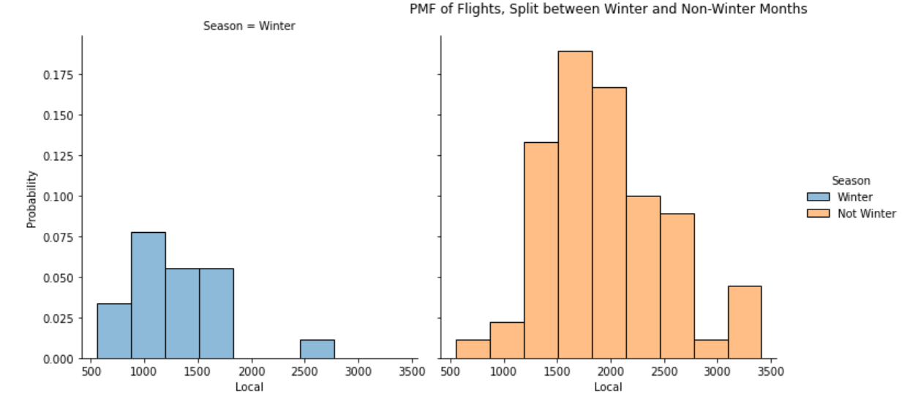
Scenario Comparison: PMF of 2 variables
Mean Temperature & Flight Counts Split between Winter and Non-Winter Months
Winter months defined as November, December, and January each year.
Winter periods are much colder than non-winter periods, and both PMF and CDF functions show very little overlap between two distributions.
As temperatures drop, the number of local flights tends to be lower. Most months have between 500-1750 flights per month; non-winter months tend to have more than 1500 flights per month.

Slide 10
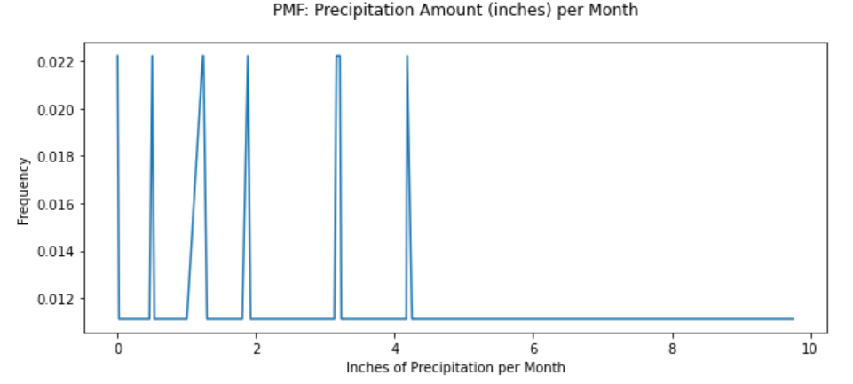
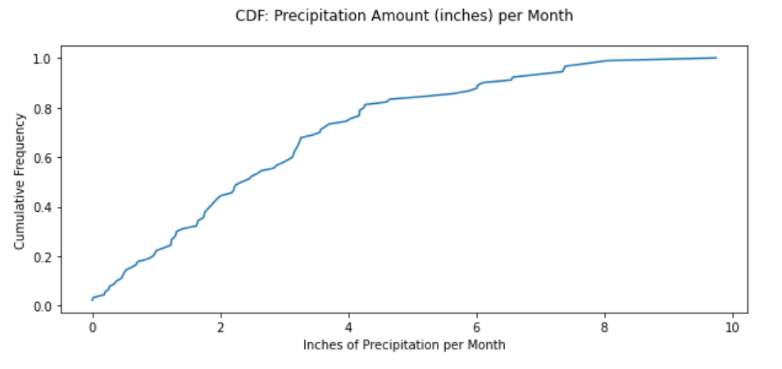
CDF Analysis of a single variable
Precipitation (inches) per Month
Most months incur precipitation between 0 and 4 inches per month. A right skewed distribution has values in excess of 4 but not less than 0.
The CDF suggests an exponential distribution.
If precipitation impacts flights, the relationship is probably negatively correlated and more impacted by periods of higher precipitation. With fewer observations of months with excess precipitation, modeled impacts may be difficult to measure.

Slide 11
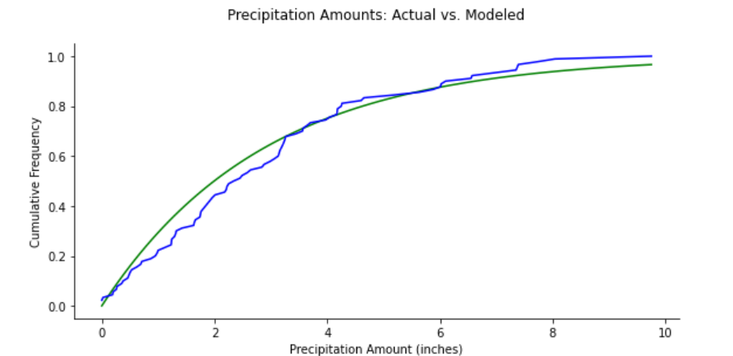
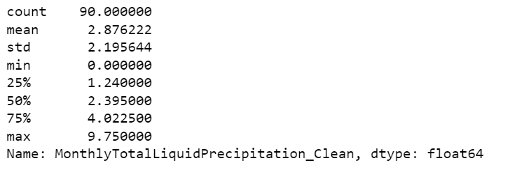
ANALYTICAL DISTRIBUTION: Precipitation
Modeled Curves – Precipitation Amount
In the prior slide, the CDF for precipitation amount appears to be exponentially shaped. This assumptions is tested here.
The chart plots the precipitation amount as a CDF (shown as the blue line).
An exponential distribution was constructed using the mean and standard deviations of the precipitation distribution.
While the precipitation data is roughly exponential, a modeled exponential curve would overestimate values below 4 inches and underestimate values above 4.
Given our assumption that higher precipitation months are more likely to reduce flights, using an exponential model for this variable might underestimate this impact.
Actual Precipitation
Modeled Exp. Curve

Slide 12
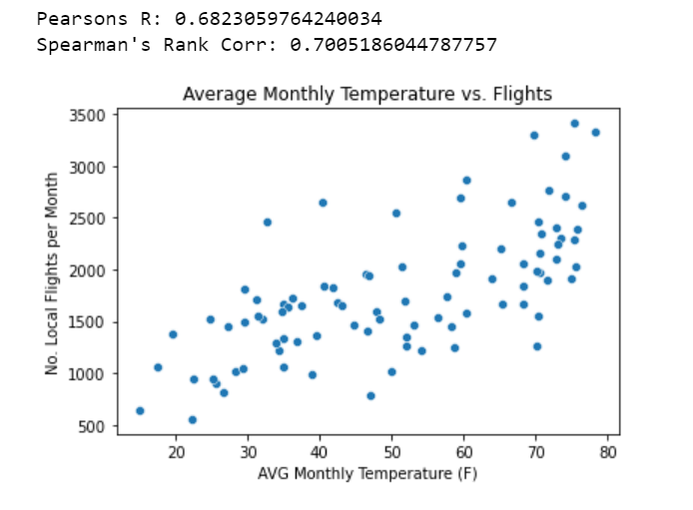
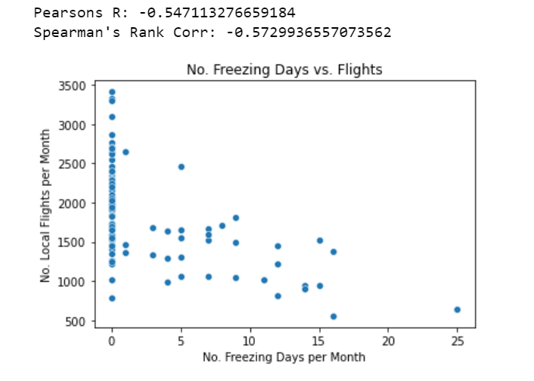
Scatter plots
Of all independent variables, temperature seems most impactful on the number of flights in a month. This may be reasonable given light aircraft may be less enjoyable to fly during extreme temperatures.
Mean temperature (left) demonstrates the strongest correlation to the number of flights and is positively correlated with a 0.68 Pearson R and 0.70 Spearman’s Rank. The higher Spearman’s Rank value suggests the distribution is not linear. A non-linear distribution is likely as more extreme low and high temperatures may impact flights more so than changes in average temperatures.
Number of freezing days has a lower correlation than average temperature, which may be due to excluding the impact of extreme high temperatures in the comparison.
These two variables have a -0.84 Spearman’s Rank correlation. Given both variables model temperature and are correlated, only the Average Monthly Temperature will be used in the model.

Slide 13
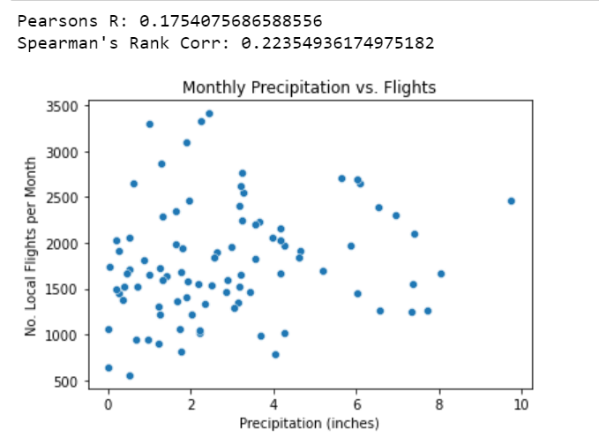
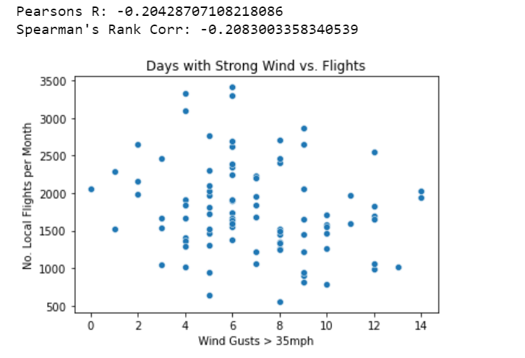
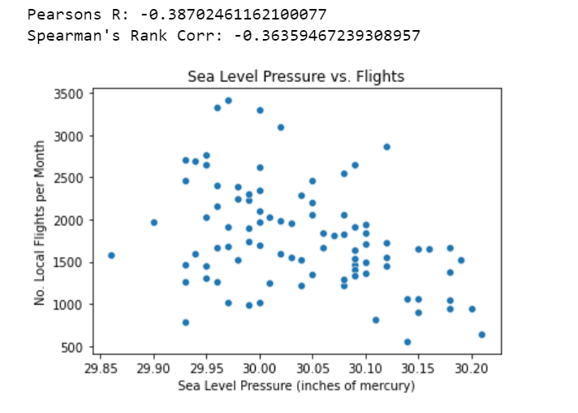
Scatter plots
Scatter plots for precipitation, wind speeds, and pressure do not seem to demonstrate any correlation to the number of flights each month.
The low Pearson correlation values confirm the weak relationship between these variables and flight counts.
Spearman’s Rank confirms that even a non-linear relationship is also weak.
Precipitation is uncorrelated. The assumption would be less flights would occur during months with higher precipitation. The correlation suggests an opposite effect, albeit weak. The outlier at 10 inches probably influences the correlation.
Wind gusts greater than 35 mph do not seem to affect flights. Although the negative direction of the correlation statistics seems appropriate (more gusts of wind leads to fewer flights), the variable does not appear meaningful by itself.

Slide 14
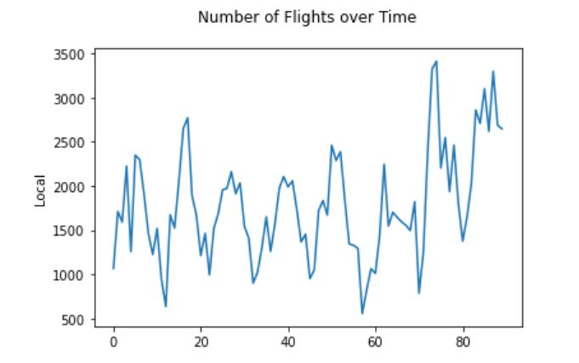
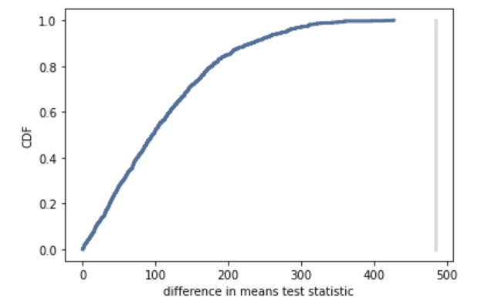
Hypothesis test
Number of flights over time is graphed in lower left. The period is from 2014-2021. After 60 months (2018), the flights appear to increase.
A difference in means test used to evaluate whether the mean number of flights is different for the two periods (0-60 months and 61+ months).
Using the difference of means test (left chart shows simulated output), it is highly likely the mean for the period after 61 months differs from the earlier period. The p-value of 0.003 (gray line) confirms means significantly different. The difference in means could be due to operational changes at the airport or perhaps population changes impacting the total number of flights.
This change due to time will negatively impact the model as something other than weather is likely affecting the number of flights.
Graph of Test Statistic
(Difference in Means Test)
Test Statistic
P-value

Slide 15
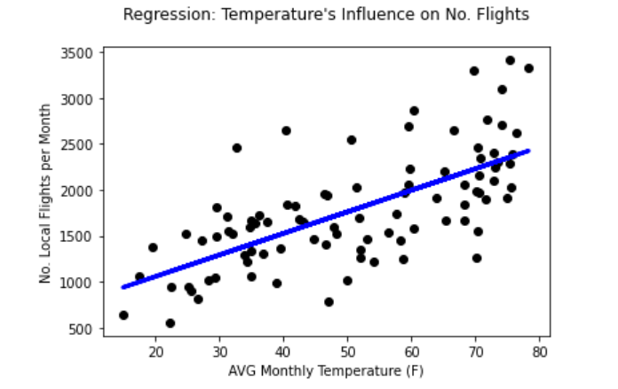
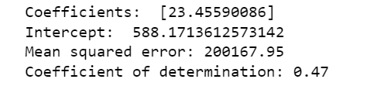
Model of monthly local flights
Linear model using a single variable, average monthly temperature, is a useful predictor of the number of monthly, local flights. The coefficient of determination is 0.47.
Other variables were excluded from the model due to their low or unexpected correlations.
The linear model likely suffers from the change in flights over time, which was confirmed through hypothesis testing. Prediction accuracy could be improved by selecting a non-linear model, finding a variable to explain the changes in flights over time, or by detrending the number of flights over time.

