Slide 1
OpenAI
Function Calling
You can describe functions and have the model intelligently choose to output a JSON object containing arguments to call one or many functions

Slide 2
We’ll Walk Through
Learning how to connect large language models to external tools
Common use cases
Function calling allows you to more reliably get structured data back from the model.
For example, you can:
Create assistants that answer questions by calling external tools
Convert natural language into API calls
  convert "Who are my top customers?" to get_customers(min_revenue: int, created_before: string, limit: int) and call your internal API
Extract structured data from text
  define a function called extract_data(name: string, birthday: string)
  or sql_query(query: string)
...and much more!

Slide 3
You can see the documentation here: https://platform.openai.com/docs/guides/function-calling

Slide 4
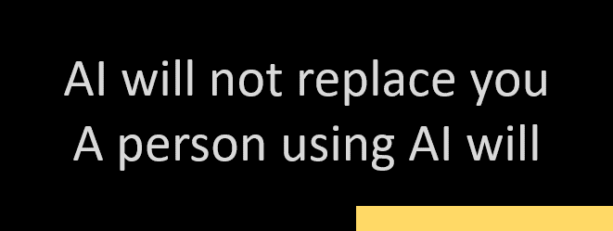
Don’t believe the hype!
Do believe

Slide 5
Who Am I
Doug Finke
15 time Microsoft MVP
Wrote a book “PowerShell for Developers”
Significant contributor to the Microsoft and PowerShell community
Maintainer of the OSS PowerShell Excel module
Maintainer of the PowerShell OpenAI SDK - PowerShellAI

Slide 6

Catch up with me
X: https://x.com/dfinke
GitHub: https://github.com/dfinke/PowerShellAI
YouTube: https://www.youtube.com/@DougFinke
Blog: https://dfinke.github.io/
I run a monthly virtual meetup ~4K members
  Do regular livestreams on OpenAI/GPT etc
  Also doing livestreams on PowerShell
  https://www.meetup.com/nycpowershellmeetup/

Slide 7
Demo Time

