Slide 1
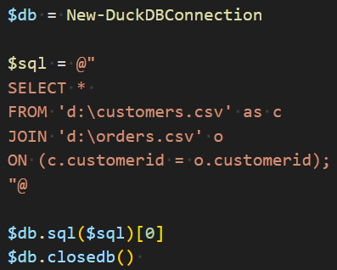
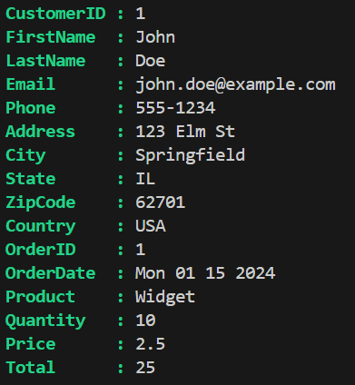
Join CSV files in PowerShell
Customer
Order
Install-Module PSDuckDB
DuckDB an in-process SQL OLAP database management system

Slide 2
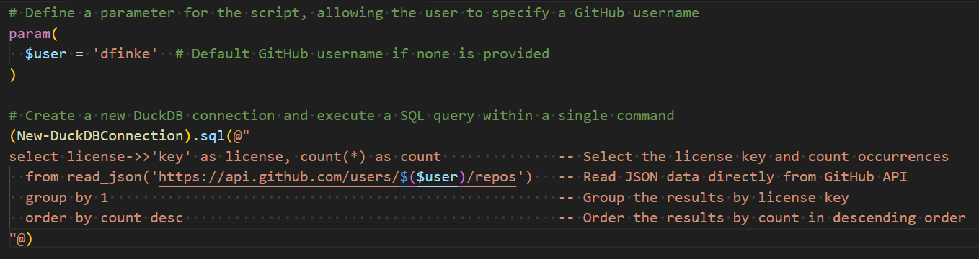
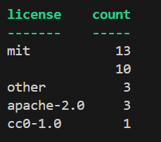
Install-Module PSDuckDB
DuckDB an in-process SQL OLAP database management system

Slide 3
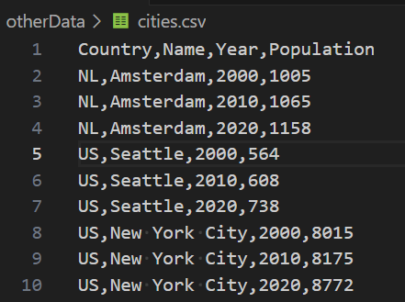
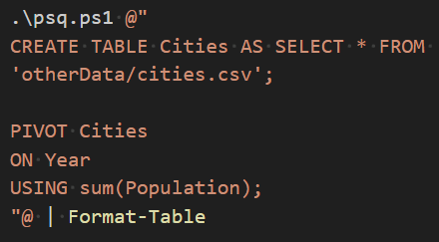
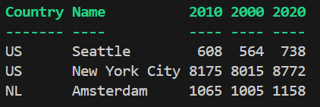
POWERSHELL + DuckDB
DATA
SQL – Pivoting CSV Data
OUTPUT
Install-Module PSDuckDB
DuckDB an in-process SQL OLAP database management system

