Slide 1
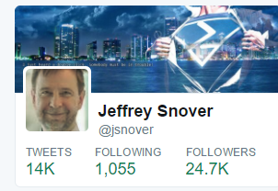
PowerShell Where we are, where we‘re going

Slide 2
PS/Devops Summit AMA Questions
What would today’s Monad Manifesto say?
What’s the next “big thing” in PowerShell?
What does the PowerShell team re-org mean?
Are we at the end of the Monad Manifesto?

Slide 3
Is PowerShell Done?

Slide 4
Is PowerShell Done?
YES!
and
NO!

Slide 5
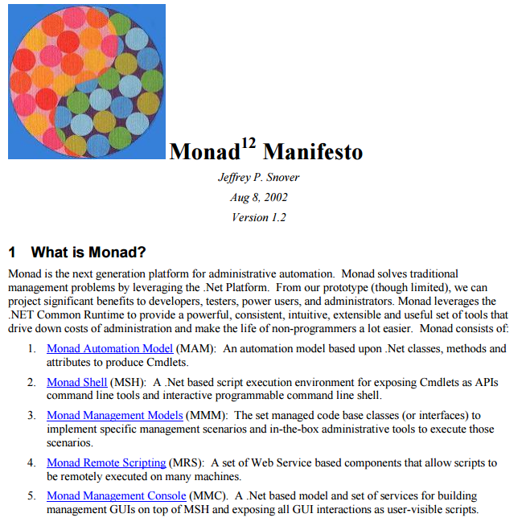
Monad Manifesto

Slide 6
Automation Model
Cmdlets are very efficient & lots of implementation options:
.NET
Script
Native code(WMI)
Workflows
OData
Swagger annotated REST APIs

Slide 7
Shell
Wide range of rich interactive consoles & IDEs
PowerShell.exe & PSReadline
PowerShell_ISE
Visual Studio & VS Code
Cloud Console
Strong set of Scripting options & support
Ad hoc => Advanced scripting
Classes
Script Analyzer
PSGallery
Anti-Malware Integration
Security++

Slide 8

Remote Scripting
Many cmdlets support their own remoting
Generalized remote scripting (PSRP) over:
WSMAN
NamedPipes
VMBus
OpenSSH
Remote Debugging

Slide 9
Management Console
Exchange Admin console
Server Manager
Phosphor

Slide 10
Is PowerShell Done?
YES!
PowerShell has achieved critical mass as a general purpose Windows Scripting tool

Slide 11
But . . . The Cloud Changes Everything

Slide 12
PowerShell: Connector of the Hybrid Cloud
From ANY client
Manage ANY server
Running on ANY cloud
Or on-prem using:
ANY hypervisor
ANY storage
and ANY networking

Slide 13
Is PowerShell Done?
NO!
From | To
Windows | Cross Platform
Platform | Solutions
Servers | Services/Applications/Clouds

Slide 14
Architects View
Generalizable pattern behind the details
When faced with success:
Incremental change
Transformational change

Slide 15
Types of Change
Incremental | Transformational

Slide 16
Types of Change
Incremental | Transformational
We know the answer, we just need to implement it | We don’t know the answer (or question)

Slide 17
Types of Change
Incremental | Transformational
We know the answer, we just need to implement it | We don’t know the answer (or question)
Sharpen our thinking | New way of thinking

Slide 18
Types of Change
Incremental | Transformational
We know the answer, we just need to implement it | We don’t know the answer (or question)
Sharpen our thinking | New way of thinking
High probability of success | Failures WILL happen

Slide 19
Types of Change
Incremental | Transformational
We know the answer, we just need to implement it | We don’t know the answer (or question)
Sharpen our thinking | New way of thinking
High probability of success | Failures WILL happen
Preserves identity & customers | New identity & customers

Slide 20
Types of Change
Incremental | Transformational
We know the answer, we just need to implement it | We don’t know the answer (or question)
Sharpen our thinking | New way of thinking
High probability of success | Failures WILL happen
Preserves identity & customers | New identity & customers
Team stays intact | Not everyone makes it

Slide 21
Transformational Changes Are Hard

Slide 22
Easy To Fail at Transformational Change
Just treat it like an incremental change

Slide 23
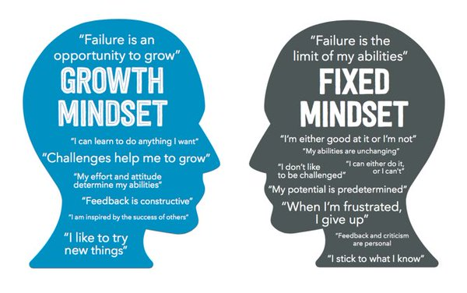
Transformation Requires A Growth Mindset

Slide 24
Examples of Transformational Change
Windows GUI => Automation
Mgmt of Silos => Mgmt of the full portfolio
Traditional IT => DevOps
On Premises => Cloud
Windows PowerShell => Core PowerShell

Slide 25
Core PowerShell is a Transformational Change

Slide 26
PowerShell: Connector of the Hybrid Cloud
From ANY client
Manage ANY server
Running on ANY cloud
Or on-prem using:
ANY hypervisor
ANY storage
and ANY networking

Slide 27
Core PowerShell is Open Sourced
Source => GitHub
Reimplement our build/test
Establish community governance
Launch partners: AWS, Vmware, and Google

Slide 28
Core PowerShell Runs On Linux
Core .NET
First class citizen => VS Code
Cultural Compatibility
& backgrounding
Case-sensitivity
Support for SSH

Slide 29
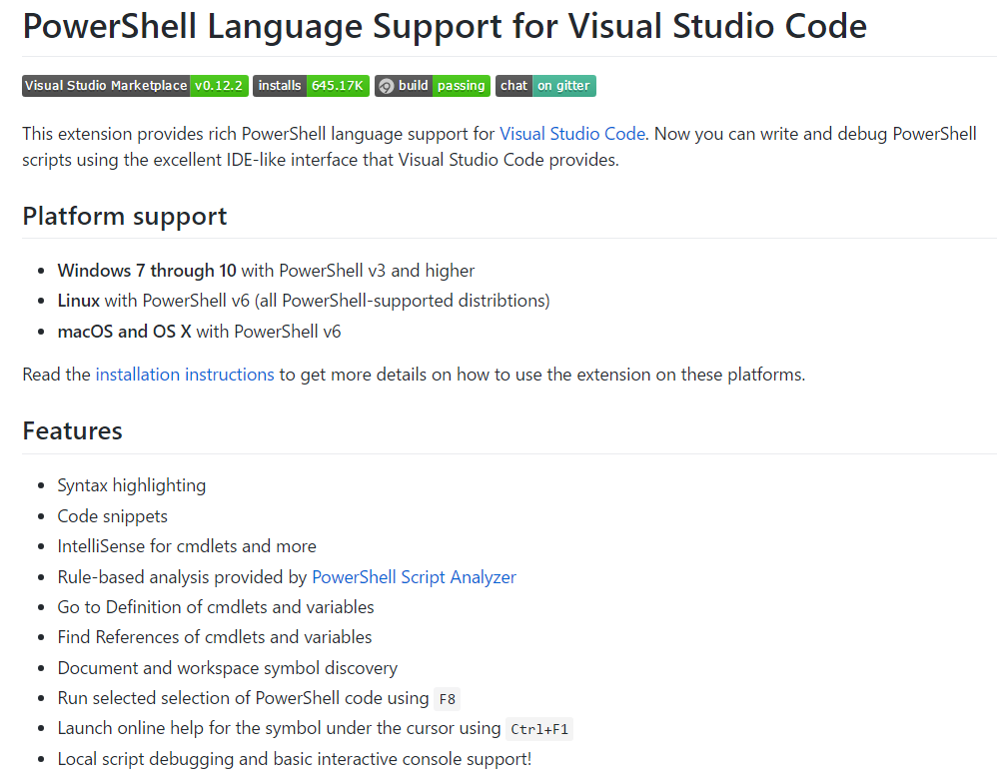
OSS: Editor Services & VSCode
David Wilson and Keith Hill are maintainers

Slide 30
Core PowerShell & DevOps
Developer enhancements
VS Code
Classes++
PS Script Analyzer
Remote script debugging
DSC resource debugging

Slide 31
Core PowerShell In Azure
Cloud Command Console
DSC as Native Azure Configuration
Common Windows & Linux LCM
Multiple LCM instances
Native code LCM for lightweight environments
LCM as a Library

Slide 32
Is PowerShell Done?

Slide 33
Is PowerShell Done?
NO!
From | To
Windows | Cross Platform
Platform | Solutions
Servers | Services/Applications/Clouds

Slide 34
PowerShell: Connector of the Hybrid Cloud
From ANY client
Manage ANY server
Running on ANY cloud
Or on-prem using:
ANY hypervisor
ANY storage
and ANY networking

Slide 35
WHY?

Slide 36
PS Supports YOUR Transformational Changes
Windows GUI => Automation
Mgmt of Silos => Mgmt of the full portfolio
Traditional IT => DevOps
On Premises => Cloud

Slide 37
Succeeding with Your Transformational Change
No playbook | Uncomfortable is the new norm
New way of thinking | Go back to first principles
Failures WILL happen | Adopt a growth mindset
New identity and customers | Have courage and confidence in the path
Not everyone makes it | Don’t let adverse facts stand in the way of a good decision

Slide 38
Summary
PowerShell is:
All about making YOU successful
Widely used throughout the industry
We are investing heavily and transforming to enable you to solve bigger and harder problems
So that you can be a hero and get rewarded

Slide 39
Questions?
Thank you!

