Slide 1



Carpenter_Lab_Python_Worshop Summer_2020

Slide 2
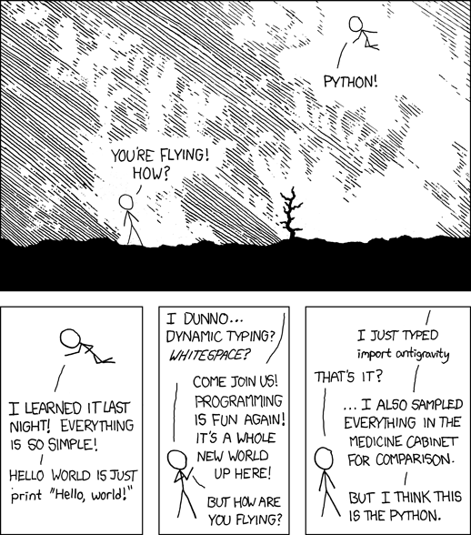

Slide 3




Start up instructions
Please download and install the required software.
Everything is on GitHub.

Slide 4
Regular expressions regex

Slide 5
Text files, why do we love them?
*.txt
no hidden characters (well kinda)
no space consuming extra formatting
stable format
easy to read
free to open and save
we can regex them

Slide 6
Regular Expressions
powerful search and replace toolkit
power lies in wildcard operators
\w \d \t \s \n \r .
\

Slide 7
Extending the language
Custom character sets []
Boundaries ^$
+ * ? and {}

Slide 8
Dan’s words of advice:
Start small and think big
a few notes on failure
plan to fail well
build in redundancies
don’t be lazy (i.e. match a whole line specifically)

Slide 9
