Slide 1
KnockoutJS
Building a Rich & Responsive UI with KnockoutJS + Twitter Bootstrap

Slide 2
Why Knockout?
Users expect rich, interactive, post-back-less UIs
More code moving to client-side
Client-side is hard!

Slide 3
Why Knockout?
Difficulties:
Gathering input from form elements
Complex interactions (drag & drop, sort, etc.)
Client-side validations
Immediate feedback of user actions

Slide 4
What is Knockout?
Client-side binding/templating engine
Light-weight
Easy learning curve
Follows MV-VM design pattern

Slide 5
MVVM in Knockout
Model: JSON data from the server
Loaded via AJAX
Loaded by burning JSON onto page*
Use JSON.Net on your C# objects!

Slide 6
MVVM in Knockout
View: HTML with special data-* attributes
data-bind attributes tell your view what view model properties to bind to
Example:
Translation: Bind the value of the input to the property “myProperty” on my view model
Everything inside a data-bind MUST be valid javascript
<input type="text" data-bind="value: myProperty"/>

Slide 7
MVVM in Knockout
View Model: “POJO”s that contain fields and methods to bind to
Use regular JavaScript classes
Takes in server-side model as input
Fields that need two-way binding use Knockout Observables
Fields that are computations use Knockout Computeds
Methods can be bound too!
Example:
<button type="submit" data-bind="click: doSomething"></button>

Slide 8
MVVM in Knockout
Example JavaScript class with observables
function Person(data) {
var self = this; // Alias this to self for nested closures!
// Observables
self.firstName = ko.observable(data.FirstName); // Takes an initial value
self.lastName = ko.observable(data.LastName);
// Computed
self.fullName = ko.computed({
read: function () {
// Invoke to return observable value
return self.firstName() + ' ' + self.lastName();
}
});
}

Slide 9
Why Twitter Bootstrap?
CSS and layout also really hard!
Users use many different devices:
Phone
Tablet
Desktop browser
Users expect sites to work well on all of these!

Slide 10
What is Twitter Bootstrap?
CSS layout framework
Made to simplify cross-browser responsive Uis
UI dynamically scales as browser size shrinks
Contains components for many UI patterns

Slide 11
What is Twitter Bootstrap?
Layout:
Achieved via 12-column fluid grid system
Css classes for layout
Can specify layout per device size
Example:
Translation: One column that takes up 8/12ths of the width on medium-sized and up devices and another that takes up 4/12ths of the width
<div class="col-md-8"></div>
<div class="col-md-4"></div>

Slide 12
What is Twitter Bootstrap?
Responsiveness:
Uses media queries to scale UI well across devices
Css classes for device-specific content
Examples:
Visible only on medium-sized devices:
Hidden on large-sized devices:
<div class="visible-md"></div>
<div class="hidden-lg"></div>

Slide 13
What is Twitter Bootstrap?
Patterns:
Components for many UI patterns
Modals
Panels
Contextual messages
Form elements
Tables
Grids

Slide 14
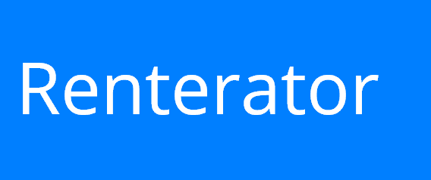
Putting it all together
TM

