Slide 1
Welfare Gains and Distributional Dynamics: A “Carbon Charge” in New York State Daniel F. Noriega Structural Estimation 2019-1

Slide 2
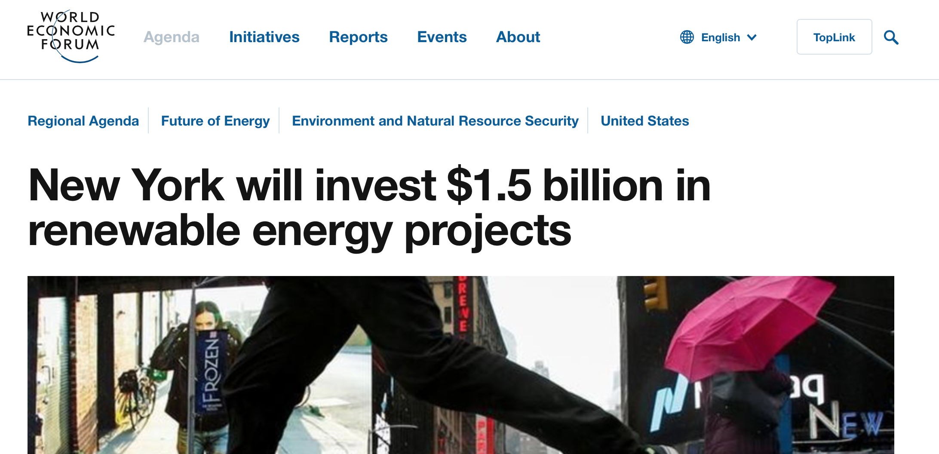
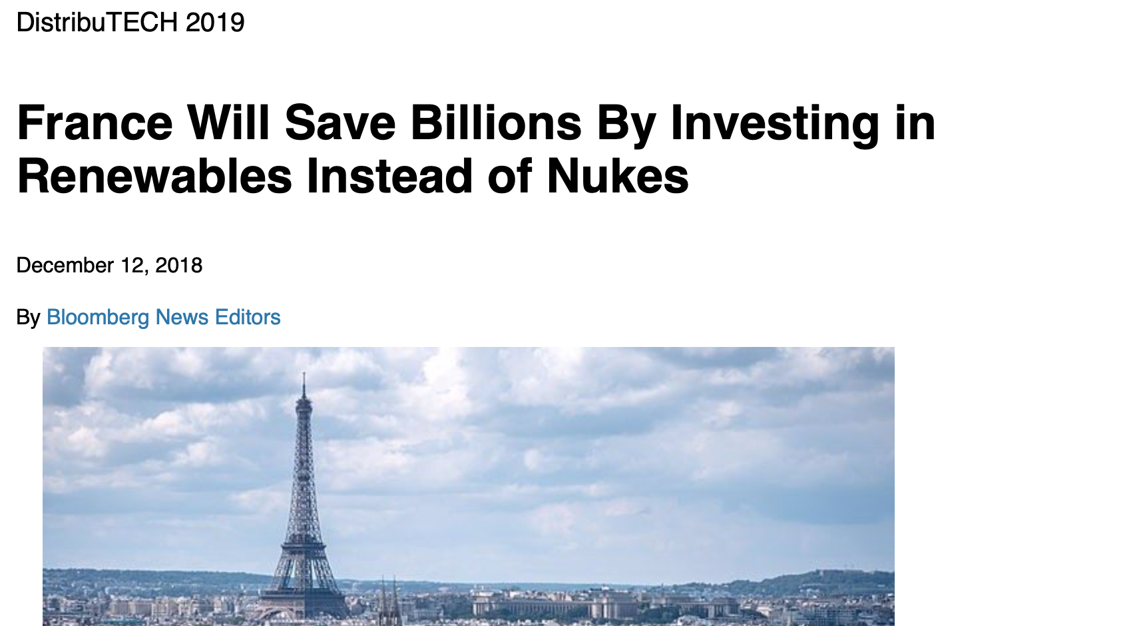
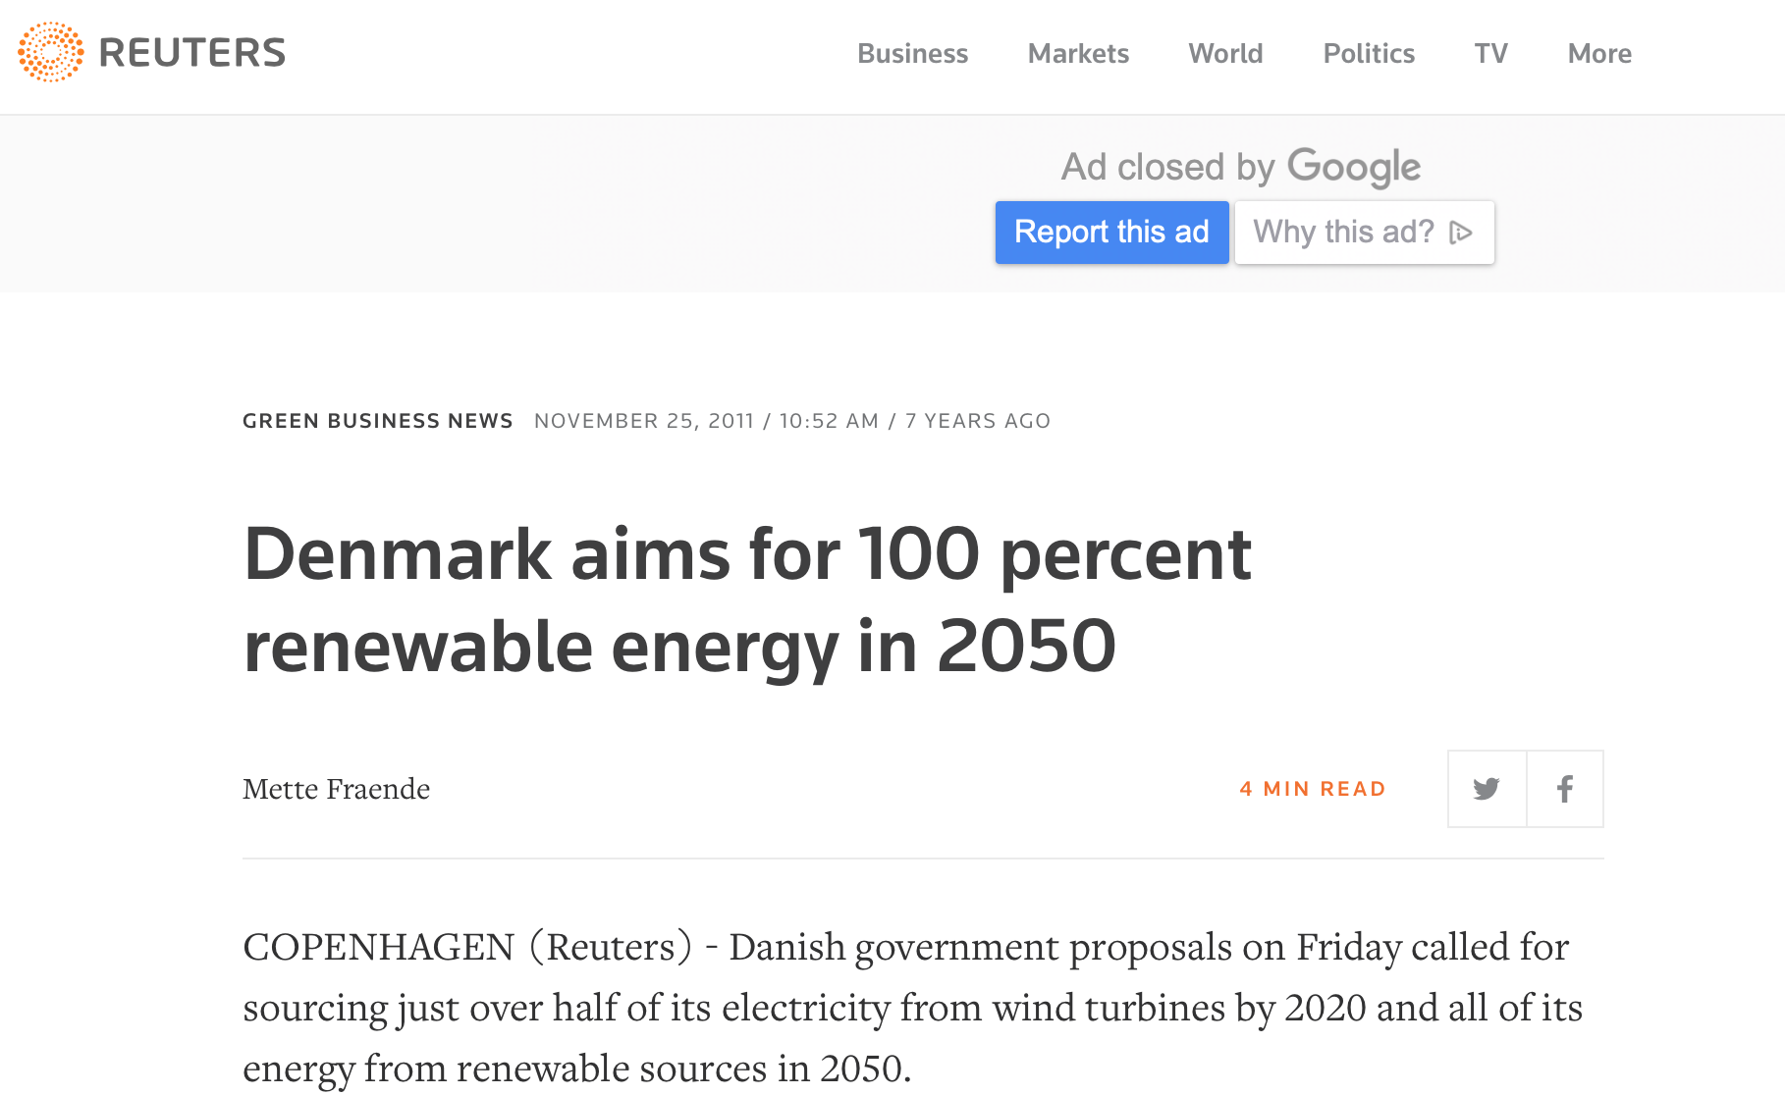
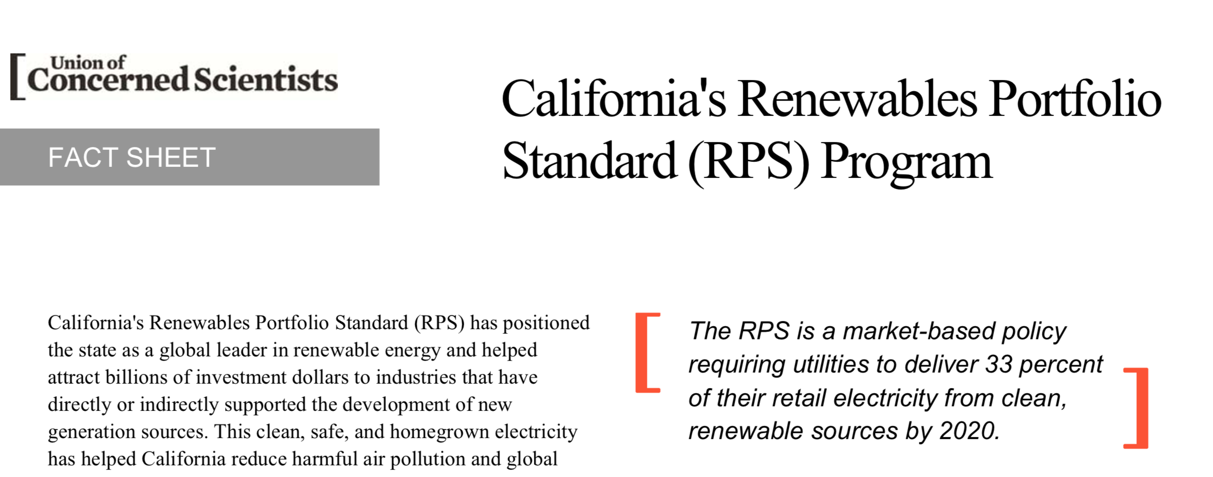
Large-scale policies encouraging investment in renewable resources have become quite common

Slide 3
New York State should consider a welfare evaluation to decide on its “Carbon Charge”
Should New York State implement a carbon tax now in its wholesale electricity markets based on a social- welfare evaluation?
What are their distributional impacts? (i.e. who benefits more or bears a higher share of the cost?)
Lever: Simulation model estimated using SMM. Uses data from the New York market.

Slide 4
The distributional impacts of a carbon tax would be significant
Results:
Carbon taxes can be beneficial. However, consumers may suffer, and producers may capture most of the welfare gains.
Notes:
Customer classes:
Residential
Commercial
Industrial
Ramsey: even a flat tariff could be more efficient. Taxing more inelastic sector (residential) creates an implicit transfer to other customers who do not reduce demand, thereby reducing the abatement. (No leakage assumption!!!)

Slide 5
Welfare gains are not evenly distributed
Net Welfare Gain: ~0 [+2]

Slide 6

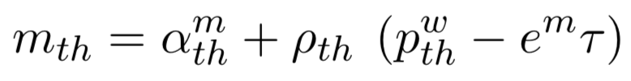
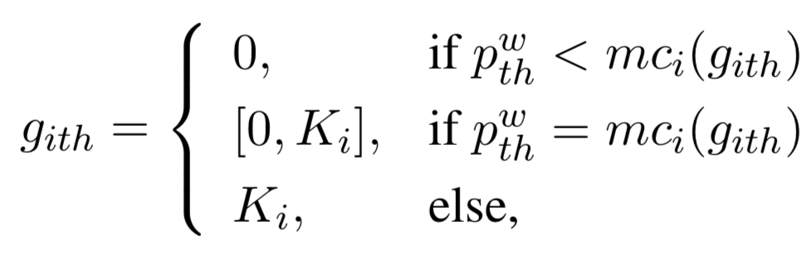
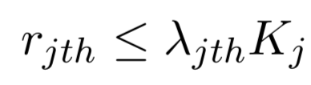

Analytical framework: the model
Partial equilibrium with three demand sectors: residential, commercial and industrial.
Demand:
[level – price response]
Imports:
[level – price response]
Generation:
[Thermal]
[Renewable]
[Hydro, nuclear]

Slide 7
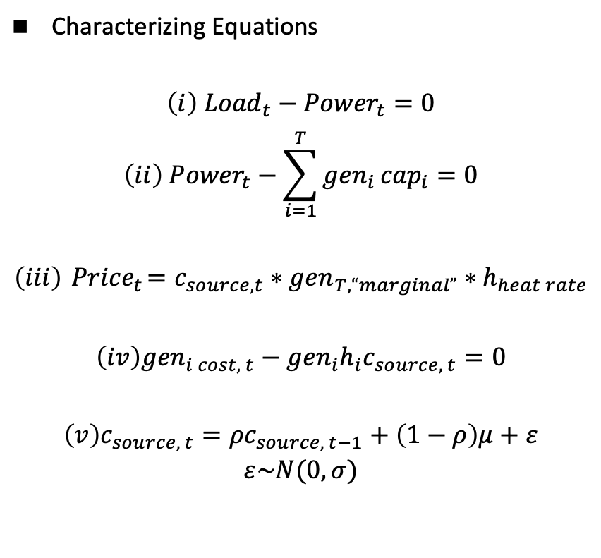
Estimation Model
Characterizing Equations
$$\left(i\right) {Load}_{t}−{Power}_{t}=0$$
$$\left(ii\right) {Power}_{t}−\sum_{i=1}^{T}{{gen}_{i }{cap}_{i}}=0$$
$$\left(iii\right){ Price}_{t}=c_{source, t}∗gen_{T, “marginal”}∗h_{heat rate}$$
$$\left(iv\right){gen}_{i cost, t}−{gen}_{i}h_{i}c_{source, t}=0$$
$$\left(v\right)c_{source, t}=ρc_{source, t−1}+\left(1−ρ\right)μ+ε$$
$$ε\sim N(0,σ)$$
Variables:
Load (exogenous)
Price (endogenous)
Emissions (end.)
Cost of primary energy source (estimated), c
Variables (*):
Generator, gen
Installed capacity, cap
Heat rate (i.e. efficiency), h
Emissions rate
Parameters to be estimated
𝛔
𝛒
𝛍

Slide 8

Moments considered
$$\left(i\right)\frac{\sum_{t=1}{{price}_{t}}}{t_{max}}$$
$$\left(ii\right) var\left(\frac{price_{t}}{load_{t}}\right)$$
$$\left(iii\right) corr(price_{t}, Load_{t})$$
$$\left(iv\right)corr(price_{t},price_{t+1})$$

Slide 9

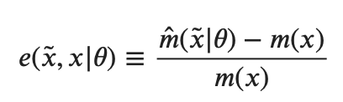
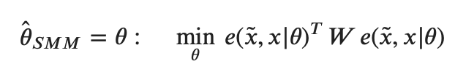
Minimizing criteria
Parameter Vector
Error function (defined as percentage)
SMM Estimator

Slide 10
Estimation Results
Estimated parameters:
𝛒: 0.56
𝛍: 3.87
𝛔: 1.34
Vector of Differences:
[ 0.18 -0.12 -0.35 -0.0015]
Standard Errors of Parameter Vector
[0.00018, 0.00335, 0.00043]
Number of Simulations, number of periods
1200, ~3000

Slide 11
Assumptions
Natural Gas-fired plants, wind, hydro and nuclear plants combined provide the entirety of the power demanded (~95% in 2017)
Imports and exports remain at the level they were in the actual market run
Adjusted capacity for thermal units to average summer derating factor
Modified wind capacity to attain a constant output that resulted in the same capacity factor as in 2017
Hydro and Nuclear units will have a constant output (NG will usually be on the margin, consistent with data)

Slide 12
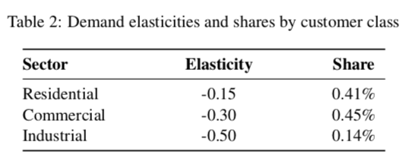
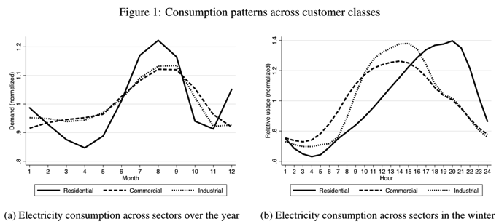
Improvements
Demand can also be modeled as elastic
Consistent with literature, an elasticity of -0.2 could be assumed
Different sectors on the demand side consume electricity differently
*Figures from Reguant, Mar, “The Efficiency and Sectoral Distributional Impacts of Large-Scale Renewable Policies”, Journal of the Association of Environmental and Resource Economics, forthcoming

Slide 13
Data
Generation facilities participating in NYS wholesale energy markets (~500) [NYISO]
Load Historic and Forecast: Seasonal Peak load and total consumption (2019 – 2030) [NYISO] ***First simulation only leveraged 2017 data
Historic Load: Down to 5-minute granularity, 10 years [NYISO]
Social Cost of Carbon [Interagency Working Group on Social Cost of Greenhouse Gases]
eGRID: Plant level and State level emissions data [EPA, 2016]
Plant level efficiency/heat-rates [EPA, 2016]
Notes:
Intuitively, if there is no revenue raising motive, (lambda=0) , prices become marginal cost + externality
Describe hypothetical of reverse case (tax raises revenue past the scc) – more elastic would be taxed more!

