Slide 1
Analysis of the response of void BAO to systematic effects in SDSS observations using mock datasets
Daniel Felipe Forero-Sánchez
Laboratory of Astrophysics (LASTRO)
École Polytechnique Fédérale de Lausanne (EPFL)
Lausanne, Suisse
January 20, 2020

Slide 2
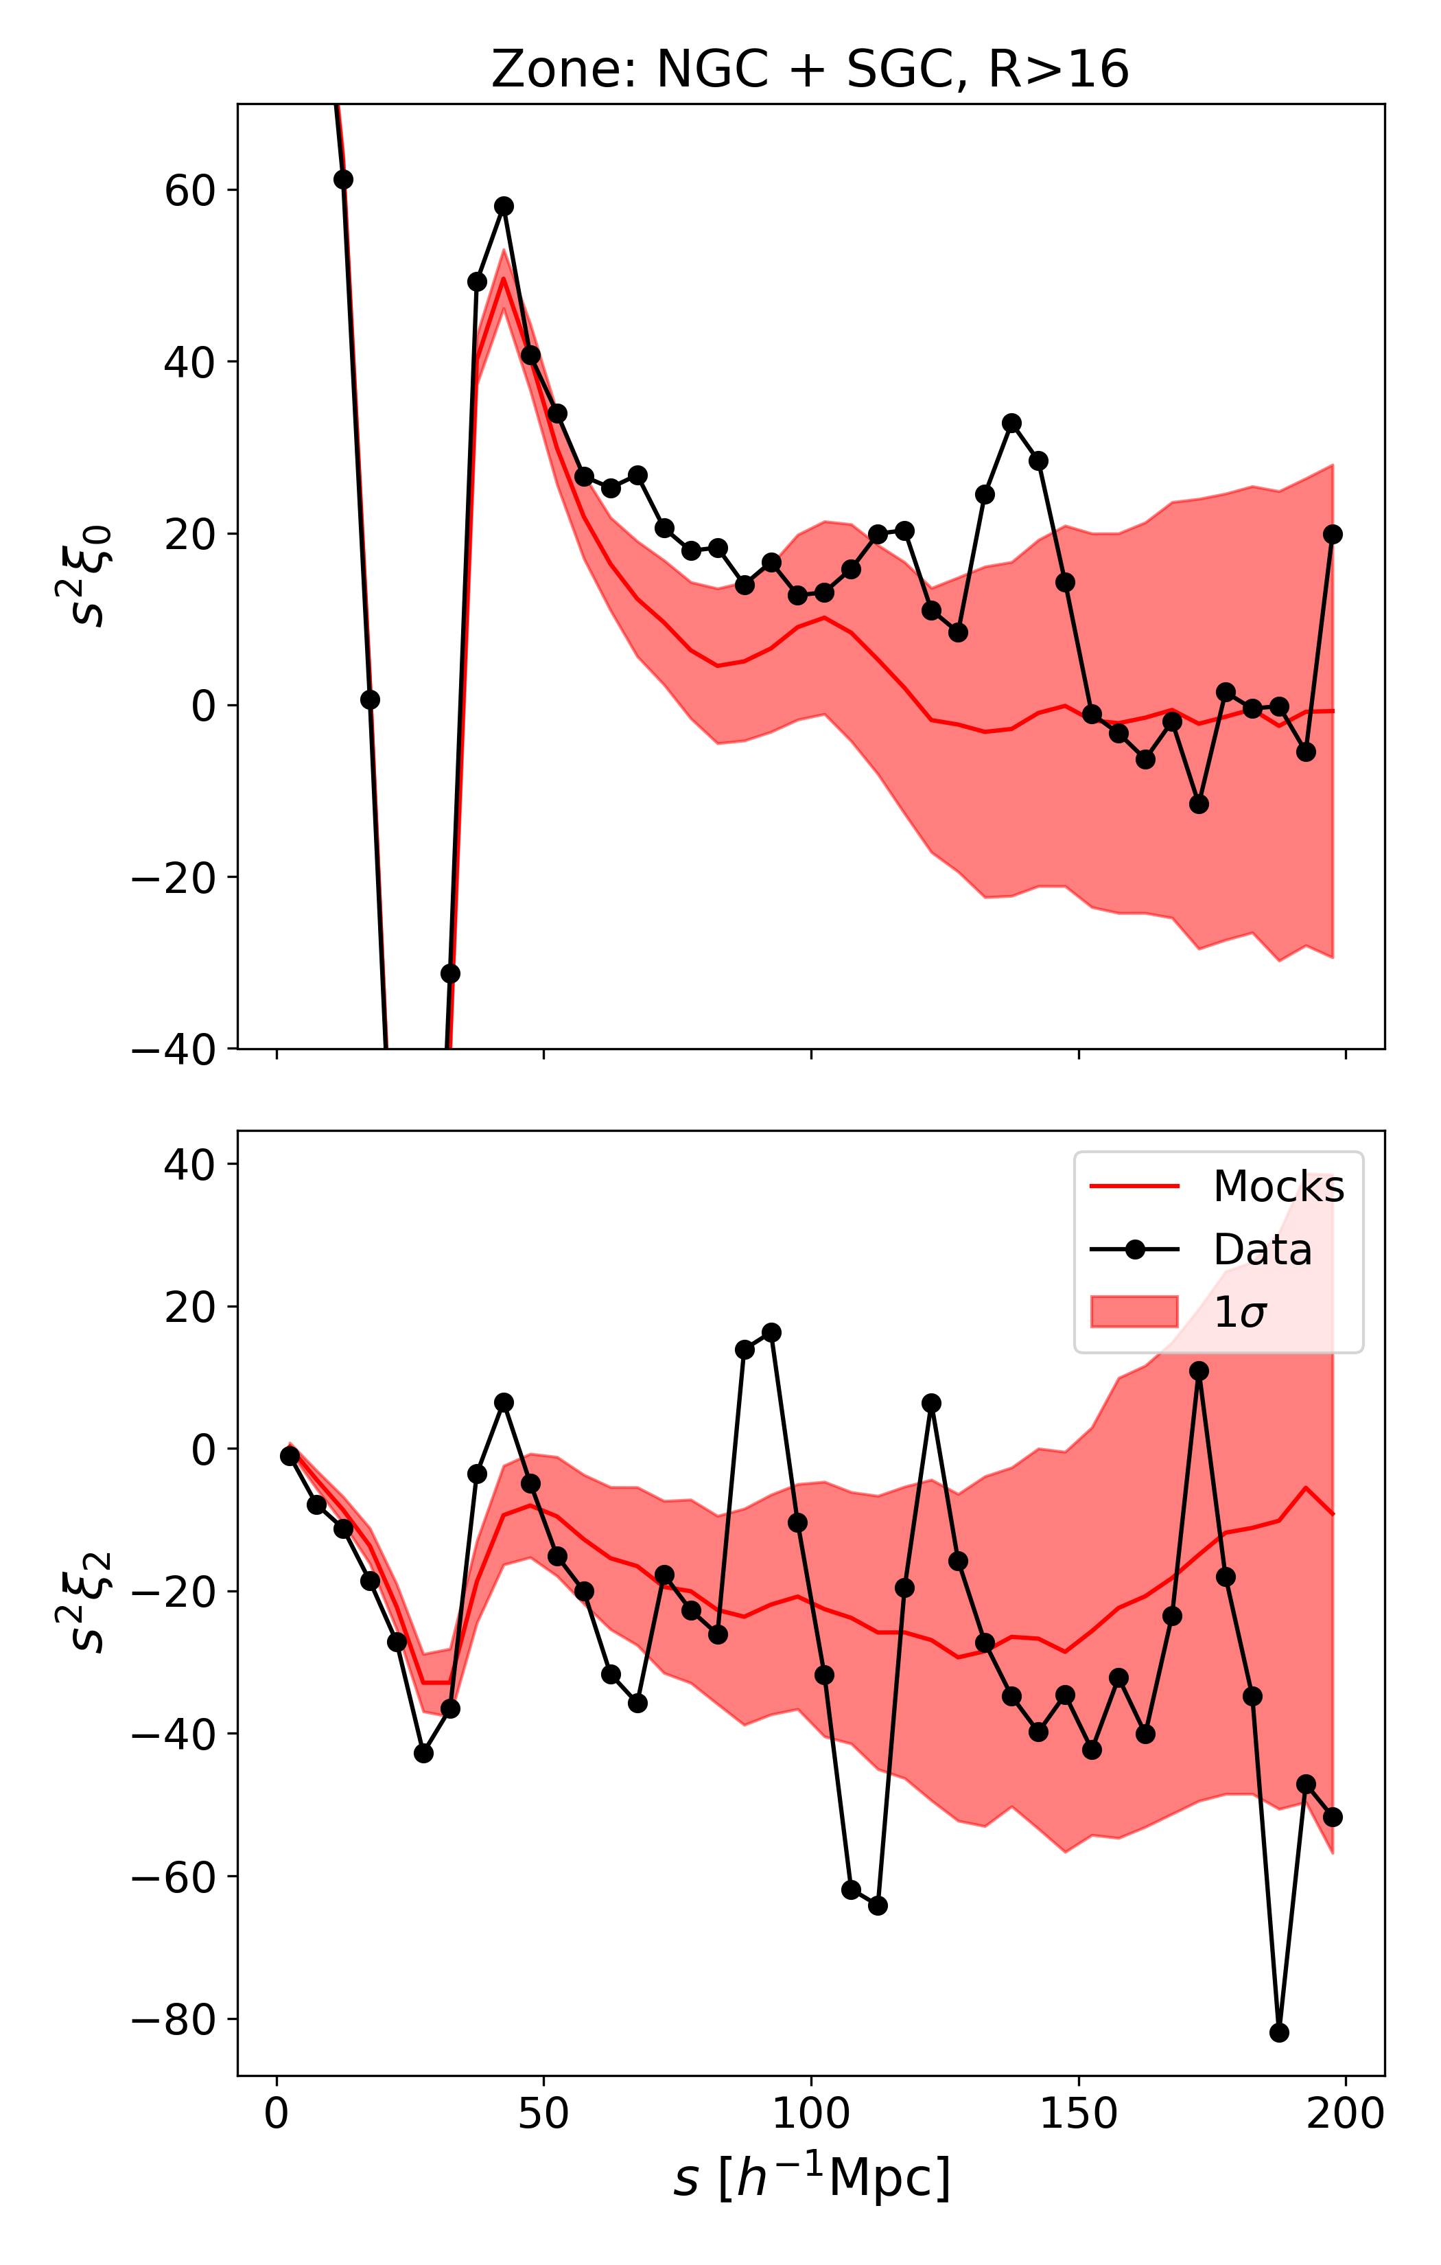
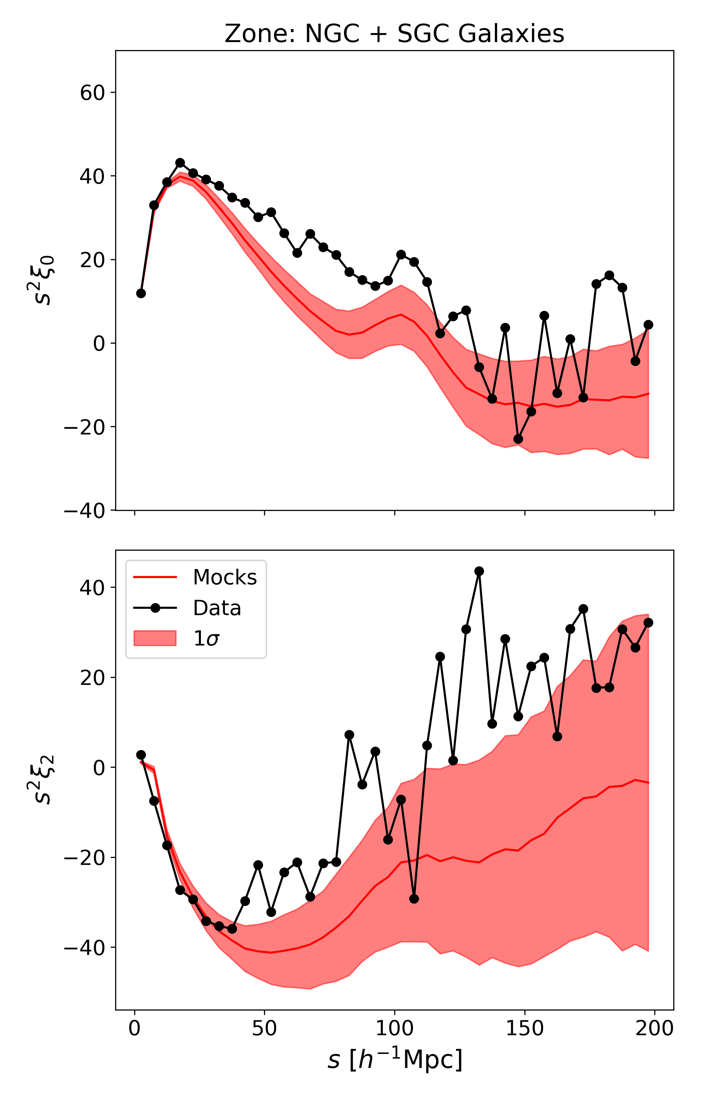
Introduction
Void + Matter
    10% improvement in error
    20% Survey size increase
Voids less sensitive to systematical effects.
Negativity of quadrupole is expected for galaxies at large scales.
Systematics affect the measurement of BAO peak.
How different is this effect on voids?

Slide 3
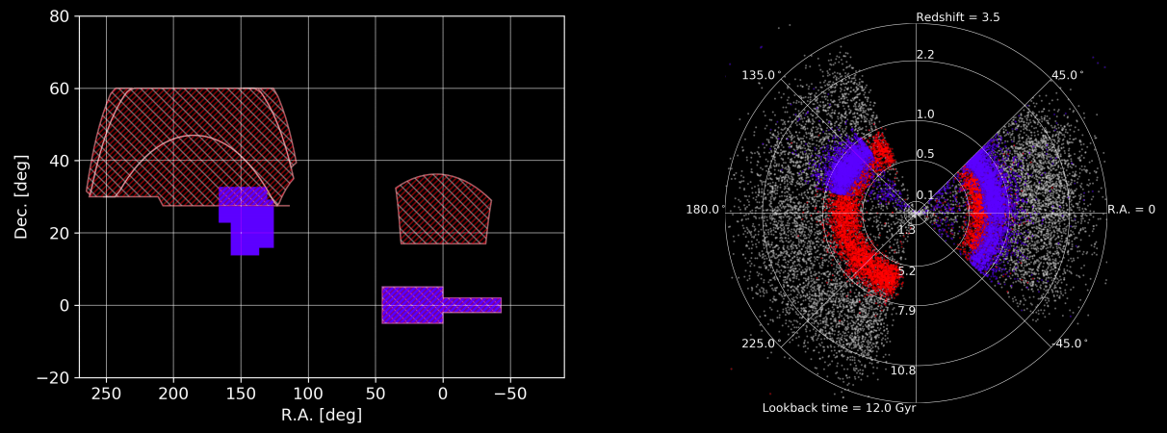
The eBOSS Survey
Extended Baryon Oscillation Spectroscopic Survey
Measure 3D (RA, DEC, ) position of matter tracers:
  LRG:
  ELG:
  QSO:
Data taking from 2014 to 2019
Currently: Final data analysis
Credits: A. Raichoor

Slide 4
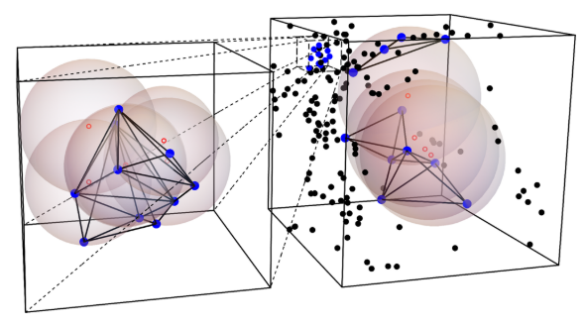
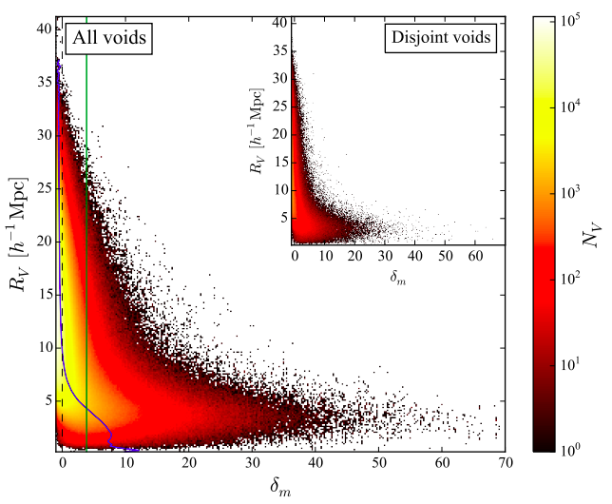
Voids
Geometrical definition: Delaunay Triangulation: Spherical voids.
Two populations:
  Small “voids”:
    Not actually voids
    Small radii
    Correlated with matter tracers.
  Big voids:
    Underdensities
    Large radii
    Anticorrelated with matter tracers
Zhao et. al. 2016

Slide 5
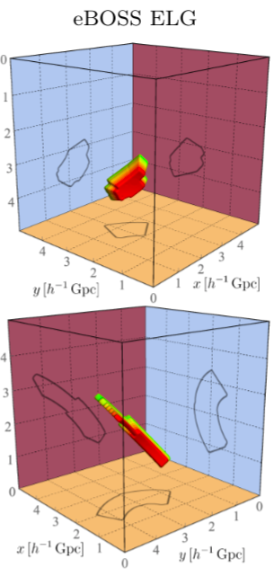
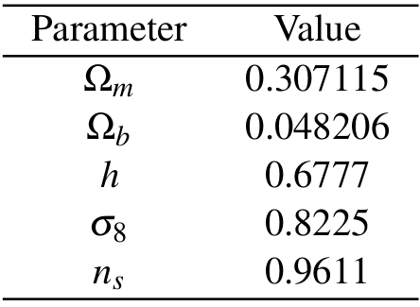
Data
1000 EZ mocks emulating ELG observations.:
  Displacement field from Zel’dovich Approximation
  PDF extraction from n-body simulation.
  Halo position assignment
Planck fiducial cosmology:
Zhao et. al. 2020

Slide 6
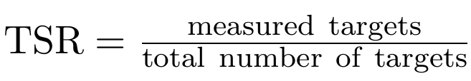

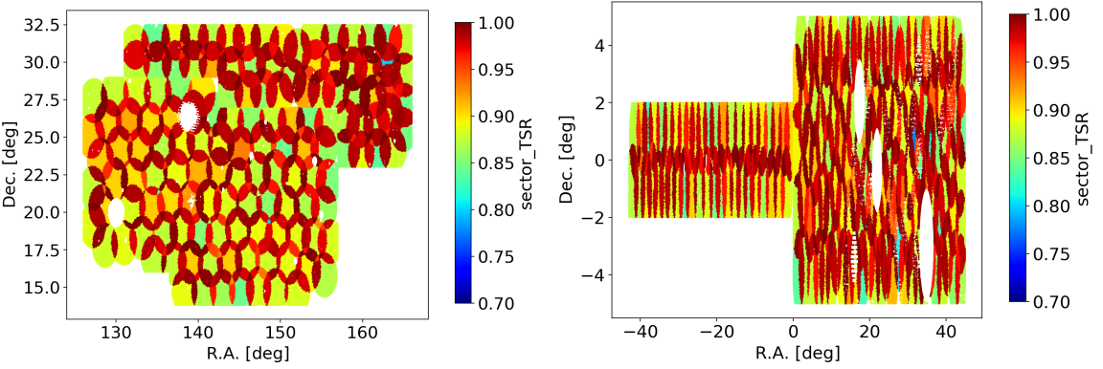
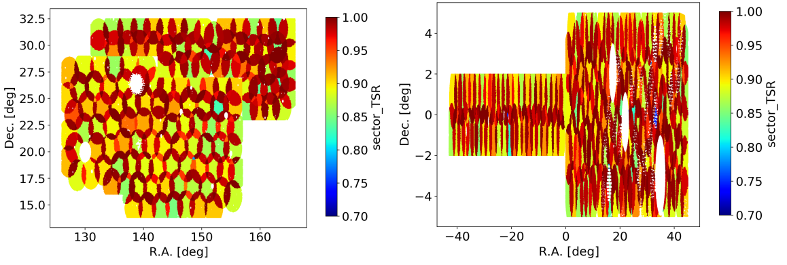
Systematics: Fiber Collisions
Two (or more) objects too close in the sky (62’’) can’t be resolved by a single fiber.
Choose which one to measure. The remaining ones can be seen by other plate.
Tiling Success Rate (by sector)
Upweight missing objects (by collision group)
De Mattia et. al.. 2020
eBOSS
EZ mocks

Slide 7

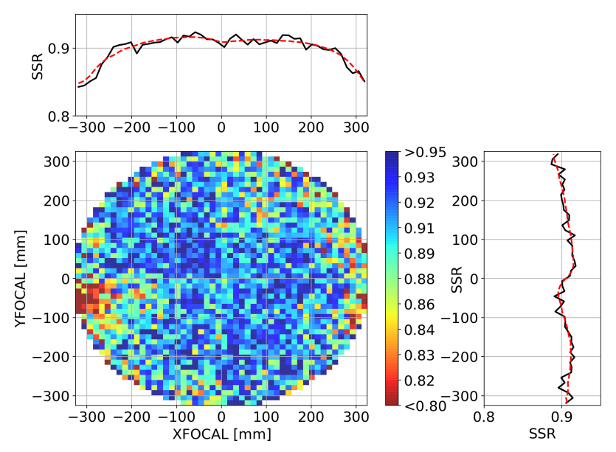
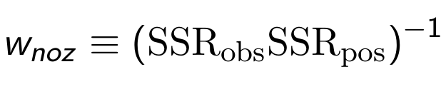
Systematics: Redshift Failures
Errors in spectroscopic pipeline: Spectroscopic Success Rate (SSR)
Errors due to observational conditions (SNR) and fiber position.
Upweight objects teking into account both effects.
De Mattia et. al.. 2020

Slide 8
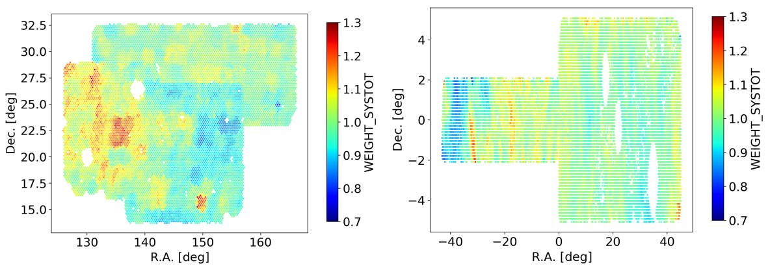
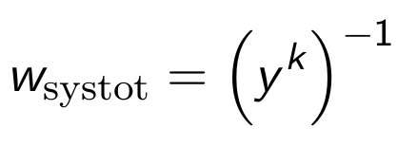
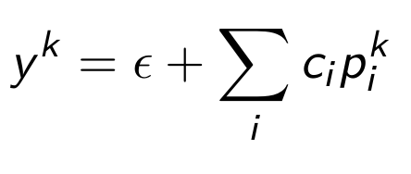
Systematics: Angular Photometric
De Mattia et. al.. 2020
Model inhomogeneities in the sky with some function of observational parameters
Partially correct for a “homogeneous sky”

Slide 9

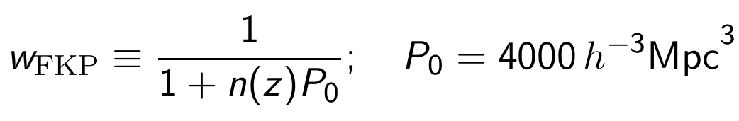
Systematics: Normalization and cuts
Define
Normalize photometrics before and redshift failures after computing completeness.
Remove invalid objects by setting weight to 0
Choose elements with SSR > 0.5
Choose elements with
Take into account the redshift density

Slide 10
Catalog generation
Zhao et. al. 2020
Export catalogs with
Use DIVE to extract void catalogs with
Mask catalogs to the survey geometry
Create randoms:
  Combine 100 mocks
  Divide in redshift bins
  Divide each in radius bins
  Split columns as
  Shuffle one half
  Recombine
  Randomly choose 2 700 000 elements with

Slide 11
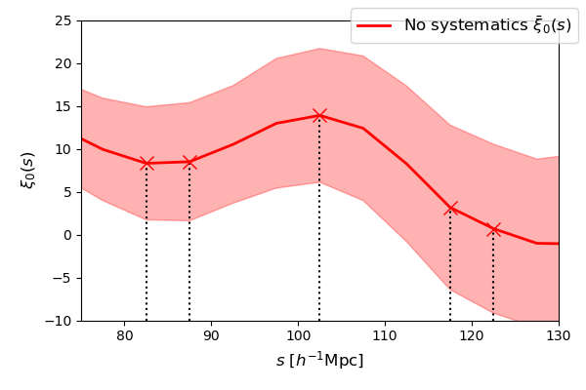
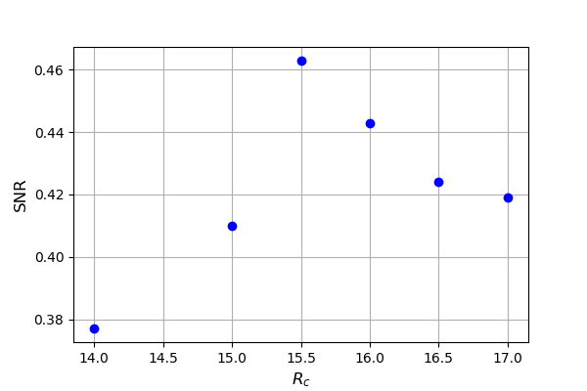

Radius cut
Define signal as in Liang et. al. (2016)
Analyze the signal-to-noise ratio SNR using 100 EZ mocks without systematics.
Optimum cut

Slide 12
The BAO Model
We use the model in Zhao et. al. (2019)
We need a template (halo) correlation function:
With
Finally our tracer model is given by
Galaxies
Voids

Slide 13
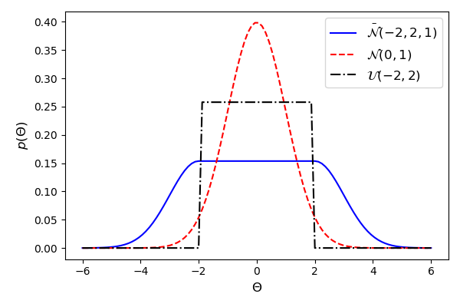


Parameter Fitting
Bayesian inference:
Priors:
Galaxies
Voids

Slide 14
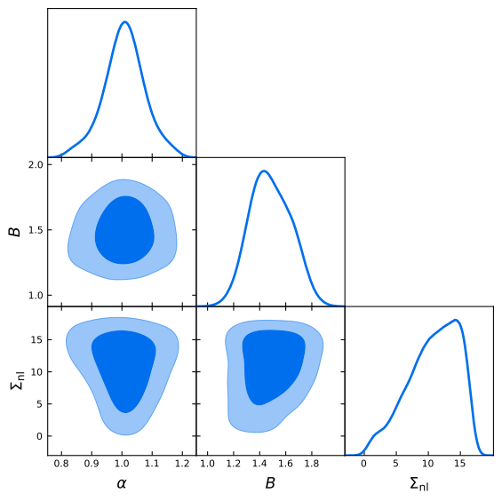
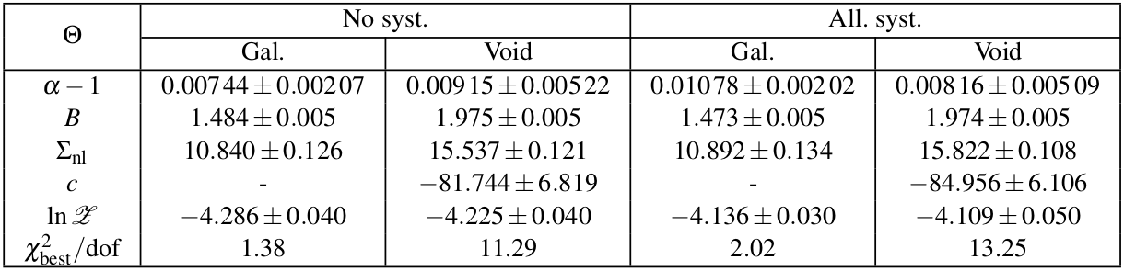

Results: Galaxy Mean 2PCF
No systematics
All systematics

Slide 15
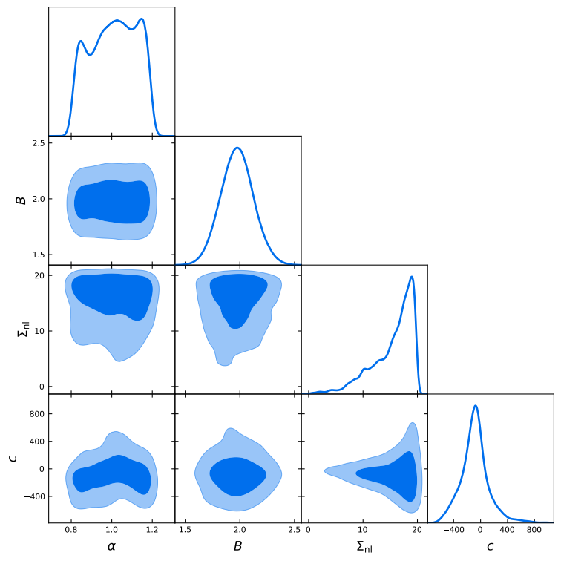
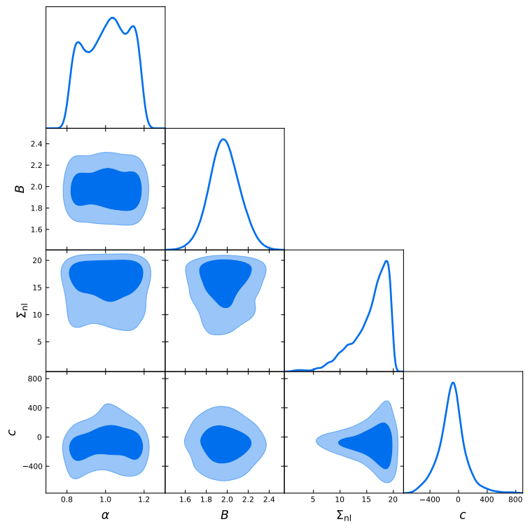
Results: Void Mean 2PCF
No systematics
All systematics

Slide 16
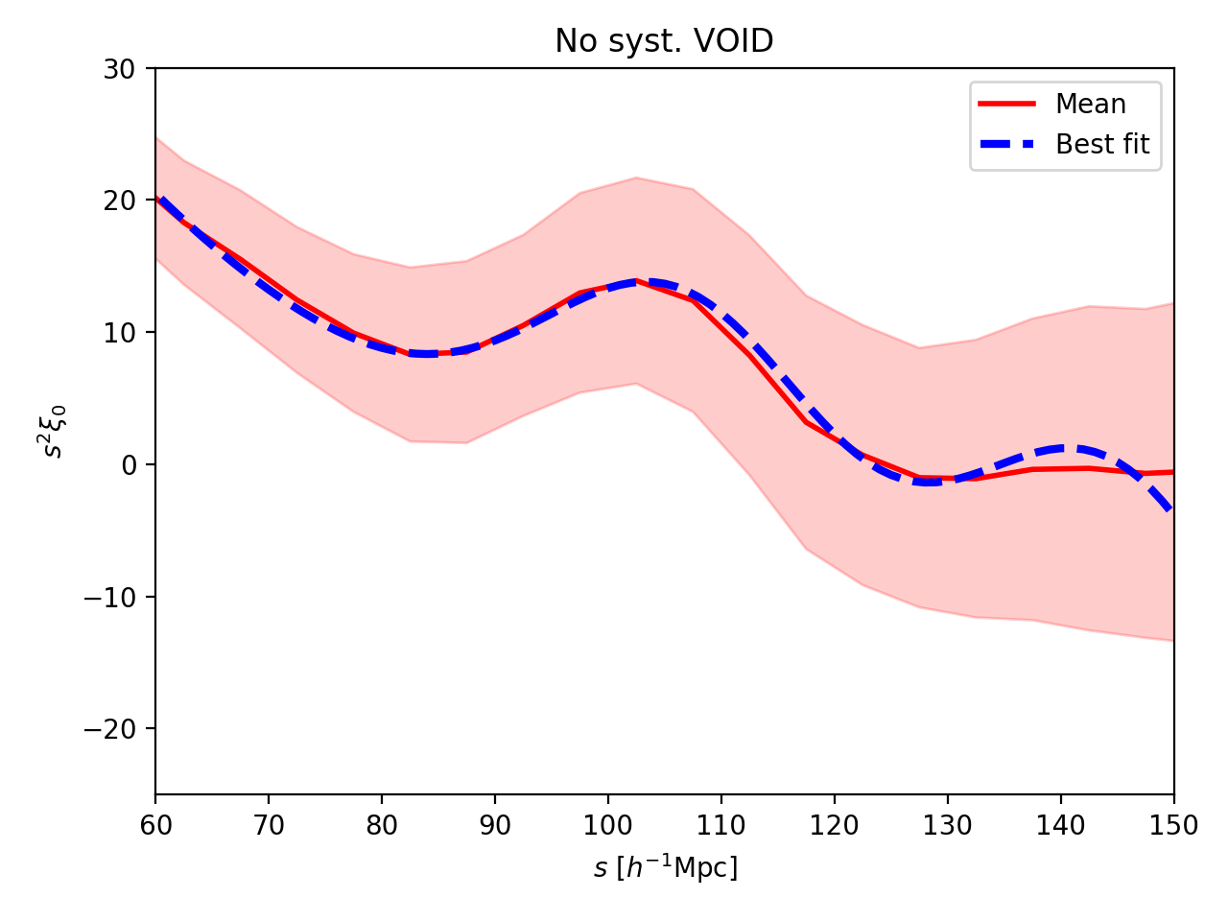
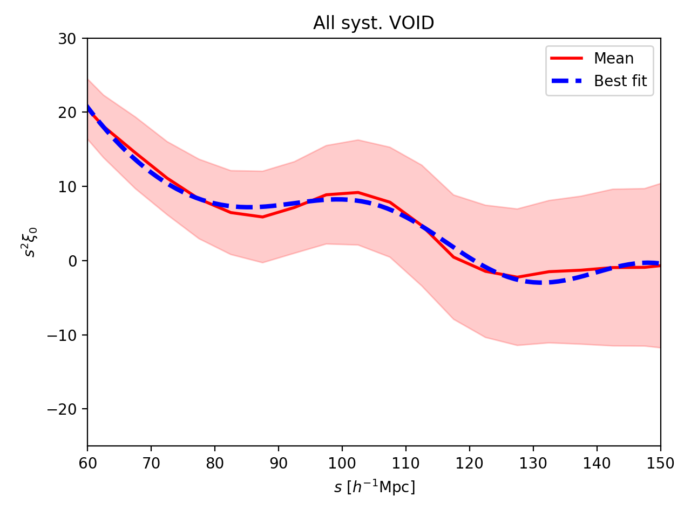
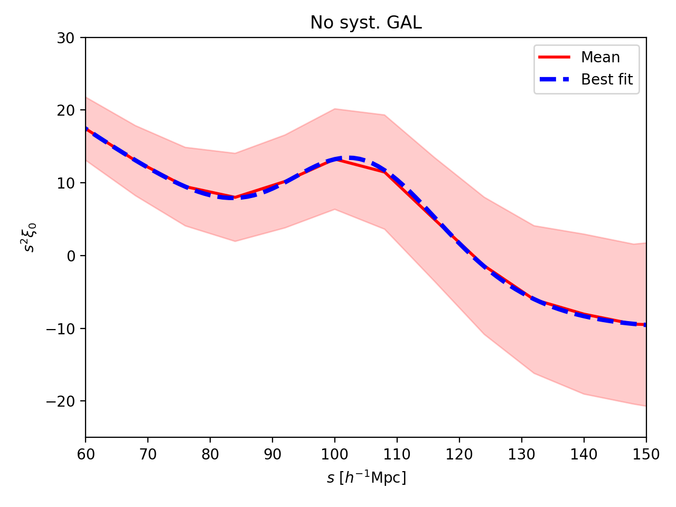

Results: Mean 2PCF Best-fits

Slide 17
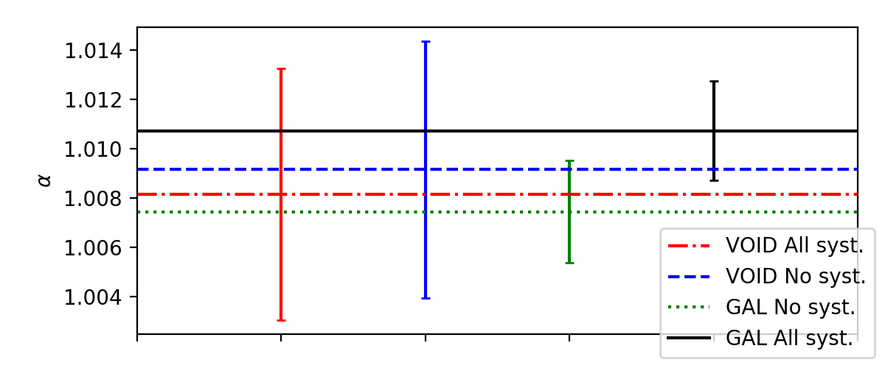
Results: Mean 2PCF Comparison
Mean
Individual

Slide 18
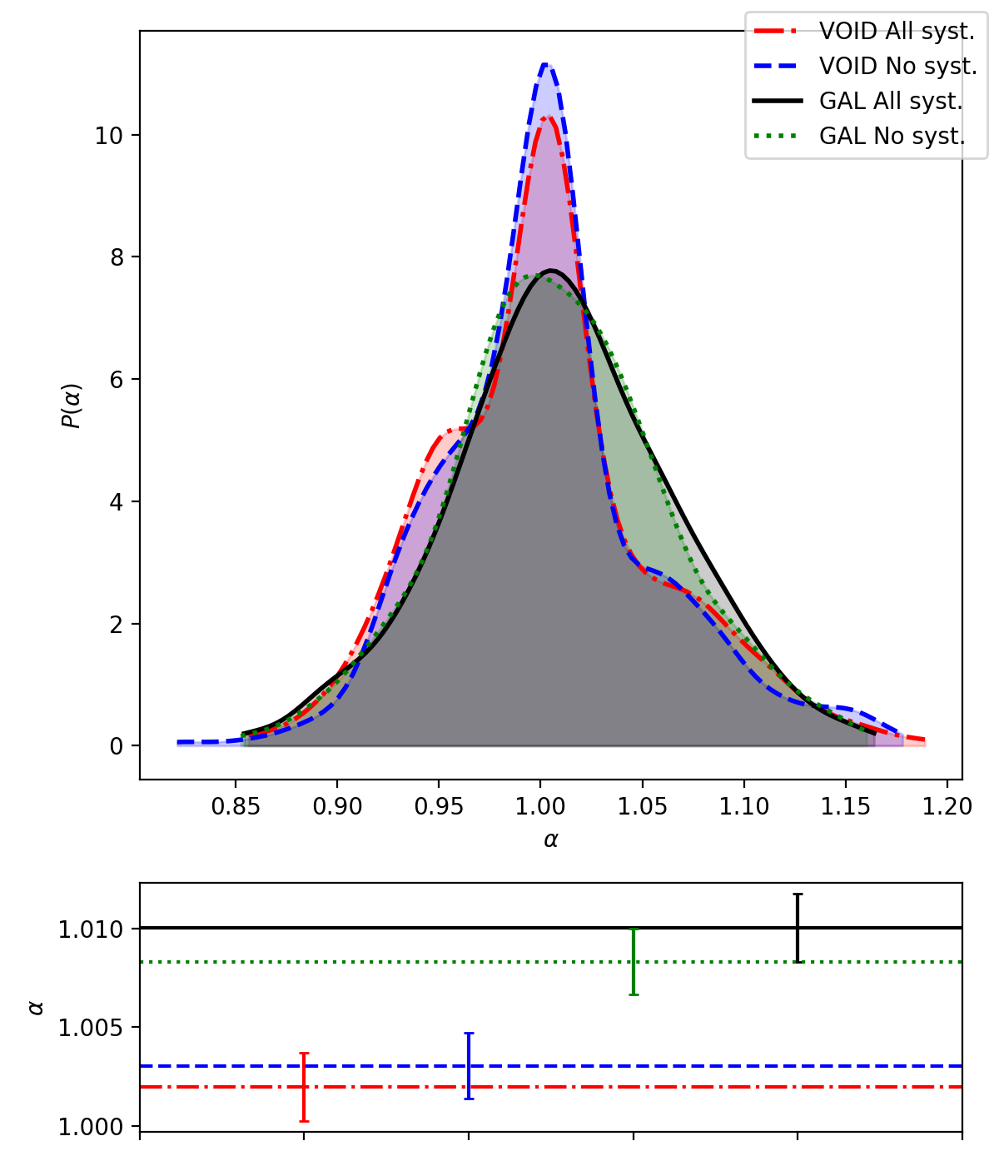
Results: Individual 2PCF Comparison
Mean
Individual

Slide 19
Conclusion
Mean 2PCF: Smaller shift using voids
Void posteriors: Very wide – Multimodal-like
Improve fitting method (increase evidence):
  Improve/tweak priors: Difficult, time consuming.
  Template non-wiggle void power spectra (See. Variu et.al. 2020) Already shows better results. Relies on decreasing complexity by removing parameter c.
Individual 2PCF: Smaller widths in distribution shows robustness in the analysis
Individual 2PCF: Smaller shift using voids
ELG BAO is noisy: SNR < 1 so BAO signal not significant.
Use tracer with higher SNR: Repeat analysis with LRG (SNR~10, Liang et. al. 2016) and QSO

