Slide 1
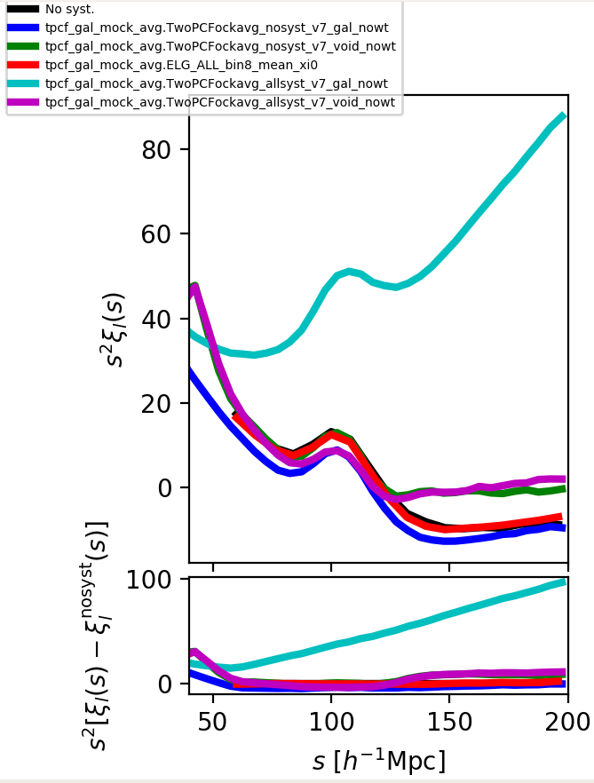
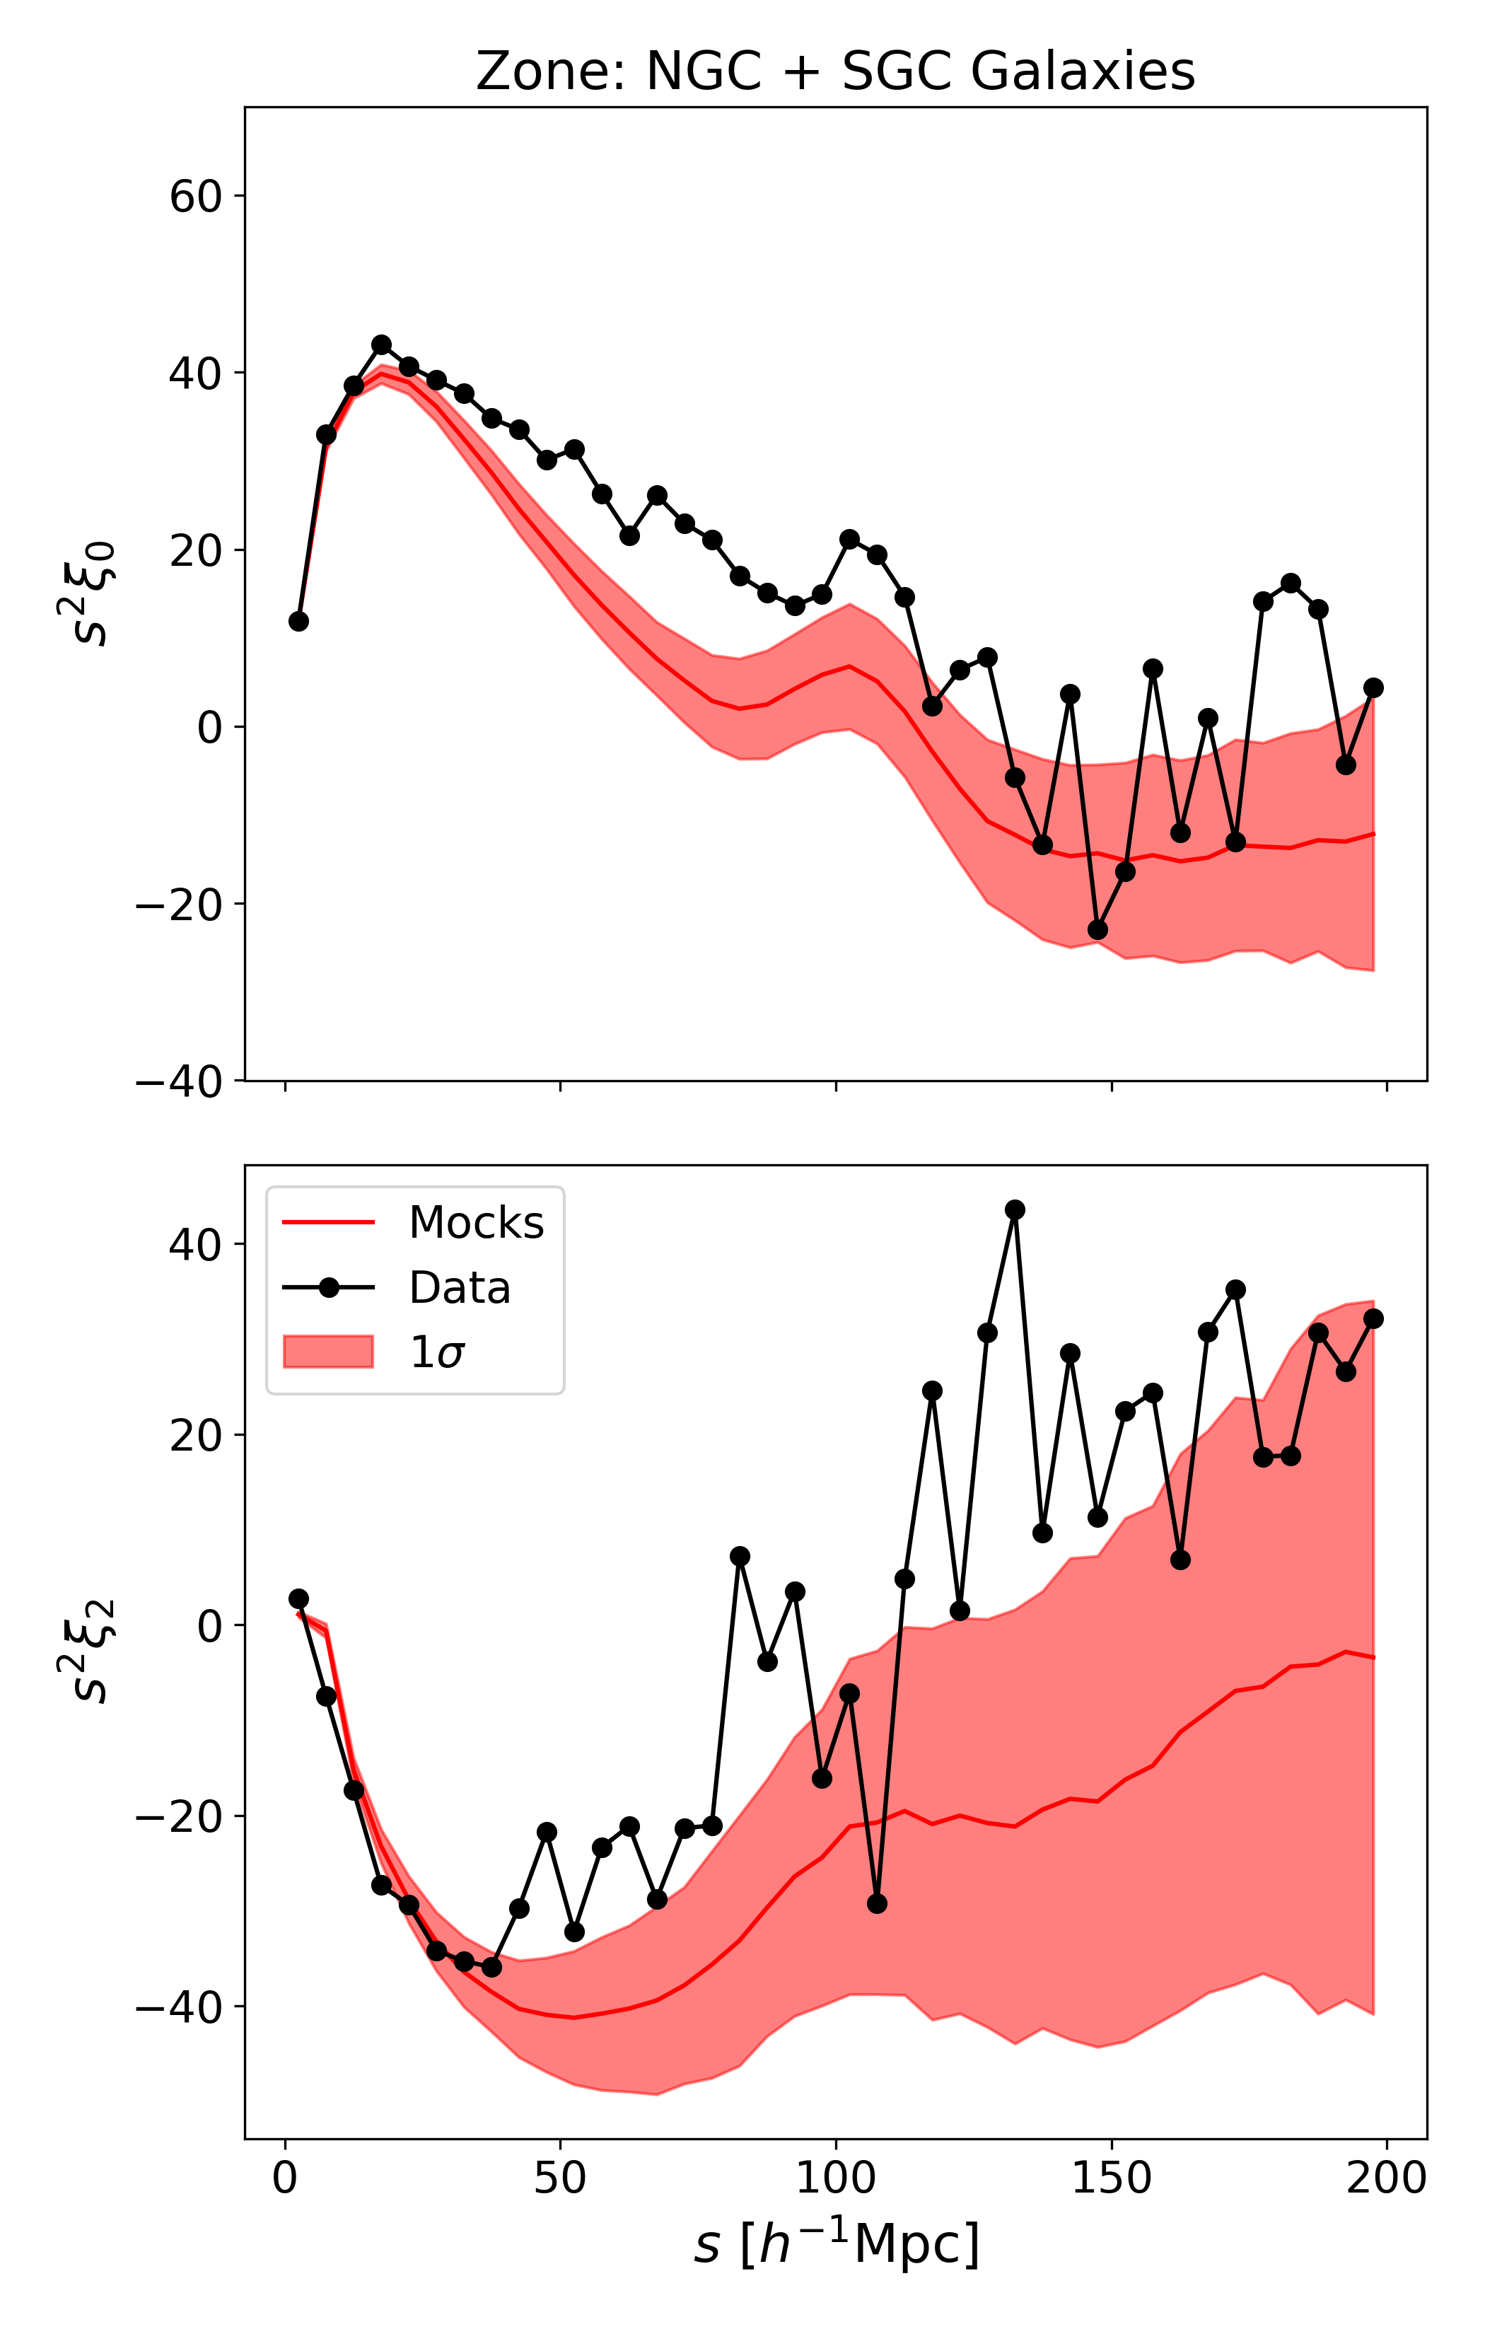
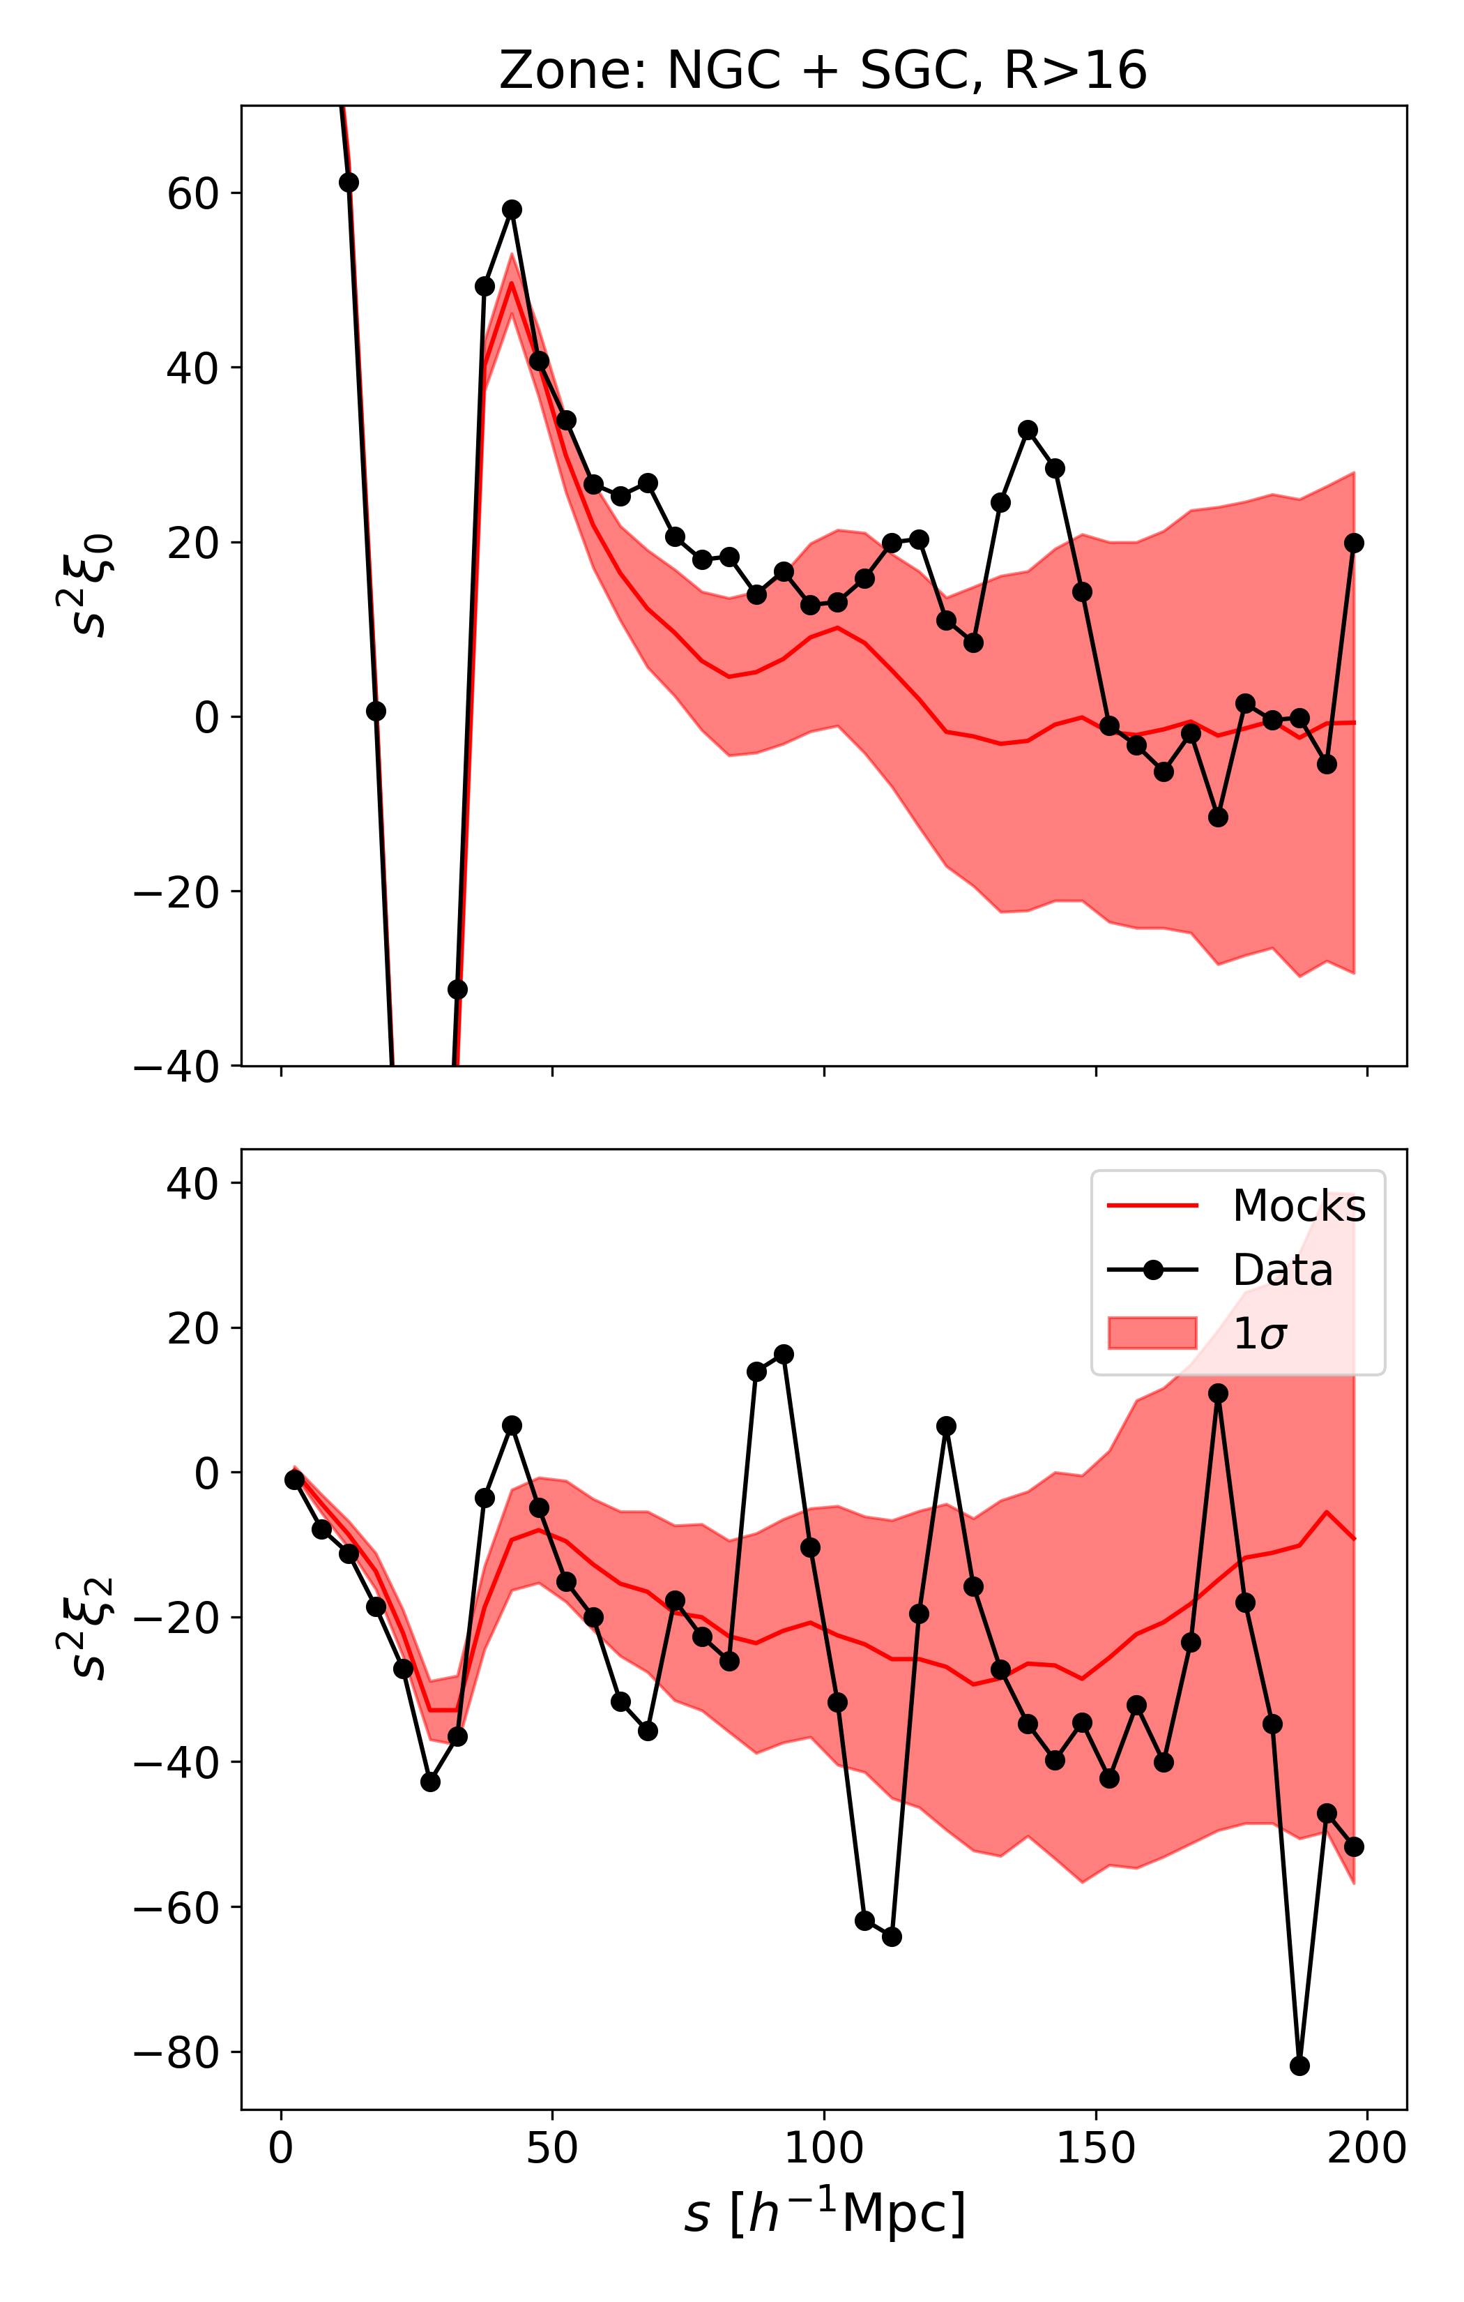
Systematics on ELGs
Large positive bias in galaxy 2pcf using only FKP weights
Amplitude of BAO peak decreased by systematics (green vs. magenta (?) curves)
Small bias even in weighted galaxy 2pcf (red vs. blue)

Slide 2
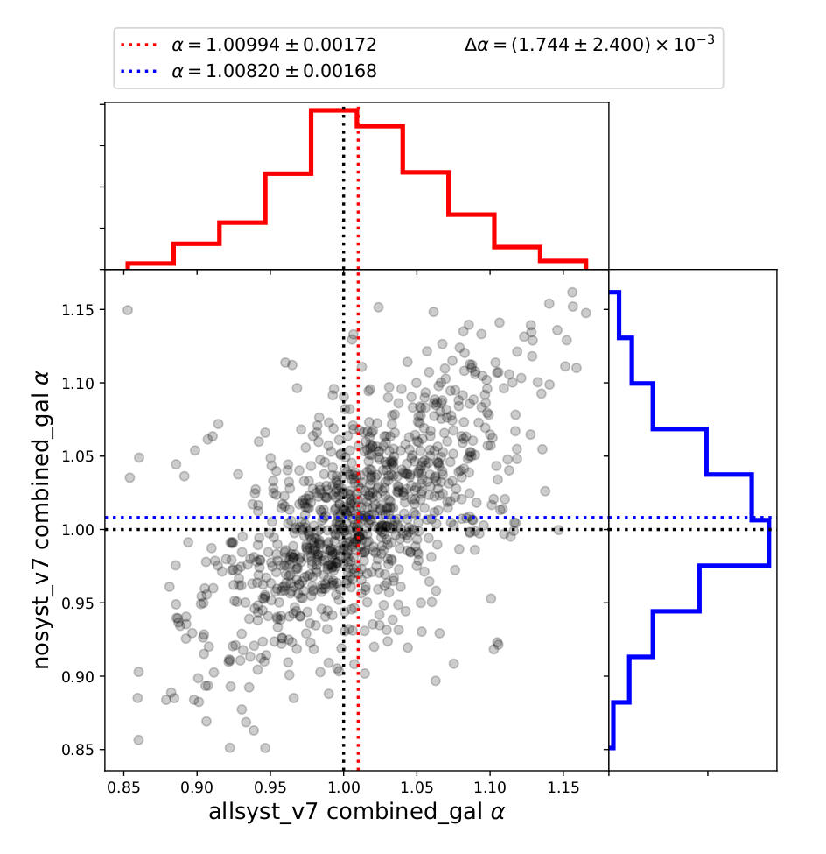
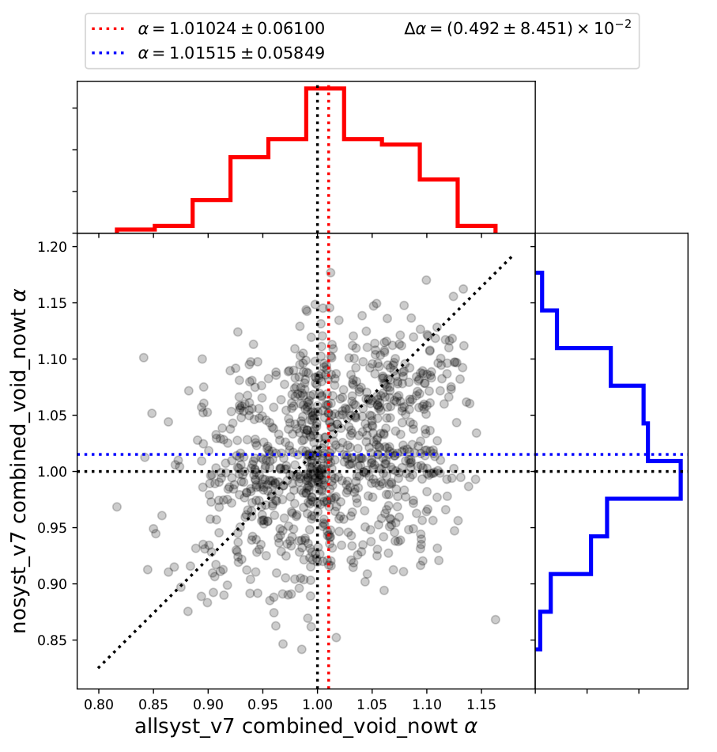
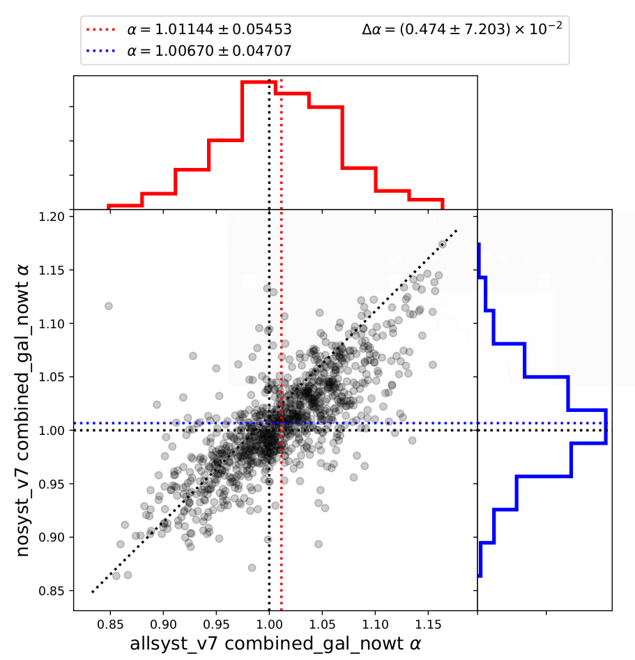
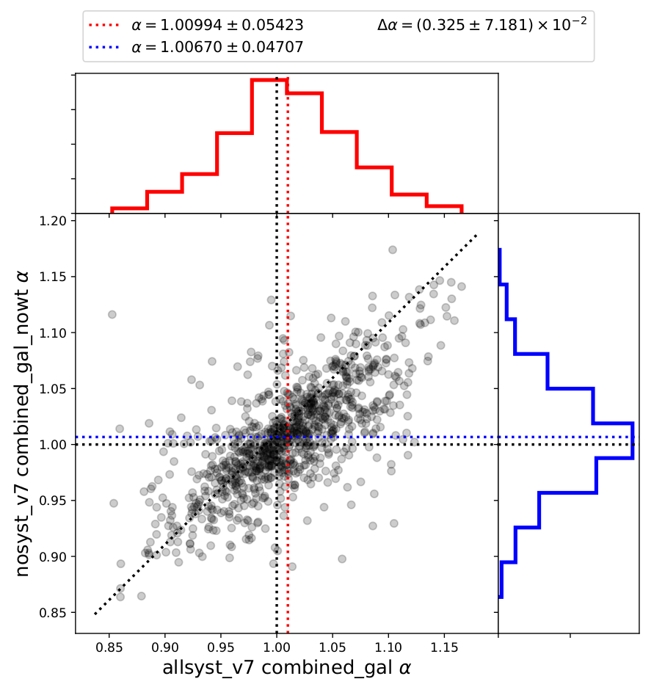
ELG void template fits alpha distributions
Templates to be improved.
Galaxies no weights
Galaxies weights
Voids no weights

Slide 3
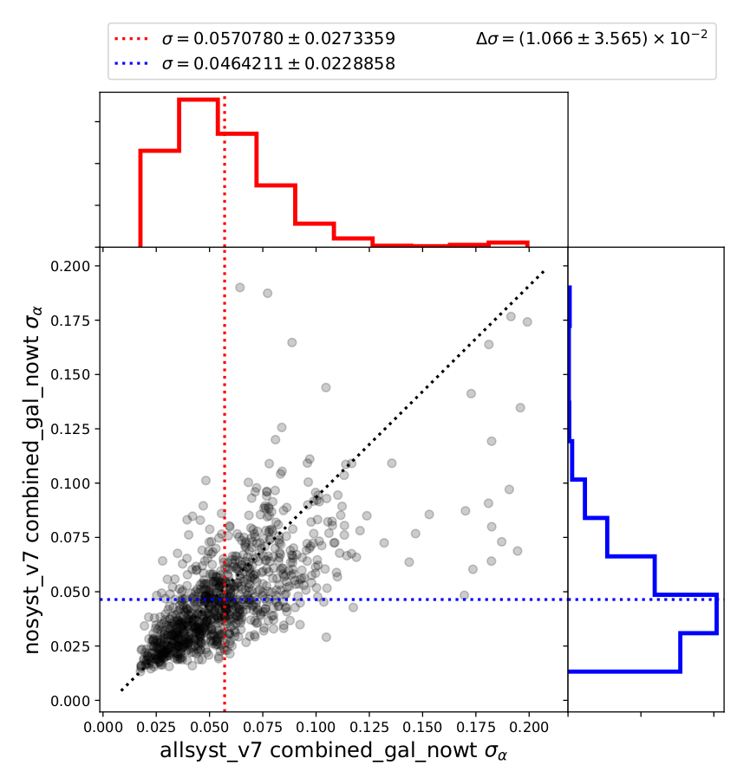
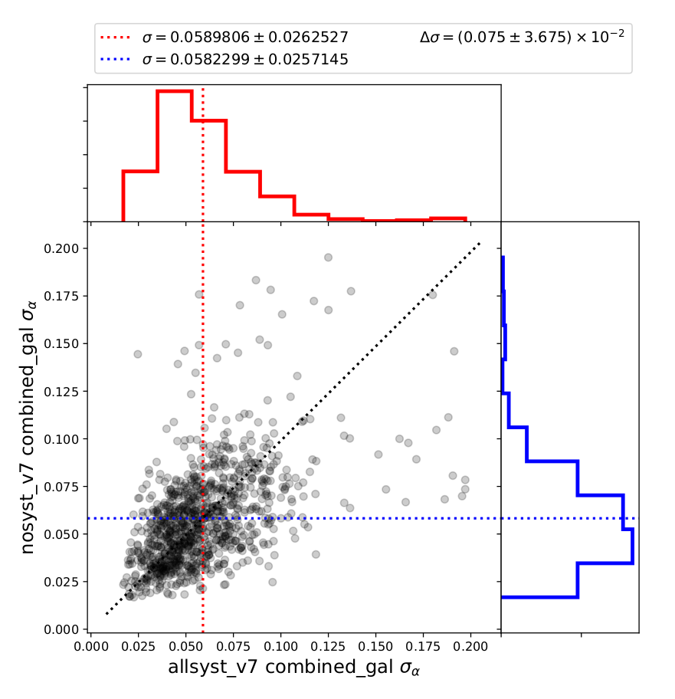
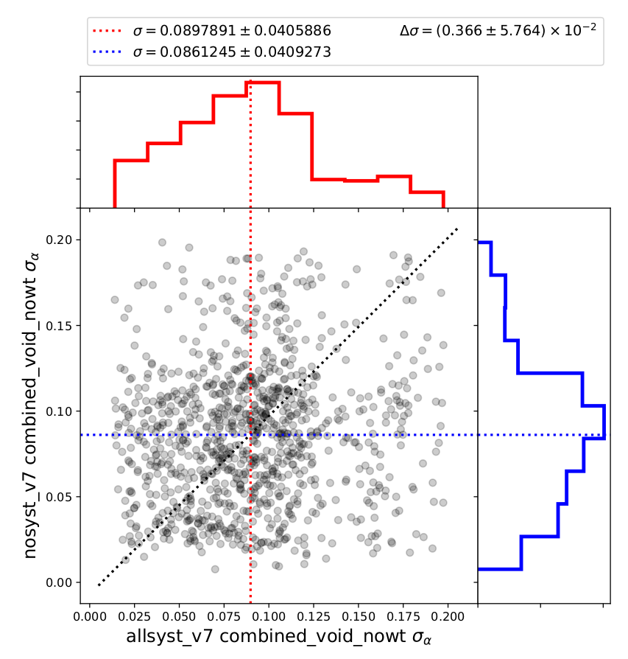
ELG void template fits sigma distributions
Template in progress
Galaxies no weights
Galaxies weights
Voids no weights

Slide 4
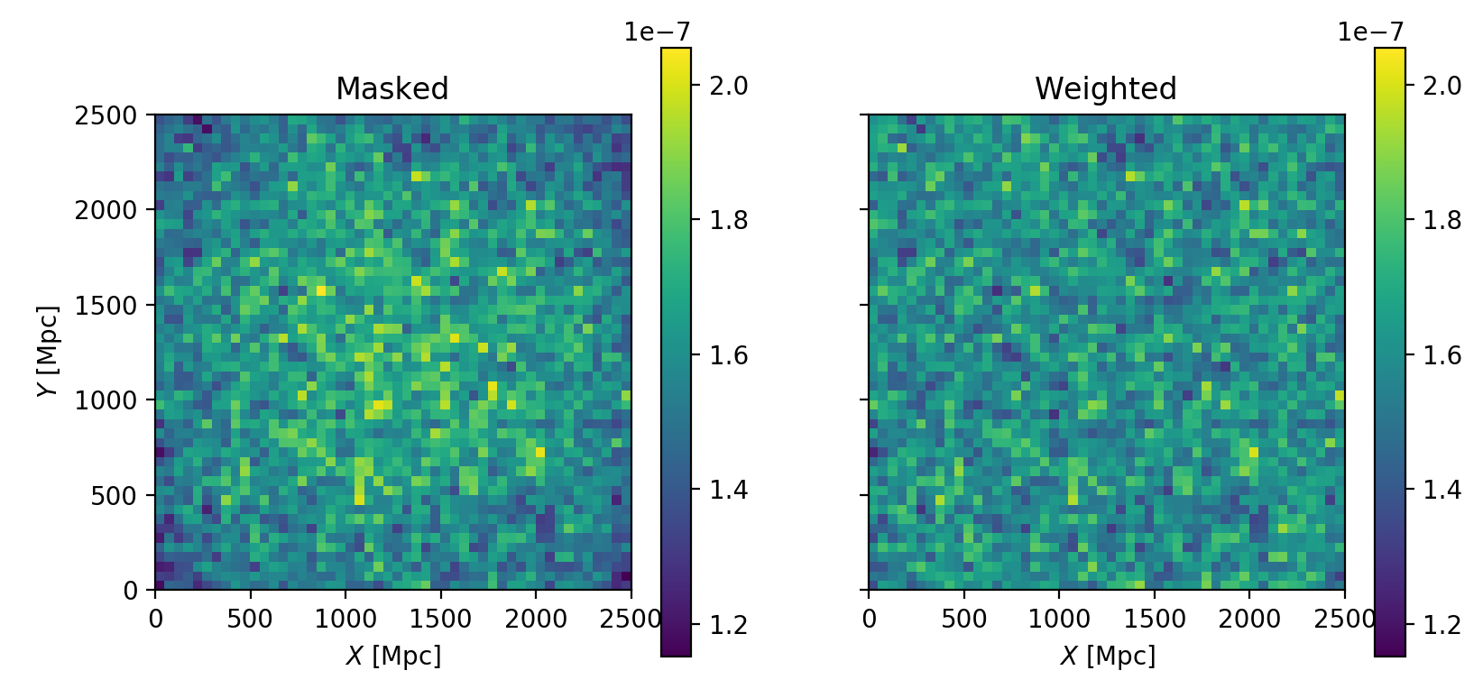
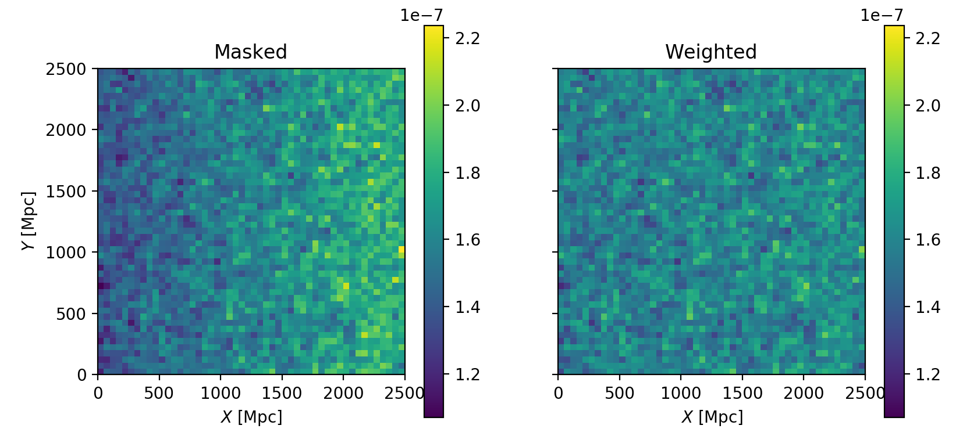
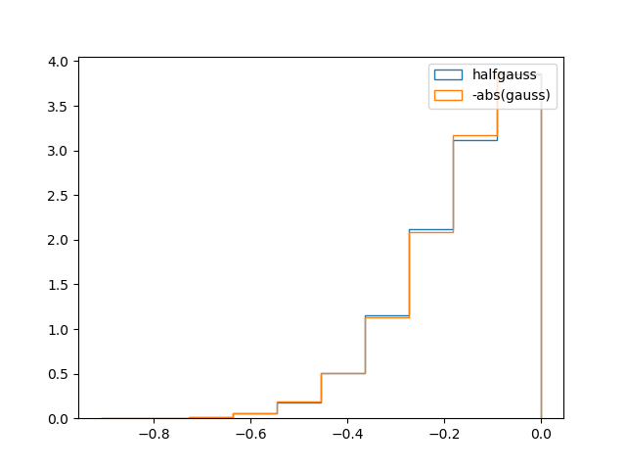
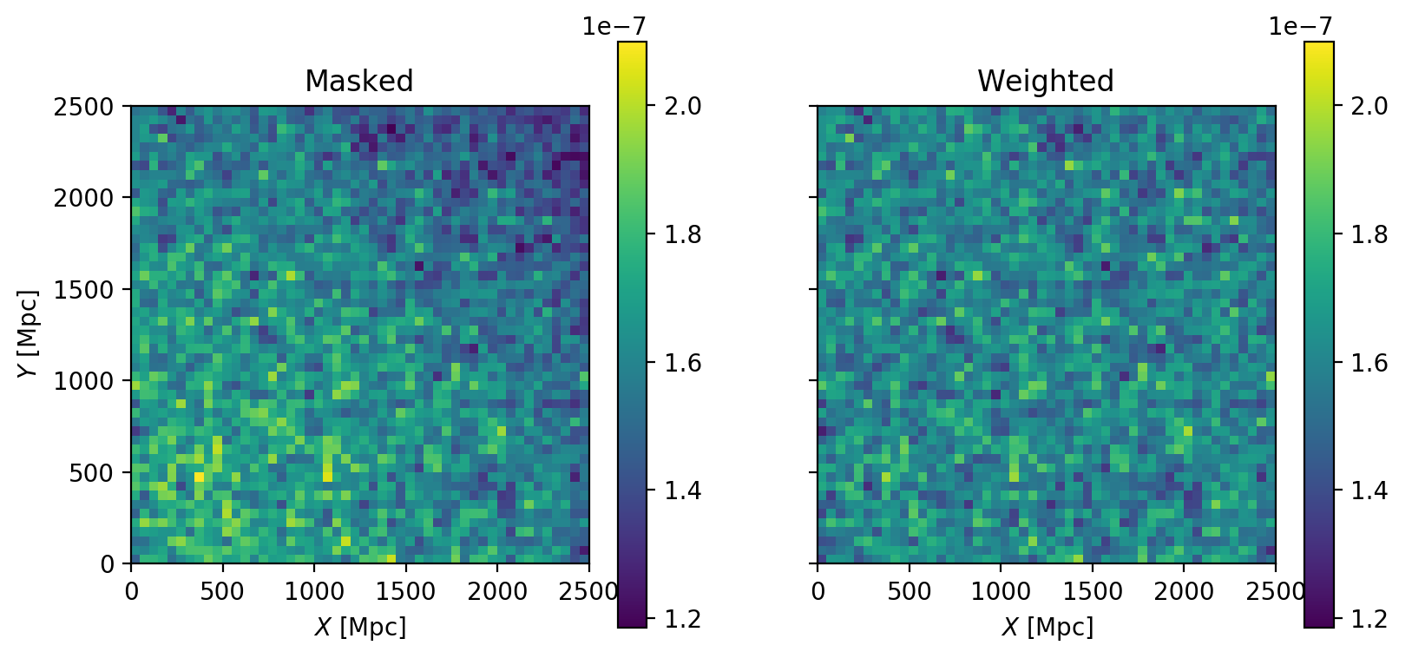
Systematics on boxes
Apply completeness maps to catalogs:
Smooth map: Simulate angular distribution.
Noisy map: Simulate angular distribution + Random angular effects (eg. redshift failures)
Add weights from inverse smooth completeness.

Slide 5
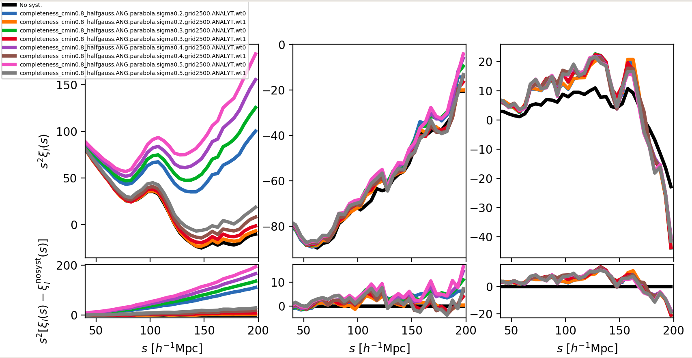
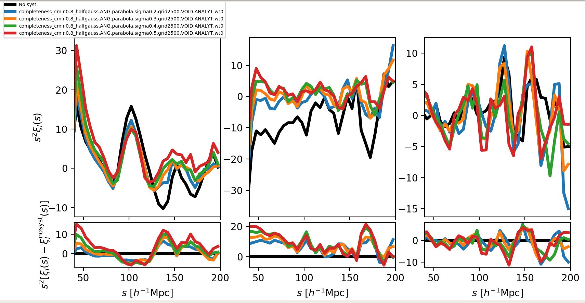
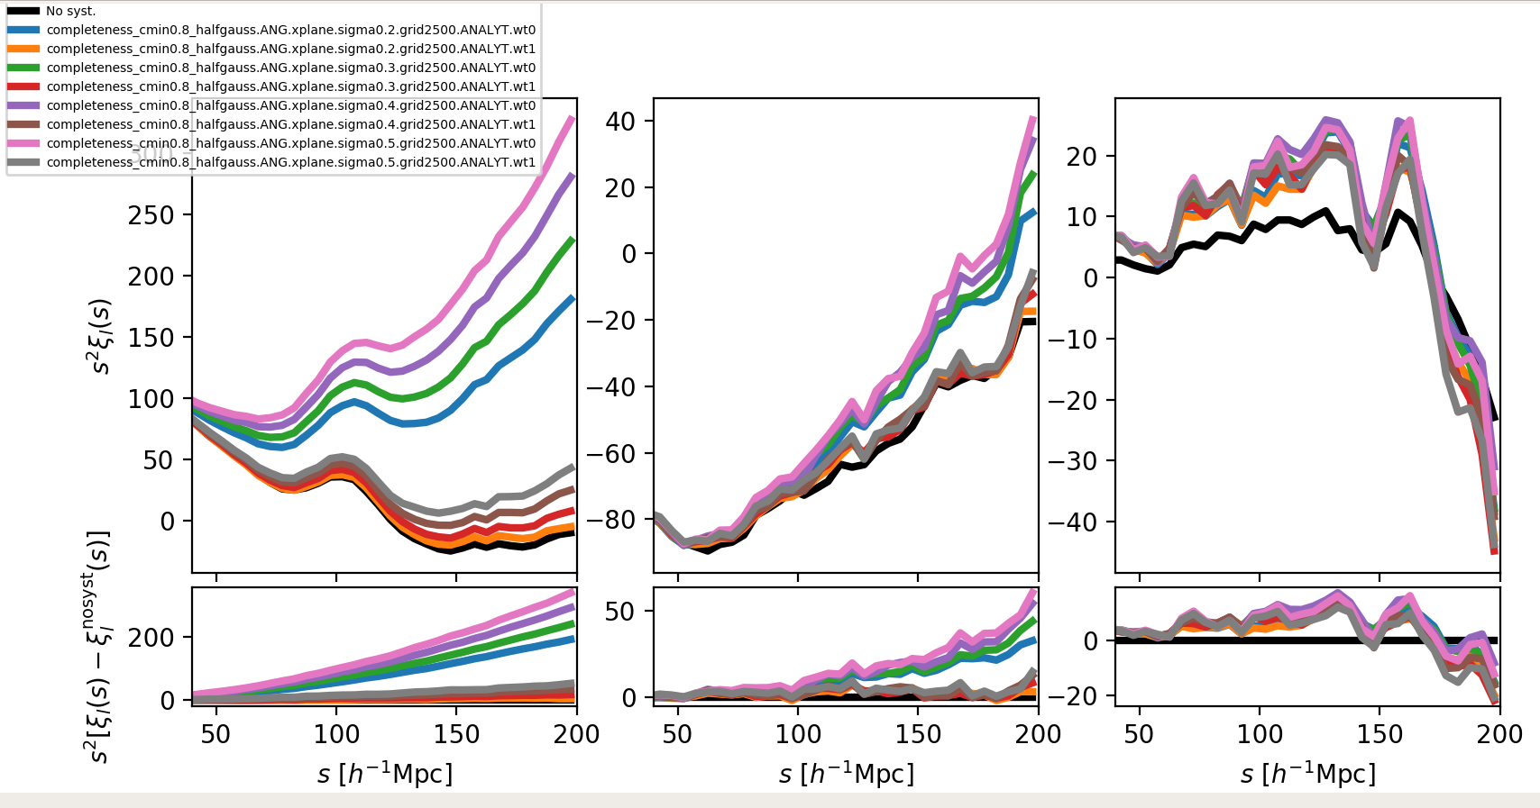
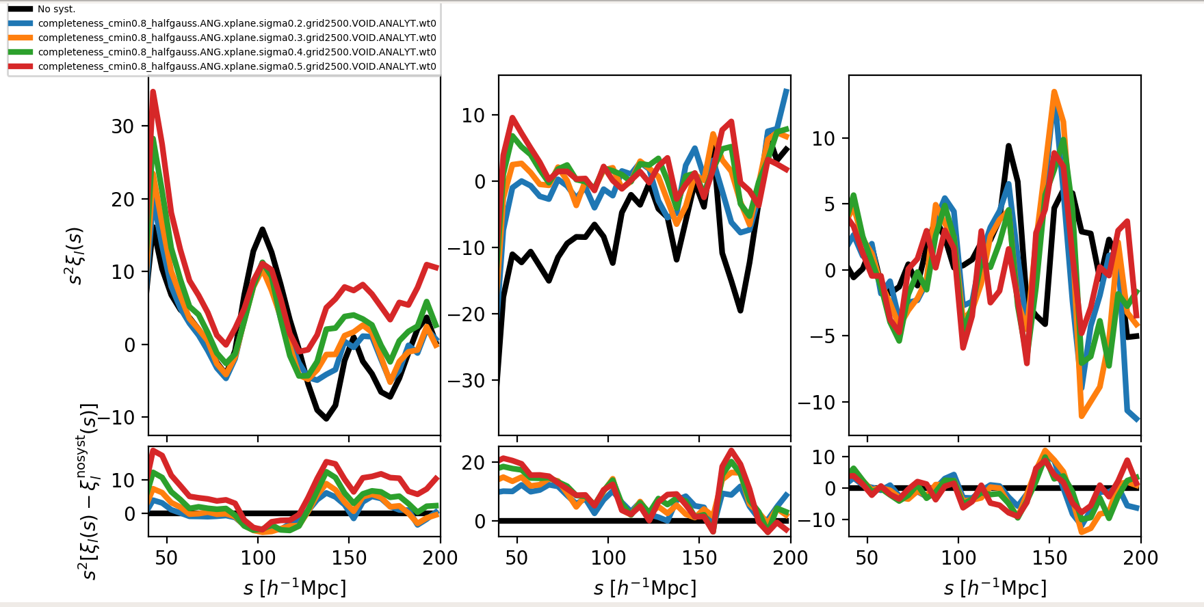
Example on one realization
Parabola
Plane

Slide 6
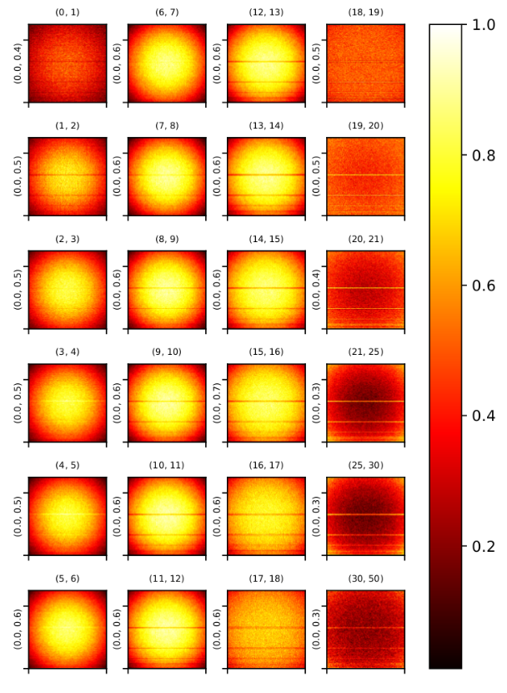
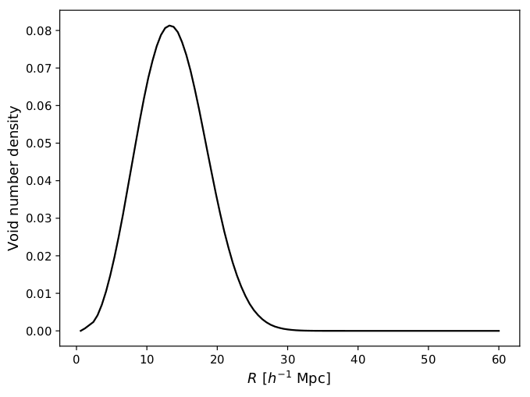
Comp. Map: Voids
(Rmin, Rmax)
Noisy r-space normalized
Small voids reflect completeness map.
Bigger voids ~16-17 Mpc/h are more uniform.
Biggest voids even show an “inverse map”
It is worth investigating weights for voids
(vmin/vmax, mean/vmax)

Slide 7
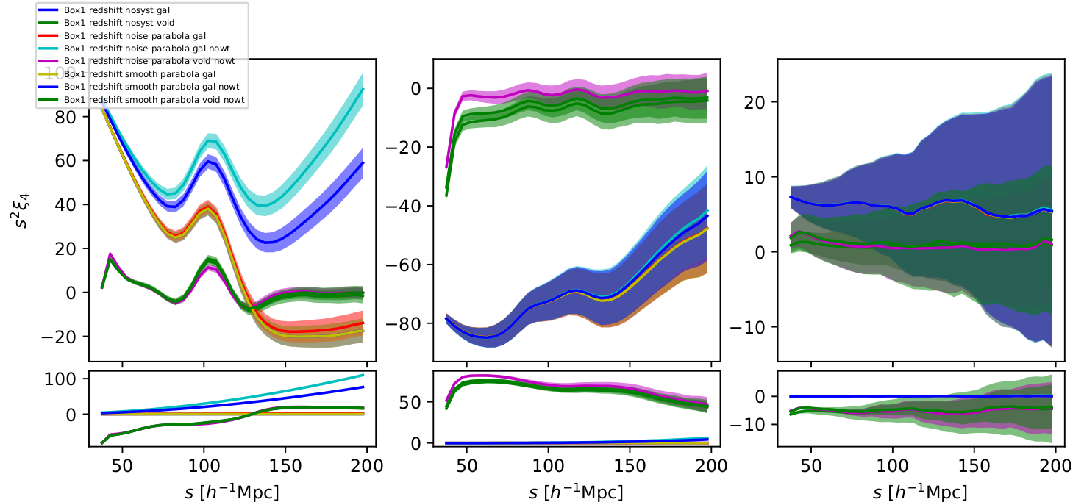
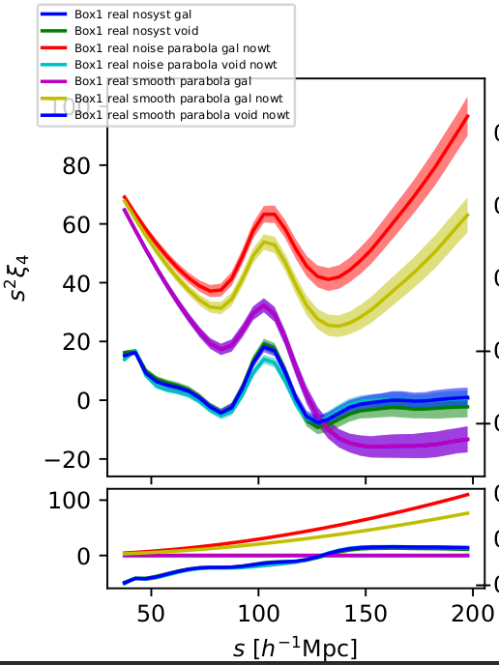
Average 2PCF
Large positive bias in galaxy 2pcf without weights
Amplitude of BAO peak decreased by random systematics (a.k.a. noise, green vs. magenta (?) curves)
Small bias even in weighted galaxy 2pcf (red vs. yellow-ish)

Slide 8
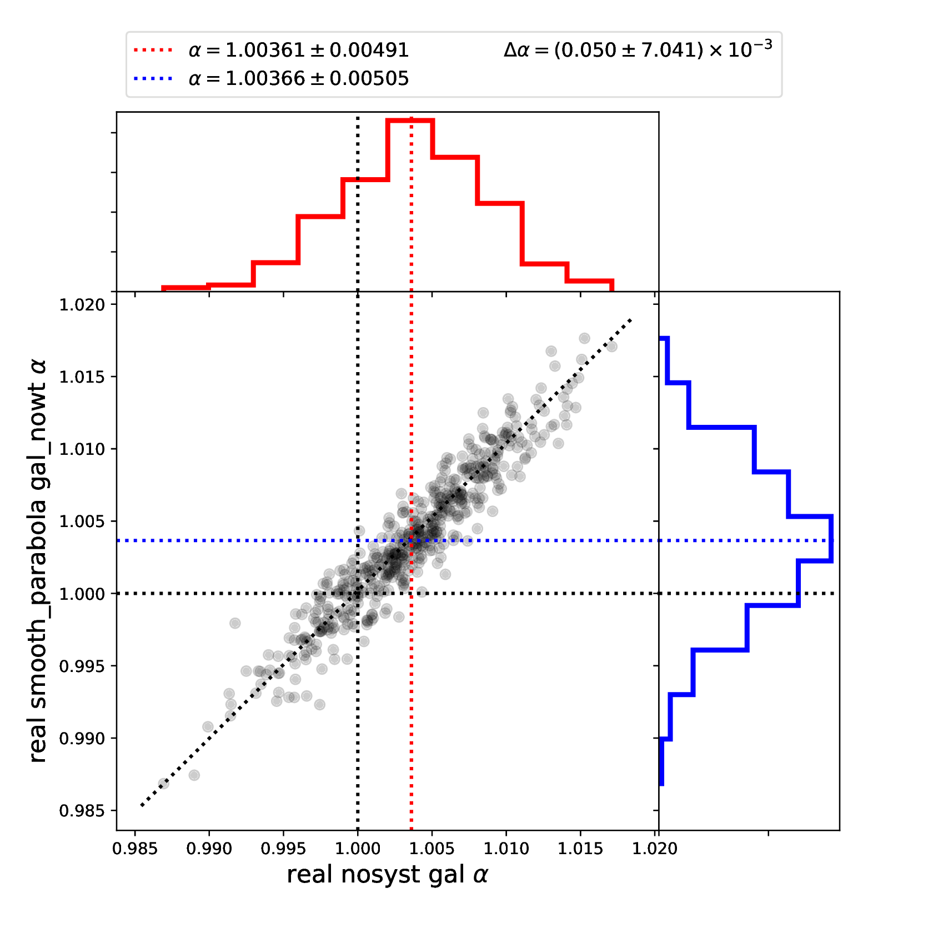
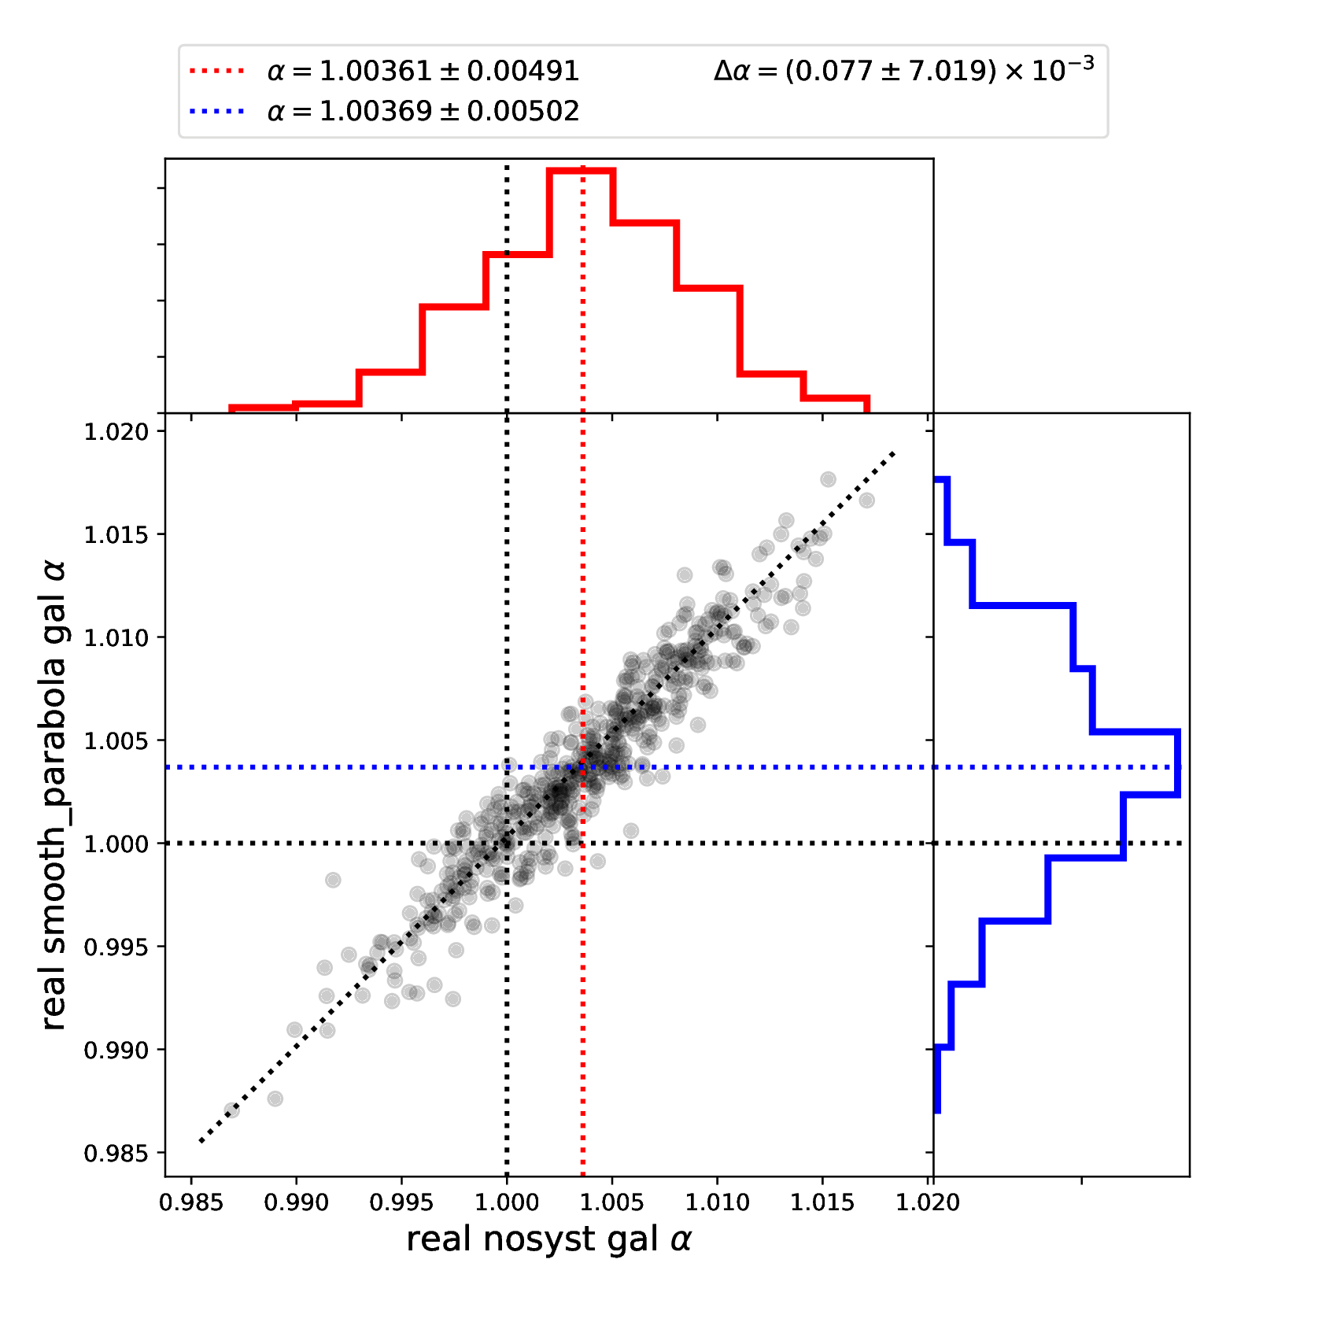
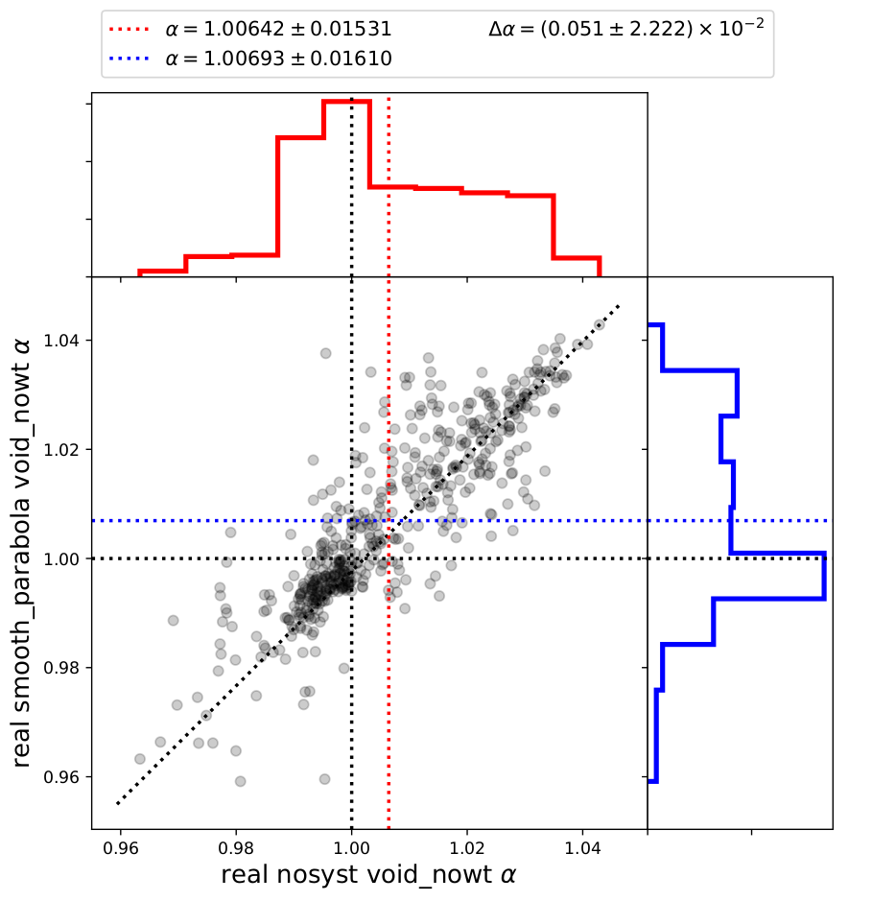
Boxes fits real space: Smooth Comp.

Slide 9
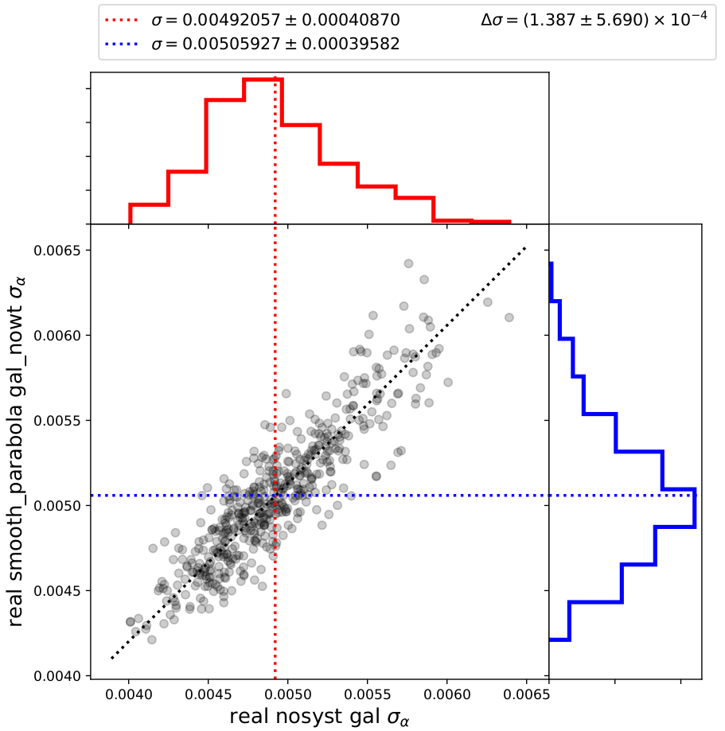
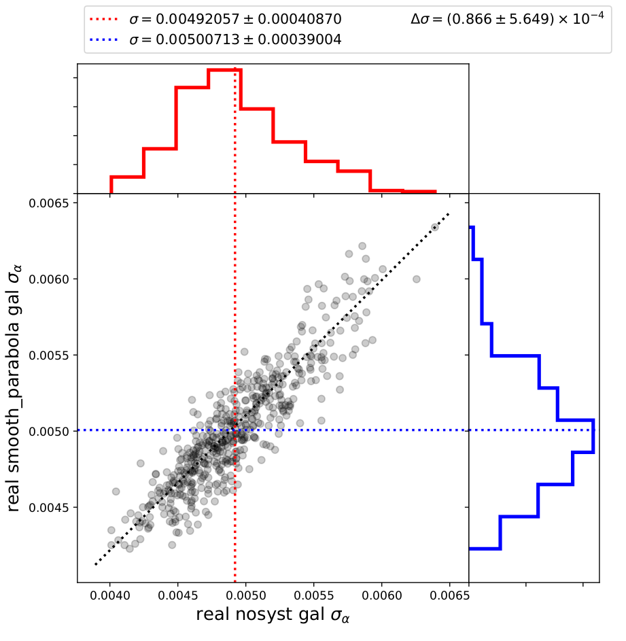
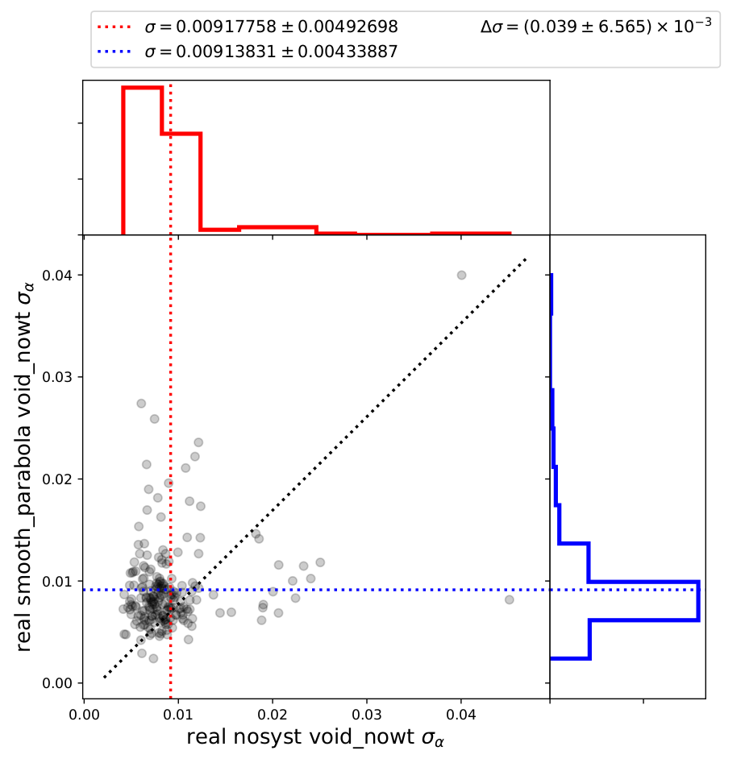
Boxes fits real space: Smooth Comp.
Sigma distributions

Slide 10
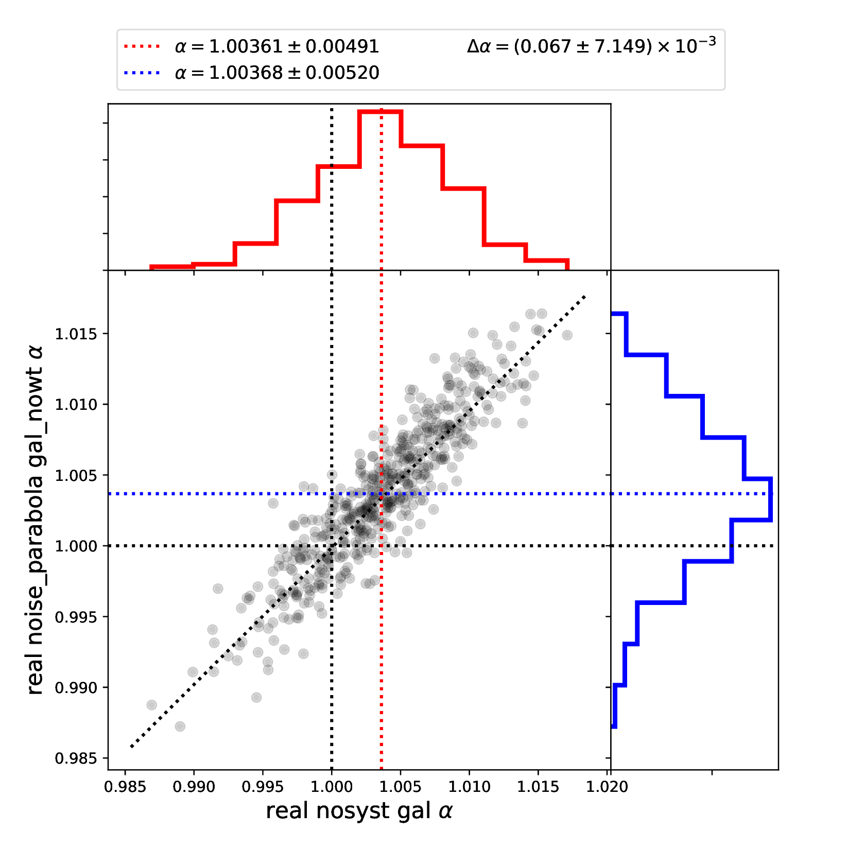
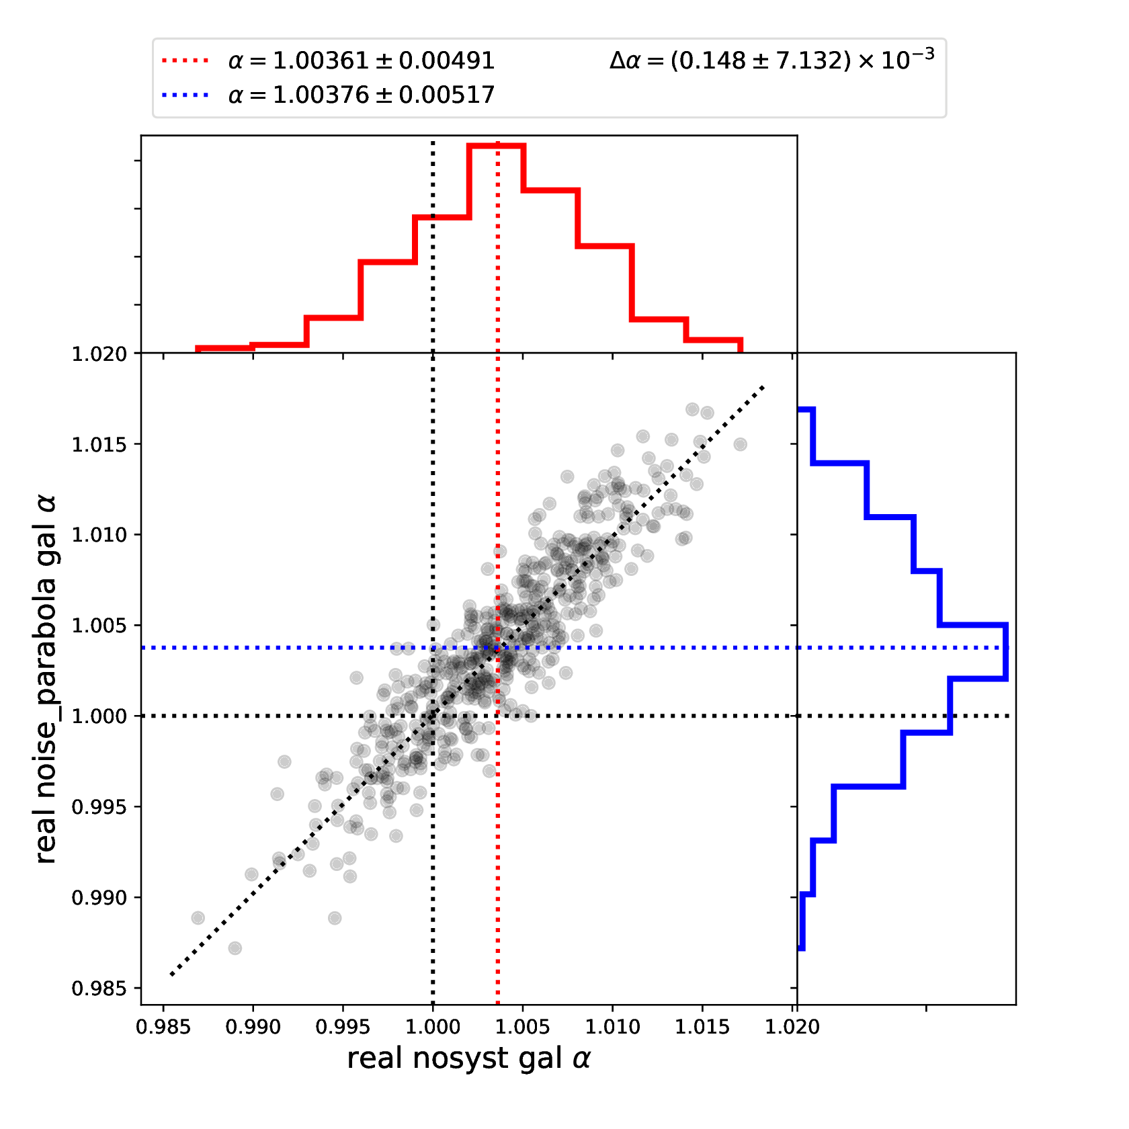
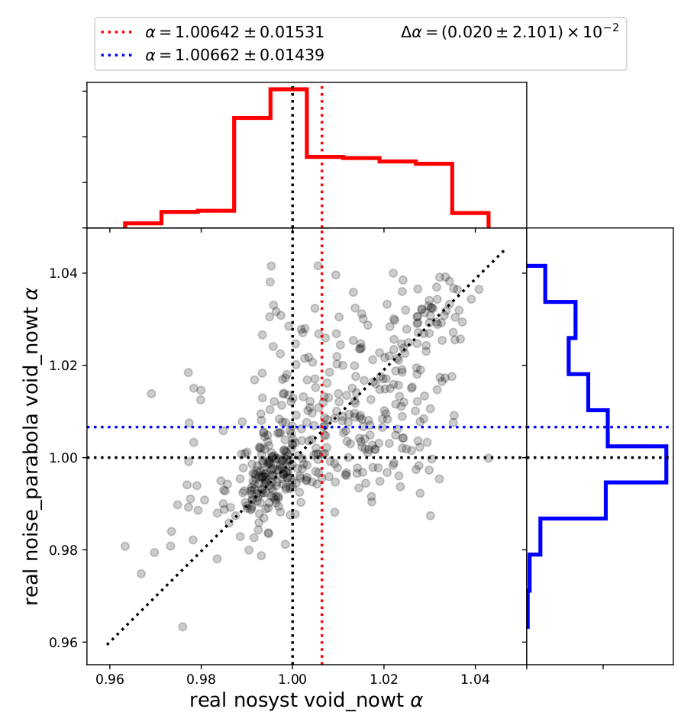
Boxes fits real space: Noisy Comp.

Slide 11
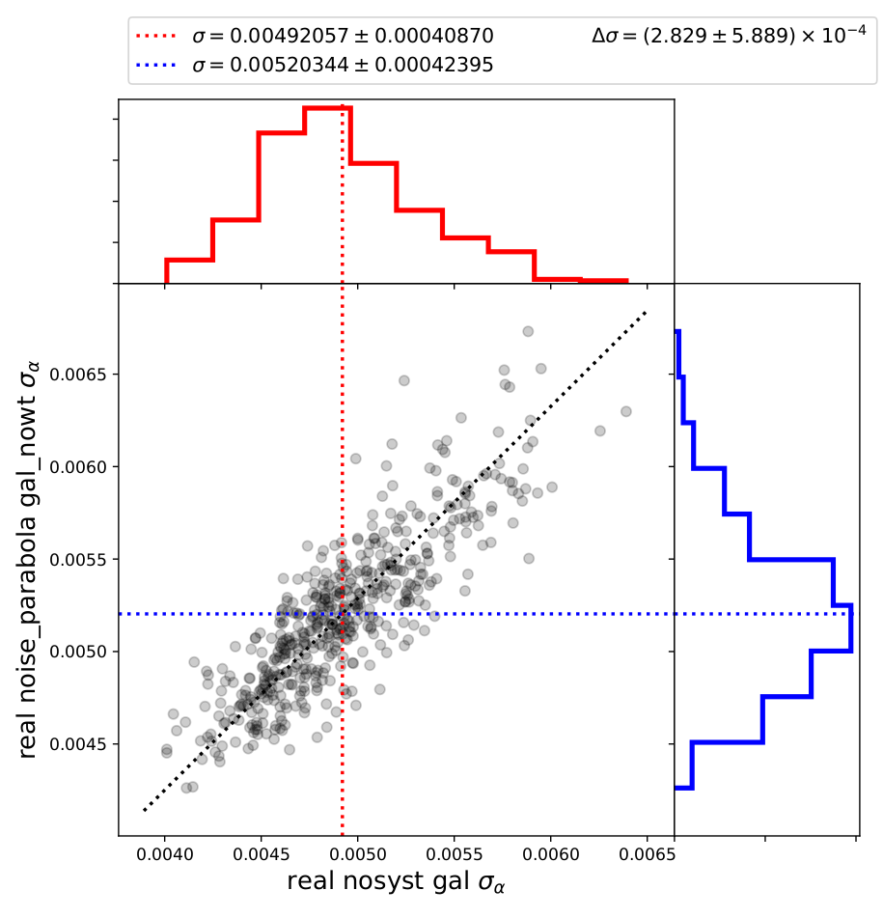
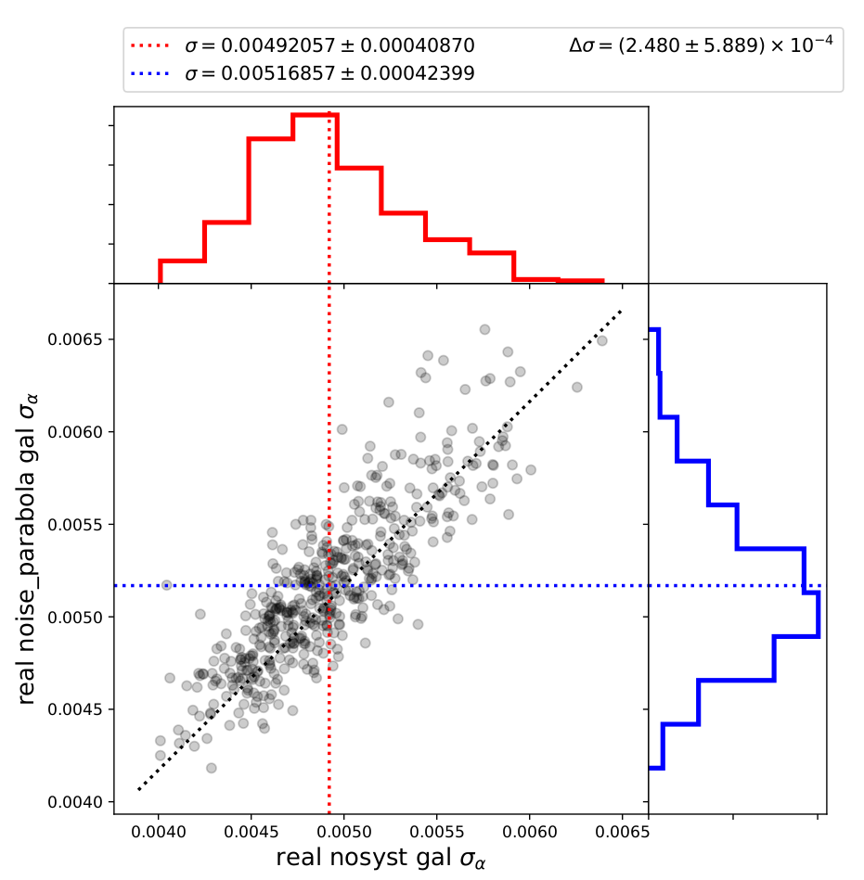
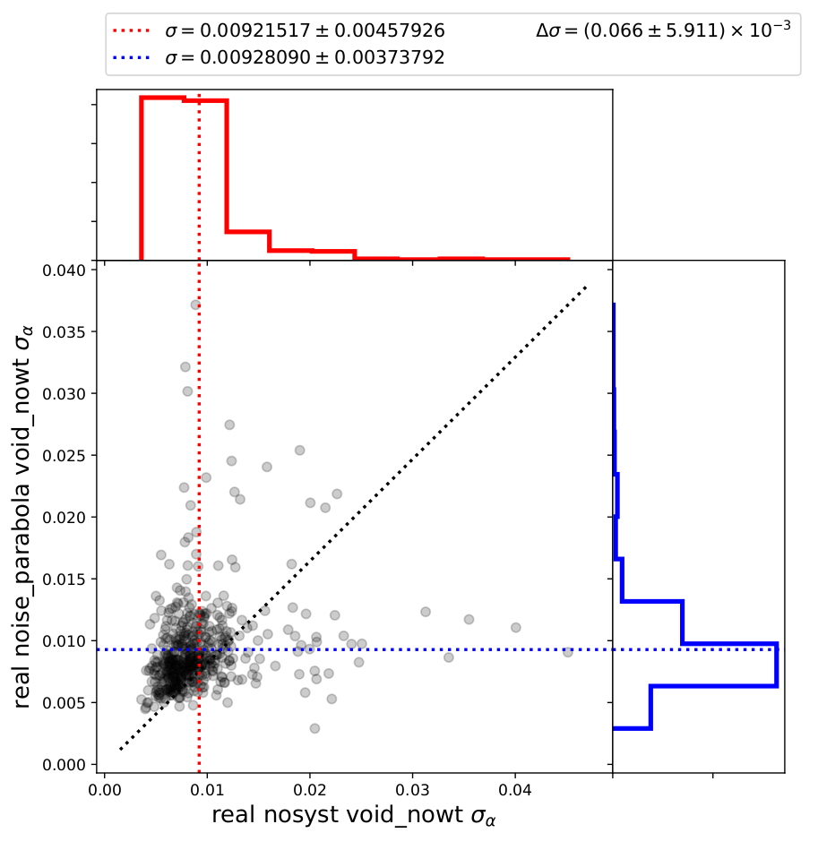
Boxes fits real space: Noisy Comp.
Sigma distributions

Slide 12
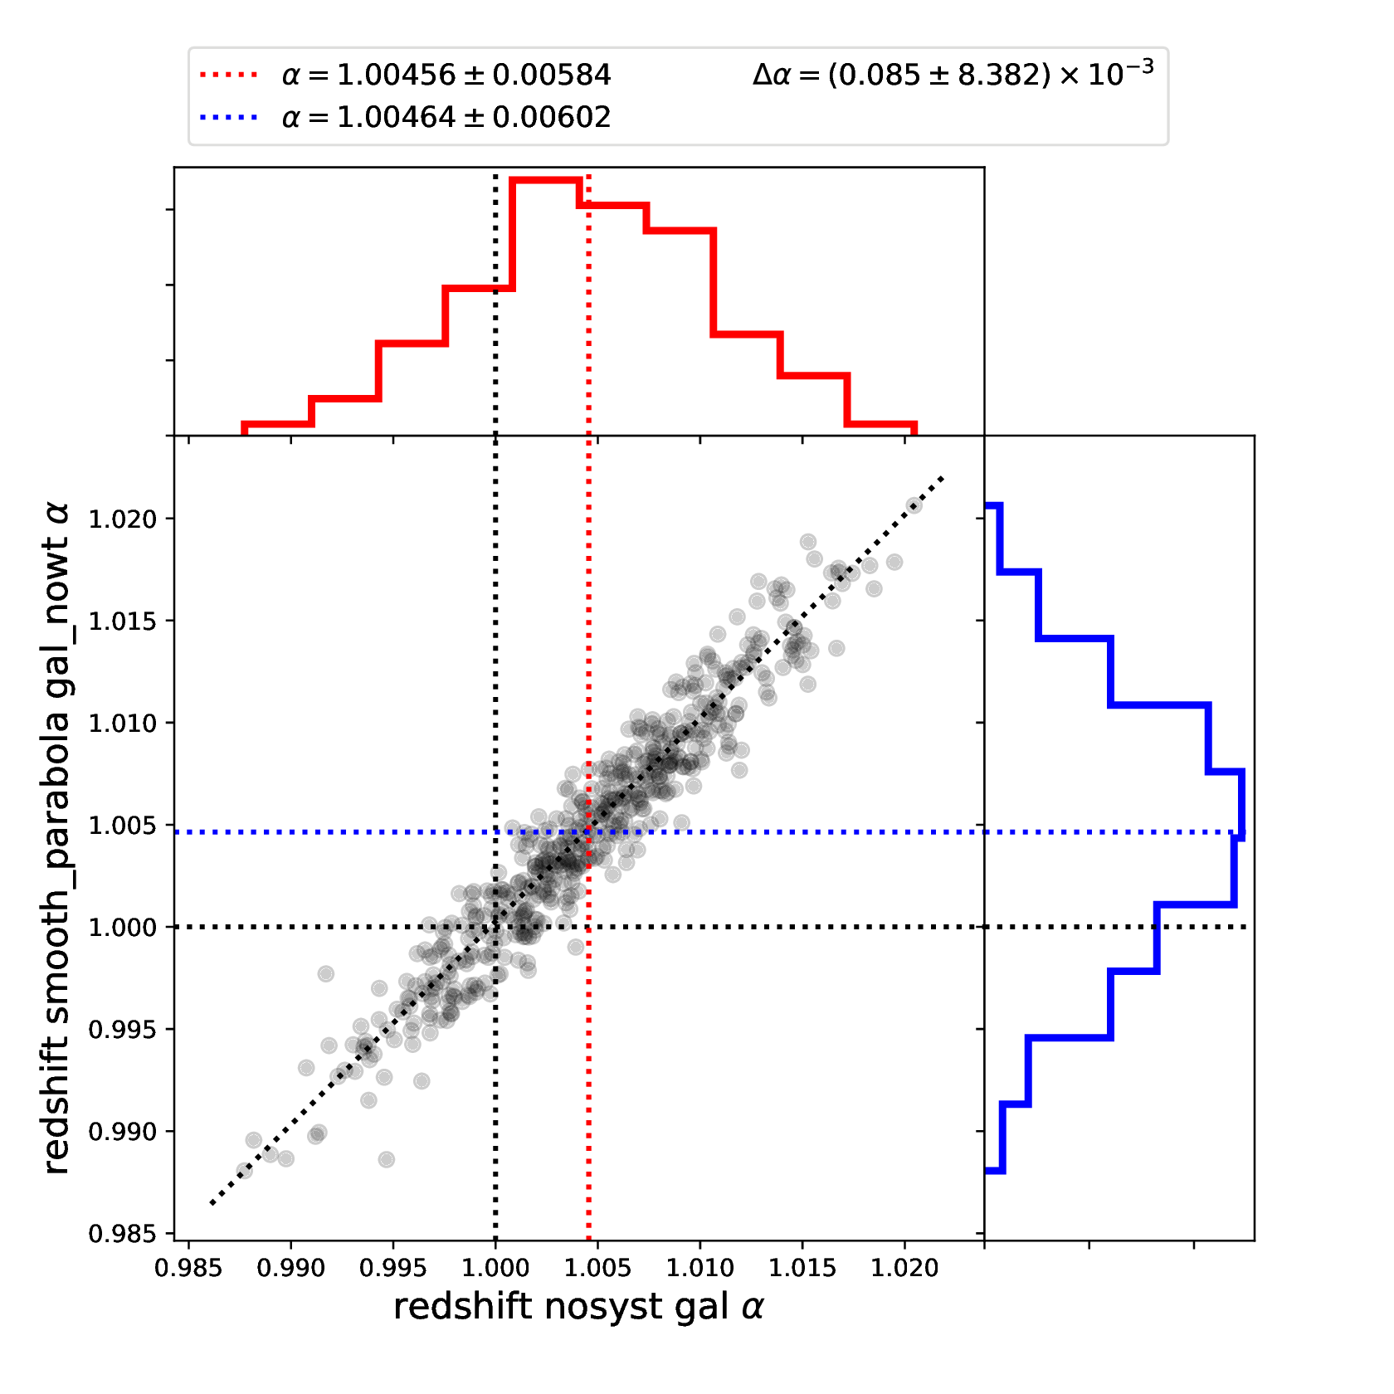
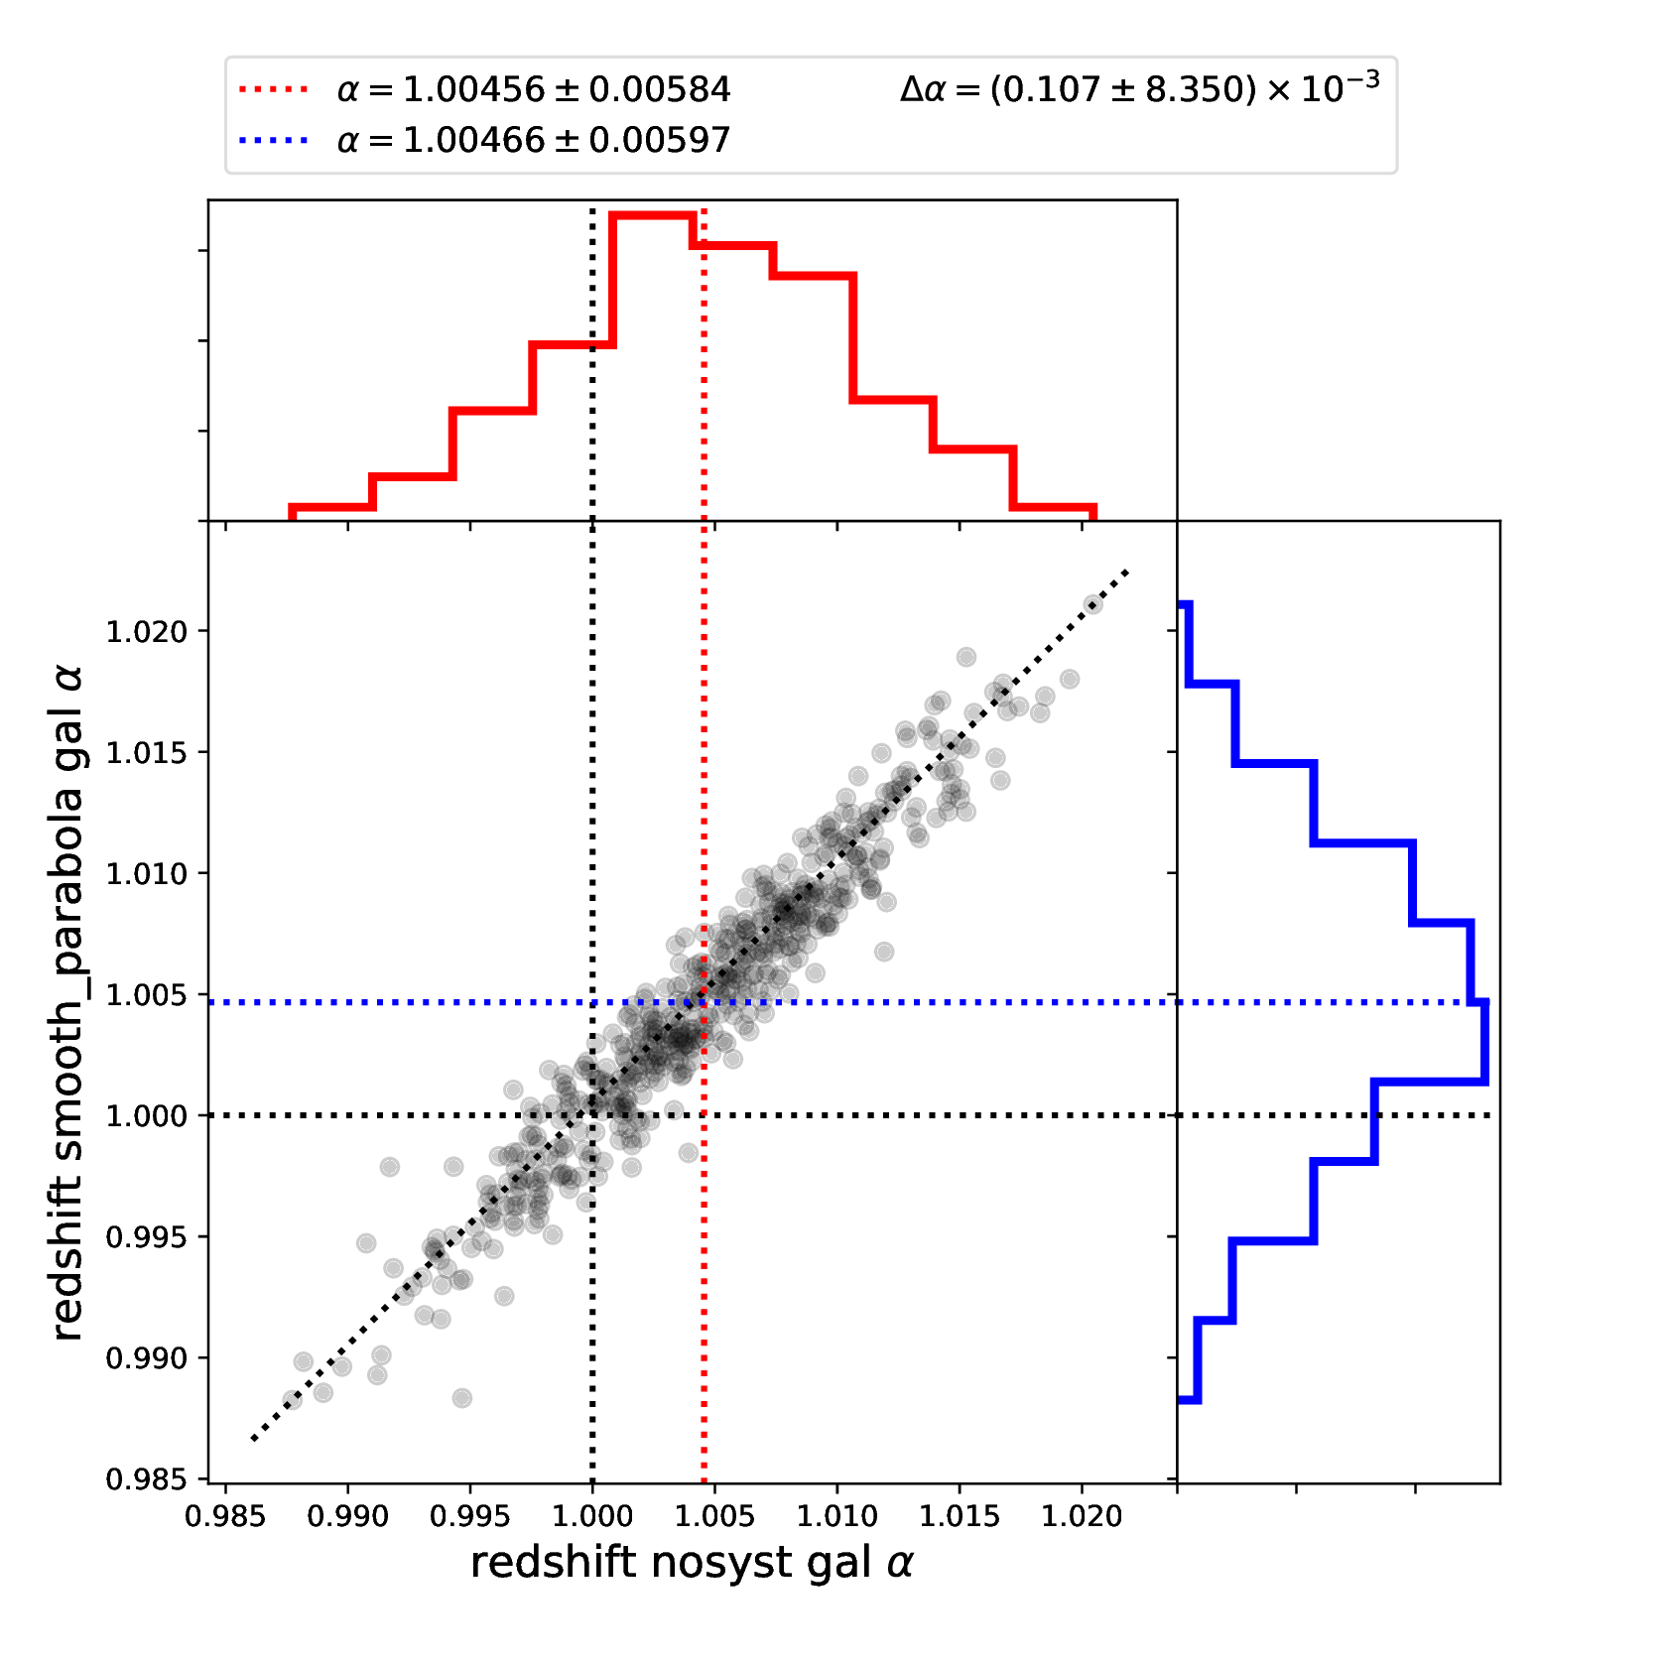
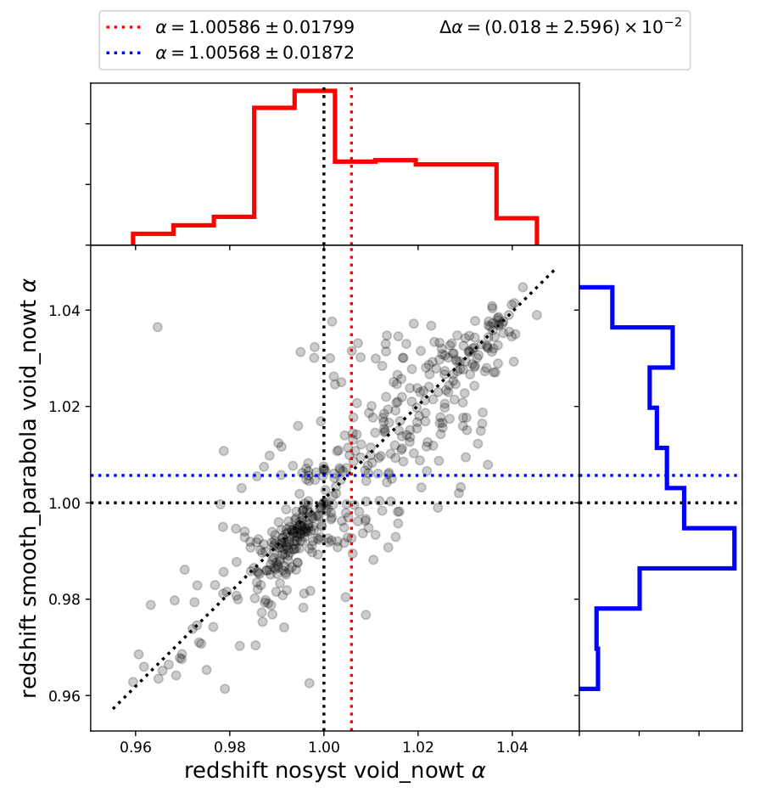
Boxes fits redshift space: Smooth Comp.

Slide 13
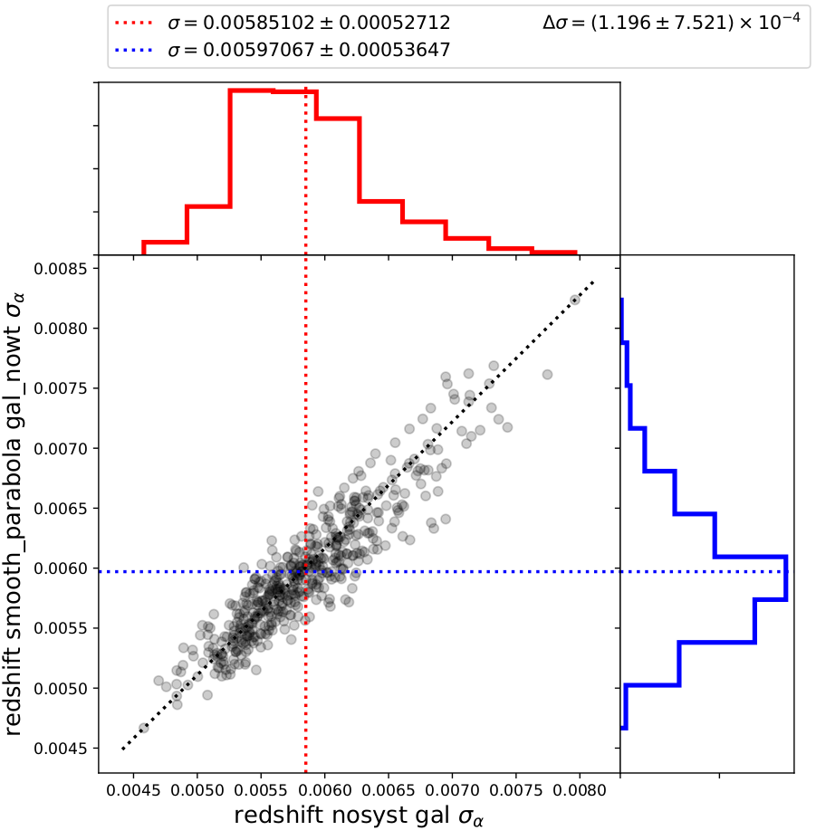
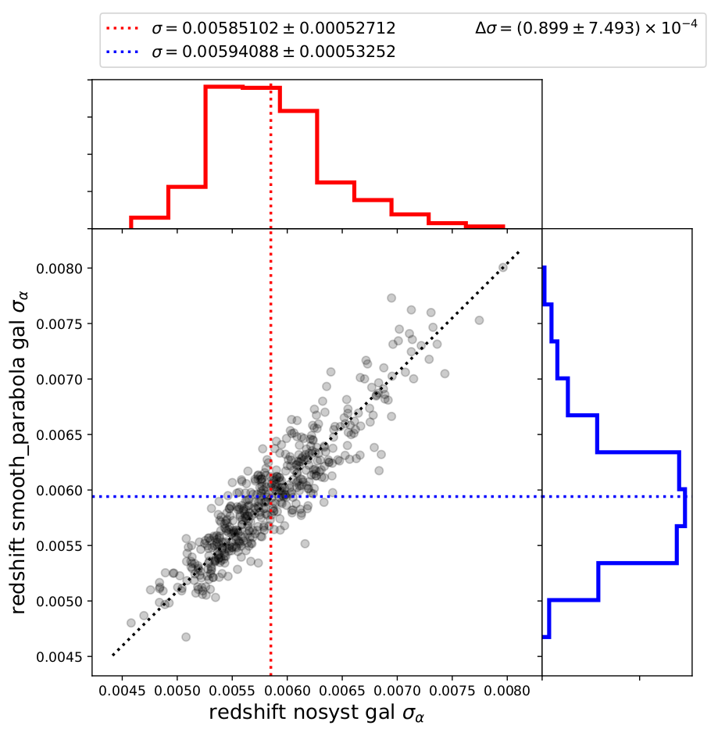
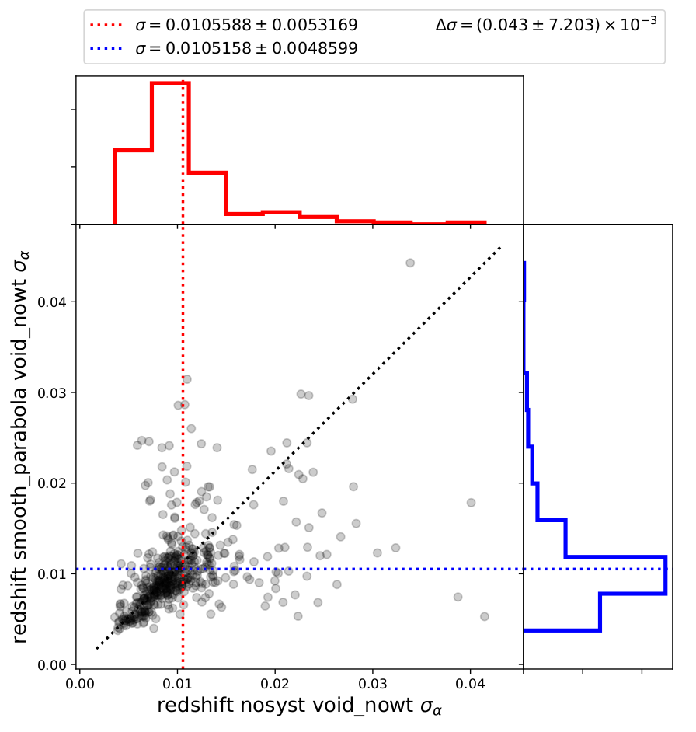
Boxes fits redshift space: Smooth Comp.
Sigma distributions

Slide 14
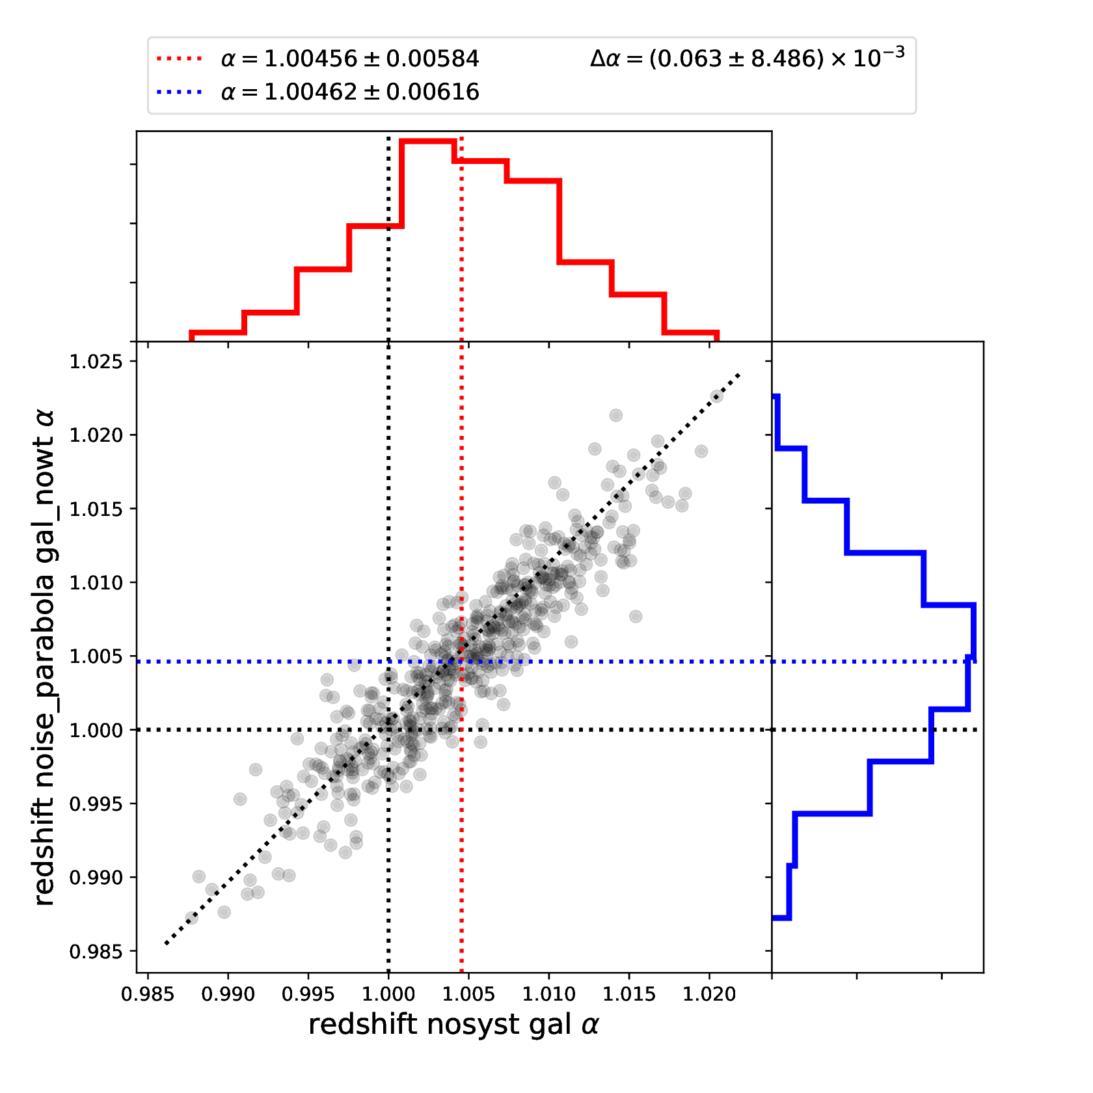
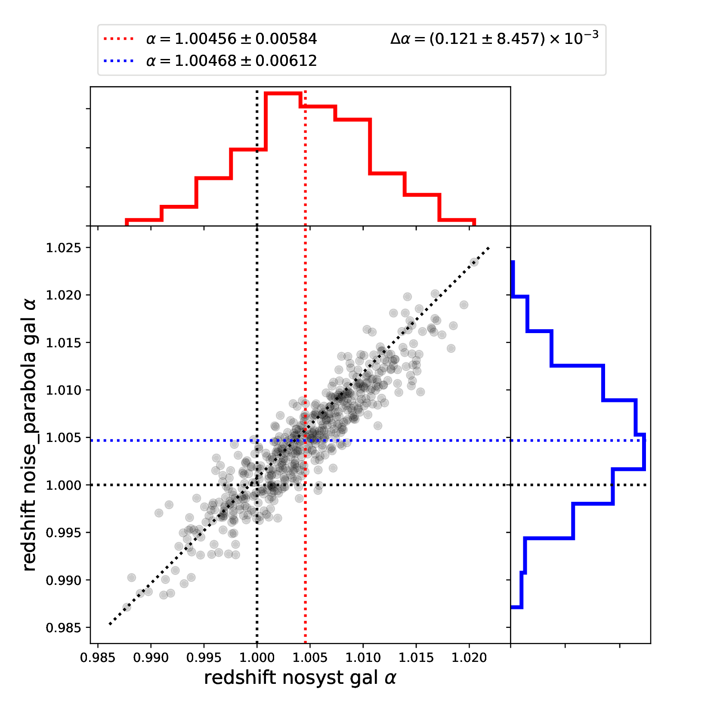
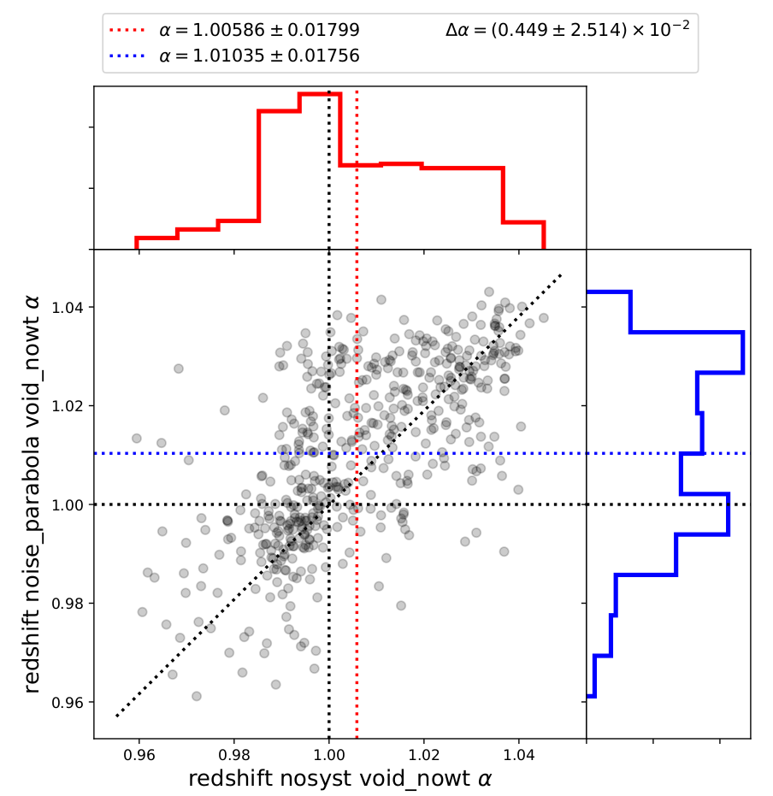
Boxes fits redshift space: Noisy Comp.

Slide 15
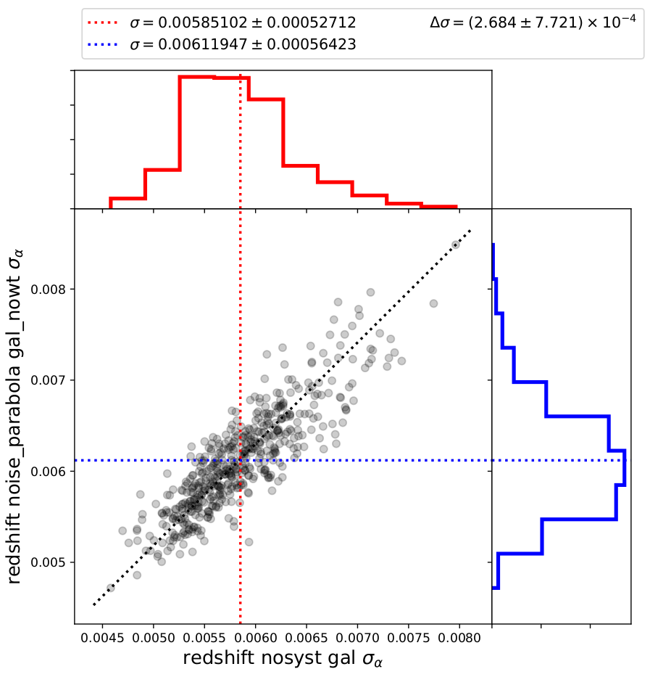
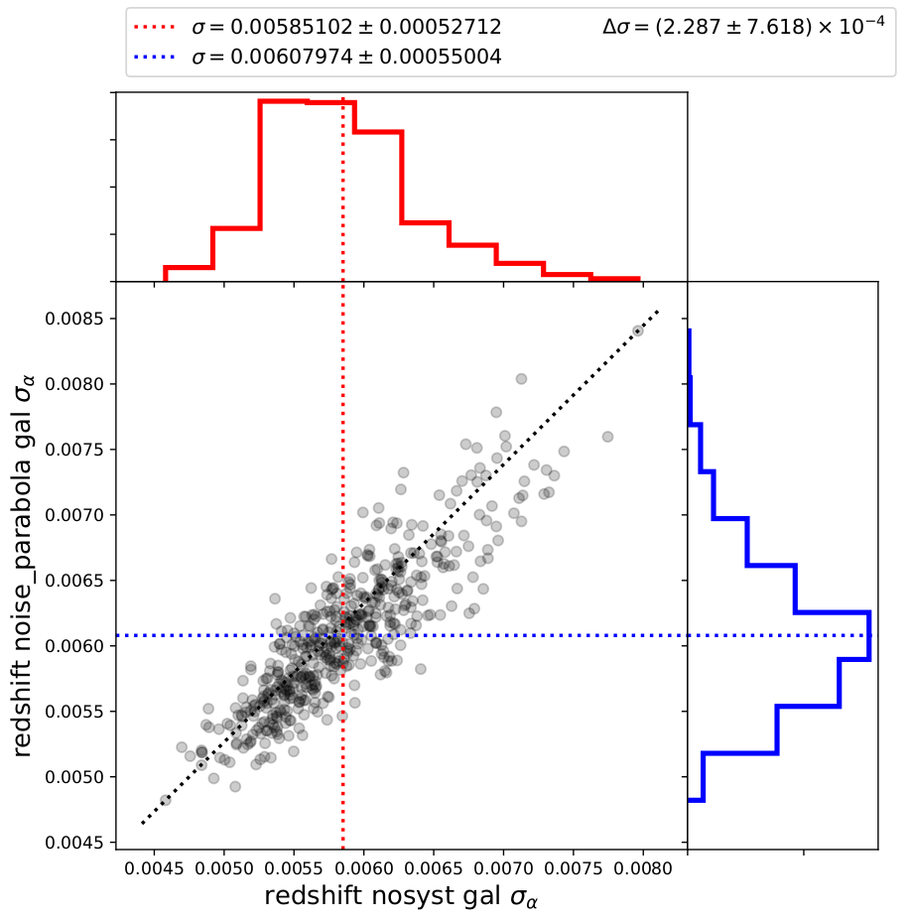
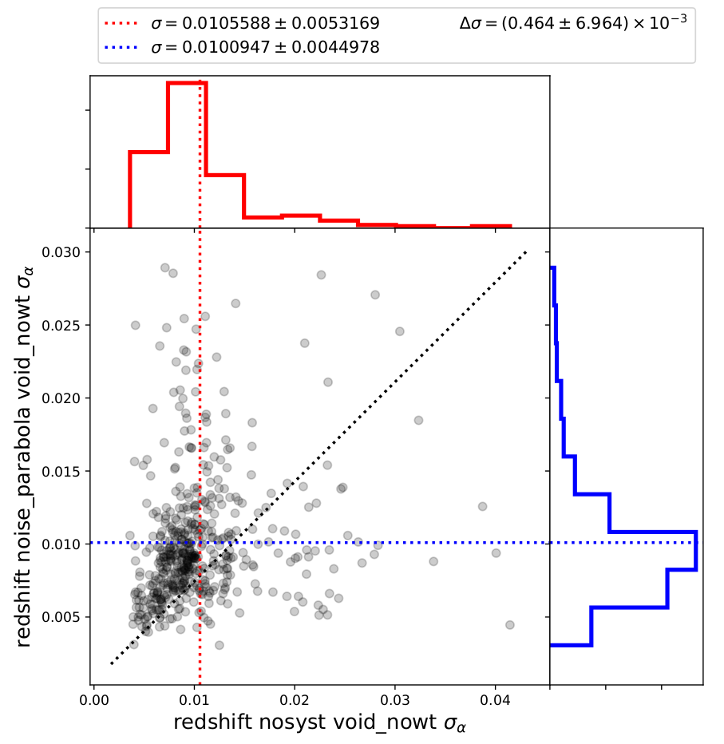
Boxes fits redshift space: Noisy Comp.
Sigma distributions

