Slide 1
Final Presentation: SQL for Data Science Capstone Project
Denise Foster
May 2022

Slide 2
Table of Contents
Data Set
Initial Approach
Changes
Results of Initial Hypotheses
Discussion of Hypotheses
Metrics
Correlations
Insights
Recommendations and Next Steps

Slide 3
Data Set
Pew Research Center American Trends Panel Wave 83, February 2021
Accompanying documentation (methodology, full questionnaire, topline numbers, codebook and instructions)
Covers various topics related to coronavirus vaccines and restrictions

Slide 4
Initial Approach

Slide 5
Initial Approach
Analysis of responses regarding:
COVID-19 restrictions
Schools reopening
Mental health
Government response to COVID-19 pandemic
Vaccination status
Analysis of respondent demographics
Total for each rating to view summary of data
Correlations with certain demographic factors

Slide 6
Initial Questions
Based on the results of the survey, how do Americans generally feel about how Donald Trump responded to the coronavirus (COVID-19) outbreak?
Based on the results of the survey, how do Americans feel about schools reopening?
Based on the results of the survey, how has COVID-19 affected Americans’ mental health?
Based on the results of the survey, what percentage of Americans are vaccinated against COVID-19?
How do the demographics for this survey affect Americans’ responses?

Slide 7
Initial Hypotheses
The majority of Americans are vaccinated against COVID-19.
The majority of Americans are not happy with the way Donald Trump handled the response to COVID-19 during his term as president.
The majority of Americans want schools to reopen (and in general want a return to normalcy in society).
Americans with a lower level of education and a lower level of household income likely did not receive the vaccine for the coronavirus.

Slide 8
Changes
Mental health questions included in original data model
More demographic factors also originally included
Chose to focus on more specific factors and responses
Too many variables in survey to focus on all at once

Slide 9
Results of Initial Hypotheses

Slide 10
Hypothesis 1
The majority of Americans are vaccinated against COVID-19 — DISPROVEN
Responses to question “Have you received a vaccine to prevent COVID-19?”
1: Yes, have received at least one dose of a vaccine
2: No, have not received a vaccine

Slide 11
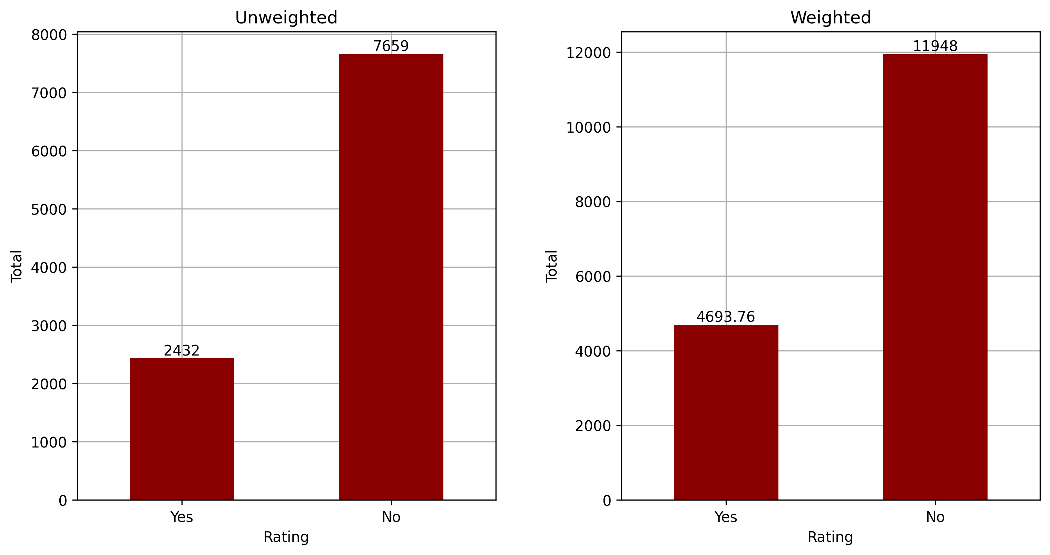
Results for Question COVID_VAXD_W83

Slide 12
Hypothesis 2
The majority of Americans are not happy with the way Donald Trump handled the response to COVID-19 during his term as president — PROVEN
Responses to question “And overall, how would you rate the job Donald Trump did responding to the coronavirus outbreak during his time in office?”

Slide 13
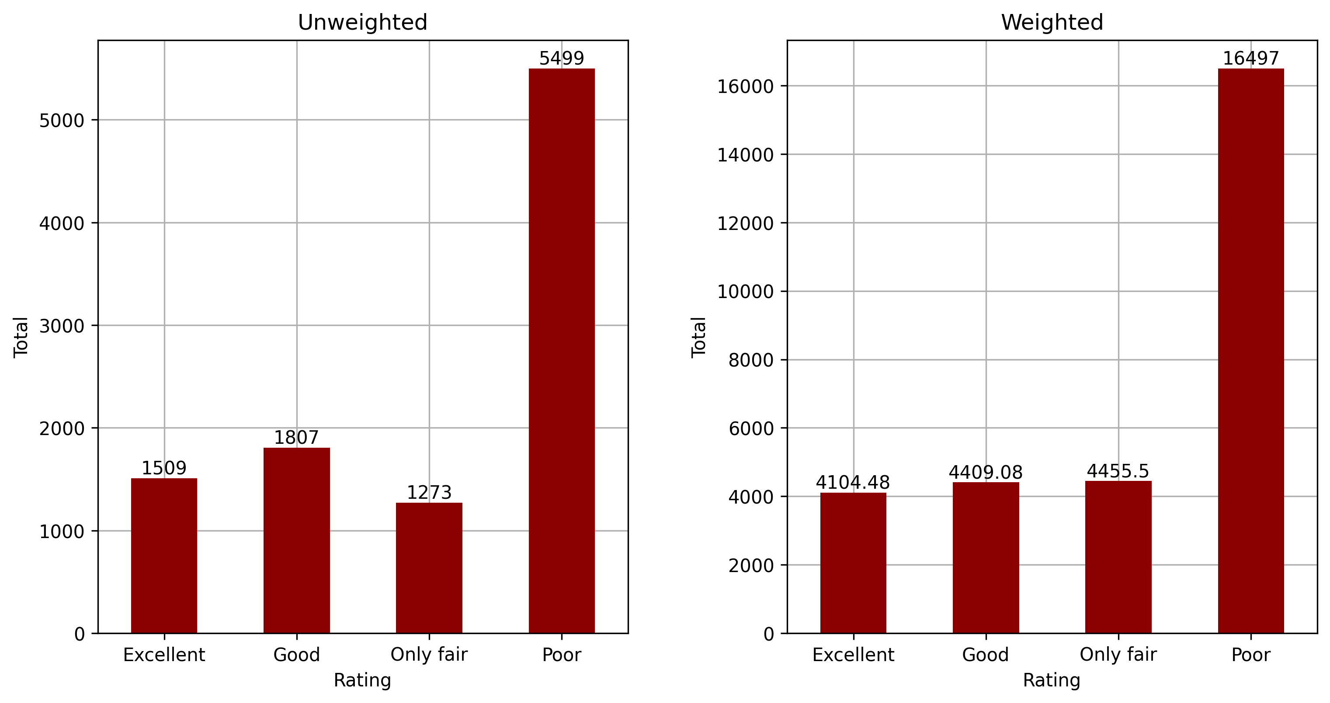
Results for Question COVIDEGFPDT_W83

Slide 14
Hypothesis 2
Responses to question “How would you rate the job each of the following is doing responding to the coronavirus outbreak?”
1: Excellent
2: Good
3: Only fair
4: Poor
Items were randomized

Slide 15
Hypothesis 2
Joe Biden
Your state elected officials
Your local elected officials
Public health officials such as those at the CDC (Centers for Disease Control and Prevention)
NO ITEMS e-f
Hospitals and medical centers in your area

Slide 16
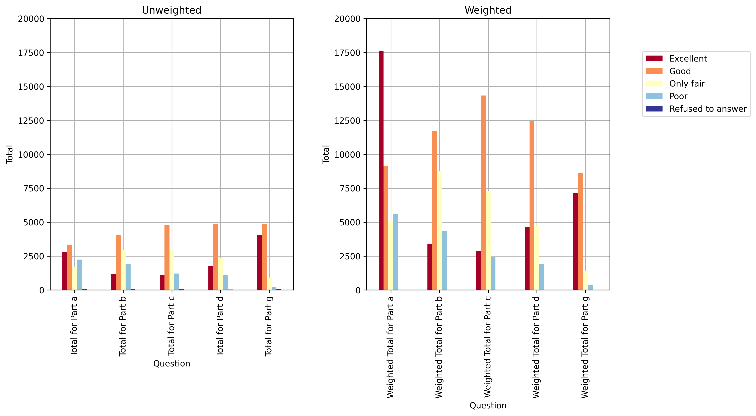
Results for Question COVIDEGFP_W83(a–d, g)

Slide 17
Hypothesis 3
The majority of Americans want schools to reopen (and in general want a return to normalcy in society) — PARTIALLY PROVEN
Responses to question “Thinking about K-12 schools that are not currently open for any in-person instruction, how much consideration should be given to each of the following as these schools decide whether to reopen?”
1: A lot
2: Some
3: Not too much
4: None at all
Items were randomized

Slide 18
Hypothesis 3
ALL:
The risk to teachers of getting or spreading the coronavirus
The risk to students of getting or spreading the coronavirus
FORM 1 ONLY:
The financial cost to school systems of following public health guidelines for safe reopening
The possibility that students will fall behind academically without in-person instruction
FORM 2 ONLY:
Parents not being able to work if their children are at home
The possibility that students’ emotional well-being will be negatively impacted if they don’t attend school in person

Slide 19
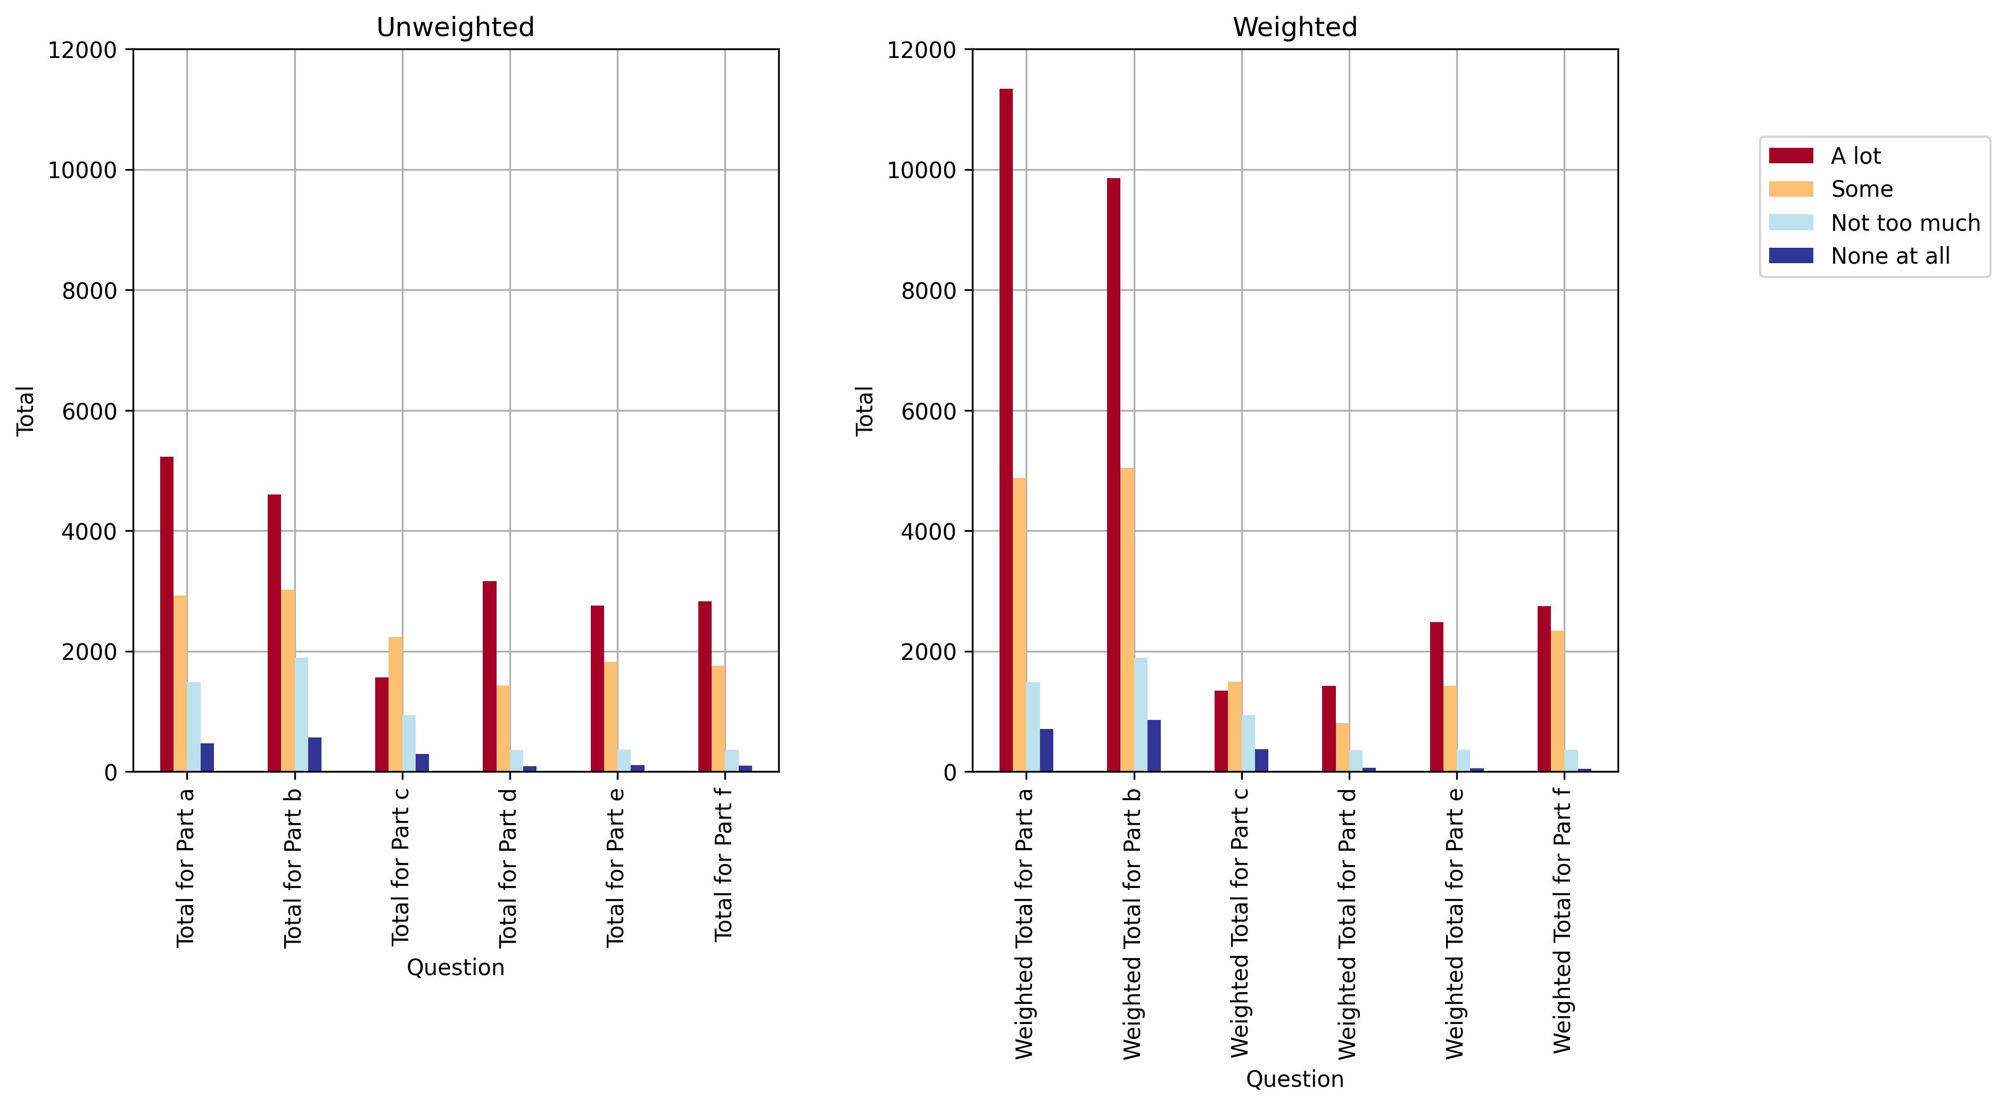
Results for Question SCHLREOPEN_W83(a–f)

Slide 20
Hypothesis 3
Responses to question “Thinking about K-12 schools that are not currently open for any in-person instruction, do you think these schools should…”
1: Reopen as soon as possible, even if many teachers who want the coronavirus vaccine haven’t received it
2: Wait to reopen until all teachers who want the coronavirus vaccine have received it
Response options were randomized

Slide 21
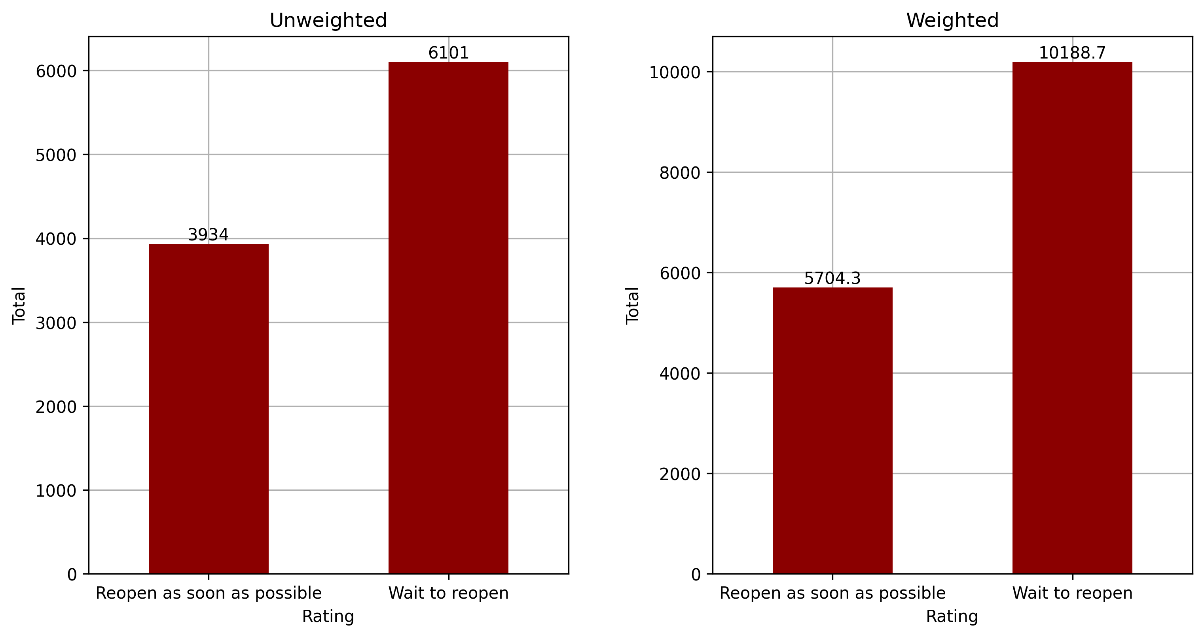
Results for Question TCHRVACCINE_W83

Slide 22
Hypothesis 3
Responses to question “Thinking about policies in place in some areas to address the coronavirus outbreak, in general do you think each of the following is necessary or unnecessary?”
1: Necessary
2: Unnecessary
Items were randomized

Slide 23
Hypothesis 3
Restricting international travel to the U.S.
NO ITEM b
Asking people to avoid gathering in large groups
NO ITEM d
Closing K-12 schools for in-person learning
Limiting restaurants to carry-out only
NO ITEM g
Requiring masks or face coverings for travelers on airplanes and public transportation

Slide 24
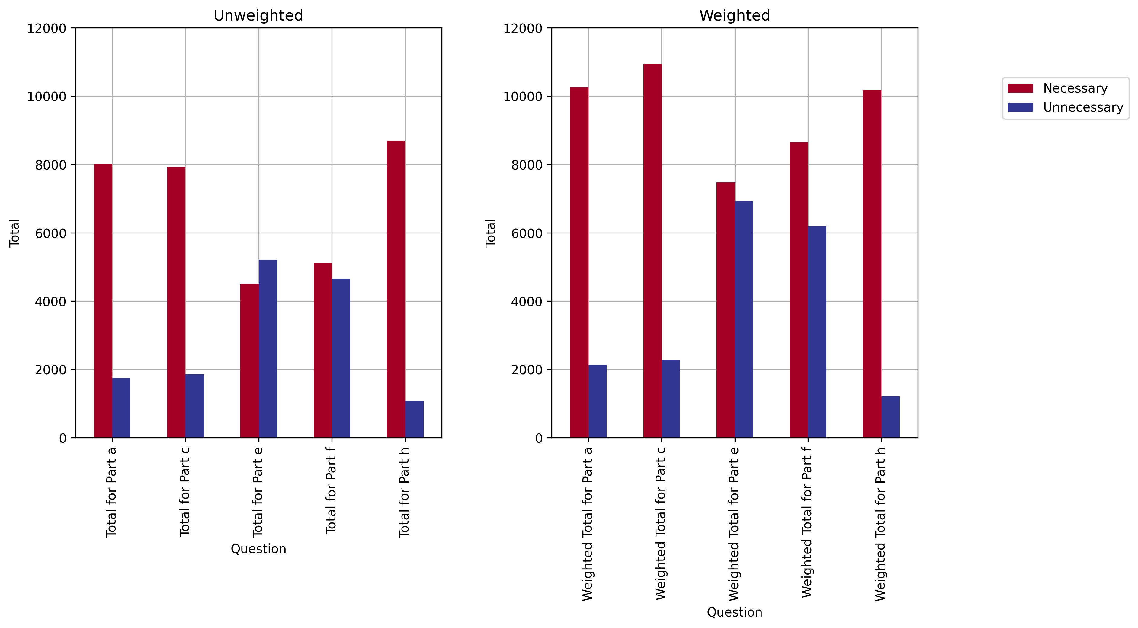
Results for Question COVID_RESTRICTION_W83(a, c, e, f, h)

Slide 25
Hypothesis 3
Responses to question “Thinking about restrictions on public activity because of the coronavirus outbreak IN YOUR AREA, do you think there should be…”
1: MORE restrictions right now
2: FEWER restrictions right now
3: About the same number of restrictions right now

Slide 26
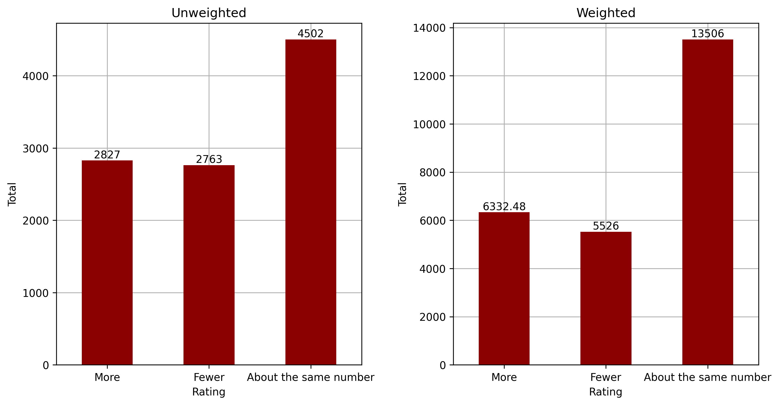
Results for Question COVID_OPENMORE_W83

Slide 27
Hypothesis 4
Americans with a lower level of education and a lower level of household income likely did not receive the vaccine for the coronavirus — PARTIALLY PROVEN
Examined correlations

Slide 28
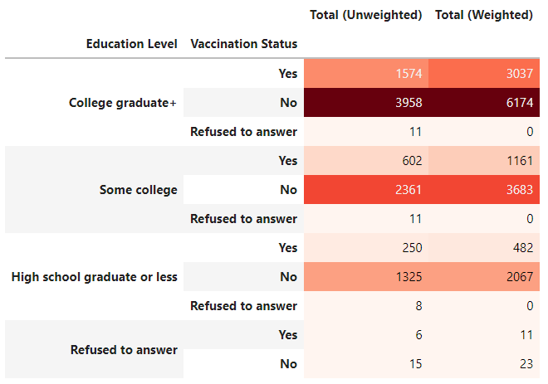
Education Level

Slide 29
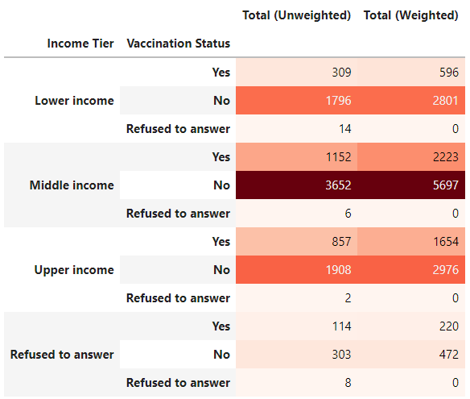
Income Tier

Slide 30
Discussion

Slide 31
Discussion of Hypotheses
Originally overly simplistic — weighted values not incorporated and only summary of weighted values analyzed
Additional metrics and correlations needed
More specific focus (vaccination status) needed

Slide 32
Metrics
Percentages
Unweighted vs. weighted values
More accurately represent the population being studied
Can make generalizations regarding broader population
Correlations using Pearson’s correlation coefficient

Slide 33
Correlations

Slide 34
Initial Correlation Analysis
Examined various demographic factors, including:
Vaccination status
Mask-wearing habits
Age
Gender
Education
Family income
Income tier
Religious affiliation
Political party affiliation

Slide 35
Initial Correlation Analysis
Heat map shows unweighted values only
Examined responses to question “Have you received a vaccine to prevent COVID-19?”
1: Yes, have received at least one dose of a vaccine
2: No, have not received a vaccine

Slide 36
Demographics
From survey documentation:
Each ATP dataset comes with a number of variables prefixed by “F_” (for “frame”) that contain demographic profile data. These variables are not measured every wave; instead, they are sourced from panel profile surveys conducted on a less frequent basis. Some profile variables are also occasionally asked on panel waves and are accordingly updated for each panelist. Profile information is based on panelists’ most recent response to the profile questions. Some variables are coarsened to help protect the confidentiality of our panelists.

Slide 37
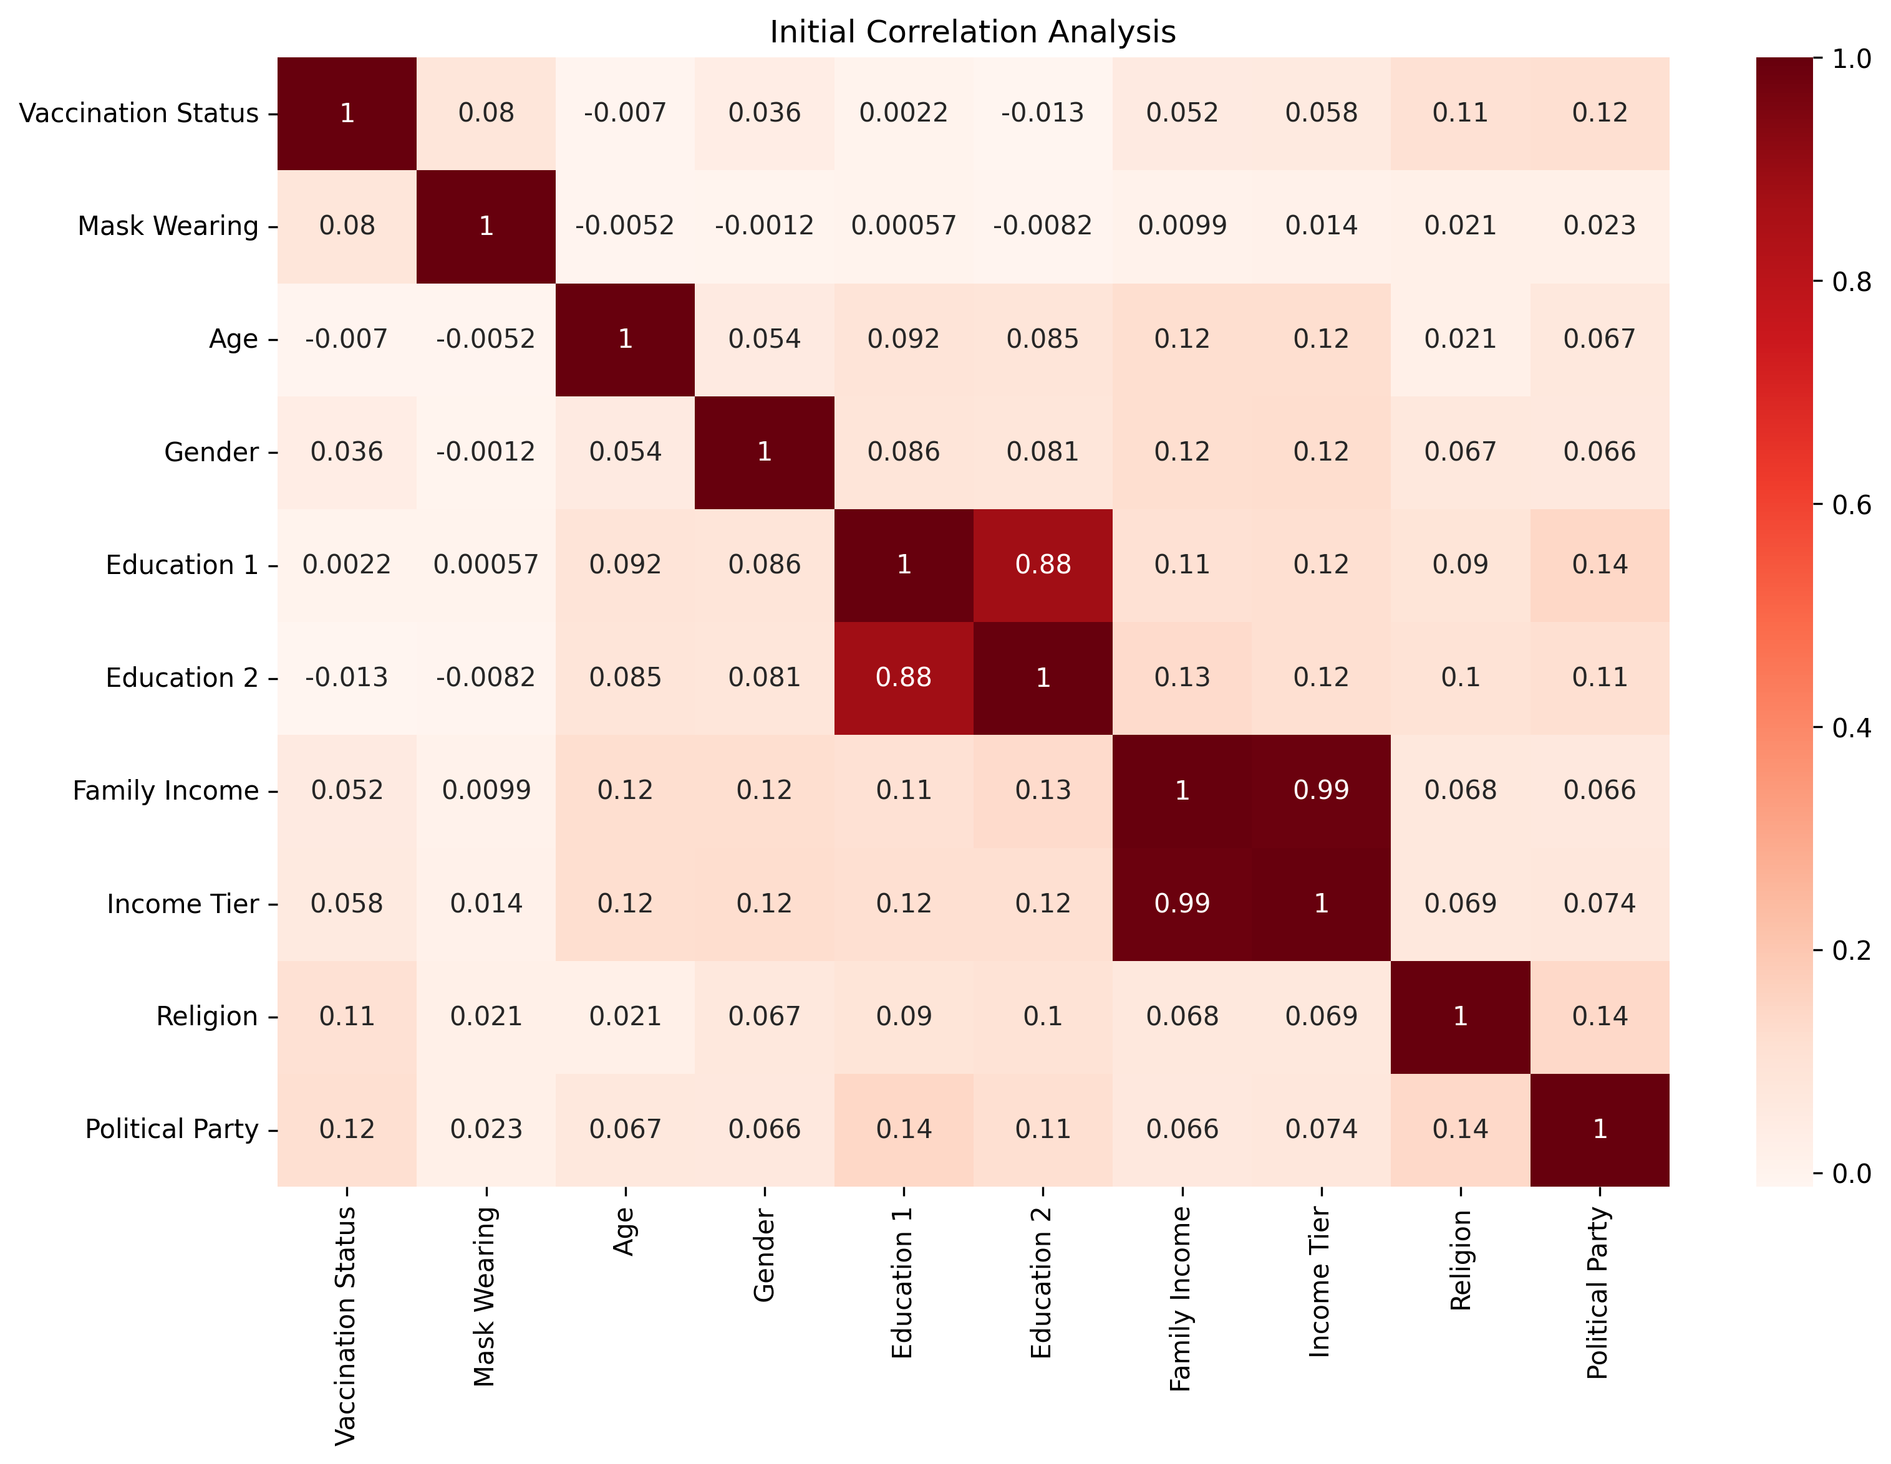

Slide 38
Vaccination Status and Education Level
Heat map shows unweighted values only
F_EDUCCAT (Education 1)
Three-way category coded from self-reported educational attainment
F_EDUCCAT2 (Education 2)
Six-way category coded from self-reported educational attainment

Slide 39
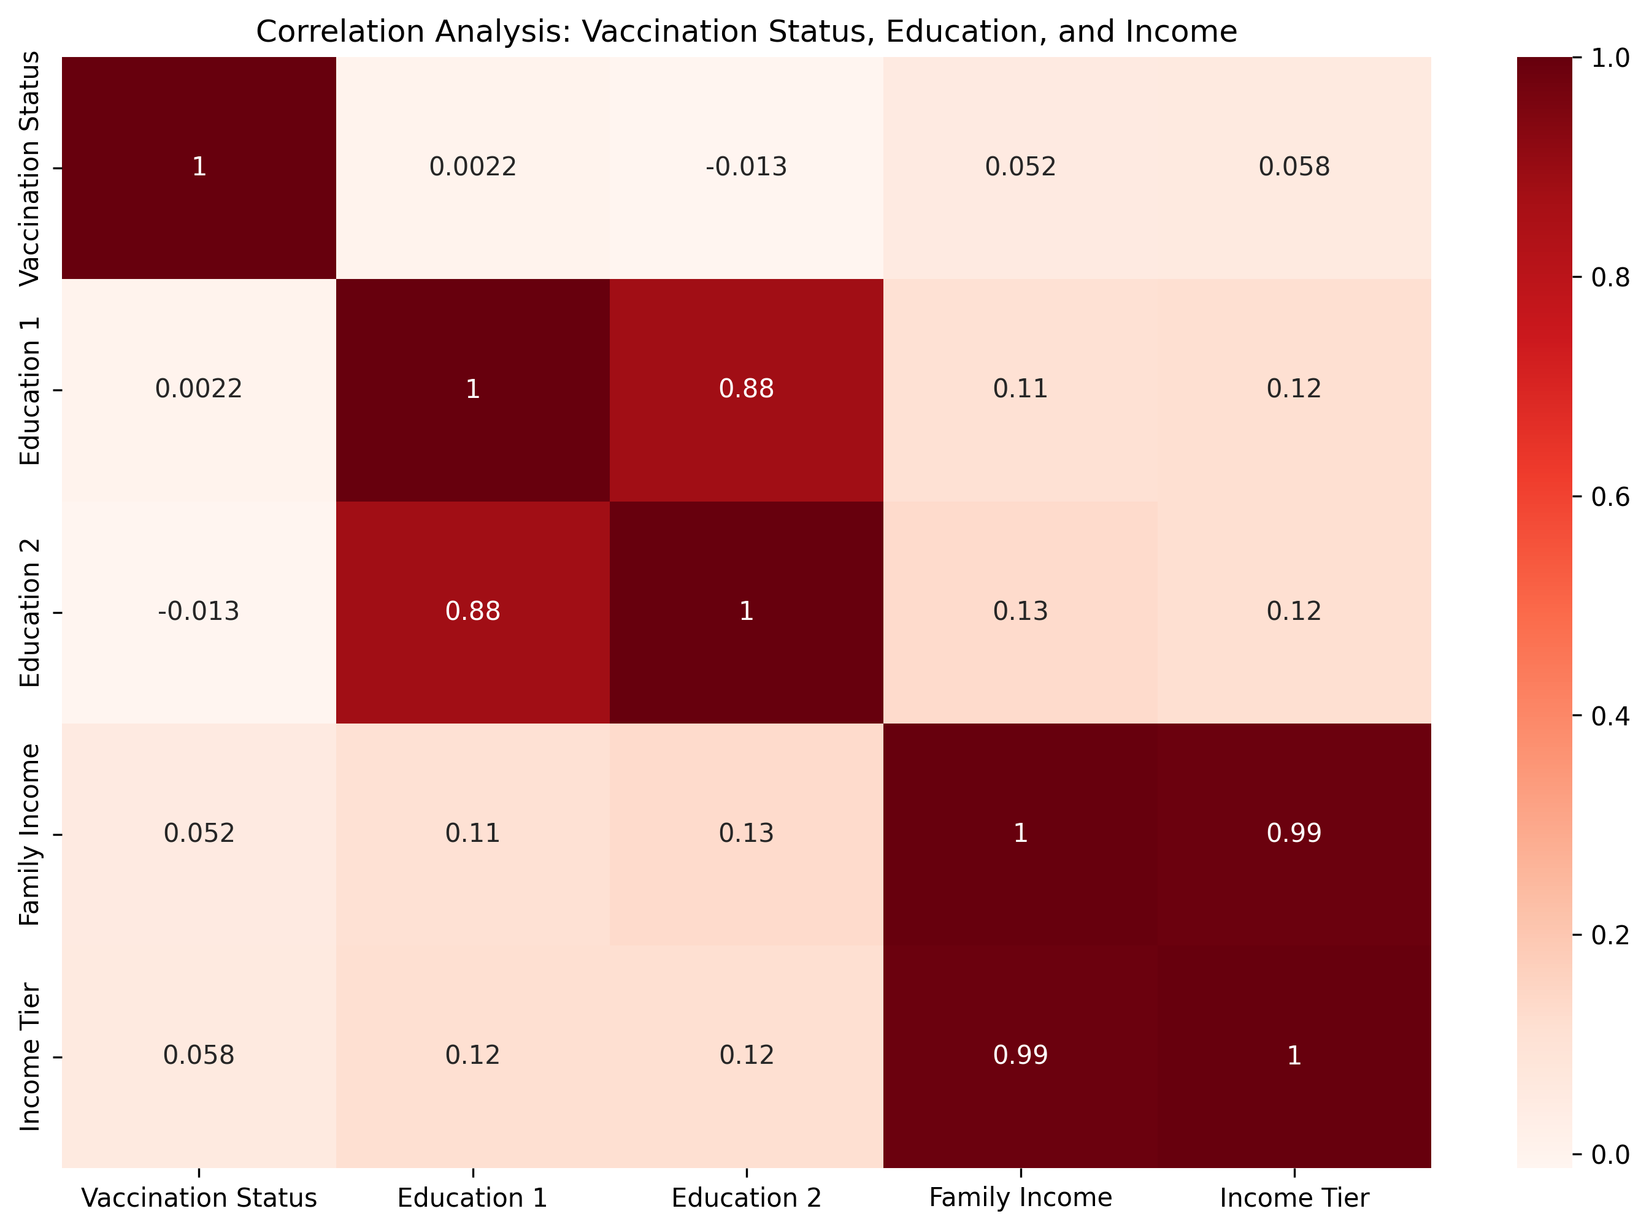

Slide 40
Education 1
F_EDUCCAT
Three-way category coded from self-reported educational attainment
1: College graduate+
2: Some college
3: High school graduate or less

Slide 41
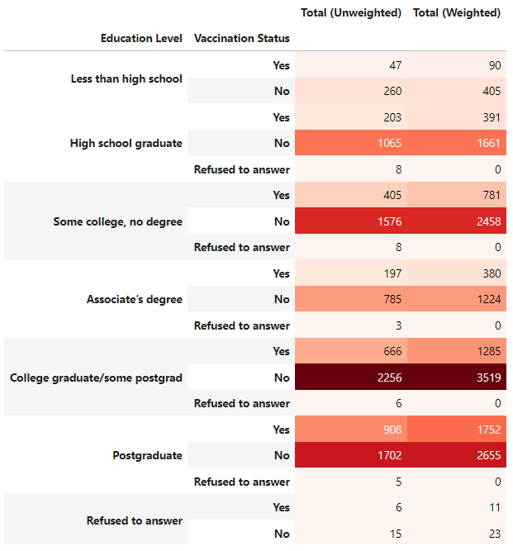
Education 2
F_EDUCCAT2
Six-way category coded from self-reported educational attainment
1: Less than high school
2: High school graduate
3: Some college, no degree
4: Associate’s degree
5: College graduate/some postgrad
6: Postgraduate

Slide 42
Vaccination Status and Income Level
Family income
Last year, that is in [PREVIOUS YEAR], what was your total family income from all sources, before taxes?

Slide 43
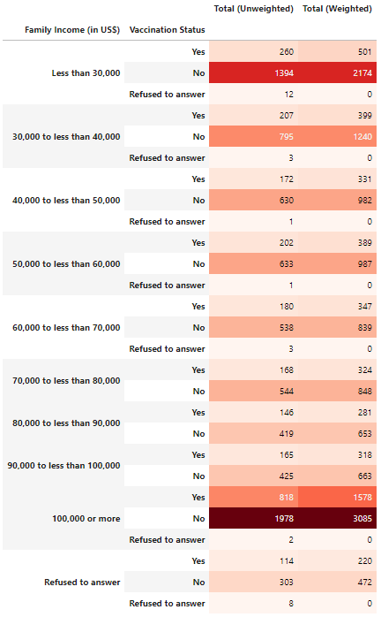
Family Income

Slide 44
Vaccination Status and Income Tier
Income tier 3-way
From survey documentation:
To create upper-, middle- and lower-income tiers, respondents’ family incomes were adjusted for differences in purchasing power by geographic region and for household size. “Middle-income” adults live in families with annual incomes that are two-thirds to double the median family income in the panel (after incomes have been adjusted for the local cost of living and for household size). The middle-income range for the American Trends Panel is about $38,900 to $116,800 annually for an average family of three. Lower-income families have incomes less than roughly $38,900, and upper-income families have incomes greater than roughly $116,800.

Slide 45
Income Tier

Slide 46
Vaccination Status and Mask Wearing
Examined responses to question “In the past month, how often, if ever, have you worn a mask or face covering when in stores or other businesses?”
1: All or most of the time
2: Some of the time
3: Hardly ever
4: Never
5: Have not gone to these types of places

Slide 47
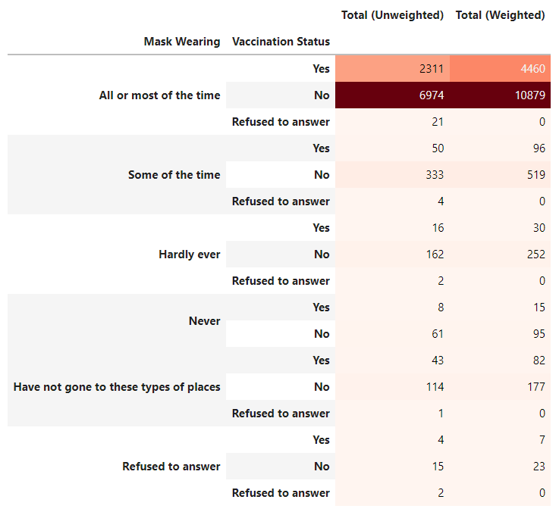
Mask Wearing

Slide 48
Vaccination Status and Religious Beliefs
F_RELIG
Religion
F_BORN
Born-again or evangelical Christian
F_RELIGCAT1
Condensed 4-way religion variable

Slide 49
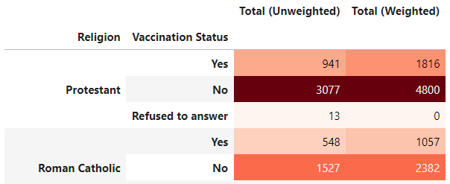
Religion
F_RELIG

Slide 50
Vaccination Status and Political Affiliation
F_PARTY_FINAL
Party
F_PARTYLN_FINAL
Party lean
F_PARTYSUM_FINAL
Party summary
F_PARTYSUMIDEO
Combining ideology and party identification

Slide 51
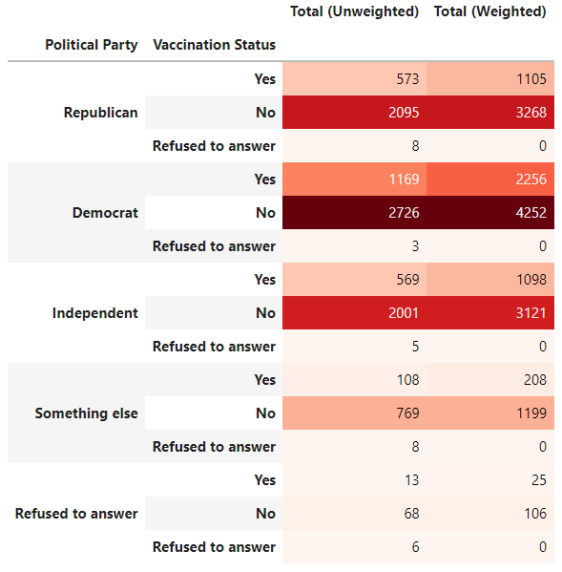
Political Affiliation
F_PARTY_FINAL

Slide 52
Insights

Slide 53
Insights
Most people not vaccinated
As of survey date (February 2021), vaccines not yet widely available

Slide 54
Insights
Majority of respondents believed Trump did a poor job handling the COVID-19 pandemic
Response from most government entities rated “good”
Biden’s response overwhelmingly rated “excellent” in weighted values

Slide 55
Insights
Respondents most concerned with:
The risk to teachers of getting or spreading the coronavirus
The risk to students of getting or spreading the coronavirus

Slide 56
Insights
Majority felt schools should wait to reopen until all teachers who want the coronavirus vaccine have received it
Unexpected finding

Slide 57
Insights
In terms of COVID-19 restrictions, following items significant for weighted values:
Closing K-12 schools for in-person learning
Limiting restaurants to carry-out only

Slide 58
Insights
Vaccination status highly correlated with:
Mask wearing
Family income
Income tier
Religion
Political affiliation

Slide 59
Insights
Highest level of vaccinations reported for those with a college degree or above
Postgraduates specifically reported the most vaccinations
For income tier, more middle-income respondents were vaccinated compared with lower-income or upper-income participants

Slide 60
Insights
Highest level of vaccinations in the following income brackets:
Less than $30,000
More than $100,000
Unexpected and surprising gap — each end of spectrum
Were most families in these brackets?

Slide 61
Insights
Compared with those affiliated with other political parties, most Democrats were vaccinated
Is this because most participants were Democrats?

Slide 62
Recommendations and Next Steps

Slide 63
Recommendations and Next Steps
Compare results with those from more recent surveys or other past surveys
Vaccines now more widely available
Evaluate questions regarding future plans — are those who had planned to be vaccinated indeed vaccinated now?
If respondents are not vaccinated, why not?
More recent data could provide more nuanced insights

