Slide 1
This is a test of the emergency broadcast system. I like scrambled eggs and toast for breakfast.Bush
the macros`
This is another text box.
manage
a
Color | Name | Id
Yellow | Dude | Elbow
Black | Gary | foot
Notes:
This is a tbd test

Slide 2
My Title
Green eggs and ham. Yucky breakfast
Color | Name | Id
Red | Frank | Head
Orange | Elmer | knee
Notes:
blue

Slide 3

what is the current
Walking on eggs on my way to breakfast.

Slide 4
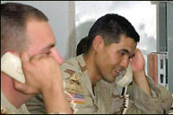
Walking on eggs on my way to breakfast.

Slide 5
  Customer Representative
  Responsible for the entire customer service and job fulfillment process for existing accounts and trainers
  Identifies qualified trainers for open jobs
  Negotiates vendor rates
  Coordinates travel arrangements
  Builds relationships with trainers
  Provides excellent customer service
Walking on eggs on my way to breakfast.
CR

Slide 6
Walking on eggs on my way to breakfast.
/PM

Slide 7
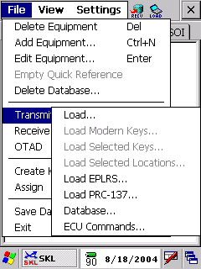

Slide 9
ColorKB editor | Name | Id
Red | Frank | Head
Orange | Elmer | knee
Color | Name | Id
Red | Frank | Head
Orange | Elmer | knee

Slide 10
yes add
yes add

Slide 11
This is a bullet.
This is another bullet.
This is yet a third bullet.
What? Another bullet!

Slide 12
This is a bullet.
This is another bullet.
This is yet a third bullet.
What? Another bullet!

