Slide 1
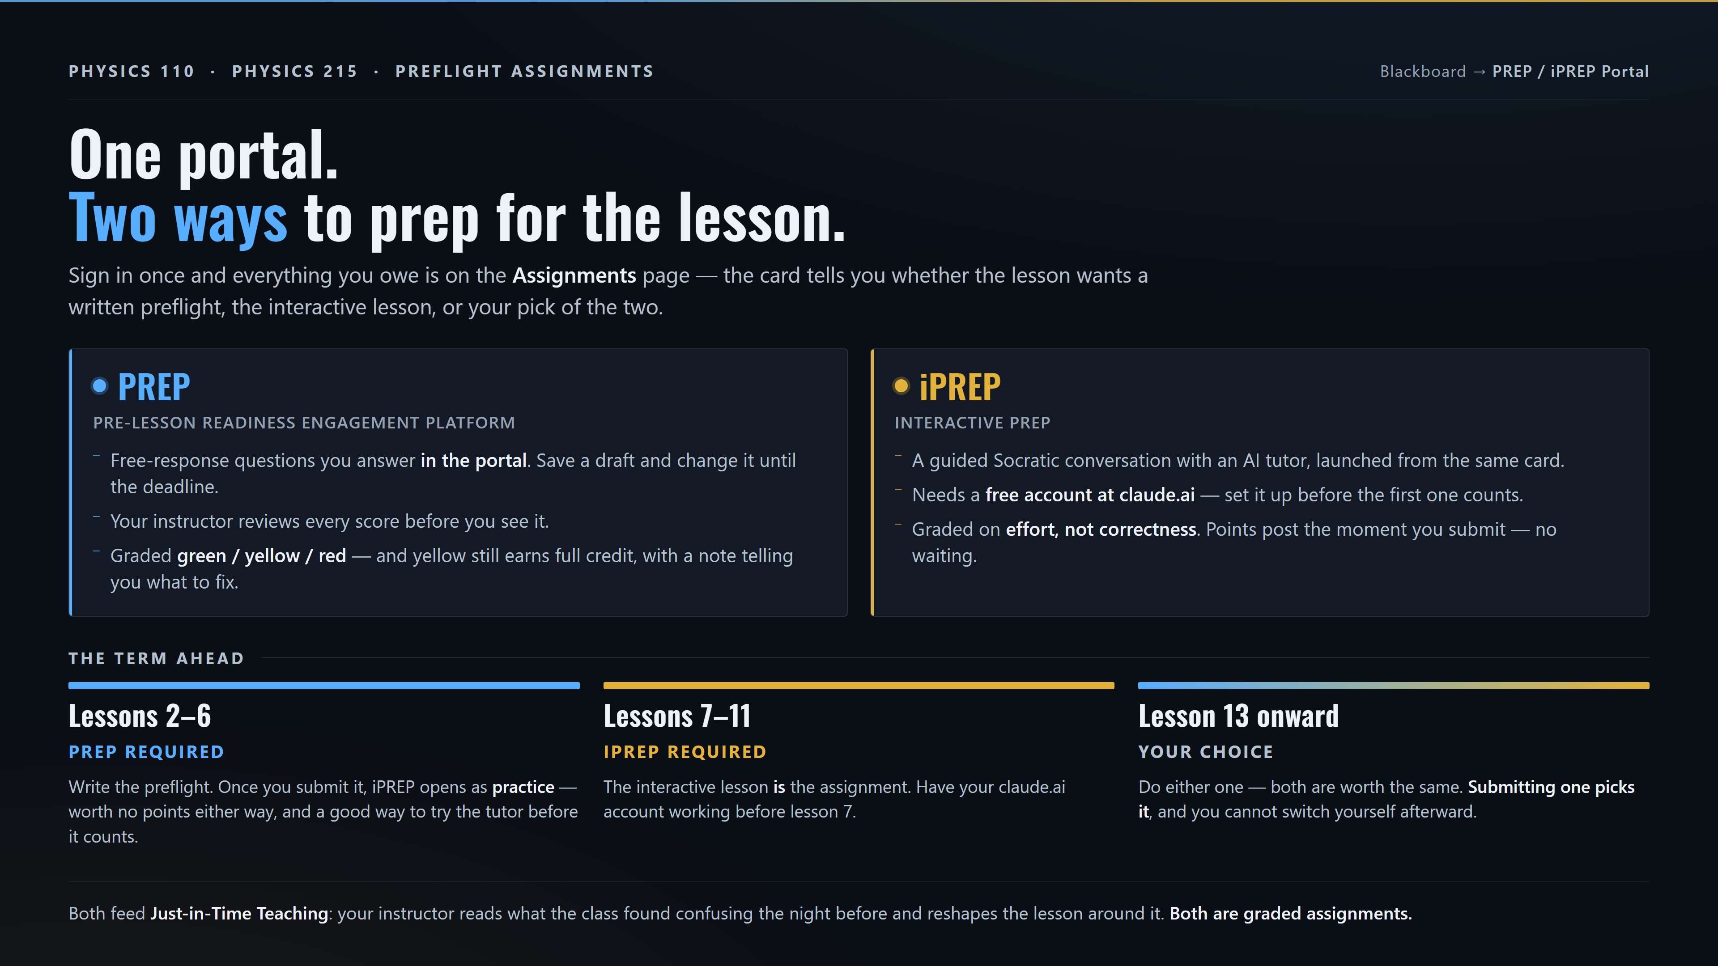
Notes:
One portal. Two ways to prep for the lesson.
Sign in once and everything you owe is on the Assignments page — the card tells you
whether the lesson wants a written preflight, the interactive lesson, or your pick of
the two.
PREP — Pre-lesson Readiness Engagement Platform
- Free-response questions you answer in the portal. Save a draft and change it until the deadline.
- Your instructor reviews every score before you see it.
- Graded green / yellow / red — and yellow still earns full credit, with a note telling you what to fix.
iPREP — interactive PREP
- A guided Socratic conversation with an AI tutor, launched from the same card.
- Needs a free account at claude.ai — set it up before the first one counts.
- Graded on effort, not correctness. Points post the moment you submit — no waiting.
THE TERM AHEAD
- Lessons 2-6, PREP required: write the preflight. Once you submit it, iPREP opens as
practice — worth no points either way, and a good way to try the tutor before it counts.
- Lessons 7-11, iPREP required: the interactive lesson IS the assignment. Have your
claude.ai account working before lesson 7.
- Lesson 13 onward, your choice: do either one — both are worth the same. Submitting one
picks it, and you cannot switch yourself afterward.
Both feed Just-in-Time Teaching: your instructor reads what the class found confusing the
night before and reshapes the lesson around it. Both are graded assignments.

Slide 2
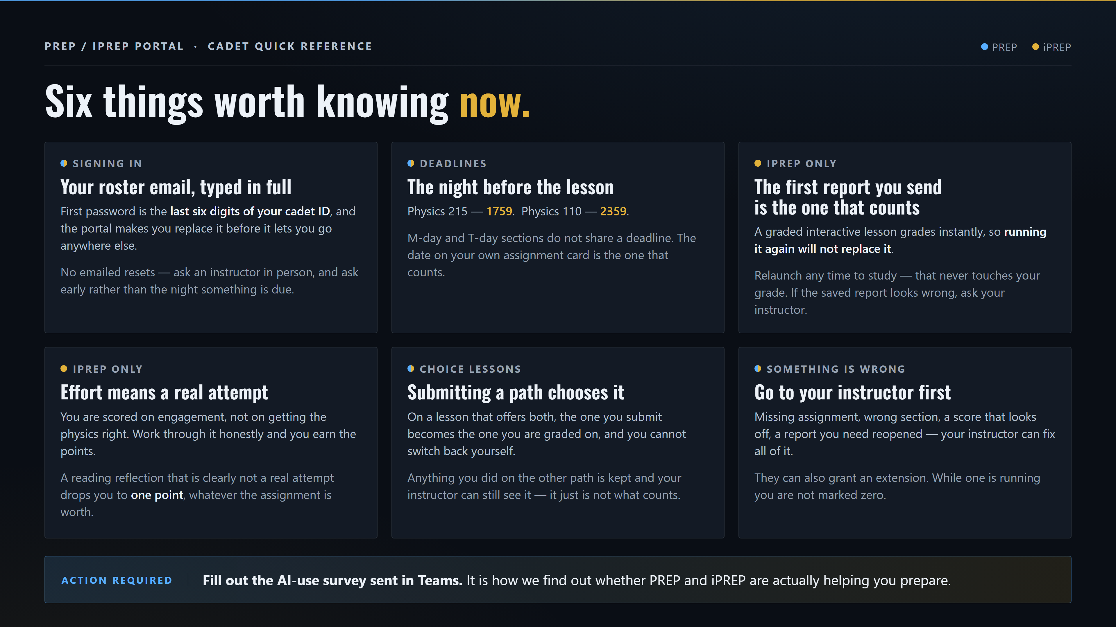
Notes:
Six things worth knowing now.
SIGNING IN — Your roster email, typed in full.
First password is the last six digits of your cadet ID, and the portal makes you replace it
before it lets you go anywhere else. No emailed resets — ask an instructor in person, and
ask early rather than the night something is due.
DEADLINES — The night before the lesson.
Physics 215 at 1759. Physics 110 at 2359. M-day and T-day sections do not share a deadline.
The date on your own assignment card is the one that counts.
iPREP ONLY — The first report you send is the one that counts.
A graded interactive lesson grades instantly, so running it again will not replace it.
Relaunch any time to study — that never touches your grade. If the saved report looks wrong,
ask your instructor.
iPREP ONLY — Effort means a real attempt.
You are scored on engagement, not on getting the physics right. Work through it honestly and
you earn the points. A reading reflection that is clearly not a real attempt drops you to one
point, whatever the assignment is worth.
CHOICE LESSONS — Submitting a path chooses it.
On a lesson that offers both, the one you submit becomes the one you are graded on, and you
cannot switch back yourself. Anything you did on the other path is kept and your instructor
can still see it — it just is not what counts.
SOMETHING IS WRONG — Go to your instructor first.
Missing assignment, wrong section, a score that looks off, a report you need reopened — your
instructor can fix all of it. They can also grant an extension. While one is running you are
not marked zero.
ACTION REQUIRED: fill out the AI-use survey sent in Teams.

