Slide 1

RION Imaging
Real-time Terrain. Real-time Decisions.
A Dedicated Lunar Imaging Constellation
Airbus Space Competition 25/26 · Team 31 · Finals Day

Slide 2
01
The Concept
What is RION Imaging and why does it matter?
RION Imaging · Airbus Space Competition 25/26
Notes:
SECTION 1: THE CONCEPT (2 minutes)
Introduce RION Imaging - what it is, the problem it solves, and the core value proposition.

Slide 3



The Problem
Infrequent
Outdated
Not dedicated
Current lunar imaging is limited in scope and low frequency..
Existing lunar data and infrastructure is old. Operators planning missions lack current surface intelligence.
No dedicated imaging infrastructure exists for the Moon. Each mission must bring its own imaging capability if it needs it.
The Moon will become a hub for scientific, commercial, and logistical missions — but operators lack continuous, reliable surface information.
RION Imaging · Airbus Space Competition 25/26
Notes:
The Moon is becoming a hub — Artemis, CLPS, international landers — but there's no persistent imaging infrastructure. Current data is from LRO (2009+) and mission-specific. This means operators cannot get timely terrain intelligence for landing site selection, hazard assessment, or resource prospecting.
Diego

Slide 4




Our Solution
CHEAP
A dedicated, multi-orbit microsat constellation in low lunar orbit
2U CubeSat platform
reduces unit cost
Continuous high-resolution optical & IR coverage
FAST
Global lunar surface imaging
Rapid revisit &
low-latency relay
Data relay through Lunar Gateway to Earth
Rapid revisit times across all orbital planes
GLOBAL
No single point of failure
Full lunar surface
coverage by 2045
RION Imaging · Airbus Space Competition 25/26
Notes:
Sankarshan: Present the RION Imaging solution: a constellation of microsats in varied lunar orbits providing continuous imaging. Key differentiators are cost (microsat platform), speed (rapid revisit + Gateway relay), and coverage (global). Data flows from Imaging Sats → Relay Sats → Gateway → Earth.
Plz talk about future radar imaging services

Slide 5
02
Commercial Viability
Market study, potential clients, and threat assessment
RION Imaging · Airbus Space Competition 25/26
Notes:
Sankarshan: SECTION 2: COMMERCIAL VIABILITY ASSESSMENT (4 minutes)
Covers SWOT analysis, market study, potential clients, and threats. This is the business case section.

Slide 6

Market Study
Market Opportunity in 2045
Key Market Drivers
£1.17B
Total Projected Addressable Market (annual)
£815M
Potential Institutional Market
£362M
Potential Commercial and Research Market
Artemis programme & Gateway operational by 2045
Growing cislunar economy & commercial lunar missions
Institutional customers = 65-75% of upstream demand
National security interest in cislunar domain awareness
No incumbent commercial lunar imaging service exists
RION Imaging · Airbus Space Competition 25/26
Notes:
Sankarshan: Present TAM/SAM/SOM breakdown. Key message: institutional customers (space agencies + gov/defense) represent 65-75% of upstream space market demand. The cislunar economy is projected to grow significantly with Artemis and Gateway becoming operational. There's currently no dedicated commercial lunar imaging service.

Slide 7



Potential Clients
Space Agencies
Gov / Defence
Commercial
· NASA (Artemis)
· National security agencies
· Mining companies
· ESA
· MoD / DoD
· Lunar lander operators
· JAXA / ISRO
· Intelligence community
· Tourism ventures
· UK Space Agency
· Telecom providers
Landing site selection, mission planning, science support
Cislunar domain awareness, threat monitoring, national security
Resource prospecting, surface ops, navigation, site surveys
RION Imaging · Airbus Space Competition 25/26
Notes:
Sankarshan: Three customer segments: 1) Space agencies (NASA Artemis, ESA, JAXA) for landing site selection and science. 2) Government/Defence for cislunar domain awareness and national security. 3) Commercial clients (mining, tourism, lander ops) for resource prospecting and surface operations. Government customers are early adopters and anchor customers (65-75% of demand).

Slide 8
SWOT Analysis
STRENGTHS
WEAKNESSES
· First-mover in dedicated lunar imaging
· Unproven cislunar business model
· 2U Cubesat = low cost per unit
· High initial capital requirements
· Gateway data relay infrastructure
· Dependency on Gateway schedule
OPPORTUNITIES
THREATS
· Growing cislunar economy
· Firefly Ocula (lander-supported imaging)
· Defence/intelligence demand rising
· Gateway delays or cancellation
· Artemis program momentum
· Regulatory uncertainty
RION Imaging · Airbus Space Competition 25/26
Notes:
Diego SWOT analysis. Strengths: first mover, low-cost microsat, Gateway relay, resilient constellation. Weaknesses: long timeline, unproven lunar business model, high capex, Gateway dependency. Opportunities: cislunar economy growth, defense demand, Artemis momentum, Mars extension. Threats: Firefly Ocula competition, Chinese cislunar capabilities, Gateway delays, regulatory gaps.

Slide 9
03
Our Constellation
Architecture, data pipeline, and TRL timeline
RION Imaging · Airbus Space Competition 25/26
Notes:
SECTION 3: TECHNICAL CONSTELLATION PRESENTATION (7 minutes)
Covers constellation architecture, RION Nova satellite platform, mission architecture, and TRL timeline.
- To provide this, we have designed our unique constellation

Slide 10


Architecture
Imaging Sats
Relay Sats
Power Sats
High-resolution optical and infrared sensors capturing lunar surface data.
Link the imaging constellation to the Lunar Gateway for low-latency, high-bandwidth data downlink to Earth.
Supply microwave wireless power to nearby satellites, extending operational lifetime and capability in lunar orbit.
Data Flow: Imaging Sats → Relay Sats → Lunar Gateway → Earth Ground Station → Rion Portal
RION Imaging · Airbus Space Competition 25/26
Notes:
Michal:
The architecture of which employs three distinct types of satellites working in tandem: imaging satellites for data collection, relay satellites for communication, and power satellites for wireless energy transmission.
The 2U-sized CubeSats (2-3 kg each) will be equipped with high-resolution visible-light and infrared sensors to map the lunar surface.
By 2045, these satellites will feature MDPE-graphene nanocomposite hulls that simultaneously provide structural support and radiation shielding.
Solid-state lithium-metal batteries deliver 550-650 Wh/kg specific energy, survive extreme temperature cycles and eclipse periods.
The relay satellites, on the other hand, will operate as store-and-forward communication nodes positioned in highly stable frozen orbits, linking the imaging constellation to the Lunar Gateway.
The power satellites supply microwave wireless power to nearby 2U satellites, extending their operational lifetime and capability.

Slide 11
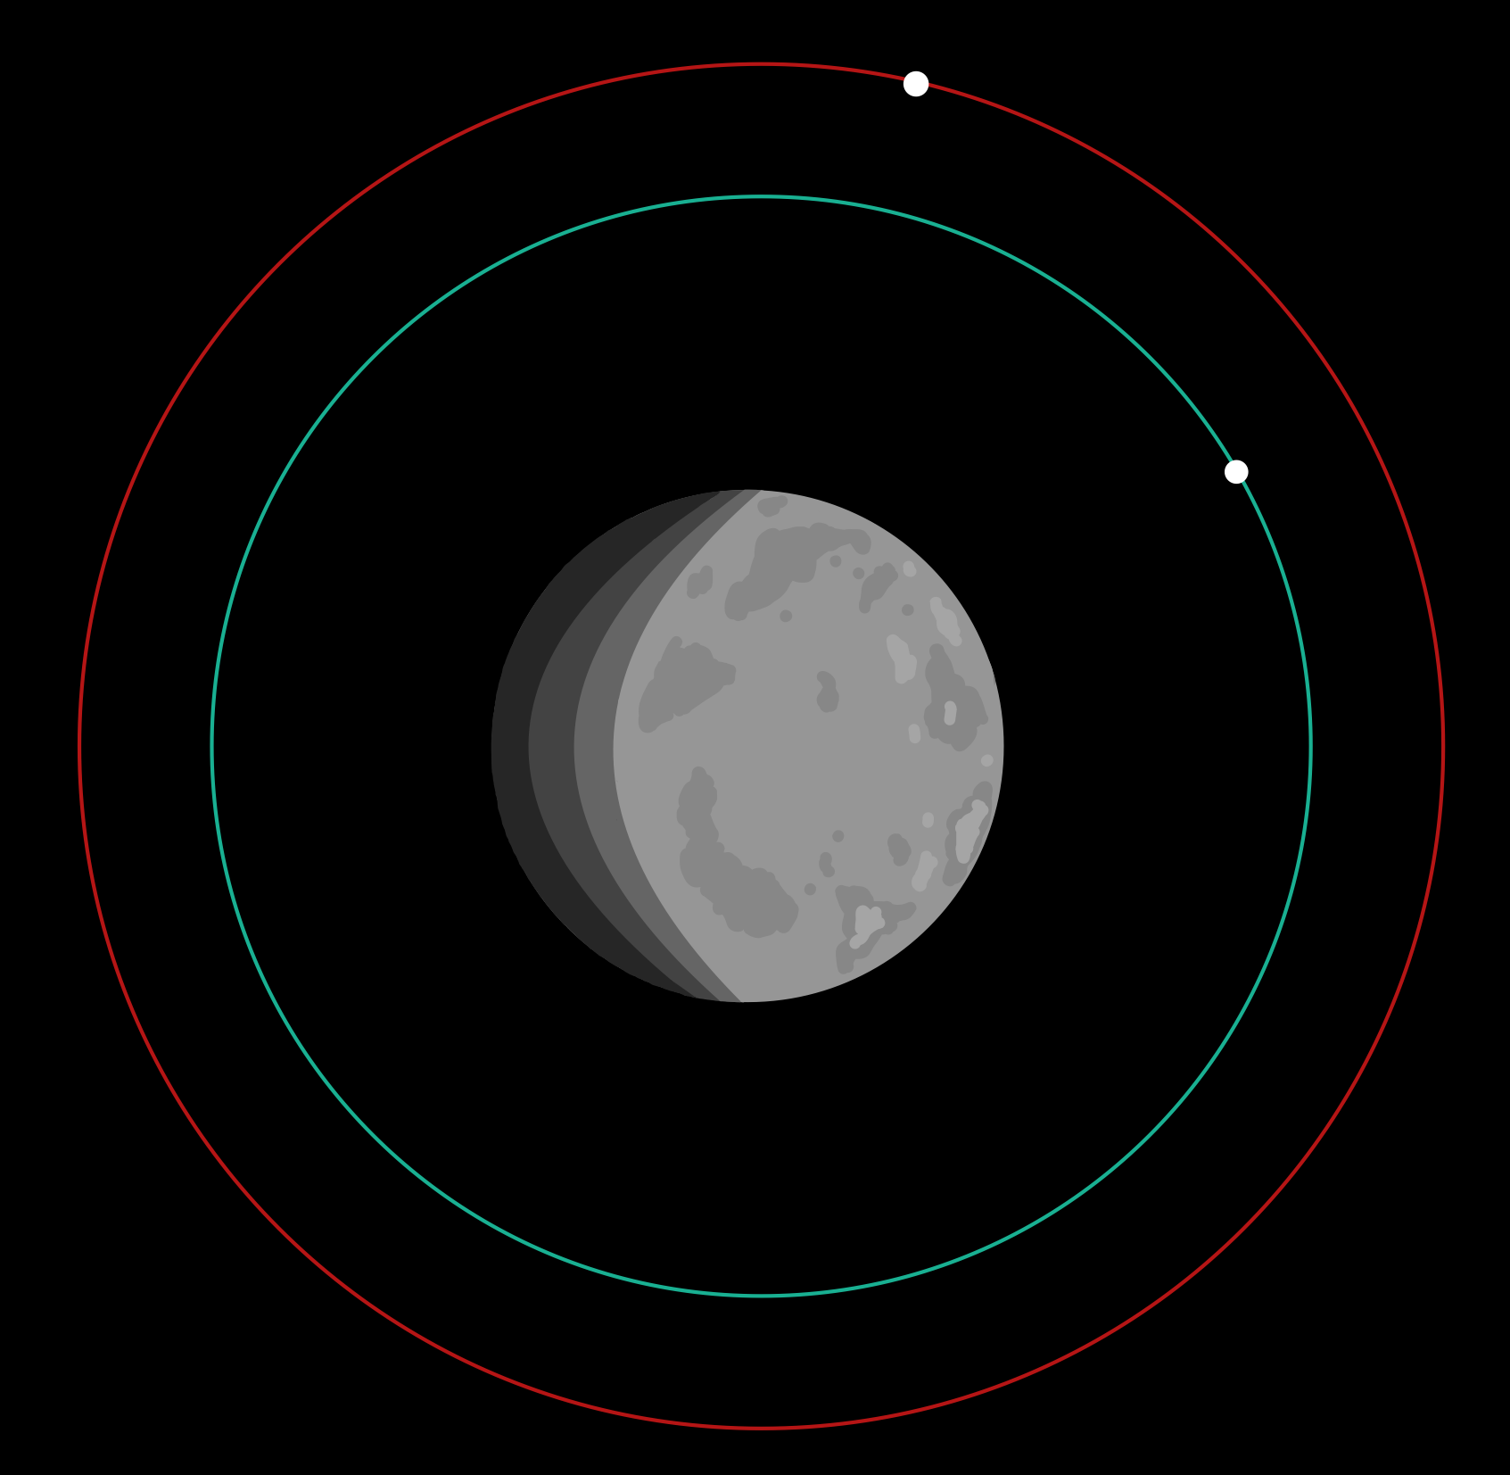
Rational and Specifications
How we will do it
Constellation Specifications
Primary Imaging Layer – 350km Altitude
No. of 2U CubeSats
30 x 2U Imagin CubeSats and 4 x 2U Relay CubeSats
Secondary Support Layer – 100km Altitude
Number of orbital planes
30 for Primary Imaging layer
4 planes for Secondary Support Layer
Lunar coverage
99%
Time to full renewal
8-10 Years
Imaging Res.
8 m/pixel optical, 16 m IR (with current tech)
Design Rational
Coverage and Orbit selection:
93° inclination selected from GMAT trade study.
Walker-style distributed plane spacing.
Even RAAN separation to avoid coverage clustering.
Renewal Strategy:
Gradual replenishment model.
Replace 1 plane per 2 years.
Avoid full constellation replacement at end-of-life.
RION Imaging · Airbus Space Competition 25/26
Notes:
old[After hearing about our mission architecture and data pipeline, I will now present our orbital architecture that facilitates these processes. ]
new[So, what exactly does this architecture look like physically?]
Our primary imaging layer has a fixed orbit of 93 degrees inclination across 30 orbital planes with 1 satellite in each plane.
We utilize a walker-style plane distribution which ensures uniform RAAN separation, preventing clustering and maintaining consistent global access, including the lunar polar regions.
At 350 km altitude, the system achieves approximately 99% surface coverage with an optical resolution of around 8 metres per pixel, supported by infrared capability for thermal mapping. It is important to note this is a conservative estimate from current imaging technology and we predict a significant improvement in resolution for our payload size.
From a lifecycle perspective, we adopt a gradual replenishment strategy, replacing one plane every 2 years. This avoids an end-of-life replacement cliff and spreads cost, launch cadence, and integration risk over time.

Slide 12
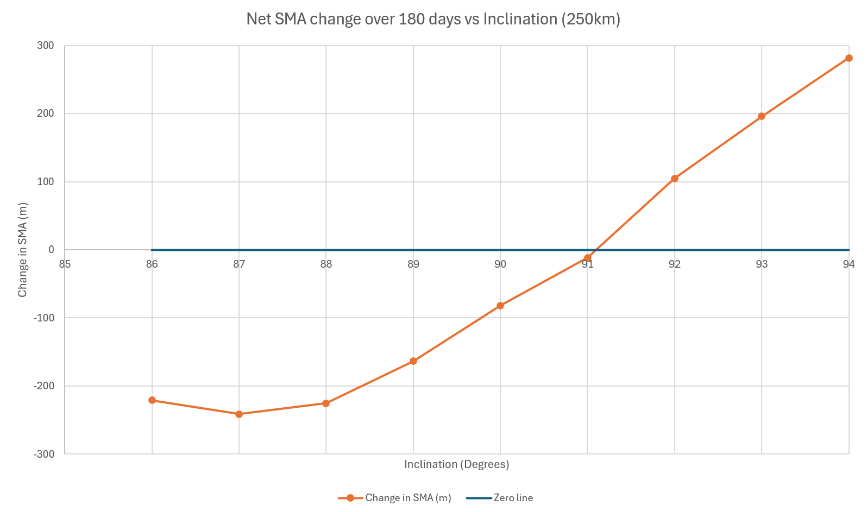
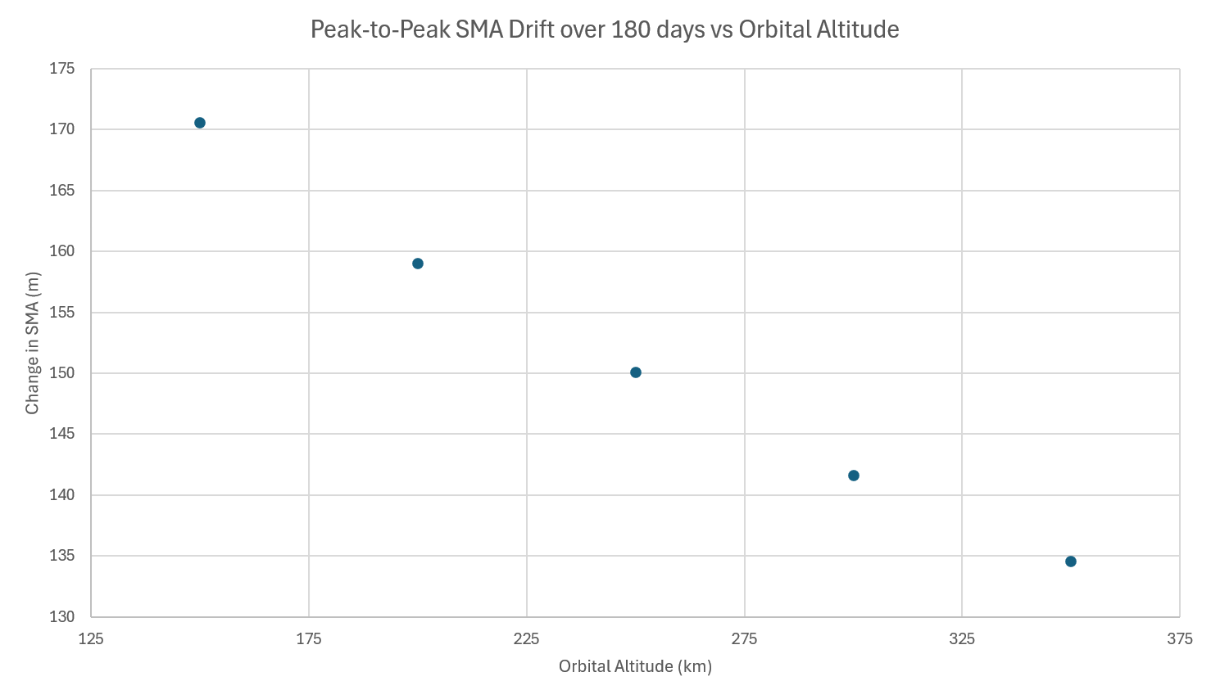
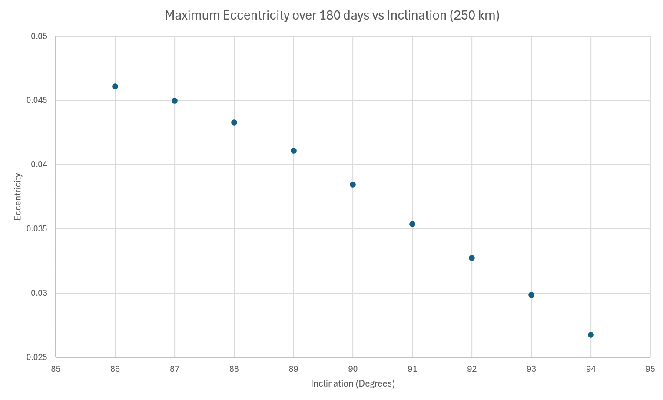
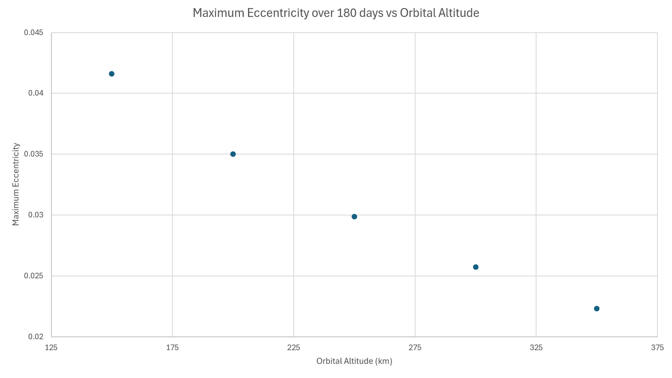
Inclination and Altitude Trade study
Selected Orbit
Inclination: [93°]
Altitude: [350km]
Stable side of SMA transition.
Low eccentricity growth.
Reduced RAAN drift magnitude.
Lower peak-to-peak perturbation at higher altitude.
Improved long-term constellation predictability.
Parameter | 93°, 250 km | 93°, 350 km
Net SMA drift (m) | +195 m | -70 m
Peak-to-peak SMA drift (m) | 150 m | 135 m
RAAN drift (°/day) | -0.276 | -0.238
RION Imaging · Airbus Space Competition 25/26
Notes:
Ana
Throughout the design process we had concerns surrounding lunar rotation, orbital stability in different inclinations, altitudes and their consequential delta V requirements. We initially designed for the minimum number of satellites required for a one-day revisit cycle which at the time produced 20 satellites but this left no performance margin. In response we performed an inclination and altitude trade study using NASA’s GMAT to shift the design of the constellation architecture to prioritize redundancy, continuous coverage, and long-term stability.
The additional planes provide natural resilience and the constellation can now tolerate multiple satellite losses before the revisit constraint is violated.
We performed an inclination sweep from 86° to 94° and assessed three long-term stability metrics: semi-major axis drift, eccentricity growth, and RAAN drift.
From the SMA plot, the least significant drift came from 91°. Below and above 91, we see more significant drift in opposite directions.
Eccentricity and RAAN drift show almost linear trends with higher altitudes producing more desirable results.
Therefore, to minimise the magnitude of drift to reduce station-keeping demand, 93° sits on a balance: moderate SMA drift, low eccentricity growth and manageable RAAN drift.
Estimated 20 second conclusion from altitude trade study

Slide 13
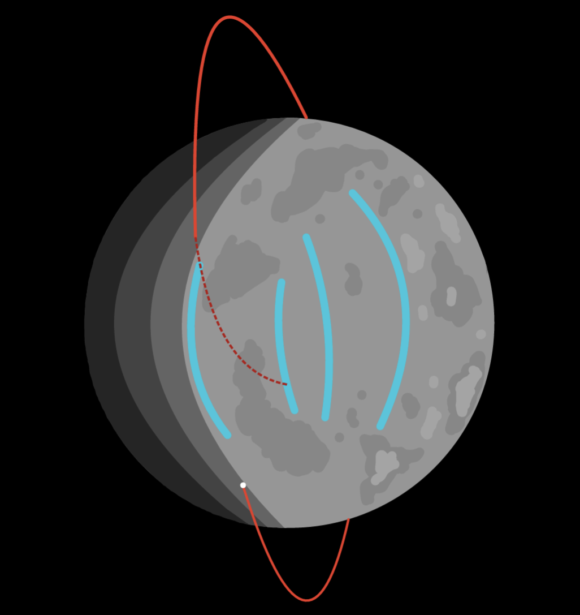
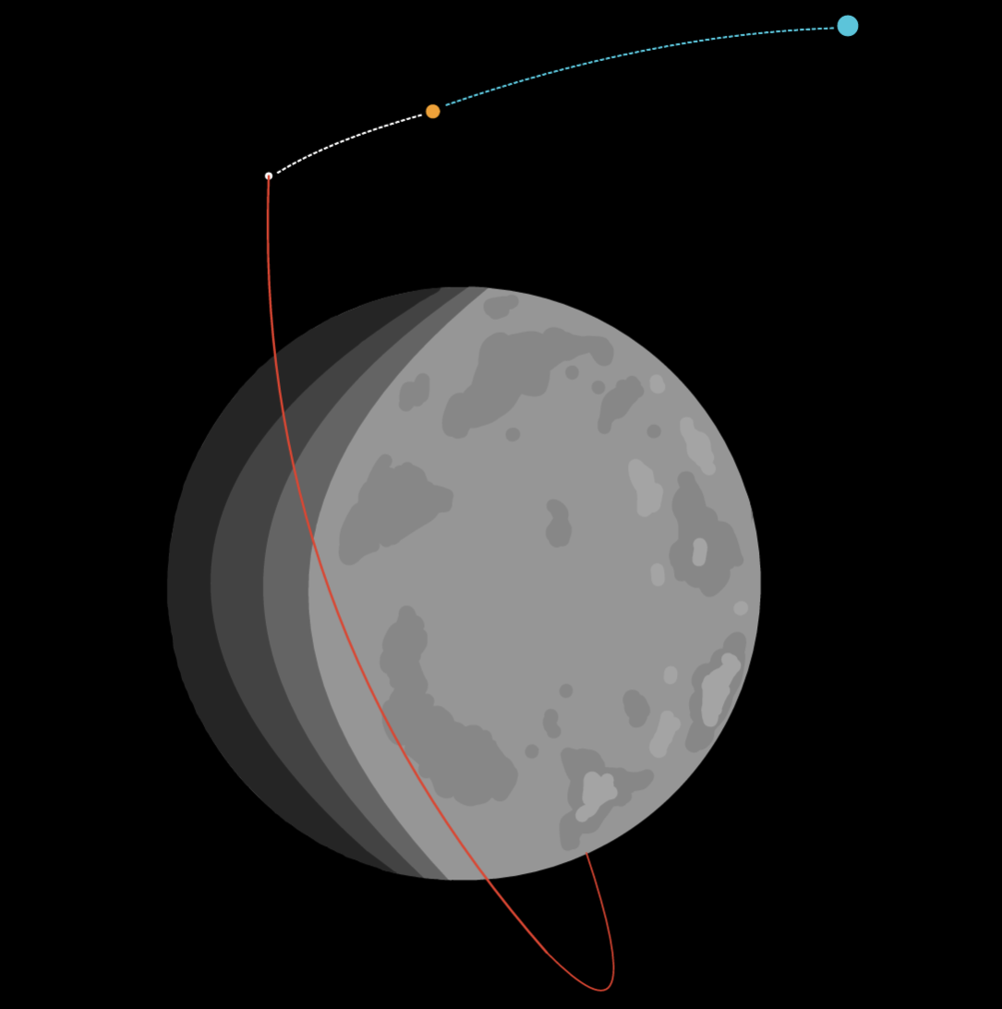
End Of Life Strategy
Primary Imaging Layer
Secondary Support Layer
Small servicing vehicle approaching satellite from Gateway
Controlled deorbit burn into non-sensitive corridor
Potential non-sensitive corridor
Relay CubeSat in frozen long-term orbit at 86°, 100km
Imaging CubeSat in 350km, 93° orbit
Flow: Operate → EOM mode → Controlled Impact
Flow: Life-long Orbit → Selective Recovery → Gateway Return
RION Imaging · Airbus Space Competition 25/26
Notes:
Ana
But what happens with our satellites when they reach the end of their mission?
Well we treat the constellation as two distinct layers with 2 different lifetime philosophies.
The near-polar imaging layer is intentionally designed as a bounded-lifetime operational layer. These satellites experience higher perturbation sensitivity and require higher maintenance demand SO before disposal, each satellite transitions into end-of-mission mode to extract their remaining their value which may be in communications relaying, calibration, or science demonstrations.
Following this, the satellites are passivated and removed via controlled impact into pre-defined non-sensitive lunar corridors to avoid polar volatile regions, heritage sites, and protected scientific areas, preventing long-term debris accumulation in lunar orbit.
The secondary infrastructure layer satellites are placed in long-term frozen orbits with lower natural drift and reduced station-keeping requirements also determined from GMAT simulations. These spacecraft are also designed with modular interfaces to enable a sustainability demonstration involving selectively recovering high-value components such as batteries, reaction wheels, and communications hardware using an experimental servicing vehicle. This servicing vehicle acts as a proof-of-concept for in-orbit component recovery and reuse, with the long-term objective of extending the architecture to support future sustainable constellation operations in Martian orbit.

Slide 14


Mission Architecture & Data Pipeline
Capture
Relay
Gateway
Ground
Rion Portal
Imaging sats acquire optical & IR data
Data routed to Relay sats
High-bandwidth downlink through Lunar Gateway
Data received at Earth ground stations
Processed imagery served to customers via API
Rion Portal: A secure online platform offering live and archived imagery, mission insights, alerts, and API integration. Designed for seamless customer access with future mission extensibility.
RION Imaging · Airbus Space Competition 25/26
Notes:
Michal:
To bring this all together, after our satellites capture the imagery.
The processed data is then aggregated to relay satellites, which in turn transmit to the Lunar Gateway using quantum-proof systems.
In turn, the Gateway relays the data to Earth via a secure link with proprietary encryption.
Algorithms will be developed to automatically perform ground-based processing for quality assessment.
At the last step, the RION Portal is used to distribute the final images to the consumer
Customers can access the Rion Portal via an independent secure API with built-in individual per customer access as one of its innovative features

Slide 15
04
Operational Timeline
Route to 2045
RION Imaging · Airbus Space Competition 25/26
Notes:
SECTION 4: FUTURE PLANS & CONCLUSION (2 minutes)

Slide 16
Technology Readiness Level Timeline
2025–2030
2030–2035
2035–2040
2040–2045
TRL 1–3
TRL 4–5
TRL 6–7
TRL 8–9
Research & Concept
Component Development
Prototype & Demo
Qualification & Launch
Basic research, concept formulation, proof-of-concept simulations
Component validation in lab and relevant environment testing
System prototype demo in relevant environment, pathfinder mission
Flight qualification, constellation deployment, full operational capability
Target: Ready for external investment by 2030, operational by 2045
RION Imaging · Airbus Space Competition 25/26
Notes:
TRL timeline across 4 phases: 2026-2030 (TRL 1-3, basic research), 2030-2035 (TRL 4-5, component dev), 2035-2040 (TRL 6-7, prototype & demo mission), 2040-2045 (TRL 8-9, qualification & deployment). Mention key milestones: prototype mission, first constellation deployment, full operational capability.
External Investment by 2030- Prob gov/private contracts

Slide 17
Cost Breakdown & Funding Strategy
Cost Category | Est. Cost | Notes
Development (NRE) | £18 M | Platform R&D, Payload dev
Space Segment (RE) | £16 M | Satellite manufacturing
Launch | £23 M | Launcher Selection & cost
Ground Segment | £7 M | Operations Centre, Rion Portal
Operations | £5.5 M | Annual operations staff and capital investment
TOTAL | £69.5 M | (Non-Recurring)
Funding Strategy
Phase 1: Grants
£30.80 M
UK Space Agency, ESA, Innovate UK
Phase 2: Venture Capital
Subscription Tier | Services
No Subscription | Per Image Pricing
Commercial/Academic | Standard priority service, 300 image limit per year
Enterprise | Unlimited Images at standard priority with 50 high priority images, private database
Defence/Security | High priority service, unlimited images, private and secured database
£38.50 M
Seraphim Space, Airbus Ventures, Space Capital
Phase 3: Strategic
£7.70 M
Industry partnerships, government contracts
RION Imaging · Airbus Space Competition 25/26
Notes:
Cost breakdown. Three-phase funding strategy: grants → VC → strategic partnerships, following ICEYE model.
Pricing Plan
Subscription services

Slide 18
05
ROI & Future Plans
Scaling beyond the Moon
RION Imaging · Airbus Space Competition 25/26
Notes:
SECTION 4: FUTURE PLANS & CONCLUSION (2 minutes)

Slide 19
10 Year Projection
Metric | 2045 | 2046 | 2047 | 2048 | 2049 | 2050 | 2051 | 2052 | 2053 | 2054 | Total
EBITDA (£ M) | 7.78 | 12.61 | 16.70 | 19.52 | 21.94 | 25.39 | 29.45 | 32.75 | 37.03 | 39.55 | 242.72
Recurring Costs (£ M) | 3.70 | 3.70 | 3.70 | 3.70 | 3.70 | 3.70 | 3.70 | 3.70 | 3.70 | 3.70 | 37.00
Net Cash Flow (£ M) | 4.08 | 8.91 | 13.00 | 15.82 | 18.24 | 21.69 | 25.75 | 29.05 | 33.33 | 35.85 | 205.72
Cumulative Cash Flow (£ M) | 4.08 | 12.99 | 25.99 | 41.81 | 60.05 | 81.74 | 107.49 | 136.54 | 169.87 | 205.72 | -
Metric | Description | Value (£ M)
Total Non-Recurring Investment | Non-Recurring Cost Analysis | 69.50
Total Revenue (10 yr) | 10-Year Projection Analysis | 242.72
Total Recurring Costs (30 yr) | 30-Year Projection Analysis | 81.50
Net Profit | Revenue minus all costs | 91.72
ROI | (Net Profit / Total Investment) x 100 - 100 | 32.0%
RION Imaging · Airbus Space Competition 25/26
Notes:
First Mover Advantage
Pricing Plan
Subscription Services

Slide 20
Growth Roadmap & ROI
Growth Roadmap
ROI Summary
32.0%
Projected ROI within 10-year operational period
Comparable to ICEYE or Planet Labs
2045
Full Operational Capability — lunar constellation live
2047
Service expansion — enhanced resolution, analytics
2055
Mars pathfinder — adapt platform for Martian orbit
2060+
Multi-planetary imaging network
RION Imaging · Airbus Space Competition 25/26
Notes:
The ROI justifies the risk. Emphasize varying EBITDA with low end at 2045 and higher near 2055

Slide 21
RION Imaging
Real-time Terrain. Real-time Decisions.
Thank you
Team 31 · Airbus Space Competition 25/26
Stevenage, United Kingdom
Notes:
Closing slide. Thank the judges, open for Q&A. Be ready for 5+ minutes of questions from Airbus experts.

