Slide 1

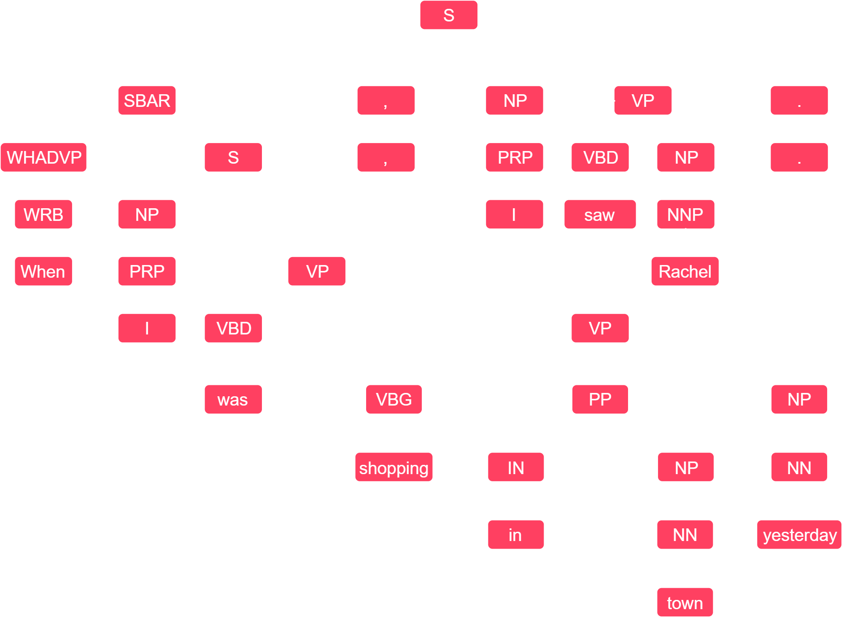
Detecting Periodic Sentences For The Purposes Of Argument Mining
Summary
WHAT
This project aimed to create a periodic sentence detection algorithm, making use of an API to enable future work and a UI to expand the potential audience beyond computer scientists.
HOW
The application was built using Python with the Flask framework. The algorithm looks for subordinate clauses in sentences and, if they match the characteristics of a periodic sentence, will mark the sentence as periodic. It looks for these clauses in two ways: By analysing the structure of the sentence, and by looking at the first words of the sentence. The structure is shown as a tree, as depicted in the diagram of a periodic sentence below.
KEY FINDINGS
It was found that the algorithm can detect periodic sentences without context. It is also capable of detecting new sentences with a similar level of accuracy.
RESULTS
After some experimentation and subsequent adjustments, the algorithm achieved an accuracy of 94% on the test data set.
The project
Argument mining is the extraction of arguments from a given block of text. It provides information about the claims being made and the evidence being used to back them up. There are various use cases for this technology such as ArgumenText, an online search engine that can find arguments for and against a given topic.
A periodic sentence is made up of two parts: A subordinate clause and a main clause. The subordinate clause is dependent on the main clause. “When I was shopping in town yesterday, I saw Rachel.” is a periodic sentence. The subordinate clause is “When I was shopping in town yesterday” and the main clause is “I saw Rachel”. A periodic sentence always has the subordinate clause first, whereas other sentence types with subordinate clauses have them at the end of the sentence. Therefore the position of the subordinate clause is what we use to determine if the sentence is periodic.
Argument mining is far from a solved problem due to the immense complexity of natural language. This project aims to advance the field by providing some metadata on the text being mined – namely whether or not it is periodic. Periodic sentences are similar in structure to arguments, with premise in the subordinate clause followed by conclusion in the main clause – so if the argument mining algorithm knows that a sentence is periodic, it knows where to find premises (Claims) and conclusions (Evidence).
Methodology
To detect periodic sentences, the algorithm looks for subordinate clauses towards the start of the sentence. This is a key characteristic of periodic sentences.
To do this, the algorithm first looks for ‘S’ or ‘SBAR’ tags attached to clauses near the start of the sentence. These are indicators of a subordinate clause when using the Penn Treebank. If one of these tags is found in a position that would indicate a periodic sentence, the algorithm sets the sentence’s periodic attribute to True.
If the structure does not contain ‘S’ or ‘SBAR’ tags towards the start of the sentence, perhaps due to a misinterpretation in the sentence parsing, the algorithm will look for a subordinating conjunctive (Represented by the “IN” POS tag). These words are found at the start of a subordinate clause, so if one can be found in the first few words of the sentence, we can call it periodic.
Finally, the algorithm returns the list of annotated sentences to the UI or the caller of the API, as HTML or JSON/Pickle respectively.
Periodic
Subordinate Clause
Main Clause
Not periodic
Main Clause
Subordinate Clause
Results
The dataset is split into a set of periodic sentences and a set of non-periodic sentences. When running in test mode, the algorithm will go through each sentence and predict whether they are periodic or not, giving itself a 'point' if it is correct. The application then calculates the percentage of periodic sentences correctly predicted as periodic, the percentage of non-periodic sentences predicted as non-periodic and the run time.
This approach allowed the success of each prototype to be measured, and the separate accuracy scores for periodic and non-periodic detection made narrowing down issues easier. After each experiment, the results were recorded and a hypothesis was made suggesting the next steps to improve it further. The graphs below show the improvement with each prototype.
Conclusion
Argument Mining has the potential to make research papers more digestible, natural language processing more intelligent and comparison between contrasting viewpoints more manageable. However, argument mining is still in it's infancy and cannot, at present, achieve it's theoretical potential.
To combat this, we need to provide argument mining tools with as much information as possible. Hence, this project aimed to build an accurate periodic sentence detection algorithm, which could provide useful metadata to an argument mining algorithm in the future.
It was hypothesised that a software tool we create could detect periodic sentences, and to an equal or better standard than that achieved by existing solutions.
This hypothesis was proven to be accurate as we not only achieved 50% accuracy (The minimum requirement), but achieved an accuracy over 90%.
Future Work
Currently, the application can detect periodic sentences with a high level of accuracy. However if it was integrated into an argument mining library, the primary use case of providing useful metadata to an argument mining algorithm would be possible.
There are many more options for expansion, such as exposing the testing suite to the user, allowing them to test the algorithm’s effectiveness on their own corpora using their own test dataset.
Other expansion options include real-time analysis built into a web plugin, allowing writers to see the types of their sentences as they write them, similar to the grammar correction plugin ‘Grammarly’.

