Slide 1

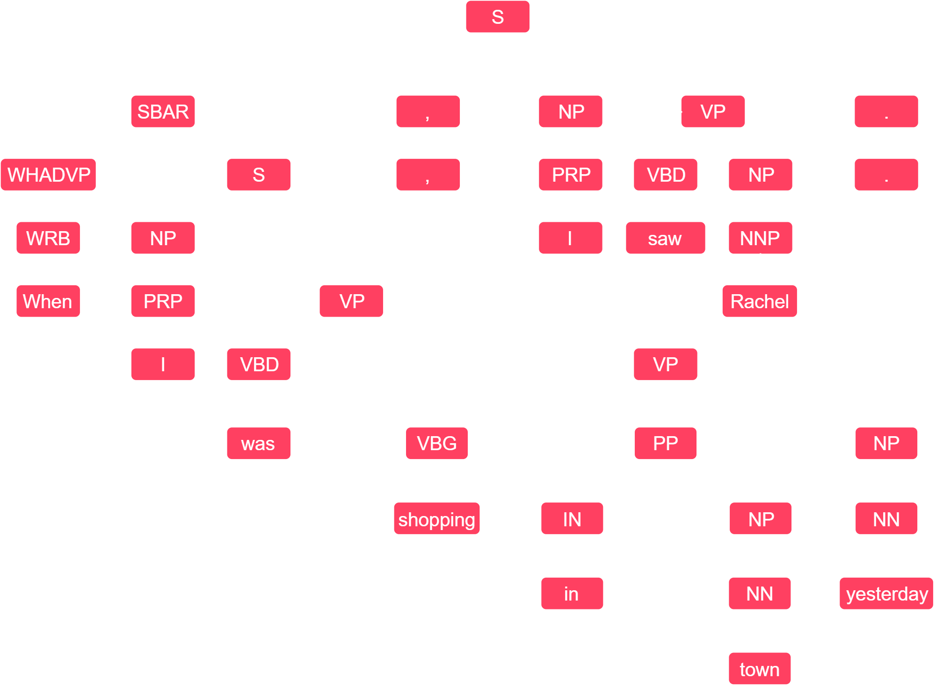
Detecting Periodic Sentences For The Purposes Of Argument Mining
David Frame
40200819
The aim of this project was to create a periodic sentence detection algorithm that makes use of an API to enable future work and a UI to expand the potential audience. The application was built using Python with the Flask framework. It looks at a list of sentences for characteristics of a periodic sentence and marks each one as periodic or non-periodic. The algorithm achieved an accuracy of 94% on the test data set.
Methodology
The defining characteristic of a periodic sentence is that it starts with a subordinate clause, so if the algorithm finds evidence of a subordinate clause towards the start of each sentence, it labels the sentence as periodic.
To do this, the algorithm first looks for ‘S’ or ‘SBAR’ tags attached to clauses near the start of the sentence. These are indicators of a subordinate clause when using the Penn Treebank. If one of these tags is found in a position that would indicate a periodic sentence, the algorithm sets the sentence’s periodic attribute to True.
In addition, the algorithm will look for a subordinating conjunctive (Represented by the ‘IN’ POS tag). These words are found at the start of a subordinate clause, so if one can be found in the first few words of the sentence, we can call it periodic.
Finally, the algorithm returns the list of annotated sentences to the UI or the caller of the API, as HTML or JSON/Pickle respectively.
Background
Argument mining is the extraction of arguments from a given block of text. It provides information about the claims being made and the evidence being used to back them up. Currently, argument mining is very difficult due to the immense complexity of natural language. This project aims to advance the field by providing some metadata on the text being mined – namely whether or not each sentence is periodic.
A periodic sentence is made up of two parts: A subordinate clause and a main clause. The subordinate clause is dependent on the main clause.
“When I was shopping in town yesterday, I saw Rachel.” is a periodic sentence. A periodic sentence always has the subordinate clause followed by the main clause, whereas other sentence types containing subordinate clauses are the other way around.
Periodic sentences are similar in structure to arguments, with a premise in the subordinate clause followed by conclusion in the main clause. Therefore, if the argument mining algorithm knows that a sentence is periodic, it knows where to find premises (Claims) and conclusions (Evidence), making argument detection easier.
Subordinate Clause
When I was shopping in town yesterday,
Main Clause
I saw Rachel.
Results
The dataset is split into a set of periodic sentences and a set of non-periodic sentences. When running in test mode, the algorithm will go through each sentence and predict whether they are periodic or not, giving itself a 'point' if it is correct. The application then calculates the percentage of periodic sentences correctly predicted as periodic, the percentage of non-periodic sentences predicted as non-periodic and the run time.
Conclusions
Argument Mining has the potential to make research papers more digestible, natural language processing more intelligent and comparison between contrasting viewpoints more manageable. However, argument mining is still in it's infancy and cannot, at present, achieve it's theoretical potential.
To combat this, we built an accurate periodic sentence detection algorithm, which could provide useful metadata to an argument mining algorithm in the future.
It was hypothesised that a software tool we create could detect periodic sentences, and to an equal or better standard than that achieved by existing solutions. This hypothesis was proven to be accurate as we achieved an accuracy of approx. 95%.
This approach allowed the success of each prototype to be measured, and the separate accuracy scores for periodic and non-periodic detection made narrowing down issues easier. After each experiment, the results were recorded and a hypothesis was made suggesting the next steps to improve it further. The graphs below show the improvement with each prototype.
Future Work
Currently, the application can detect periodic sentences with a high level of accuracy. However if it was integrated into an argument mining library, the goal to advance the field of argument mining would be possible. There are many more options for expansion, such as exposing the testing suite to the user, building real-time detection into a web plugin, or distinguishing loose sentences from other types of non-periodic sentences.
95% accurate

