Slide 1
Agentic Health Interoperability Framework
Technical Deep-Dive: Architecture, Use Cases, and Extensibility
InterSystems AI Hub | May 2026 | PM / Engineering Audience

Slide 2
The %AI Framework: Five Primitives
IRIS for Health 2026.2 ships five AI primitives. The framework provides the plumbing; the content makes it useful.
Agent
MCP Server
ToolSet
Tool
Skill
%AI.Agent
%AI.MCP.Service
%AI.ToolSet
%AI.Tool
%AI.Agent.Skill
Orchestrates multi-step tasks. Routes to tools, skills, policies. Manages conversation context.
Groups related tools into named service domains. In-process or HTTP/SSE transport.
Collection of related tools. Auto-discovered by framework. JSON Schema input/output.
Single capability callable by LLM. ObjectScript, SQL, or Python. Confirmation gate support.
Domain knowledge as text. Injected as sub-agent tool. Up to 32K chars of instructions.
Binding chain: Agent (1) --> MCP Servers (N) --> ToolSets (N) --> Tools (N) | Skills (N) <-> Agent (N)
FRAMEWORK (shipped by InterSystems, not modified)
CONTENT (agents, tools, skills -- built on top of the framework)

Slide 3
Architecture: Healthcare Agent Interop
UI Layer
Chat UI (SSE streaming, tool-call cards, confirmation gate)
Admin UI (agents, MCPs, tools, skills, connections, catalogs, transforms, audit)
API Layer
REST API: /api/agentic/* (14 service classes, JWT/Basic auth, audit logging)
Agent Layer
HealthInterop Agent Manager + Monitor + SkillLoader
Policies ConfirmationGate ToolFilter
12 Skills HL7 | FHIR | DTL | BPL SDA | CDA | X12 | ...
MCP Layer
Production 13 tools
Transform 13 tools
Testing 8 tools
Catalog 8 tools
Tool Layer
42 Tools: ObjectScript class methods | SQL queries | Embedded Python | REST wrappers
IRIS Stores
Vector Search HNSW + FastEmbed
Secured Wallet API keys only
Productions live runtime
%Dictionary class metadata

Slide 4
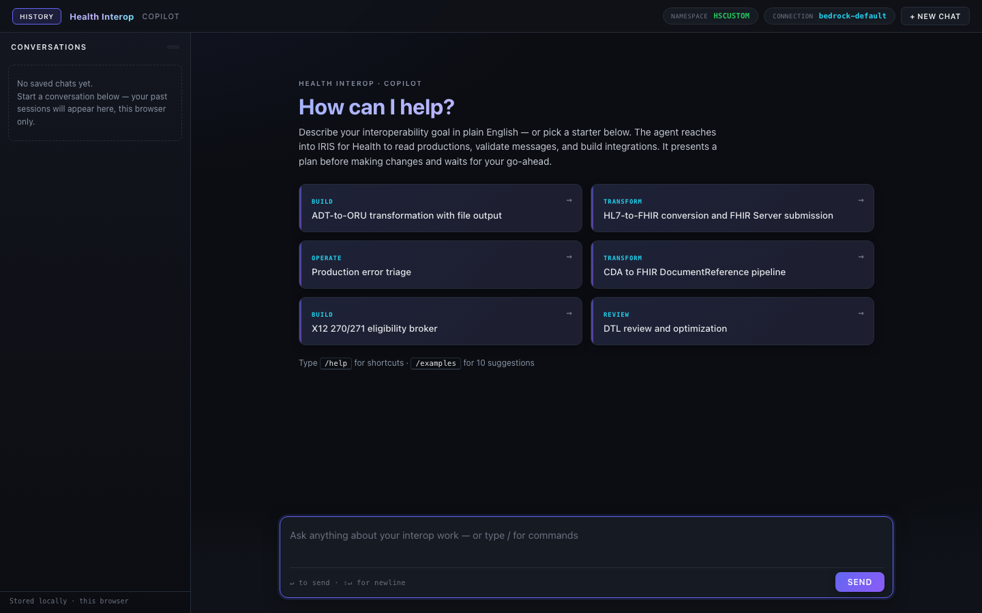
Use Case 1: Build Productions
1. Discover
2. Propose
3. Build
4. Validate
5. Report
Agent searches Ens.* catalog for Business Hosts
Agent presents production layout for approval
Creates production, adds hosts, settings, routing rules
PostBuildValidation + test HL7 message through pipeline
Summarizes what was built, surfaces any warnings
Tools: search_ens, describe_class, create_production, add_business_host, update_settings, create_routing_rule, start/stop_production, PostBuildValidation, BuildAndSendHL7TestMessage

Slide 5
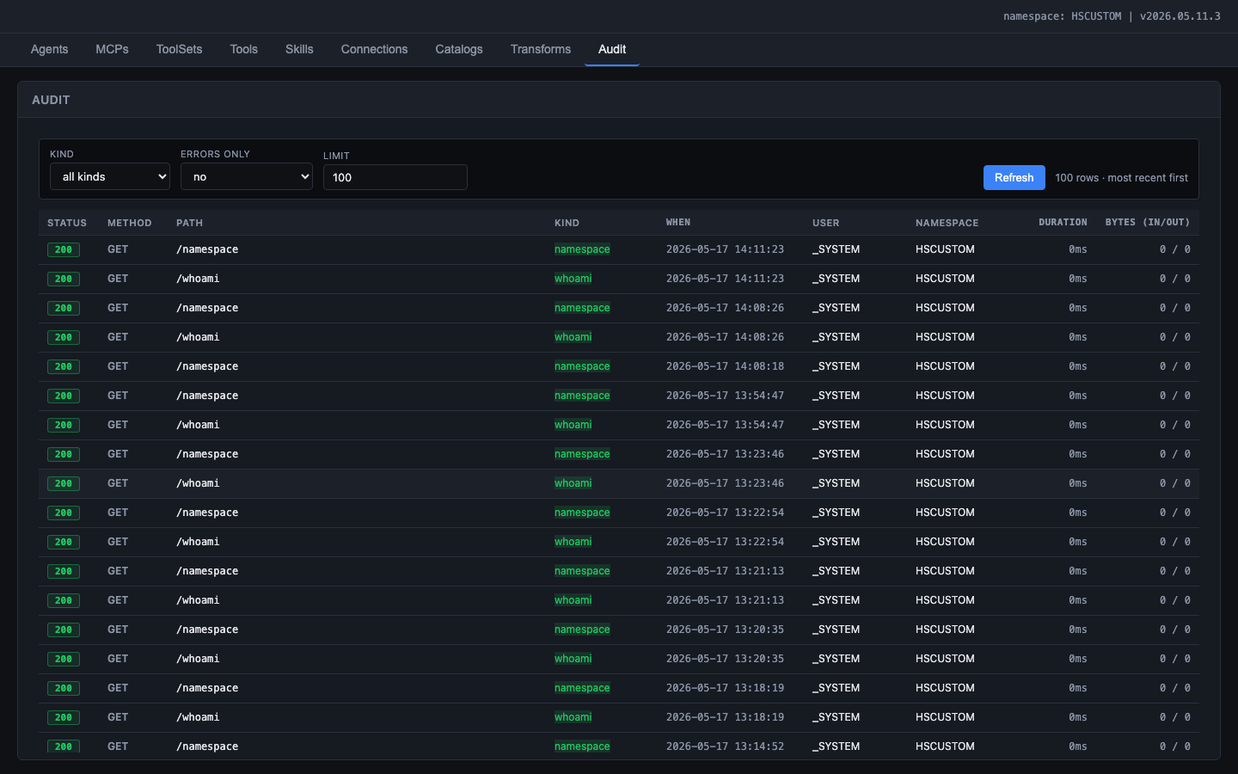
Use Case 2: Review & Improve Existing Productions
Error Triage
Health Assessment
DTL Review
Modernization
Query Event Log for recent errors. Group by Business Host. Identify suspended messages. Recommend remediation.
Inspect production config. Check queue depths and throughput. Identify bottlenecks. Recommend settings changes.
Spot hardcoded values. Find missing null checks. Flag repeating-field bugs. Suggest refactored versions.
Recommend newer IRIS features. Replace custom BPL with DTL. Adopt HL7-to-SDA-to-FHIR. Use record maps over parsers.
Tools: get_production, query_event_log, top_errors, query_message_status, message_summary, queue_status, list_dtls, describe_class
Skills: Productions, DTL, BPL, Adapters, ESBPattern -- deep domain knowledge for context-aware recommendations

Slide 6
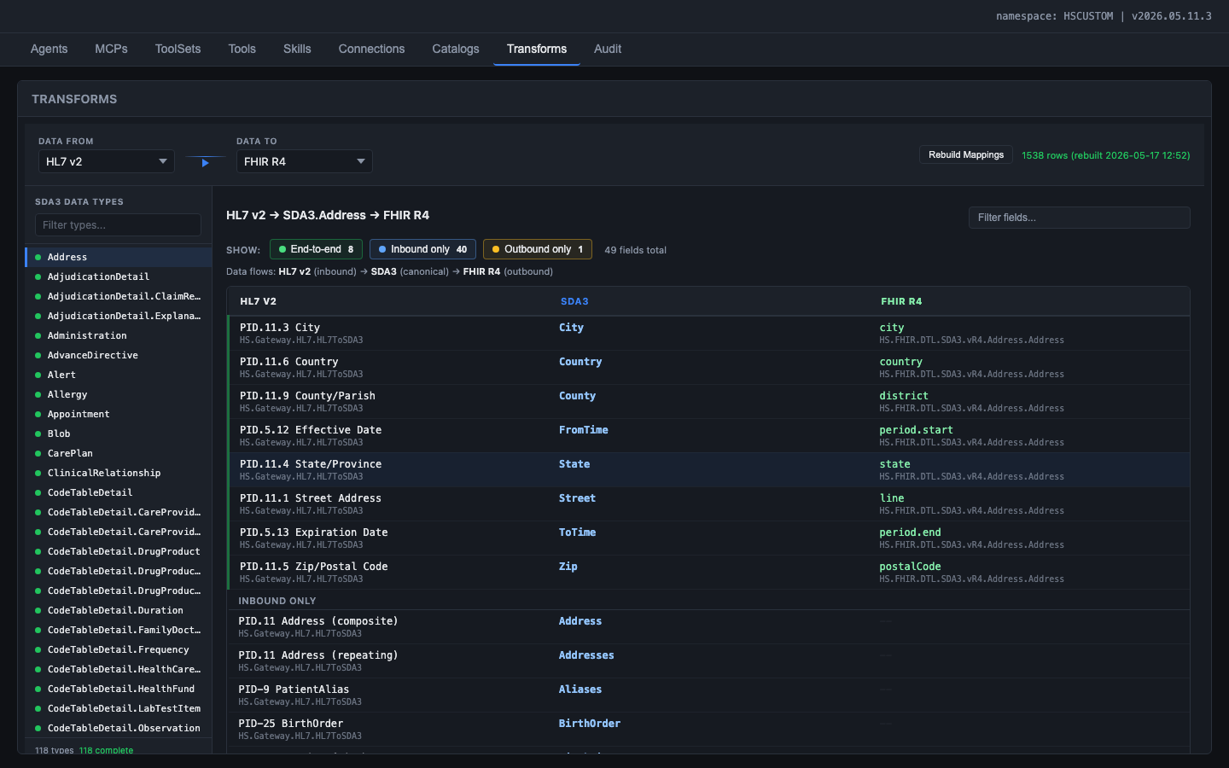
Use Case 3: Create & Optimize Transformations
SDA3 is the universal pivot -- all external formats map through it
HL7 v2 (inbound) PID.11.3 City
SDA3 (canonical) Address.City
FHIR R4 (outbound) Address.city
HS.Gateway.HL7. HL7ToSDA3
HS.FHIR.DTL.SDA3. vR4.Address.Address

Slide 7
Framework vs. Content: What Ships vs. What's Built
IRIS %AI Framework
Out-of-the-Box Content
Customer / Community
Shipped by InterSystems Do NOT modify
Shipped as IPM package Upgradeable, overridable
Built on top of framework Distributed via IPM / OX
%AI.Agent runtime
%AI.MCP.Service transport
%AI.ToolSet / %AI.Tool
%AI.Agent.Skill engine
%AI.RAG.KnowledgeBase
Rust LLM bridge (multi-provider)
FastEmbed (384-dim vectors)
JSON Schema validation
HealthInterop Agent + policies
4 MCP Servers
42 Tools across 5 ToolSets
12 Skills (HL7, FHIR, DTL, ...)
2 Vector Catalogs (222 classes)
Transformation and Mapping Catalog (1,538 field mappings)
Admin UI + Chat UI
Overlay pattern for customization
Custom Agents (Lab, Pharmacy, Claims)
Custom MCP Servers (EHR wrappers)
Custom Tools (org-specific APIs)
Custom Skills (local conventions)
SE accelerators (common patterns)
ISV tool packs
Training datasets for skills
Regional HL7 profile knowledge

Slide 8
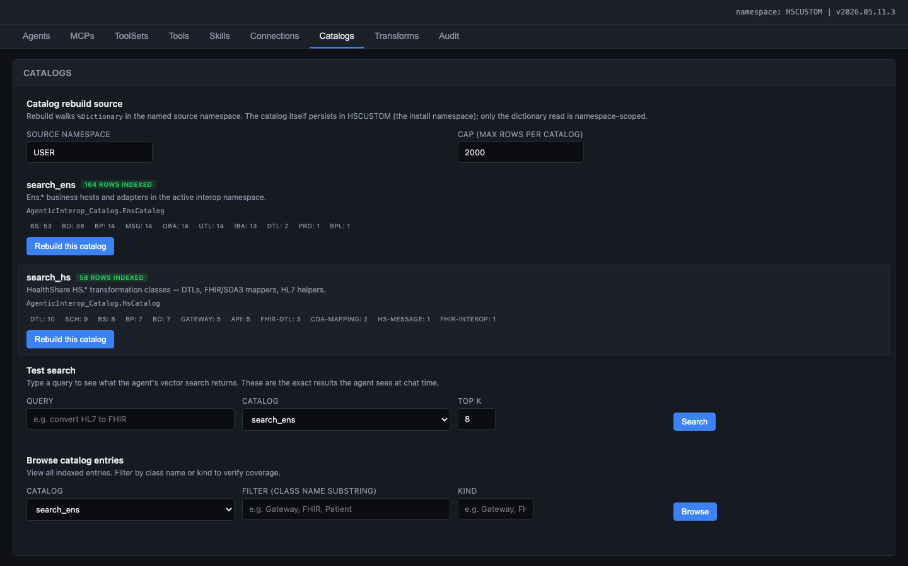
Vector Catalogs: Semantic Search over IRIS Classes
search_ens (164 classes)
Business Hosts, Services, Processes, Operations, Adapters
BS:53 BO:38 BP:14 MSG:14 OBA:14 UTL:14 IBA:13 DTL:2 PRD:1 BPL:1
search_hs (58 classes)
HealthShare transformations, FHIR mappers, SDA helpers, HL7 gateways
DTL:10 SCH:9 BS:8 BP:7 BO:7 GATEWAY:5 API:5 FHIR-DTL:3 CDA:2 HS-MESSAGE:1
Key lesson: curated prose (class name + description + key parameters) dramatically outperforms raw class dumps in 384-dim embeddings. Auto-generated accessors and storage boilerplate drown out semantic signal.

Slide 9
Performance: Measured Token Usage
Metric
Measured
Context
Source
Simple query (total)
16,690
14 seconds
Measured
Planning turn (ADT build)
32,794
25 seconds
Measured
Full build (est. 3-5 turns)
80-150K
2-5 minutes
Estimated
Cost per build (Bedrock)
$0.30-$0.75
vs. 2-3 days labor
Calculated
Tools called per turn
2-6
42 available
Measured
Skills loaded per build
3-5
of 12 total
On-demand
Cost control strategies (all implemented and active):
ToolFilter policy: strips FileSystem, SQL, Shell tools from LLM catalog on every turn
Rate-limit retry: exponential backoff on Bedrock 429s (30s/60s/90s) with user-visible status
On-demand skills: only the domains the task needs are loaded (e.g. ADT build loads 4 of 12)
Compact system prompt: < 2K tokens. Domain knowledge lives in Skills, not in the base prompt
Monitor token budget: 100K cap per turn prevents runaway costs on stuck iterations
Fabrication guard: detects claims without tool calls and forces retry before reporting success

Slide 10
Roadmap & Next Steps
Now (Q3 2026)
Next (Q4 2026)
Later (2027)
Fix Skill %OnNew $ZF marshaling bug
Fix Bedrock tool-result round-trip hang
Ship ToolFilter as framework default
Document %AI.ToolMgr.ExecuteTool query path
Package as IPM for field trial (3 customers)
Multi-agent support (Lab, Pharmacy, Claims)
Tool authoring wizard in admin UI
Skill content editor with live preview
FHIR STU3 and CDA Transformation and Mapping Catalog coverage
Open Exchange publication
Community marketplace for tools and skills
SE accelerator library (20+ production patterns)
Automated migration assistant (upgrade old DTLs)
Multi-namespace agent isolation
Embedded training mode (learn-by-building)
Blockers to resolve before field trial: 2 framework bugs (Skill %OnNew, Bedrock hang) | Built on IRIS for Health 2026.2 with %AI Framework build 162.0

